Slide 1
PROBLEM STATEMENT
HK09 - Secure IOT BASED PATIENT MONITORING SYSTEM
In today’s modern healthcare, patients suffering from chronic diseases, post-surgical complications, or senior patients require continuous health monitoring. However, most existing systems are dependent on periodic manual checkups, which can delay medical response during emergencies and deprive the efficiency of modern patient care and wellness system.

Slide 2



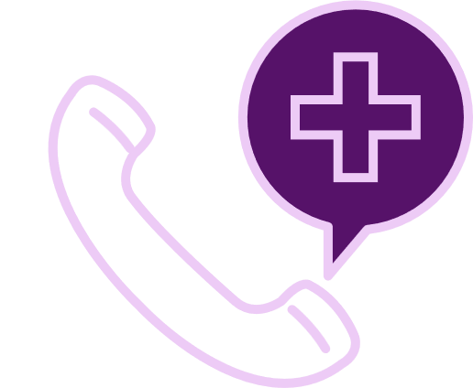


PROPOSED SOLUTION
Real-time Health Monitoring
AI based anomaly detection
We propose a Secure IoT-Based Patient Monitoring System that continuously monitors patient vital signs and securely transmits the data to a cloud-based dashboard, and provides intelligent alerts for abnormal health conditions.
Authorized and secure access control
Emergency Alert System
Automated data acquisition
Secure Data Transfer

Slide 3

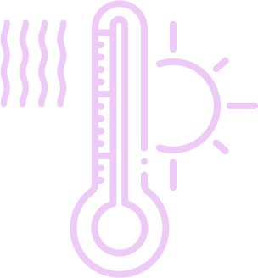






SYSTEM ARCHITECTURE
Patient
Sensors
Data
Data storage
Cloud
Wearable devices
Real time alerts
Data
Patient health report
Analytics Processing
Diagnosis
Doctors
Medical Data

Slide 4
PROTOTYPE WORKFLOW
START
Initialize sensors
Check health parameters
No
Yes
No
Yes
No
Temperature Normal ?
Yes
SPO2 Normal ?
BP Normal ?
Send alert message to doctor,paramedic and realtive
Store values to cloud
Get and display the values on the mobile app

Slide 5
IMPLEMENTATION PLAN
1
Hardware assembling and data acquisition
2
Secure data transmission through encrypted communication
3
Developing API’s(backend) and database setup
PHASES OF IMPLEMENTATION
4
Detect abnormal conditions through algorithms and classify emergency levels
5
Integrate alert and notification system
6
Design secure login system and dashboard for patient vitals
7
Through testing and validation ensure system stability and accuracy

Slide 6
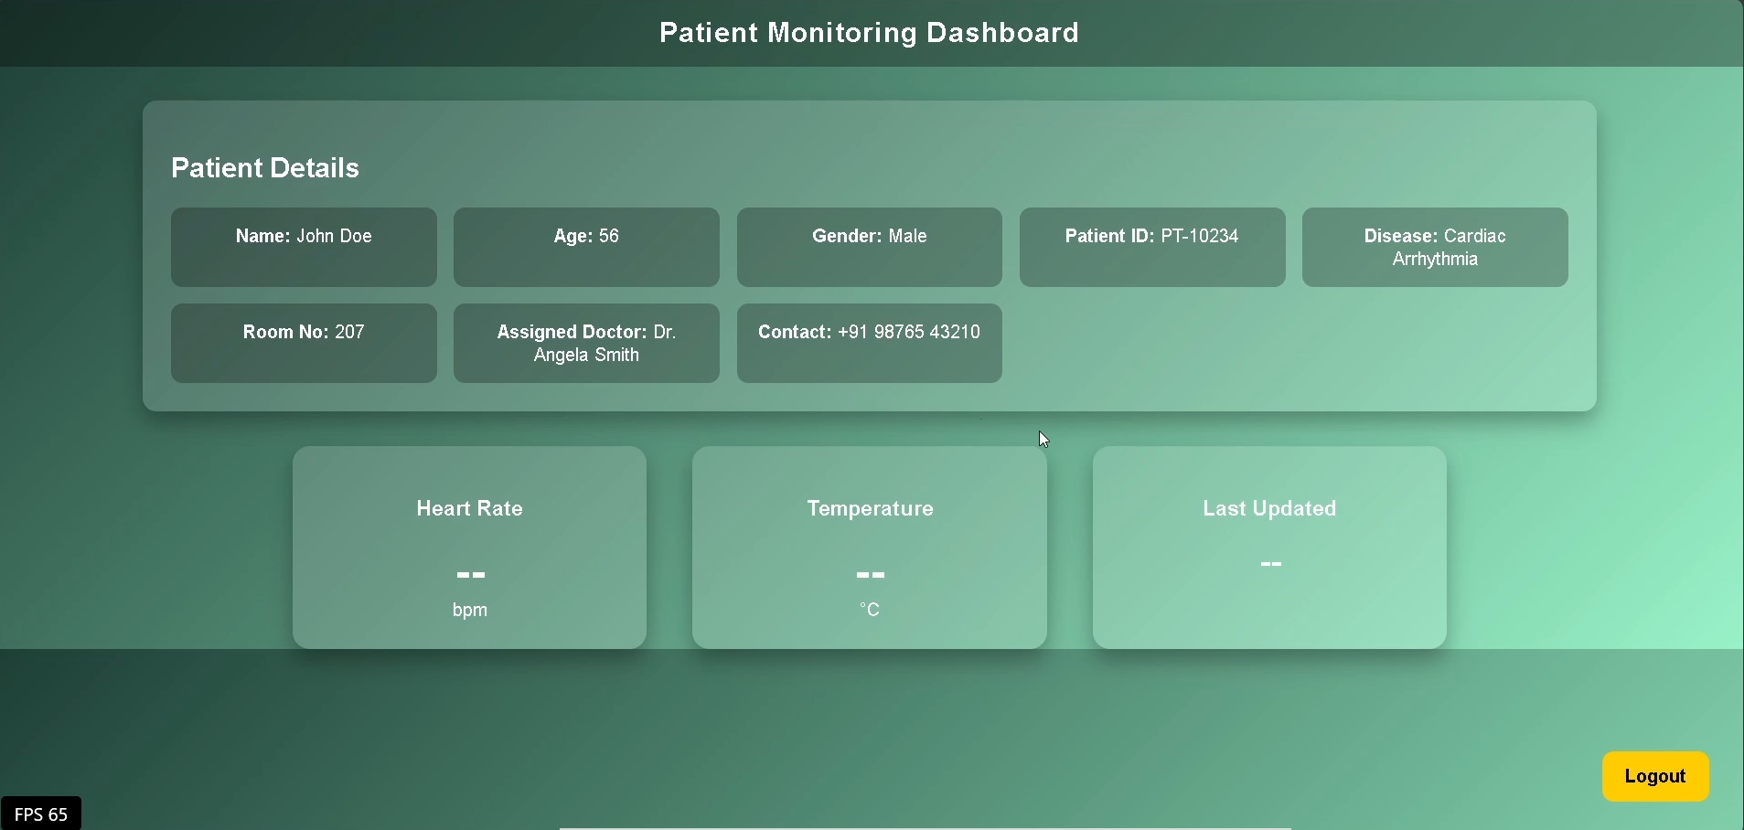

DASHBOARD INTERFACE
Dashboard Interface Video :
https://drive.google.com/file/d/1yPuH1c0k_oOb0QgqlO_QbKkCHWzLWa1J/view?usp=sharing

Slide 7
THANK YOU !!
-TEAM CIPHER SQUAD
RANGALA NITHIN
MOSES GUNASEELAN
NITHIESH.M

