Slide 1
Git

Slide 3
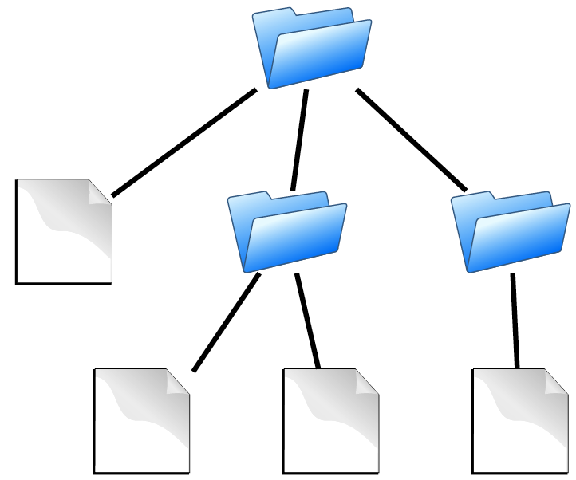
Components
contains
Directories
Files
is the substance of a software configuration

Slide 4

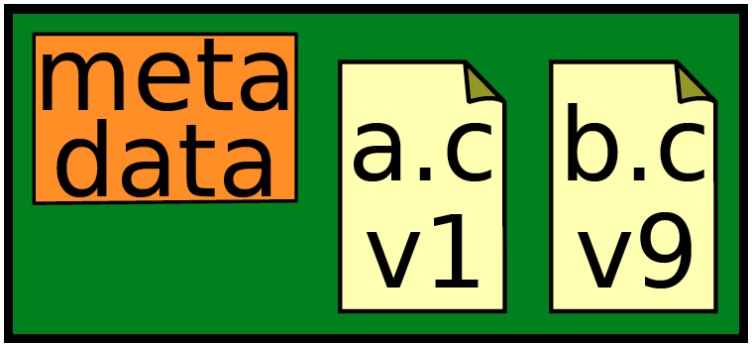
Repository
Contains Components
files
commits
records history of changes to configuration

Slide 5
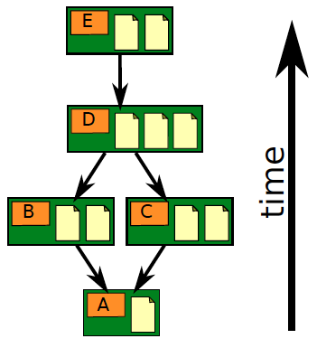
Repository
Contains Components
files
commits
ancestry relationships

Slide 6
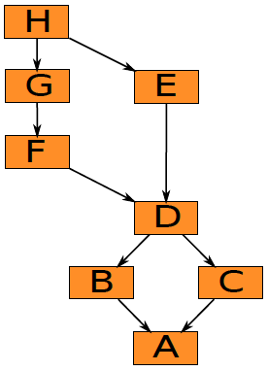
Ancestry graph
form a directed acyclic graph (DAG)

Slide 7
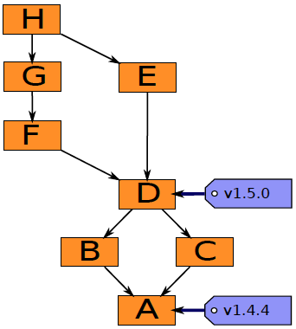
Ancestry graph features
Tags
identify versions of interest
including “releases”

Slide 8
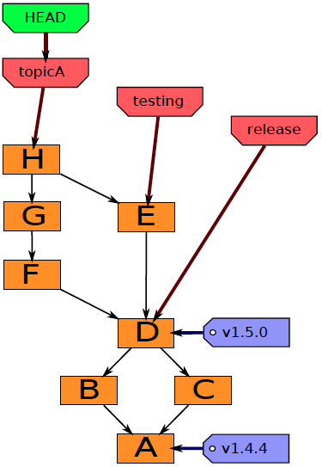
Ancestry graph features
HEAD
is current checkout
usually points to a branch

Slide 9
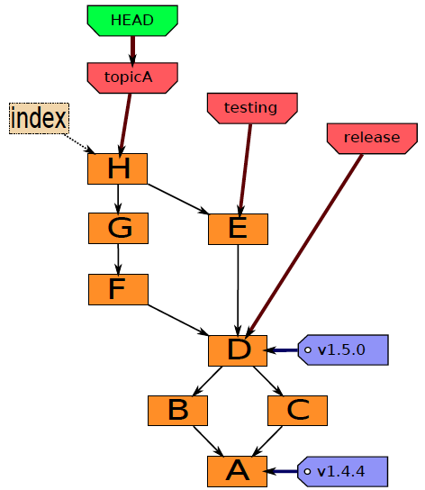
components
Index
“staging area”
what is to be committed

Slide 10
Local Operations
Repository (.git directory)
Index (staging area)
Working directory
checkout the project
add (stage) files
commit

Slide 11
Lifecycle of the status of files

Slide 12
Git
A collection of tools developed by Linux kernel group for SCM
Actually implements a replicated versioned file system
Decentralized version control
Non Linear development
Efficient

Slide 13
Git has a lot of commands
Learn a core subset of them
And one of the GUI tools (e.g., gitk)
Then learn the rest as you need them

Slide 14
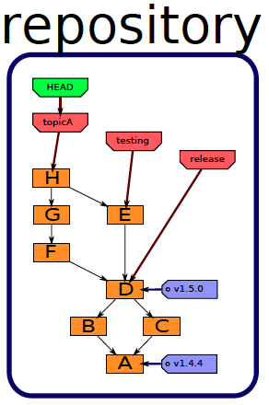
History
A database, stored in directory “.git”.

Slide 15
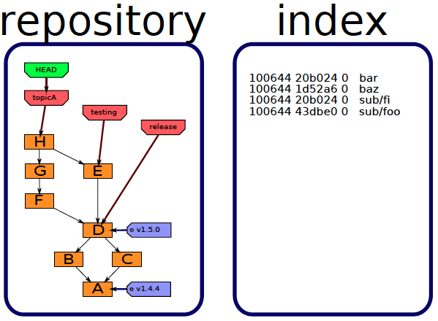
Staging area
Also stored in directory “.git”.

Slide 16
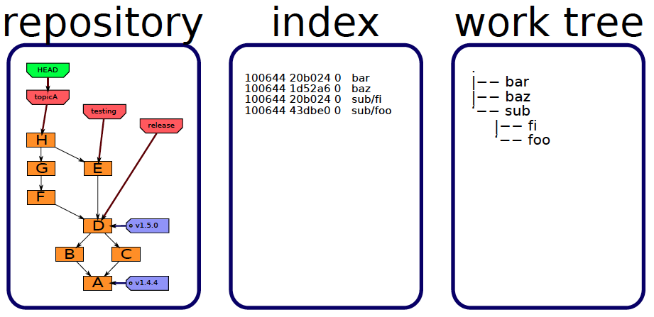
Files you edit
Stored in the directory containing directory “.git”.

Slide 17
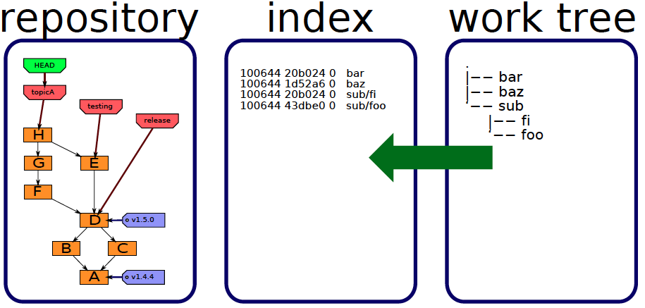
Staging
add

Slide 18
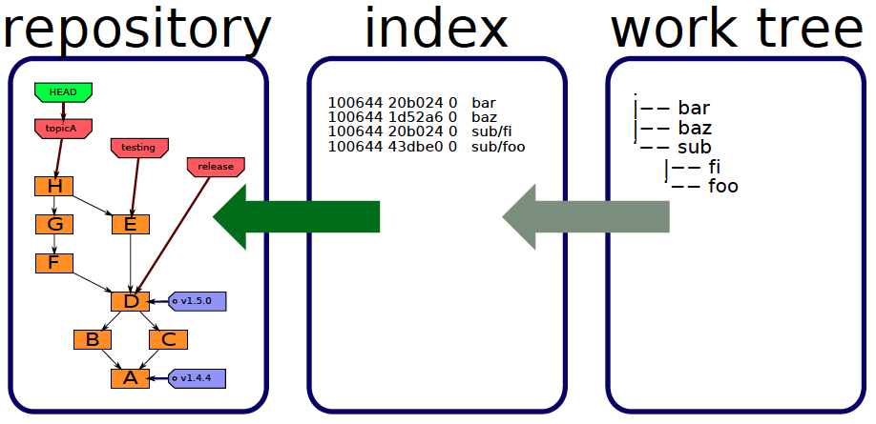
Committing
commit

Slide 19
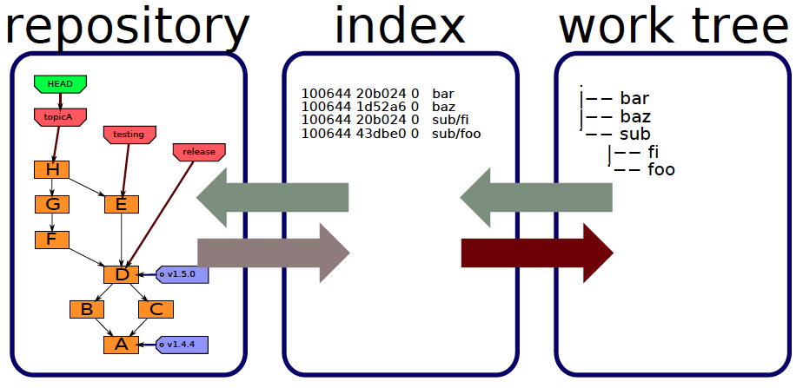
Checking out
checkout
checkout

Slide 20
Object types
Blobs
Trees
Commits
Tags

Slide 21
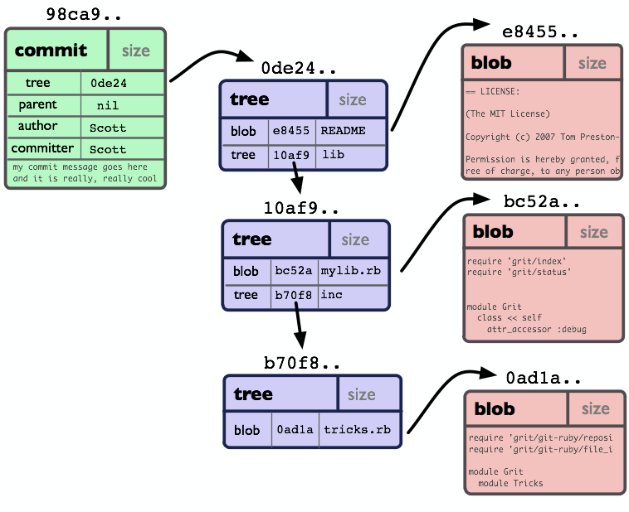
Git Object Model

Slide 22
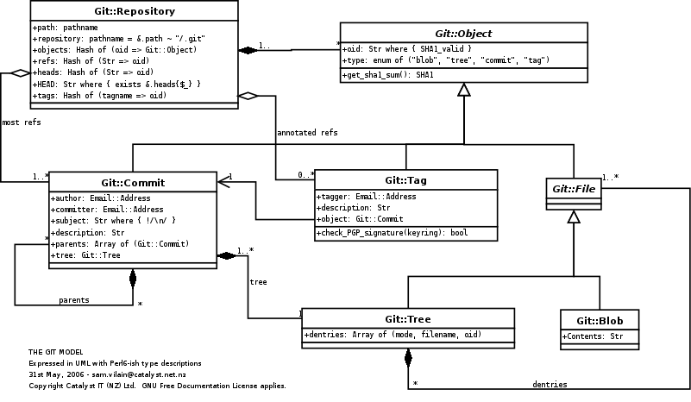
As UML class diagram
Notes:
The component clases of the Git object model, as a UML class diagram.

Slide 23
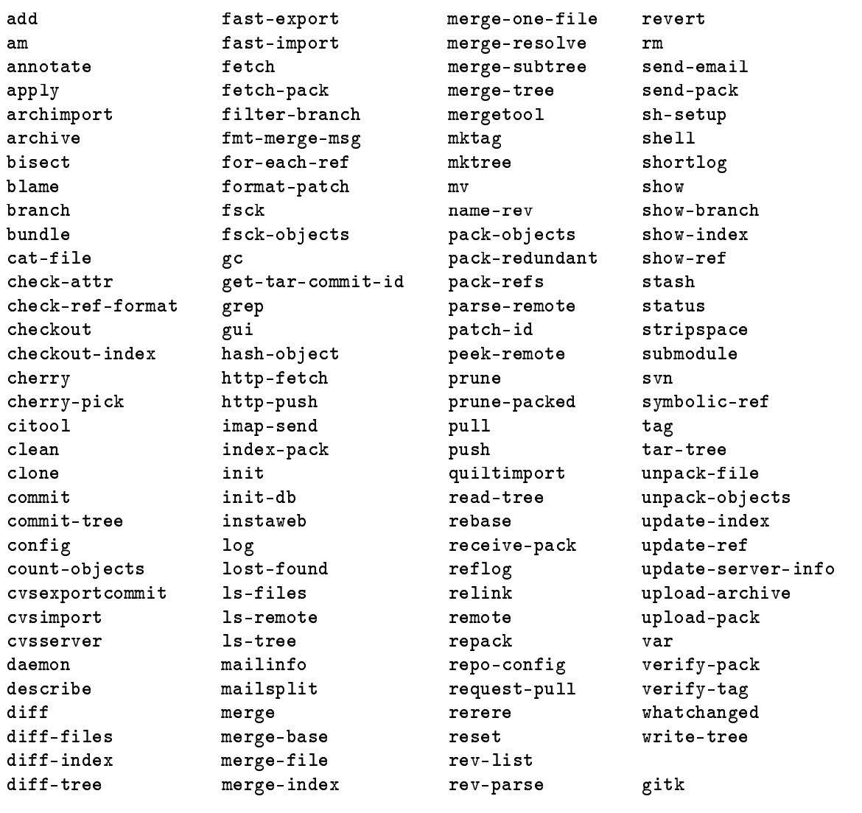
Commands (137)

Slide 24
Groups of Git commands
Setup and branch management or bootstrapping
init, checkout, branch
Modify
add, delete, rename, commit
Get information
status, diff, log
Create reference points
tag, branch

Slide 25
Commands - Every day Use
add | config | init | push | show
branch | diff | log | rebase | stash
checkout | fetch | merge | remote | status
clone | gc | mv | reset | tag
commit | grep | pull | rm | cherry-pick

Slide 26
Git Command
git <global options> command <options>

Slide 27
Help
git help : list of common commands
git <command> -h : brief help output
man git-<command>
git help <command>
git <command> --help : manual page

Slide 28
Configuration
git config --global user.name "Your Name”
git config --global user.email you@here.com
git config --global alias.ci commit
git config --global core.editor "vim"
git config -l
cat .gitconfig

Slide 29
Bootstrapping
git init
git init my-project

Slide 30
Staging
git add
git add files…
git add resource/*.xml
git add .

Slide 31
Staging
git rm file
git rm lib/*.properties
git rm logs/*
git rm -r logs
git mv <old> <new>

Slide 32
Committing
git commit
git commit -a
git commit file1 file2
git commit -a -m “change description “

Slide 33
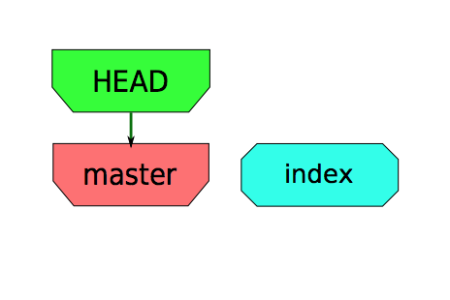
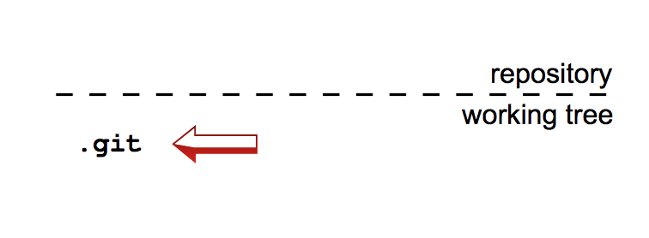
Bootstrapping
mkdir projet
cd projet
git init

Slide 34
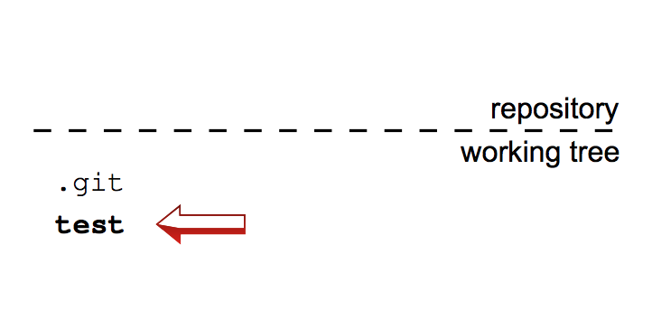
New file
echo test > test

Slide 35
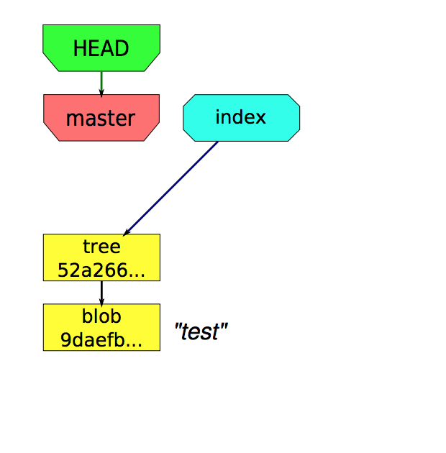
Stage file
echo test > test
git add test

Slide 36
Commit
echo test > test
git add test
git commit -m “new file”

Slide 37
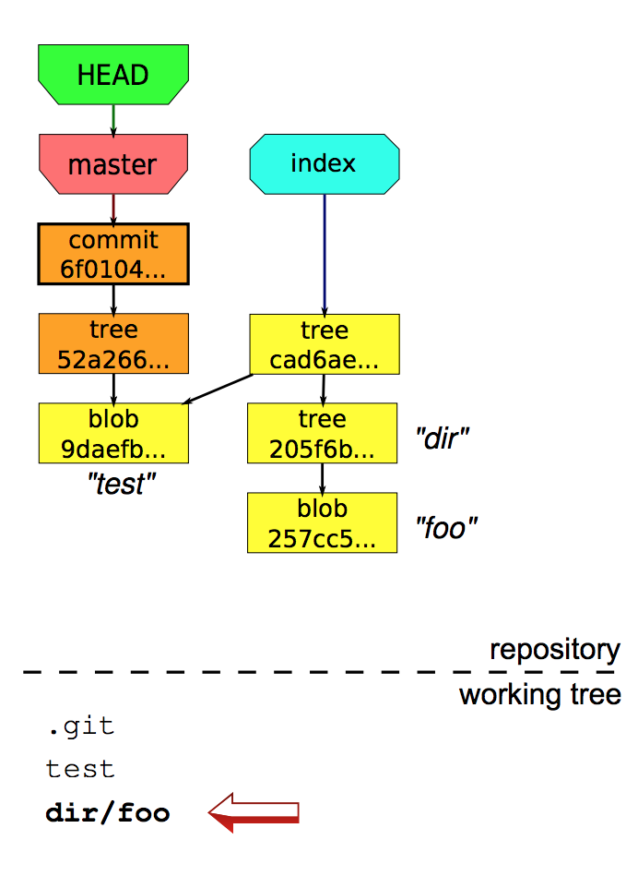
Stage another
echo test > test
git add test
git commit -m “new file”
mkdir dir
echo foo > dir/foo
git add dir/foo

Slide 38
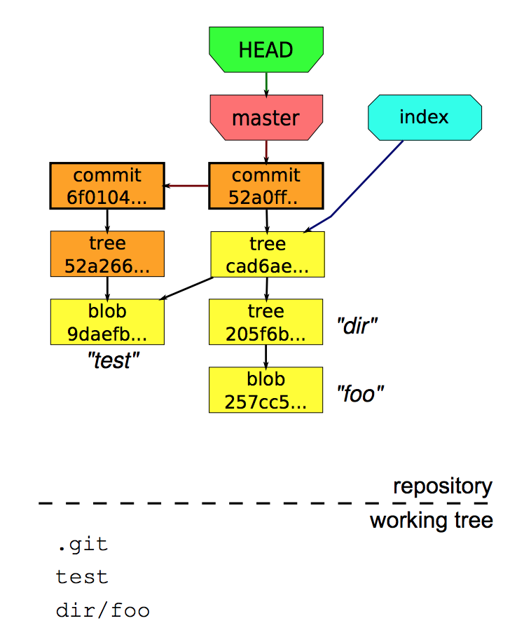
Commit another
echo test > test
git add test
git commit -m “new file”
mkdir dir
echo foo > dir/foo
git add dir/foo
git commit -m “foo”

Slide 39
Staged and Unstaged changes
git status
git status dir/dir2
git status --short
git status -b branch
git status --untracked-files
— staged
— unstaged
— untracked

Slide 40
What is changed
git diff
git diff --staged
git diff HEAD
git diff commit1 commit2

Slide 41
Show Me!
git show
git show --stat
git show --name-status
git show HEAD
git show HEAD^^^
git show master~10
git show master{May.16}
git show HEAD:file/folder

Slide 42
Log
git log
git log -5
git log -p -5
git log somefile/folder
git log --pretty=online|short|full|format
git log --graph
git log --since=2.weeks
git log --autor=SomeName
git log tag..branch
git log HEAD~10..
git log branch1 branch2 ^common
git log -10
git log -10 master{yesterday}
git log --since="May 1" --until="June 1

Slide 43
Faster Grep
git grep -e "pattern" file/folder
git grep -e "pattern" --branch file/folder

Slide 44
New Branch
git branch
git branch -r
git branch my-jira-branch
git branch -d test-branch
git branch -D test-branch # --delete --force
git branch my-debug-branch tag123/commit123

Slide 45
Switching branches
git checkout test-branch
git checkout -f test-branch
git checkout -b my-new-branch
git checkout -m existing-branch

Slide 46
Working on branches
git

Slide 47
Merge branch
git

Slide 48
Rebase branch
git

Slide 49
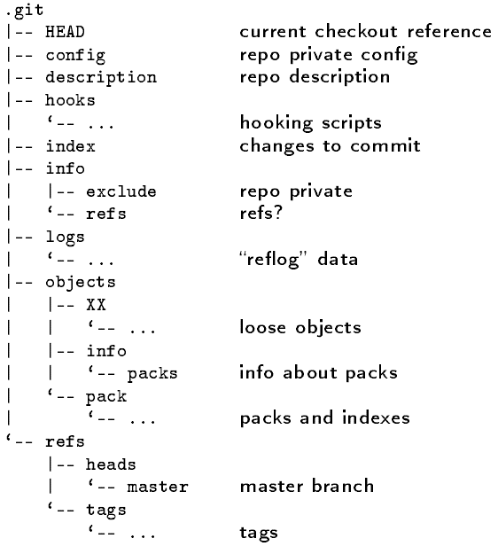
Repository
Notes:
The repository is stored in the subdirectory .git of the working directory.

Slide 50
.git/objects
|-- 23
| ‘-- d4bd826aba9e29aaace9411cc175b784edc399
|-- 76
| ‘-- 49f82d40a98b1ba59057798e47aab2a99a11d3
|-- c4
| ‘-- aaefaa8a48ad4ad379dc1002b78f1a3e4ceabc
|-- e7
| ‘-- 4be61128eef713459ca4e32398d689fe80864e
|-- info
| ‘-- packs
‘-- pack
|-- pack-b7b026b1a0b0f193db9dea0b0d7367d25d3a68cc.idx
‘-- pack-b7b026b1a0b0f193db9dea0b0d7367d25d3a68cc.pack
loose

Slide 51
Some other repository files
.git/config
.git/description – used by gitweb
.git/info/exclude – files to ignore
...

Slide 52
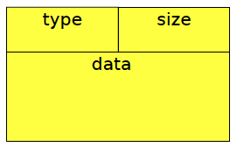
Repository object naming convention
“content addressable” (hashed)

Slide 53
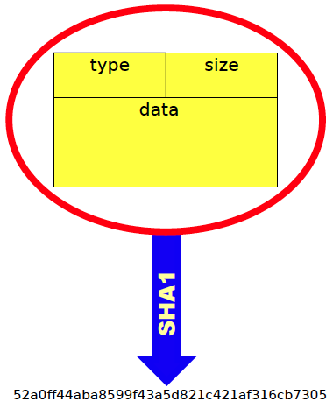
Data values determine hash

Slide 54
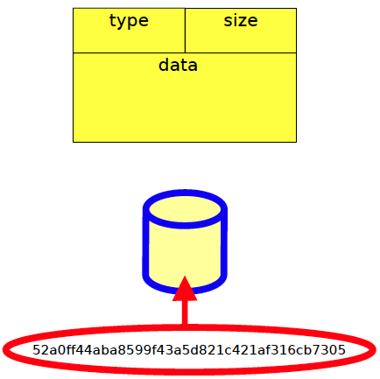
Hash value is filename

Slide 55
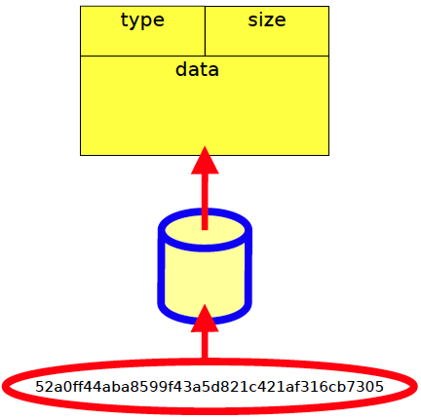
File contains data

Slide 56
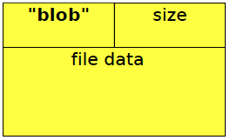
Blobs
Represents a file

Slide 57
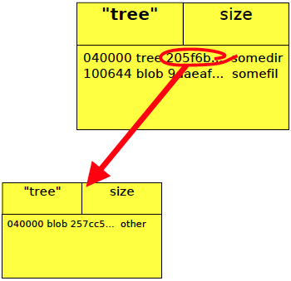
Trees
Directory entries, indexes, files

Slide 58
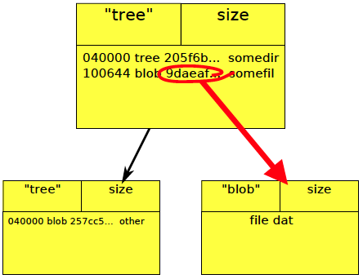
Trees

Slide 59
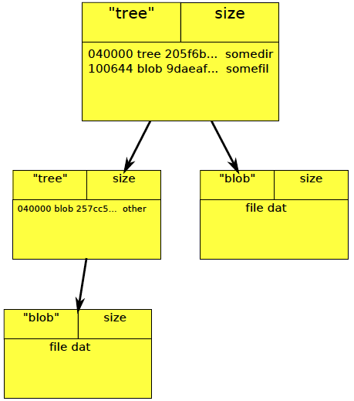
Trees

Slide 60
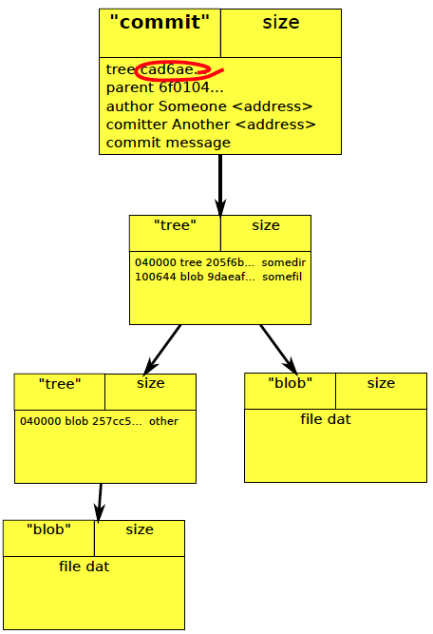
Commits
Who, When, What got changed

Slide 61
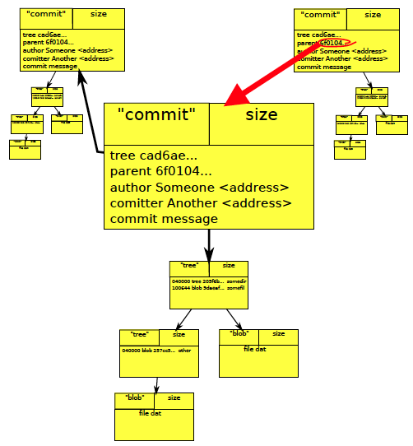
Commits
Points to trees, other commits

Slide 62
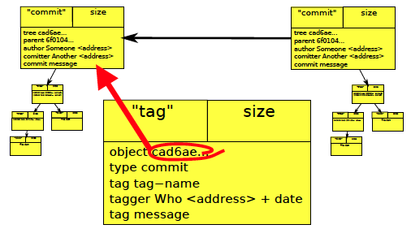
Tag
Points to trees, commit

Slide 63
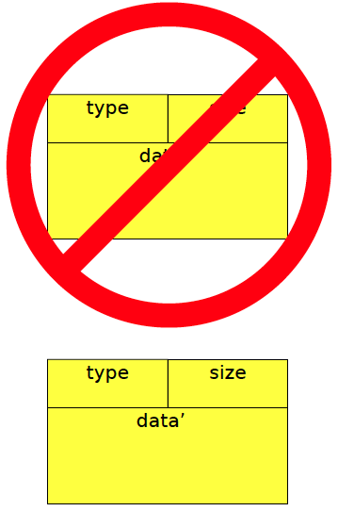
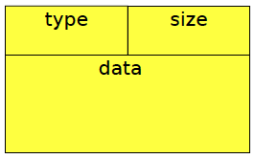
Objects are immutable
Cannot be modified
Can be deleted

Slide 64
Exercises & Tools
https://training-course-material.com/training/Git_exercises
https://learngitbranching.js.org/

Slide 65
References
http://book.git-scm.com/index.html
http://excess.org/article/2008/07/ogre-git-tutorial/
http://www-cs-students.stanford.edu/~blynn/gitmagic/
http://progit.org/book/
http://www.geekherocomic.com/2009/01/26/who-needs-git/
https://github.com/pluralsight/git-internals-pdf/raw/master/drafts/peepcode-git.pdf
https://learngitbranching.js.org/

