Slide 1


Kafka

Slide 2
What is a Messaging system?
Responsible for transferring data from one application to another.
Two types of Messaging Systems.
Point to Point Messaging system
Publish-Subscribe Messaging system

Slide 3
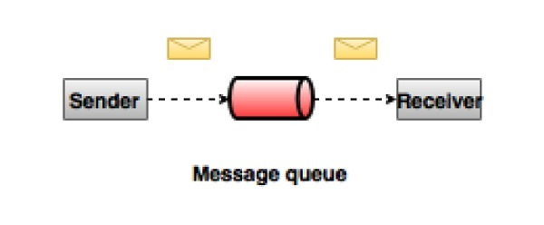
Point to Point Messaging System
In a point-to-point system, messages are persisted in a queue.
One or more consumers can consume the messages in the queue.
But a particular message can be consumed by a maximum of one consumer only.
Once a consumer reads a message in the queue, it disappears from that queue.

Slide 4
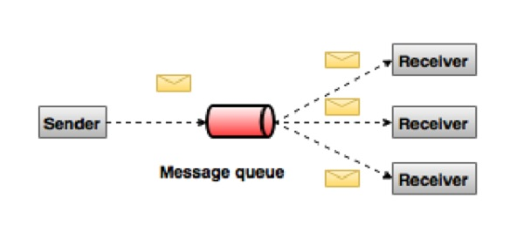
Publish-Subscribe Messaging System
Messages are persisted in a topic.
Consumers can subscribe to one or more topic and consume all the messages in that topic.

Slide 5
What is Kafka?
Kafka is a distributed streaming platform that is used to publish and subscribe to streams of messages.
Kafka is designed to allow your apps to process records as they occur.
Apache Kafka was originally developed by LinkedIn, and was open sourced in early 2011.

Slide 6
Why Kafka?
Multiple Producers
Multiple Consumers
Disk-based Retention
Scalable
High Performance

Slide 7
Kafka Key Terminology
Topic: A stream of messages belonging to a particular category is called a topic. Data is stored in topics.
Producer: Producers are the publisher of messages to one or more Kafka topics. Producers send data to Kafka brokers.
Consumer: Consumer reads data from topics.
Broker: A Kafka Broker receives messages from producers and stores them on disk and allows consumers to fetch messages by topic.

Slide 8
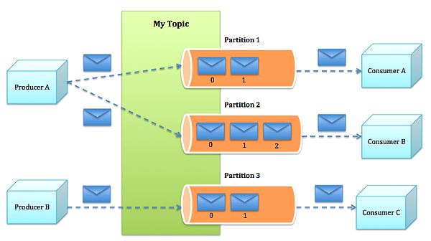
Kafka Cluster Architecture

Slide 9
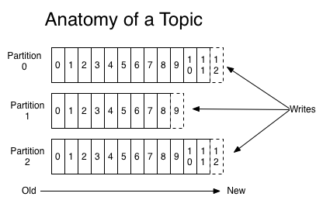
Kafka Topic Partitions
Partition: Topics are split into partitions. For each topic, Kafka keeps a minimum of one partition. Each such partition contains messages in an immutable ordered sequence.

Slide 10
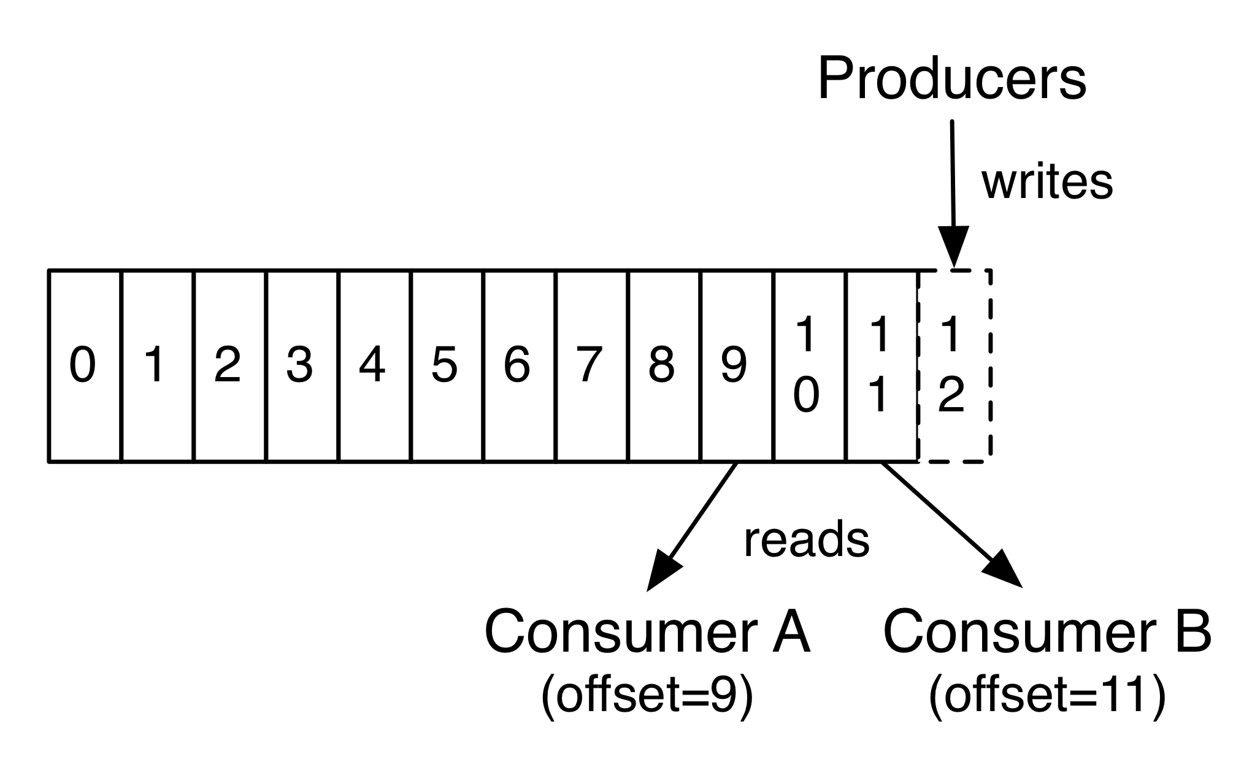
Kafka Topic & Partition Offset
Offset: Each partitioned message has a unique sequence id called as offset.

Slide 11
Kafka Topic Partition Replication
Backups of a partition to prevent data loss.
Each partition can have multiple replicas.
Replicas are stored on brokers
Two types: Leader Replica, Follower Replica
Replicas that are currently alive and caught-up to the leader are called in-sync replicas.

Slide 12
Producer
Producers/Publishers/Writers send messages to a particular Topic.
Producer can send messages:
Typically by Round-robin
Can also do Semantic Partitioning
Producer direct messages to specific partitions.

Slide 13
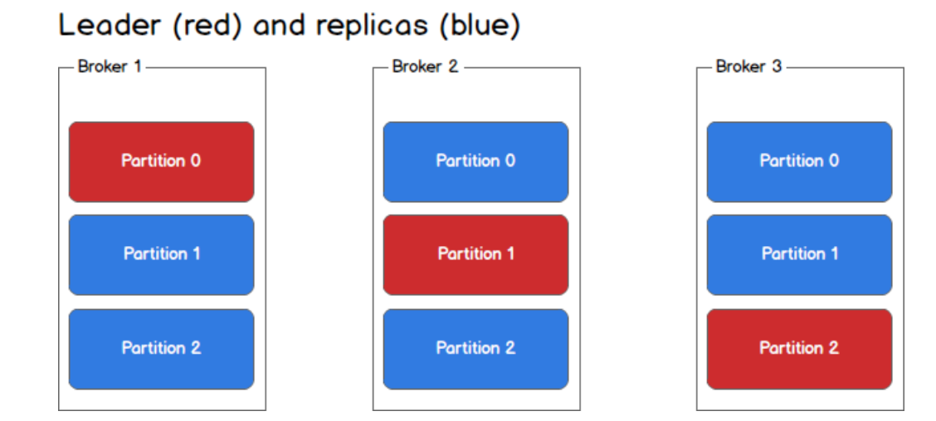
Producer

Slide 14
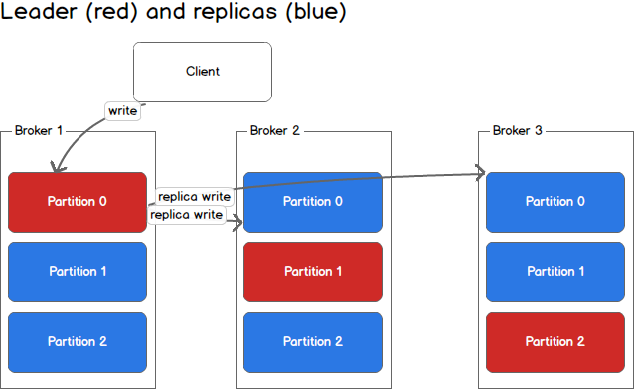
Producer

Slide 15
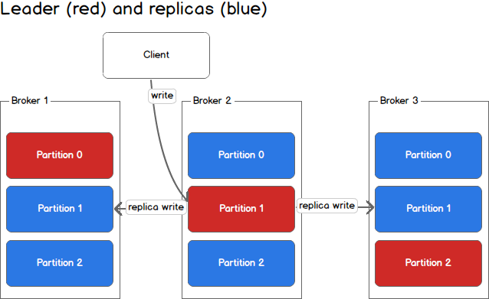
Producer

Slide 16
Consumer
Consumers/Subscribers/readers reads Messages.
Multiple Consumers can read Messages from a same Topic.
The consumer keeps track of offset of the messages it consumed.
Messages stay on Kafka even after they are received by Consumers.

Slide 17
Consumer Group
Consumers can be organized into Consumer groups.
Common Patterns
All Consumers in one group.
All Consumers in different groups.
Logical subscriber - Many consumers in a group.
There can not be more Consumers than Partitions.

Slide 18
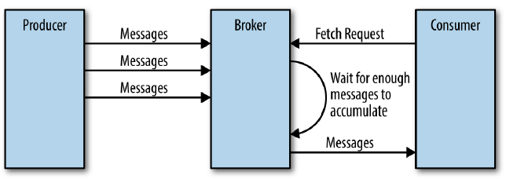
Consumer

Slide 19
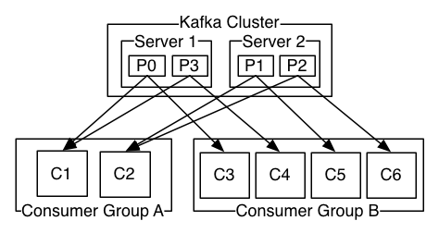
Consumer Group

Slide 20
Use cases
Messaging
Metrics & Logging
Commit log
Website Activity Tracking

Slide 21
Zookeeper
Zookeeper is a distributed, open-source configuration, synchronization service along with naming registry for distributed applications.
ZooKeeper is used for managing and coordinating Kafka brokers.
Zookeeper serves as the coordination interface between the Kafka brokers and consumers.
Kafka stores basic metadata in Zookeeper such as information about topics, brokers, consumer offsets (queue readers) etc.
Used to notify producers and consumers about the presence of any new broker in the Kafka system or about the failure of any broker in the Kafka system.

Slide 22
Zookeeper role in Kafka Brokers
State: Check if the Kafka Broker is alive listening on the heartbeats requests the broker sends. Also decides on the replication based on livilyness of broker
Quotas: Manages the quotas of producers and consumers
Replicas: Manages the in-sync replicas of brokers
Topics Registry: Keep a record of topic registries, which Kafka topics are held by each broker,

Slide 23
Setup
Download and extract Kafka from http://kafka.apache.org/downloads.html
Start Zookeeper
bin/zookeeper-server-start.sh config/zookeeper.properties
Start Kafka Server
bin/kafka-server-start.sh config/server.properties
Create Kafka Topic
bin/kafka-topics.sh --create --zookeeper localhost:2181 --replication-factor 1 --partitions 1 --topic Kafka_Example
List topic
bin/kafka-topics.sh --list --zookeeper localhost:2181

Slide 24


