Slide 1



Slide 2
What is Spring Cloud?
Spring Cloud–an open-source library–makes it easy to develop JVM applications for the cloud. With it, applications can connect to services and discover information about the cloud environment easily in multiple clouds such as Cloud Foundry and Heroku. Further, you can extend it to other cloud platforms and new services
Distributed Application :
Distributed applications (distributed apps) are applications or software that runs on multiple computers within a network at the same time and can be stored on servers or with cloud computing. Unlike traditional applications that run on a single system, distributed applications run on multiple systems simultaneously for a single task or job.

Slide 3
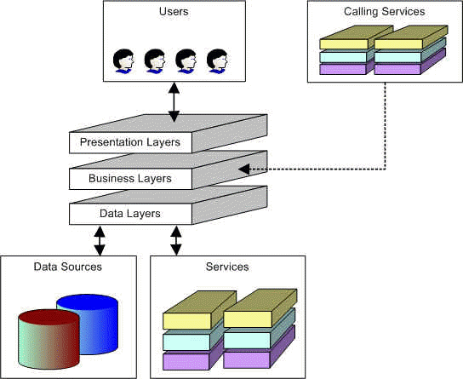
Pictorial representation of Distributed apps:

Slide 4
Problems that spring cloud can solve
Service discovery and registry
Spring config server
Circuit Breaker
Zuul API gateway
Load balancing(ribbon)
Spring 0Auth

Slide 5
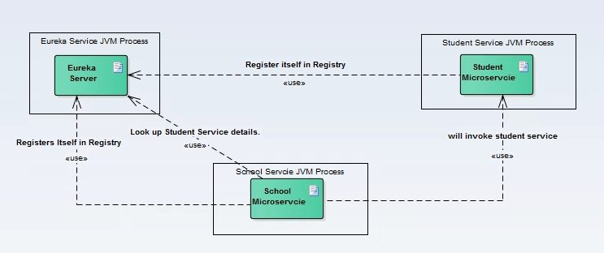
Service discovery and registry
Problem:
Fetching the service details to hit a microservice is very difficult in Distributed application world.
Spring cloud Solution:

Slide 6
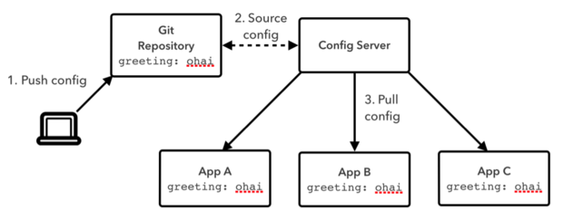
2. Spring config server
Problem: let’s say one service is dependent on another service (invoked for certain business scenario) and if that dependent service URL got changed to some other service, and then usually we need to build and deploy our service with the updated location is required.
Spring cloud Solution :
Now if we go by 12 factor app approach and if we read those config from external service deployed as different process, then we just need to refresh that config server.

Slide 7
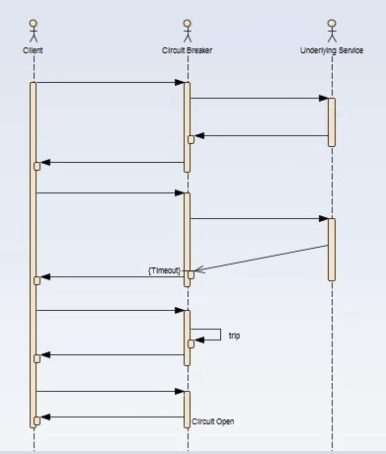
3. Circuit Breaker
Work flow:
It is generally required to enable fault tolerance in the application where some underlying service is down/throwing error permanently, we need to fall back to different path of program execution automatically. This is related to distributed computing style of Eco system using lots of underlying Microservices. This is where circuit breaker pattern helps and Hystrix is an tool to build this circuit breaker

Slide 8
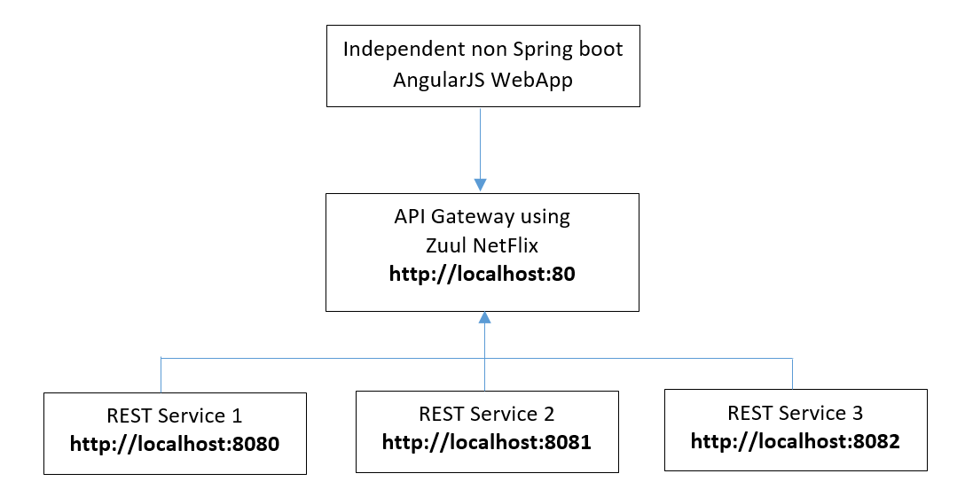
4. Zuul API gateway
Zuul is the front door for all requests from devices and web sites to the backend of the Netflix streaming application. As an edge service application, Zuul is built to enable dynamic routing, monitoring, resiliency and security. It also has the ability to route requests to multiple Amazon Auto Scaling Groups as appropriate.

Slide 9
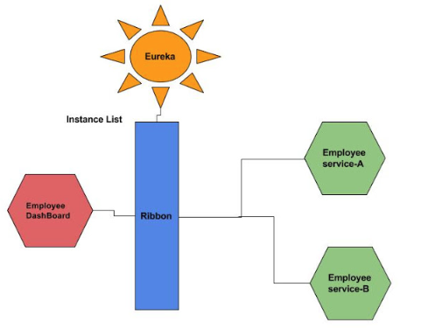
5. Load balancers - Ribbon
Client side load balancing maintains an algorithm like round robin or zone specific, by which it can invoke instances of calling services. The advantage is s service registry always updates itself; if one instance goes down, it removes it from its registry, so when the client side load balancer talks to the Eureka server, it always updates itself, so there is no manual intervention- unlike server side load balancing- to remove an instance.
Advantage is, as the load balancer is in the client side, you can control its load balancing algorithm programmatically. Ribbon provides this facility, so we will use Ribbon for client side load balancing.

Slide 10
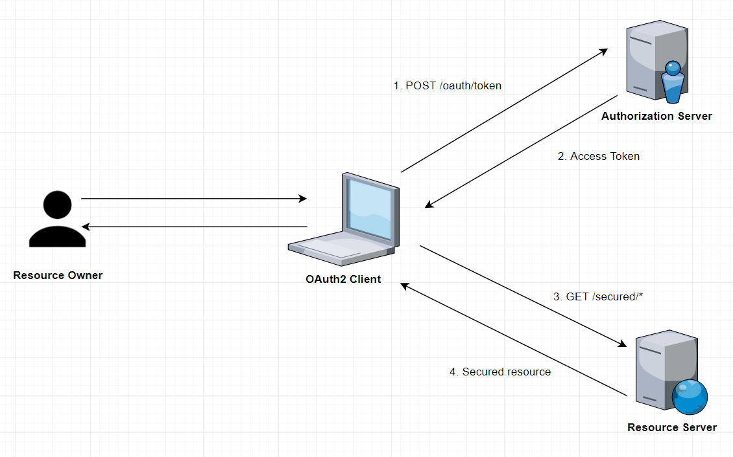
6. OAuth Security
The OAuth 2.0 specification defines a delegation protocol that is useful for conveying authorization decisions across a network of web-enabled applications and APIs. OAuth is used in a wide variety of applications, including providing mechanisms for user authentication.
OAuth specifies four roles:
Resource owner (the User) – an entity capable of granting access to a protected resource (for example end-user).
Resource server (the API server) – the server hosting the protected resources, capable of accepting responding to protected resource requests using access tokens.
Client – an application making protected resource requests on behalf of the resource owner and with its authorization.
Authorization server – the server issuing access tokens to the client after successfully authenticating the resource owner and obtaining authorization.

Slide 11
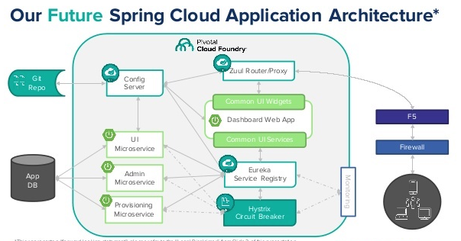

Slide 12
Thank you...

