Slide 1
Spring Boot

Slide 2
Prerequisites
Java 1.8
Eclipse / STS / IntelliJ / NetBeans
Basic Knowledge on Spring

Slide 3
Spring Modules
IoC container
Resources
Validation
AOP
SpEL
Web - Spring MVC, WebSockets

Slide 4
Spring IoC Container
Bean Definition
Dependency Injection
Beans Auto Wiring

Slide 5
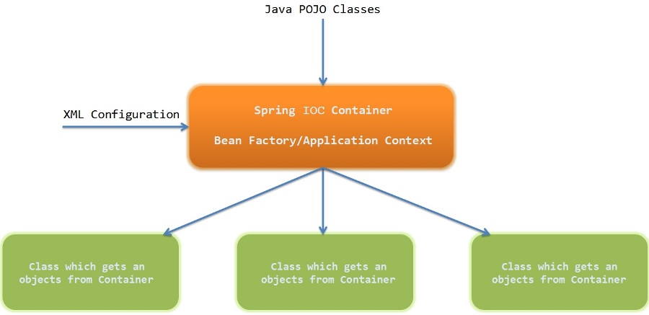
IoC Container
A principle in software engineering by which the control of objects or portions of a program is transferred to a container or framework. It’s most often used in the context of object-oriented programming.

Slide 6
Advantages of IoC
Decoupling the execution of a task from its implementation
Making it easier to switch between different implementations
Greater modularity of a program
Greater ease in testing a program by isolating a component
Mocking its dependencies and allowing components to communicate through contracts

Slide 7
Bean creation
@Bean
@Component
@ComponentScan
@Service

Slide 8
@Bean method in boot application
@SpringBootApplication
public class DemoApplication {
private static Logger logger = LoggerFactory.getLogger(DemoApplication.class);
private static ApplicationContext applicationContext;
public static void main(String[] args) {
applicationContext = SpringApplication.run(DemoApplication.class, args);
addNumbers();
}
@Bean("calculator")
public Calculator mathCalculator() {
return new Calculator();
}

Slide 9
@Bean methods in @Configuration
@Configuration
public class MyConfiguration {
@Bean
public Calculator getCalculator() {
return new Calculator();
}
@Bean
public MathService getMathService() {
return new MathService(getCalculator());
}
}

Slide 10
@Component
package spring.app.beans;
import org.springframework.stereotype.Component;
import java.util.Arrays;
@Component
public class Calculator {
public Integer add(Integer... operands) {
return Arrays.stream(operands).mapToInt(i -> i.intValue()).sum();
}
}
@SpringBootApplication(scanBasePackages = "spring.app.beans")
public class DemoApplication {
…..
}

Slide 11
@Bean Lite Mode : Bean method in @Component
@Component
public class MyBeans {
@Bean
public Calculator getCalculator() {
return new Calculator();
}
@Bean
public MathService getMathService() {
return new MathService(getCalculator());
}
}

Slide 12
@Service
@Service
public class Calculator {
public Integer add(Integer... operands) {
return Arrays.stream(operands).mapToInt(i -> i.intValue()).sum();
}
}

Slide 13
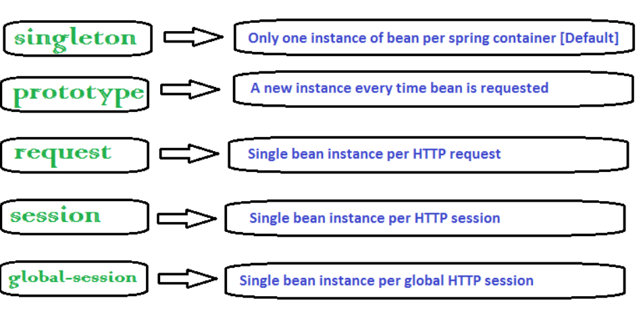
Bean Scopes

Slide 14
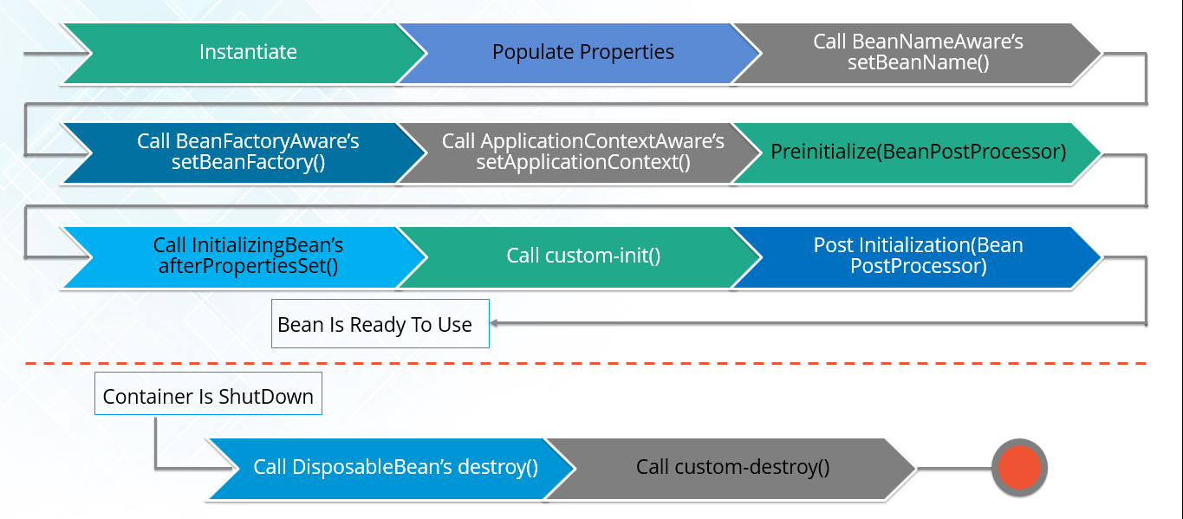
Bean life cycle

Slide 15
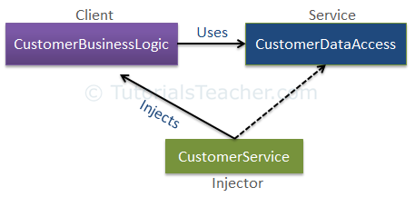
Dependency Injection

Slide 16
@Autowired
@Service
public class InboxService {
@Autowired
private MemberMessageSummaryService summaryService;
}

Slide 17
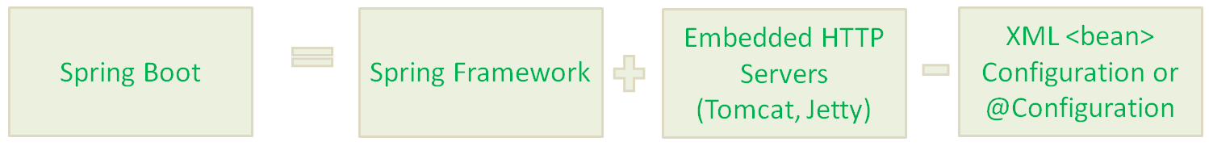
What is Spring Boot?
Spring Boot makes it easy to create stand-alone, production-grade Spring-based Applications that you can run. We take an opinionated view of the Spring platform and third-party libraries, so that you can get started with minimum fuss. Most Spring Boot applications need very little Spring configuration.

Slide 18
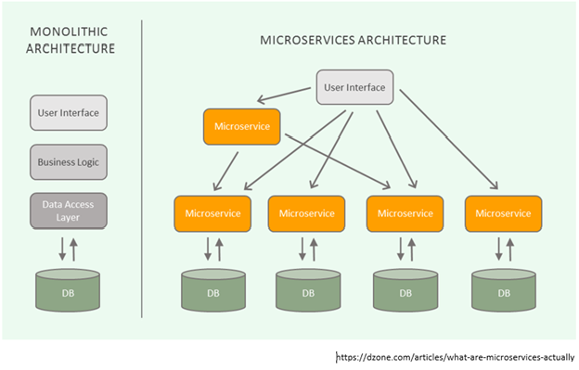
Why Spring to Spring Boot?
Spring Boot is not intended to replace Spring, but to make working with it faster and easier.
Most of the changes needed for migrating an application are related to configuration.
Notes:
Change this slide. This is not explaining SpringBoot..

Slide 19
Creating a Spring Application includes
A project structure, complete with a Maven or Gradle build file including required dependencies. At the very least, you’ll need Spring MVC and the Servlet API expressed as dependencies.
A web.xml file (or a WebApplicationInitializer implementation) that declares Springs DispatcherServlet.
A Spring configuration that enables Spring MVC.
A controller class that will respond to HTTP requests with “Hello World”.
A web application server, such as Tomcat, to deploy the application to.

Slide 20
How Spring Boot Solves the Problem?
Simpler dependency management
Default auto-configuration
Embedded web server
Application metrics and health checks
External Configuration

Slide 21
Primary Goals of Spring Boot
Provide a radically faster and widely accessible getting-started experience for all Spring development.
Be opinionated out of the box but get out of the way quickly as requirements start to diverge from the defaults.
Provide a range of non-functional features that are common to large classes of projects (such as embedded servers, security, metrics, health checks, and externalized configuration).
Absolutely no code generation and no requirement for XML configuration.
Notes:
More context om goals dependency on spring projects

Slide 22
Key Spring Boot Features
SpringBoot starters
SpringBoot AutoConfiguration
Elegant Configuration Management
SpringBoot Actuator
Easy to use Embedded Servlet container support

Slide 23
Things to know Before Creating a Spring Boot project
What is pom?
What are dependencies?
What are maven Coordinates?
What is packaging?
Notes:
What are mavenCoordinates

Slide 24
What is a POM file?
POM stands for “Project Object Model”.
It is an XML representation of a Maven project.
Contains dependent libraries
Contains plugins to be used during the build process.

Slide 25
What are dependencies?
Dependencies are libraries or frameworks that one would need to develop the project.
<dependency> <groupId>org.springframework.boot</groupId> <artifactId>spring-boot-starter-test</artifactId> <version>test</version> </dependency>

Slide 26
What is Packaging?
Project's artifact type.
Types of Packaging:
JAR
WAR
EJB
EAR
POM
Maven Plugin
Default to JAR

Slide 27
Steps for creating Spring Boot Project using STS
Open STS.
Right click on the project panel (or go on Menu > File) then New > Spring Starter Project.
Fill the following fields in the form:
Name: the eclipse project name (e.g. “Hello world”).
Group: a group name for your projects (e.g. “Demo”).
Artifact: the name of the jar file (e.g. “demp”).
Description: a brief human readable description (e.g. “Spring Boot base Web Application”)(optional).
Package name: the java root package name (e.g. “netgloo”).
Click Next. Search and select the “Web” dependency, then click Finish.
Will be downloaded a basic project template from the Spring web site.

Slide 28
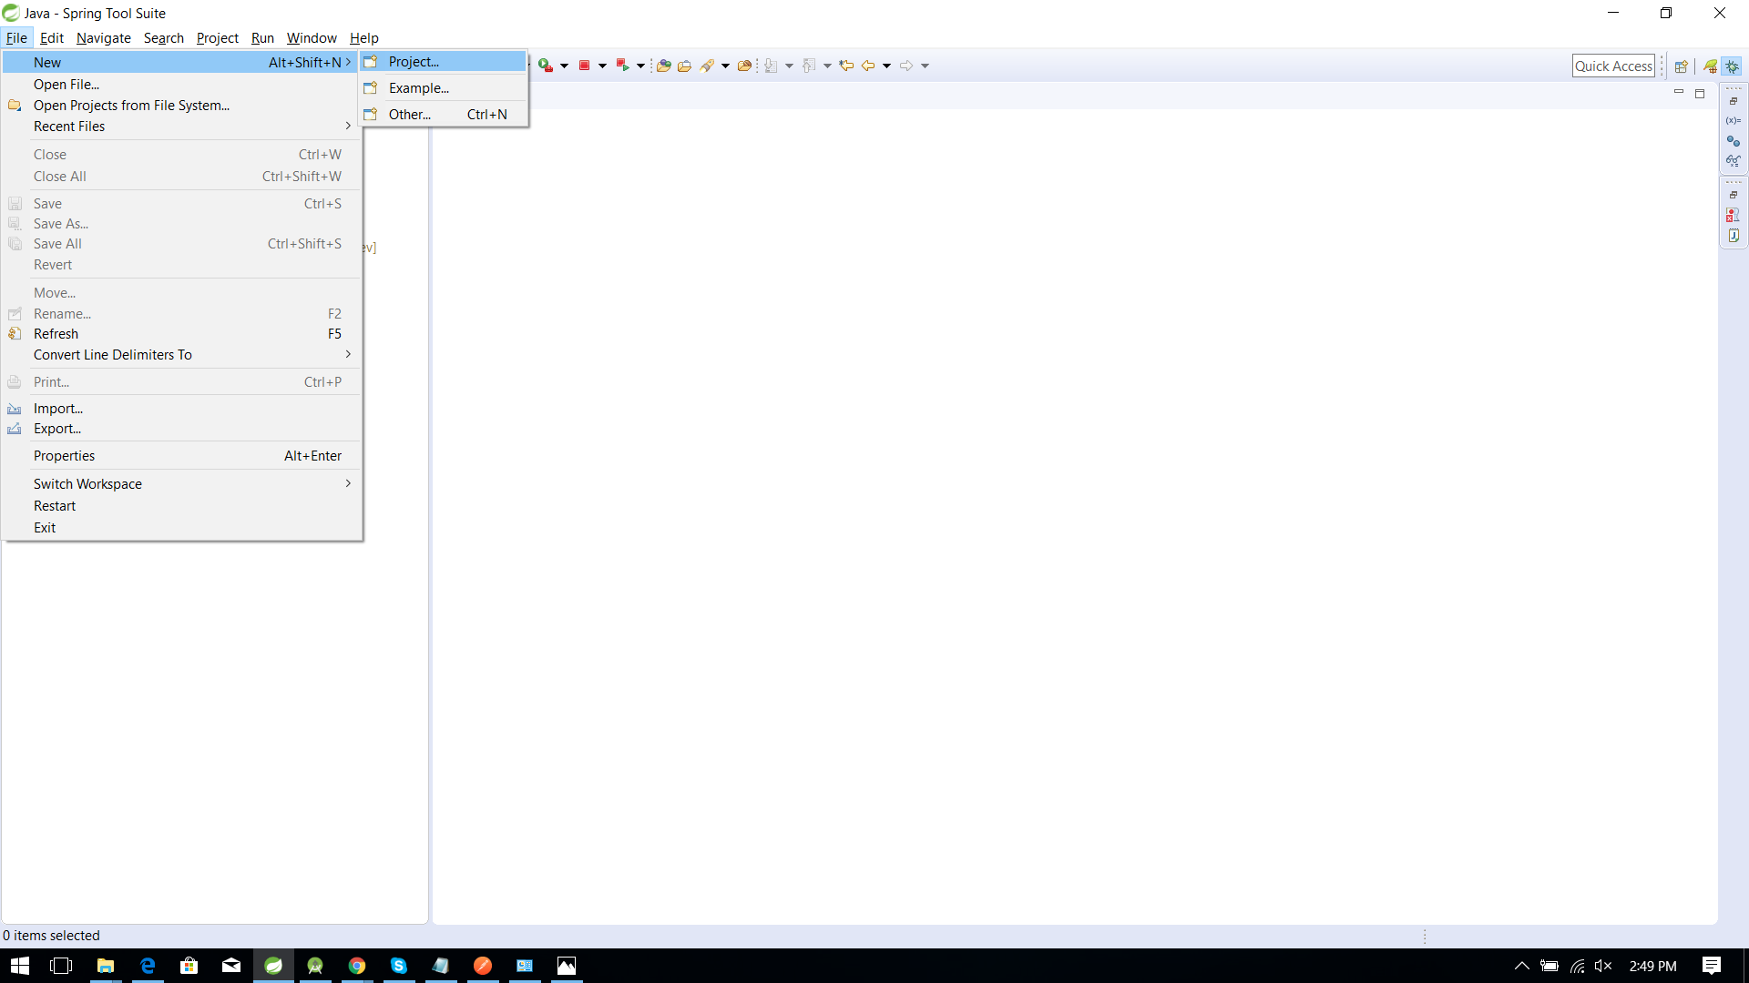
STS - Create a boot App

Slide 29
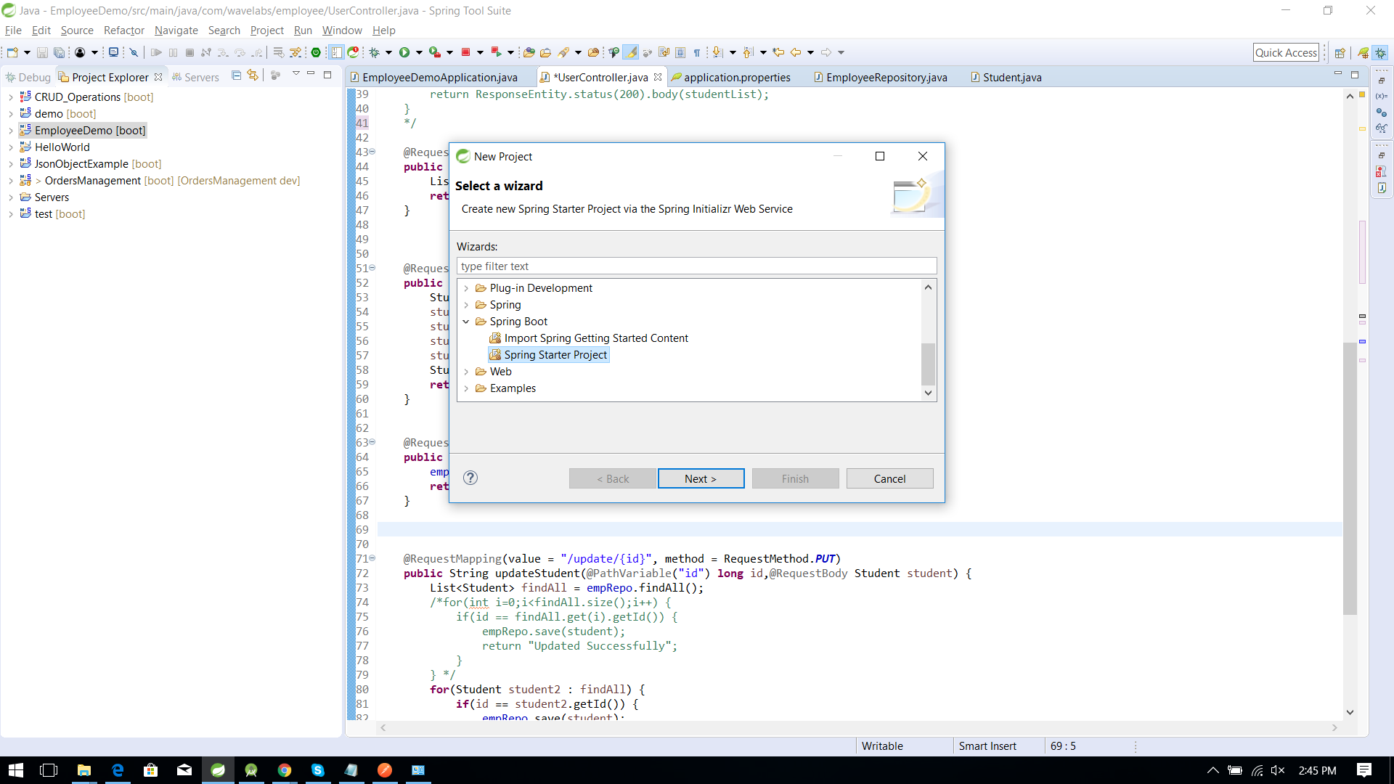
STS - Create a Boot App

Slide 30
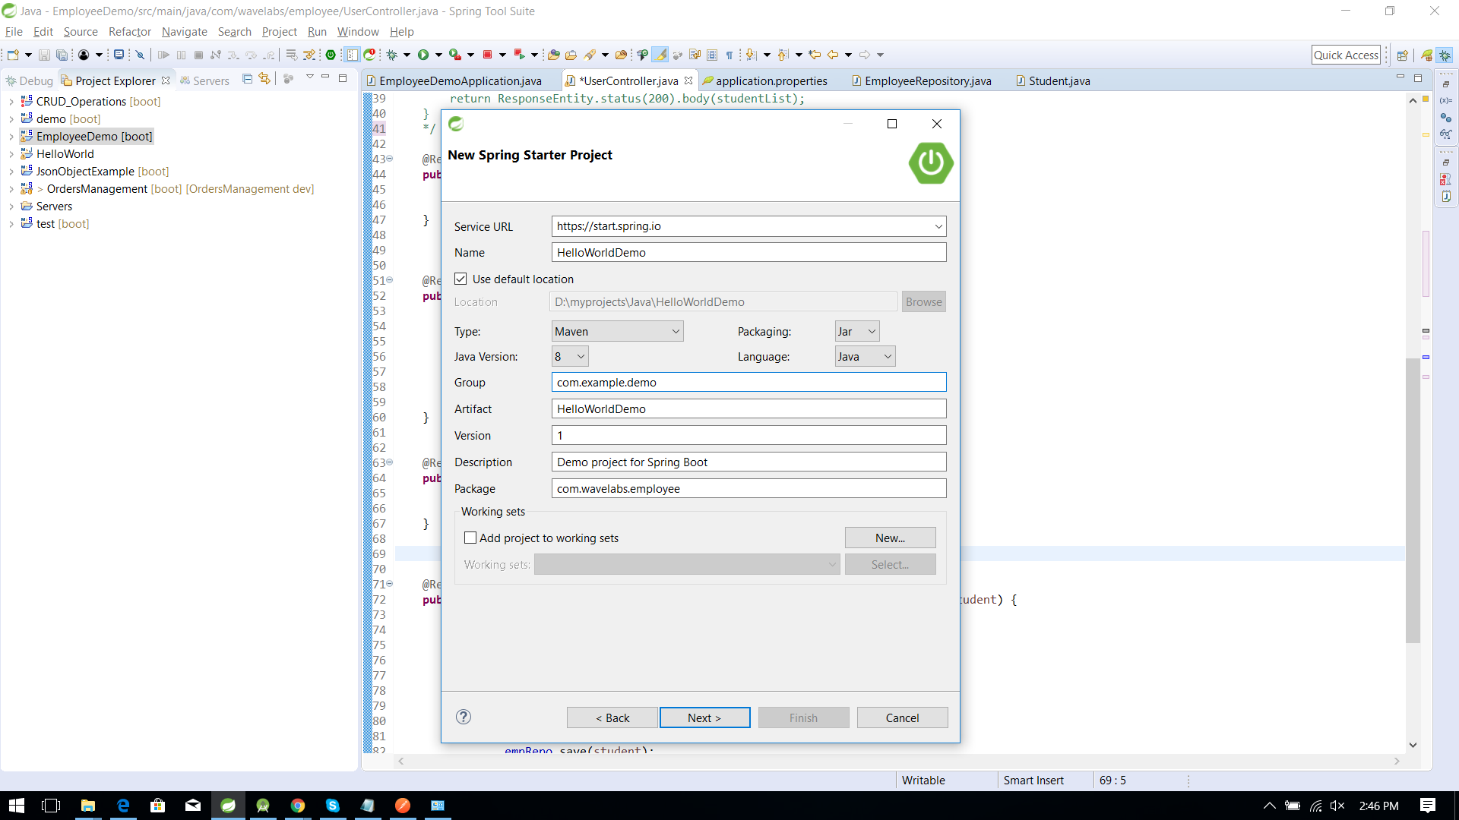
STS - Create a Boot App

Slide 31
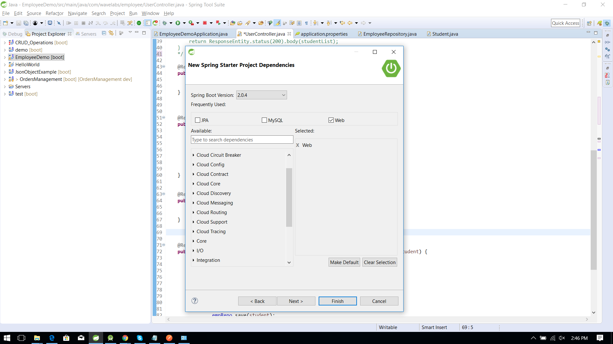
STS - Create a Boot App

Slide 32
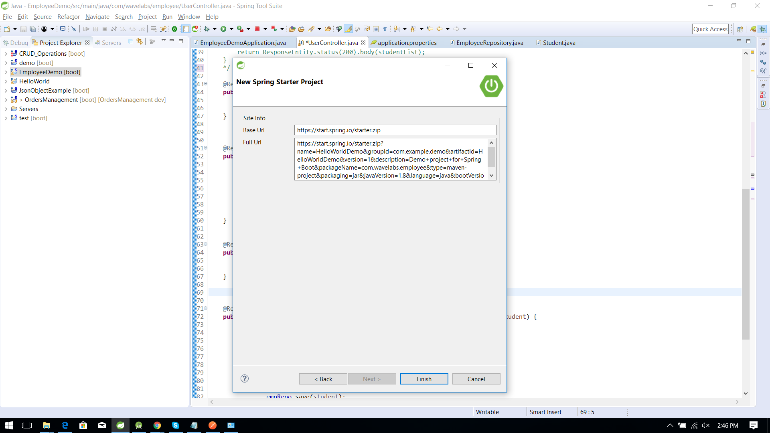
STS - Create a Boot App

Slide 33
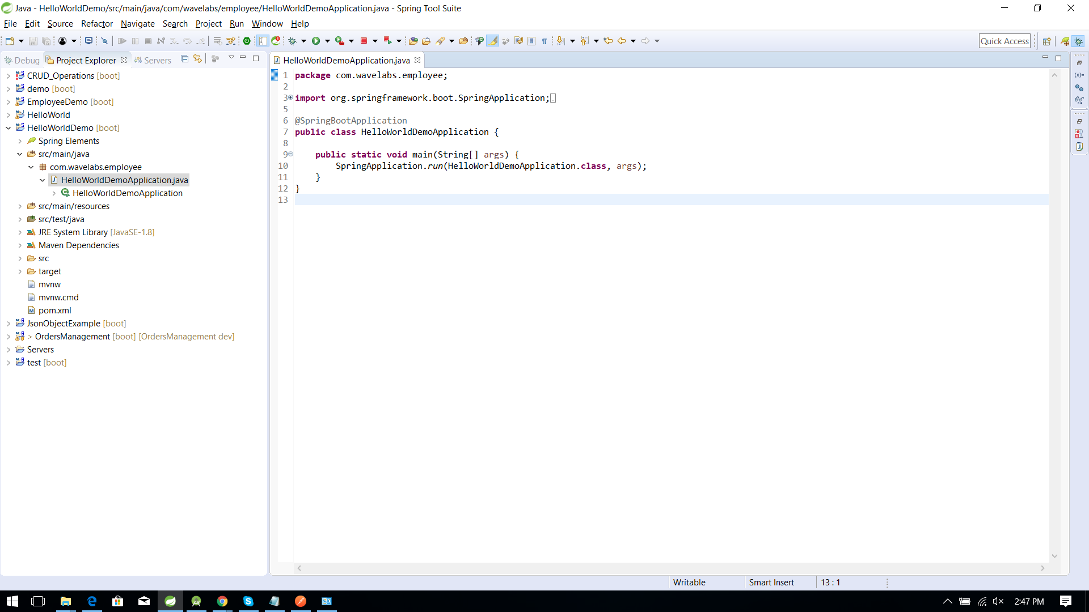
STS - Create a Boot App

Slide 34
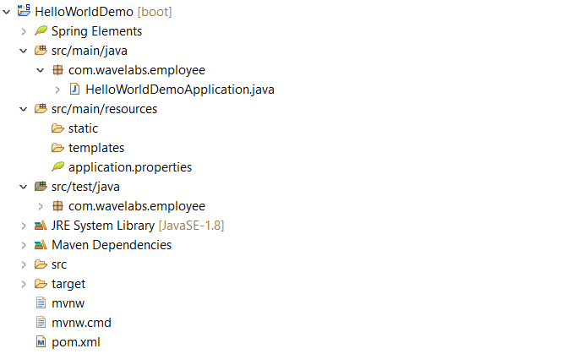
Project Structure

Slide 35
pom.xml - Spring Boot starters
<parent>
<groupId>org.springframework.boot</groupId>
<artifactId>spring-boot-starter-parent</artifactId>
<version>2.0.0.RELEASE</version>
<relativePath/> <!-- lookup parent from repository -->
</parent>
<dependency>
<groupId>org.springframework.boot</groupId>
<artifactId>spring-boot-starter-data-jpa</artifactId>
</dependency>
<dependency>
<groupId>org.springframework.boot</groupId>
<artifactId>spring-boot-starter-web</artifactId>
</dependency>
<dependency>
<groupId>com.h2database</groupId>
<artifactId>h2</artifactId>
<scope>runtime</scope>
</dependency>

Slide 36
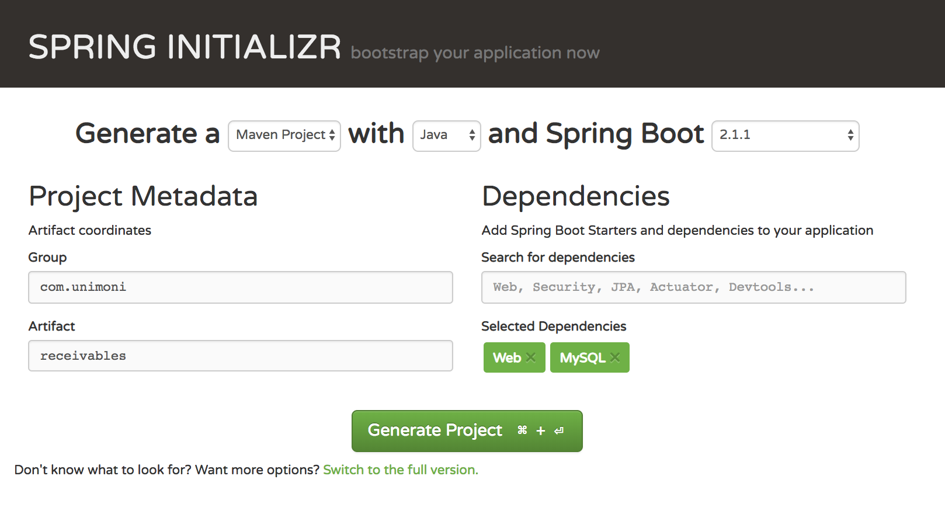
Spring Boot Starter using Spring Initializr
https://start.spring.io/

Slide 37
SpringBoot Starters
Dependency management is a critical aspects of any complex project. And doing this manually is less than ideal; the more time you spent on it the less time you have on the other important aspects of the project.
Starters are pre-configured with the most commonly used library dependencies so that we don’t have to search for the compatible library versions and configure them manually.
spring-boot-starter-data-jpa : Spring Data JPA, JPA, Hibernate dependencies and its transitive dependencies
$ spring init —list ## list all the spring boot starters available
http://start.spring.io page list all the starters

Slide 38
Exercise
Create a Hello World spring Boot Project

Slide 39
Some of the Basic Annotations
@SpringBootApplication
@Controller
@RestController
@RequestMapping
@GetMapping
@PostMapping
@QueryParams
@PathVariable
@RequestBody and @ResponseBody
@RequestHeader and @ResponseHeader
@ExceptionHandler
@ResponseStatus
@ControllerAdvice
@RestControllerAdvice

Slide 40
@SpringBootApplication
@EnableAutoConfiguration: Enable Spring Boot’s auto-configuration mechanism
@ComponentScan: Enable @Component scan on the package where the application is located.
@Configuration: Allows us to register extra beans in the context or import additional configuration classes.
@SpringBootApplication
public class SpringBoot2RestServiceApplication {
public static void main(String[] args) {
SpringApplication.run(SpringBoot2RestServiceApplication.class, args);
}
}

Slide 41
@RestController
@RestController = @Controller + @ResponseBody
HTTP Requests are handled by a controller.
@Controller: is a class which is responsible for preparing a model Map with data to be displayed by the view as well as choosing the right view itself.
@ResponseBody: tells a controller that the object returned is automatically serialized into JSON and passed back into the HttpResponse object.
@RestController takes care of mapping request data to the defined request handler method. Once response body is generated from the handler method, it converts it to JSON or XML response.

Slide 42
@RequestMapping
Maps HTTP requests to handler methods of MVC and Rest Controllers.
Can be applied on a Controller at Class level or Method level or both.
Attributes:
method : GET, POST, HEAD, OPTIONS, PUT, PATCH, DELETE, TRACE
produces: response media types of
consumes: media types that controller method supports
value: request uri
headers: restrict the callers by matching the headers specified

Slide 43
@RequestBody
Maps HttpRequest body to a transfer or domain object, enabling automatic deserialization of the inbound HttpRequest body onto a Java object.

Slide 44
ResponseEntity
ResponseEntity is meant to represent the entire HTTP response. You can control anything that goes into it: status code, headers, and body.
@ResponseBody is a marker for the HTTP response body and @ResponseStatus declares the status code of the HTTP response.
@ResponseStatus isn't very flexible. It marks the entire method so you have to be sure that your handler method will always behave the same way. And you still can't set the headers. You'd need the HttpServletResponse or a HttpHeaders parameter.

Slide 45
@RestController sample
@RestController
@RequestMapping("/message/member")
public class MemberMessageController {
@Autowired
private ConversationService msgSvc;
@RequestMapping(value = “{memberId}/conversation/{otherMemberId}”,
method = RequestMethod.GET,
produces = MediaType.APPLICATION_JSON )
public ResponseEntity<ConversationSummaryResponse> conversationSummary(
@PathVariable("memberId") Long memberId,
@PathVariable("otherMemberId") Long otherMemberId,
@RequestParam(required = false) Long since) {
Date sinceDate=since!=null?new Date(since):null;
ConversationSummaryResponse response = null;
response = msgSvc.thread(memberId,otherMemberId,sinceDate);
return new ResponseEntity(response, HttpStatus.OK);
}
URL : http://messageing.app/message/member/1234/conversation/3456

Slide 46
Exercise
Create a sample JSON object and display Person details using @RequestBody.
( take person Pojo with name, age, address as fields)

Slide 47
Exercise
Perform Following operations By taking one POJO(Model) class and perform operations on List(id,name,age,salary as Fields)
write an rest API to add an Employee into the List?
Write an rest API to get all Employees from the list?
Write rest API to update the details of an employee in the list using the ID.
Write an API to delete an Employee using the Id?.
Time to complete: 45 minutes.

Slide 48
Response Codes
When we make a request to a web server, a three digit HTTP Response Status Code is returned. This code indicates what is about to happen.
List of Response Codes:
200 - Success
201 - Created
403 - Forbidden
404 - Not Found
500 - Internal Server Error

Slide 49
Exercise
Write a POST API Which return Response code 201 on successful addition of an object into a list with a success message.

Slide 50
application.properties
Various properties can be specified inside your application.properties file.
This provides a list of common spring boot properties and references to the underlying classes that consume them.
Boot applies it’s typical convention over configuration approach to property files. This means that we can simply put an “application.properties” file in our “src/main/resources” directory, and it will be auto-detected. We can then inject any loaded properties from it as normal.
So, by using this default file, we don’t have to explicitly register a PropertySource, or even provide a path to a property file.

Slide 51

application.properties
Changing port number:
Setting Context Path:
For Logging Levels:

Slide 52
Validation
Why input validation is needed?
To prevent malicious users from abusing the system
Improper data may cause security vulnerabilities
Expose the website to attacks
Can lead to system crash
Corrupt application data

Slide 53
Validation Annotations
AssertFalse | Min
AssertTrue | NotNull
DecimalMax | Null
DecimalMin | Past
Digits | Pattern
Future | Size
Max
Javax Validations

Slide 54
Bean Validation
import com.fasterxml.jackson.annotation.JsonCreator;
import com.fasterxml.jackson.annotation.JsonProperty;
import javax.validation.constraints.Min;
import javax.validation.constraints.NotNull;
public class Data {
@NotNull
private final String someStringValue;
@Min(1)
private final int someIntValue;
@JsonCreator
public Data(@JsonProperty("someStringValue") String someStringValue, @JsonProperty("someIntValue") int someIntValue) {
this.someStringValue = someStringValue;
this.someIntValue = someIntValue;
}
public String getSomeStringValue() {
return someStringValue;
}
public int getSomeIntValue() {
return someIntValue;
}
}

Slide 55
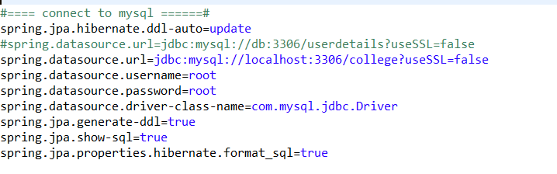
application.properties
To connect to mysql Database:
For more properties:
https://docs.spring.io/spring-boot/docs/current/reference/htmlsingle/#common-application-properties

Slide 56
Exercise
Change port number to 8014 and run the application.

