Slide 2
Spring Data
Spring Data provides a familiar and consistent Spring-based programming model for data access while still retaining the special traits of the underlying data store.
It makes it easy to use data access technologies, relational and non-relational databases, map-reduce frameworks, and cloud-based data services.

Slide 3
Spring Data Modules
Spring Data Commons
Spring Data JPA
Spring Data KeyValue
Spring Data LDAP
Spring Data MongoDB
Spring Data Redis
Spring Data REST
Spring Data for Apache Cassandra
Spring Data for Apache Geode
Spring Data for Apache Solr
Spring Data for Pivotal GemFire
Spring Data Couchbase
Spring Data Elasticsearch
Spring Data Neo4j

Slide 4
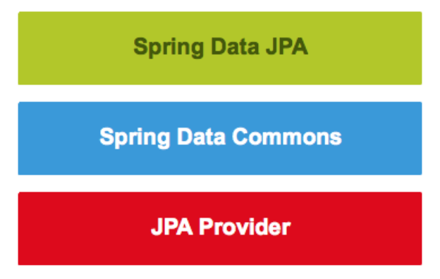
Spring Data JPA

Slide 5
JPA - Java Persistance API
JPA acts as a bridge between object-oriented domain models and relational database systems.
JPA is just a specification, it doesn't perform any operation by itself.
JPA requires an implementation.
ORM tools like Hibernate, TopLink and iBatis implements JPA

Slide 6
Spring Data Commons
Convert data object entities into target datasource records
Convert database records back to entities
Lookup datasource records by citing the entity attributes
Uses RepositoryPattern to create, read, update and delete of entities
Provides common Repositories for target datasources like JpaRepository, MongoRepository

Slide 7
Spring Data JPA
Part Of Spring Data family
It is not a JPA provider
Sophisticated support to build repositories based on Spring and JPA
Support for Querydsl predicates and thus type-safe JPA queries
Pagination support, dynamic query execution, ability to integrate custom data access code
Validation of @Query annotated queries at bootstrap time
Support for XML based entity mapping
JavaConfig based repository configuration by introducing @EnableJpaRepositories.

Slide 9
Repository Interfaces

Slide 10
Entity
POJO class annotated with @Entity
Persistent fields
Any non static and non transient field is a persistent field
Should have an field with @Id (identity field)

Slide 11
JPA starter app - Maven Dependencies
<dependency>
<groupId>org.springframework.boot</groupId>
<artifactId>spring-boot-starter-data-jpa</artifactId>
</dependency>
<dependency>
<groupId>mysql</groupId>
<artifactId>mysql-connector-java</artifactId>
<scope>test</scope>
</dependency>

Slide 12
JPA starter app - JPA Configuration
@Configuration
@EnableJpaRepositories(basePackages= {"jpa.repo"})
@EntityScan(basePackages = {"jpa.entity"})
public interface JpaConfiguration {
}
@SpringBootApplication
@Import(JpaConfiguration.class)
public class DemoApplication {
public static void main(String[] args) {
SpringApplication.run(DemoApplication.class, args);
}
}

Slide 13
JPA starter app - datasource configuration
## https://docs.spring.io/spring-boot/docs/2.1.1.RELEASE/reference/htmlsingle/common-application-properties
# DATASOURCE (DataSourceAutoConfiguration & DataSourceProperties)
spring.datasource.url=jdbc:mysql://mysqllocal/test
spring.datasource.username=root
spring.datasource.password=123456
#spring.datasource.driver-class-name=com.mysql.jdbc.Driver
spring.jpa.generate-ddl=true
spring.jpa.show-sql=true
# The SQL dialect makes Hibernate generate better SQL for the chosen database
spring.jpa.properties.hibernate.dialect = org.hibernate.dialect.MySQL5InnoDBDialect
# Hibernate ddl auto (create, create-drop, validate, update)
spring.jpa.hibernate.ddl-auto = update
# logging configuration
logging.level.org.hibernate.SQL=DEBUG
logging.level.org.hibernate.type=TRACE

Slide 14
Logging
logging.level.org.hibernate=INFO
logging.level.org.hibernate.SQL=DEBUG
logging.level.org.hibernate.type=TRACE
logging.level.org.hibernate.hql.ast.AST=INFO
logging.level.org.hibernate.tool.hbm2ddl=WARN
logging.level.org.hibernate.hql=DEBUG
logging.level.org.hibernate.cache=INFO
logging.level.org.hibernate.jdbc=DEBUG

Slide 15
Annotations
@Column | @Id | @OneToOne | @Query
@Embeddable | @IdClass | @OrderBy | @Table
@Embedded | @Inheritance | @PostLoad | @Transient
@Entity | @InheritanceType | @PostPersist | @UniqueConstraint
@FetchType | @JoinColumn | @PostRemove | @Version
@FlushModeType | @JoinTable | @PostUpdate
@ForeignKey | @ManyToMany | @PrePersist
@GeneratedValue | @ManyToOne | @PreRemove
@GenerationType | @OneToMany | @PreUpdate

Slide 16
Entity Life Cycle

Slide 17
CurdRepository
<S extends T> S save(S var1);
<S extends T> Iterable<S> saveAll(Iterable<S> var1);
Optional<T> findById(ID var1);
boolean existsById(ID var1);
Iterable<T> findAll();
Iterable<T> findAllById(Iterable<ID> var1);
long count();
void deleteById(ID var1);
void delete(T var1);
void deleteAll(Iterable<? extends T> var1);
void deleteAll();

Slide 18
Repository Query Methods
public interface AccountRepository extends CrudRepository<Account, Long> {
Account findByName(String name);
Account findByNameAndAccountNumber(String name, String accountNumber);
Account deleteByAccountNumber(String accountNumber);
}

Slide 19
Query Method Prefixes & Limiting Query results
find…By
read…By
query…By
count…By
get…By
findFirstX
findTopX
Distinct

Slide 20
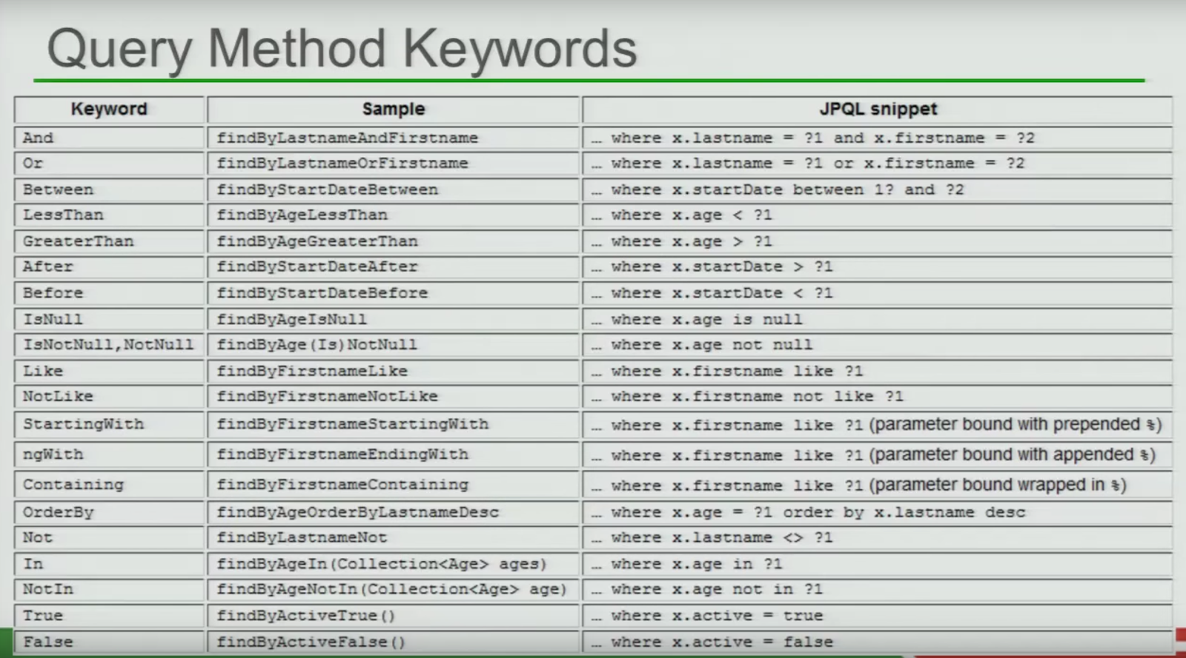
Query Method Keywords and Property Expressions

Slide 21
Query Methods - Pros and Cons
Benefits
Creating simple queries is fast.
The method name of our query method describes the selected value(s) and the used search condition(s).
Drawbacks
Method names of complex query methods are long and ugly
No Support for Dynamic Queries

Slide 22
Queries with the @Query Annotation
Using JPQL
@Query("SELECT t FROM Todo t WHERE t.title = ‘title’”)
public List<Todo> findByTitle();
Using SQL
@Query("SELECT t FROM Todo t WHERE LOWER(t.title) = :searchTerm”)
List<Todo> findBySearchTerm(@Param("searchTerm") String searchTerm);

Slide 23
PagingAndSortingRepository
Iterable<T> findAll(Sort var1);
Page<T> findAll(Pageable var1);
Sort.Order | Pageable
Sort.Order(property) Sort.Order by(property) Sort.Order asc(property) Sort.Order desc(property) Sort.Direction.ASC Sort.Direction.DESC | Pageable.pageNumber Pageable.pageSize Pageable.offSet Pageable.sort Pageable.next Pageable.first

Slide 24
Entity Relationships
Many-to-One
One-to-One
One-to-Many
Many-to-Many

Slide 25
Entity Relationships

Slide 26
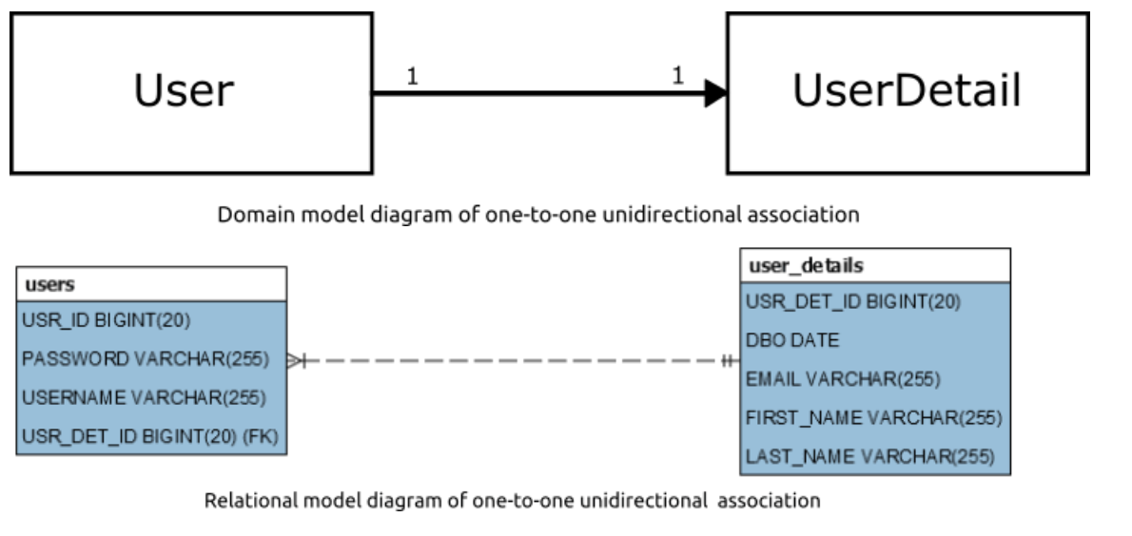
One-to-One: unidirectional
@OneToOne(cascade = CascadeType.ALL)
@JoinColumn(name="USR_DET_ID")
private UserDetail userDetail;

Slide 27
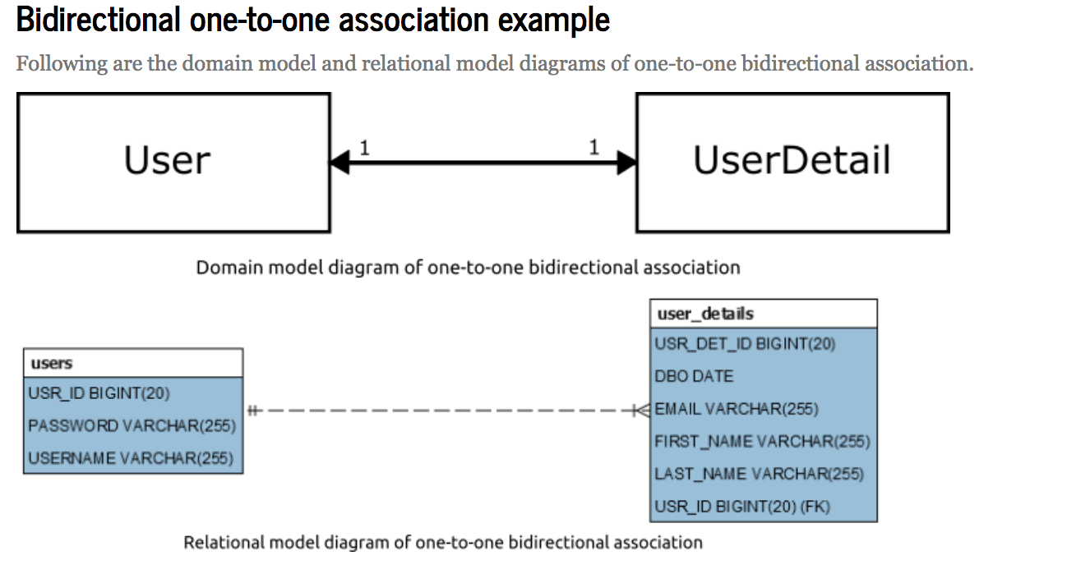
One-to-One: bi-directional
@OneToOne(fetch=FetchType.LAZY)
@JoinColumn(name = "USR_ID")
private User user;
@OneToOne(mappedBy = "user")
private UserDetail userDetail;

Slide 28
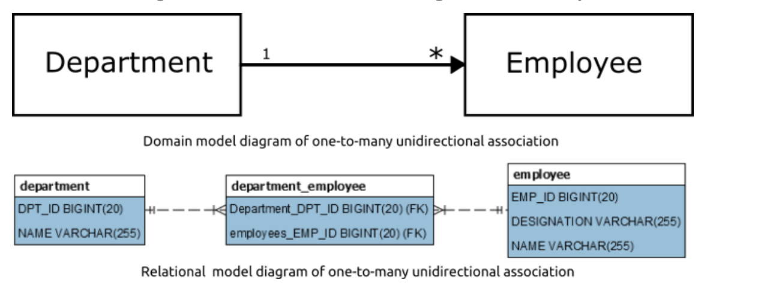
One-to-Many:
@OneToMany(cascade = CascadeType.ALL)
private List<Employee> employees;

Slide 29
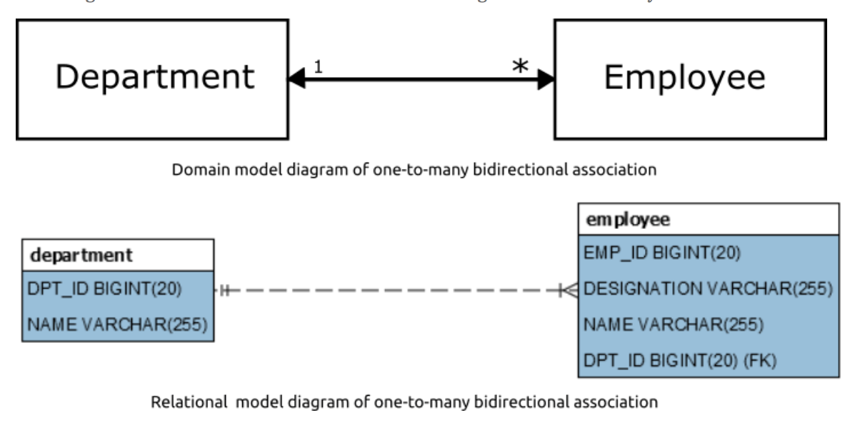
One-to-Many : unidirectional
@OneToMany(mappedBy = "department")
private List<Employee> employees;
@ManyToOne
@JoinColumn(name = "DPT_ID")
private Department department;

Slide 30
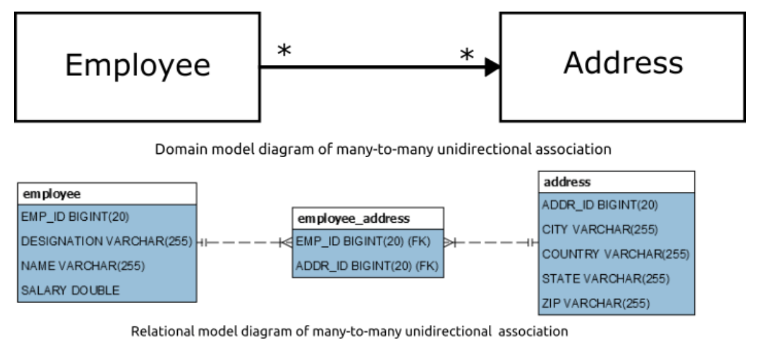
Many-to-Many: unidirectional
@ManyToMany(cascade = CascadeType.ALL)
@JoinTable(name = "EMPLOYEE_ADDRESS",
joinColumns = { @JoinColumn(name = "EMP_ID") },
inverseJoinColumns = { @JoinColumn(name = "ADDR_ID") })
private List<Address> addresses = new ArrayList<>();

Slide 31
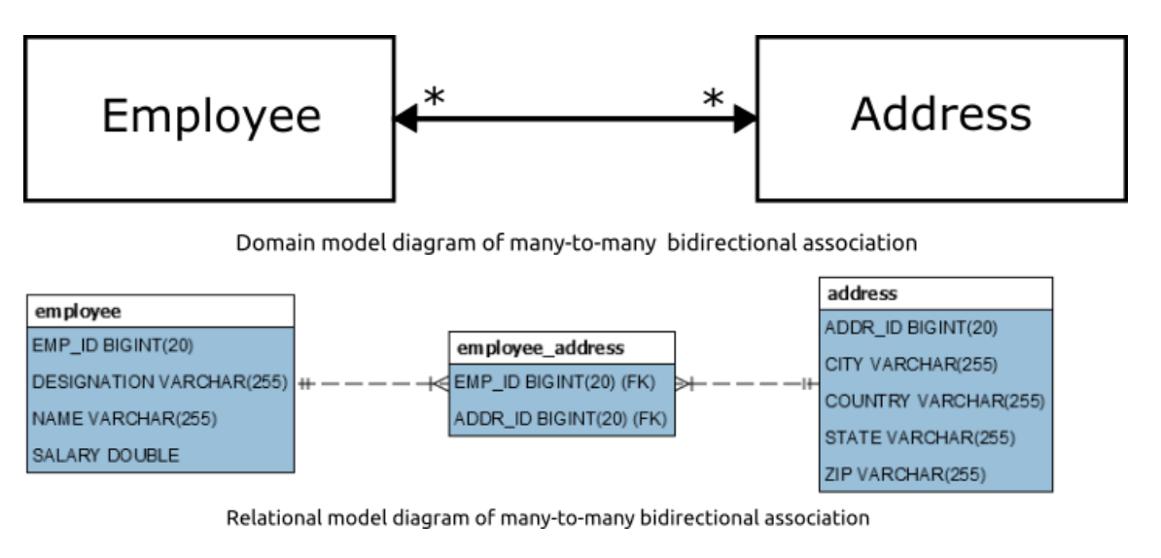
Many-to-Many: bidirectional
Employee.java
@ManyToMany(cascade = CascadeType.ALL, fetch=FetchType.LAZY)
@JoinTable(name = "EMPLOYEE_ADDRESS",
joinColumns = { @JoinColumn(name = "EMP_ID") },
inverseJoinColumns = { @JoinColumn(name = "ADDR_ID") })
private List<Address> addresses = new ArrayList<>();
Address.java
@ManyToMany(fetch=FetchType.LAZY, mappedBy = "addresses")
private List<Employee> employees = new ArrayList<>();

