Slide 1
Output Streams in Java
Ranganathan Kasiganesan

Slide 2
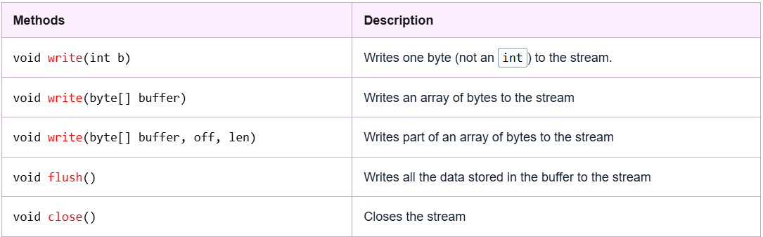
OutputStram class

Slide 3
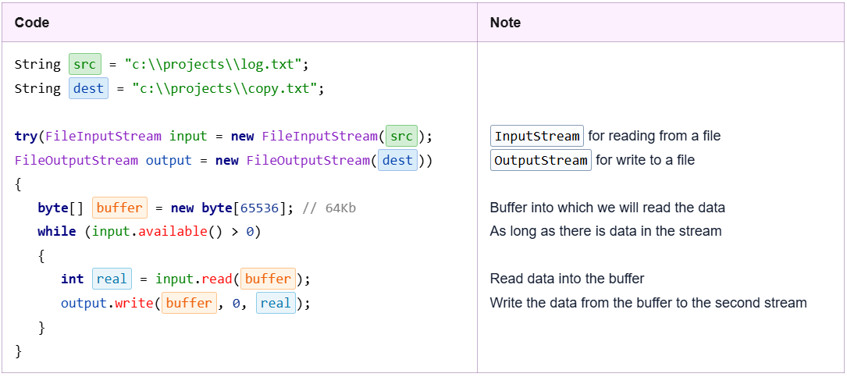
FileOutputStream

Slide 4
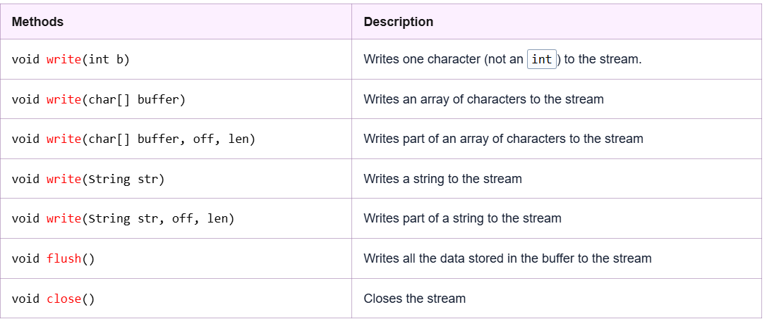
Writer Class & its methods

Slide 5
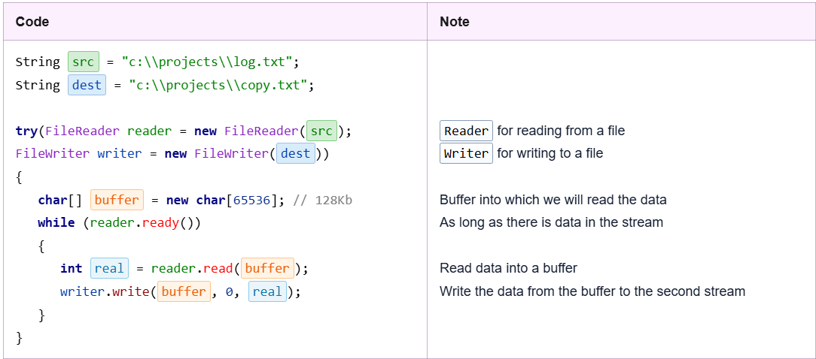
Reader & Writer classes

Slide 6
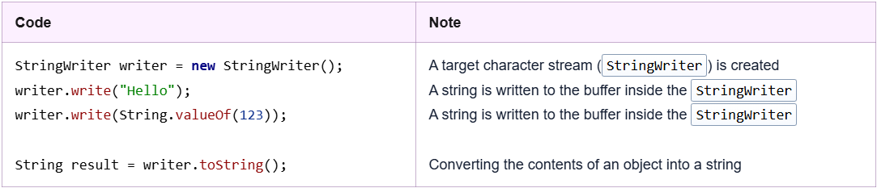
StringWriter class

Slide 7
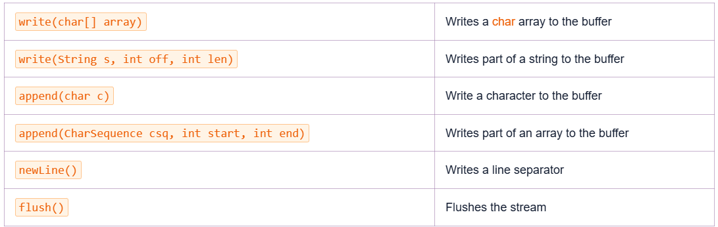
BufferedWriter

Slide 8

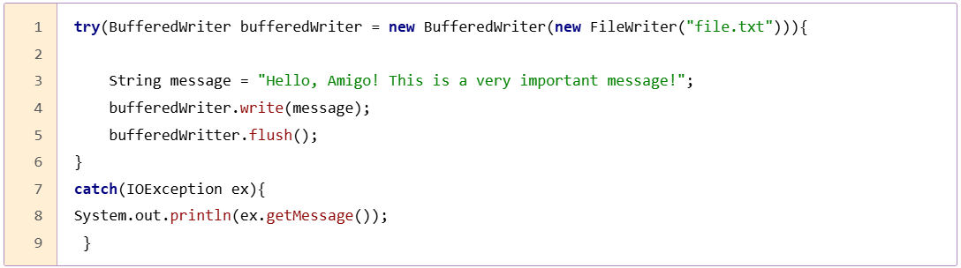
BufferedWriter needs to be paired with FileWriter in case we need to write on a file

Slide 9
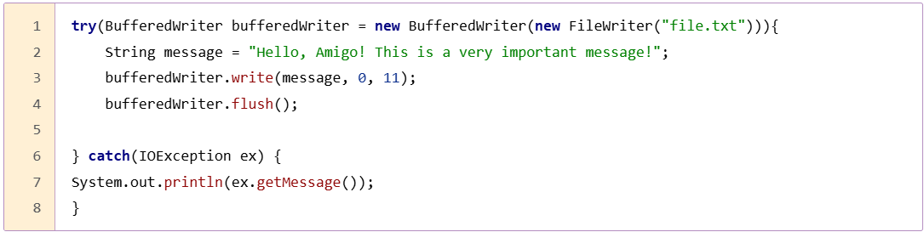
More methods…

Slide 10
Try with Resources

Slide 11
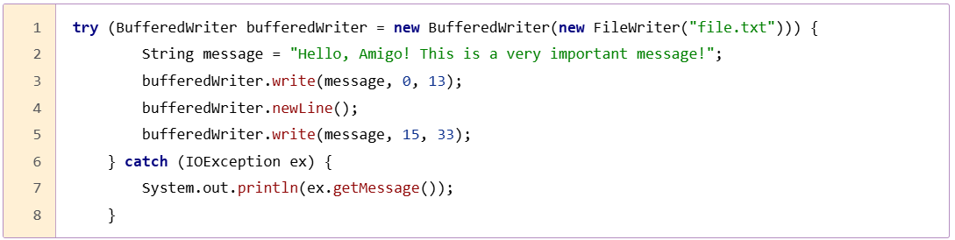
More methods… newLine()

Slide 12
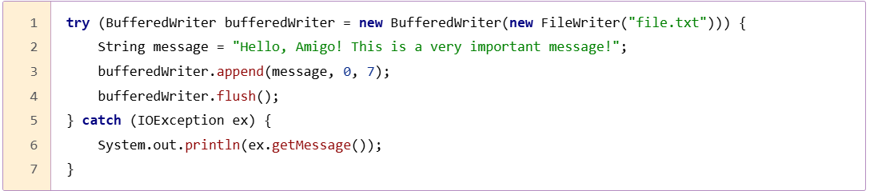
More methods… append()

