Slide 1
Input Streams in Java
K. Ranganathan Kasiganesan

Slide 2
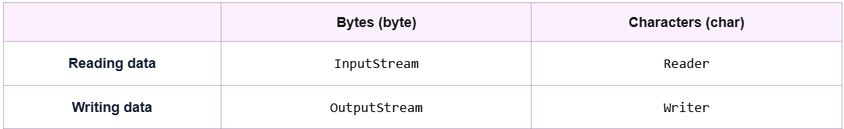
Input Streams

Slide 3
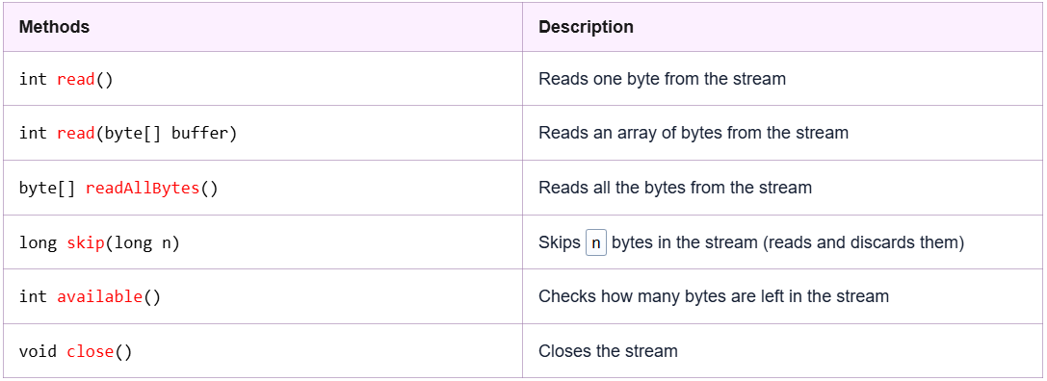

Slide 4
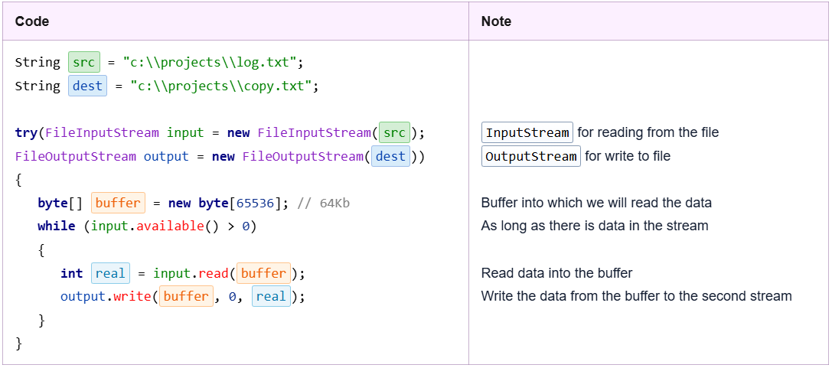
0,…. 64,536 byte buffer[0].. buffer[64,536]
System.out.print((char) real + “ ”);

Slide 5
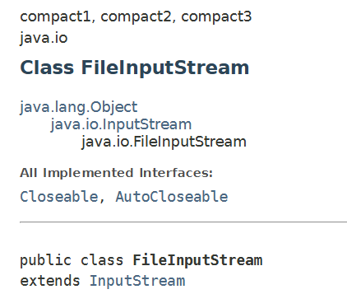
FileInputStream
FileInputStream (Java Platform SE 8 ) (oracle.com)

Slide 6
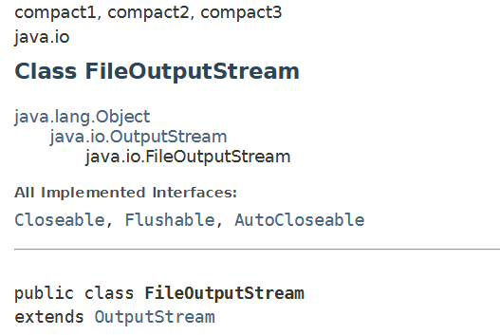
FileOutputStream
FileOutputStream (Java Platform SE 8 ) (oracle.com)

Slide 7
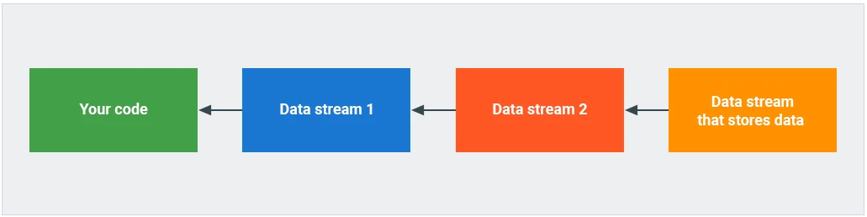

Slide 8
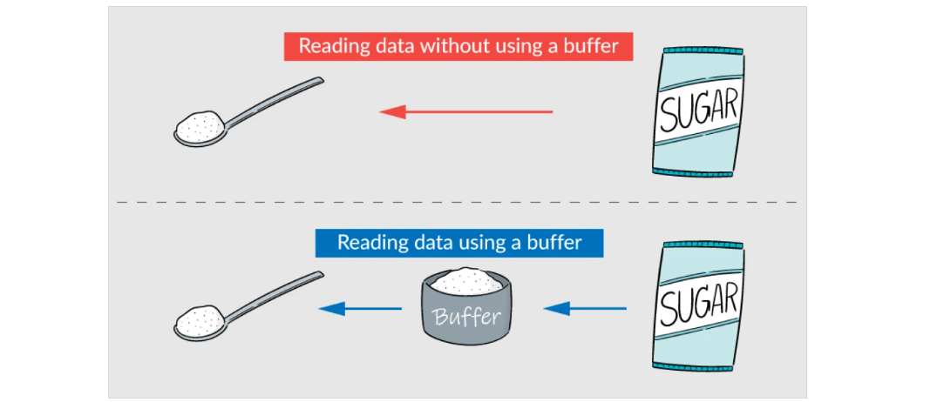
Syntactic Sugar

Slide 9
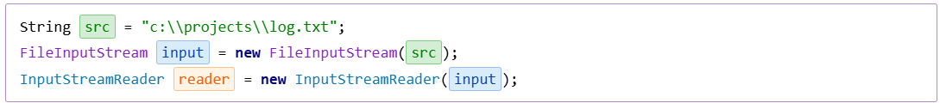

Slide 10
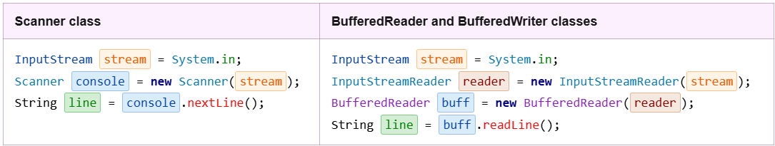
InputStream & InputStreamReader
FileInputStream file = “C:/\projects/\log.txt;
InputStramReader reader = new InputStreamReader( file);
BufferedReader buffRead = new BufferedReader(reader);
char readNow = (char) buffRead.read(); // char
String word = sc.read();

Slide 11
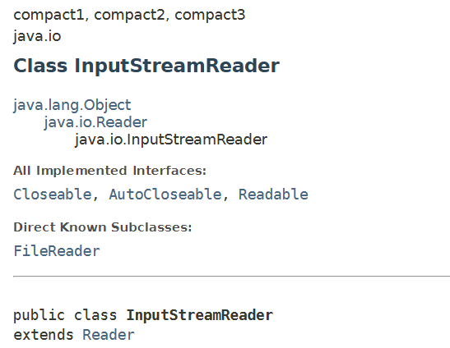
InputStreamReader
InputStreamReader (Java Platform SE 8 ) (oracle.com)

Slide 12
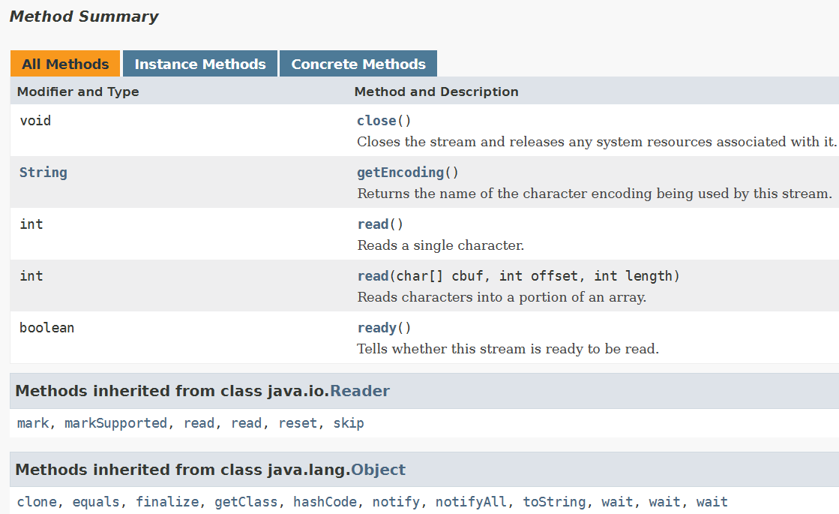
InputStreamReader
InputStreamReader (Java Platform SE 8 ) (oracle.com)

Slide 13
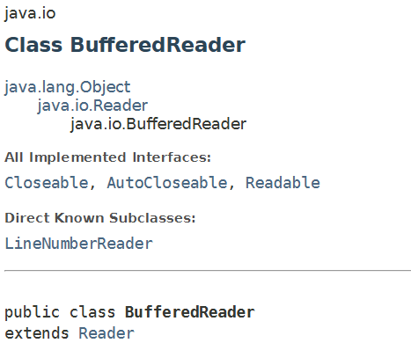
BufferedReader
BufferedReader (Java Platform SE 8 ) (oracle.com)

Slide 14
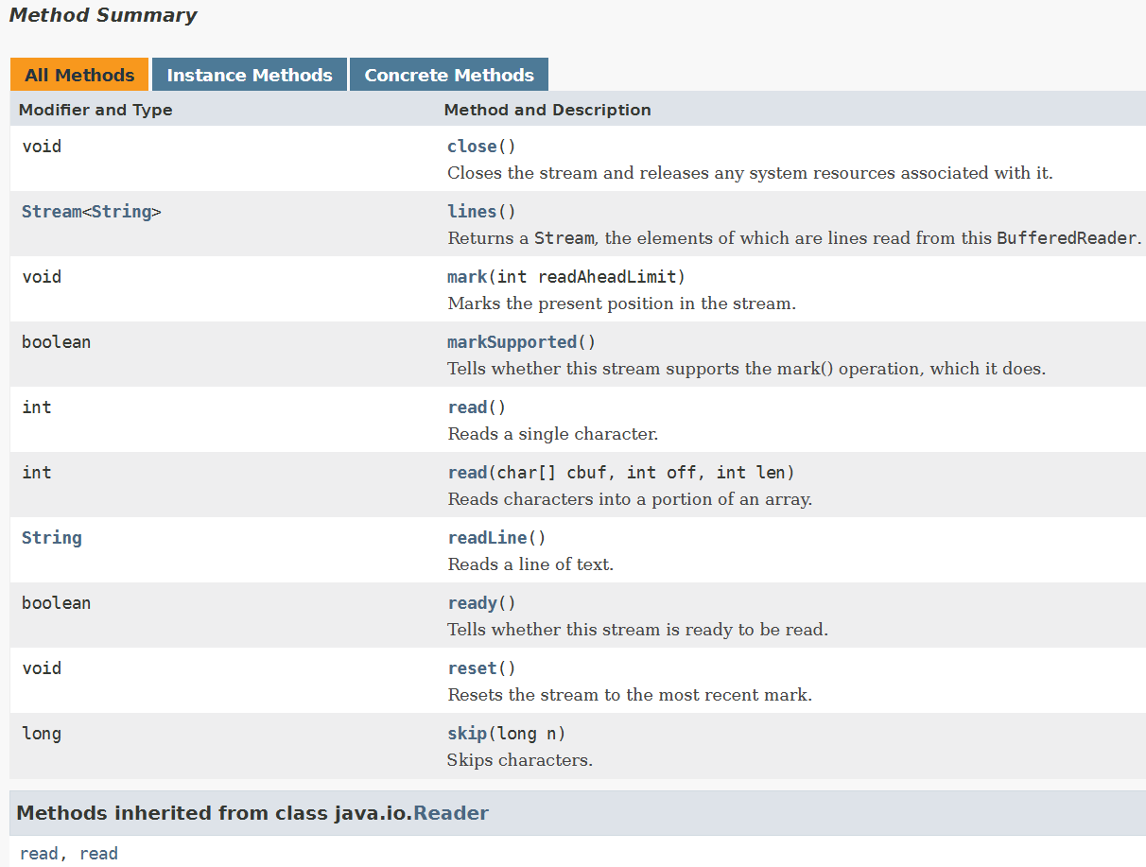
BufferedReader
BufferedReader (Java Platform SE 8 ) (oracle.com)

Slide 15
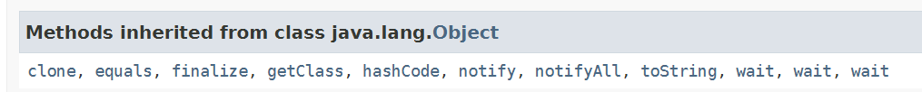
Other Methods
BufferedReader (Java Platform SE 8 ) (oracle.com)

Slide 16
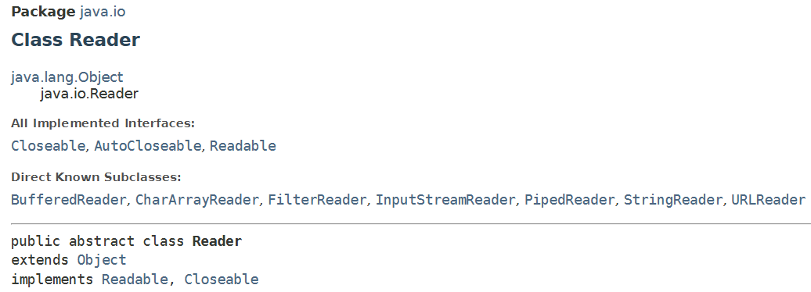
Reader
Reader (Java SE 11 & JDK 11 ) (oracle.com)

Slide 17
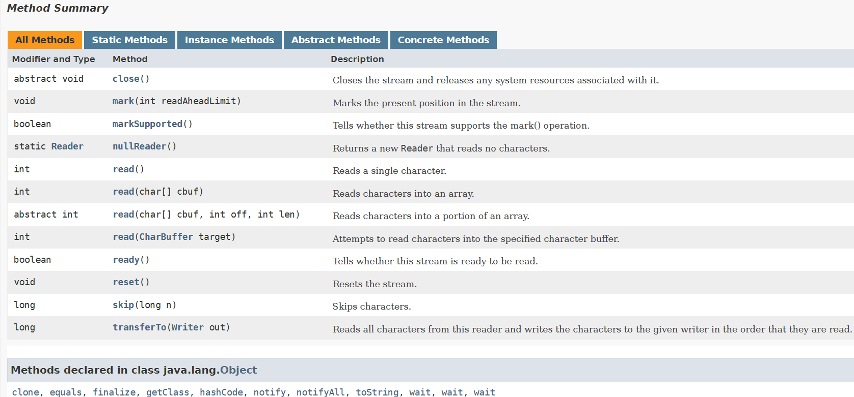
Reader
Reader (Java SE 11 & JDK 11 ) (oracle.com)

Slide 18

Thank you.

