Slide 1
Temperature Analysis: Comprehensive Visualizations and Insights on Global Temperatures
Amit Rangane - 38915109

Slide 2
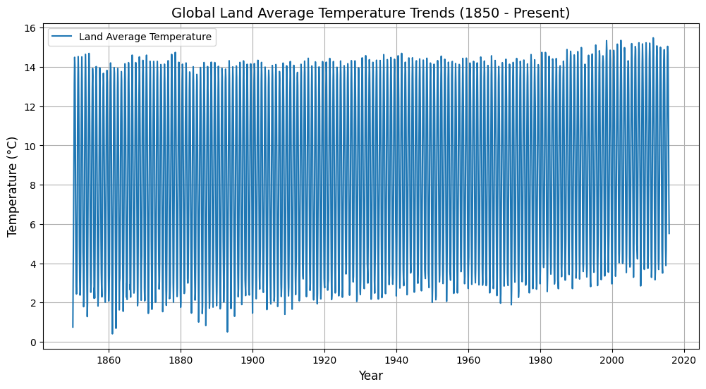
Global Land Average Temperature Trends
Global land temperatures have steadily increased since 1850, highlighting climate warming.
Significant yearly variability, with seasonal patterns evident throughout the dataset.
Clear indication of global warming, especially post-1950.

Slide 3
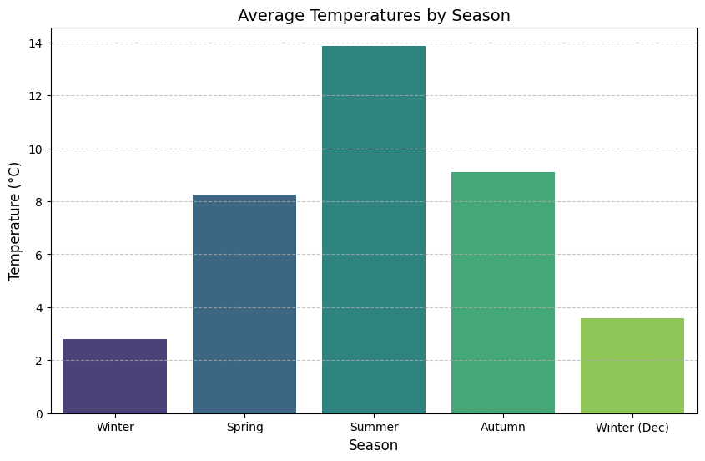
Seasonal Temperature Analysis
Summer has the highest average temperature (~14°C), while winter is the coldest (~2°C).
Spring and autumn show intermediate temperatures, indicating smooth seasonal transitions.
Clear seasonal differences emphasize climate cycles and their regularity.
Slightly higher average temperature in December compared to other winter months.

Slide 4
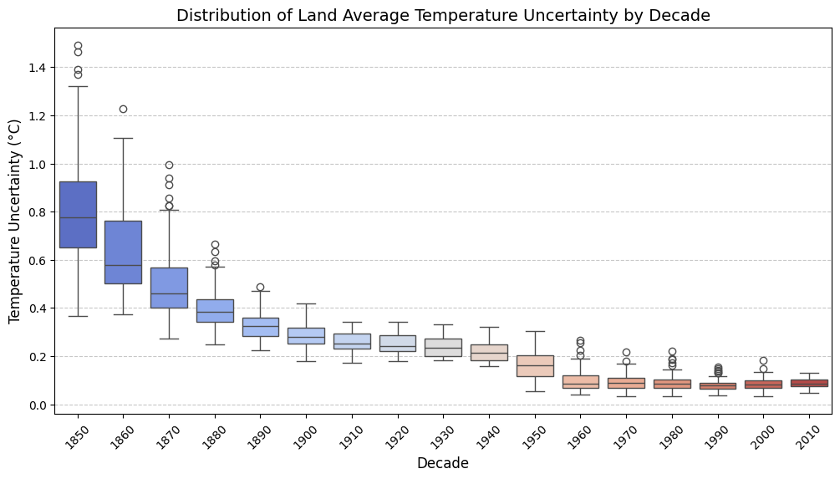
Temperature Uncertainty by Decade
Temperature uncertainty has significantly decreased over time, especially post-1900.
Reduced variability indicates advancements in data collection and climate monitoring.
Higher uncertainty in the 1850s-1900s reflects limitations in historical temperature recording.
Post-1950s data shows minimal variability, highlighting reliable modern measurement techniques.

Slide 5
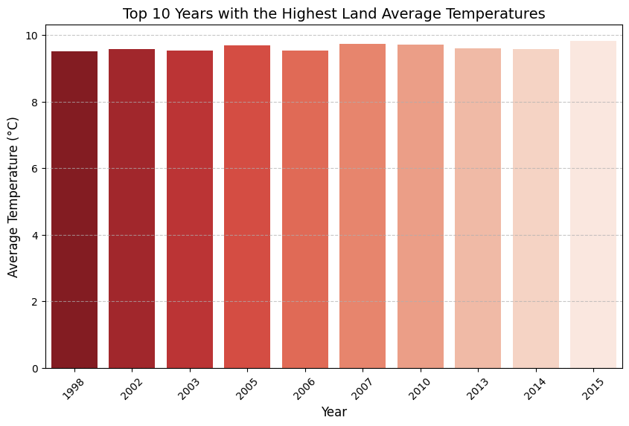
Top 10 Hottest Years
All top 10 hottest years occurred after 1998, reflecting recent climate changes.
2005 and 2010 are among the highest recorded years, emphasizing the global warming trend.
Consistent rise in temperatures highlights the impact of modern climate factors.

Slide 6
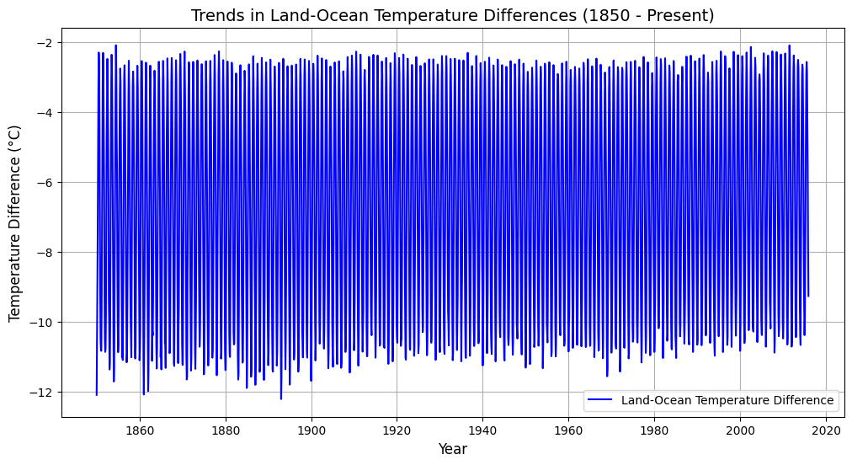
Land-Ocean Temperature Differences
The land-ocean temperature difference remains relatively stable, fluctuating between -2°C and -12°C.
Larger temperature differences in the 19th century suggest significant land cooling compared to oceans.
A slight decrease in fluctuations in recent decades reflects a balancing trend between land and ocean temperatures.
Highlights the unique thermal responses of land and ocean to global warming.

Slide 7
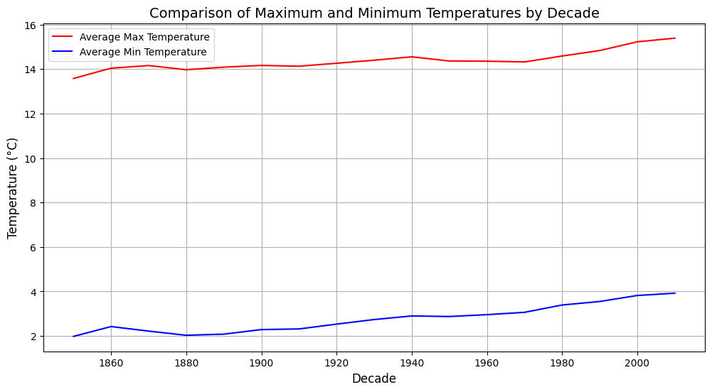
Decadal Trends in Maximum and Minimum Temperatures
Both maximum and minimum temperatures show a steady increase over the decades.
The gap between max and min temperatures persists, indicating consistent seasonal and diurnal variation.
Significant rise in both metrics after the 20th century reflects the effects of global warming.
The simultaneous rise highlights warming trends affecting both extreme and baseline temperatures.

Slide 8
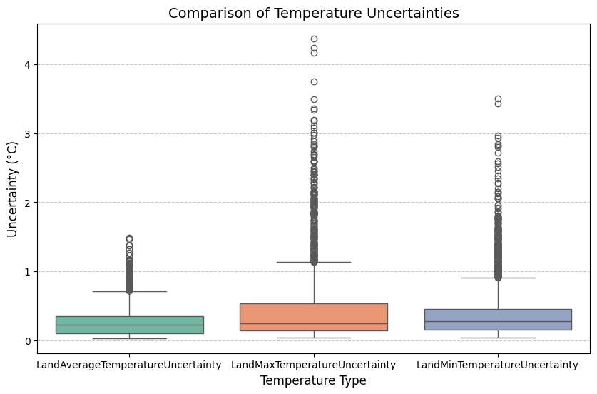
Temperature Uncertainty Comparison by Type
Temperature uncertainties are generally low, staying below 1°C for most observations.
Maximum temperature shows slightly higher uncertainty compared to average and minimum temperatures.
Some outliers exceed 3°C uncertainty, indicating occasional inconsistencies in historical data.
Boxplots reveal a stable and narrow uncertainty range for all temperature types.

Slide 9
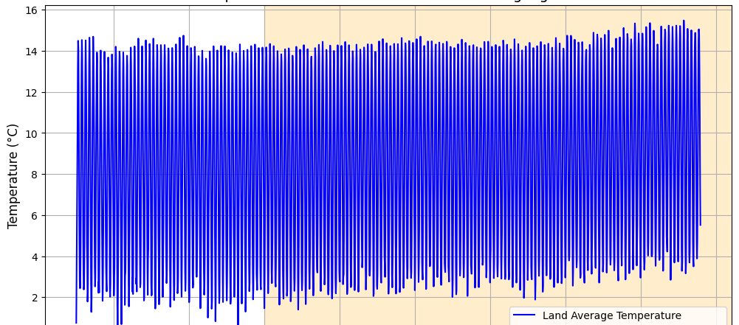
Temperature Trends with Industrialization Highlighted
Land average temperatures exhibit an upward trend over time, consistent with global warming.
Clear fluctuations indicate seasonal cycles within the dataset.
Shaded sections may signify significant climate events or trends requiring further attention.
The data visually represents a warming pattern over the years.

Slide 10
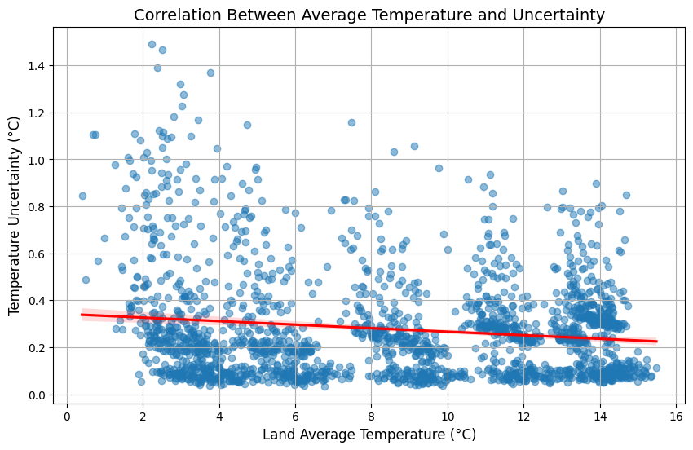
Relationship Between Temperature and Uncertainty
A slight negative correlation exists between average temperature and uncertainty, as shown by the trend line.
Uncertainty decreases as temperatures rise, indicating more reliable data in warmer periods.
Data points are concentrated at specific temperature ranges, reflecting distinct climate conditions or seasons.

Slide 11
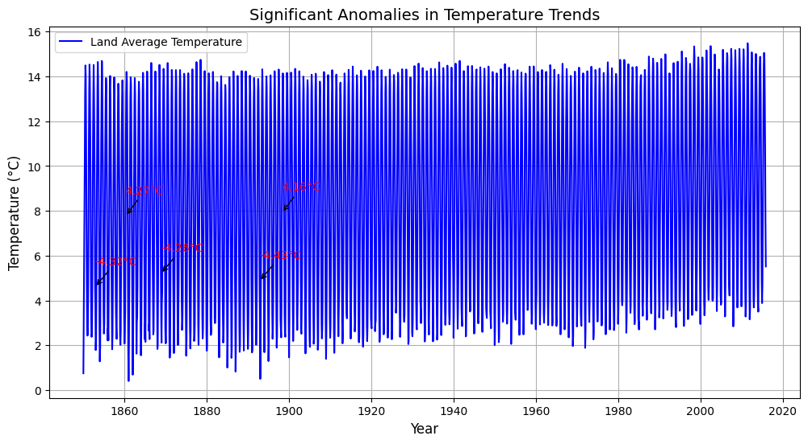
Most Significant Anomalies in Temperature Trends
Specific years with significant temperature deviations are identified, reflecting unusual climate events.
Anomalies occur sporadically but may indicate impactful historical climate events or measurement errors.
Despite anomalies, the general trend of increasing temperatures remains clear.
These deviations warrant further investigation to understand their causes and implications.

Slide 12
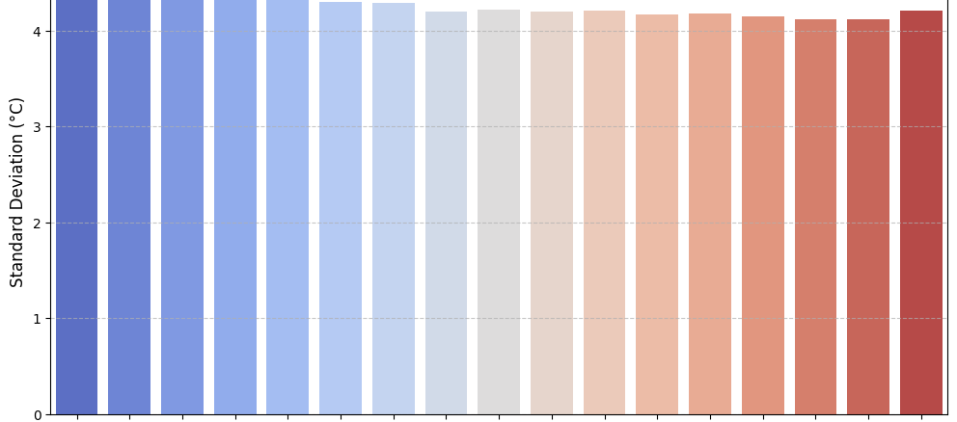
Temperature Variability Across Decades
Standard deviation values are consistent, indicating steady fluctuations in temperature over the dataset.
A slight rise in standard deviation toward the later periods may reflect increasing temperature extremes.
The colour gradient visually highlights changes in variability over time.
The data suggests growing variability in recent years, aligning with global climate change discussions.

Slide 13
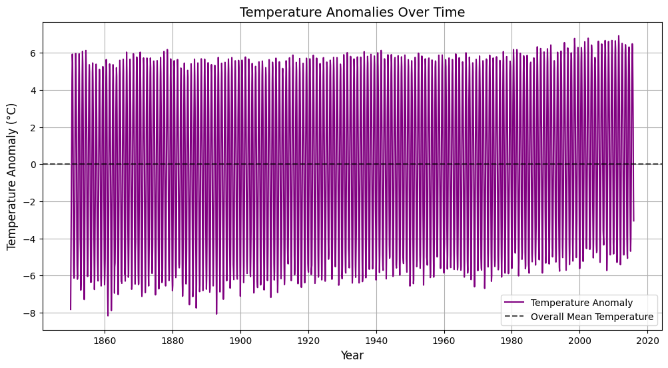
Temperature Anomalies Over Time
Temperature anomalies fluctuate around the overall mean, showing clear variability across the Post-1900, there is a visible increase in positive anomalies, indicating a warming trend.
Earlier years show a more balanced spread of positive and negative anomalies, suggesting a stable climate.
The upward trend in anomalies aligns with evidence of recent global warming.

Slide 14
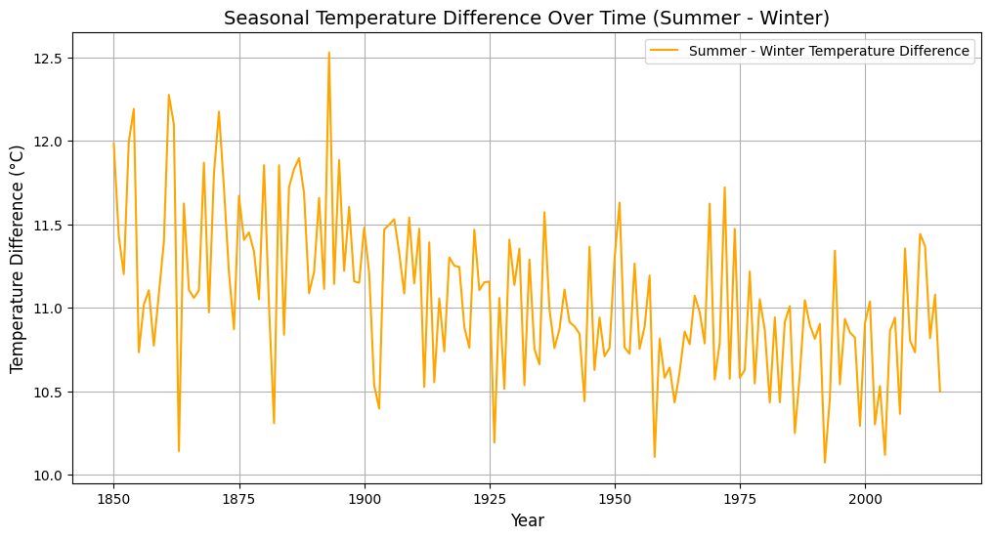
Seasonal Temperature Differences Over Time
The temperature difference between summer and winter has gradually decreased over time.
Early years show more variability in seasonal differences, indicating a less stable climate pattern.
Post-1950, seasonal differences have become more consistent, reflecting a changing climate dynamic.
Reduced seasonal contrasts align with global warming impacts on temperature patterns.

Slide 15

Significant Cooling Periods
Specific years with significant temperature drops are marked, reflecting historical cooling events.
Most notable cooling periods occurred before 1900, highlighting historical climate volatility.
After 1900, fewer significant cooling events are visible, emphasizing a shift towards warming trends.\
These cooling periods could relate to volcanic activity or other natural phenomena impacting global temperatures.

Slide 16
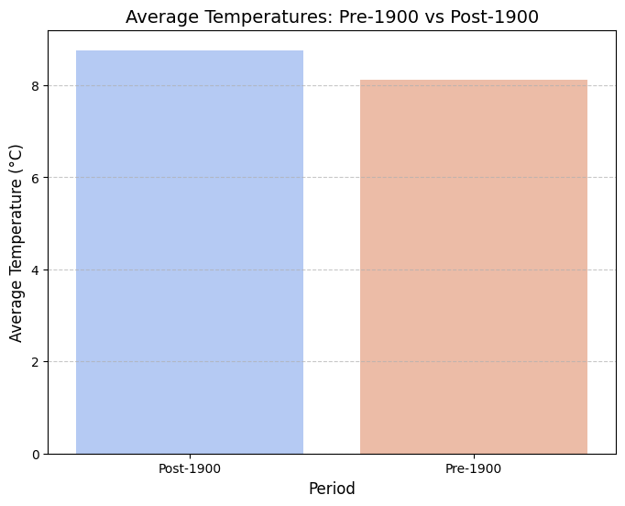
Pre-1900 vs Post-1900 Average Temperatures
Average temperatures post-1900 are slightly higher than pre-1900, reflecting a long-term warming trend.
While the difference isn't dramatic, it highlights the beginning of modern climate changes.
Pre-1900 data serves as a baseline for evaluating the impact of industrialization on temperatures.
The comparison underlines the gradual but consistent rise in global land temperatures.

Slide 17
Conclusion
Global Warming Evidence: A clear warming trend since the pre-industrial era, accelerating after 1900.
Improved Data Accuracy: Reduced uncertainty and variability highlight advancements in temperature measurement.
Seasonal Impacts: Narrowing gaps between summer and winter temperatures reflect climate change effects.
Historical Anomalies: Natural cooling periods were notable pre-1900 but are overshadowed by modern warming trends.
Anthropogenic Influence: Rising average and extreme temperatures point to human impact on the climate.
Urgency for Action: Findings emphasize the need for global efforts to mitigate and adapt to climate change.

Slide 18
Thank you

