Slide 1
Generalized Decrease Schedule of Learning Parameters for SOM
Prashant Kalvapalle, Shoeb Mohammed, Ragib Mostofa

Slide 2
Motivation
SOM needs decreasing parameters
Learning rate, Neighborhood radius
SOM learning methods have no objective function
No information about progress of algorithm
Parameters schedule depends on the state of the network
Embedding: How well prototypes represent data distribution
Topology: Twisting, Topography
How do we evaluate network state to dynamically change parameters?

Slide 3
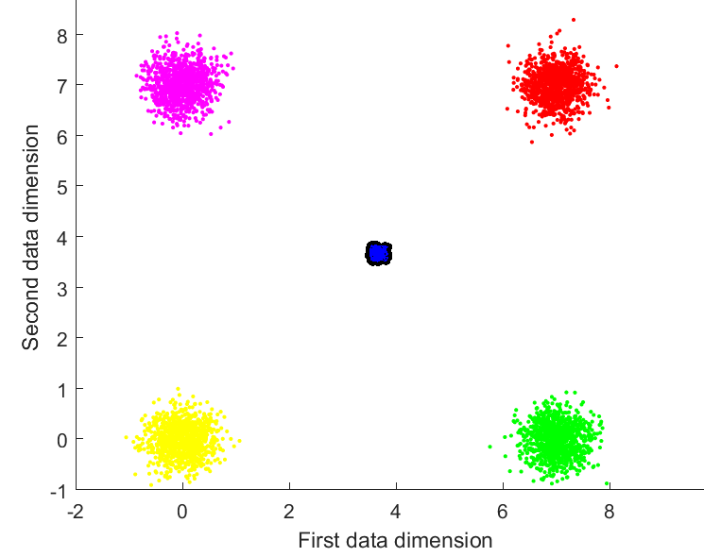
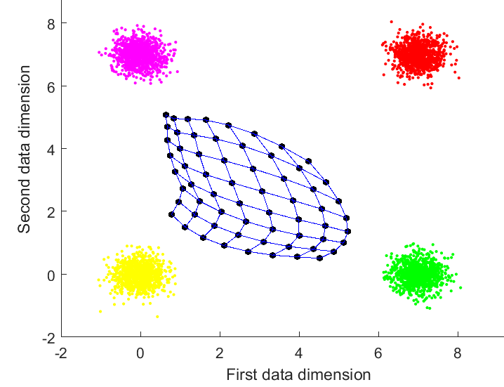
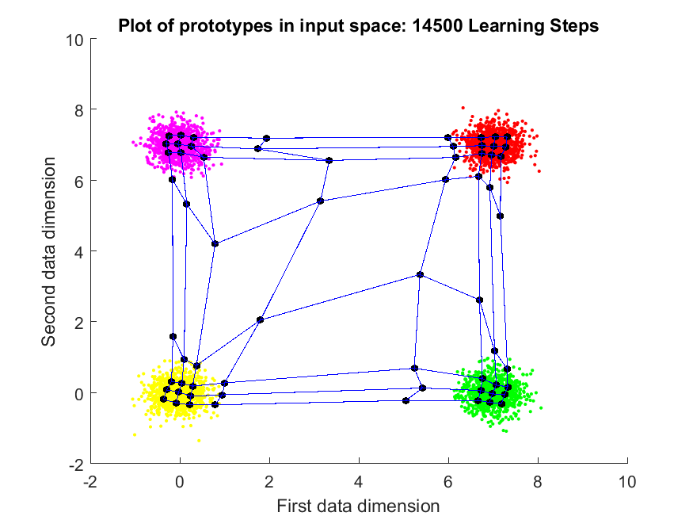

Monitoring Learning
$\text{Embedding} \text{Error}\text{ = (1 - }\frac{σ_{p}^{2}}{σ_{d}^{2}}\text{) }$
Weights initialization: $μ_{p}=μ_{d}, σ_{p}^{2}= \frac{1}{10}σ_{d}^{2}$
Error = 0.99
Error = 0.81
Error = 0.17

Slide 4

Monitoring Learning
$Topological Error= \frac{1}{n}\sum_{i=1}^{n}{err(x_{i}) }$¹
(1) Hamel L. (2016) SOM Quality Measures: An Efficient Statistical Approach. In: Merényi E., Mendenhall M., O’Driscoll P. (eds) Advances in Self-Organizing Maps and Learning Vector Quantization. Advances in Intelligent Systems and Computing, vol 428. Springer, Cham

Slide 5
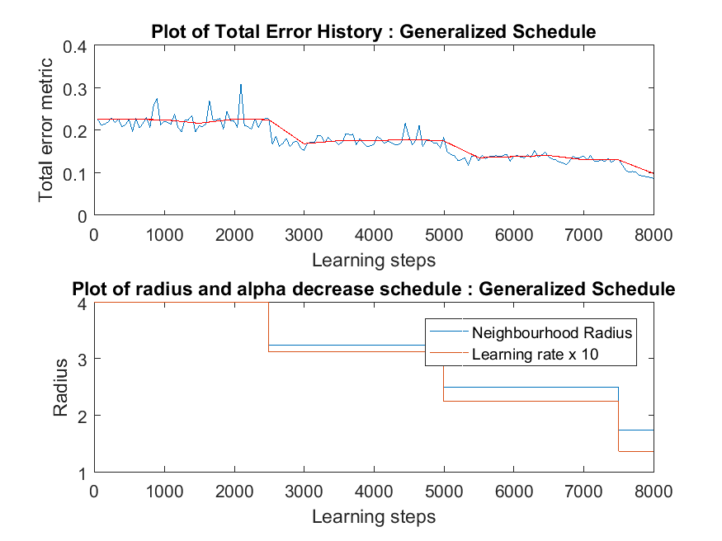

Error measure
$Total Error=α∗Embedding Error+\left(1 −α\right)∗Topological Error$
Errors calculated every 50 learning steps (-)
Errors smoothened (-) : Moving average of every 10 data points (500 learn steps)

Slide 6
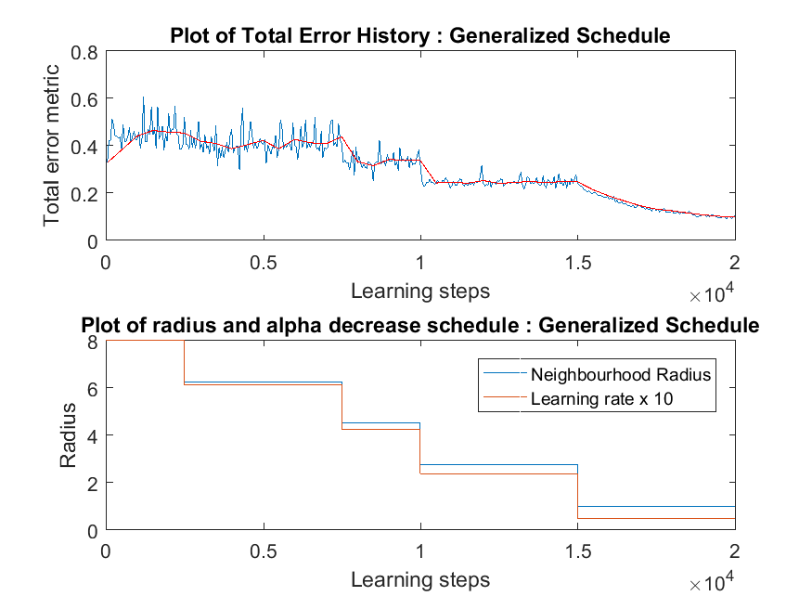
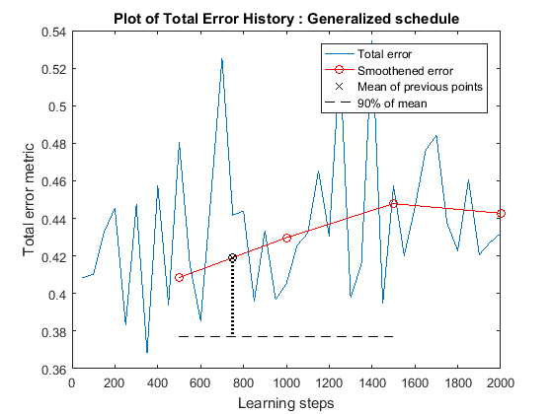
Decrease schedule
Check smoothened error every 1500 learn steps
If non decreasing then lower both SOM parameters

Slide 7
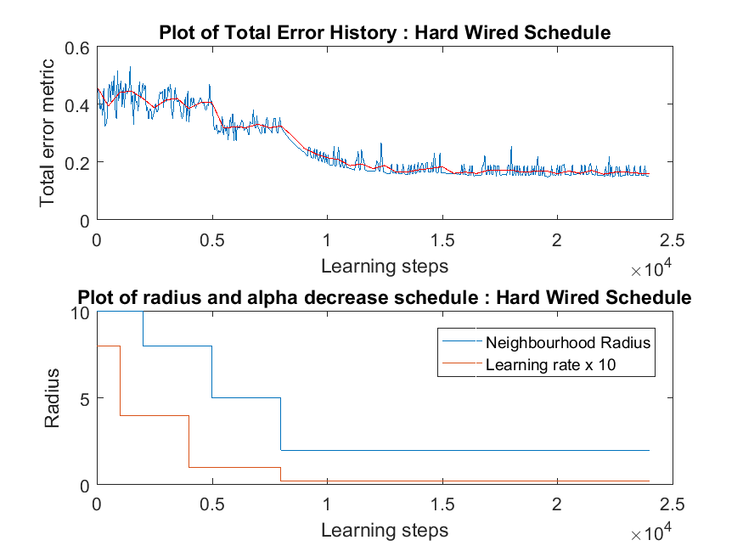
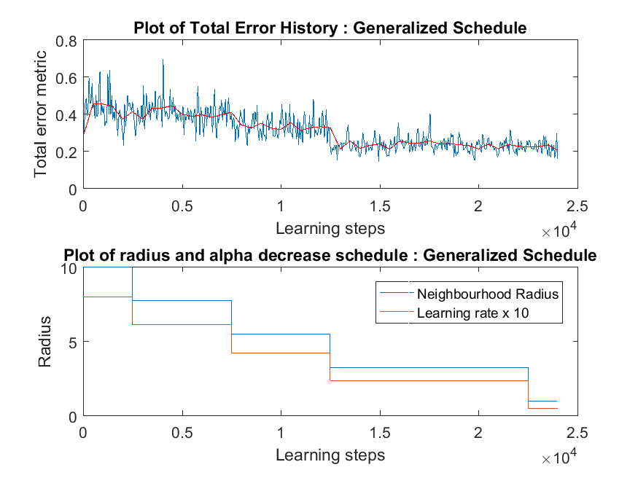
Learning Rate & Neighborhood Radius Schedule

Slide 8
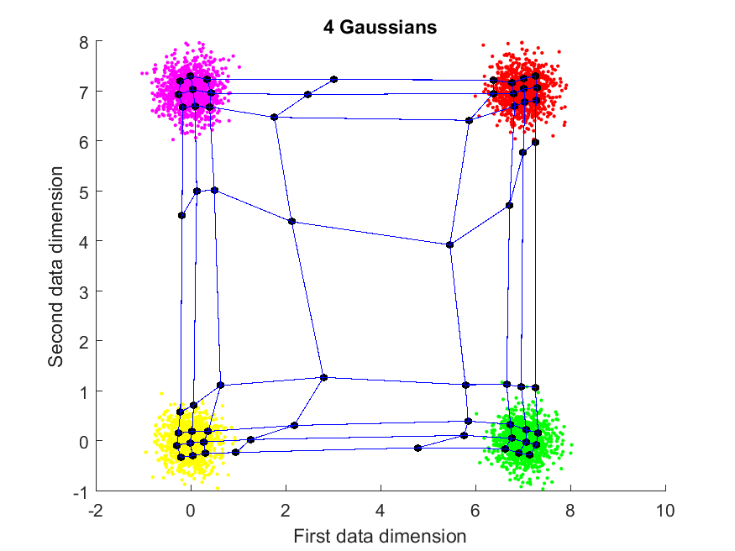
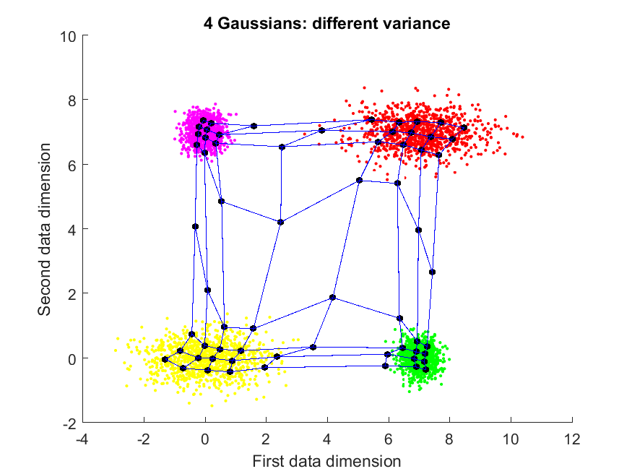
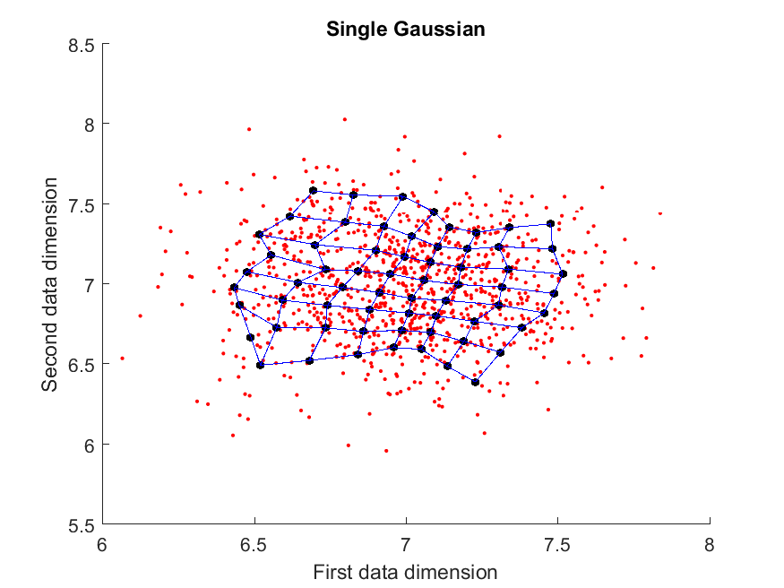
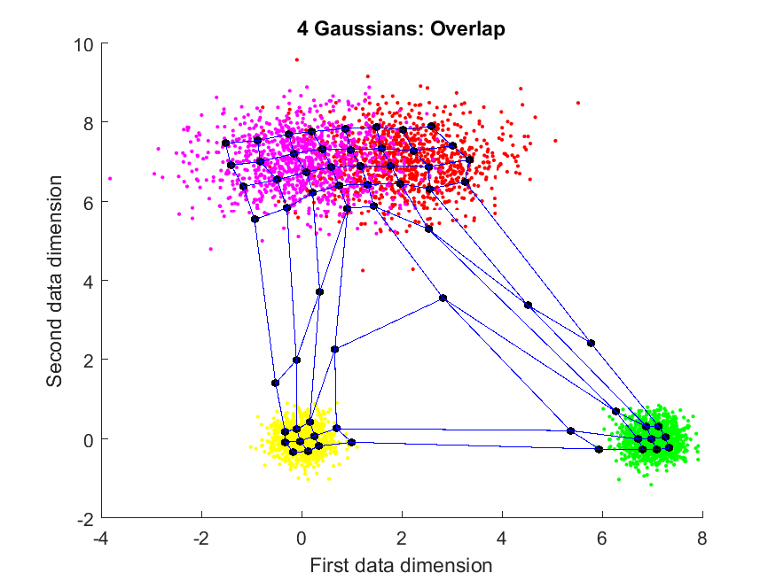
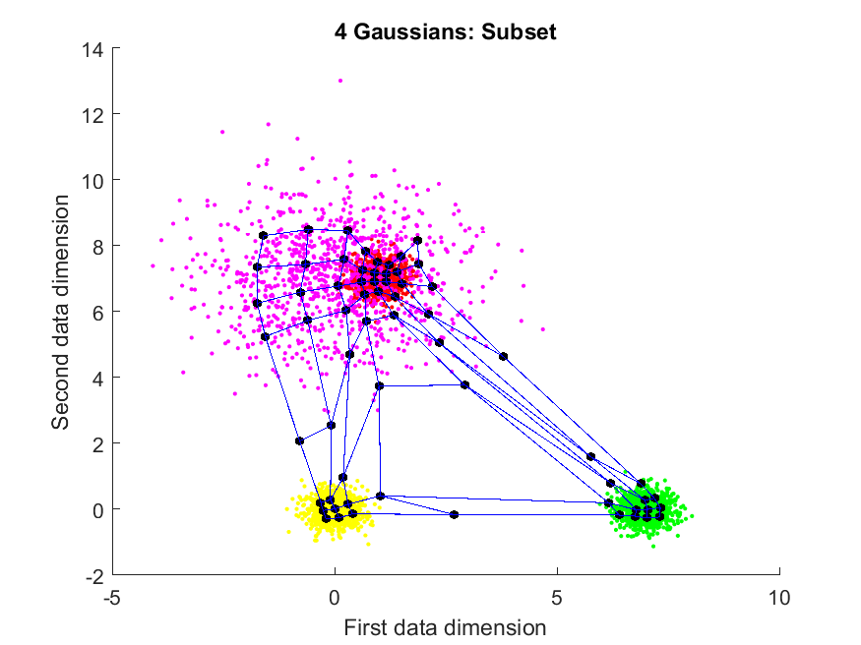
Converged SOM

Slide 9
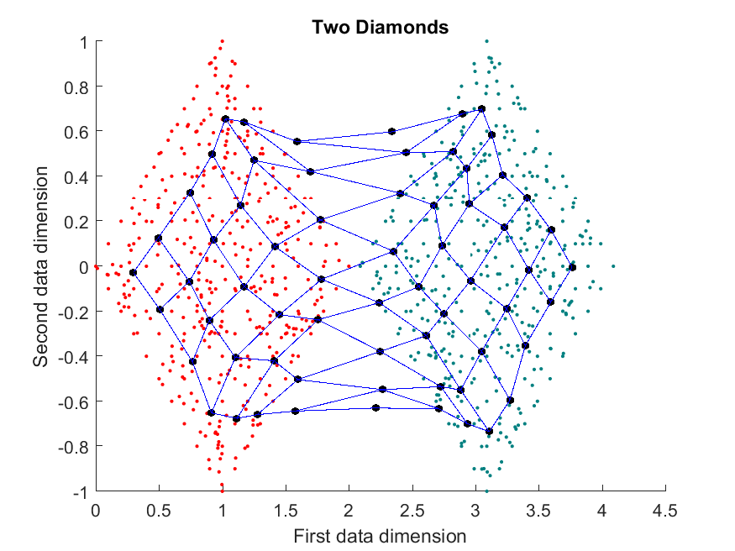
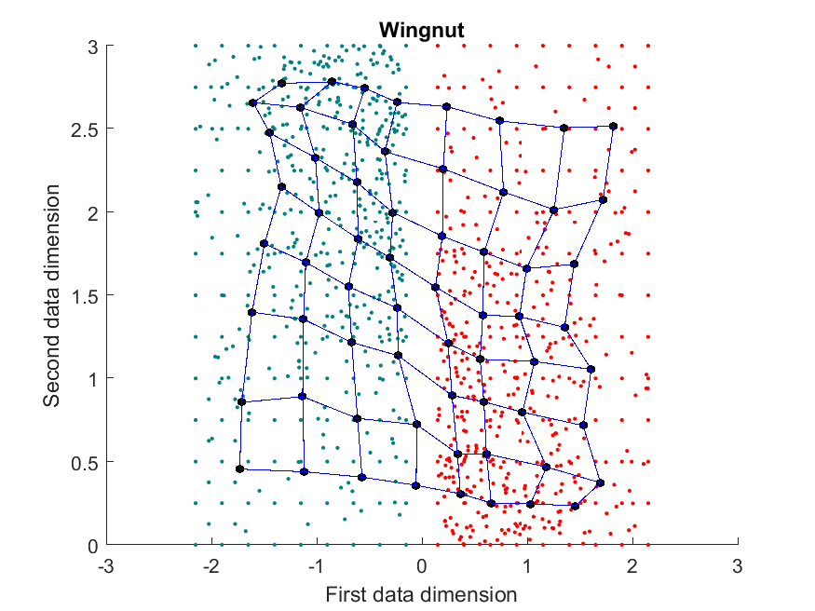
Converged SOM

Slide 10
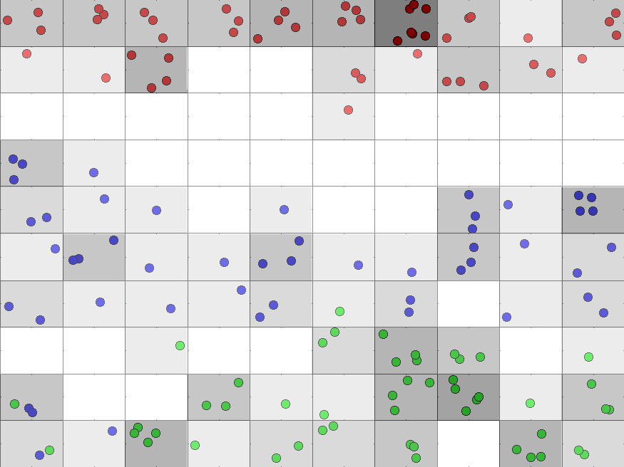
Converged SOM – Iris Dataset

Slide 11
Generalized Schedule is Faster and More Reliable
53.0%
49.7%
16.2%
21.3%
7.1%

Slide 12
Generalized Schedule is Faster and More Reliable
58.0%
27.4%
24.7%

Slide 13
Conclusion
Comparison between data and prototype mean and variance indicates the learning progress of SOM
SOM embedding and topology information can be used to set parameters real-time
Useful as a default decrease schedule for any SOM
Leads to faster learning for most data sets

Slide 14


Slide 15
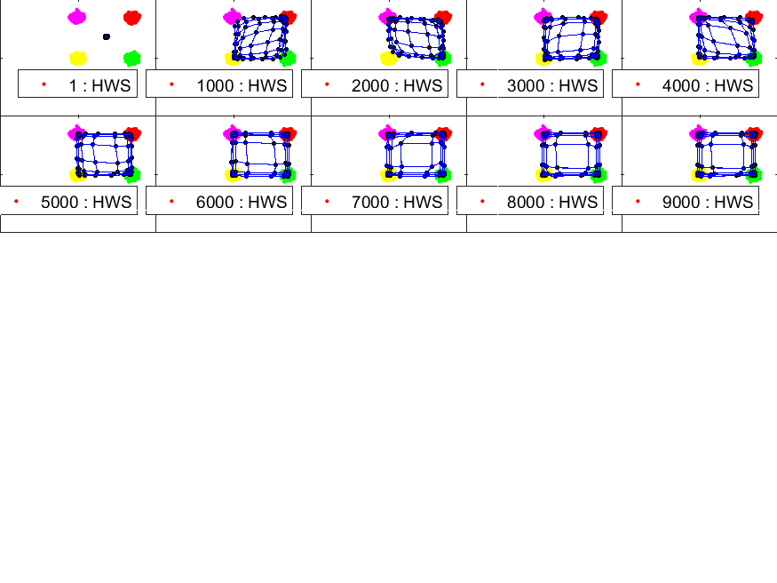
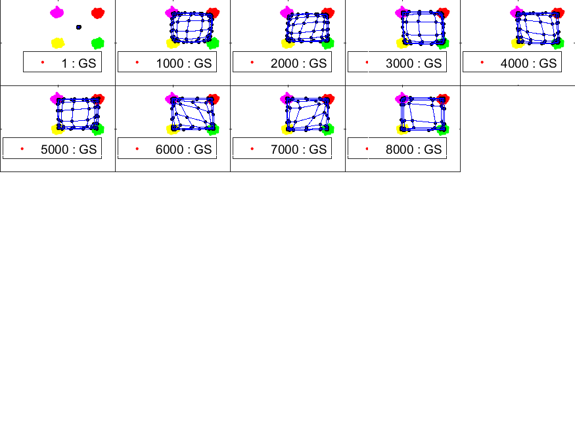
Progression of clusters
Hard-coded decrease schedule
Generalized decrease schedule

