Slide 1
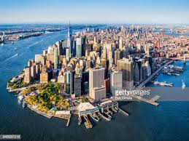
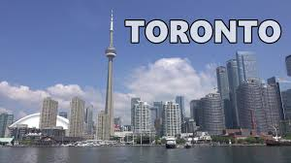
Exploring common venues in Manhattan, NY and Toronto, CA
Pictures of Manhattan, NY and Toronto, CA

Slide 2
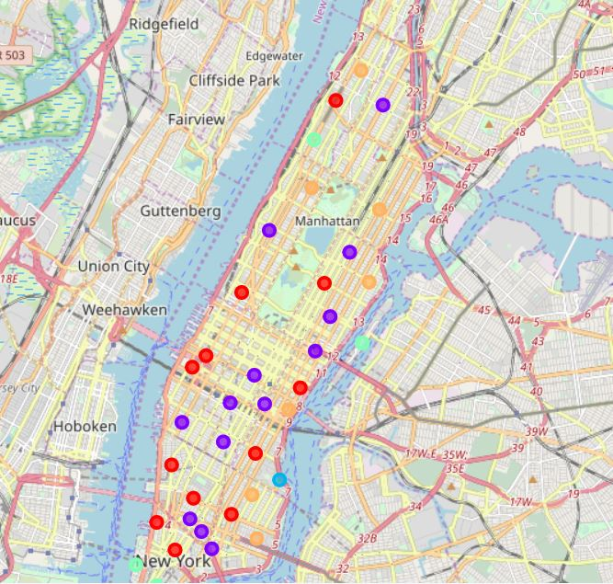
Using K-means clustering to cluster Manhattan, NYC neighborhoods by common venues

Slide 3
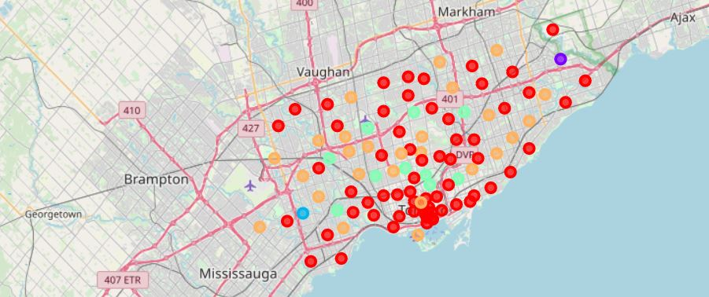
Using k-means clustering to cluster Toronto, CA neighborhoods by common venues

Slide 4
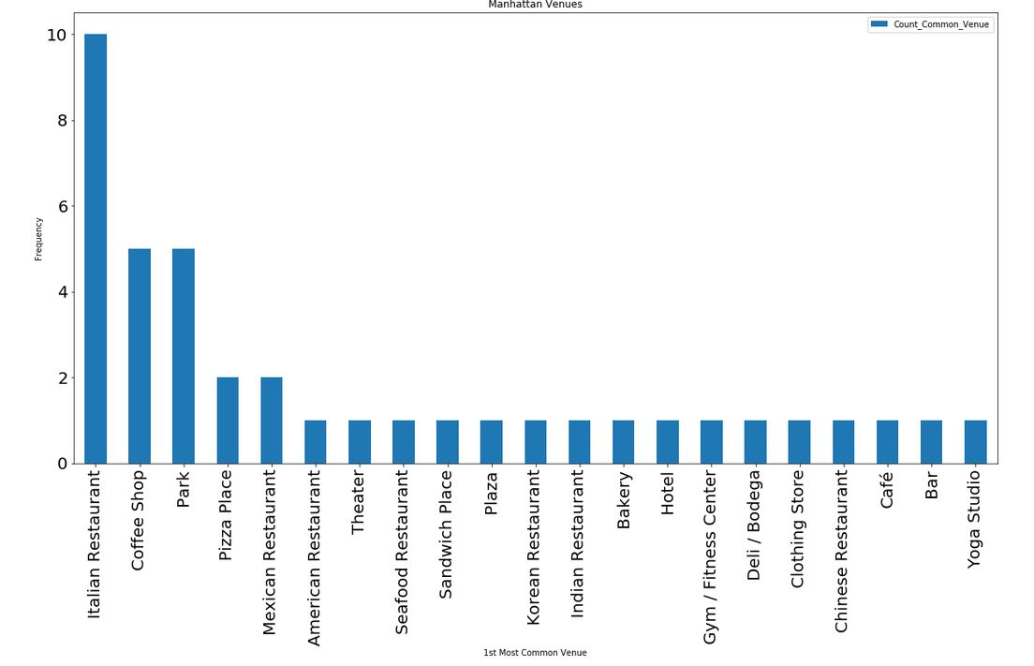
Most common venues in Manhattan, NYC

Slide 5
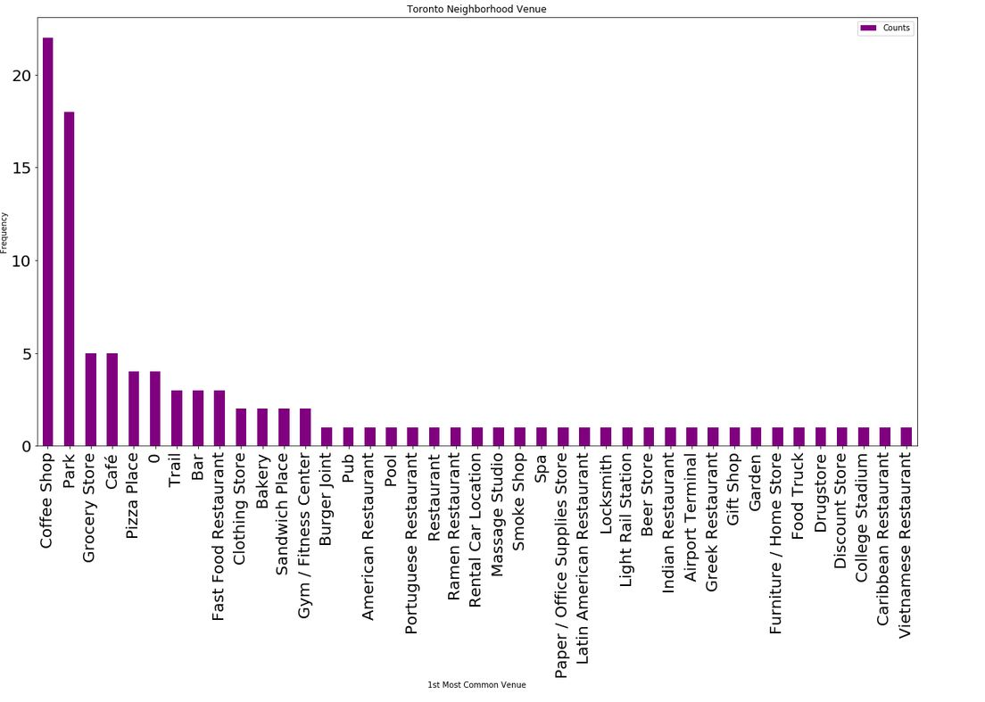
Most common venues in Toronto, Canada

Slide 6
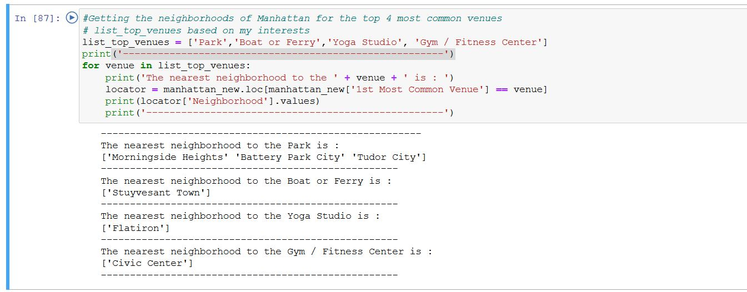
Neighborhoods close to venues of my interest in Manhattan, New York

Slide 7
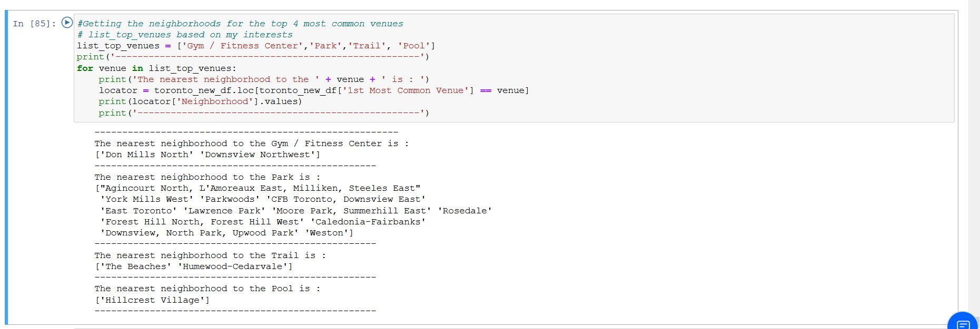
Neighborhoods close to venues of my interest in Toronto, Canada

