Slide 1
<+Pos/Com>
The Happy Comment Filter

Slide 2
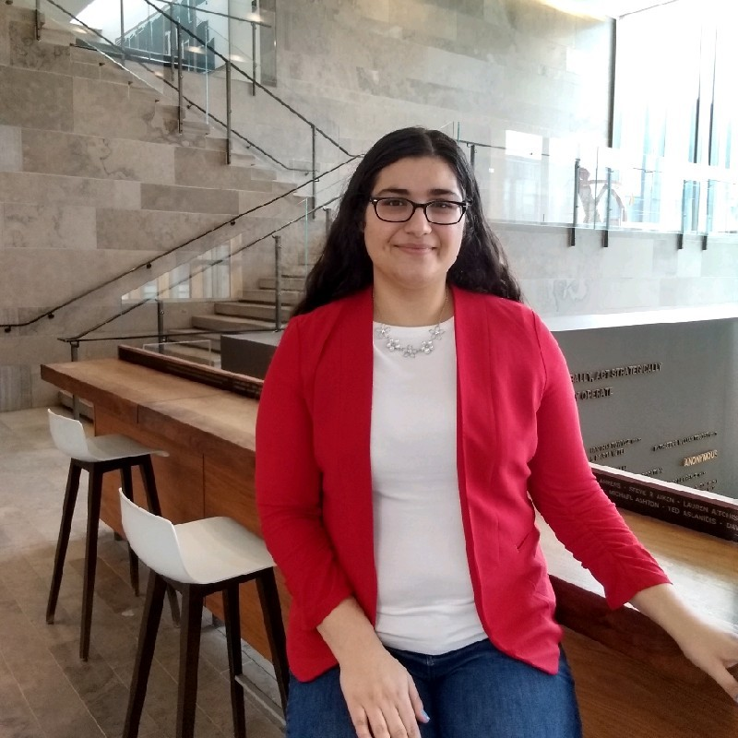


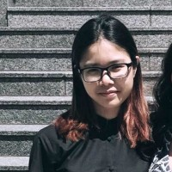
OUR CREATIVE TEAM
MICHELLE DOMAGALA-TANG
NINAVA SIBO
NIYATHA RANGARAJAN
ERIN VU
Third year – Software Engineering
Western University
Second year – Software Engineering and Management
McMaster University
Second year – Software Engineering
McMaster University
Second year – Computer Science
Western University

Slide 3
engage in social content without being negatively triggered.
INSPIRATION

Slide 4
detects comments that contain aggression or negativity and replaces with a happier comment
WHAT IT DOES

Slide 5



TOOLS
Natural Language API
Rest API
Chrome Extension

Slide 6
PROCESS
The Chrome extension scrapes youtube comments out of the window and sends that information to the Rest API using an HTTP post request.
Based on the result, the client replaces the negative comment with a positive one.
1
2
3
4
API Implementation
Scrapes Comments
Sentiment Analyzing
Return Results
Using Google's Natural Language API, it communicates with the Chrome Extension using a Rest API
Our Rest API then uses the analyze_sentiment method from the Natural Language API to determine if it is a good or bad comment and returns the answer to the client.

Slide 7
set up the Google Natural Language API and its service account credentials.
CORB error
CHALLENGES

Slide 8
incorporating PosCom on more platforms like Facebook, Twitter, etc. The future iteration of our extension will fix the CORB error.
WHAT’S NEXT

Slide 9
THE
END

