Slide 1
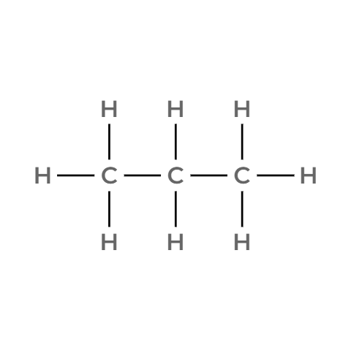
CARD NO. 1 - Propane (C3H8)
  Molecular Formula
  Lewis Structure
C3H8
  Condensed Structural Formula
  Bond-Line Formula
CH3CH2CH3
Verification Strip
✓Atom Count Verified ✓Valence Checked ✓Bond Order Checked ✓Same Connectivity Confirmed

Slide 2
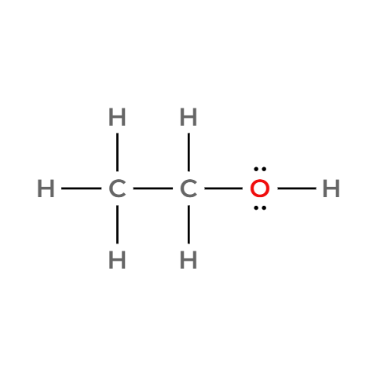

CARD NO. 2 - Ethanol (C2H6O)
  Molecular Formula
  Lewis Structure
C2H6O
  Condensed Structural Formula
  Bond-Line Formula
CH3CH2OH
Verification Strip
✓Atom Count Verified ✓Valence Checked ✓Bond Order Checked ✓Same Connectivity Confirmed

Slide 3
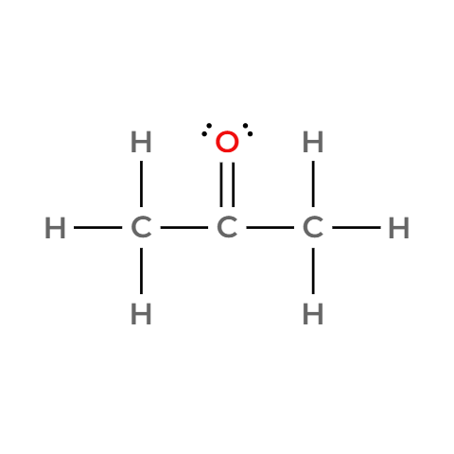

CARD NO. 3 - Acetone/propan-2-one (C3H6O)
  Molecular Formula
  Lewis Structure
C3H6O
  Condensed Structural Formula
  Bond-Line Formula
CH3COCH3
Verification Strip
✓Atom Count Verified ✓Valence Checked ✓Bond Order Checked ✓Same Connectivity Confirmed

Slide 4
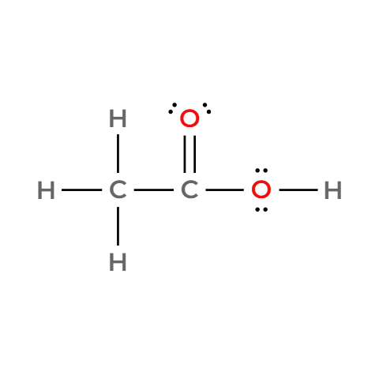

CARD NO. 4 - Acetic Acid/Ethanoic Acid (C2H4O2)
  Molecular Formula
  Lewis Structure
C2H4O2
  Condensed Structural Formula
  Bond-Line Formula
CH3COOH
Verification Strip
✓Atom Count Verified ✓Valence Checked ✓Bond Order Checked ✓Same Connectivity Confirmed

Slide 5
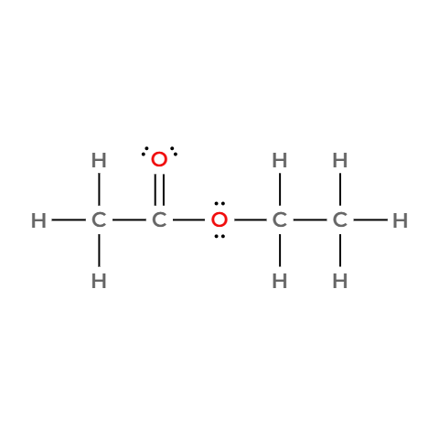

CARD NO. 5 - Ethyl Acetate/Ethyl Ethanoate (C4H8O2)
  Molecular Formula
  Lewis Structure
C4H8O2
  Condensed Structural Formula
  Bond-Line Formula
CH3COOCH2CH3
Verification Strip
✓Atom Count Verified ✓Valence Checked ✓Bond Order Checked ✓Same Connectivity Confirmed

Slide 6
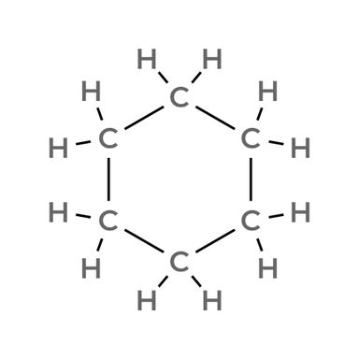

CARD NO. 6 - Cyclohexane (C6H12)
  Molecular Formula
  Lewis Structure
C6H12
  Condensed Structural Formula
  Bond-Line Formula
(CH2)6
Verification Strip
✓Atom Count Verified ✓Valence Checked ✓Bond Order Checked ✓Same Connectivity Confirmed

Slide 7
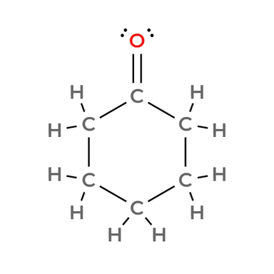

CARD NO. 7 - Cyclohexanone (C6H10O)
  Molecular Formula
  Lewis Structure
C6H10O
  Condensed Structural Formula
  Bond-Line Formula
(CH2)5CO
Verification Strip
✓Atom Count Verified ✓Valence Checked ✓Bond Order Checked ✓Same Connectivity Confirmed

Slide 8
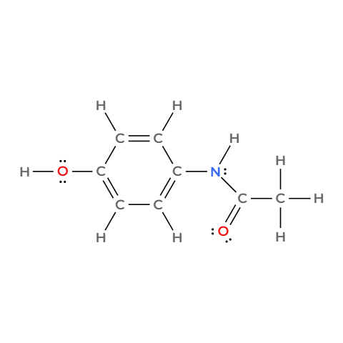
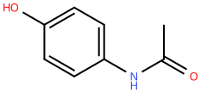
CARD NO. 8 - Acetaminophen/Paracetamol (C8H9NO2)
  Molecular Formula
  Lewis Structure
C8H9NO2
  Condensed Structural Formula
  Bond-Line Formula
CH3CONHC6H4OH
Verification Strip
✓Atom Count Verified ✓Valence Checked ✓Bond Order Checked ✓Same Connectivity Confirmed

Slide 9
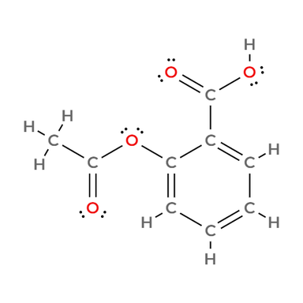
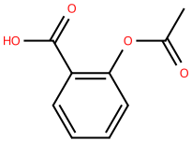
CARD NO. 9 - Aspirin/Acetylsalicylic Acid (C9H8O4)
  Molecular Formula
  Lewis Structure
C9H8O4
  Condensed Structural Formula
  Bond-Line Formula
CH3COOC6H4COOH
Verification Strip
✓Atom Count Verified ✓Valence Checked ✓Bond Order Checked ✓Same Connectivity Confirmed

Slide 10
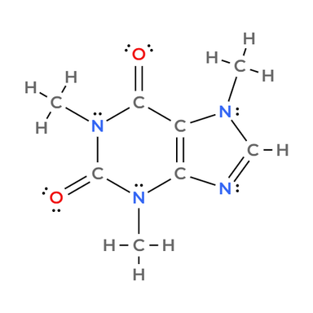
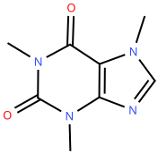
CARD NO. 10 - Caffeine (C8H10N4O2)
  Molecular Formula
  Lewis Structure
C8H10N4O2
  Condensed Structural Formula
  Bond-Line Formula
CH3NC(=O)N(CH3)C(=O)C=C1N(CH3)CH=N1
Verification Strip
✓Atom Count Verified ✓Valence Checked ✓Bond Order Checked ✓Same Connectivity Confirmed

