Slide 1
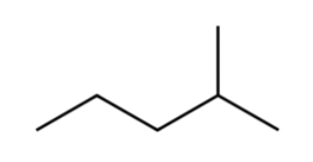
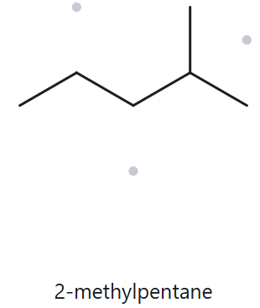
Card A01 - Foundation; C6H14
Numbered Parent
Naming Trail
Parent: Longest chain = 5 C→pentane, chain.
Numbering: Left to right gives 4; right to left gives 2. First point of difference: 2 < 4, so number from the right.
Substituent: Methyl on C2 →2-methyl
4
3
2
5
1
My Name
The Alkane Check
2-methylpentane
Returned name:
2-methylpentane
✓ Match
Verification Strip
✓longest chain confirmed ✓lowest locant ✓alphabetical order ✓punctuation ✓formula counted

Slide 2
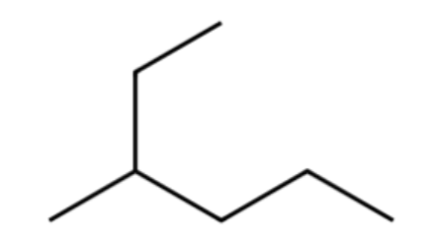
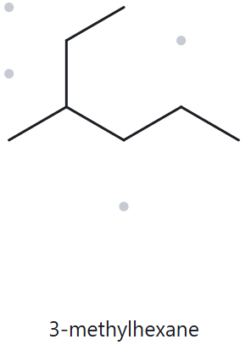
Card A02 - Foundation; C7H16
Numbered Parent
Naming Trail
Parent: Longest chain = 6 C→hexane, chain.
Numbering: Top end to bottom-right gives 3; bottom-right end to top gives 4. First point of difference: 3 < 4, so number from the top end.
Substituent: Methyl on C3 →3-methyl
1
2
3
4
5
6
My Name
The Alkane Check
3-methylhexane
Returned name:
3-methylhexane
✓ Match
Verification Strip
✓longest chain confirmed ✓lowest locant ✓alphabetical order ✓punctuation ✓formula counted

Slide 3
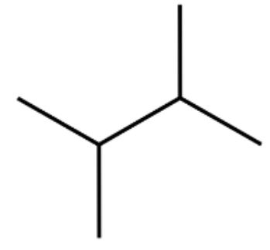
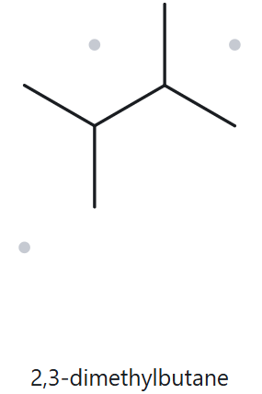
Card A03 - Foundation; C6H14
Numbered Parent
Naming Trail
Parent: Longest chain = 4 C→butane, chain. Two C1 and two C4 paths exist, but each has two methyl groups, so they give the same name.
Numbering: Left to right gives 2,3; right to left also gives 2,3. Both directions give identical locants (2,3), so either direction works.
Substituent: Methyl on C2 and C3 →2,3-dimethyl
1
3
2
4
My Name
The Alkane Check
2,3-dimethylbutane
Returned name:
2,3-dimethylbutane
✓ Match
Verification Strip
✓longest chain confirmed ✓lowest locant ✓alphabetical order ✓punctuation ✓formula counted

Slide 4
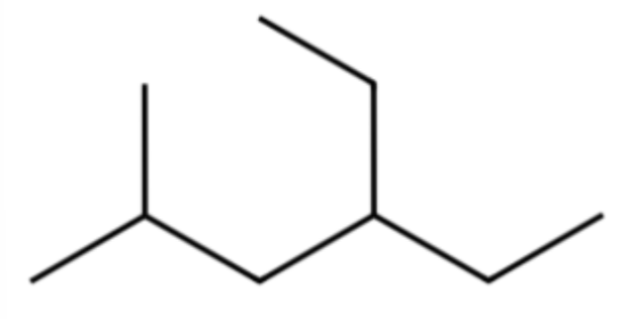
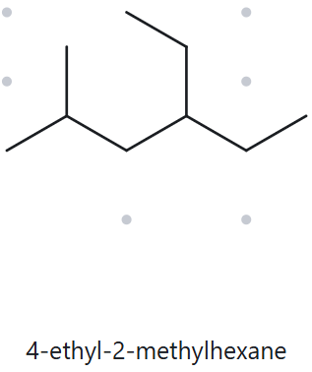
Card A04 - Developing; C9H20
Numbered Parent
Naming Trail
Parent: Longest chain = 6 C→hexane, chain.
Numbering: Left to right gives 2,4; right to left gives 3,5. First point of difference: 2 < 3, so number from left to right.
Substituents: Ethyl on C4, methyl on C2 → ordered alphabetically as 4-ethyl-2-methyl.
1
2
3
4
5
6
My Name
The Alkane Check
4-ethyl-2-methylhexane
Returned name:
4-ethyl-2-methylhexane
✓ Match
Verification Strip
✓longest chain confirmed ✓lowest locant ✓alphabetical order ✓punctuation ✓formula counted

Slide 5
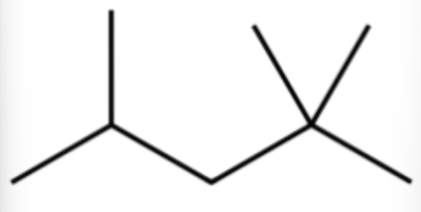
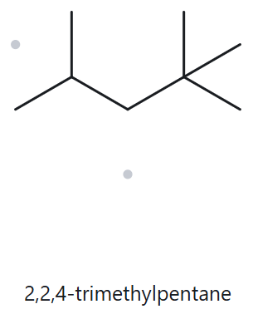
Card A05 - Developing; C8H18
Numbered Parent
Naming Trail
Parent: Longest chain = 5 C→pentane, chain.
Numbering: Left to right gives 2,4,4; right to left gives 2,2,4. First point of difference: 2 < 4, so number from right to left.
Substituents: Methyl on C2, C2, and C4 → 2,2,4-trimethyl.
4
3
2
5
1
My Name
The Alkane Check
2,2,4-trimethylpentane
Returned name:
2,2,4-trimethylpentane
✓ Match
Verification Strip
✓longest chain confirmed ✓lowest locant ✓alphabetical order ✓punctuation ✓formula counted

Slide 6
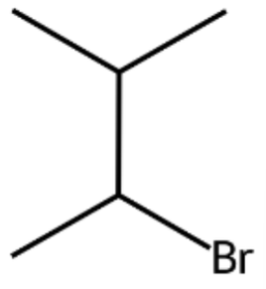
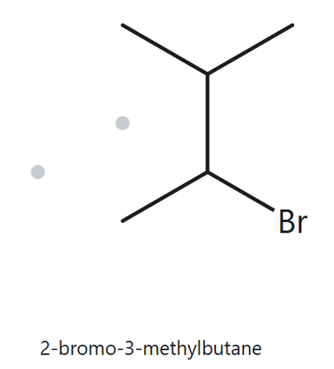
Card A06 - Developing; C5H11Br
Numbered Parent
Naming Trail
Parent: Longest chain = 4 C→butane, chain.
Numbering: Bottom-left to top gives 2,3; top to bottom-left also gives 2,3. The lower number (2) goes to bromo due to alphabetical priority ('b' < 'm').
Substituents: Bromo on C2, methyl on C3 → ordered alphabetically as 2-bromo-3-methyl.
4
3
2
1
My Name
The Alkane Check
2-bromo-3-methylbutane
Returned name:
2-bromo-3-methylbutane
✓ Match
Verification Strip
✓longest chain confirmed ✓lowest locant ✓alphabetical order ✓punctuation ✓formula counted

Slide 7
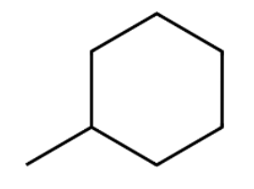
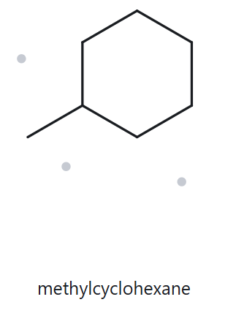
Card A07 - Developing; C7H14
Numbered Parent
Naming Trail
Parent: 6-carbon ring→cyclohexane, ring.
Numbering: The substituted carbon is automatically C1. Because it is the only substituent on the ring, the locant number "1" is omitted from the final name.
Substituents: Methyl on ring → methyl.
5
6
4
1
3
2
My Name
The Alkane Check
methylcyclohexane
Returned name:
methylcyclohexane
✓ Match
Verification Strip
✓longest chain confirmed ✓lowest locant ✓alphabetical order ✓punctuation ✓formula counted

Slide 8
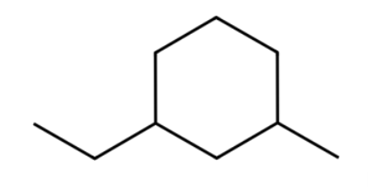
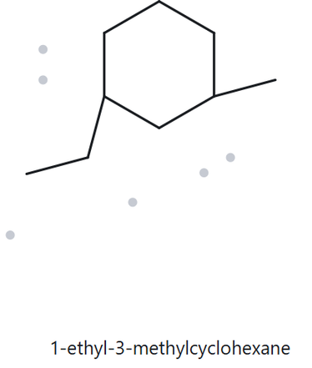
Card A08 - Challenge; C9H18
Numbered Parent
Naming Trail
Parent: 6-carbon ring→cyclohexane, ring.
Numbering: Counting through the bottom vertex gives locants 1,3 regardless of which substituent you start from. Since both directions yield the identical locant set (1,3), 1 is assigned to ethyl due to alphabetical priority ('e' < 'm').
Substituents: Ethyl on C1, methyl on C3→ordered alphabetically as 1-ethyl-3-methyl.
5
6
4
1
3
2
My Name
The Alkane Check
1-ethyl-3-methylcyclohexane
Returned name:
1-ethyl-3-methylcyclohexane
✓ Match
Verification Strip
✓longest chain confirmed ✓lowest locant ✓alphabetical order ✓punctuation ✓formula counted

Slide 9
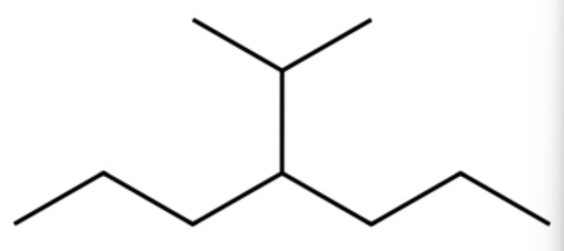
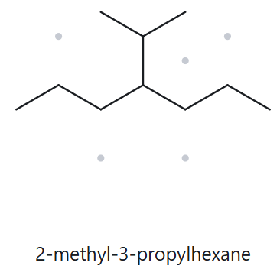
Card A09 - Challenge; C10H22
Numbered Parent
Naming Trail
Parent: Longest chain = 7 C→heptane, chain.
Numbering: Left to right gives 4; right to left also gives 4. Both directions yield identical locants (4), so either direction works (shown left to right).
Substituents: Isopropyl on C4→4-isopropyl.
1
2
3
4
5
6
7
My Name
The Alkane Check
4-isopropylheptane
Returned name:
2-methyl-3-propylhexane
✘ Not match
The Alkane Tool incorrectly chose a 6-carbon chain (hexane) to maximize substituent count. Chain length takes absolute priority over substituent count, making the 7-carbon heptane chain correct.
Verification Strip
✓longest chain confirmed ✓lowest locant ✓alphabetical order ✓punctuation ✓formula counted

Slide 10
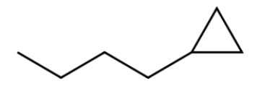
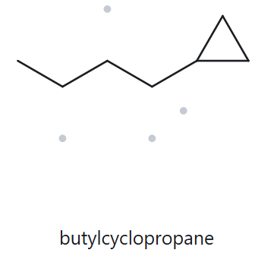
Card A10 - Challenge; C7H14
Numbered Parent
Naming Trail
Parent: Open chain has 4 C vs. ring's 3 C→cyclopropane, ring (activity specifies that the ring will be the parent).
Numbering: The ring carbon bearing the butyl group is C1. Both directions around the ring give the same locant, and with only one substituent the locant “1” is omitted.
Substituents: Butyl on C1→butyl.
3
1
2
My Name
The Alkane Check
butylcyclopropane
Returned name:
butylcyclopropane
✓ Match
Verification Strip
✓longest chain confirmed ✓lowest locant ✓alphabetical order ✓punctuation ✓formula counted

Slide 11
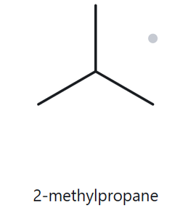
Card B01 - Foundation; 2-methylpropane
Name Decoded
Bond-line Structure (The Alkane)
Parent: Propane → a 3-carbon chain.
Substituents: methyl on C2
Expected Formula: 3+1=4 C; open-chain alkane →CnH2n+2 →C4H10
Formula Check
Back-Check
Counted from the drawing: C4H10
Acyclic alkane: CnH2n+2 = C4H10 ✓
Returned by The Alkane: 2-methylpropane
✓ Same as the given name.
Verification Strip
✓parent length matches ✓substituent positions match ✓formula agrees ✓back-check

Slide 12
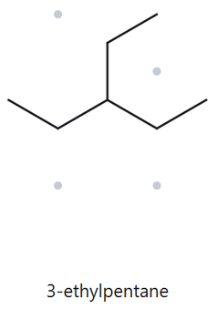
Card B02 - Foundation; 3-ethylpentane
Name Decoded
Bond-line Structure (The Alkane)
Parent: Pentane → a 5-carbon chain.
Substituents: ethyl on C3.
Expected Formula: 5+2=7 C; open-chain alkane →CnH2n+2 →C7H16
Formula Check
Back-Check
Counted from the drawing: C7H16
Acyclic alkane: CnH2n+2 = C7H16 ✓
Returned by The Alkane: 3-ethylpentane
✓ Same as the given name.
Verification Strip
✓parent length matches ✓substituent positions match ✓formula agrees ✓back-check

Slide 13
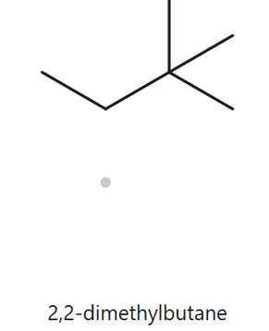
Card B03 - Foundation; 2,2-dimethylbutane
Name Decoded
Bond-line Structure (The Alkane)
Parent: Butane → a 4-carbon chain.
Substituents: Two methyl groups, both on C2.
Expected Formula: 4+1+1=6 C; open-chain alkane →CnH2n+2 →C6H14
Formula Check
Back-Check
Counted from the drawing: C6H14
Acyclic alkane: CnH2n+2 = C6H14 ✓
Returned by The Alkane: 2,2-dimethylbutane
✓ Same as the given name.
Verification Strip
✓parent length matches ✓substituent positions match ✓formula agrees ✓back-check

Slide 14
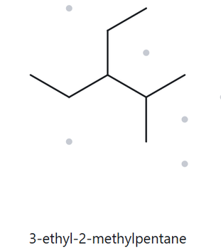
Card B04 - Developing; 3-ethyl-2-methylpentane
Name Decoded
Bond-line Structure (The Alkane)
Parent: Pentane → a 5-carbon chain.
Substituents: Ethyl on C3; methyl on C2.
Expected Formula: 5+2+1=8 C; open-chain alkane →CnH2n+2 →C8H18
Formula Check
Back-Check
Counted from the drawing: C8H18
Acyclic alkane: CnH2n+2 = C8H18 ✓
Returned by The Alkane: 3-ethyl-2-methylpentane
✓ Same as the given name.
Verification Strip
✓parent length matches ✓substituent positions match ✓formula agrees ✓back-check

Slide 15
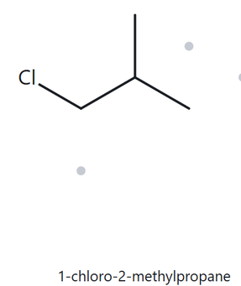
Card B05 - Developing; 1-chloro-2-methylpropane
Name Decoded
Bond-line Structure (The Alkane)
Parent: Propane→ a 3-carbon chain.
Substituents: Chloro on C1; methyl on C2.
Expected Formula: 3+1=4 C; chloro replaces one H on an acyclic alkane(C4H10)→C4H9Cl
Formula Check
Back-Check
Counted from the drawing: C4H9Cl
Acyclic haloalkane: CnH2n+1Cl = C4H9Cl ✓
Returned by The Alkane: 1-chloro-2-methylpropane
✓ Same as the given name.
Verification Strip
✓parent length matches ✓substituent positions match ✓formula agrees ✓back-check

Slide 16
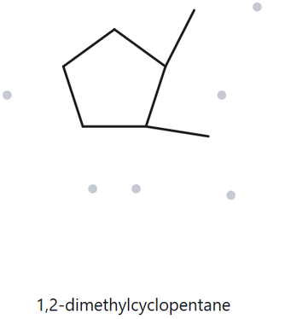
Card B06 - Developing; 1,2-dimethylcyclopentane
Name Decoded
Bond-line Structure (The Alkane)
Parent: Cyclopentane→ a 5-carbon ring.
Substituents: Methyl groups on C1 and C2.
Expected Formula: 5+2=7 C; single ring alkane →CnH2n→C7H14
Formula Check
Back-Check
Counted from the drawing: C7H14
Monocyclic alkane: CnH2n = C7H14 ✓
Returned by The Alkane:
1,2-dimethylcyclopentane
✓ Same as the given name.
Verification Strip
✓parent length matches ✓substituent positions match ✓formula agrees ✓back-check

Slide 17
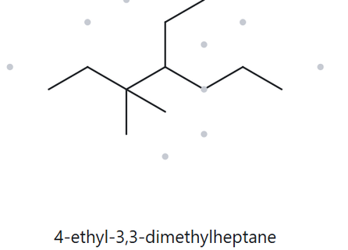
Card B07 - Developing; 4-ethyl-3,3-dimethylheptane
Name Decoded
Bond-line Structure (The Alkane)
Parent: Heptane→ a 7-carbon chain.
Substituents: Ethyl on C4; two methyl groups on C3.
Expected Formula: 7+2+1+1=11 C; open-chain alkane →CnH2n+2→C11H24
Formula Check
Back-Check
Counted from the drawing: C11H24
Acyclic alkane: CnH2n+2 = C11H24 ✓
Returned by The Alkane:
4-ethyl-3,3-dimethylheptane
✓ Same as the given name.
Verification Strip
✓parent length matches ✓substituent positions match ✓formula agrees ✓back-check

Slide 18
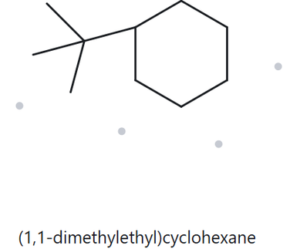
Card B08 - Challenge; tert-butylcyclohexane
Name Decoded
Bond-line Structure (The Alkane)
Parent: Cyclohexane→ a 6-carbon ring.
Substituents: tert-butyl on C1 (systematically: (1,1-dimethylethyl)).
Expected Formula: 6+4=10 C; single ring alkane →CnH2n→C10H20
Formula Check
Back-Check
Counted from the drawing: C10H20
Monocyclic alkane: CnH2n = C10H20 ✓
Returned by The Alkane:
(1,1-dimethylethyl)cyclohexane
✓ Same as the given name.
Note: The tool outputs the systematic bracketed form (1,1-dimethylethyl) for the common tert-butyl group, which is an accepted equivalent form earning full credit.
Verification Strip
✓parent length matches ✓substituent positions match ✓formula agrees ✓back-check

Slide 19
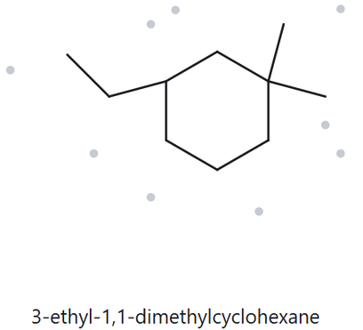
Card B09 - Challenge; 3-ethyl-1,1-dimethylcyclohexane
Name Decoded
Bond-line Structure (The Alkane)
Parent: Cyclohexane→ a 6-carbon ring.
Substituents: Ethyl on C3; two methyl groups on C1.
Expected Formula: 6+2+1+1=10 C; single ring alkane →CnH2n→C10H20
Formula Check
Back-Check
Counted from the drawing: C10H20
Monocyclic alkane: CnH2n = C10H20 ✓
Returned by The Alkane:
3-ethyl-1,1-dimethylcyclohexane
✓ Same as the given name.
Verification Strip
✓parent length matches ✓substituent positions match ✓formula agrees ✓back-check

Slide 20
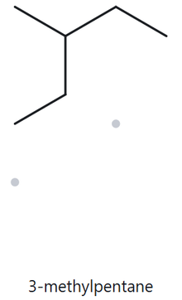
Card B10 - Challenge; 2-ethylbutane
Name Decoded
Bond-line Structure (The Alkane)
Parent: Butane→ a 4-carbon chain.
Substituents: Ethyl on C2
Expected Formula: 4+2=6 C; open-chain alkane →CnH2n+2→C6H14
Formula Check
Back-Check
Counted from the drawing: C6H14
Acyclic alkane: CnH2n+2 = C6H14 ✓
Returned by The Alkane:
3-methylpentane
✘ Not the same as the given name.
Reason: The given name "2-ethylbutane" violates the longest continuous chain rule. Tracing through the ethyl group creates a 5-carbon chain (pentane) with a single methyl branch at carbon-3.
Verification Strip
✓parent length matches ✓substituent positions match ✓formula agrees ✓back-check

