Slide 1

Process Mining
by
K RANGA SWAMY
Roll No. 214G1A3285
Department of Computer Science and Engineering (Data Science)
Srinivasa Ramanujan Institute of Technology
(Affiliated to JNTUA & Approved by AICTE) (Accredited by NAAC with ‘A’ Grade & Accredited by NBA (EEE, ECE & CSE)
Rotarypuram Village, B K Samudram Mandal, Ananthapuramu – 515701.
2023 - 2024

Slide 2

Contents
Course Objective
Introduction
Technology
Applications
Modules
Real Time applications
Learning outcomes
GitHub Link
Queries

Slide 3
Course Objective
Learn how to discover, visualize, and model their business processes based on event data.
Practical skills in process mining, enabling them to analyze, optimize, and enhance business processes using data-driven techniques.

Slide 4
Introduction
Process mining is a widely-used technology to model, analyze, and optimize business processes.
Process Mining is the combination of two disciplines: Data Science and Business Process Management.
Process Mining essentially uses Data Science techniques, such as Big Data and AI, to address Process Science problems such as process improvement and automation .

Slide 5
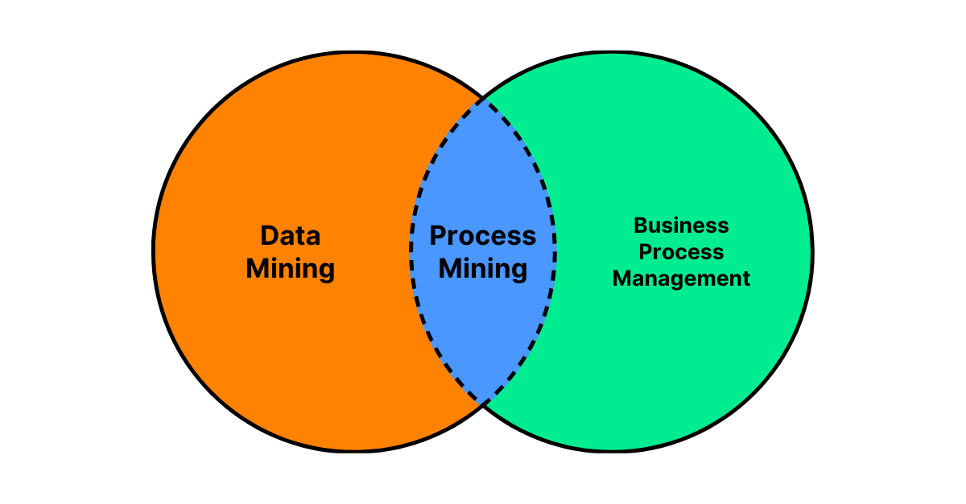
Contd...
It involves extracting valuable information from event logs and using this data to create visual representations of how processes are actually performed.
Process mining enables organizations to understand their processes, identify inefficiencies, and make informed decisions for process improvement and optimization.

Slide 6
Technology
Process mining utilizes various technologies to extract, analyze, and visualize insights from event data.
These technologies enable the discovery, monitoring, and improvement of business processes.
key technologies involved in process mining:
Big Data Technologies: Technologies like Hadoop and Spark are used to process and analyze massive datasets efficiently.
Data Integration and ETL (Extract, Transform, Load):
Data connectors: These enable the integration of data from various sources, such as ERP systems, databases, logs, and spreadsheets.
ETL tools: These help transform and preprocess raw data into structured event logs suitable for process analysis.

Slide 7
Contd…
Event Collection and Management System (EMS):An EMS provides a platform to store, manage, and process event data collected from different sources. It forms the foundation for process mining analyses.
Data Warehousing and Databases:Relational databases and data warehouses store large volumes of event data for analysis and reporting.

Slide 8
Applications
Financial Process Analysis: Organizations in finance can use process mining to analyze financial processes like invoice handling, expense approval, and risk assessment. This leads to better financial control and compliance.
Retail and E-commerce: Process mining helps optimize inventory management, order processing, and customer fulfillment processes in retail and e-commerce.
Telecommunications: Process mining can be used to optimize customer onboarding, service provisioning, and billing processes in the telecommunications industry.

Slide 9
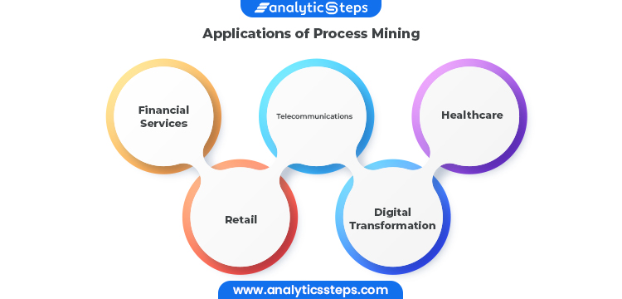
Contd…

Slide 10
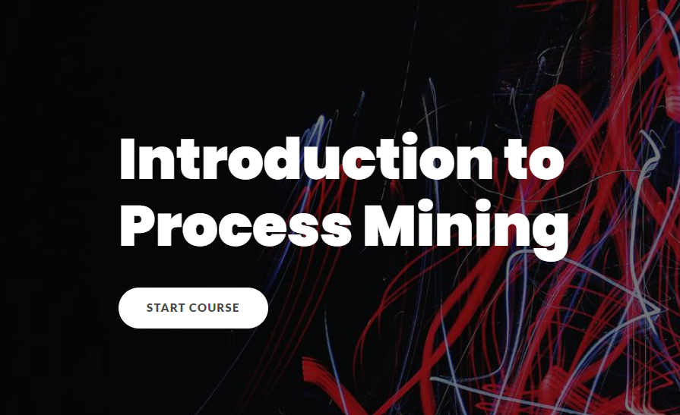
Modules
Module-1.Introduction to Process Mining:
Process mining is a data-driven methodology that aims to discover, monitor, and improve business processes by analyzing event data logs generated during the execution of these processes
It involves using specialized software and techniques to extract valuable insights from event logs and transform them into visual representations and actionable recommendations.

Slide 11
Cond…
Module-2.Process Mining Fundamentals:
The fundamentals of process mining encompass the core concepts, principles, and techniques that constitute the foundation of this methodology
key fundamentals of process mining:
Event Data: Event data consists of recorded activities, actions, and events that occur during the execution of a business process. Each event is associated with attributes such as timestamps, case identifiers, activity names, and additional contextual information.
Process Models:Process models represent the flow and sequence of activities within a business process. These models visually depict how different activities are performed and how cases move through the process.

Slide 12
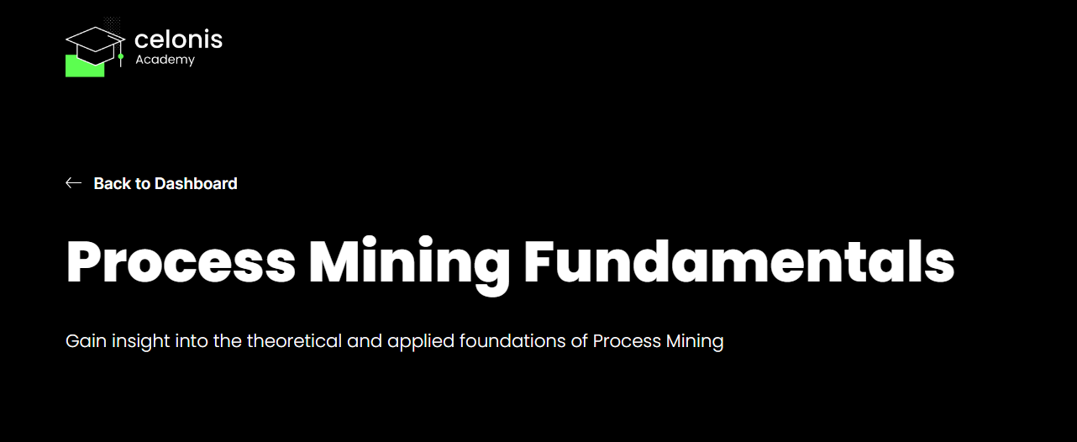
Contd…
Process Discovery:Process discovery involves automatically generating process models from event data. This process aims to uncover the actual process flow by analyzing event logs and identifying patterns in the sequence of activities

Slide 13
Contd…
Module-3.Rising star:
1.Build Analyses :
SQL (Structured Query Language):
SQL is a widely used language for managing and querying relational databases. In process mining, SQL can be employed to retrieve, filter, and aggregate event data stored in a database. Organizations often use event logs stored in databases for process mining analyses.
PQL (Process Query Language):
PQL is a specialized query language designed for process mining purposes. PQL is often used in combination with process mining software tools that support its syntax. PQL allows you to express queries that target specific aspects of processes and analyze event data accordingly.

Slide 14
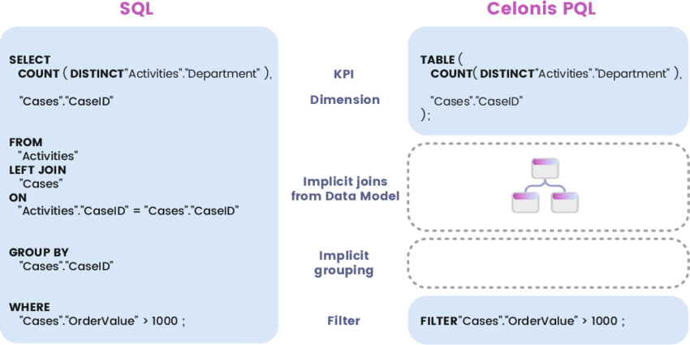
Contd…

Slide 15
Contd…
2.Get Data into the EMS ( Execution Management System):
Celonis EMS (Event Collection and Management System) is a component of Celonis Process Mining that allows you to collect and manage event data for analysis.
Data integration:Data integration is a critical step in the process mining journey. It involves collecting, preparing, and incorporating relevant event data from various sources into a central location, often referred to as the Event Collection and Management System (EMS) or process mining tool, for analysis.
Data Extraction:Extract the relevant event data from your data sources. This data should include information such as timestamps, case IDs, activity names, and additional attributes relevant to your processes.
Data Preparation:Clean and preprocess the extracted data to ensure its quality and consistency. This might involve handling missing values, removing duplicates, and transforming data formats.
Connect to EMS:Log in to your Celonis platform and navigate to the EMS component. This is where you'll manage and store the event data for your analysis.
Create Data Pipelines:Within Celonis, set up data pipelines that connect your data sources to the EMS. Data pipelines define how the data should be transferred from your sources into the EMS.

Slide 16
Contd…
Data Upload:Use the established data pipelines to upload the prepared event data into the EMS. This process transfers the data from your sources to the Celonis platform.
Data Validation:After uploading the data, validate that it has been accurately transferred to the EMS. Check for any discrepancies or errors that might have occurred during the upload.
Data Analysis:Once your event data is in the EMS, you can start utilizing Celonis Process Mining features to analyze your processes, discover insights, and identify areas for improvement.

Slide 17
Real Time applications
Healthcare Process Improvement: Process mining is used to analyze patient pathways, improve hospital workflows, reduce waiting times, and optimize resource allocation in healthcare settings.
Fraud Detection: Real-time process mining can help identify fraudulent activities by detecting unusual patterns or behaviors in transactional data. This is particularly valuable in financial services and e-commerce industries.
Customer Journey Analysis: Real-time process mining can track customer interactions across various touchpoints. This helps businesses understand how customers navigate their services and identify points where customer satisfaction can be improved

Slide 18
Learning outcomes
Learnt about Process Mining by Celonis faltform.
What are the technologies in Process Mining.
Fundamentals of Process Mining.
Structured Query Language and Process Query Language.
Also learnt about Get Data into EMS (Execution Management System)
Real-Time applications & uses of Process Mining.

Slide 19
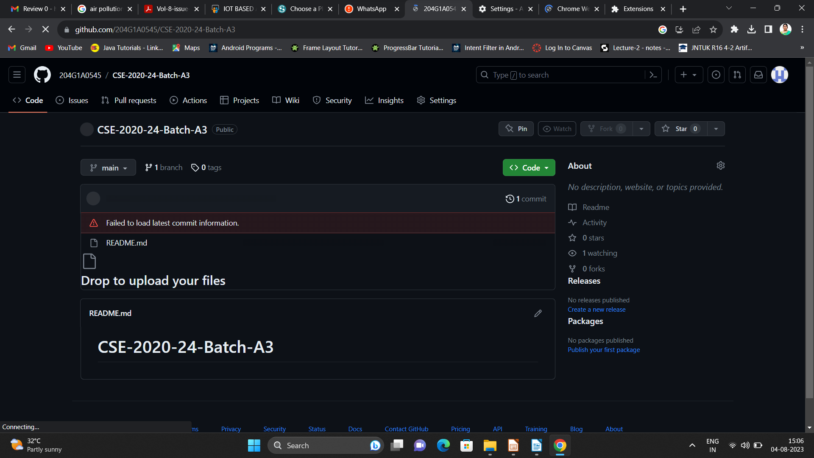

Git Hub Dashboard
Repository Name Like: Summer Internship - I
Under that include document, presentation and Certificate(Pdf).

Slide 20
Any Queries?

Slide 21
Thank You!!!

