Slide 1
Range42 — Progress & Showcase
Open Cyber Range Platform for Collaborative Security Training
NC3 / Range42 Team
FIC Lille 2026
Proxmox | Ansible | Orchestration | Telemetry
TLP:CLEAR — Information may be shared freely without restriction.
Notes:
Goal: 20-minute overview of Range42's progress since 2025 with screenshots of the deployer UI. Audience: cybersecurity professionals, government, European ecosystem partners.

Slide 2
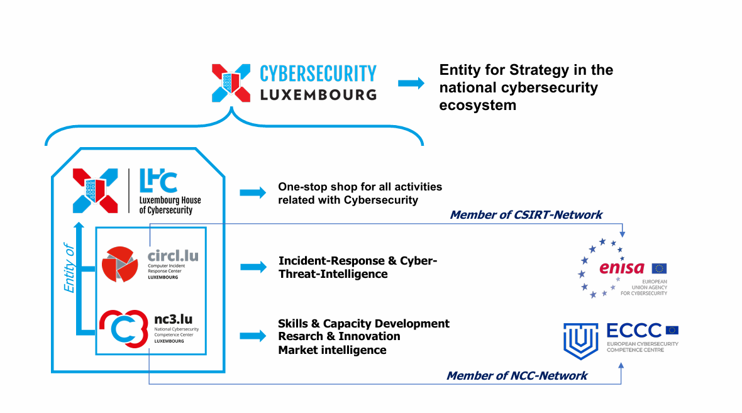

Slide 3


Slide 4
Why an Open-Source Cyber Range?
The case for SMEs, integrators, and service providers
Reduced costs: freely available tools lower the investment for security testing and training — no licence fees
Empowers integrators & MSSPs: service providers can build tailored solutions for SME clients without vendor lock-in
Accessible compliance: SMEs can conduct vulnerability assessments, penetration tests, and compliance drills at a fraction of the cost
Workforce development: training providers can deploy realistic labs for students and employees without expensive infrastructure
Community-driven quality: open-source contributions from the security community continuously expand scenario coverage
Sovereignty & control: organisations keep full control over sensitive training data — no cloud dependency
Open-source cyber ranges make professional-grade security training economically viable for organisations of all sizes.
TLP:CLEAR — Information may be shared freely without restriction.
Notes:
Key message: Open-source dramatically lowers the cost of entry for cyber range capabilities. - SMEs typically can't afford commercial cyber range platforms (50k-500k EUR/year) - Service providers (MSSPs, integrators) can build on Range42 without licensing overhead - Training institutions can deploy realistic labs for students - Keeps sensitive training data sovereign — no cloud dependency - Community contributions improve quality continuously

Slide 5
Public Money, Public Code. Let's go all the way, shall we?
Team & Funding
Core team of 3 — InfoSec & DevOps engineers
Collaboration model with NC3 & ecosystem partners
Public grant for cyber training infrastructure
FOSS model: no licensing costs, transparent development
PUBLIC MONEY
PUBLIC CODE
publiccode.eu
If it is public money,
it should be public code.
TLP:CLEAR — Information may be shared freely without restriction.
Notes:
Emphasize public funding = public ownership = public benefit. The FSFE 'Public Money, Public Code' campaign advocates that publicly funded software should be Free and Open Source.

Slide 6
Agenda
1. Why open-source cyber ranges matter
2. Public Money, Public Code
3. What is a cyber range & what is Range42
4. Progress since 2025: what's new
5. Architecture & Deployer UI in action
6. What's coming: Reporting Tool & Exercise Management Platform
7. Today vs. tomorrow & development roadmap
8. Key repositories, lessons learned & how to get involved
TLP:CLEAR — Information may be shared freely without restriction.
Notes:
Highlight the deployer UI screenshots as the centerpiece of this talk (item 6). The agenda now reflects the two new slides: open-source rationale and cyber range definition.

Slide 7
What is a Cyber Range?
A simulated, isolated environment where cybersecurity professionals practice attack and defence techniques, test tools, and train for real-world incidents — without risk to production systems.
Common use cases:
Penetration testing — practice offensive techniques against realistic targets
Incident response — train blue teams to detect, contain, and remediate attacks
Red vs. Blue exercises — adversarial team drills with live attack and defence
Vulnerability assessment — scan and evaluate systems for known weaknesses (CVEs)
Malware analysis — safely detonate and study malware in sandboxed environments
Security training — structured courses for students, employees, and certification prep
Think of it as a flight simulator for cybersecurity — real tools, real techniques, zero production risk.
TLP:CLEAR — Information may be shared freely without restriction.
Notes:
A cyber range is essentially a 'flight simulator for cybersecurity'. Examples: - Military/government: simulate nation-state attacks, test critical infrastructure defences - Enterprise: train SOC analysts on real incident scenarios - Education: hands-on labs for cybersecurity students - Compliance: validate security controls and incident response procedures

Slide 8
What is Range42?
Open cyber range platform for offensive, defensive, and hybrid training
Reproducible Infrastructure-as-Code: Proxmox, Ansible, Docker
Flexible & extensible: supports CVE labs, misconfigurations, forensics, malware analysis
Built to simulate real-world incidents safely, with isolation, snapshots, and telemetry.
TLP:CLEAR — Information may be shared freely without restriction.
Notes:
Anchor on 'safe realism' and extensibility. Range42 is not just a tool — it's a modular platform. - Built on Proxmox (hypervisor), Ansible (automation), Docker (containers), FastAPI (backend), Vue 3 (frontend). - Every component is open-source and replaceable. - The IaC approach means entire lab environments are reproducible and version-controlled. - Snapshots allow instant reset between training sessions.

Slide 9
Progress Since 2025
TLP:CLEAR — Information may be shared freely without restriction.
Notes:
Transition to the progress update section. Since the 2025 OSCL presentation, Range42 has seen significant development across all repositories. The next few slides show concrete numbers and milestones.

Slide 10
Progress Since 2025
By the Numbers
520+ total commits across 14 repositories (up from 400+)
Backend API: 156 commits — major refactor (86 routes -> 10 modules)
Deployer UI: 74 commits — from prototype to functional tool
Proxmox controller: 112 commits — cloud-init, VM templates, storage
Key Milestones
Docker deployment for the backend API
Real-time VM status via WebSocket on the canvas
Comprehensive test suite and Sphinx documentation
CyCon 2026 paper submitted — academic publication
TLP:CLEAR — Information may be shared freely without restriction.
Notes:
Concrete, measurable progress. This is not vaporware. - 520+ total commits across 14 repositories (up from 400+ in 2025). - Backend API: major refactor consolidated 86 route files into 10 clean domain modules. - Deployer UI went from early prototype to a functional, daily-use tool. - Proxmox controller handles cloud-init, VM templates, storage management. - Docker deployment and WebSocket real-time status are key new capabilities. - CyCon 2026 paper: first academic publication about Range42.

Slide 11
Current Achievements
What's Working Today
~100 CVEs & misconfigurations identified, ~20 deployable scenarios
Automated provisioning on Proxmox with networking, VPN, firewalling
Visual lab designer with drag-and-drop infrastructure composition
Integrated monitoring via Wazuh for telemetry and alerting
14 repositories managing automation, content, and tooling
Easy setup with an TUI
Key Milestone: Backend is production-ready. The visual designer is now functional and actively used.
TLP:CLEAR — Information may be shared freely without restriction.
Notes:
Emphasize: both backend AND frontend are operational now. - ~100 CVEs and misconfigurations have been catalogued, ~20 are fully deployable as lab scenarios. - Provisioning is fully automated: VMs, LXC containers, network segments, VPN tunnels, firewall rules. - The visual lab designer lets users drag-and-drop infrastructure components and deploy with one click. - Wazuh provides SIEM-level monitoring for training environments. - This is real, working software — not a prototype or concept.

Slide 12
Range42 vs. Other Cyber Ranges
Feature | Range42 | Commercial SaaS | Cloud Native | Traditional
Open Architecture | ✓ | ✗ | ✗ | ✗
IaC / GitOps | ✓ | ~ | ✓ | ✗
Private Deployment | ✓ | ✗ | ~ | ✓
Cost Control | ✓ | ✗ | ~ | ✓
Full Data Custody | ✓ | ✗ | ✗ | ✓
API Orchestration | ✓ | ✓ | ✓ | ✗
Rapid Reset / Snapshots | ✓ | ✓ | ~ | ~
Custom Scenarios | ✓ | ✗ | ~ | ✓
Visual Lab Designer | ✓ | ✓ | ✗ | ✗
Range42's Edge: Full control, reproducibility, and cost-effectiveness without vendor lock-in.
TLP:CLEAR — Information may be shared freely without restriction.
Notes:
Added visual lab designer row — new differentiator since 2025. Range42 uniquely combines: - Open architecture (no vendor lock-in, full source access) - Visual lab designer (only open-source range with this) - Full data sovereignty (on-premise, no cloud dependency) - IaC/GitOps approach (reproducible, version-controlled environments) Commercial SaaS platforms cost 50k-500k EUR/year and lock you in. Traditional ranges lack automation and modern UX. Cloud-native solutions sacrifice data custody.

Slide 13
Architecture at a Glance
Hypervisor layer: Proxmox VMs/LXCs; snapshots; network segments
Automation layer: Ansible roles orchestrate lifecycle, network, firewall, images
Control plane: Backend API (FastAPI) with Docker deployment; WebSocket for live status
UX layer: Deployer UI (visual designer), Exercise Management Platform (in development)
Observability: Wazuh for logs/alerts; structured telemetry
TLP:CLEAR — Information may be shared freely without restriction.
Notes:
Highlight WebSocket and Docker as new additions to the architecture. - Hypervisor layer: Proxmox manages VMs, LXC containers, snapshots, and isolated network segments. - Automation layer: Ansible roles handle the full lifecycle — provisioning, configuration, network setup, firewall rules, image management. - Control plane: FastAPI backend deployed via Docker; WebSocket provides real-time VM status updates to the UI. - UX layer: Deployer UI is the visual lab designer; Exercise Management Platform (EMP) is planned for scoring and reporting. - Observability: Wazuh SIEM provides log collection, alerting, and structured telemetry for training environments.

Slide 14
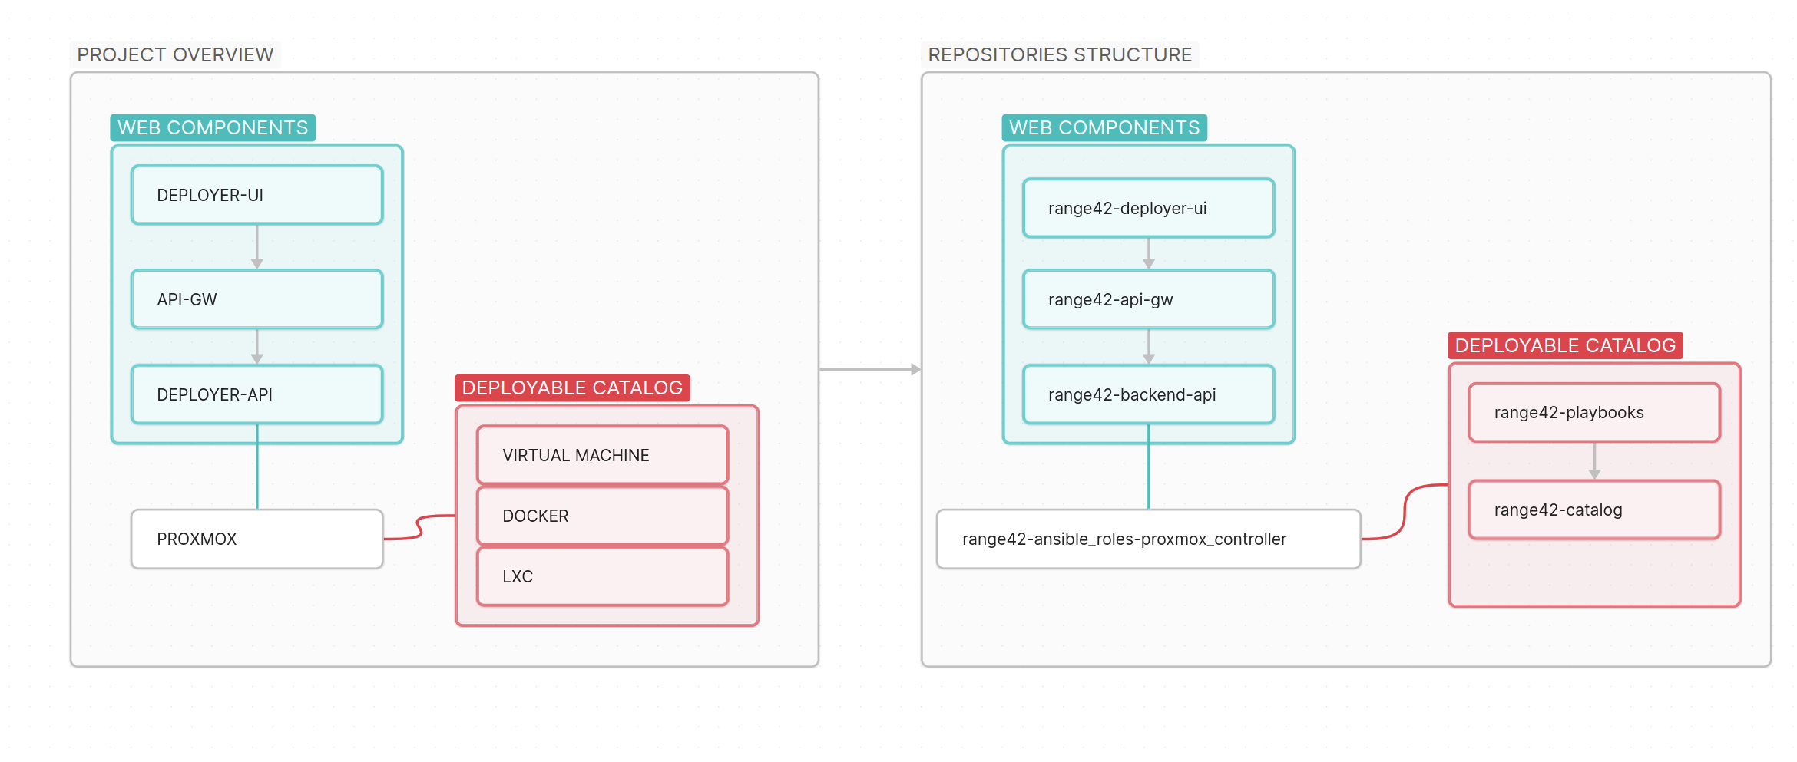
Architecture: Logical Components → Repository Mapping
Left: Logical architecture flow. Right: Actual GitHub repository structure.
TLP:CLEAR — Information may be shared freely without restriction.
Notes:
Left side shows logical architecture; right side shows actual GitHub repos.

Slide 15
The setup in Action
TLP:CLEAR — Information may be shared freely without restriction.
Notes:
Transition to the Deployer UI showcase. The next slides show actual screenshots of the Deployer UI — the visual lab designer that makes Range42 accessible to users who don't want to write Ansible playbooks manually.

Slide 16
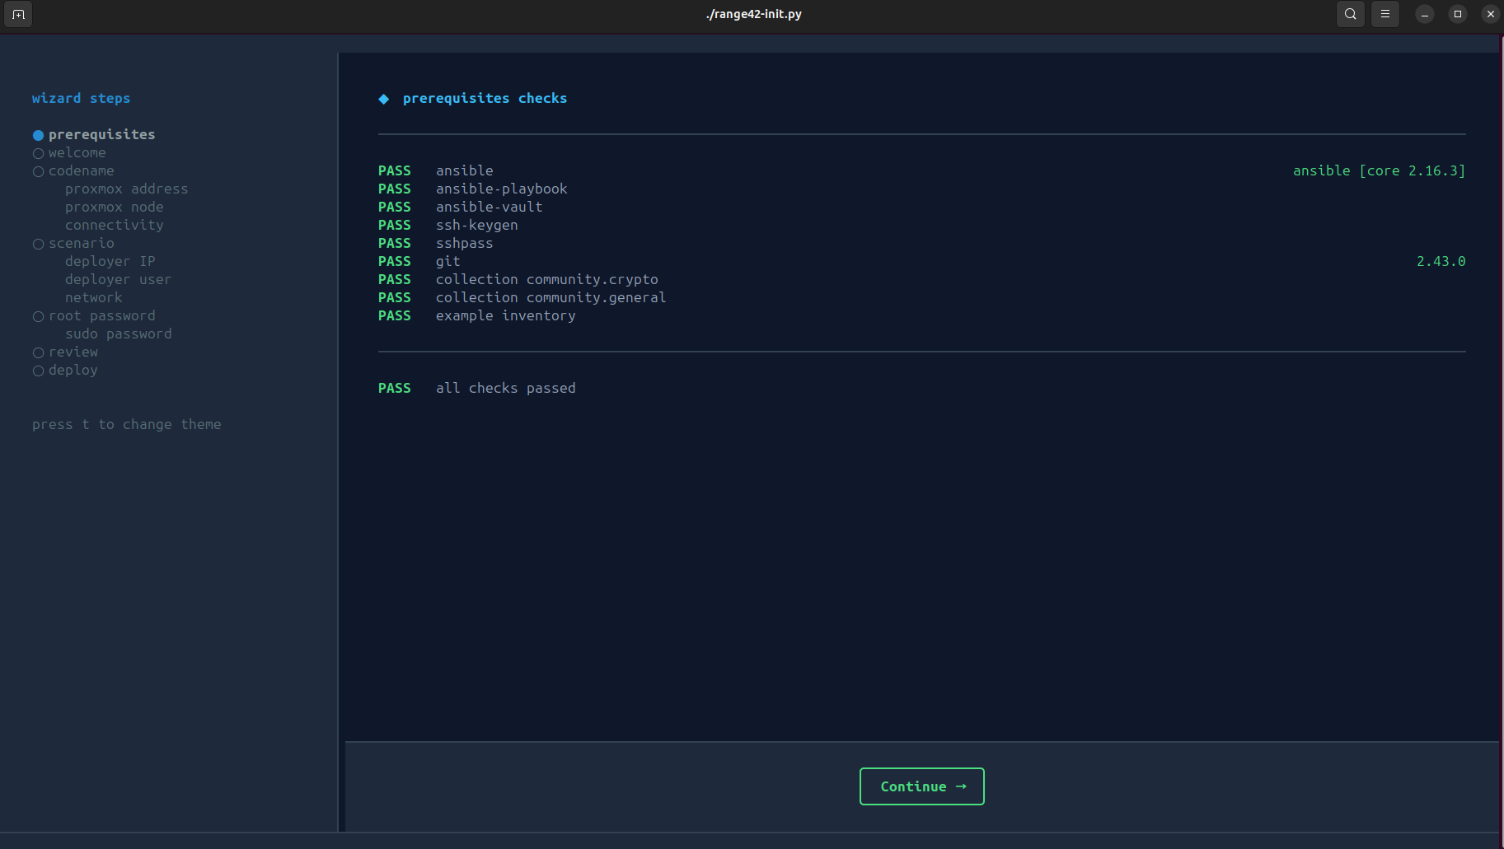
Setup in action
TLP:CLEAR — Information may be shared freely without restriction.
Notes:
The deployer UI canvas: drag-and-drop infrastructure design. Left sidebar: component types (VM, LXC, Network, Router, Firewall). Resources section: inventory browser, templates, import/export. Canvas shows connected nodes with real-time status colours.

Slide 17
Deployer UI in Action
TLP:CLEAR — Information may be shared freely without restriction.
Notes:
Transition to the Deployer UI showcase. The next slides show actual screenshots of the Deployer UI — the visual lab designer that makes Range42 accessible to users who don't want to write Ansible playbooks manually.

Slide 18
Deployer UI: Visual Lab Designer
Design
Deploy
Drag-and-drop VMs, LXC, networks, routers, firewalls
Configure CPU, memory, disk, ISO per node
Proxmox template selection with auto-fill
Connect nodes to define topology
Pre-deploy reconciliation and validation
Ordered: networks → routers → VMs → config → start
Real-time status via WebSocket
Start, stop, restart, delete from the UI
TLP:CLEAR — Information may be shared freely without restriction.
Notes:
Set up context before showing the screenshots. The UI is the most visual and impressive part of the platform.

Slide 19
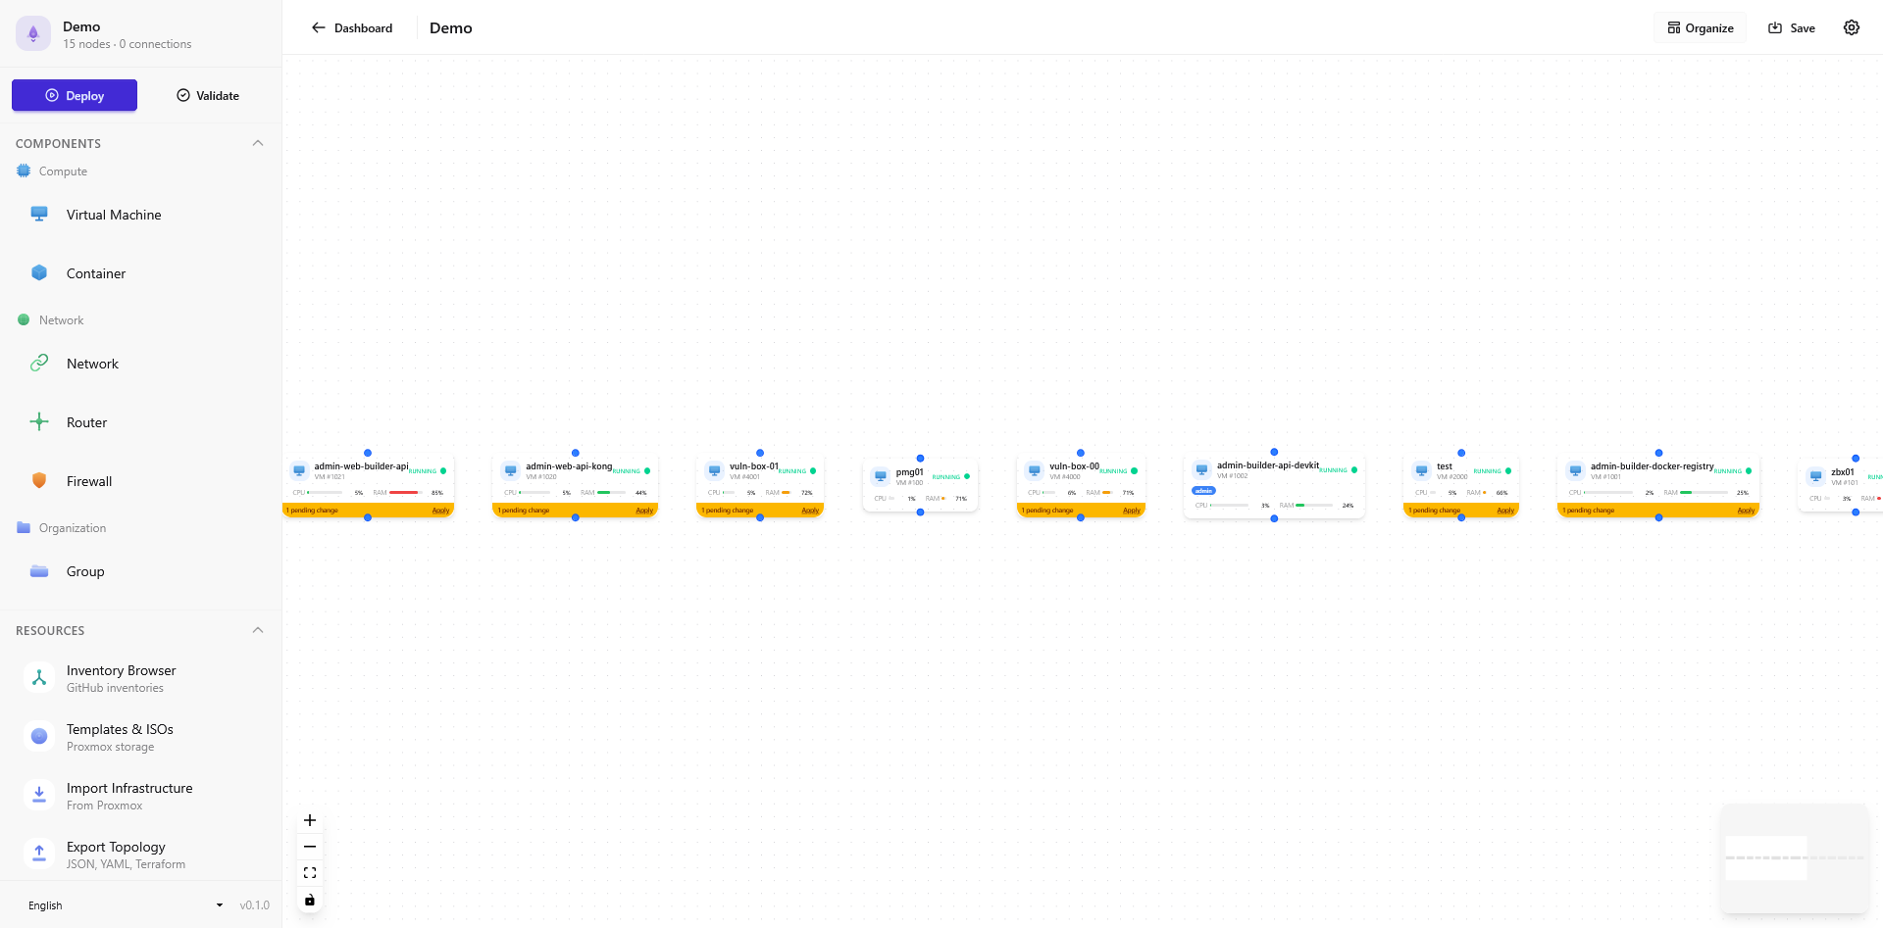
Deployer UI: Canvas Overview
TLP:CLEAR — Information may be shared freely without restriction.
Notes:
The deployer UI canvas: drag-and-drop infrastructure design. Left sidebar: component types (VM, LXC, Network, Router, Firewall). Resources section: inventory browser, templates, import/export. Canvas shows connected nodes with real-time status colours.

Slide 20
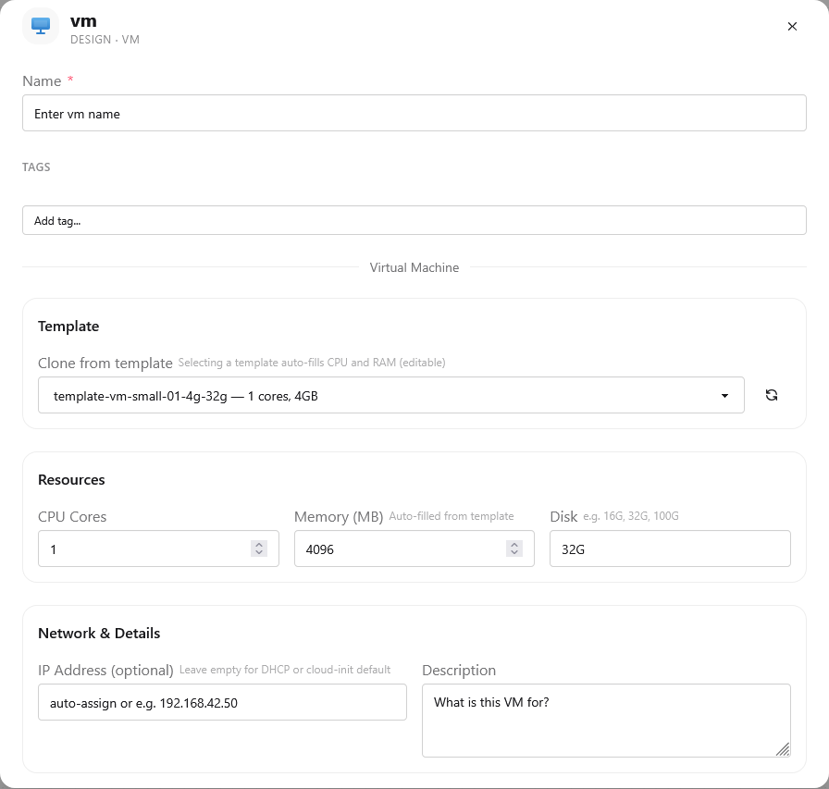
Deployer UI: VM Configuration
Configure each node:
Select Proxmox template with auto-fill
Fine-tune CPU, RAM, storage
Set IP addresses or use DHCP/cloud-init
Add tags for organisation and filtering
Attach description and metadata
TLP:CLEAR — Information may be shared freely without restriction.
Notes:
The configuration panel opens when clicking a node on the canvas. Template selection auto-fills resource values. Tags are synced to Proxmox for deployed VMs.

Slide 21
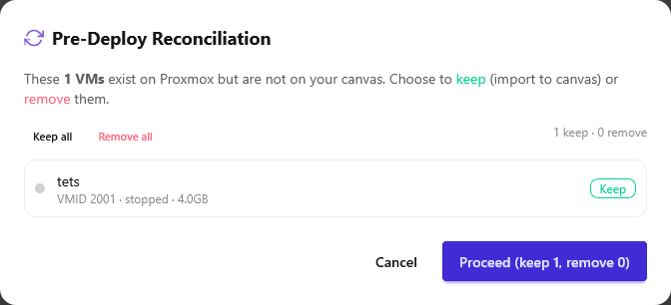
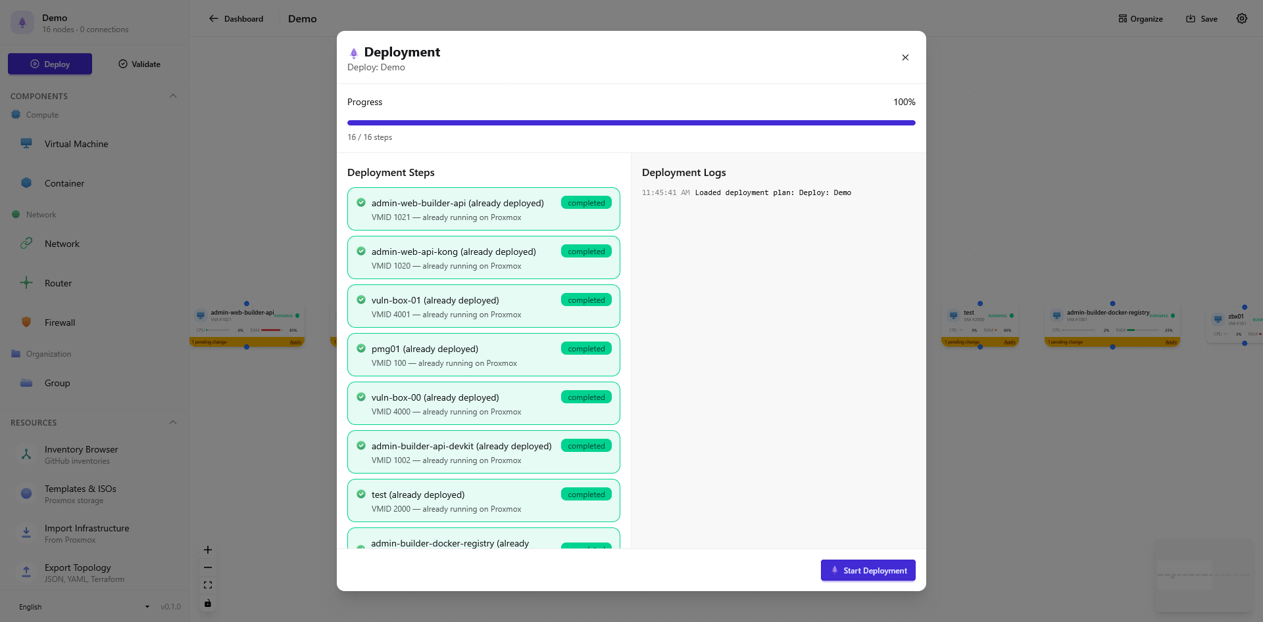
Deploy: Reconciliation & Progress
Pre-Deploy Reconciliation
Deployment Progress
Detect VMs on Proxmox not in your canvas — keep or remove.
Ordered deployment with real-time progress and per-VM feedback.
Full workflow: Design → Reconcile → Deploy in order (networks → routers → VMs → config → start) → Monitor via WebSocket
TLP:CLEAR — Information may be shared freely without restriction.
Notes:
Pre-deploy reconciliation detects VMs existing on Proxmox but not on the canvas. Deployment follows strict order: networks, routers, VMs, configuration, start. Real-time logs show progress per VM.

Slide 22
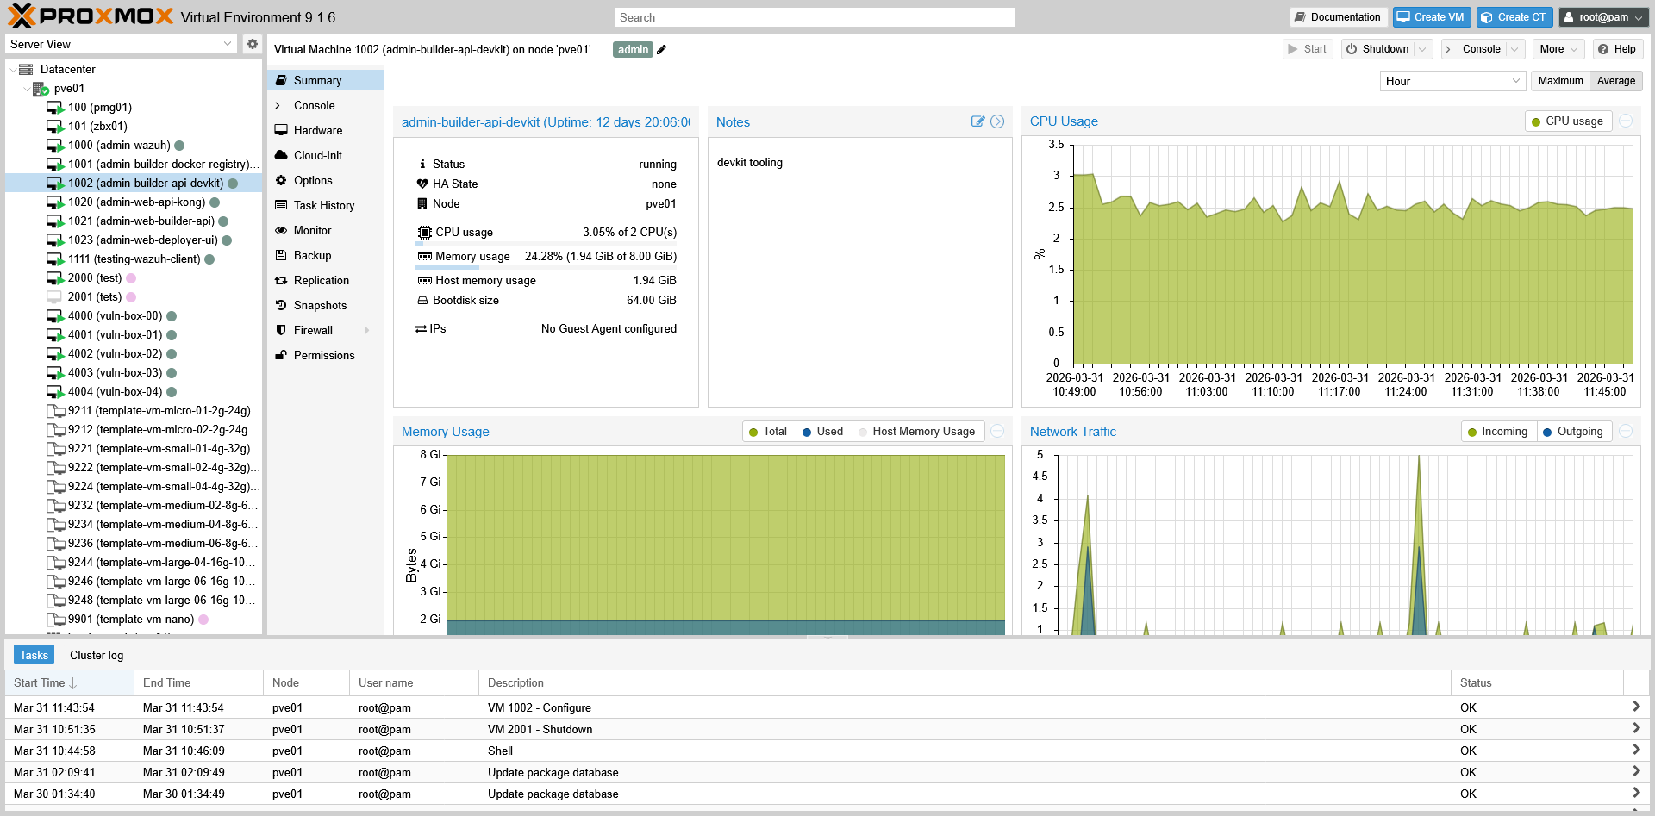
Proxmox: The Hypervisor Backend
Range42 provisions and manages VMs directly through the Proxmox API
TLP:CLEAR — Information may be shared freely without restriction.
Notes:
Proxmox VE is the hypervisor that Range42 automates. Shows management UI with deployed VMs, CPU/memory graphs, and task logs. Range42 interacts entirely via REST API — no manual intervention.

Slide 23
Backend API: Production-Ready
Major Refactoring
New Capabilities
86 route files → 10 domain modules
52 schema files → grouped modules
Application factory pattern
Structured logging throughout
Centralised secret management
Docker deployment (compose)
WebSocket API for live status
Test suite: unit + integration
Sphinx documentation
TLP:CLEAR — Information may be shared freely without restriction.
Notes:
Backend went from prototype-quality to production-grade. - Major refactoring: 86 route files consolidated into 10 clean domain modules (auth, deployment, monitoring, etc.). - 52 Pydantic schema files grouped into coherent modules. - Application factory pattern for clean startup and testing. - Structured logging with correlation IDs for debugging. - Centralised secret management via Ansible Vault integration. - New: Docker Compose deployment makes setup trivial. - New: WebSocket API pushes real-time VM status changes to connected UI clients. - New: Comprehensive test suite covers both unit and integration testing. - New: Sphinx-generated API documentation.

Slide 24
What's Coming Next
TLP:CLEAR — Information may be shared freely without restriction.
Notes:
Transition to the two major platforms under development: the Situational Reporting Tool and the Exercise Management Platform. These represent the next evolution of Range42 — moving beyond infrastructure provisioning into exercise orchestration, evaluation, and scoring.

Slide 25
Situational Reporting Tool (WIP)
Managing the full report lifecycle during cyber range exercises
Report Lifecycle
Roles & Evaluation
Template library: reusable, per-exercise report templates
Multi-type reports: situational, CTI, incident, and spot reports
Rich text editing with attachments and inline images
Approval workflow: write → approve → submit → evaluate
Campaign mode: track report evolution over time
5 roles: Admin, BT Admin, Writer, Approver, Evaluator
Per-section grading with configurable scales
Evaluator view: compare teams side-by-side
Scoring dashboard with granular access controls
REST API for exporting scores to external systems
Designed for blue team reporting today — architecture supports future red team engagement reports, attack logs, and findings.
TLP:CLEAR — Information may be shared freely without restriction.
Notes:
The Situational Reporting Tool is a web application for managing reports during cyber exercises. Key concepts: - Template library: admins create reusable report templates scoped per exercise. - Multi-section reports: each section has a free-text field, evaluator feedback field, and configurable grade. - Campaign mode: group reports of the same type to track evolution across multiple deadlines. - Approval workflow: optional — writers submit, approvers validate, then reports go to evaluators. - Evaluator views: campaign mode (section-by-section with history) and exercise mode (compare teams). 5 roles: 1. Global Admin — defines exercises, assigns users, creates templates 2. BT Admin — assigns reports to team members, activates approval 3. BT Report Writer — writes and submits reports 4. BT Report Approver — approves before submission (optional) 5. Report Evaluator — grades submitted reports Scoring dashboard: per-team counts, grades, optional leaderboard. REST API enables integration with external scoring systems. Future scope: red team reporting (engagement reports, attack timelines, vulnerability findings). Status: concept document (v0.1, Feb 2026) — awaiting stakeholder review and tech stack decision.

Slide 26
Exercise Management Platform (WIP)
Beyond CTFd — a full exercise orchestration and scoring platform
Platform Capabilities
Connecting the Dots
Student portal: access exercises, view progress, leaderboards
Scenario-driven: learning objectives, dependencies, timelines
Gamified themes: hospital, bank, newsroom skins
Multi-language support (i18n: EN, FR, DE, …)
LLM-assisted scenario generation (with human validation)
Deployer UI: provisions the lab infrastructure
Backend API: orchestrates deployment and VM lifecycle
Wazuh: feeds real-time security telemetry to exercises
Reporting Tool: blue team reports scored alongside challenges
Catalogue: exercise metadata, difficulty, prerequisites
EMP ties the entire Range42 ecosystem together — from infrastructure provisioning to exercise delivery, monitoring, scoring, and reporting.
TLP:CLEAR — Information may be shared freely without restriction.
Notes:
The Exercise Management Platform (EMP) is the student-facing portal and exercise orchestration layer. How it extends beyond CTFd: - Not just a flag-submission platform — integrates with the full Range42 ecosystem. - Deployer UI provisions the lab; EMP delivers the exercises on top. - Wazuh feeds real-time security telemetry into exercises (detect the attack, write the report). - Reporting Tool handles blue team reports; EMP handles challenge scoring. - Gamification layer provides themed skins: hospital, bank, mechanic, newsroom, classic. - Exercises have learning objectives, dependencies, timelines, and difficulty metadata from the catalogue. - LLM-assisted scenario generation can produce exercise content with human validation. Architecture integration: - Backend API provides REST + WebSocket endpoints for deployment status, scoring, submissions. - Catalogue provides exercise metadata (CVE info, difficulty, prerequisites). - Wazuh streams security events for detection-based challenges. - Gamification layer wraps the UI in themed skins per exercise context. Current status: - Vue 3 mockup exists (range42-emp-mockup/) - Infrastructure slot prepared in deployment playbooks (web_emp.yml, VMID 1022) - Detailed specification not yet written — concept phase. - Related to Axis 2 (End-User Interfaces) and Axis 3 (Student-Facing Services) in the roadmap.

Slide 27
Today & Tomorrow
TLP:CLEAR — Information may be shared freely without restriction.
Notes:
Transition to the comparison of what works today versus what's planned. This section covers the current capabilities, the development roadmap with 6 strategic axes, and the 50 work blocks planned across quarterly milestones.

Slide 28
Today vs. Tomorrow
Operational Today
Coming Next
Full Proxmox automation (VMs, LXC, network, firewall, VPN)
Visual lab designer with drag-and-drop
Real-time VM status via WebSocket
Template provisioning + reconciliation
Docker-based API deployment
Wazuh monitoring integration
Situational Reporting Tool (blue team reports & evaluation)
Exercise Management Platform (scoring, gamification, student portal)
LLM-assisted scenario generation
Declarative Live State Engine
ICS / IoT training scenarios
Federated catalogue exchange
TLP:CLEAR — Information may be shared freely without restriction.
Notes:
Left = operational today. Right = roadmap items in development or planned.

Slide 29
Development Roadmap: 6 Strategic Axes
Axis 0 — Core Stabilisation & Hardening
Axis 3 — Student-Facing Services
Lock architecture, expand catalogue to 50+ labs
Portals, guided workflows, self-service access
Axis 1 — State Management (DLSE)
Axis 4 — Industrial & IoT
Declarative Live State Engine for reconciliation
ICS/SCADA and IoT training scenarios
Axis 2 — End-User Interfaces
Axis 5 — Open-Source Ecosystem
Deployer UI, EMP with scoring dashboards
NGSOTI synergy, federated catalogues, community
Based on the Range42 Execution Framework v0.8 — 50 work blocks across 6 axes with quarterly sequencing.
TLP:CLEAR — Information may be shared freely without restriction.
Notes:
These axes come from the official Range42 execution framework v0.8. - Axis 0: Foundation — stabilise the core architecture, expand the scenario catalogue to 50+ deployable labs. - Axis 1: DLSE (Declarative Live State Engine) — enable declarative state management so environments auto-reconcile to their desired state. - Axis 2: End-user interfaces — continue evolving the Deployer UI and build the Exercise Management Platform with scoring dashboards. - Axis 3: Student-facing services — self-service portals and guided workflows for trainees. - Axis 4: Industrial & IoT — ICS/SCADA and IoT training scenarios for critical infrastructure security. - Axis 5: Open-source ecosystem — NGSOTI collaboration, federated catalogue exchange, community growth. 50 work blocks total, sequenced across quarterly milestones.

Slide 30
Key Repositories
TLP:CLEAR — Information may be shared freely without restriction.
Notes:
Transition to repository overview. Range42 is organised as 14 separate Git repositories under the github.com/range42 organisation. 10 are public, 4 are private (deployment configs and sensitive playbooks).

Slide 31
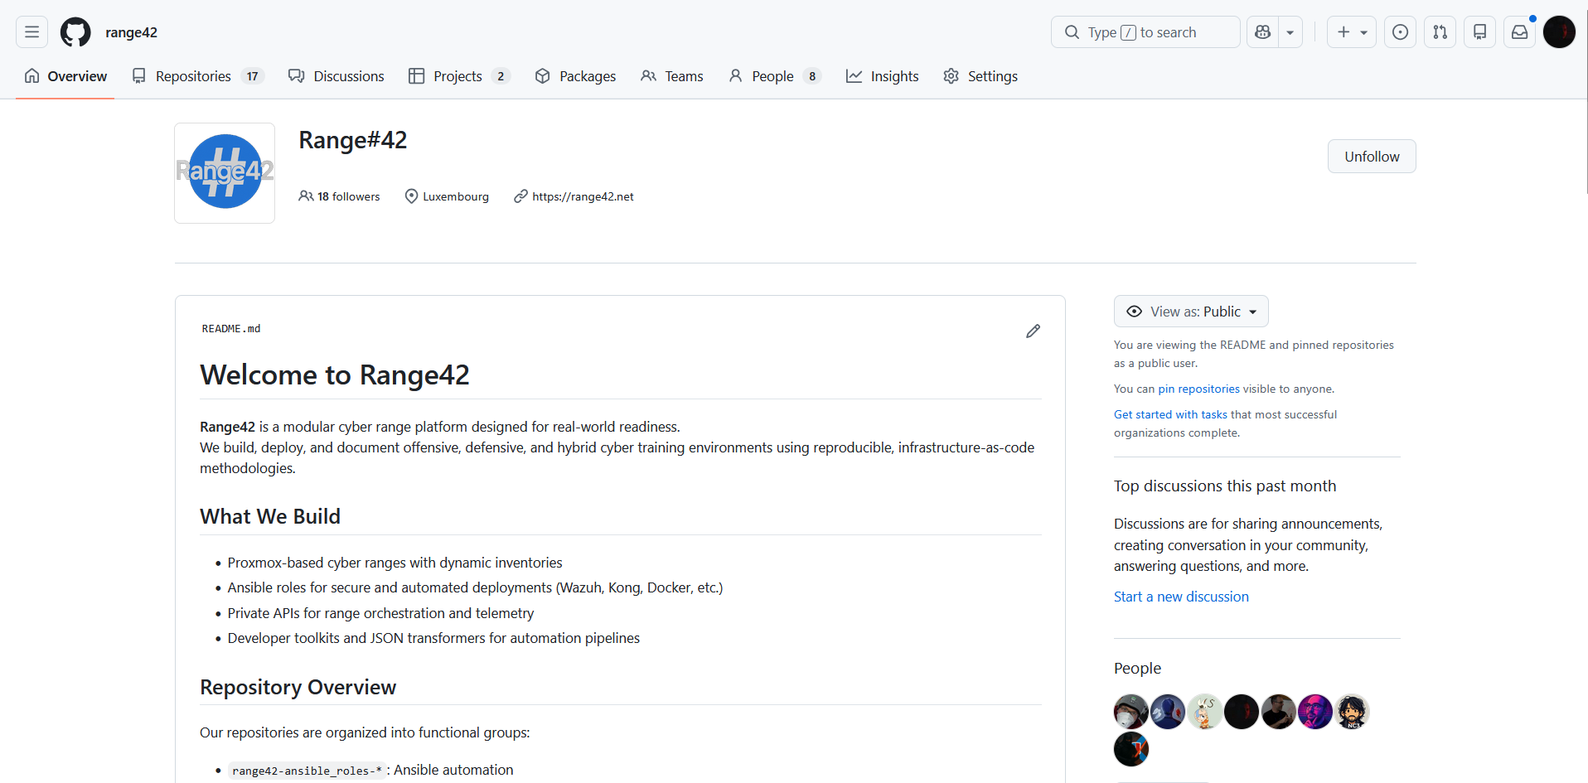
GitHub: github.com/range42
14 repositories | 10 public, 4 private | 520+ commits | Zero high-severity findings
TLP:CLEAR — Information may be shared freely without restriction.
Notes:
The Range42 GitHub organisation hosts all project repositories. 14 repos total, 520+ commits.

Slide 32
Organisation Overview
14 Repositories (10 public, 4 private) — 520+ commits, zero high-severity findings
Repository | Commits | Language | Status
backend-api | 156 | Python / FastAPI | Active
proxmox_controller | 112 | Ansible / YAML | Active
catalog | 97 | Ansible / Docker | Stable
playbooks | 81 | Ansible / YAML | Active
deployer-ui | 74 | Vue 3 / TypeScript | Active
TLP:CLEAR — Information may be shared freely without restriction.
Notes:
Updated commit counts as of March 2026. - backend-api (156 commits): Python/FastAPI — the orchestration engine. Major refactor completed. - proxmox_controller (112 commits): Ansible role for Proxmox API — handles VM creation, networking, templates, cloud-init. - catalog (97 commits): Ansible roles + Docker containers for CVE labs, misconfigurations, forensics, malware. - playbooks (81 commits): Deployment bundles and full scenario definitions (demo_lab, forensics_lab, etc.). - deployer-ui (74 commits): Vue 3 visual lab designer — newest but fastest-growing repo. Highlight the velocity in backend-api and deployer-ui — most active development areas.

Slide 33
Lessons Learned
TLP:CLEAR — Information may be shared freely without restriction.
Notes:
Transition to lessons learned. Be honest about what worked and what was harder than expected. This builds credibility with the audience.

Slide 34
Lessons Learned
Technical
Process
Ansible + Proxmox API = powerful IaC combo
Snapshots are critical for training resets
Early refactoring pays off (86 → 10 route files)
WebSocket enables compelling real-time UX
Governance overhead is real but unlocks collaboration
6-axis framework aligns a small team
Documentation lags code — a universal pattern
Docker simplifies cross-environment deployment
TLP:CLEAR — Information may be shared freely without restriction.
Notes:
Be honest about challenges. It builds trust with the audience. Technical: - Ansible + Proxmox API is an extremely powerful combination for Infrastructure-as-Code. - Snapshots are essential — trainees break things, and instant reset is a must. - The early decision to refactor the backend from 86 files to 10 modules paid off enormously in maintainability. - WebSocket for real-time VM status makes the UI feel alive and responsive. Process: - Governance (code review, documentation, planning) takes time but enables collaboration across the team. - The 6-axis framework helps a small team (3 people) stay aligned on priorities. - Documentation always lags behind code — this is universal, not unique to Range42. - Docker deployment removed the 'works on my machine' problem for the backend.

Slide 35
Open Challenges & Opportunities
Content & Coverage
Platform Maturity
Expand to 50+ deployable scenarios
ICS/IoT and forensics content
Standardised scenario format
CI/CD across all repositories
Exercise Management Platform
Federated catalogue exchange (NGSOTI)
Your Expertise Matters: Every contribution — code, docs, testing, scenarios — moves the platform forward.
TLP:CLEAR — Information may be shared freely without restriction.
Notes:
Frame challenges as opportunities for impactful contributions. Content & Coverage: - Currently ~20 deployable scenarios out of ~100 identified CVEs/misconfigs. Goal is 50+. - ICS/IoT and forensics are high-demand areas with limited open-source content. - A standardised scenario format would enable community contributions and catalogue exchange. Platform Maturity: - CI/CD pipelines needed across all 14 repositories for automated testing and deployment. - Exercise Management Platform (EMP) will add scoring, reporting, and student progress tracking. - Federated catalogue exchange (via NGSOTI) would let organisations share scenarios securely. Every type of contribution matters: security researchers can add scenarios, developers can improve infrastructure, designers can enhance the UI.

Slide 36

Get Involved
Contribute
Scenarios: CVE research, automation, gamification
Infrastructure: Ansible roles, backend API, CI/CD
UI/UX: Lab designer, Exercise Management Platform
range42.lu
github.com/range42
info@nc3.lu
TLP:CLEAR — Information may be shared freely without restriction.
Notes:
Final call to action with clear next steps and contact information. Three main areas for contribution: - Scenarios: security researchers can contribute CVE labs, automation playbooks, gamified exercises. - Infrastructure: Ansible roles, backend API features, CI/CD pipelines. - UI/UX: the Deployer UI lab designer and the upcoming Exercise Management Platform. Contact: - Website: range42.lu - GitHub: github.com/range42 (10 public repos, open issues, contribution guide) - Email: info@nc3.lu Emphasize that contributions of all sizes are welcome — from fixing a typo in documentation to building a complete training scenario.

