Slide 1


APS1052 Final Project
Ran Ge
University of Toronto
Ran Ge
Summer 2023
Notes:
Hi everyone, this is group 14. my name is Ran, this is Hejia, this is Xiaodi, and this is Xianxin. our group project topic is “Exploring the Role of ChatGPT in assisting software engineers for coding purposes”

Slide 2

Introduction
1.

Slide 3
1 Introduction
APS 1052: Course Project
▪ This project is based on the Option3:
▪ Explain and extend a case model in: Machine Learning and Data Science Blueprints for finance by Tatsat
▪ Use: White Reality Check for evaluating the results, in addition to financial
metrics: CAGR, Sharpe Ratio etc..
▪ We Choose the case study 1 in chapter 5 as our case model
Notes:
I believe everyone is quite familiar with ChatGPT. Maybe we can skip this part and jump into research question.

Slide 4
1 Introduction
Project Objectives
▪ This project is explaining and extending a case model in Machine Learning and Data Science Blueprints for Finance by Tatsat. Especially focused on Case 1: Stock price prediction from chapter 5.
▪ In the project, we download dataset from yahoo and implemented several different models to predict the stock price of Google, We also used residuals, white reality check and multiple indicators to evaluate the model. Finally, we compared the different models and made a conclusion.
Notes:
I believe everyone is quite familiar with ChatGPT. Maybe we can skip this part and jump into research question.

Slide 5
1 Introduction
Enhancements from the previous case
Data and Preprocessing
▪ Predict a new dataset (Google instead of Microsoft)
▪ Collect more dataset to predict the stock (including stock, ETF, finance index and currencies)
▪ Calculate more tech indicator based on TA-LIB as new column in the dataset to predict the stock
Model Construction
▪ Use models not discussed in the book(Ridge regression and XGBoost)
▪ Use pipelines consisting of scaler, PCA() and model to predict the data.
▪ Use GridSearch to tune the hyperparameters.
Model Evaluation
▪ Calculated more metrics to evaluate the model.
▪ Implemented white reality check and drawed equity curves to evaluate the model.
Notes:
I believe everyone is quite familiar with ChatGPT. Maybe we can skip this part and jump into research question.

Slide 6
1 Introduction
Seed Code
From Tatsat’s Book: Machine Learning and Data Science Blueprints for Finance:
▪ StockPricePrediction.ipynb (access: https://github.com/tatsath/fin
ml/blob/master/Chapter%205%20-%20Sup.%20Learning%20-
%20Regression%20and%20Time%20Series%20models/Case%20Study%201%20-
%20Stock%20Price%20Prediction/StockPricePrediction.ipynb)
▪ From Course Webpage:
▪ linear_svc_optim_talib.py
▪ detrendPrice.py
▪ fAux.py
▪ WhiteRealityCheckFor1.py
Notes:
I believe everyone is quite familiar with ChatGPT. Maybe we can skip this part and jump into research question.

Slide 7
1 Introduction
Dataset
For the Project, the source of dataset is from yahoo finance:
▪ StockPrice Data:
Google stock data, Apple stock data, AMD stock data,
Amazon Stock Data, IBM stock data, Microsoft stock data, Nvidia stock data
▪ ETF:
QQQ data, SPY data
▪ Currency Data:
JPY currency data, GPBUSD currency data
▪ Financial indicator:
DIA data, VIX data, IVV data
Notes:
I believe everyone is quite familiar with ChatGPT. Maybe we can skip this part and jump into research question.

Slide 8
Exploratory Analysis
2.

Slide 9
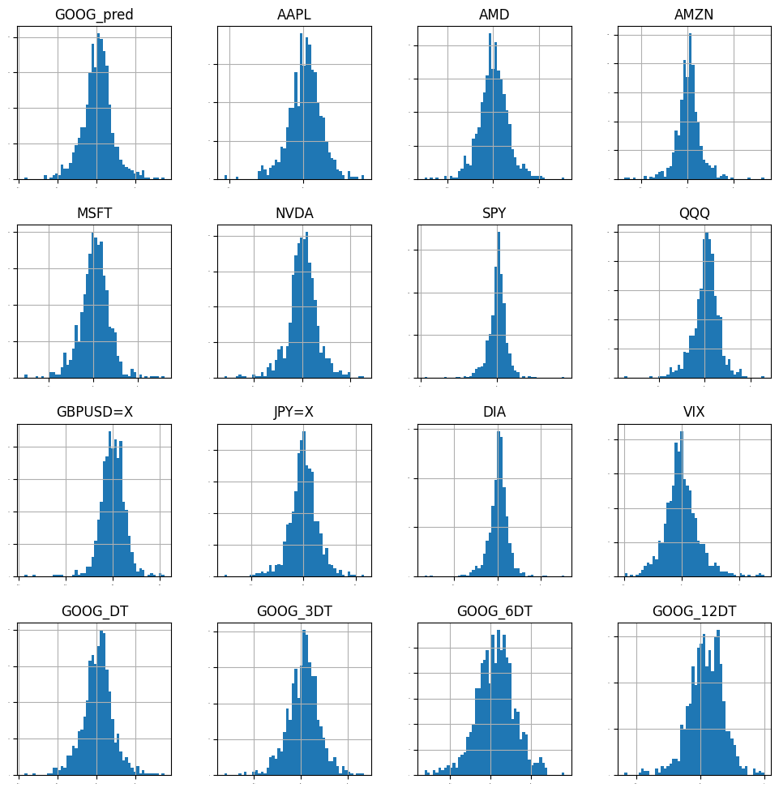
Normal Distribution
We conducted normal distribution analysis of the our dataset and visualized them. The results shows that all of the data is normal distributed, which is good for our model.
Notes:
I believe everyone is quite familiar with ChatGPT. Maybe we can skip this part and jump into research question.

Slide 10
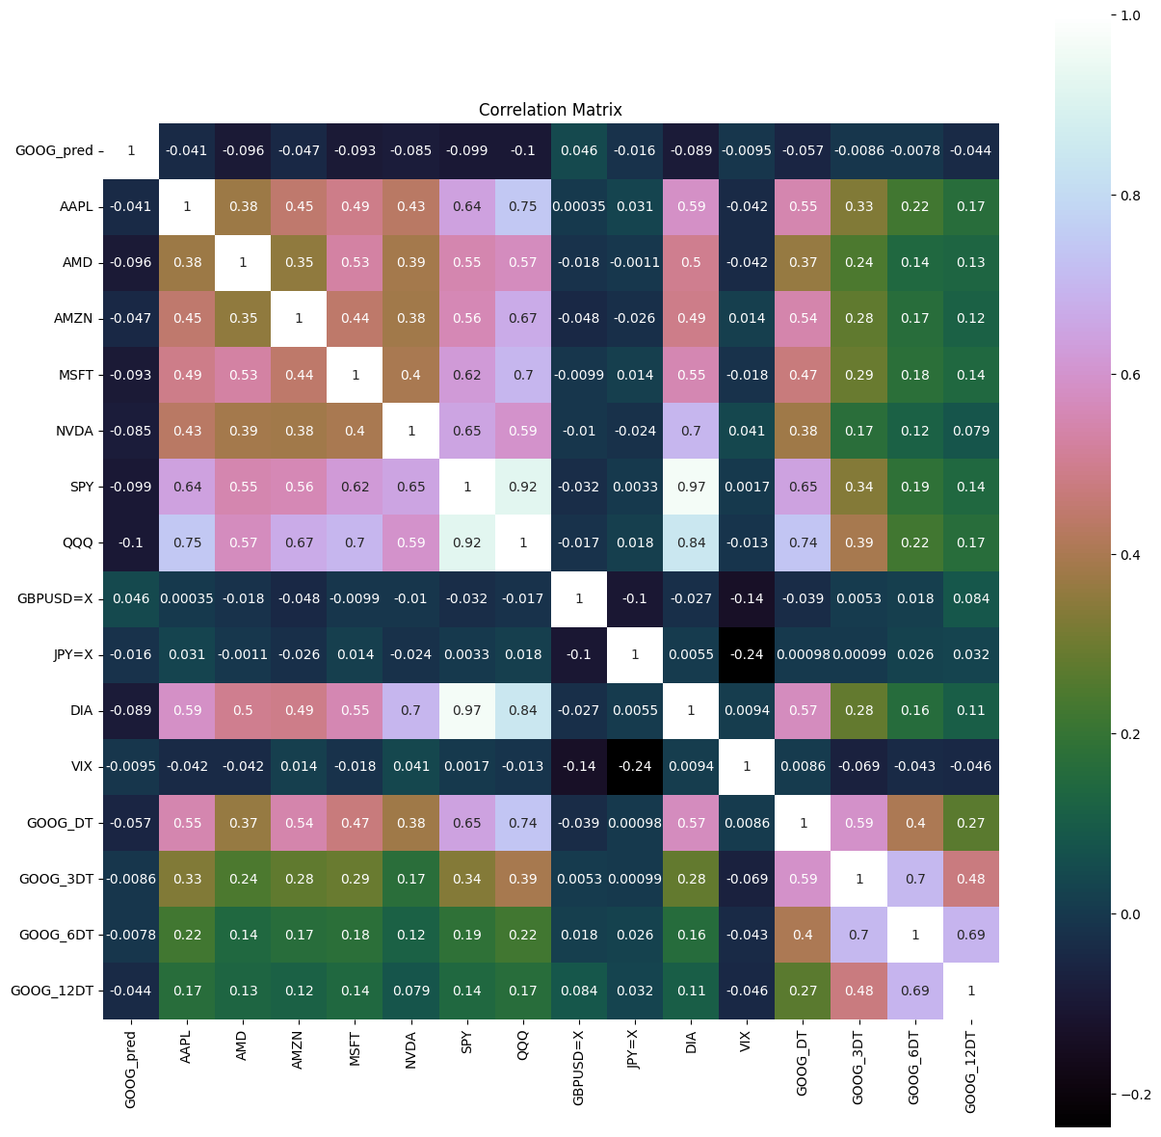
Correlation Analysis
We conducted correlation analysis for the dataset, testing if the dataset is correlated to the target dataset. The results shows that most of the dataset is correlated to target dataset, except the VIX, JPY and GPDUSD dataset
Notes:
I believe everyone is quite familiar with ChatGPT. Maybe we can skip this part and jump into research question.

Slide 11
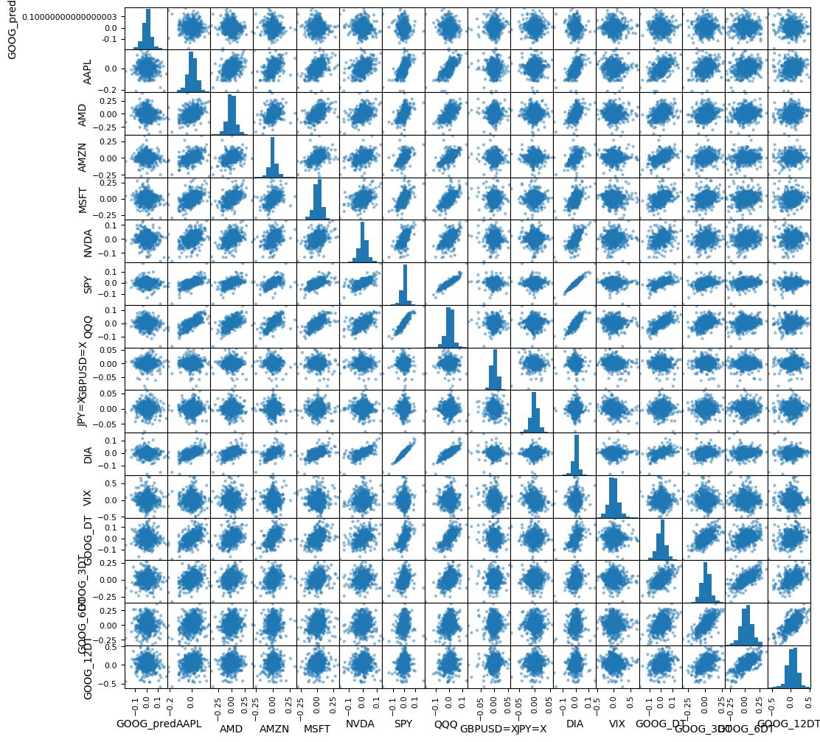
Correlation Analysis
We conducted correlation analysis for the dataset, testing if the dataset is correlated to the target dataset. The results shows that most of the dataset is correlated to target dataset, except the VIX, JPY and GPDUSD dataset
Notes:
I believe everyone is quite familiar with ChatGPT. Maybe we can skip this part and jump into research question.

Slide 12
2 Exploratory Analysis
Conclusion
Normal Distribution:
▪ From the normal distribution analysis, we can see that all the data is normal distribute
Correlation Analysis:
▪ From the correlation analysis above, we can see that most of the data is correlated to the target data, except ‘VIX’, ‘JPY’ and ‘GPBUSD’
Data Clearing:
▪ from the above two exploratory analysis, we decide to clear out the ’VIX’, ‘JPY’ and ‘USD’ data
Notes:
I believe everyone is quite familiar with ChatGPT. Maybe we can skip this part and jump into research question.

Slide 13
Model Evaluation
3.

Slide 14
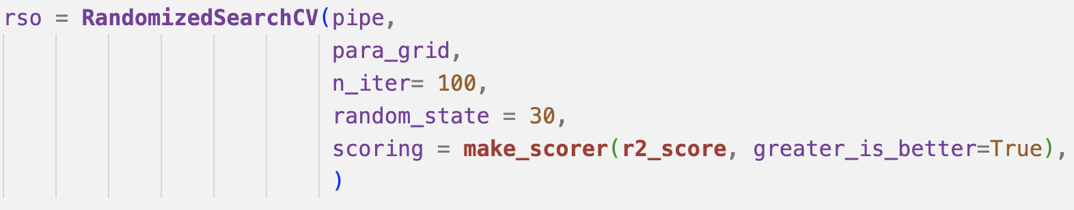
3 Model Evaluation – Linear Regression
Linear regression pipeline
Params Search
Notes:
I believe everyone is quite familiar with ChatGPT. Maybe we can skip this part and jump into research question.

Slide 15
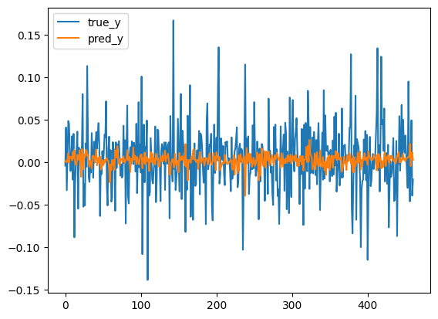
3 Model Evaluation – Linear Regression
Prediction Result – Linear Regression
Notes:
I believe everyone is quite familiar with ChatGPT. Maybe we can skip this part and jump into research question.

Slide 16
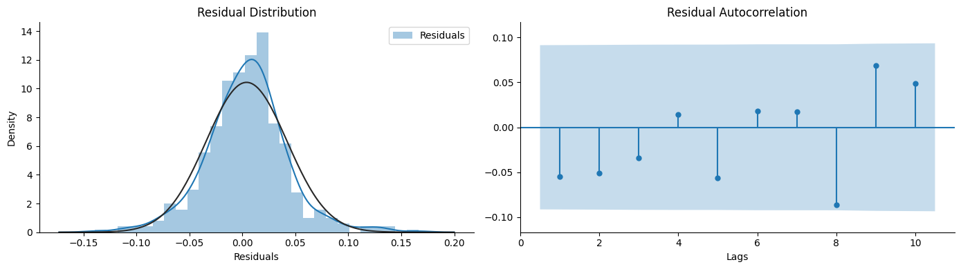
3 Model Evaluation – Linear Regression
Residuals Analysis
Notes:
I believe everyone is quite familiar with ChatGPT. Maybe we can skip this part and jump into research question.

Slide 17
3 Model Evaluation – Linear Regression
Tech indicators calculation
In Sample:
Out Of Sample:
CAGR: 0.121627
Sharpe ratio: 0.521755
maxDD: -0.732162
maxDDD: 320
Calmer ratio: 0.16612
Rho: -0.0415887
Pval: 0.372978
CAGR: 0.116561
Sharpe ratio: 0.55598
maxDD: -0.502246
maxDDD: 232
Calmer ratio: 0.232079
Rho: -0.0415887
Pval: 0.372978
Notes:
I believe everyone is quite familiar with ChatGPT. Maybe we can skip this part and jump into research question.

Slide 18
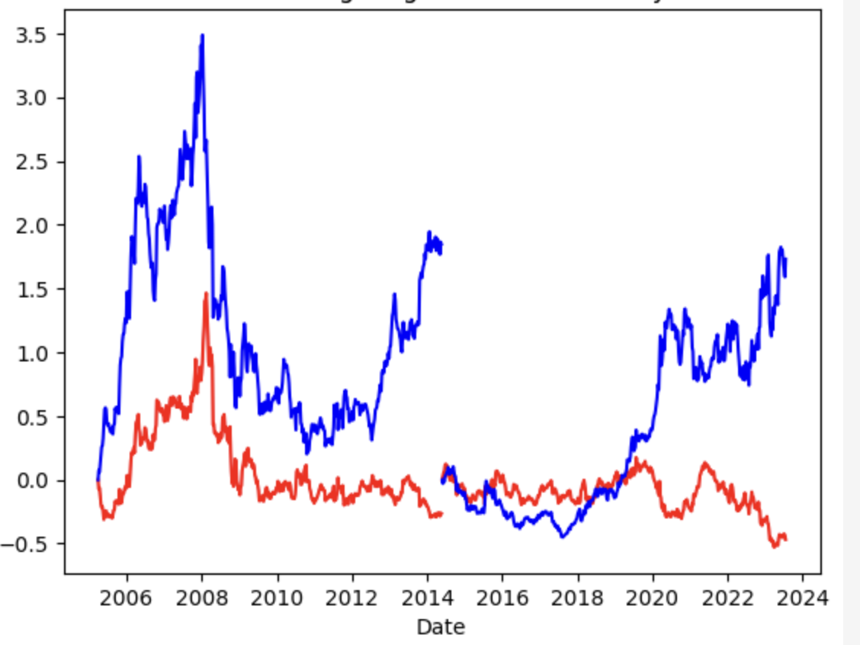
3 Model Evaluation – Linear Regression
Cross Validation
Notes:
I believe everyone is quite familiar with ChatGPT. Maybe we can skip this part and jump into research question.

Slide 19
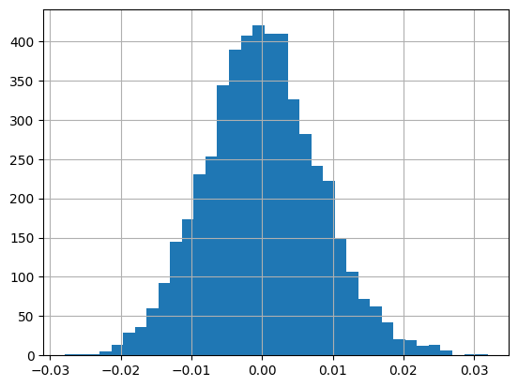
3 Model Evaluation – Linear Regression
WhietReality Check
Notes:
I believe everyone is quite familiar with ChatGPT. Maybe we can skip this part and jump into research question.

Slide 20
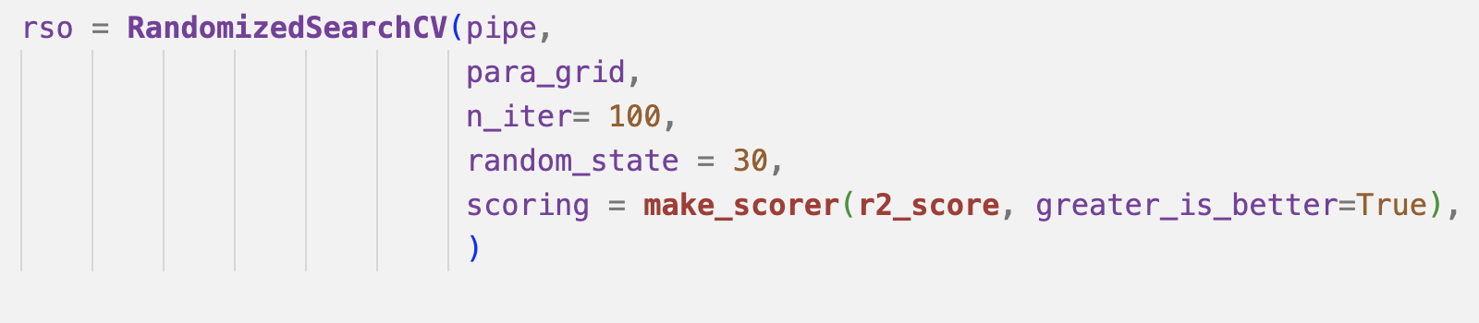
3 Model Evaluation – Xgboost
Xgboost pipeline
Params Search
Notes:
I believe everyone is quite familiar with ChatGPT. Maybe we can skip this part and jump into research question.

Slide 21
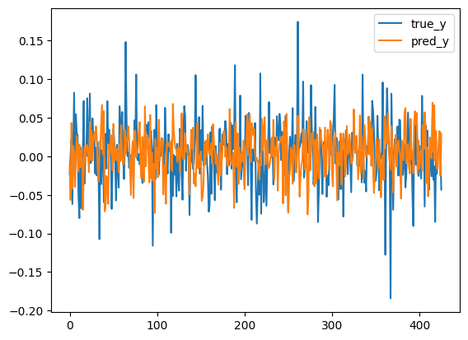
3 Model – Xgboost
Prediction Result – Xgboost
Notes:
I believe everyone is quite familiar with ChatGPT. Maybe we can skip this part and jump into research question.

Slide 22
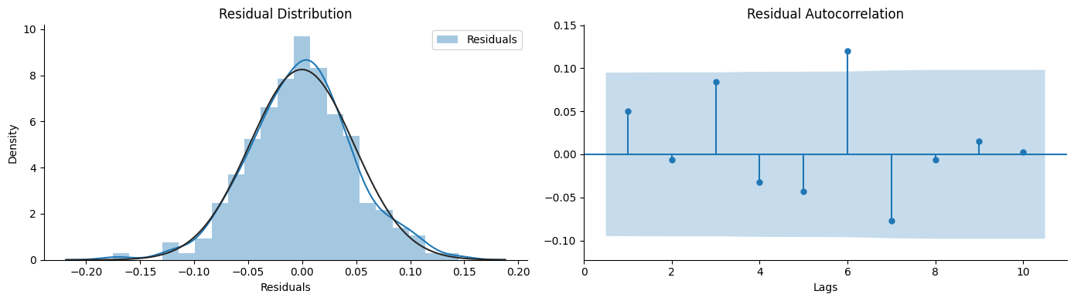
3 Model Evaluation – Xgboost
Residuals Analysis
Notes:
I believe everyone is quite familiar with ChatGPT. Maybe we can skip this part and jump into research question.

Slide 23
3 Model Evaluation – Xgboost
Tech indicators calculation
In Sample:
Out Of Sample:
CAGR: 0.00697507
Sharpe ratio: 0.190687
maxDD: -0.746201
maxDDD: 416
Calmer ratio: 0.00934141
Rho: 0.0494161
Pval: 0.308886
CAGR: -0.0864164
Sharpe ratio: -0.209166
maxDD: -0.605321
maxDDD: 365
Calmer ratio: -0.142761
Rho: 0.0494161
Pval: 0.308886
Notes:
I believe everyone is quite familiar with ChatGPT. Maybe we can skip this part and jump into research question.

Slide 24
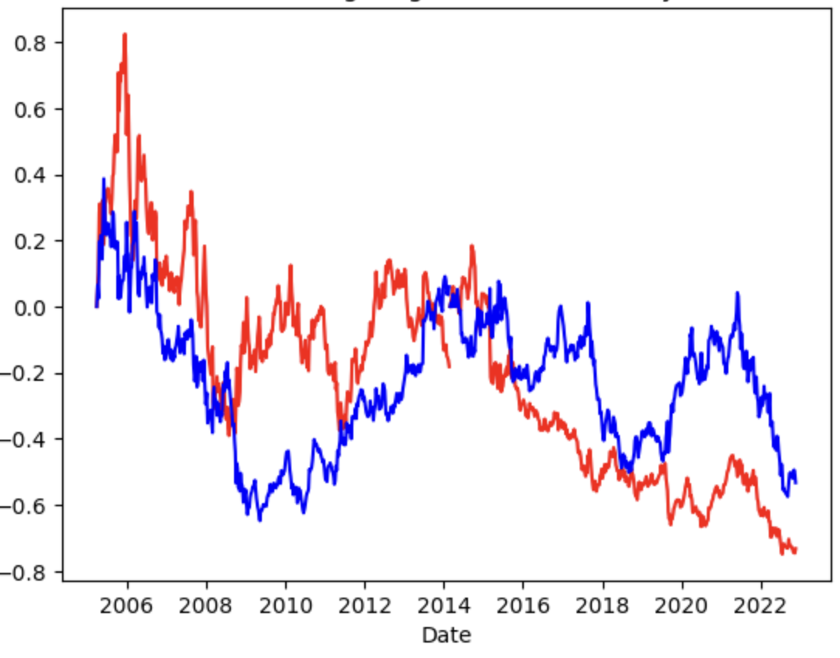
3 Model Evaluation – Xgboost
Cross Validation
Notes:
I believe everyone is quite familiar with ChatGPT. Maybe we can skip this part and jump into research question.

Slide 25
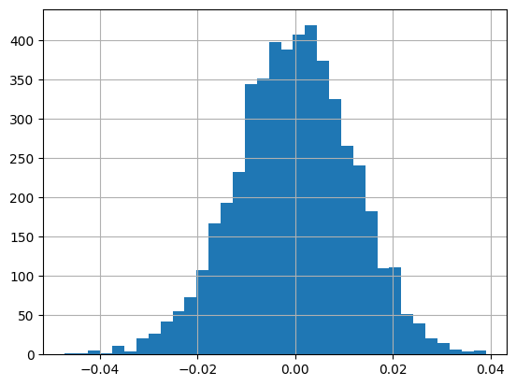
3 Model Evaluation – Xgboost
WhietReality Check
Notes:
I believe everyone is quite familiar with ChatGPT. Maybe we can skip this part and jump into research question.

Slide 26
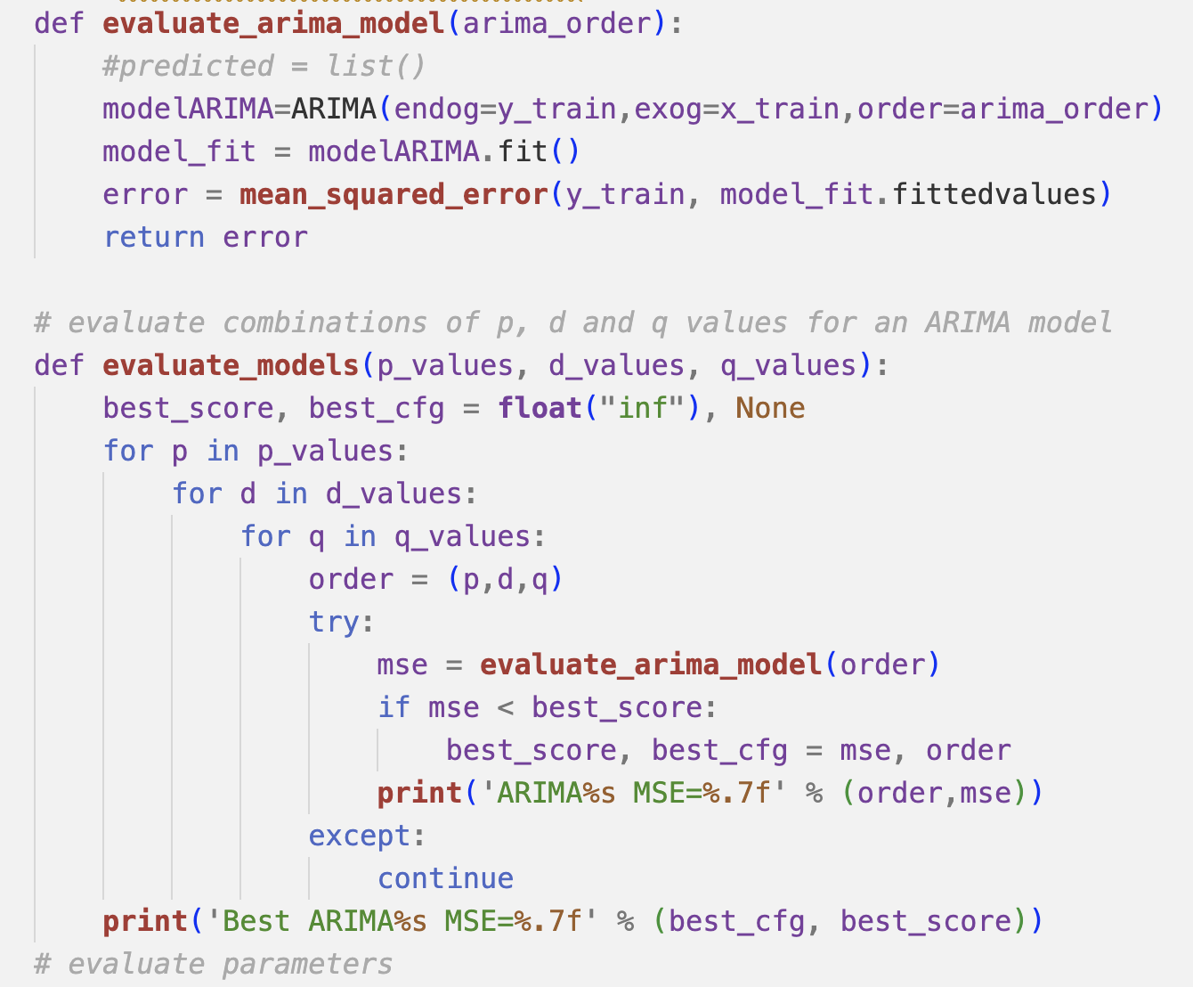
3 Model Evaluation – Arima
Arima Model With Params Search
Notes:
I believe everyone is quite familiar with ChatGPT. Maybe we can skip this part and jump into research question.

Slide 27
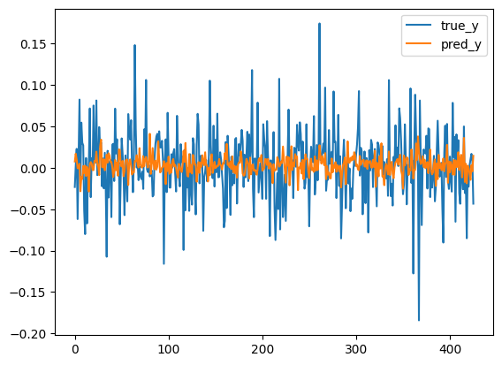
3 Model Evaluation – Arima
Prediction Result – Arima
Notes:
I believe everyone is quite familiar with ChatGPT. Maybe we can skip this part and jump into research question.

Slide 28
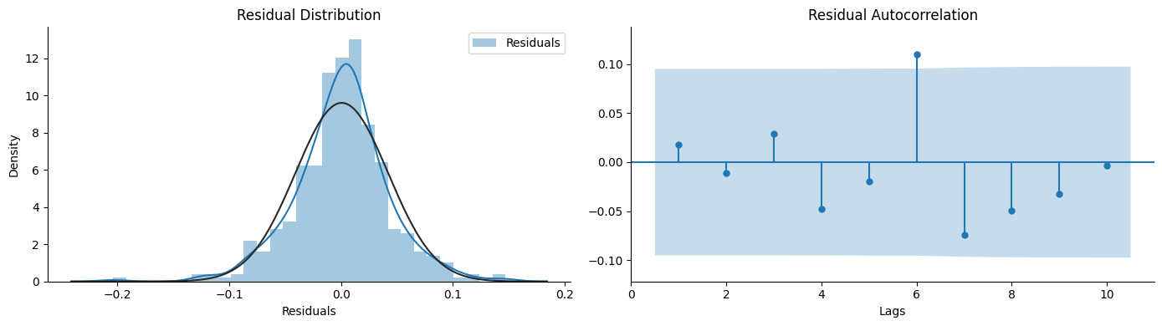
3 Model Evaluation – Arima
Residuals Analysis
Notes:
I believe everyone is quite familiar with ChatGPT. Maybe we can skip this part and jump into research question.

Slide 29
3 Model Evaluation – Arima
Tech indicators calculation
In Sample:
Out Of Sample:
CAGR: -0.110674
Sharpe ratio: -0.173127
maxDD: -0.826086
maxDDD: 422
Calmer ratio: -0.133974
Rho: -0.00357113
Pval: 0.941415
CAGR: 0.0216495
Sharpe ratio: 0.212829
maxDD: -0.680674
maxDDD: 254
Calmer ratio: 0.031806
Rho: -0.00357113
Pval: 0.941415
Notes:
I believe everyone is quite familiar with ChatGPT. Maybe we can skip this part and jump into research question.

Slide 30
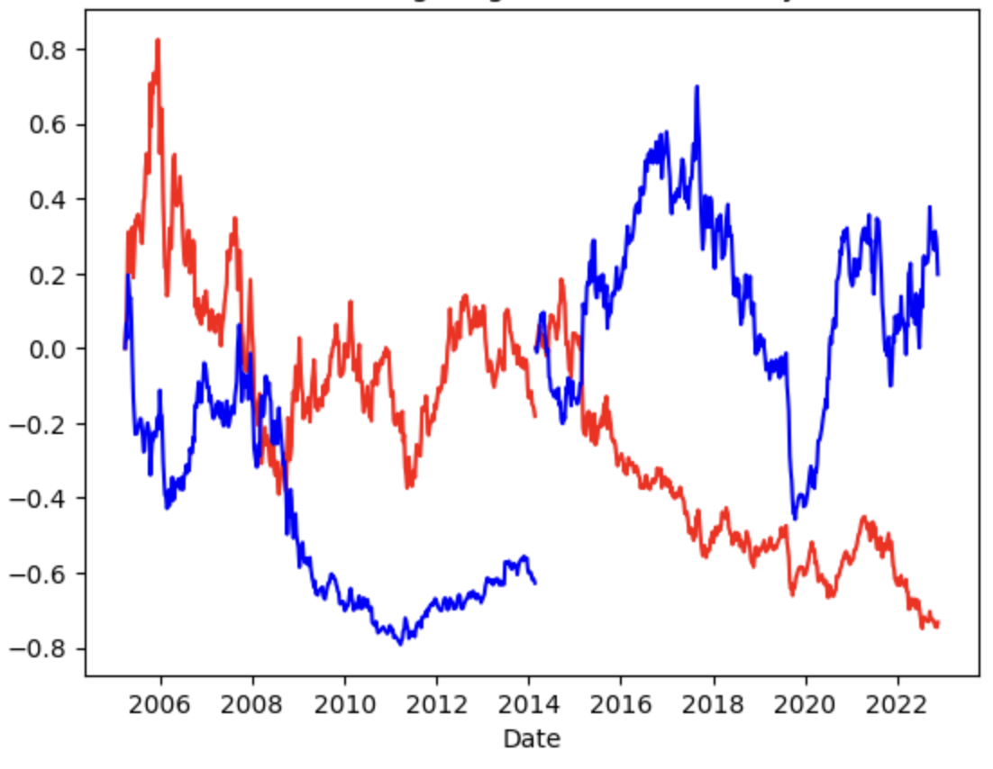
3 Model Evaluation – Arima
Cross Validation
Notes:
I believe everyone is quite familiar with ChatGPT. Maybe we can skip this part and jump into research question.

Slide 31
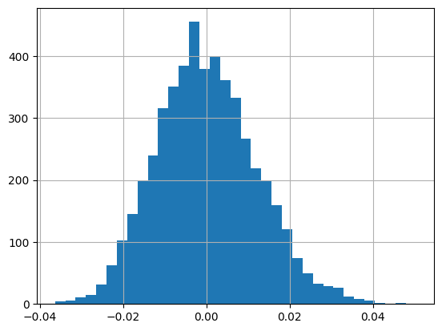
3 Model Evaluation – Arima
WhietReality Check
Notes:
I believe everyone is quite familiar with ChatGPT. Maybe we can skip this part and jump into research question.

Slide 32
3 Model Evaluation – Train errors and Test errors
Train errors and Test errors
Linear Regression:
Train error: 0.0016999752468979303
Test error:
0.0015356740911956041
Xgboost:
Train error: 0.0020641675814924714
Test error:
0.0023356173013301985
Arima:
Train error: 0.0016582267494510859
Test error:
0.001725324837221361
Notes:
I believe everyone is quite familiar with ChatGPT. Maybe we can skip this part and jump into research question.

Slide 33
3 Model Evaluation – Model Comparison
Model Comparison
 | In-sample CAGR | Out-sample CAGR | Train error | Test error
Linear regression | : 0.121627 | 0.116561 | 0.0016999752468979303 | 0.0015356740911956041
Xgboost | 0.00697507 | -0.0864164 | 0.0020641675814924714 | 0.0023356173013301985
Arima | -0.110674 | 0.0216495 | 0.0016582267494510859 | 0.001725324837221361
Notes:
I believe everyone is quite familiar with ChatGPT. Maybe we can skip this part and jump into research question.

Slide 34
Conclusion
3.

Slide 35
3 Model Evaluation – Train errors and Test errors
Conclusion
From the analysis of three different models above, we can see that the linear regression model has the best performance over other two models on areas like revenues and accuracy.
Traditional linear models like lr and Xgboost has better performance over neural networks models in this particular case on areas like revenue.
Notes:
I believe everyone is quite familiar with ChatGPT. Maybe we can skip this part and jump into research question.

