Slide 1

Suite Burp: Testing HTTP-based Apps
Rebecca Deck, GSE, OSCE, CISSP
@ranger_cha
BE INFORMED. BE STRATEGIC. BE SECURE.

Slide 2
OBJECTIVE
Application Testing Methodology Overview
What is Burp
HTTP
Burp Proxy Setup
Burp Features
Authentication
Extensions
Notes:
This presentation covers two of the new attacks that are included in the 2017 OWASP top 10 that were not included in previous OWASP top 10 versions. The two we will cover are XML external entity and deserialization attacks. Both of these vulnerability types are covered from the perspective of creating, finding, exploiting, and fixing. We will also cover some information about deserialization attacks that will likely lead to further attacks in this category. Finally, we will discuss logging and inclusion of this test and how it affects application security testing.

Slide 3
APPLICATIONS USED
Burp
Juice Shop
https://abusecasejs.herokuapp.com
Mutillidae
Notes:
This presentation covers two of the new attacks that are included in the 2017 OWASP top 10 that were not included in previous OWASP top 10 versions. The two we will cover are XML external entity and deserialization attacks. Both of these vulnerability types are covered from the perspective of creating, finding, exploiting, and fixing. We will also cover some information about deserialization attacks that will likely lead to further attacks in this category. Finally, we will discuss logging and inclusion of this test and how it affects application security testing.

Slide 4
APPLICATION TESTING METHODOLOGY OVERVIEW
Use OWASP Testing Guide v4
Detailed steps for testing apps
Still need to apply some to all inputs
https://www.owasp.org/images/1/19/OTGv4.pdf
Notes:
This presentation covers two of the new attacks that are included in the 2017 OWASP top 10 that were not included in previous OWASP top 10 versions. The two we will cover are XML external entity and deserialization attacks. Both of these vulnerability types are covered from the perspective of creating, finding, exploiting, and fixing. We will also cover some information about deserialization attacks that will likely lead to further attacks in this category. Finally, we will discuss logging and inclusion of this test and how it affects application security testing.

Slide 5
APPLICATION TESTING PHASES
Customer Information
Reconnaissance
Automated Testing
Manual Testing
Exploitation
Reporting
Notes:
This presentation covers two of the new attacks that are included in the 2017 OWASP top 10 that were not included in previous OWASP top 10 versions. The two we will cover are XML external entity and deserialization attacks. Both of these vulnerability types are covered from the perspective of creating, finding, exploiting, and fixing. We will also cover some information about deserialization attacks that will likely lead to further attacks in this category. Finally, we will discuss logging and inclusion of this test and how it affects application security testing.

Slide 6
APPLICATION TESTING PHASES
Customer Information
Find “dangerous pages”
Contact forms, registration, email, etc.
In scope systems
Presence of APIs
Reconnaissance
Find dangerous pages on your own
Verify scope of systems
Notes:
This presentation covers two of the new attacks that are included in the 2017 OWASP top 10 that were not included in previous OWASP top 10 versions. The two we will cover are XML external entity and deserialization attacks. Both of these vulnerability types are covered from the perspective of creating, finding, exploiting, and fixing. We will also cover some information about deserialization attacks that will likely lead to further attacks in this category. Finally, we will discuss logging and inclusion of this test and how it affects application security testing.

Slide 7
APPLICATION TESTING PHASES
Automated Testing
Exclude dangerous pages
“Fuzzes” application input parameters
Good for injection attacks
Manual Testing
Controlled testing of dangerous pages
Fuzzing with Intruder
Good for permissions issues
Broken Access Control
Logic errors
Verify automated findings
Notes:
This presentation covers two of the new attacks that are included in the 2017 OWASP top 10 that were not included in previous OWASP top 10 versions. The two we will cover are XML external entity and deserialization attacks. Both of these vulnerability types are covered from the perspective of creating, finding, exploiting, and fixing. We will also cover some information about deserialization attacks that will likely lead to further attacks in this category. Finally, we will discuss logging and inclusion of this test and how it affects application security testing.

Slide 8
APPLICATION TESTING PHASES
Exploitation
Attack found vulnerabilities
Attempt to gain command execution
Attempt to steal data
Attempt to elevate privileges
Reporting
Notes:
This presentation covers two of the new attacks that are included in the 2017 OWASP top 10 that were not included in previous OWASP top 10 versions. The two we will cover are XML external entity and deserialization attacks. Both of these vulnerability types are covered from the perspective of creating, finding, exploiting, and fixing. We will also cover some information about deserialization attacks that will likely lead to further attacks in this category. Finally, we will discuss logging and inclusion of this test and how it affects application security testing.

Slide 9
WHAT IS BURP?
Burp is a MitM Proxy
Free version from portswigger.net
Pro lets you scan, save, search, and is faster
DAST scanner
Traffic manipulation
SSL Interception
Notes:
This presentation covers two of the new attacks that are included in the 2017 OWASP top 10 that were not included in previous OWASP top 10 versions. The two we will cover are XML external entity and deserialization attacks. Both of these vulnerability types are covered from the perspective of creating, finding, exploiting, and fixing. We will also cover some information about deserialization attacks that will likely lead to further attacks in this category. Finally, we will discuss logging and inclusion of this test and how it affects application security testing.

Slide 10
HTTP
HyperText Transport Protocol
Foundation for the “web”
Often encapsulated
Request and Response
Stateless
Designed for simple, static content
Notes:
This presentation covers two of the new attacks that are included in the 2017 OWASP top 10 that were not included in previous OWASP top 10 versions. The two we will cover are XML external entity and deserialization attacks. Both of these vulnerability types are covered from the perspective of creating, finding, exploiting, and fixing. We will also cover some information about deserialization attacks that will likely lead to further attacks in this category. Finally, we will discuss logging and inclusion of this test and how it affects application security testing.

Slide 11
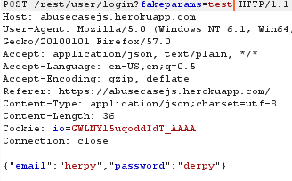
STRUCTURE OF HTTP REQUESTS
Verb/Method
Relative URL
Parameters
HTTP Version
Headers
Body
Notes:
This presentation covers two of the new attacks that are included in the 2017 OWASP top 10 that were not included in previous OWASP top 10 versions. The two we will cover are XML external entity and deserialization attacks. Both of these vulnerability types are covered from the perspective of creating, finding, exploiting, and fixing. We will also cover some information about deserialization attacks that will likely lead to further attacks in this category. Finally, we will discuss logging and inclusion of this test and how it affects application security testing.

Slide 12
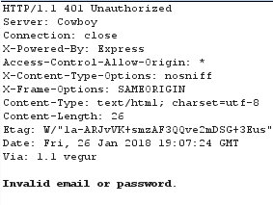
STRUCTURE OF HTTP RESPONSES
HTTP Version
Response Code
Headers
Body
Notes:
This presentation covers two of the new attacks that are included in the 2017 OWASP top 10 that were not included in previous OWASP top 10 versions. The two we will cover are XML external entity and deserialization attacks. Both of these vulnerability types are covered from the perspective of creating, finding, exploiting, and fixing. We will also cover some information about deserialization attacks that will likely lead to further attacks in this category. Finally, we will discuss logging and inclusion of this test and how it affects application security testing.

Slide 13
HTTP INTERCEPTION
“Man in the Middle” (MITM)
Several ways to accomplish this
ARP Cache Poisoning
IPv6 Neighbor Solicitation
Proxy
Explicit
WPAD probes
Routing Protocol Attacks (HSRP)
Obstacles
Encryption!
Notes:
This presentation covers two of the new attacks that are included in the 2017 OWASP top 10 that were not included in previous OWASP top 10 versions. The two we will cover are XML external entity and deserialization attacks. Both of these vulnerability types are covered from the perspective of creating, finding, exploiting, and fixing. We will also cover some information about deserialization attacks that will likely lead to further attacks in this category. Finally, we will discuss logging and inclusion of this test and how it affects application security testing.

Slide 14
CONFIGURE PROXY
Defaults to loopback port 8080
Change interface and “invisible” for mobile and IoT testing
Interception on by default
Match and Replace
Notes:
This presentation covers two of the new attacks that are included in the 2017 OWASP top 10 that were not included in previous OWASP top 10 versions. The two we will cover are XML external entity and deserialization attacks. Both of these vulnerability types are covered from the perspective of creating, finding, exploiting, and fixing. We will also cover some information about deserialization attacks that will likely lead to further attacks in this category. Finally, we will discuss logging and inclusion of this test and how it affects application security testing.

Slide 15
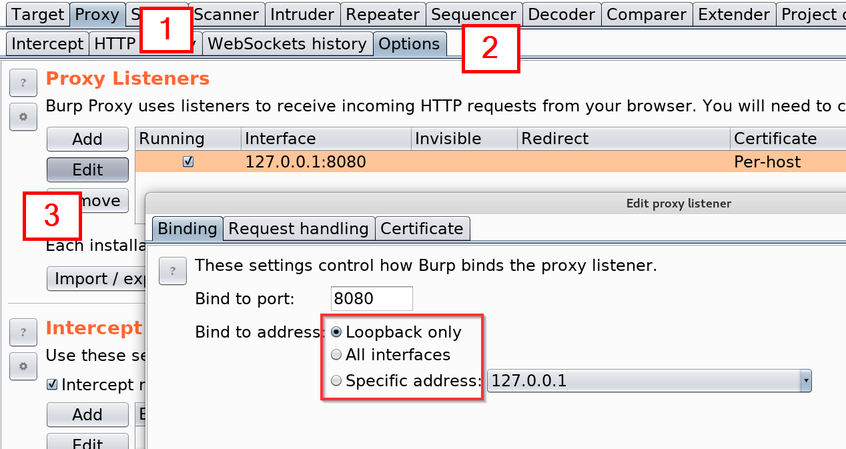
CONFIGURE PROXY
Notes:
This presentation covers two of the new attacks that are included in the 2017 OWASP top 10 that were not included in previous OWASP top 10 versions. The two we will cover are XML external entity and deserialization attacks. Both of these vulnerability types are covered from the perspective of creating, finding, exploiting, and fixing. We will also cover some information about deserialization attacks that will likely lead to further attacks in this category. Finally, we will discuss logging and inclusion of this test and how it affects application security testing.

Slide 16
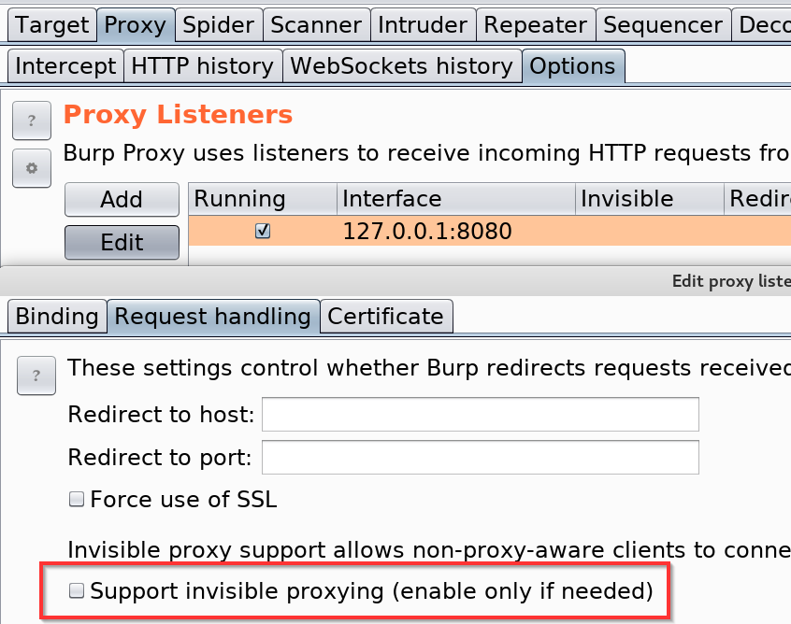
CONFIGURE PROXY IOT/MOBILE
Notes:
This presentation covers two of the new attacks that are included in the 2017 OWASP top 10 that were not included in previous OWASP top 10 versions. The two we will cover are XML external entity and deserialization attacks. Both of these vulnerability types are covered from the perspective of creating, finding, exploiting, and fixing. We will also cover some information about deserialization attacks that will likely lead to further attacks in this category. Finally, we will discuss logging and inclusion of this test and how it affects application security testing.

Slide 17
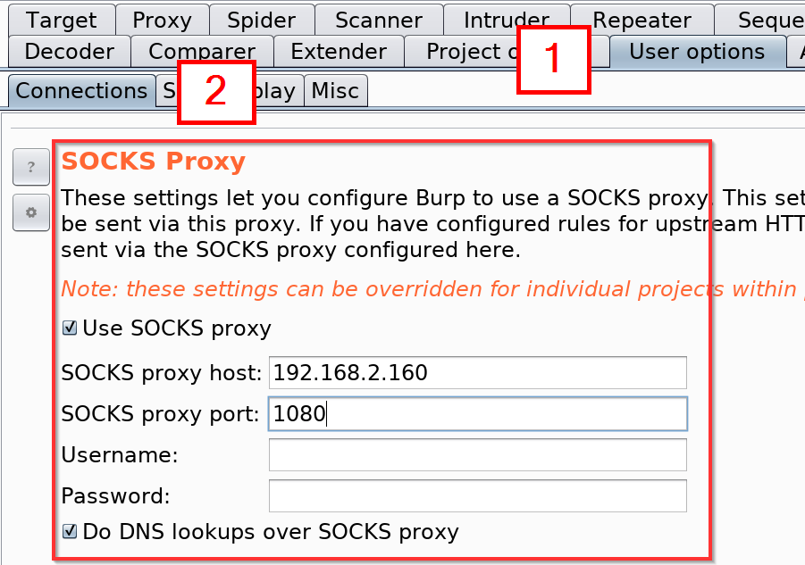
CONFIGURE UPSTREAM PROXY
Notes:
This presentation covers two of the new attacks that are included in the 2017 OWASP top 10 that were not included in previous OWASP top 10 versions. The two we will cover are XML external entity and deserialization attacks. Both of these vulnerability types are covered from the perspective of creating, finding, exploiting, and fixing. We will also cover some information about deserialization attacks that will likely lead to further attacks in this category. Finally, we will discuss logging and inclusion of this test and how it affects application security testing.

Slide 18
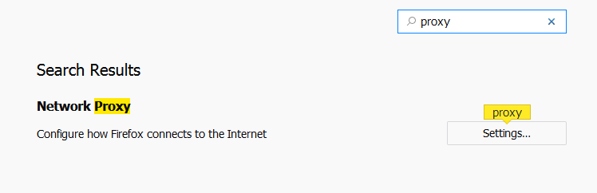
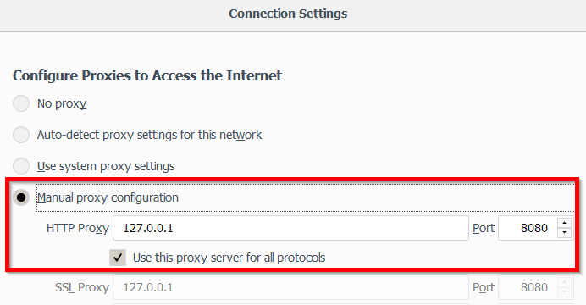
CONFIGURE BROWSER PROXY
Notes:
This presentation covers two of the new attacks that are included in the 2017 OWASP top 10 that were not included in previous OWASP top 10 versions. The two we will cover are XML external entity and deserialization attacks. Both of these vulnerability types are covered from the perspective of creating, finding, exploiting, and fixing. We will also cover some information about deserialization attacks that will likely lead to further attacks in this category. Finally, we will discuss logging and inclusion of this test and how it affects application security testing.

Slide 19
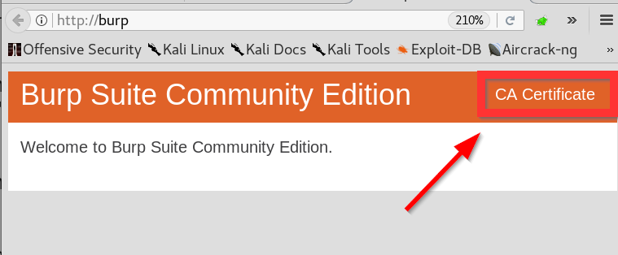
CONFIGURE CERTIFICATE
Configure proxy first
Browse to http://burp
Save certificate
Notes:
This presentation covers two of the new attacks that are included in the 2017 OWASP top 10 that were not included in previous OWASP top 10 versions. The two we will cover are XML external entity and deserialization attacks. Both of these vulnerability types are covered from the perspective of creating, finding, exploiting, and fixing. We will also cover some information about deserialization attacks that will likely lead to further attacks in this category. Finally, we will discuss logging and inclusion of this test and how it affects application security testing.

Slide 20
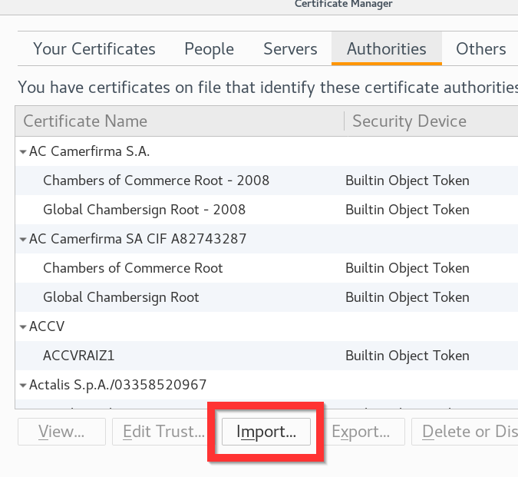
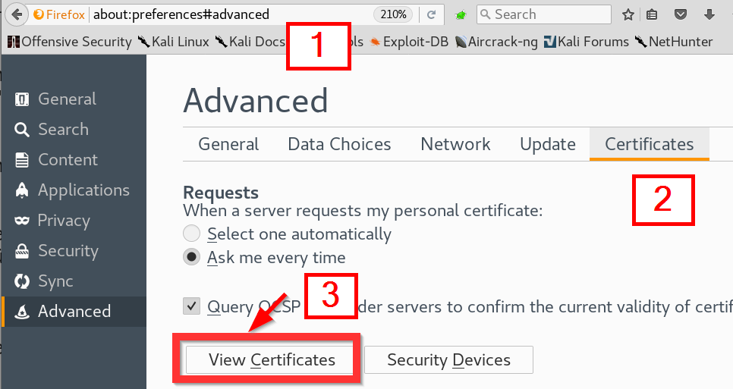
CONFIGURE CERTIFICATE
Notes:
This presentation covers two of the new attacks that are included in the 2017 OWASP top 10 that were not included in previous OWASP top 10 versions. The two we will cover are XML external entity and deserialization attacks. Both of these vulnerability types are covered from the perspective of creating, finding, exploiting, and fixing. We will also cover some information about deserialization attacks that will likely lead to further attacks in this category. Finally, we will discuss logging and inclusion of this test and how it affects application security testing.

Slide 21
TARGET
Found pages
Visited pages
Found vulnerabilities
Request log
Notes:
This presentation covers two of the new attacks that are included in the 2017 OWASP top 10 that were not included in previous OWASP top 10 versions. The two we will cover are XML external entity and deserialization attacks. Both of these vulnerability types are covered from the perspective of creating, finding, exploiting, and fixing. We will also cover some information about deserialization attacks that will likely lead to further attacks in this category. Finally, we will discuss logging and inclusion of this test and how it affects application security testing.

Slide 22
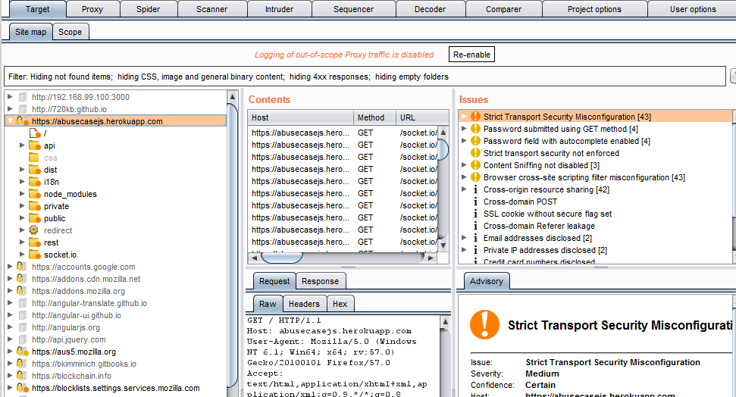
TARGET
Notes:
This presentation covers two of the new attacks that are included in the 2017 OWASP top 10 that were not included in previous OWASP top 10 versions. The two we will cover are XML external entity and deserialization attacks. Both of these vulnerability types are covered from the perspective of creating, finding, exploiting, and fixing. We will also cover some information about deserialization attacks that will likely lead to further attacks in this category. Finally, we will discuss logging and inclusion of this test and how it affects application security testing.

Slide 23
SCOPE
Defines where to focus tools
Use the app first
Can use regex
Some tools have options for their own scope
Notes:
This presentation covers two of the new attacks that are included in the 2017 OWASP top 10 that were not included in previous OWASP top 10 versions. The two we will cover are XML external entity and deserialization attacks. Both of these vulnerability types are covered from the perspective of creating, finding, exploiting, and fixing. We will also cover some information about deserialization attacks that will likely lead to further attacks in this category. Finally, we will discuss logging and inclusion of this test and how it affects application security testing.

Slide 24
SPIDER
Crawls links
USE THE APP FIRST
Sometimes fails on newer apps
Be careful with POSTs
Notes:
This presentation covers two of the new attacks that are included in the 2017 OWASP top 10 that were not included in previous OWASP top 10 versions. The two we will cover are XML external entity and deserialization attacks. Both of these vulnerability types are covered from the perspective of creating, finding, exploiting, and fixing. We will also cover some information about deserialization attacks that will likely lead to further attacks in this category. Finally, we will discuss logging and inclusion of this test and how it affects application security testing.

Slide 25
REPEATER
Use “Send to Repeater”
Tinker with requests
Most frequently used tab
Can use current cookies
Notes:
This presentation covers two of the new attacks that are included in the 2017 OWASP top 10 that were not included in previous OWASP top 10 versions. The two we will cover are XML external entity and deserialization attacks. Both of these vulnerability types are covered from the perspective of creating, finding, exploiting, and fixing. We will also cover some information about deserialization attacks that will likely lead to further attacks in this category. Finally, we will discuss logging and inclusion of this test and how it affects application security testing.

Slide 26
SCANNER
DAST functionality
Active and passive scanning
Great for Stored XSS, SQLi
Notes:
This presentation covers two of the new attacks that are included in the 2017 OWASP top 10 that were not included in previous OWASP top 10 versions. The two we will cover are XML external entity and deserialization attacks. Both of these vulnerability types are covered from the perspective of creating, finding, exploiting, and fixing. We will also cover some information about deserialization attacks that will likely lead to further attacks in this category. Finally, we will discuss logging and inclusion of this test and how it affects application security testing.

Slide 27
INTRUDER
Mass request automation
Set insertion points
Send payloads from lists
Notes:
This presentation covers two of the new attacks that are included in the 2017 OWASP top 10 that were not included in previous OWASP top 10 versions. The two we will cover are XML external entity and deserialization attacks. Both of these vulnerability types are covered from the perspective of creating, finding, exploiting, and fixing. We will also cover some information about deserialization attacks that will likely lead to further attacks in this category. Finally, we will discuss logging and inclusion of this test and how it affects application security testing.

Slide 28
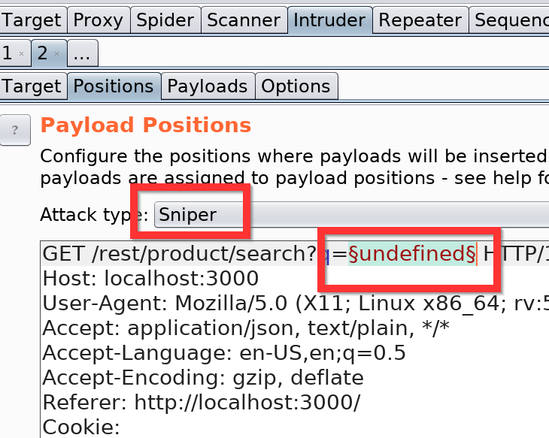
INTRUDER POSITIONS
Sniper
Send list to each insertion point in series
Battering Ram
Send list to each point at the same time
Notes:
This presentation covers two of the new attacks that are included in the 2017 OWASP top 10 that were not included in previous OWASP top 10 versions. The two we will cover are XML external entity and deserialization attacks. Both of these vulnerability types are covered from the perspective of creating, finding, exploiting, and fixing. We will also cover some information about deserialization attacks that will likely lead to further attacks in this category. Finally, we will discuss logging and inclusion of this test and how it affects application security testing.

Slide 29
INTRUDER POSITIONS
Pitchfork
Multiple lists
Each point at the same time
Cluster Bomb
Multiple lists
Cartesian join
Notes:
This presentation covers two of the new attacks that are included in the 2017 OWASP top 10 that were not included in previous OWASP top 10 versions. The two we will cover are XML external entity and deserialization attacks. Both of these vulnerability types are covered from the perspective of creating, finding, exploiting, and fixing. We will also cover some information about deserialization attacks that will likely lead to further attacks in this category. Finally, we will discuss logging and inclusion of this test and how it affects application security testing.

Slide 30
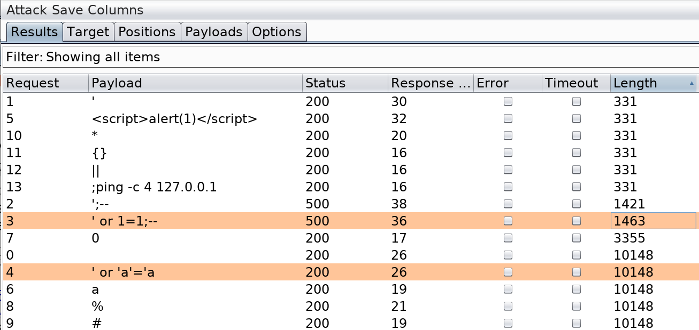
INTRUDER SCANNING
Notes:
This presentation covers two of the new attacks that are included in the 2017 OWASP top 10 that were not included in previous OWASP top 10 versions. The two we will cover are XML external entity and deserialization attacks. Both of these vulnerability types are covered from the perspective of creating, finding, exploiting, and fixing. We will also cover some information about deserialization attacks that will likely lead to further attacks in this category. Finally, we will discuss logging and inclusion of this test and how it affects application security testing.

Slide 31
SEQUENCER
Check randomness
Frequency analysis
Custom crypto
Custom tokens
Notes:
This presentation covers two of the new attacks that are included in the 2017 OWASP top 10 that were not included in previous OWASP top 10 versions. The two we will cover are XML external entity and deserialization attacks. Both of these vulnerability types are covered from the perspective of creating, finding, exploiting, and fixing. We will also cover some information about deserialization attacks that will likely lead to further attacks in this category. Finally, we will discuss logging and inclusion of this test and how it affects application security testing.

Slide 32
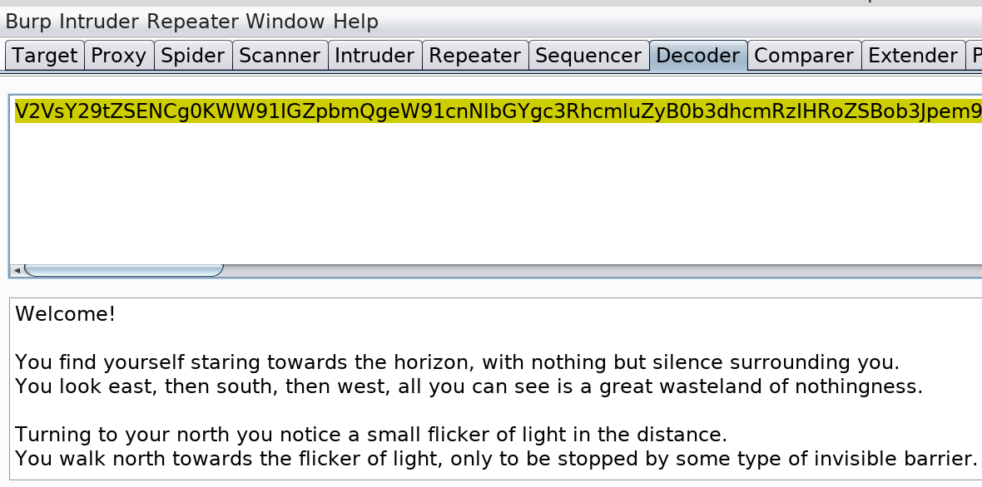
DECODER
Handle common encoding/decoding
Base64
URI
Unicode
ASCII
Gzip
Notes:
This presentation covers two of the new attacks that are included in the 2017 OWASP top 10 that were not included in previous OWASP top 10 versions. The two we will cover are XML external entity and deserialization attacks. Both of these vulnerability types are covered from the perspective of creating, finding, exploiting, and fixing. We will also cover some information about deserialization attacks that will likely lead to further attacks in this category. Finally, we will discuss logging and inclusion of this test and how it affects application security testing.

Slide 33
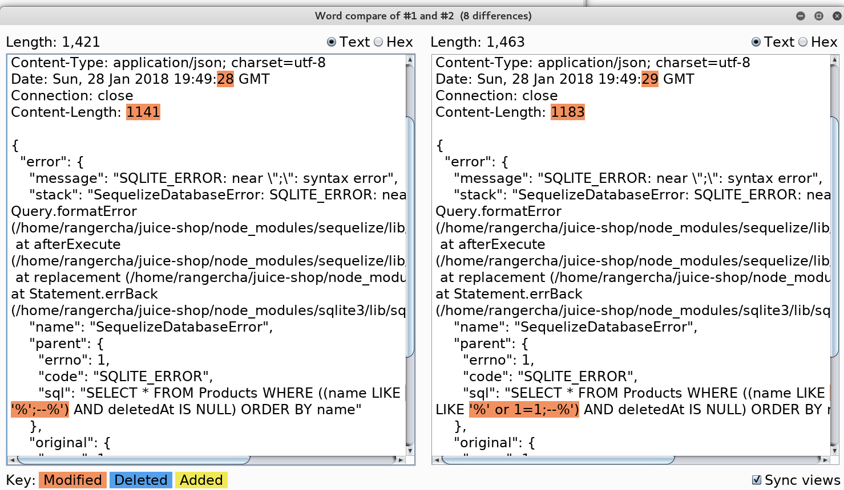
COMPARER
Notes:
This presentation covers two of the new attacks that are included in the 2017 OWASP top 10 that were not included in previous OWASP top 10 versions. The two we will cover are XML external entity and deserialization attacks. Both of these vulnerability types are covered from the perspective of creating, finding, exploiting, and fixing. We will also cover some information about deserialization attacks that will likely lead to further attacks in this category. Finally, we will discuss logging and inclusion of this test and how it affects application security testing.

Slide 34
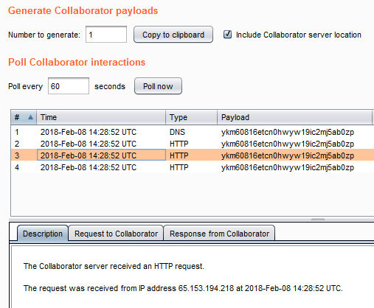
COLLABORATOR
Notes:
This presentation covers two of the new attacks that are included in the 2017 OWASP top 10 that were not included in previous OWASP top 10 versions. The two we will cover are XML external entity and deserialization attacks. Both of these vulnerability types are covered from the perspective of creating, finding, exploiting, and fixing. We will also cover some information about deserialization attacks that will likely lead to further attacks in this category. Finally, we will discuss logging and inclusion of this test and how it affects application security testing.

Slide 35
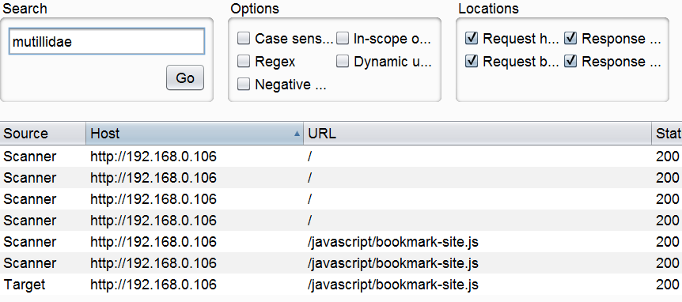
SEARCH
Notes:
This presentation covers two of the new attacks that are included in the 2017 OWASP top 10 that were not included in previous OWASP top 10 versions. The two we will cover are XML external entity and deserialization attacks. Both of these vulnerability types are covered from the perspective of creating, finding, exploiting, and fixing. We will also cover some information about deserialization attacks that will likely lead to further attacks in this category. Finally, we will discuss logging and inclusion of this test and how it affects application security testing.

Slide 36
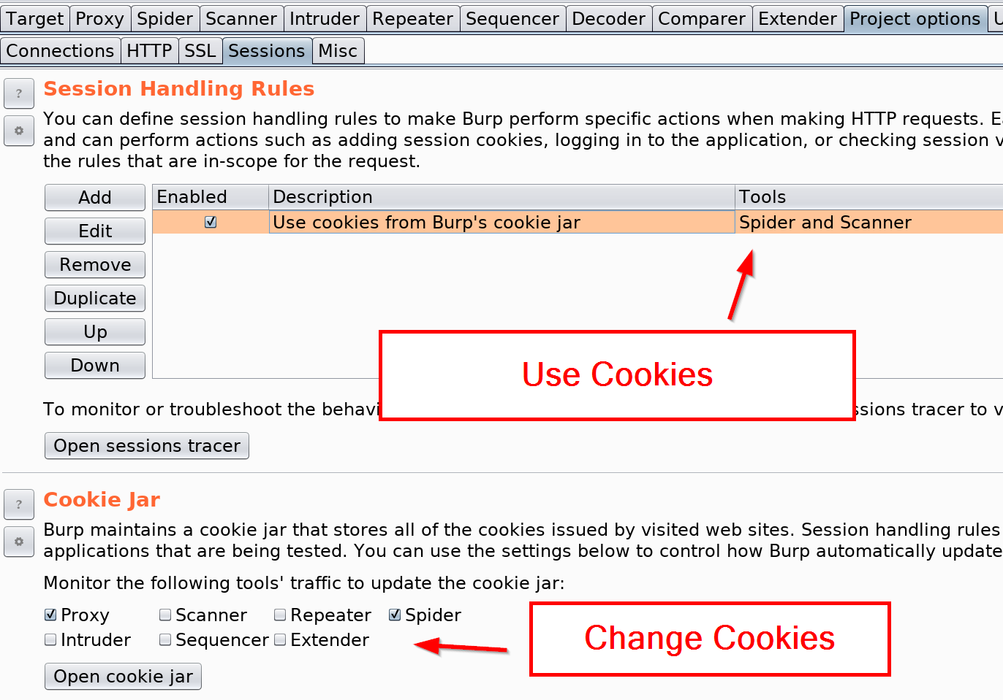
SESSION HANDLING
Project | Options
Controls cookies
Notes:
This presentation covers two of the new attacks that are included in the 2017 OWASP top 10 that were not included in previous OWASP top 10 versions. The two we will cover are XML external entity and deserialization attacks. Both of these vulnerability types are covered from the perspective of creating, finding, exploiting, and fixing. We will also cover some information about deserialization attacks that will likely lead to further attacks in this category. Finally, we will discuss logging and inclusion of this test and how it affects application security testing.

Slide 37
AUTOMATED AUTHENTICATION
Detect session death
Reauthenticate
Site must set cookie
Auth header not supported
Notes:
This presentation covers two of the new attacks that are included in the 2017 OWASP top 10 that were not included in previous OWASP top 10 versions. The two we will cover are XML external entity and deserialization attacks. Both of these vulnerability types are covered from the perspective of creating, finding, exploiting, and fixing. We will also cover some information about deserialization attacks that will likely lead to further attacks in this category. Finally, we will discuss logging and inclusion of this test and how it affects application security testing.

Slide 38
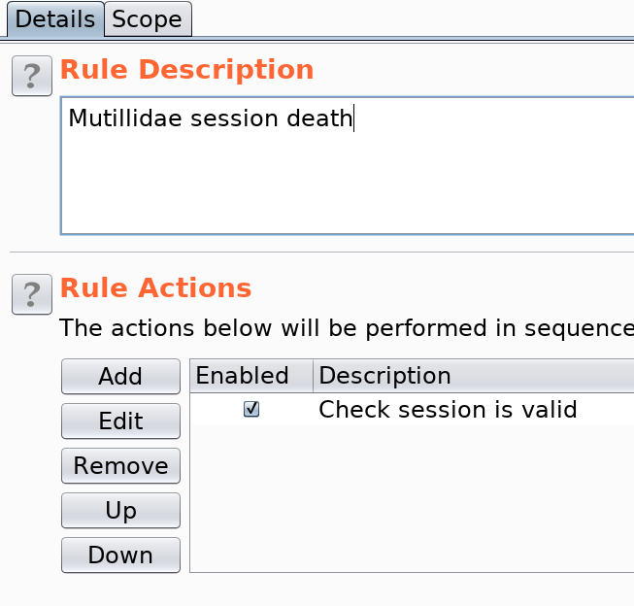
AUTOMATED AUTHENTICATION
Create macros
Session death
Authentication
Create session handling rule
Set Scope
Notes:
This presentation covers two of the new attacks that are included in the 2017 OWASP top 10 that were not included in previous OWASP top 10 versions. The two we will cover are XML external entity and deserialization attacks. Both of these vulnerability types are covered from the perspective of creating, finding, exploiting, and fixing. We will also cover some information about deserialization attacks that will likely lead to further attacks in this category. Finally, we will discuss logging and inclusion of this test and how it affects application security testing.

Slide 39
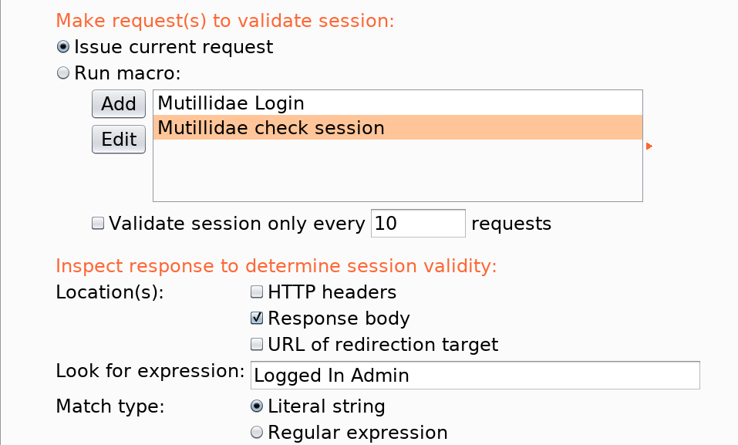
AUTOMATED AUTHENTICATION
Notes:
This presentation covers two of the new attacks that are included in the 2017 OWASP top 10 that were not included in previous OWASP top 10 versions. The two we will cover are XML external entity and deserialization attacks. Both of these vulnerability types are covered from the perspective of creating, finding, exploiting, and fixing. We will also cover some information about deserialization attacks that will likely lead to further attacks in this category. Finally, we will discuss logging and inclusion of this test and how it affects application security testing.

Slide 40
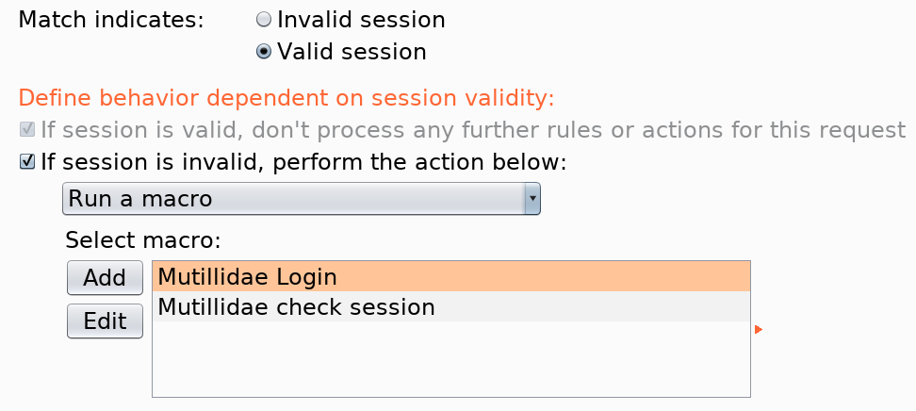
AUTOMATED AUTHENTICATION
Notes:
This presentation covers two of the new attacks that are included in the 2017 OWASP top 10 that were not included in previous OWASP top 10 versions. The two we will cover are XML external entity and deserialization attacks. Both of these vulnerability types are covered from the perspective of creating, finding, exploiting, and fixing. We will also cover some information about deserialization attacks that will likely lead to further attacks in this category. Finally, we will discuss logging and inclusion of this test and how it affects application security testing.

Slide 41
EXTENSIONS
Java, Python, or Ruby
Active & passive checks
Request / response manipulation
Logging
External app interaction
Notes:
This presentation covers two of the new attacks that are included in the 2017 OWASP top 10 that were not included in previous OWASP top 10 versions. The two we will cover are XML external entity and deserialization attacks. Both of these vulnerability types are covered from the perspective of creating, finding, exploiting, and fixing. We will also cover some information about deserialization attacks that will likely lead to further attacks in this category. Finally, we will discuss logging and inclusion of this test and how it affects application security testing.

Slide 42
EXTENSIONS
CO2
Paramalyzer
Retire.js
J2EE
SuperSerial
Notes:
This presentation covers two of the new attacks that are included in the 2017 OWASP top 10 that were not included in previous OWASP top 10 versions. The two we will cover are XML external entity and deserialization attacks. Both of these vulnerability types are covered from the perspective of creating, finding, exploiting, and fixing. We will also cover some information about deserialization attacks that will likely lead to further attacks in this category. Finally, we will discuss logging and inclusion of this test and how it affects application security testing.

Slide 43
www.directdefense.com

