Slide 1
Start-Up Code
Interrupt Code
Main Loop Code
Initialization of Cold Start Variables
-------------------------------------------
At power-on, ECT is used to index
into the current map’s 3 row x 12 col
table to obtain 2 values.
Value from 2nd row is the fuel value
and is stored at address $009B
Value from 3rd row is the time based
fuel component stored at $009C
This is an expansion of the cold start
fuel calculation (block 36) in the
spark interrupt flow chart.
A cranking but not running condition
is defined by RPM less than 505
(later reduced to 375 RPM) with
started-bit not set. Once bit is set,
RPM can dip below this value and
not reset to starting condition.
This is an expansion of block 21 on
the Main Loop Flowchart. This runs
asynchronously to the spark interrupt.
-------------------------------------------
Just before the ADC measurement
and service routine, the subroutine
described below is called.
Compare count from ECT sensor
with value from address $C0DB.
Note that this address points to the
coldest entry in the default 3 x 12
table and not the 3 x 12 of the current
fuel map. For tune R3526, this value
is $EC which represents about
0 deg F.
Injector Chattering Subroutine
--------------------------------------
Test bank indicator bit and service
opposite bank. (this is because the
bank indicator bit is toggled before
the interrupt terminates, so it is
pointing to the wrong bank)
Colder than value
at $C0DB ??
Are injectors open
for this bank?
NO
NO
Return from
subroutine
YES
YES
Set up Injectors for Chattering
-------------------------------------
Calculate a fuel value based strictly
on RPM and current fuel map.
Maps 1 and 5 use a multiplier of
$0A (later changed to $12) while
maps 2, 3 and 4 use value $07.
This value is multiplied by the MSB
of the spark period (which increases
as RPM decreases). Result is
lower limited to $05DC (1500 dec)
minimum. Value $14 is also written
To address $00A6 to control
chattering.
Finally, jump to D label on interrupt
flow chart (Phase 2 Compensation)
Is the value in
$00A6 zero?
YES
Return from
subroutine
NO
Decrement counter value in $00A6
Is lsb of $00A6
zero or one?
one
zero
Calculate cranking fuel pulse based
on ECT sensor count using 3 x 12
table from current fuel map.
Check TPS position and adjust pulse
if throttle is depressed. This may
be for flooded engine condition.
Shut OFF
injector
Turn ON
injector
Phase 2 Compensation
(see Spark Interrupt Flowchart)
14CUX Cranking Fuel Flowchart 10/27/2013 Rev 0 dhb

Slide 2
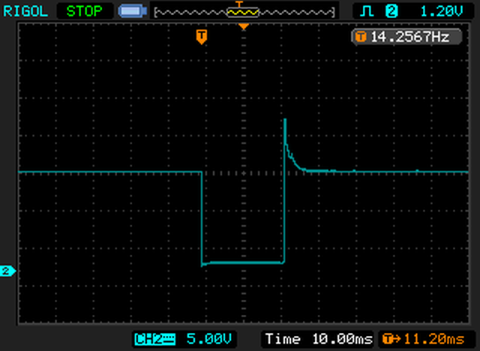
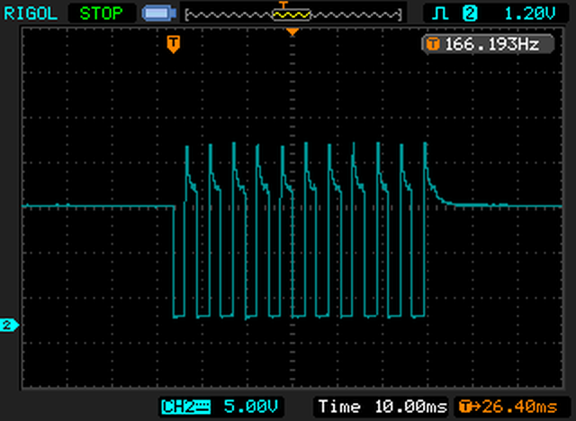
Normal cranking fuel pulse
Notes:
1- ECT sensor count set to $EB (approx 0 deg F)
2- Pulse is calculated from 2nd row of 3 x 12 table (last column is used for this example)
3- Tune R3526 was used, having $EC in last temperature location of 3 x 12 table. (address $C0DB)
Chattering cranking fuel pulse
Notes:
1- ECT sensor count set to $EC (approx –1 deg F).
2- Pulse width calculation based solely on engine cranking RPM (1500 minimum).
3- Tune R3526 was used, having $EC in last temperature location of 3 x 12 table. (address $C0DB)
4- Number of pulses is controlled by value in $00A6 (20 dec = 11 pulses)
14CUX Cranking Fuel Flowchart 10/27/2013 Rev 0 dhb

