Slide 1
Road Speed Service Routine
This is called in the main loop after each time the ADC measures channel 7 (VSS signal).
A
Is road speed zero?
Is
temp value greater
than $C8?
1) Store 8-bit ADC value in
temporary memory location
X00C8. The 8-bit convert is
overkill since we need to know
only if the VSS signal is high
or low.
YES
NO
NO
YES
6) Increment value in $207D
When value reaches value in
C258 clear VSS fail bit (if set)
12) Road Speed Over Limit
---
Set $008B.7 bit high
2) Load Timer Overflow Counter
This variable is incremented
each time the free running
1 uSec counter overflows the
16-bit counter register.
This is approx. every 65 mSec.
7) Clear fault counter
8) Reset Road Speed Counters
---------------------------------------
Clear timerOverflow2.
Clear vssStateCounter.
14) Road Speed is OK
-------------------------------------
Set $008B.7 bit low
Increment $2002 up-counter
Increment 16-bit counter at $2049
($2049 pertains to unused fault
code 26 – very lean mixture)
Equals
13
Compare counter
counter with 13
Greater
than 13
8a) Decrement A/C Counter
(not in TVR code)
Startup delay for A/C. This is
decremented at approx 1 Hz.
Less than 13
15) Load latest O2 reading into
the B accumulator
3) Update Road Speed.
Check high road speed indicator.
This is set in ICI when road
speed exceeds 122 MPH.
(see ICI block 52)
9) Condition the Idle Bit
Road Speed >= 4 KPH?
If yes, set idle related bit.
If no, clear idle related bit.
16) Return
High road
speed indicator
set?
Is road speed
value zero?
YES
NO
NO
YES
4a)
Write Actual Road Speed
---
Copy transition counter
to road speed variable
10) Fault Code 68 (VSS Test)
---
Abort test if MAF < 3.0 volts.
Abort test if engine speed is
outside the range of 2250 to
3600 RPM (note that older code
used a low limit of 2100 RPM)
If still here, increment a counter
and compare it with the 16-bit
value in $C0CE/CF. When value
is met, set 3 fail indicator bits:
$004C.6 (sets MIL)
$0088.1 (used by purge valve)
$2047.2 (used by stepper motor)
abort
4b)
Write False Road Speed
---
Limit road speed to
176 KPH (109 MPH).
For NAS D90:
150 KPH (93 MPH)
A
11) Clear fault delay counter
Go To A
14CUX Road Speed Flowchart 03/17/2014 Rev 0 dhb

Slide 2
Road Speed Comparator Test
This routine is called from 8 different places in the Spark Interrupt. The comparator mode of the HD46508 (ADC) is used to attempt detection of every high to low transition of the VSS square wave.
Speed Limit Indicator (ICI Block 52)
This is an expanded version of block 52 in the ICI flowchart. Two separate indicators are used for this. A single bit is used as is normally done, however a full byte is also used. This byte is either set to $AA or cleared to $00. The reason two indicators are used is unknown (and probably unnecessary).
Comparator Measurement
----------------------------------------
1) Load $27 into ADC control
register 1
(comparator mode, channel 7)
2) Load $C8 (high/low threshold)
into R4 register
3) Wait for busy-bit
4) Test comparator result bit
Compare road speed with
limit below
NAS D90: 175 KPH (109 MPH)
Others: 196 KPH (122 MPH)
Is VSS signal
high or low?
Is road speed
above limit?
Yes
No
High
Low
Set speed limit bit (2004.0)
Write $AA to Speed Limit
Indicator
(original address X202B)
Subtract additional margin from
road speed.
NAS D90: 7 KPH
Others: 4 KPH
Set level bit high
Return from
subroutine
Is level bit
already low?
Is road speed
below margin?
Yes
No
No
Yes
Increment VSS
transition
counter
Clear speed limit bit (2004.0)
Write $00 to Speed Limit
Indicator
(original address X202B)
Increment
Fault Code 26 Counter
(unused fault)
Next code section in ICI
Return from
subroutine
14CUX Road Speed Flowchart 03/17/2014 Rev 0 dhb

Slide 3
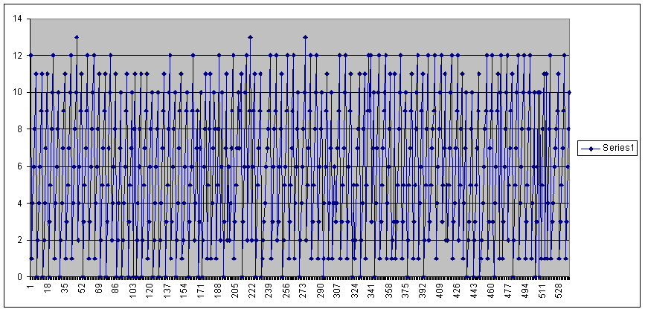
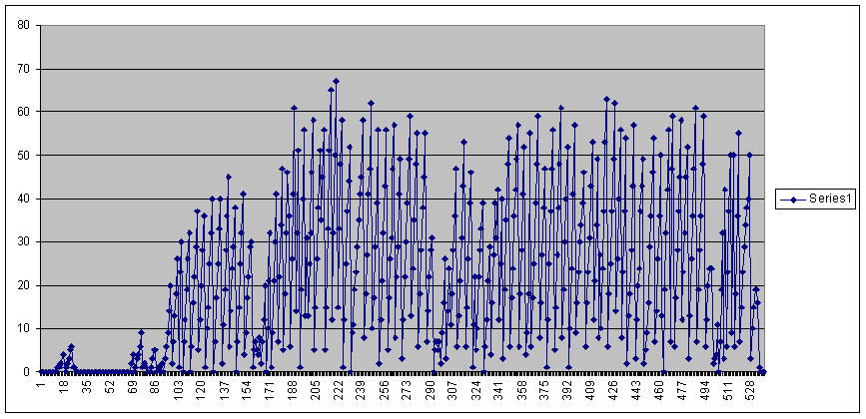
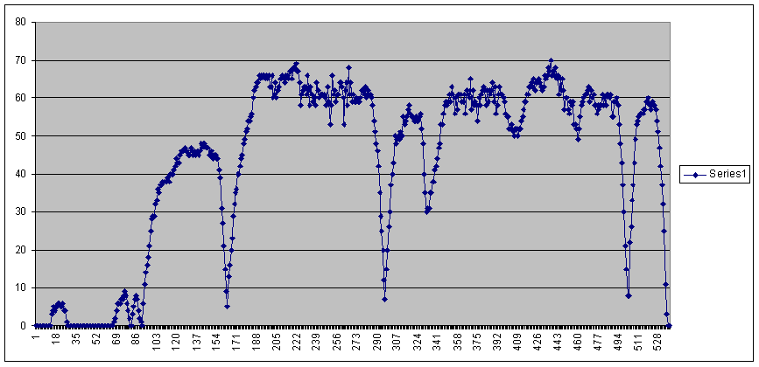
Note that in the graphs below, data samples were taken at 1 second intervals.
Timer overflow counts from zero to 14 and is reset to zero (value 14 cannot be captured). Value increments once every 65 mSec.
The VSS state counter increments each time a high to low transition is detected. At higher road speeds (and higher VSS frequency), the counter reaches a greater number before being written as road speed and then reset.
The VSS state counter is saved as Road Speed (KPH) at regular periodic intervals. It also appears as the outlined envelope of the state counter.
14CUX Road Speed Flowchart 03/17/2014 Rev 0 dhb

