Slide 1
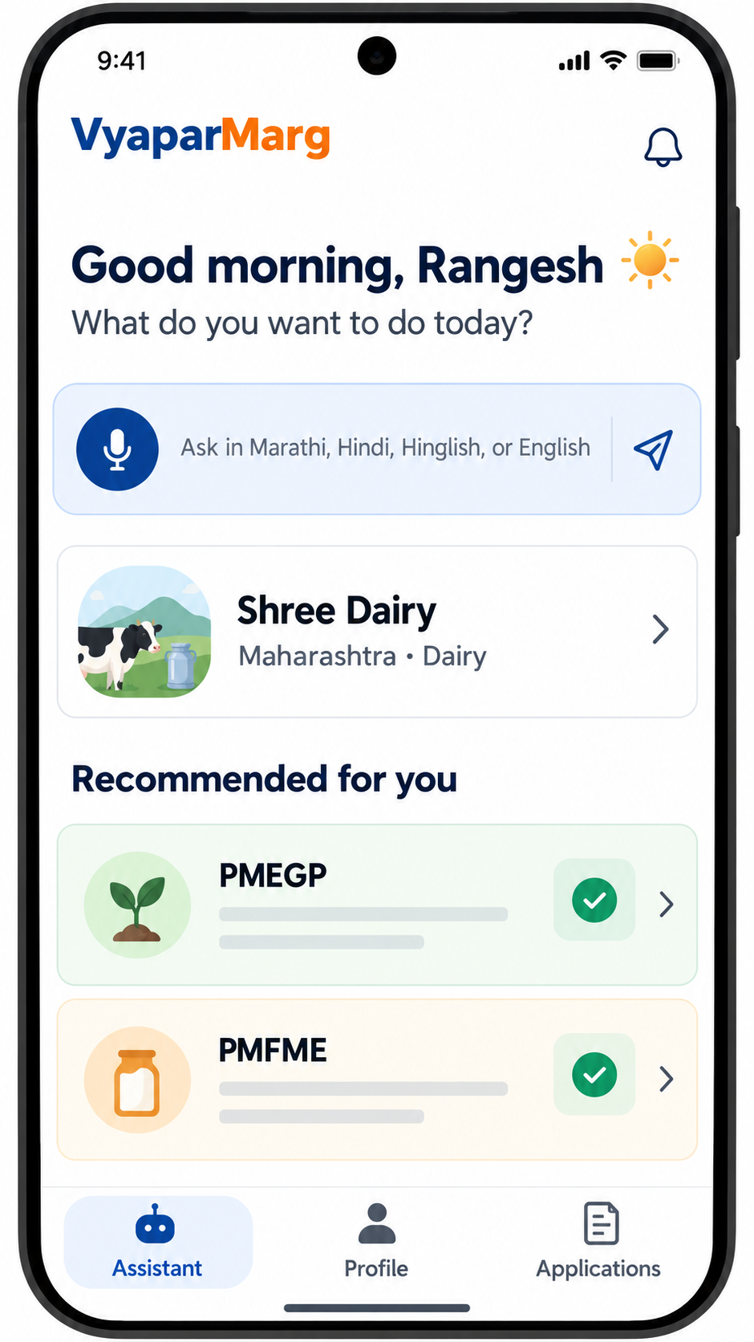
VyaparMarg
Rural business assistance, redesigned for the way micro-entrepreneurs actually work.
A trusted digital companion for rural entrepreneurs
Multilingual assistant â€¢ Explainable recommendations â€¢ Guided applications
IDEA LAB-III | Department of Computer Engineering
Rangesh Gupta | Roll No. 53 | SE CPMN A

Slide 2
The opportunity
Small businesses do not need more links. They need the right next step.
01 Discover
02 Understand
03 Act
Scheme information is scattered across portals, PDFs and offices.
Eligibility language and process steps are difficult to interpret.
Users need a guided application journey, not just a recommendation.
Core challenge
Turn a voice question into a trustworthy, actionable business decision.

Slide 3
The product
One mobile-first experience from question to application plan.
Ask naturally
Marathi, Hindi, Hinglish or English voice and text.
Build context
Business profile captures type, location, turnover and goals.
Get clarity
Recommendations show reasons, score and missing requirements.
The interface feels like a helpful local guide - not a government form.

Slide 4
How it works
A simple four-step journey with a rules-backed decision layer.
1 ASK
>
2 PROFILE
>
3 MATCH
>
4 APPLY
Voice/text input
Structured profile
Deterministic rules
Portal steps + progress
AI explains. Structured data and rules decide.

Slide 5
Product architecture
Clear boundaries keep the experience helpful, secure and testable.
Mobile app
FastAPI
Decision layer
Expo / React Native UI for assistant, profile and applications.
>
Authenticated REST contract under /api/v1.
>
Verified schemes, requirements, rules and recommendations.
Supabase Auth + Postgres + RLS
Explainable response
User-owned profiles, conversations, recommendations, applications and document metadata.
Score, reasons, eligibility status and missing information return to the user.

Slide 6
What makes it different
Designed around trust, inclusion and action.
Local-language by default
Explainable recommendations
The user can ask in the language they think in.
Every match comes with a reason - and a clear gap to fix.
Rules-backed decisions
Application continuity
The LLM explains; deterministic rules evaluate eligibility.
The user does not lose momentum between discovery and portal action.
Better access is not only better UX - it is better decision support.

Slide 7
Technical foundation
A practical first slice built for reliability.
Frontend
Backend
Data
Expo / React Native
Mobile-first screens
Voice + text interaction
FastAPI
Authenticated endpoints
Explicit error format
Supabase Auth
Postgres + RLS
Storage metadata
Quality bar: explicit errors, testable contracts, server-side service credentials and no secret keys in client apps.

Slide 8
Roadmap
Start with clarity. Scale with evidence.
NOW
>
NEXT
>
SCALE
>
IMPACT
Core vertical slice
Offline + documents
More schemes + dialects
Outcomes + partnerships

Slide 9

Team & contributions
Replace the placeholders with each teammate's name, role and screenshot.
Rangesh Gupta
Roll No. 53 | SE CPMN A
Product concept, mobile UX and project integration
Team member 2
Team member 3
Team member 4
Name / roll no.
Role / contribution
Add project screenshot
Name / roll no.
Role / contribution
Add project screenshot
Name / roll no.
Role / contribution
Add project screenshot

Slide 10
Thank you
VyaparMarg - making the next business step easier to see.
Questions?
Rangesh Gupta | Roll No. 53 | SE CPMN A

