Slide 1


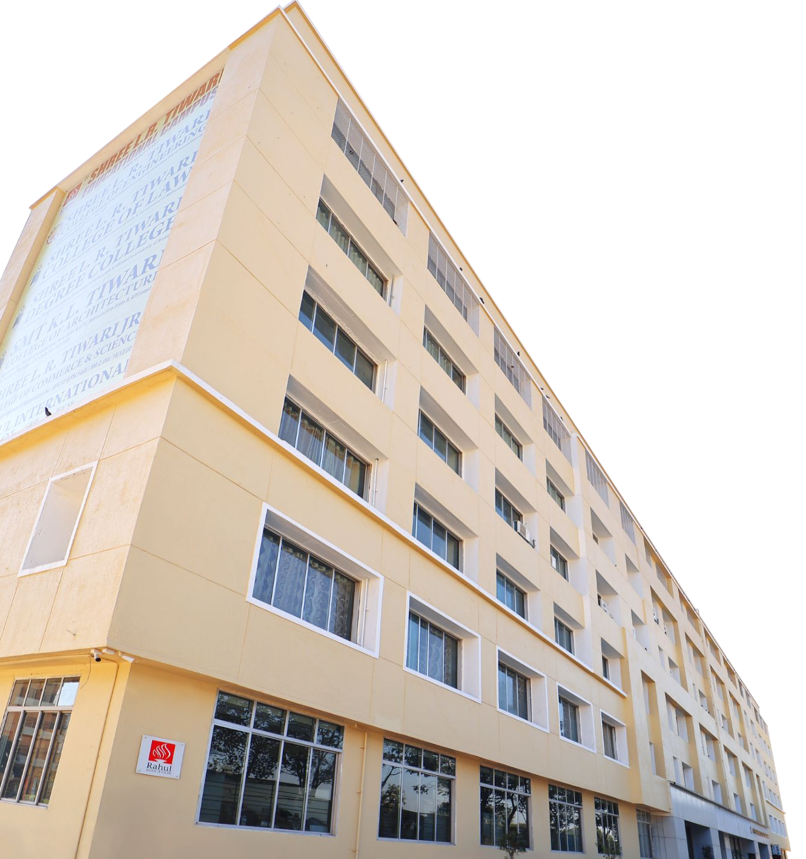
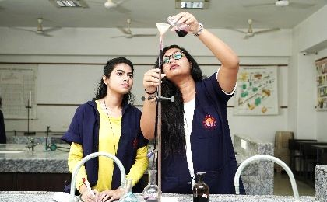
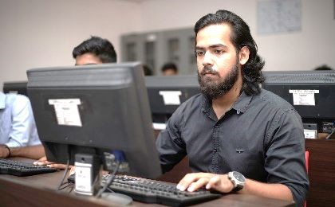
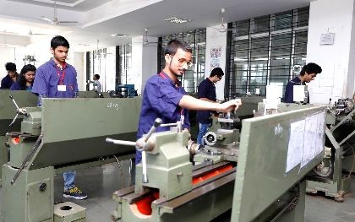
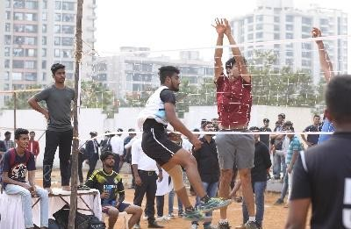
Department of Computer Engineering
(Academic Year: 2026-27)
IDEA LAB-III
(Innovation Design Engineering and Apply) | Course code: 12812310
Theme
VyaparMarg: A Rural Business Assistant for Micro-Entrepreneurs
Presented by: Rangesh Gupta
Roll No: 53 | SE CPMN A
06-10-2025
www.slrtce.in
1

Slide 2
Presentation roadmap
1. Problem statement
2. Problem definition
3. Abstract and introduction
4. Literature review
5. Existing system
6. Proposed solution and workflow
7. Objectives and technical requirements
8. Future scope
9. Team members and contributions
10. Conclusion
www.slrtce.in

Slide 3
Problem statement
Fragmented information
Language barrier
Government schemes, eligibility rules and portals are difficult to discover in one place.
Many micro-entrepreneurs prefer Marathi, Hindi or Hinglish over English-first digital journeys.
Unclear next steps
Users need explainable recommendations and assisted applications, not just a list of links.
Core challenge: turn a voice question into a trustworthy, actionable business decision.

Slide 4
Problem definition
For a rural micro-entrepreneur, finding the right scheme currently means switching between search engines, PDFs, offices and portals.

Slide 5
Abstract

Slide 6
Introduction

Slide 7
Literature review
Sr.No | Title of the paper | Author/Year | Methodology | Research Gap | Advantages | Disadvantages/Limitations | Future Scope
1 | An Empirical Study on Digital Readiness and Online Visibility Challenges of Micro Businesses in Maharashtra | Naik & Pawar / 2025 | Descriptive & correlational design; quantitative survey of 150 micro-enterprises using structured questionnaires; statistical analysis. | Limited integrated evidence on digital readiness, online visibility, cost perception and adoption barriers in Maharashtra micro-businesses. | Maharashtra-specific empirical evidence; measurable adoption barriers. | Self-reported survey data; regional scope; focuses on digital marketing rather than end-to-end business assistance. | Targeted digital-inclusion strategies, training and support for micro-enterprises.
2 | Inclusive Voice-AI for Rural India: A Deep Learning Framework for Dialectal and Low-Resource Adaptation | Srivastava, U.K. Srivastava & Arora / 2026 | Modular framework using Wav2Vec 2.0, IndicBERT, dialogue management, emotion-aware response generation, lightweight TTS; low-resource/edge optimization. | Scarcity of annotated dialect corpora and limited integration of sociocultural context in rural voice-AI. | Multilingual, context-aware and low-resource design; considers low bandwidth. | Many evaluation results are simulated; field validation was still in progress. | Expand dialects; personalize responses; add multimodal interaction and broader field validation.
3 | E-Commerce and Last Mile Delivery Optimization | Kannaa & Durgalakshmi / 2024 | Secondary-data literature review, purposive case-study selection and simulation of routing, delivery windows, pickup points and sustainability strategies. | Need scalable, integrated last-mile strategies balancing cost, speed, customer flexibility and sustainability, especially under rural constraints. | Covers ACO/route optimization, pickup points, scheduling and AI-driven delivery planning. | Technology cost, regulatory barriers and differing urban/rural conditions can limit adoption. | Develop adaptable, scalable optimization combining routing, flexible delivery and greener transport.
4 | Optimizing Decision Making in MSMEs through Business Intelligence Dashboards using Python and Power BI | Azka Raisa Subagio / 2026 | Quantitative-descriptive study using 1,980 secondary retail transactions; Python preprocessing/KPIs + Power BI dashboard; scenario-based before/after simulation. | Fragmented MSME data and limited decision support; need harmonized analytics and visualization. | Interactive KPI-based decision support; reported improvements in decision time and information accuracy. | Secondary international dataset; simulated evaluation; simple forecasting; Python/Power BI output discrepancies. | Use live MSME data, unified ETL, advanced forecasting and participatory field evaluation.
5 | Applying Transparent Shaping for Zero Trust Architecture Implementation in AWS: A Case Study | Wang, Sadjadi, Rishe & Mahara / 2024 | Case study integrating Transparent Shaping and Zero Trust in an AWS-hosted Online File Manager; security posture evaluated with Mozilla Observatory. | Need to add security controls to existing applications without extensive redevelopment. | Improves security while preserving core application logic; supports scalability and adaptability. | Manual implementation; limited security-analysis tooling; demonstrated in an AWS/OFM case context. | Automate Transparent Shaping/ZTA application and develop comprehensive security-analysis tools.

Slide 8
Existing system

Slide 9
Proposed solution

Slide 10
Objectives

Slide 11
Technical requirements

Slide 12
Future scope

Slide 13
Team members & contributions

Slide 14


www.slrtce.in
10

