Slide 1
VIDIO DATA ANALYST STUDY CASE
RANGGA PRANGWEDANA JANUWARSA

Slide 2
CONDITIONS FOR THE STUDY CASE
Dataset used is the sampling 1% plays dataset
The tools used are Spreadsheet/Excel, Anaconda Navigator (Jupyter Notebook and it’s libraries), and Tableau

Slide 3

FIRST QUESTION
Conduct 1 exploratory data analysis from this dataset and present the exploratory

Slide 4
SECOND QUESTION
After conducting the Exploratory Analysis, what kind of insight that you could extract from this datasets? If you could tell us a stories around this data, it is a plus

Slide 5
THIRD QUESTION
What kind of tools that you use to work on this dataset?

Slide 6
THE TOOLS USED
Excel / Spreadsheet
Anaconda Navigator
Jupyter Notebook
Tableau

Slide 7

EXCEL / SPREADSHEET
Basic
Excel, or Spreadsheet program in general, seems to be generic and basic for advanced field like data analytics.
... yet familiar
But people trust Excel. It’s familiar. It’s already on your computer. And it’s easy to figure out, even if you’ve never used it before.

Slide 8
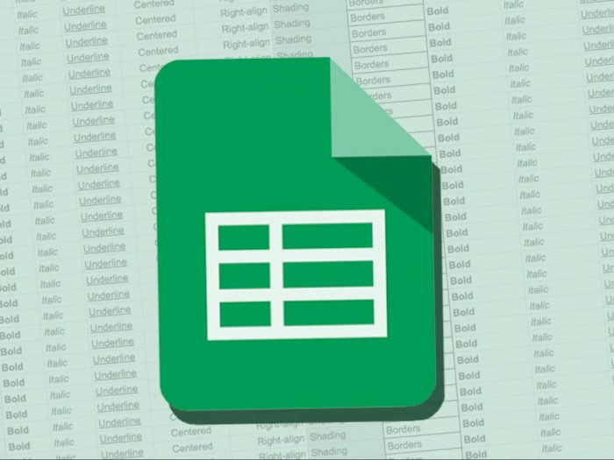
It’s not always compatible with big data, but it’s reliable and easy to view. And some company still required the employees have skill in Excel, regardless for data analytics or not.

Slide 9
ANACONDA NAVIGATOR
All in One
It comes pre-packaged with Spyder and Jupyter Notebook. You can also install more data applications like Visual Studio Code or R Studio.
... and easy
It is free and open-source. It’s also easy to install.

Slide 10
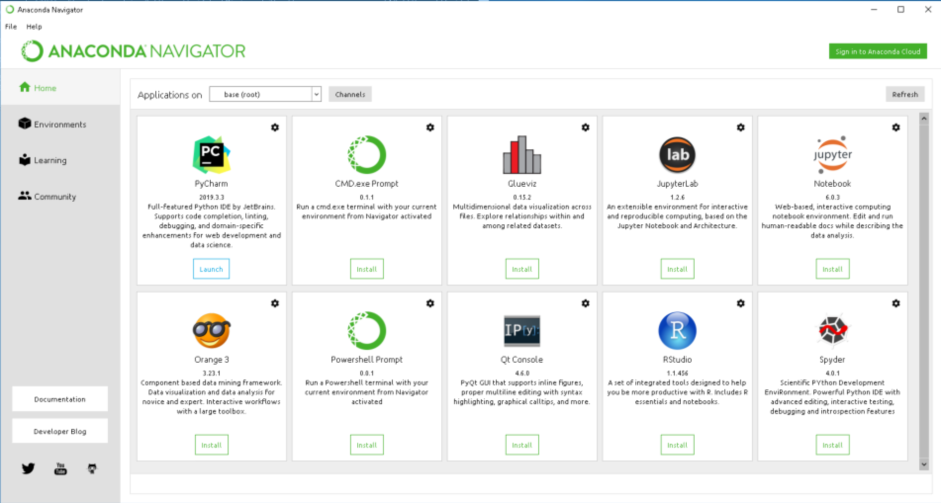
Many applications can be integrated in Anaconda Navigator

Slide 11
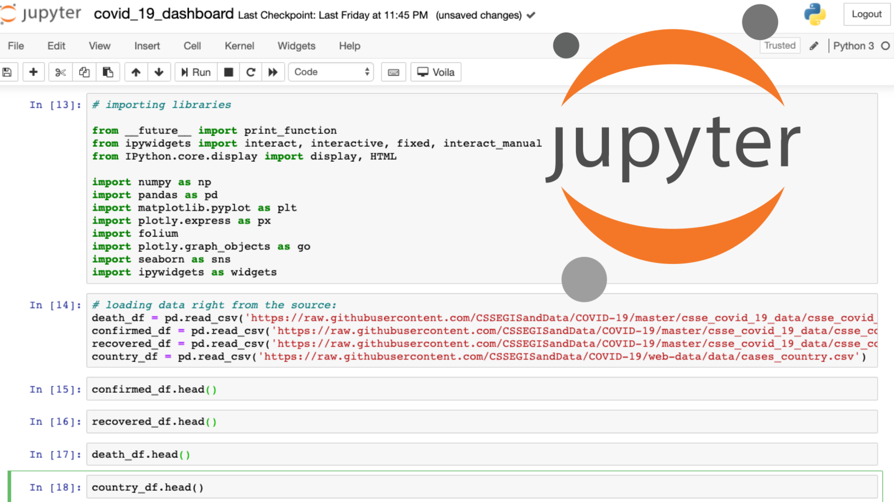
JUPYTER NOTEBOOK
The main EDA tools along with Tableau

Slide 12
“THE” NOTEBOOK
Bread
Jupyter Notebook, or Notebook type app, allows users to view the results of the code in-line without the dependency of other parts of the code.
and Butter
Jupyter Notebook can be processed by any several languages, and can be converted to any file formats such as Markdown, HTML, PDF, and others.

Slide 13
Every cell of the code can be potentially checked at any time to draw an output.

Slide 14

TABLEAU
Candidate for ultimate BI (graph) tools

Slide 15
APPLICATION THAT SPECIALIZE IN VISUALIZATION
Ease of use
With Tableau, you can bring many types of data like Excel, SQL, or even from cloud in just a few clicks.
Visuals
Tableau provide beautiful dashboards and reports.

Slide 16
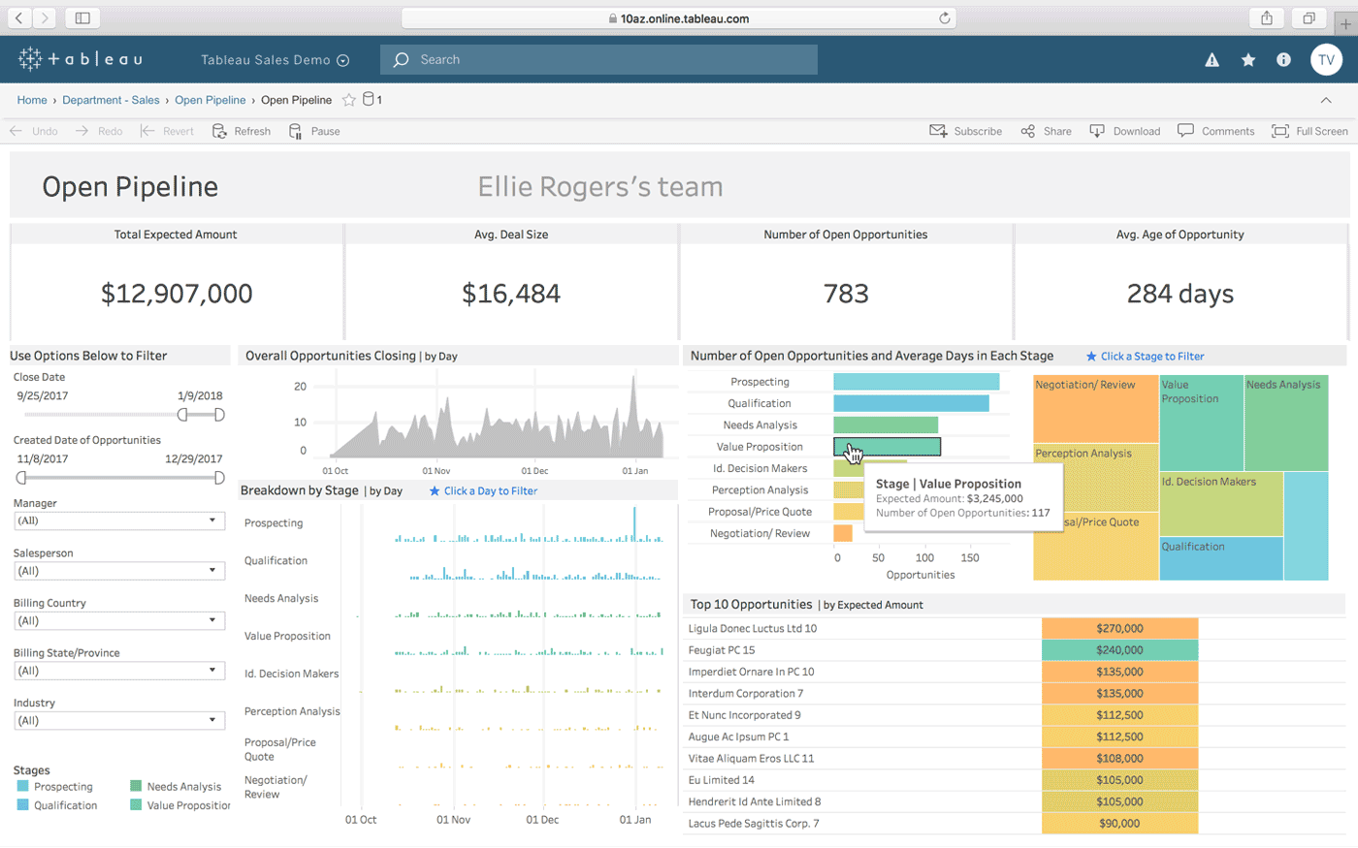
Visual best practices are built in

Slide 17
FOURTH QUESTION
How could we know the platform that user keenly used to watch? And how do you convince us that user are keenly watch on that platform?

Slide 18
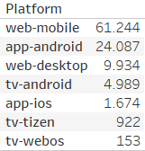
Before we answer that question, let’s see these graphs that show which platform has the most watcher.

Slide 19
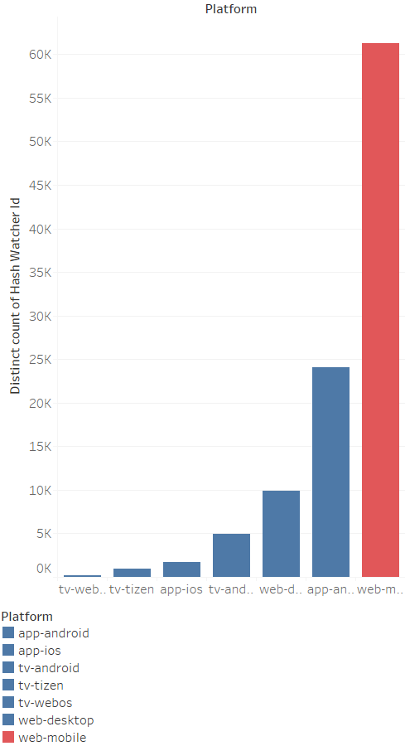

Slide 20
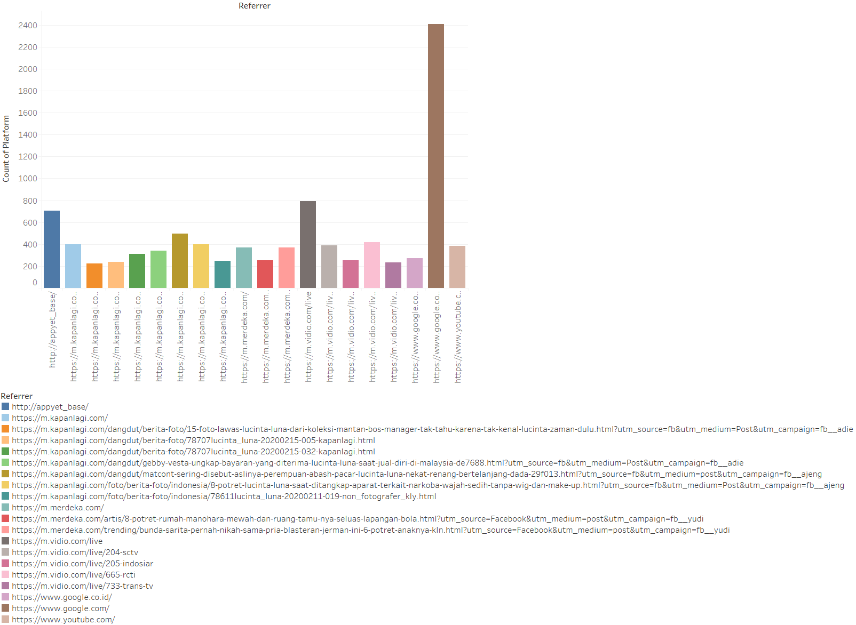

Slide 21
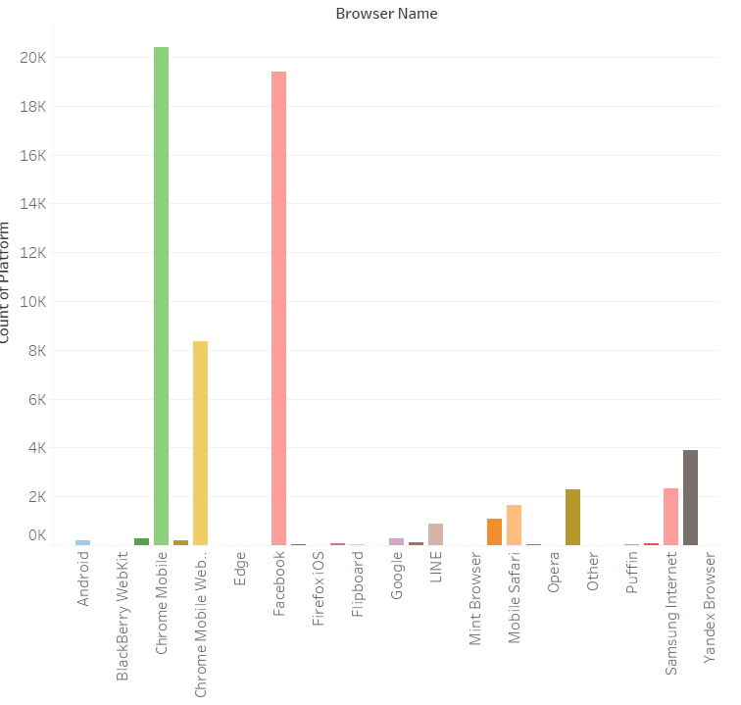

Slide 22

Why is the web-mobile that have the highest platform count?
Answer
It’s because the viewers were watching the video from the web browser in their mobile phone.
Conclusion
Most of them were opening related web page which contains the video from Vidio. The video is either related to the news or the thing they are googling, or videos from their social media site. And that is why there are many viewers from web-mobile.

Slide 23
FIFTH QUESTION
Could you list top 10 visitors by using play_duration per day?

Slide 24

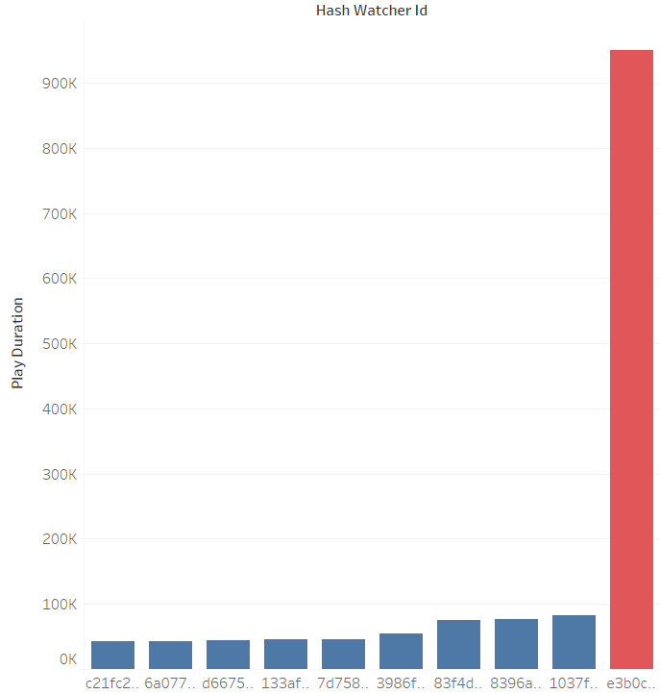
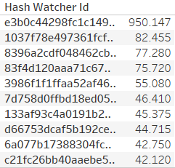
This is the graph for question 5. As you can see, there’s a large gap between first and second place

Slide 25
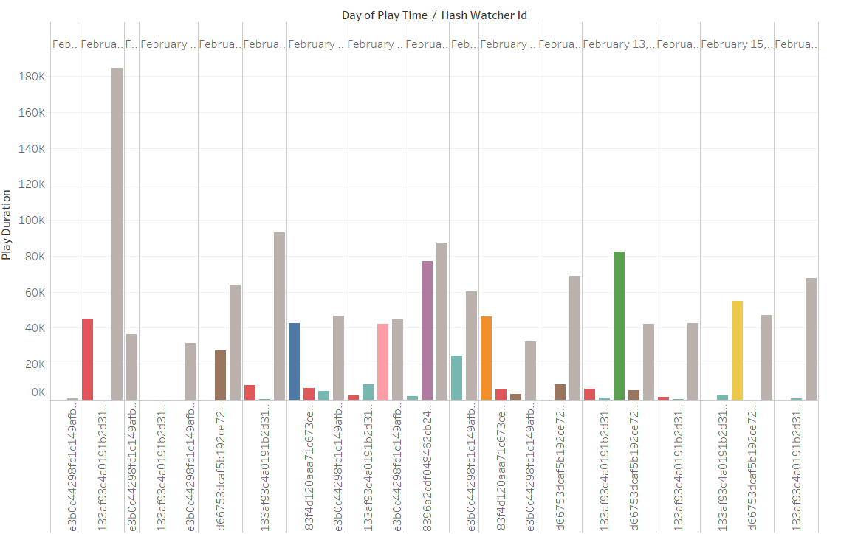

Slide 26
PLEASE CHECK THE TABLEAU FILE FOR THIS QUESTION, FOR DETAILED AND INTERACTIVE PLOTS

