Slide 1
BACKEND INTERVIEW FAQ

Slide 2
DESIGN PATTERN

Slide 3
Why are global and static objects evil?
Karena dapat membuat program state menjadi unpredictable. Karena dapat diakses darimana saja terdapat kemungkinan tidak sengaja nilainya dapat berubah.

Slide 4
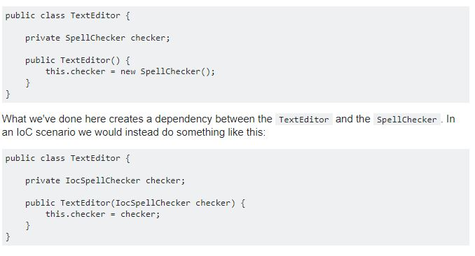
Tell me about Inversion of Control and how does it improve the design of code.
Menghilangkan dependansi dari kode kita. Dengan menghindari new tetapi menggunakan paramater

Slide 5
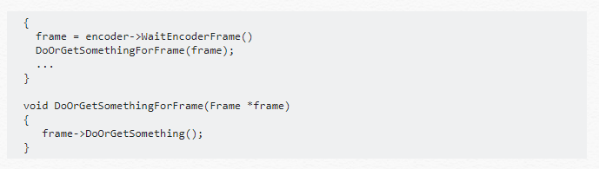
Tell me about The Law of Demeter (the Principle of Least Knowledge
client should only have knowledge of an objects members, and not have access to properties and methods of other objects via the members.
Contoh ketika streamer class memanggil method dari Frame Class dalam streamer class. Tidak langsung memanggil tetapi membuat method sendiri

Slide 6
LIMIT OF Active-Record Pattern
the biggest drawback to active record is that your domain usually becomes tightly coupled to a particular persistence mechanism. Should that mechanism require a global change, perhaps from file-based to DB-based persistence, or between data access frameworks, EVERY class that implements this pattern may change

Slide 7
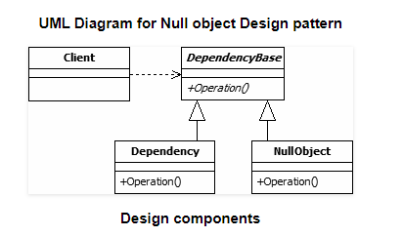
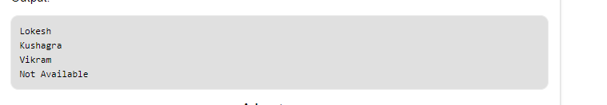
Null Object Pattern
Membuat sebuah concrete class sebagai pengganti null/undefined sehingga tidak terjadi nullpointer ketika data tersebut tidak ditemukan Tetapi mengembalikan sebuah objek
https://www.geeksforgeeks.org/null-object-design-pattern/
Ketika menemukan obyek yang tidak ditemukan tidak return null. Tetapi sebuah concret class

Slide 8
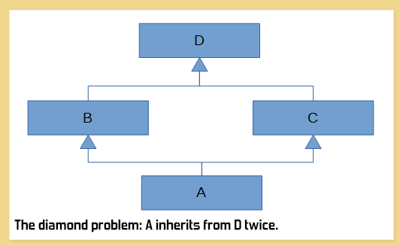
Composition vs inheritence
You do composition by having an instance of another class C as a field of your class, instead of extending C. A good example where composition would've been a lot better than inheritance is java.util.Stack, which currently extends java.util.Vector. This is now considered a blunder. A stack "is-NOT-a" vector; you should not be allowed to insert and remove elements arbitrarily. It should've been composition instead.
composition
+ Readability
+ don’t have Diamond problem

Slide 9
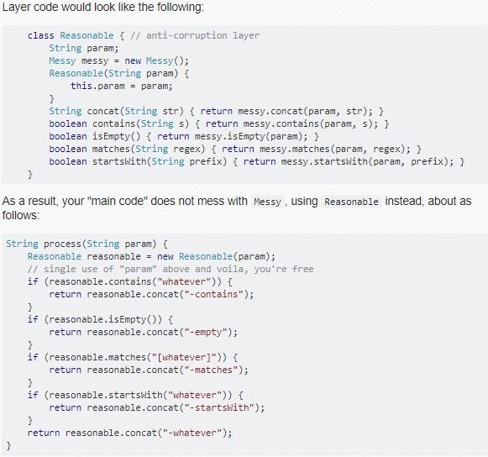
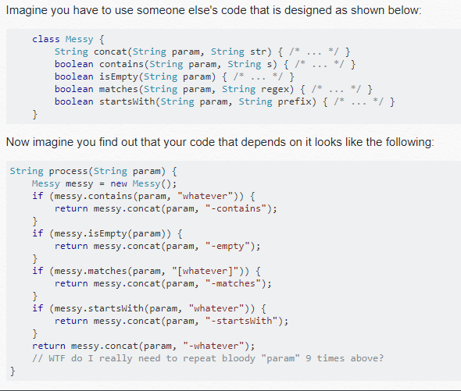
ANTI CORUPTION LAYER PATTERN
Mengisolasi layer untuk meberikan client fungsi dari sebuah class berdasrkan domain class itu sendiri. The layer talks to the other system through its existing interface, requiring little or no modification to the other system. Internally, the layer translates in both directions as necessary between the two models.

Slide 10
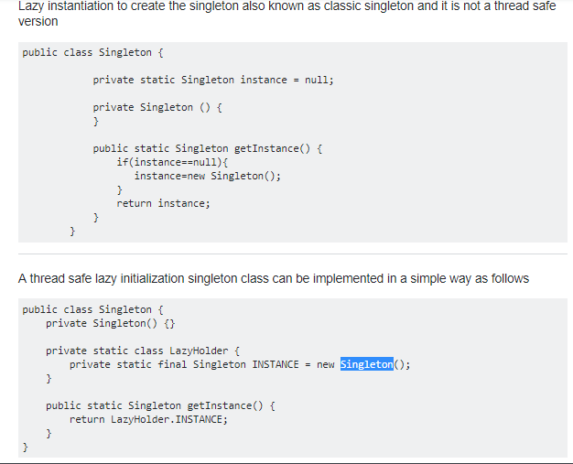
Thread safe Singleton

Slide 11
Data Abstraction
Abstraction means displaying only essential information and hiding the details. Data abstraction refers to providing only essential information about the data to the outside world, hiding the background details or implementation.

Slide 12
Dependency Hell
The dependency issue arises around shared packages or libraries on which several other packages have dependencies but where they depend on different and incompatible versions of the shared packages.

Slide 13
High Cohesion and loose coupling
High Cohesion berarti making sure one module does a thing, not many modules do the same thing
Loose coupling mengurangi derajat dependency antar satu objek dengan objek lainya

