Slide 1
Document ingestion

Slide 2

Recall the basic indexing pipeline
Documents to
be indexed
Friends, Romans, countrymen.
Tokenizer
Token stream
Friends
Romans
Countrymen
Linguistic modules
Modified tokens
friend
roman
countryman
Indexer
friend
2
4
roman
1
2
Inverted index
countryman
13
16
Notes:
Circle documents

Slide 3
Parsing a document
Sec. 2.1
What format is it in?
  pdf/word/excel/html?
What language is it in?
What character set is in use?
  (CP1252, UTF-8, …)
Each of these is a classification problem, which we will study later in the course.
But these tasks are often done heuristically …

Slide 4
Complications: Format/language
Sec. 2.1
Documents being indexed can include docs from many different languages
  A single index may contain terms from many languages.
Sometimes a document or its components can contain multiple languages/formats
  French email with a German pdf attachment.
  French email quote clauses from an English-language contract
There are commercial and open source libraries that can handle a lot of this stuff
Notes:
Nontrivial issues. Requires some design decisions.

Slide 5
Complications: What is a document?
Sec. 2.1
We return from our query “documents” but there are often interesting questions of grain size:
What is a unit document?
  A file?
  An email? (Perhaps one of many in a single mbox file)
    What about an email with 5 attachments?
  A group of files (e.g., PPT or LaTeX split over HTML pages)
Notes:
Nontrivial issues. Requires some design decisions.

Slide 6
Tokens

Slide 7
Tokenization
Sec. 2.2.1
Input: “Friends, Romans and Countrymen”
Output: Tokens
  Friends
  Romans
  Countrymen
A token is an instance of a sequence of characters
Each such token is now a candidate for an index entry, after further processing
  Described below
But what are valid tokens to emit?

Slide 8
Tokenization
Sec. 2.2.1
Issues in tokenization:
  Finland’s capital →
  Finland AND s? Finlands? Finland’s?
  Hewlett-Packard → Hewlett and Packard as two tokens?
    state-of-the-art: break up hyphenated sequence.
    co-education
    lowercase, lower-case, lower case ?
    It can be effective to get the user to put in possible hyphens
  San Francisco: one token or two?
    How do you decide it is one token?

Slide 9
Numbers
Sec. 2.2.1
3/20/91 Mar. 12, 1991 20/3/91
55 B.C.
B-52
My PGP key is 324a3df234cb23e
(800) 234-2333
  Often have embedded spaces
  Older IR systems may not index numbers
    But often very useful: think about things like looking up error codes/stacktraces on the web
    (One answer is using n-grams: IIR ch. 3)
  Will often index “meta-data” separately
    Creation date, format, etc.

Slide 10
Tokenization: language issues
Sec. 2.2.1
French
  L'ensemble → one token or two?
    L ? L’ ? Le ?
    Want l’ensemble to match with un ensemble
      Until at least 2003, it didn’t on Google
        Internationalization!
German noun compounds are not segmented
  Lebensversicherungsgesellschaftsangestellter
  ‘life insurance company employee’
  German retrieval systems benefit greatly from a compound splitter module
      Can give a 15% performance boost for German

Slide 11
Tokenization: language issues
Sec. 2.2.1
Chinese and Japanese have no spaces between words:
  莎拉波娃现在居住在美国东南部的佛罗里达。
  Not always guaranteed a unique tokenization
Further complicated in Japanese, with multiple alphabets intermingled
  Dates/amounts in multiple formats
  フォーチュン500社は情報不足のため時間あた$500K(約6,000万円)
Katakana
Hiragana
Kanji
Romaji
End-user can express query entirely in hiragana!

Slide 12
Tokenization: language issues
Sec. 2.2.1
Arabic (or Hebrew) is basically written right to left, but with certain items like numbers written left to right
Words are separated, but letter forms within a word form complex ligatures
← → ← → ← start
‘Algeria achieved its independence in 1962 after 132 years of French occupation.’
With Unicode, the surface presentation is complex, but the stored form is straightforward

Slide 13
Terms
The things indexed in an IR system

Slide 14
Stop words
Sec. 2.2.2
With a stop list, you exclude from the dictionary entirely the commonest words. Intuition:
  They have little semantic content: the, a, and, to, be
  There are a lot of them: ~30% of postings for top 30 words
But the trend is away from doing this:
  Good compression techniques (IIR 5) means the space for including stop words in a system is very small
  Good query optimization techniques (IIR 7) mean you pay little at query time for including stop words.
  You need them for:
    Phrase queries: “King of Denmark”
    Various song titles, etc.: “Let it be”, “To be or not to be”
    “Relational” queries: “flights to London”
Notes:
Nevertheless: “Google ignores common words and characters such as where, the, how, and other digits and letters which slow down your search without improving the results.” (Though you can explicitly ask for them to remain.)

Slide 15
Normalization to terms
Sec. 2.2.3
We may need to “normalize” words in indexed text as well as query words into the same form
  We want to match U.S.A. and USA
Result is terms: a term is a (normalized) word type, which is an entry in our IR system dictionary
We most commonly implicitly define equivalence classes of terms by, e.g.,
  deleting periods to form a term
    U.S.A., USA ⎝ USA
  deleting hyphens to form a term
    anti-discriminatory, antidiscriminatory ⎝ antidiscriminatory

Slide 16
Normalization: other languages
Sec. 2.2.3
Accents: e.g., French résumé vs. resume.
Umlauts: e.g., German: Tuebingen vs. Tübingen
  Should be equivalent
Most important criterion:
  How are your users like to write their queries for these words?
Even in languages that standardly have accents, users often may not type them
  Often best to normalize to a de-accented term
    Tuebingen, Tübingen, Tubingen ⎝ Tubingen

Slide 17
Normalization: other languages
Sec. 2.2.3
Normalization of things like date forms
  7月30日 vs. 7/30
  Japanese use of kana vs. Chinese characters
Tokenization and normalization may depend on the language and so is intertwined with language detection
Crucial: Need to “normalize” indexed text as well as query terms identically
Is this
German “mit”?
Morgen will ich in MIT …

Slide 18
Case folding
Sec. 2.2.3
Reduce all letters to lower case
  exception: upper case in mid-sentence?
    e.g., General Motors
    Fed vs. fed
    SAIL vs. sail
  Often best to lower case everything, since users will use lowercase regardless of ‘correct’ capitalization…
Longstanding Google example: [fixed in 2011…]
  Query C.A.T.
  #1 result is for “cats” (well, Lolcats) not Caterpillar Inc.

Slide 19
Normalization to terms
Sec. 2.2.3
An alternative to equivalence classing is to do asymmetric expansion
An example of where this may be useful
  Enter: window Search: window, windows
  Enter: windows Search: Windows, windows, window
  Enter: Windows Search: Windows
Potentially more powerful, but less efficient
Notes:
Why not the reverse?

Slide 20
Thesauri and soundex
Do we handle synonyms and homonyms?
  E.g., by hand-constructed equivalence classes
    car = automobile color = colour
  We can rewrite to form equivalence-class terms
    When the document contains automobile, index it under car-automobile (and vice-versa)
  Or we can expand a query
    When the query contains automobile, look under car as well
What about spelling mistakes?
  One approach is Soundex, which forms equivalence classes of words based on phonetic heuristics
More in IIR 3 and IIR 9

Slide 21
Stemming and Lemmatization

Slide 22
Lemmatization
Sec. 2.2.4
Reduce inflectional/variant forms to base form
E.g.,
  am, are, is → be
  car, cars, car's, cars' → car
the boy's cars are different colors → the boy car be different color
Lemmatization implies doing “proper” reduction to dictionary headword form

Slide 23
Stemming
Sec. 2.2.4
Reduce terms to their “roots” before indexing
“Stemming” suggests crude affix chopping
  language dependent
  e.g., automate(s), automatic, automation all reduced to automat.
for example compressed
and compression are both
accepted as equivalent to
compress.
for exampl compress and
compress ar both accept
as equival to compress

Slide 24
Porter’s algorithm
Sec. 2.2.4
Commonest algorithm for stemming English
  Results suggest it’s at least as good as other stemming options
Conventions + 5 phases of reductions
  phases applied sequentially
  each phase consists of a set of commands
  sample convention: Of the rules in a compound command, select the one that applies to the longest suffix.

Slide 25
Typical rules in Porter
Sec. 2.2.4
sses → ss
ies → i
ational → ate
tional → tion
Weight of word sensitive rules
(m>1) EMENT →
    replacement → replac
    cement → cement
Notes:
careses
parties
separational -> separate
factional -> faction

Slide 26
Other stemmers
Sec. 2.2.4
Other stemmers exist:
  Lovins stemmer
    http://www.comp.lancs.ac.uk/computing/research/stemming/general/lovins.htm
    Single-pass, longest suffix removal (about 250 rules)
  Paice/Husk stemmer
  Snowball
Full morphological analysis (lemmatization)
  At most modest benefits for retrieval

Slide 27
Language-specificity
Sec. 2.2.4
The above methods embody transformations that are
  Language-specific, and often
  Application-specific
These are “plug-in” addenda to the indexing process
Both open source and commercial plug-ins are available for handling these

Slide 28
Does stemming help?
Sec. 2.2.4
English: very mixed results. Helps recall for some queries but harms precision on others
  E.g., operative (dentistry) ⇒ oper
Definitely useful for Spanish, German, Finnish, …
  30% performance gains for Finnish!

Slide 29
Faster postings merges:
Skip pointers/Skip lists

Slide 30
Recall basic merge
Sec. 2.3
Walk through the two postings simultaneously, in time linear in the total number of postings entries
2
4
8
41
48
64
128
Brutus
2
8
1
2
3
8
11
17
21
31
Caesar
If the list lengths are m and n, the merge takes O(m+n)
operations.
Can we do better?
Yes (if the index isn’t changing too fast).

Slide 31
Augment postings with skip pointers (at indexing time)
Sec. 2.3
41
128
2
4
8
41
48
64
128
11
31
1
2
3
8
11
17
21
31
Why?
To skip postings that will not figure in the search results.
How?
Where do we place skip pointers?

Slide 32
Query processing with skip pointers
Sec. 2.3
41
128
2
4
8
41
48
64
128
11
31
1
2
3
8
11
17
21
31
Suppose we’ve stepped through the lists until we process 8 on each list. We match it and advance.
We then have 41 and 11 on the lower. 11 is smaller.
But the skip successor of 11 on the lower list is 31, so
we can skip ahead past the intervening postings.

Slide 33
Where do we place skips?
Sec. 2.3
Tradeoff:
  More skips → shorter skip spans ⇒ more likely to skip. But lots of comparisons to skip pointers.
  Fewer skips → few pointer comparison, but then long skip spans ⇒ few successful skips.

Slide 34
Placing skips
Sec. 2.3
Simple heuristic: for postings of length L, use √L evenly-spaced skip pointers [Moffat and Zobel 1996]
This ignores the distribution of query terms.
Easy if the index is relatively static; harder if L keeps changing because of updates.
This definitely used to help; with modern hardware it may not unless you’re memory-based [Bahle et al. 2002]
  The I/O cost of loading a bigger postings list can outweigh the gains from quicker in memory merging!

Slide 35
Index construction

Slide 36
Plan
Last lecture:
  Dictionary data structures
  Tolerant retrieval
    Wildcards
    Spell correction
    Soundex
This time:
  Index construction
a-hu
hy-m
n-z
$m
mace
madden
mo
among
amortize
on
abandon
among

Slide 37
Index construction
Ch. 4
How do we construct an index?
What strategies can we use with limited main memory?

Slide 38
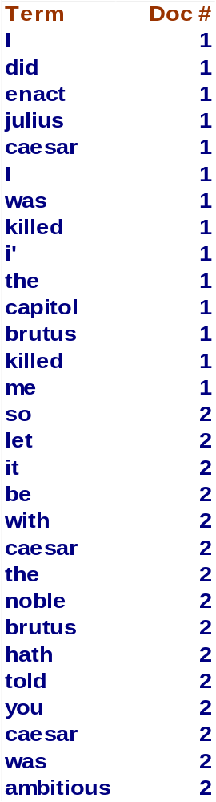
Recall IIR 1 index construction
Sec. 4.2
Documents are parsed to extract words and these are saved with the Document ID.
Doc 1
Doc 2
I did enact Julius
Caesar I was killed
i' the Capitol;
Brutus killed me.
So let it be with
Caesar. The noble
Brutus hath told you
Caesar was ambitious

Slide 39
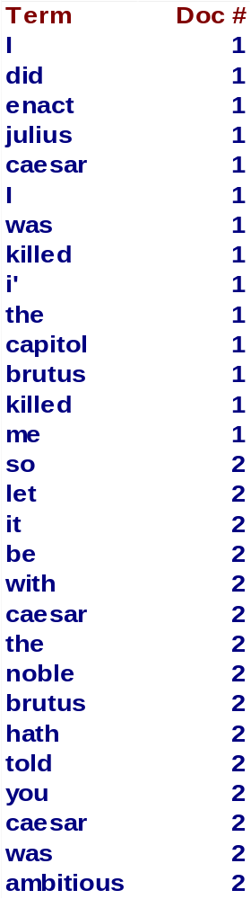
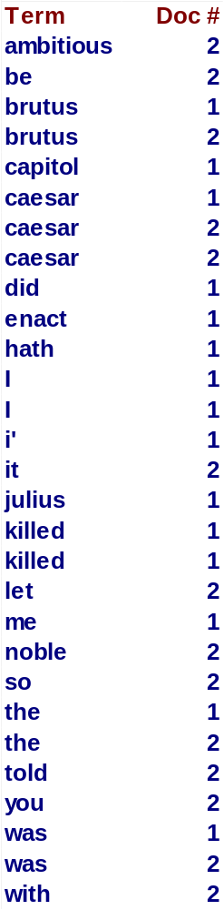
Key step
Sec. 4.2
After all documents have been parsed, the inverted file is sorted by terms.
We focus on this sort step.
We have 100M items to sort.

Slide 40
Scaling index construction
Sec. 4.2
In-memory index construction does not scale
  Can’t stuff entire collection into memory, sort, then write back
How can we construct an index for very large collections?
Taking into account the hardware constraints we just learned about . . .
Memory, disk, speed, etc.

Slide 41
Sort-based index construction
Sec. 4.2
As we build the index, we parse docs one at a time.
  While building the index, we cannot easily exploit compression tricks (you can, but much more complex)
The final postings for any term are incomplete until the end.
At 12 bytes per non-positional postings entry (term, doc, freq), demands a lot of space for large collections.
T = 100,000,000 in the case of RCV1
  So … we can do this in memory in 2009, but typical collections are much larger. E.g., the New York Times provides an index of >150 years of newswire
Thus: We need to store intermediate results on disk.

Slide 42
Sort using disk as “memory”?
Sec. 4.2
Can we use the same index construction algorithm for larger collections, but by using disk instead of memory?
No: Sorting T = 100,000,000 records on disk is too slow – too many disk seeks.
We need an external sorting algorithm.

Slide 43
Bottleneck
Sec. 4.2
Parse and build postings entries one doc at a time
Now sort postings entries by term (then by doc within each term)
Doing this with random disk seeks would be too slow – must sort T=100M records
If every comparison took 2 disk seeks, and N items could be
sorted with N log₂N comparisons, how long would this take?

Slide 44
BSBI: Blocked sort-based Indexing (Sorting with fewer disk seeks)
Sec. 4.2
12-byte (4+4+4) records (term, doc, freq).
These are generated as we parse docs.
Must now sort 100M such 12-byte records by term.
Define a Block ~ 10M such records
  Can easily fit a couple into memory.
  Will have 10 such blocks to start with.
Basic idea of algorithm:
  Accumulate postings for each block, sort, write to disk.
  Then merge the blocks into one long sorted order.

Slide 45
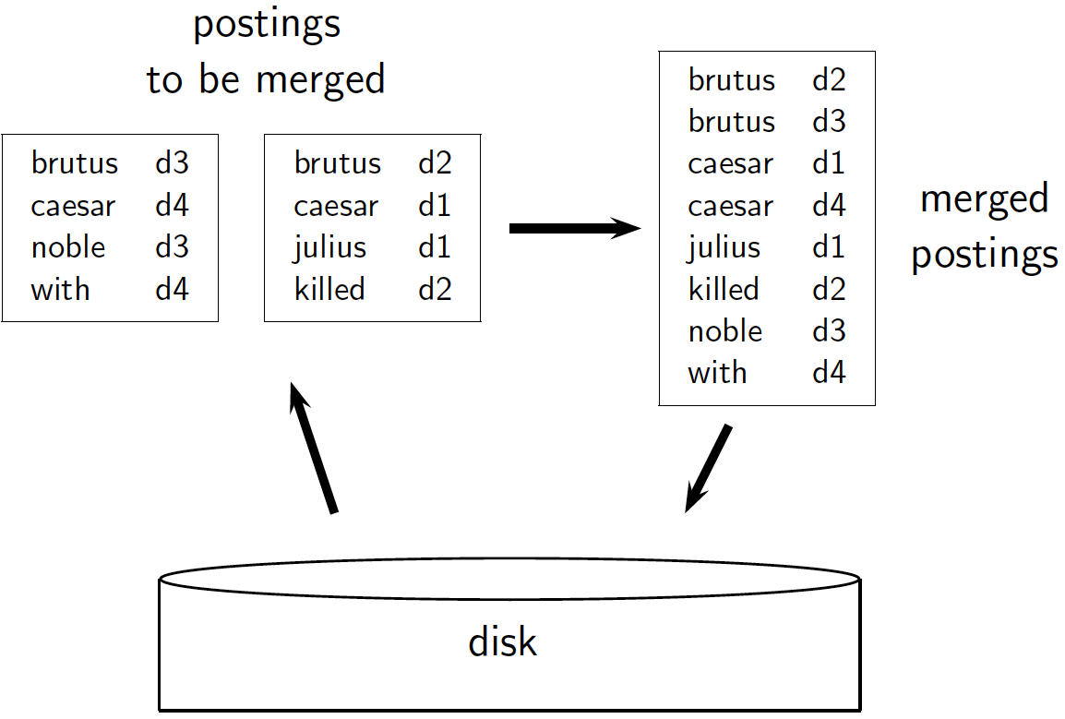
Sec. 4.2

Slide 46
How to merge the sorted runs?
Sec. 4.2
Can do binary merges, with a merge tree of log₂10 = 4 layers.
During each layer, read into memory runs in blocks of 10M, merge, write back.
1
1
2
2
Merged run.
3
4
3
4
Runs being
merged.
Disk

Slide 47
How to merge the sorted runs?
Sec. 4.2
But it is more efficient to do a multi-way merge, where you are reading from all blocks simultaneously
Providing you read decent-sized chunks of each block into memory and then write out a decent-sized output chunk, then you’re not killed by disk seeks
Notes:
What is the overall complexity of

Slide 48
Remaining problem with sort-based algorithm
Sec. 4.3
Our assumption was: we can keep the dictionary in memory.
We need the dictionary (which grows dynamically) in order to implement a term to termID mapping.
Actually, we could work with term,docID postings instead of termID,docID postings . . .
. . . but then intermediate files become very large. (We would end up with a scalable, but very slow index construction method.)

Slide 49
SPIMI:
Single-pass in-memory indexing
Sec. 4.3
Key idea 1: Generate separate dictionaries for each block – no need to maintain term-termID mapping across blocks.
Key idea 2: Don’t sort. Accumulate postings in postings lists as they occur.
With these two ideas we can generate a complete inverted index for each block.
These separate indexes can then be merged into one big index.

Slide 50
Distributed indexing
Sec. 4.4
Maintain a master machine directing the indexing job – considered “safe”.
Break up indexing into sets of (parallel) tasks.
Master machine assigns each task to an idle machine from a pool.

Slide 51
Parallel tasks
Sec. 4.4
We will use two sets of parallel tasks
  Parsers
  Inverters
Break the input document collection into splits
Each split is a subset of documents (corresponding to blocks in BSBI/SPIMI)

Slide 52
Data flow
Sec. 4.4
assign
Master
assign
Postings
Parser
a-f
g-p
q-z
Inverter
a-f
Parser
a-f
g-p
q-z
Inverter
g-p
splits
Inverter
q-z
Parser
a-f
g-p
q-z
Map
phase
Reduce
phase
Segment files

Slide 53
MapReduce
Sec. 4.4
The index construction algorithm we just described is an instance of MapReduce.
MapReduce (Dean and Ghemawat 2004) is a robust and conceptually simple framework for distributed computing …
… without having to write code for the distribution part.
They describe the Google indexing system (ca. 2002) as consisting of a number of phases, each implemented in MapReduce.

Slide 54
MapReduce
Sec. 4.4
Index construction was just one phase.
Another phase: transforming a term-partitioned index into a document-partitioned index.
  Term-partitioned: one machine handles a subrange of terms
  Document-partitioned: one machine handles a subrange of documents
As we’ll discuss in the web part of the course, most search engines use a document-partitioned index … better load balancing, etc.

Slide 55
Schema for index construction in MapReduce
Sec. 4.4
Schema of map and reduce functions
map: input → list(k, v) reduce: (k,list(v)) → output
Instantiation of the schema for index construction
map: collection → list(termID, docID)
reduce: (<termID1, list(docID)>, <termID2, list(docID)>, …) → (postings list1, postings list2, …)

Slide 56
Example for index construction
Map:
d1 : C came, C c’ed.
d2 : C died. →
<C,d1>, <came,d1>, <C,d1>, <c’ed, d1>, <C, d2>, <died,d2>
Reduce:
(<C,(d1,d2,d1)>, <died,(d2)>, <came,(d1)>, <c’ed,(d1)>) → (<C,(d1:2,d2:1)>, <died,(d2:1)>, <came,(d1:1)>, <c’ed,(d1:1)>)

Slide 57
Dynamic indexing
Sec. 4.5
Up to now, we have assumed that collections are static.
They rarely are:
  Documents come in over time and need to be inserted.
  Documents are deleted and modified.
This means that the dictionary and postings lists have to be modified:
  Postings updates for terms already in dictionary
  New terms added to dictionary

Slide 58
Simplest approach
Sec. 4.5
Maintain “big” main index
New docs go into “small” auxiliary index
Search across both, merge results
Deletions
  Invalidation bit-vector for deleted docs
  Filter docs output on a search result by this invalidation bit-vector
Periodically, re-index into one main index

Slide 59
Issues with main and auxiliary indexes
Sec. 4.5
Problem of frequent merges – you touch stuff a lot
Poor performance during merge
Actually:
  Merging of the auxiliary index into the main index is efficient if we keep a separate file for each postings list.
  Merge is the same as a simple append.
  But then we would need a lot of files – inefficient for OS.
Assumption for the rest of the lecture: The index is one big file.
In reality: Use a scheme somewhere in between (e.g., split very large postings lists, collect postings lists of length 1 in one file etc.)

Slide 60
Logarithmic merge
Sec. 4.5
Maintain a series of indexes, each twice as large as the previous one
  At any time, some of these powers of 2 are instantiated
Keep smallest (Z₀) in memory
Larger ones (I₀, I₁, …) on disk
If Z₀ gets too big (> n), write to disk as I₀
or merge with I₀ (if I₀ already exists) as Z₁
Either write merge Z₁ to disk as I₁ (if no I₁)
Or merge with I₁ to form Z₂

Slide 61
Index Compression

Slide 62
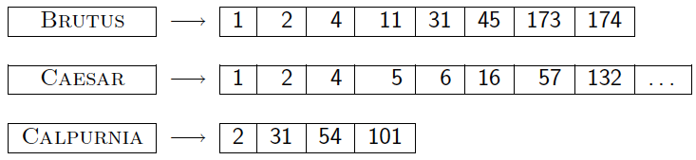
Index Compression
Ch. 5
Collection statistics in more detail (with RCV1)
  How big will the dictionary and postings be?
Dictionary compression
Postings compression

Slide 63
Why compression (in general)?
Ch. 5
Use less disk space
  Saves a little money
Keep more stuff in memory
  Increases speed
Increase speed of data transfer from disk to memory
  [read compressed data | decompress] is faster than [read uncompressed data]
  Premise: Decompression algorithms are fast
    True of the decompression algorithms we use

Slide 64
Why compression for inverted indexes?
Ch. 5
Dictionary
  Make it small enough to keep in main memory
  Make it so small that you can keep some postings lists in main memory too
Postings file(s)
  Reduce disk space needed
  Decrease time needed to read postings lists from disk
  Large search engines keep a significant part of the postings in memory.
    Compression lets you keep more in memory
We will devise various IR-specific compression schemes

Slide 65
Index parameters vs. what we index (details IIR Table 5.1, p.80)
Sec. 5.1
size of | word types (terms) |  |  | non-positional postings |  |  | positional postings
 | dictionary |  |  | non-positional index |  |  | positional index
 | Size (K) | ∆% | cumul % | Size (K) | ∆ % | cumul % | Size (K) | ∆ % | cumul %
Unfiltered | 484 |  |  | 109,971 |  |  | 197,879
No numbers | 474 | -2 | -2 | 100,680 | -8 | -8 | 179,158 | -9 | -9
Case folding | 392 | -17 | -19 | 96,969 | -3 | -12 | 179,158 | 0 | -9
30 stopwords | 391 | -0 | -19 | 83,390 | -14 | -24 | 121,858 | -31 | -38
150 stopwords | 391 | -0 | -19 | 67,002 | -30 | -39 | 94,517 | -47 | -52
stemming | 322 | -17 | -33 | 63,812 | -4 | -42 | 94,517 | 0 | -52
Exercise: give intuitions for all the ‘0’ entries. Why do some zero entries correspond to big deltas in other columns?

Slide 66
Lossless vs. lossy compression
Sec. 5.1
Lossless compression: All information is preserved.
  What we mostly do in IR.
Lossy compression: Discard some information
Several of the preprocessing steps can be viewed as lossy compression: case folding, stop words, stemming, number elimination.
Chap/Lecture 7: Prune postings entries that are unlikely to turn up in the top k list for any query.
  Almost no loss quality for top k list.

Slide 67
Vocabulary vs. collection size
Sec. 5.1
How big is the term vocabulary?
  That is, how many distinct words are there?
Can we assume an upper bound?
  Not really: At least 70²⁰ = 10³⁷ different words of length 20
In practice, the vocabulary will keep growing with the collection size
  Especially with Unicode ☺
Notes:
Also - the calculation "At least 7020 = 1037 different words of length 20" seems like a bit of a gross overestimate (and in any case, might be more useful to say it's 2 raised to some power rather than 10 raised to the power 37)

Slide 68
Vocabulary vs. collection size
Sec. 5.1
Heaps’ law: M = kT^{b}
M is the size of the vocabulary, T is the number of tokens in the collection
Typical values: 30 ≤ k ≤ 100 and b ≈ 0.5
In a log-log plot of vocabulary size M vs. T, Heaps’ law predicts a line with slope about ½
  It is the simplest possible relationship between the two in log-log space
  An empirical finding (“empirical law”)

Slide 69
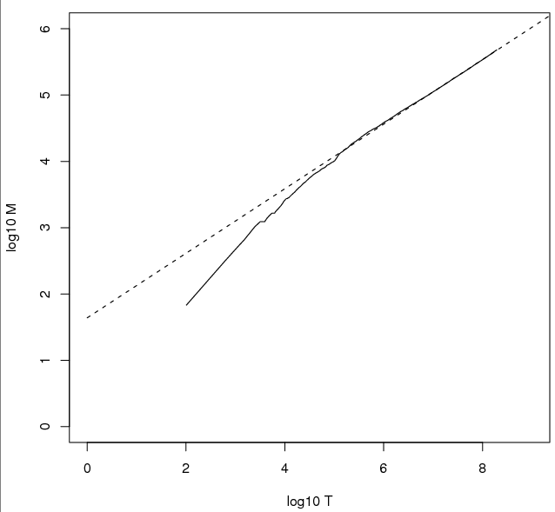
Heaps’ Law
Sec. 5.1
Fig 5.1 p81
For RCV1, the dashed line
log₁₀M = 0.49 log₁₀T + 1.64 is the best least squares fit.
Thus, M = 10^{1.64}T^{0.49} so k = 10^{1.64} ≈ 44 and b = 0.49.
Good empirical fit for Reuters RCV1 !
For first 1,000,020 tokens,
law predicts 38,323 terms;
actually, 38,365 terms
Notes:
Example: for the first 1,000,020 tokens Heaps’ law predicts
38,323 terms:
44 Å~ 1,000,0200.49 ≈ 38,323
The actual number is 38,365 terms, very close to the
prediction.
Empirical observation: fit is good in general.

Slide 70
DICTIONARY COMPRESSION
Sec. 5.2

Slide 71
Why compress the dictionary?
Sec. 5.2
Search begins with the dictionary
We want to keep it in memory
Memory footprint competition with other applications
Embedded/mobile devices may have very little memory
Even if the dictionary isn’t in memory, we want it to be small for a fast search startup time
So, compressing the dictionary is important

Slide 72
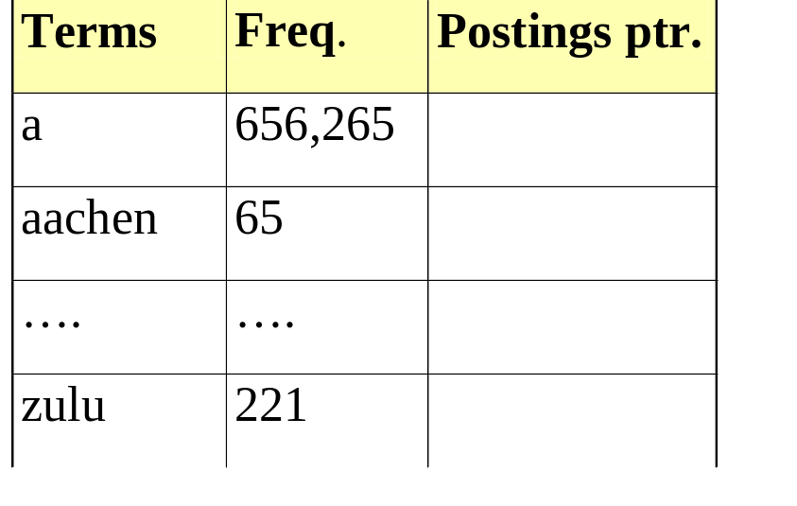
Dictionary storage - first cut
Sec. 5.2
Array of fixed-width entries
  ~400,000 terms; 28 bytes/term = 11.2 MB.
Dictionary search
structure
20 bytes
4 bytes each

Slide 73
Fixed-width terms are wasteful
Sec. 5.2
Most of the bytes in the Term column are wasted – we allot 20 bytes for 1 letter terms.
  And we still can’t handle supercalifragilisticexpialidocious or hydrochlorofluorocarbons.
Written English averages ~4.5 characters/word.
  Exercise: Why is/isn’t this the number to use for estimating the dictionary size?
Ave. dictionary word in English: ~8 characters
  How do we use ~8 characters per dictionary term?
Short words dominate token counts but not type average.

Slide 74
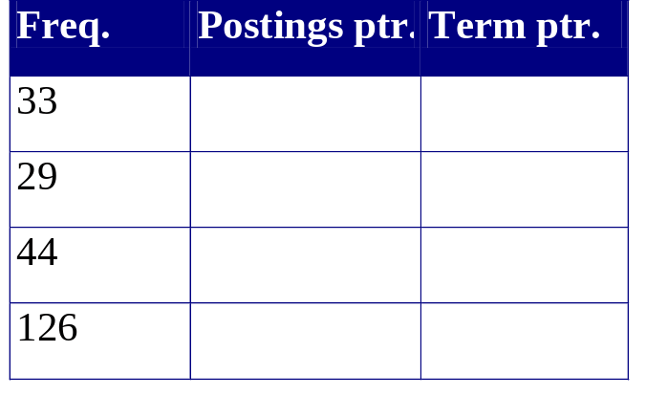
Compressing the term list:
Dictionary-as-a-String
Sec. 5.2
Store dictionary as a (long) string of characters:
  Pointer to next word shows end of current word
  Hope to save up to 60% of dictionary space.
….systilesyzygeticsyzygialsyzygyszaibelyiteszczecinszomo….
Total string length =
400K x 8B = 3.2MB
Pointers resolve 3.2M
positions: log₂3.2M =
22bits = 3bytes

Slide 75
Space for dictionary as a string
Sec. 5.2
4 bytes per term for Freq.
4 bytes per term for pointer to Postings.
3 bytes per term pointer
Avg. 8 bytes per term in term string
400K terms x 19 ⇒ 7.6 MB (against 11.2MB for fixed width)
⎫ Now avg. 11
⎬ bytes/term,
⎭ not 20.

Slide 76
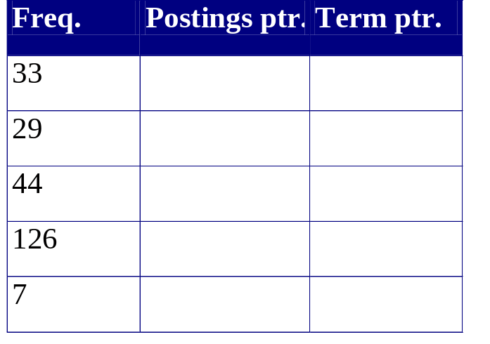
Blocking
Sec. 5.2
Store pointers to every kth term string.
  Example below: k=4.
Need to store term lengths (1 extra byte)
….7systile9syzygetic8syzygial6syzygy11szaibelyite8szczecin9szomo….
⎫ Save 9 bytes
⎬ on 3
⎭ pointers.
Lose 4 bytes on
term lengths.

Slide 77
Net
Sec. 5.2
Example for block size k = 4
Where we used 3 bytes/pointer without blocking
  3 x 4 = 12 bytes,
now we use 3 + 4 = 7 bytes.
Shaved another ~0.5MB. This reduces the size of the dictionary from 7.6 MB to 7.1 MB.
We can save more with larger k.
Why not go with larger k?

Slide 78
POSTINGS COMPRESSION
Sec. 5.3

Slide 79
Postings compression
Sec. 5.3
The postings file is much larger than the dictionary, factor of at least 10.
Key desideratum: store each posting compactly.
A posting for our purposes is a docID.
For Reuters (800,000 documents), we would use 32 bits per docID when using 4-byte integers.
Alternatively, we can use log₂ 800,000 ≈ 20 bits per docID.
Our goal: use far fewer than 20 bits per docID.

Slide 80
Postings: two conflicting forces
Sec. 5.3
A term like arachnocentric occurs in maybe one doc out of a million – we would like to store this posting using log₂ 1M ~ 20 bits.
A term like the occurs in virtually every doc, so 20 bits/posting is too expensive.
  Prefer 0/1 bitmap vector in this case

Slide 81
Variable length encoding
Sec. 5.3
Aim:
  For arachnocentric, we will use ~20 bits/gap entry.
  For the, we will use ~1 bit/gap entry.
If the average gap for a term is G, we want to use ~log₂G bits/gap entry.
Key challenge: encode every integer (gap) with about as few bits as needed for that integer.
This requires a variable length encoding
Variable length codes achieve this by using short codes for small numbers

Slide 82
Variable Byte (VB) codes
Sec. 5.3
For a gap value G, we want to use close to the fewest bytes needed to hold log₂ G bits
Begin with one byte to store G and dedicate 1 bit in it to be a continuation bit c
If G ≤127, binary-encode it in the 7 available bits and set c =1
Else encode G’s lower-order 7 bits and then use additional bytes to encode the higher order bits using the same algorithm
At the end set the continuation bit of the last byte to 1 (c =1) – and for the other bytes c = 0.

Slide 83
Example
Sec. 5.3
docIDs | 824 | 829 | 215406
gaps |  | 5 | 214577
VB code | 00000110 10111000 | 10000101 | 00001101 00001100 10110001
Postings stored as the byte concatenation
000001101011100010000101000011010000110010110001
Key property: VB-encoded postings are
uniquely prefix-decodable.
For a small gap (5), VB
uses a whole byte.

Slide 84
Index compression summary
Sec. 5.3
We can now create an index for highly efficient Boolean retrieval that is very space efficient
Only 4% of the total size of the collection
Only 10-15% of the total size of the text in the collection
However, we’ve ignored positional information
Hence, space savings are less for indexes used in practice
  But techniques substantially the same.

