Slide 1
Hinrich Schütze and Christina Lioma
Lecture 17: Hierarchical Clustering

Slide 2
Overview
Recap
Introduction
Single-link/ Complete-link
Centroid/ GAAC
Variants
Labeling clusters

Slide 3
Outline
Recap
Introduction
Single-link/ Complete-link
Centroid/ GAAC
Variants
Labeling clusters

Slide 4
Applications of clustering in IR
Application |  | What is clustered? | Benefit | Example
Search result clustering |  | search results | more effective information presentation to user
Scatter-Gather |  | (subsets of) collection | alternative user interface: “search without typing”
Collection clustering |  | collection | effective information presentation for exploratory browsing | McKeown et al. 2002, news.google.com
Cluster-based retrieval |  | collection | higher efficiency: faster search | Salton 1971
4

Slide 5
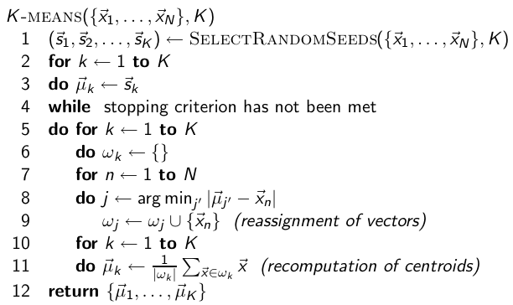
K- means algorithm
5

Slide 6
Initialization of K-means
Random seed selection is just one of many ways K-means can be initialized.
Random seed selection is not very robust: It’s easy to get a suboptimal clustering.
Better heuristics:
Select seeds not randomly, but using some heuristic (e.g., filter out outliers or find a set of seeds that has “good coverage” of the document space)
Use hierarchical clustering to find good seeds (next class)
Select i (e.g., i = 10) different sets of seeds, do a K-means clustering for each, select the clustering with lowest RSS
6

Slide 7

External criterion: Purity
Ω= {ω₁, ω₂, . . . , ω_{K}} is the set of clusters and C = {c₁, c₂, . . . , c_{J}} is the set of classes.
For each cluster ω_{k} : find class c_{j} with most members n_{kj} in ω_{k}
Sum all n_{kj} and divide by total number of points
7

Slide 8
Outline
Recap
Introduction
Single-link/ Complete-link
Centroid/ GAAC
Variants
Labeling clusters

Slide 9
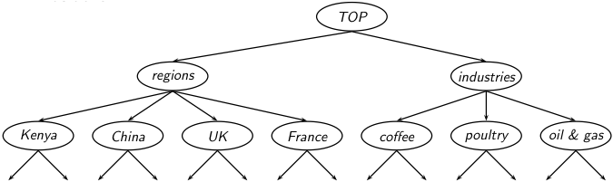
Hierarchical clustering
Our goal in hierarchical clustering is to
create a hierarchy like the one we saw earlier
in Reuters:
We want to create this hierarchy
automatically. We can do this either
top-down or bottom-up. The best known
bottom-up method is hierarchical
agglomerative clustering.
9

Slide 10
Hierarchical agglomerative clustering (HAC)
HAC creates a hierachy in the form of a binary tree.
Assumes a similarity measure for determining the similarity of two clusters.
Up to now, our similarity measures were for documents.
We will look at four different cluster similarity measures.
10

Slide 11
Hierarchical agglomerative clustering (HAC)
Start with each document in a separate cluster
Then repeatedly merge the two clusters that are most similar
Until there is only one cluster
The history of merging is a hierarchy in the form of a binary tree.
The standard way of depicting this history is a dendrogram.
11

Slide 12
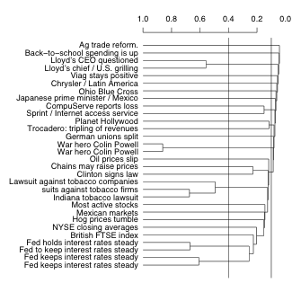
A dendogram
The history of mergers can be read off from bottom to top.
The horizontal line of each merger tells us what the similarity of the merger was.
We can cut the dendrogram at a particular point (e.g., at 0.1 or 0.4) to get a flat clustering.
12

Slide 13
Divisive clustering
Divisive clustering is top-down.
Alternative to HAC (which is bottom up).
Divisive clustering:
Start with all docs in one big cluster
Then recursively split clusters
Eventually each node forms a cluster on its own.
→ Bisecting K-means at the end
For now: HAC (= bottom-up)
13

Slide 14
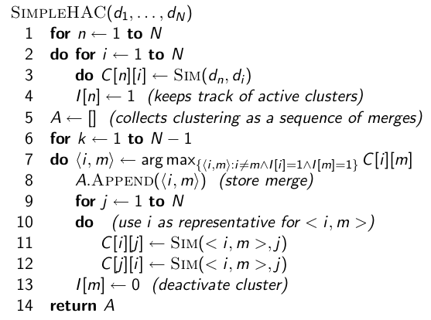
Naive HAC algorithm
14

Slide 15
Computational complexity of the naive algorithm
First, we compute the similarity of all N × N pairs of documents.
Then, in each of N iterations:
We scan the O(N × N) similarities to find the maximum similarity.
We merge the two clusters with maximum similarity.
We compute the similarity of the new cluster with all other (surviving) clusters.
There are O(N) iterations, each performing a O(N × N) “scan” operation.
Overall complexity is O(N³).
We’ll look at more efficient algorithms later.
15

Slide 16
Key question: How to define cluster similarity
Single-link: Maximum similarity
Maximum similarity of any two documents
Complete-link: Minimum similarity
Minimum similarity of any two documents
Centroid: Average “intersimilarity”
Average similarity of all document pairs (but excluding pairs of docs in the same cluster)
This is equivalent to the similarity of the centroids.
Group-average: Average “intrasimilarity”
Average similary of all document pairs, including pairs of docs in the same cluster
16

Slide 17
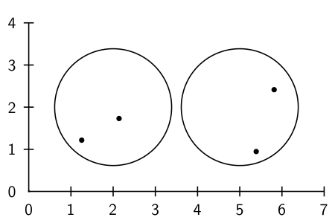
Cluster similarity: Example
17

Slide 18
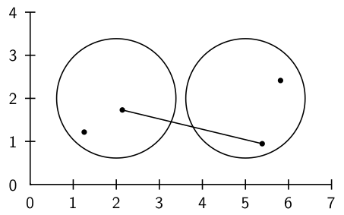
Single-link: Maximum similarity
18

Slide 19
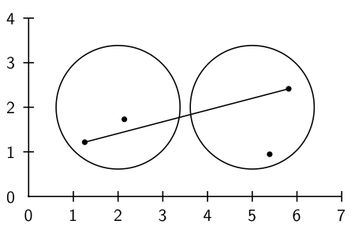
Complete-link: Minimum similarity
19

Slide 20
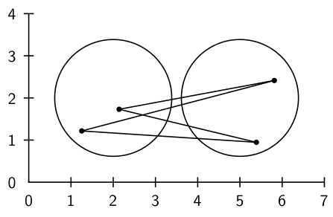
Centroid: Average intersimilarity
intersimilarity = similarity of two documents in different clusters
20

Slide 21
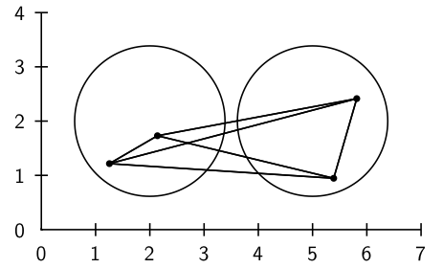
Group average: Average intrasimilarity
intrasimilarity = similarity of any pair, including cases where the
two documents are in the same cluster
21

Slide 22
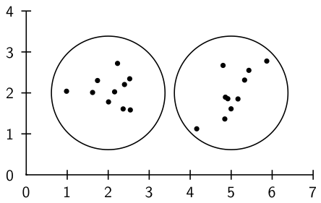
Cluster similarity: Larger Example
22

Slide 23
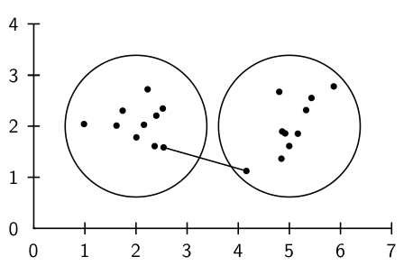
Single-link: Maximum similarity
23

Slide 24
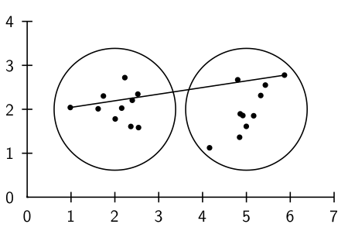
Complete-link: Minimum similarity
24

Slide 25
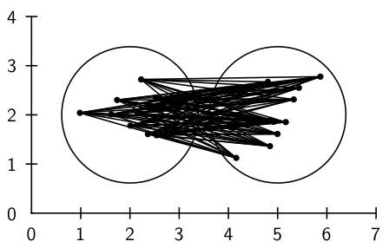
Centroid: Average intersimilarity
25

Slide 26
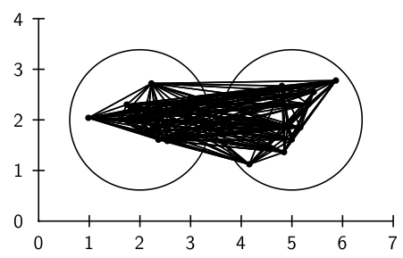
Group average: Average intrasimilarity
26

Slide 27
Outline
Recap
Introduction
Single-link/ Complete-link
Centroid/ GAAC
Variants
Labeling clusters

Slide 28
Single link HAC
The similarity of two clusters is the maximum intersimilarity – the maximum similarity of a document from the first cluster and a document from the second cluster.
Once we have merged two clusters, how do we update the similarity matrix?
This is simple for single link:
SIM(ω_{i} , (ω_{k1} ∪ ω_{k2})) = max(SIM(ω_{i} , ω_{k1}), SIM(ω_{i} , ω_{k2}))
28

Slide 29
This dendogram was produced by single-link
Notice: many small clusters (1 or 2 members) being added to the main cluster
There is no balanced 2-cluster or 3-cluster clustering that can be derived by cutting the dendrogram.
29

Slide 30
Complete link HAC
The similarity of two clusters is the minimum intersimilarity – the minimum similarity of a document from the first cluster and a document from the second cluster.
Once we have merged two clusters, how do we update the similarity matrix?
Again, this is simple:
SIM(ω_{i} , (ω_{k1} ∪ ω_{k2})) = min(SIM(ω_{i} , ω_{k1}), SIM(ω_{i} , ω_{k2}))
We measure the similarity of two clusters by computing the diameter of the cluster that we would get if we merged them.
30

Slide 31
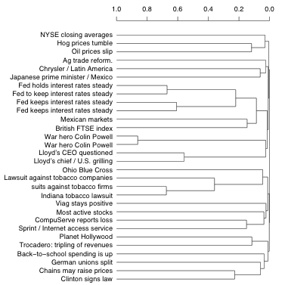
Complete-link dendrogram
Notice that this dendrogram is much more balanced than the single-link one.
We can create a 2-cluster clustering with two clusters of about the same size.
31

Slide 32
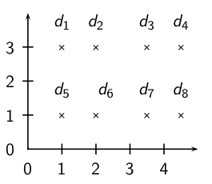
Exercise: Compute single and complete link clustering
32

Slide 33
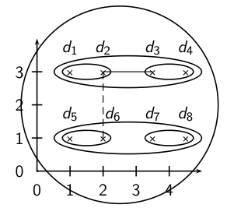
Single-link clustering
33

Slide 34
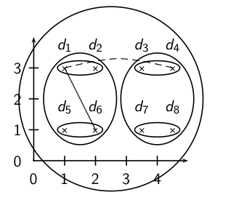
Complete link clustering
34

Slide 35
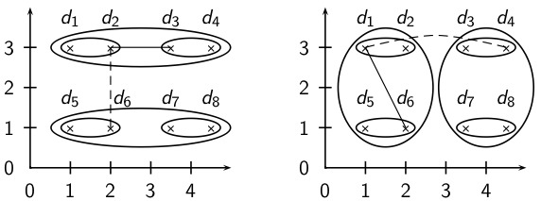
Single-link vs. Complete link clustering
35

Slide 36
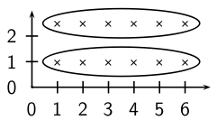
Single-link: Chaining
Single-link clustering often produces long, straggly clusters. For most applications, these are undesirable.
36

Slide 37
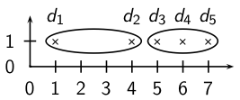
What 2-cluster clustering will complete-link produce?
Coordinates:
1 + 2 × ϵ, 4, 5 + 2 × ϵ, 6, 7 − ϵ.
37

Slide 38
Complete-link: Sensitivity to outliers
The complete-link clustering of this set splits d₂ from its right neighbors – clearly undesirable.
The reason is the outlier d₁.
This shows that a single outlier can negatively affect the outcome of complete-link clustering.
Single-link clustering does better in this case.
38

Slide 39
Outline
Recap
Introduction
Single-link/ Complete-link
Centroid/ GAAC
Variants
Labeling clusters

Slide 40
Centroid HAC
The similarity of two clusters is the average intersimilarity – the average similarity of documents from the first cluster with documents from the second cluster.
A naive implementation of this definition is inefficient (O(N²)), but the definition is equivalent to computing the similarity of the centroids:
Hence the name: centroid HAC
Note: this is the dot product, not cosine similarity!
40

Slide 41
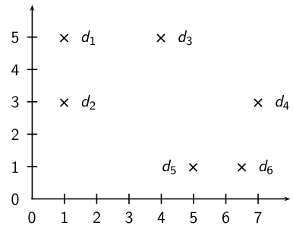
Exercise: Compute centroid clustering
41

Slide 42
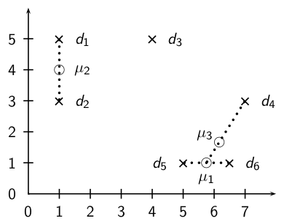
Centroid clustering
42

Slide 43
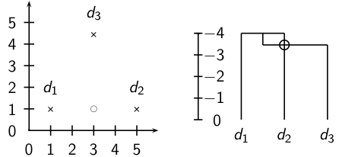
The Inversion in centroid clustering
In an inversion, the similarity increases during a merge sequence. Results in an “inverted” dendrogram.
Below: Similarity of the first merger (d₁ ∪ d₂) is -4.0, similarity of second merger ((d₁ ∪ d₂) ∪ d₃) is ≈ −3.5.
43

Slide 44
Inversions
Hierarchical clustering algorithms that allow inversions are inferior.
The rationale for hierarchical clustering is that at any given point, we’ve found the most coherent clustering of a given size.
Intuitively: smaller clusterings should be more coherent than larger clusterings.
An inversion contradicts this intuition: we have a large cluster that is more coherent than one of its subclusters.
44

Slide 45
Group-average agglomerative clustering (GAAC)
GAAC also has an “average-similarity” criterion, but does not have inversions.
The similarity of two clusters is the average intrasimilarity – the average similarity of all document pairs (including those from the same cluster).
But we exclude self-similarities.
45

Slide 46
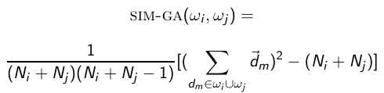
Group-average agglomerative clustering (GAAC)
Again, a naive implementation is inefficient (O(N²)) and there is an equivalent, more efficient, centroid-based definition:
Again, this is the dot product, not cosine similarity.
46

Slide 47
Which HAC clustering should I use?
Don’t use centroid HAC because of inversions.
In most cases: GAAC is best since it isn’t subject to chaining and sensitivity to outliers.
However, we can only use GAAC for vector representations.
For other types of document representations (or if only pairwise similarities for document are available): use complete-link.
There are also some applications for single-link (e.g., duplicate detection in web search).
47

Slide 48
Flat or hierarchical clustering?
For high efficiency, use flat clustering (or perhaps bisecting k-means)
For deterministic results: HAC
When a hierarchical structure is desired: hierarchical algorithm
HAC also can be applied if K cannot be predetermined (can start without knowing K)
48

Slide 49
Outline
Recap
Introduction
Single-link/ Complete-link
Centroid/ GAAC
Variants
Labeling clusters

Slide 50
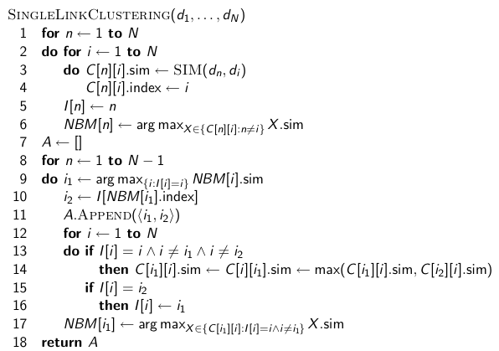
Efficient single link clustering
50

Slide 51
Time complexity of HAC
The single-link algorithm we just saw is O(N²).
Much more efficient than the O(N³) algorithm we looked at earlier!
There is no known O(N²) algorithm for complete-link, centroid and GAAC.
Best time complexity for these three is O(N² log N): See book.
In practice: little difference between O(N² log N) and O(N²).
51

Slide 52
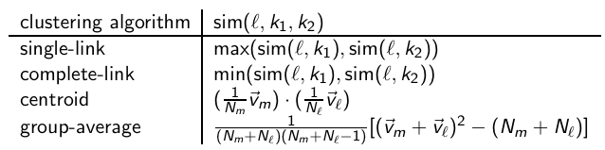
Combination similarities of the four algorithms
52

Slide 53
Comparison of HAC algorithms
method | combination similarity | time compl. | optimal? | comment
single-link | max intersimilarity of any 2 docs | Ɵ(N²) | yes | chaining effect
complete-link | min intersimilarity of any 2 docs | Ɵ(N² log N) | no | sensitive to outliers
group-average | average of all sims | Ɵ(N² log N) | no | best choice for most applications
centroid | average intersimilarity | Ɵ(N² log N) | no | inversions can occur
53

Slide 54
What to do with the hierarchy?
Use as is (e.g., for browsing as in Yahoo hierarchy)
Cut at a predetermined threshold
Cut to get a predetermined number of clusters K
Ignores hierarchy below and above cutting line.
54

Slide 55
Bisecting K-means: A top-down algorithm
Start with all documents in one cluster
Split the cluster into 2 using K-means
Of the clusters produced so far, select one to split (e.g. select the largest one)
Repeat until we have produced the desired number of clusters
55

Slide 56
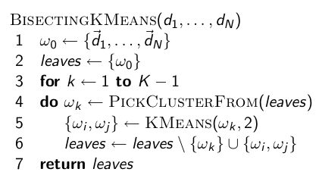
Bisecting K-means
56

Slide 57
Bisecting K-means
If we don’t generate a complete hierarchy, then a top-down algorithm like bisecting K-means is much more efficient than HAC algorithms.
But bisecting K-means is not deterministic.
There are deterministic versions of bisecting K-means (see resources at the end), but they are much less efficient.
57

Slide 58
Outline
Recap
Introduction
Single-link/ Complete-link
Centroid/ GAAC
Variants
Labeling clusters

Slide 59
Major issue in clustering – labeling
After a clustering algorithm finds a set of clusters: how can they be useful to the end user?
We need a pithy label for each cluster.
For example, in search result clustering for “jaguar”, The labels of the three clusters could be “animal”, “car”, and “operating system”.
Topic of this section: How can we automatically find good labels for clusters?
59

Slide 60
Exercise
Come up with an algorithm for labeling clusters
Input: a set of documents, partitioned into K clusters (flat clustering)
Output: A label for each cluster
Part of the exercise: What types of labels should we consider? Words?
60

Slide 61
Discriminative labeling
To label cluster ω, compare ω with all other clusters
Find terms or phrases that distinguish ω from the other clusters
We can use any of the feature selection criteria we introduced in text classification to identify discriminating terms: mutual information, χ² and frequency.
(but the latter is actually not discriminative)
61

Slide 62
Non-discriminative labeling
Select terms or phrases based solely on information from the cluster itself
Terms with high weights in the centroid (if we are using a vector space model)
Non-discriminative methods sometimes select frequent terms that do not distinguish clusters.
For example, MONDAY, TUESDAY, . . . in newspaper text
62

Slide 63
Using titles for labeling clusters
Terms and phrases are hard to scan and condense into a holistic idea of what the cluster is about.
Alternative: titles
For example, the titles of two or three documents that are closest to the centroid.
Titles are easier to scan than a list of phrases.
63

Slide 64
Cluster labeling: Example
 | # docs | labeling method
 |  | centroid | mutual information | title
4 | 622 | oil plant mexico production crude power 000 refinery gas bpd | plant oil production barrels crude bpd mexico dolly capacity petroleum | MEXICO: Hurricane Dolly heads for Mexico coast
9 | 1017 | police security russian people military peace killed told grozny court | police killed military security peace told troops forces rebels people | RUSSIA: Russia’s Lebed meets rebel chief in Chechnya
10 | 1259 | 00 000 tonnes traders futures wheat prices cents september tonne | delivery traders futures tonne tonnes desk wheat prices 000 00 | USA: Export Business - Grain/oilseeds complex
Three methods: most prominent terms in centroid, differential labeling using MI, title of doc closest to centroid
All three methods do a pretty good job.
64

Slide 65
Resources
Chapter 17 of IIR
Resources at http://ifnlp.org/ir
Columbia Newsblaster (a precursor of Google News): McKeown et al. (2002)
Bisecting K-means clustering: Steinbach et al. (2000)
PDDP (similar to bisecting K-means; deterministic, but also less efficient): Saravesi and Boley (2004)
65

