Slide 1
VBA Programming for Excel
Review Excel Objects
Excel Methods
Identifying Specific Cells
Review Functions for Excel
Custom Menus

Slide 2
Range Objects
Range(Name)
  Name: text string
  “B3”,”Input”
Offset
  Range(“B3”).Offset(2,1) = Range(“C5”)
  Offset numbers can be called
    MyNumber = 3
    Range(“D4”).Offset(myNumber, -1).Select
    <Results: Cursor ends up in cell C7>

Slide 3
Default Objects
ActiveCell
  ActiveCell.Offset(0,1).Select
  RowNum = ActiveCell.Row
ActiveSheet
  ActiveSheet.Name = “Data”
  ActiveSheet.Visible = VeryHidden
Selection
  Selection.Clear

Slide 4
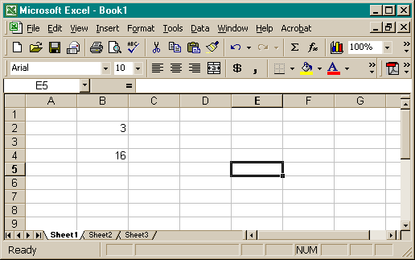
What does this code do?
ActiveCell.Offset(Range(“B2”),-2) = [b4]/4
4

Slide 5
Controlling Objects
Use assignment statements to change objects or properties
Different effects, similar results
  Range(“F3”).Value = Range(“D3”).Value*15
  Range (“F3”).Formula = “=D3*15”
  First form enter a number – no updates!
  Second form enters a formula

Slide 6
Collections
Worksheets
  Worksheets(1)
  Worksheets(“Sheet2”)
Columns
  Columns(“C:D”).HorizontalAlignment = xlCenter
Rows
  Rows(5).RowHeight = 19.5
Note difference between Row and Rows

Slide 7
Excel Methods
Record macros to define
Copy, Paste
  Range(“B3:D6”).Select
  Selection.Copy
Sort

Slide 8
Find a Given Cell
GoTo
  Edit, Goto, Special
  Last Cell
  Current Region
{End}{Down}
Find first column in the last row

Slide 9
Look-ups
VLookUp(value, table, col_num, close)
  Value: item to find
  Table: range of data to search
    Must be sorted by 1st column
  Col_num: which column has data?
  Close: true or false
    True: select nearest match – always finds
    False: find exact, or return #N/A

Slide 10
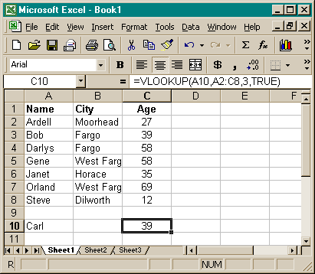
VLookUp
Value to LookUp
True: find closest match
Search range
Return column

Slide 11
Spreadsheet Functions in VBA
Application.WorkSheetFunction.Name(Arguments)
  Application.WorksheetFunction.Today()
Cell addresses must appear as ranges
  Application.WorkSheetFunction.IsNumber(Range(“B3”))
Most worksheet functions have a VBA equivalent
Functions must be used in assignment statements
  vAns = Application.WorkSheetFunction. _
  vLookup(Range(“A10”), Range(“A2:C8”), 3, True)
  vOut = Range(“A10”).formula & “ lives in “ vAns
  MsgBox vOut

Slide 12
Find()
VBA Function – not available on sheet
Expression.Find(What)
Expression must define a range on the spreadsheet
Returns Range location of first match
Expression range need not be sorted
If no match is found, it returns Nothing

Slide 13
Find( ) Function
Range(“C10”).Value = _
Range(“A2:A8”).Find(“Gene”).Offset(0,2).Value
Looks in cells A2:A8 for “Gene”,
returns [A5]
Offsets 2 cells right from [A5]
returns [C5]
Finds the value in [C5] = 58
Puts the value 58 in [C10]

Slide 14
User Defined Functions
You can write your own custom functions
  Decide what information will be passed in
  (Arguments)
  Decide what value will be returned
  Decide how VBA will use the arguments to calculate the returned value
  Example: Determine employee bunuses
    Argument: Amount of sales
    Return value: Bonus amount
    Bonus = 2% if Sales > $50,000

Slide 15
User-defined Functions
Form: Function Name(Arguments)
Unlike Sub – the name of the function
must be repeated in the code
  Function Bonus(Sales)
    If Sales > 50000 Then
    Bonus = Sales * 0.02
    Else
    Bonus = 0
    End If
  End Function

Slide 16
Using Custom Functions
Functions can be called from another sub
  vSales = Range(“B3”).Value
  vBonus = Bonus(vSales)
  Range(“C3”).Value = vBonus
Functions can be used in the spreadsheet
  Use Function Generator [fx]
  Look under “User-defined”
  Place cursor in [C3], write:
  =Bonus(B3)
Note how the results differ!
See VBAFunctions.xls in the handouts

Slide 17
Custom Menus
Define Variables
Use Set to define contents
Dim myButton As CommandBarButton
  Set myButton = CommandBars("Worksheet Menu Bar")_ .Controls("Tools").Controls.Add
  With myButton
  .Caption = "Say Hi"
  .MoveBefore:=4
  .OnAction = "SayHi"
  .FaceId = 2174
  End With
Caption: Words in menu list
MoveBefore: Position in list
OnAction: Macro to call
FaceID: Icon to display

Slide 18
Removing Menu Items
Search the existing buttons
Remove identified items
For Each Item In CommandBars("Worksheet Menu Bar")_ .Controls("Tools").Controls
If Item.Caption = "Say Hi" Then
Item.Delete
Exit For
End If
Next Item

Slide 19
Activating Custom Menus
Menu code goes in a macro
Macro must be run to make menu appear or disappear
Use WorkBook_Open to add menues
Use WorkBook_BeforeClose to remove
See SayHi.xls in the handouts

