Slide 1
Selling without suits
Presented by Chris Cormack // 9 March 2017

Slide 2
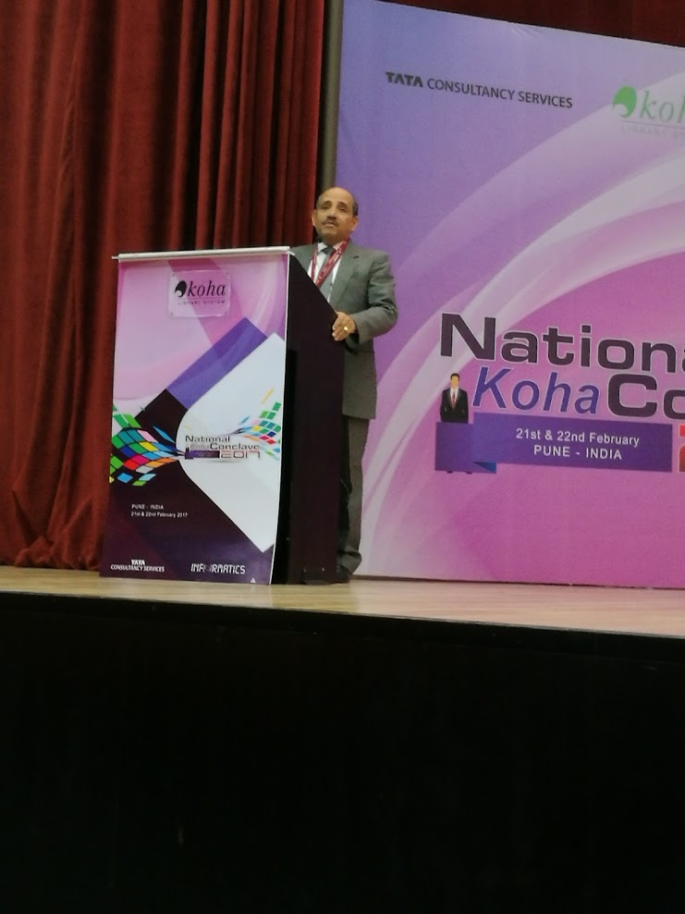
Where was I?

Slide 3
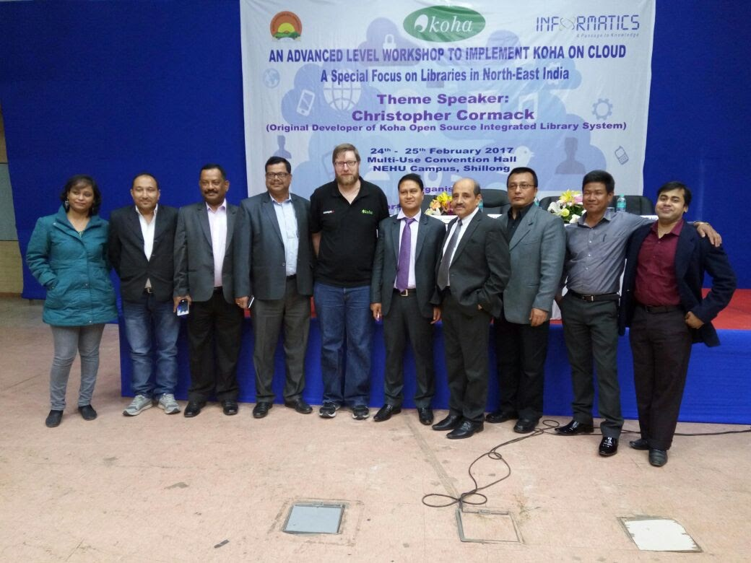
And here

Slide 4
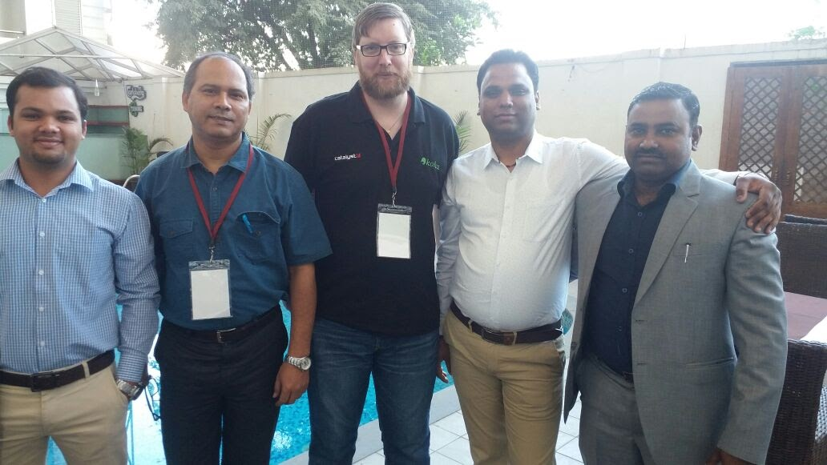
Relaxing more

Slide 5
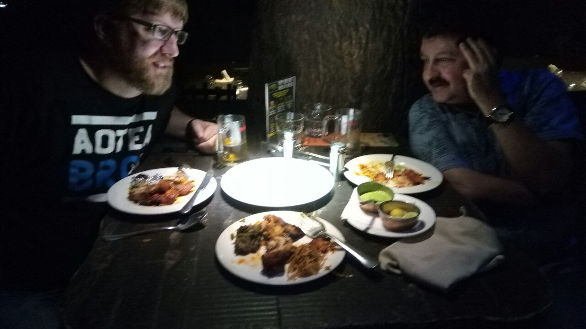
Eat and drink

Slide 6
Quotes
“We like you, because we don’t have to wear a suit with you”
“I changed the programme twice on Chris, and he just flowed with it, it is very unlike westerners”

Slide 7
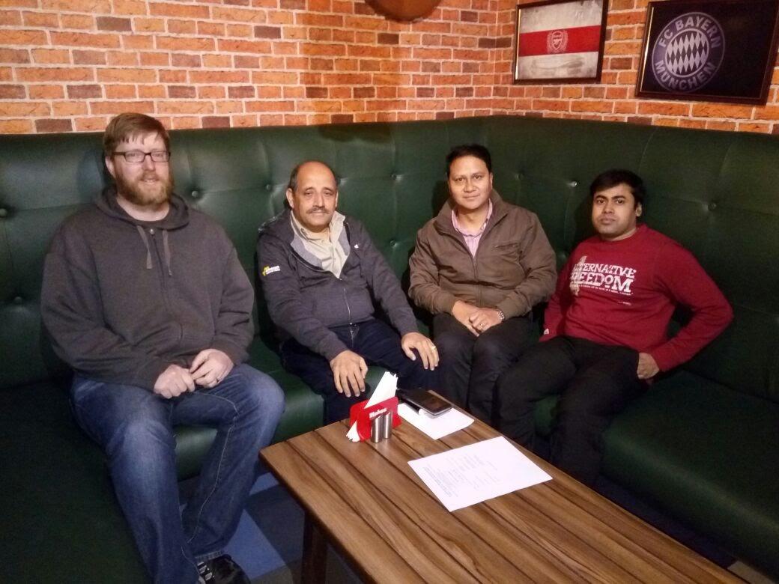
Success

