Slide 1


National e-portfolio system for the Medical Council
Presented by Catalyst IT // 26 June 2014

Slide 2
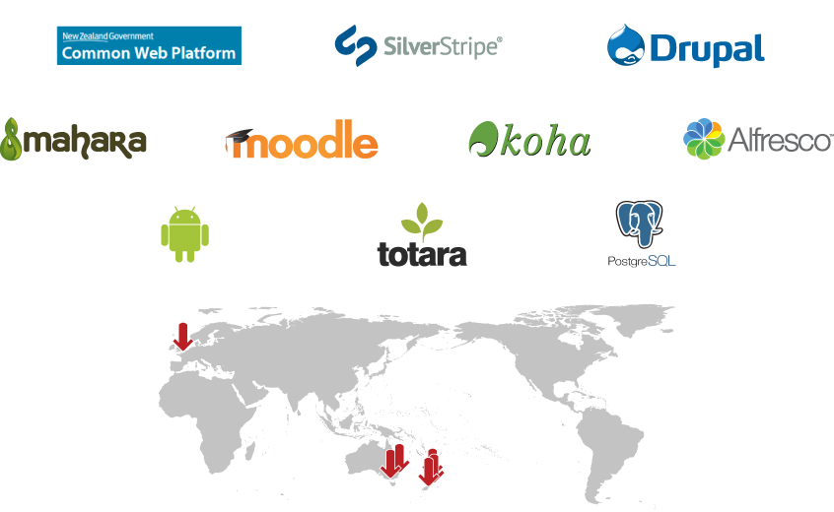
Catalyst – Open source technologists

Slide 3

Catalyst – Clients

Slide 4

Benefits of open source

Slide 5

Usage

Slide 6
Primary school to lifelong learning
Primary and secondary schools
Tertiary and medical institutions
Associations with accreditation requirements
Businesses
Communities of practice
Individuals

Slide 7

Example

Slide 8
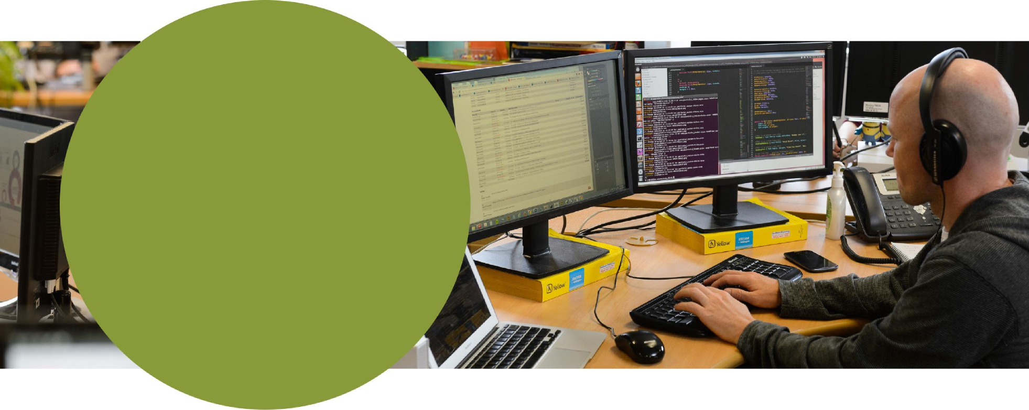
MVP

Slide 9
Delivery of the minimum viable product
Profile data
Skills log
Supervision forms
CPD / learning modules log
PDP – Setting goals

Slide 10

MVP benefits

Slide 11

Mobile

Slide 12

Approach

Slide 13
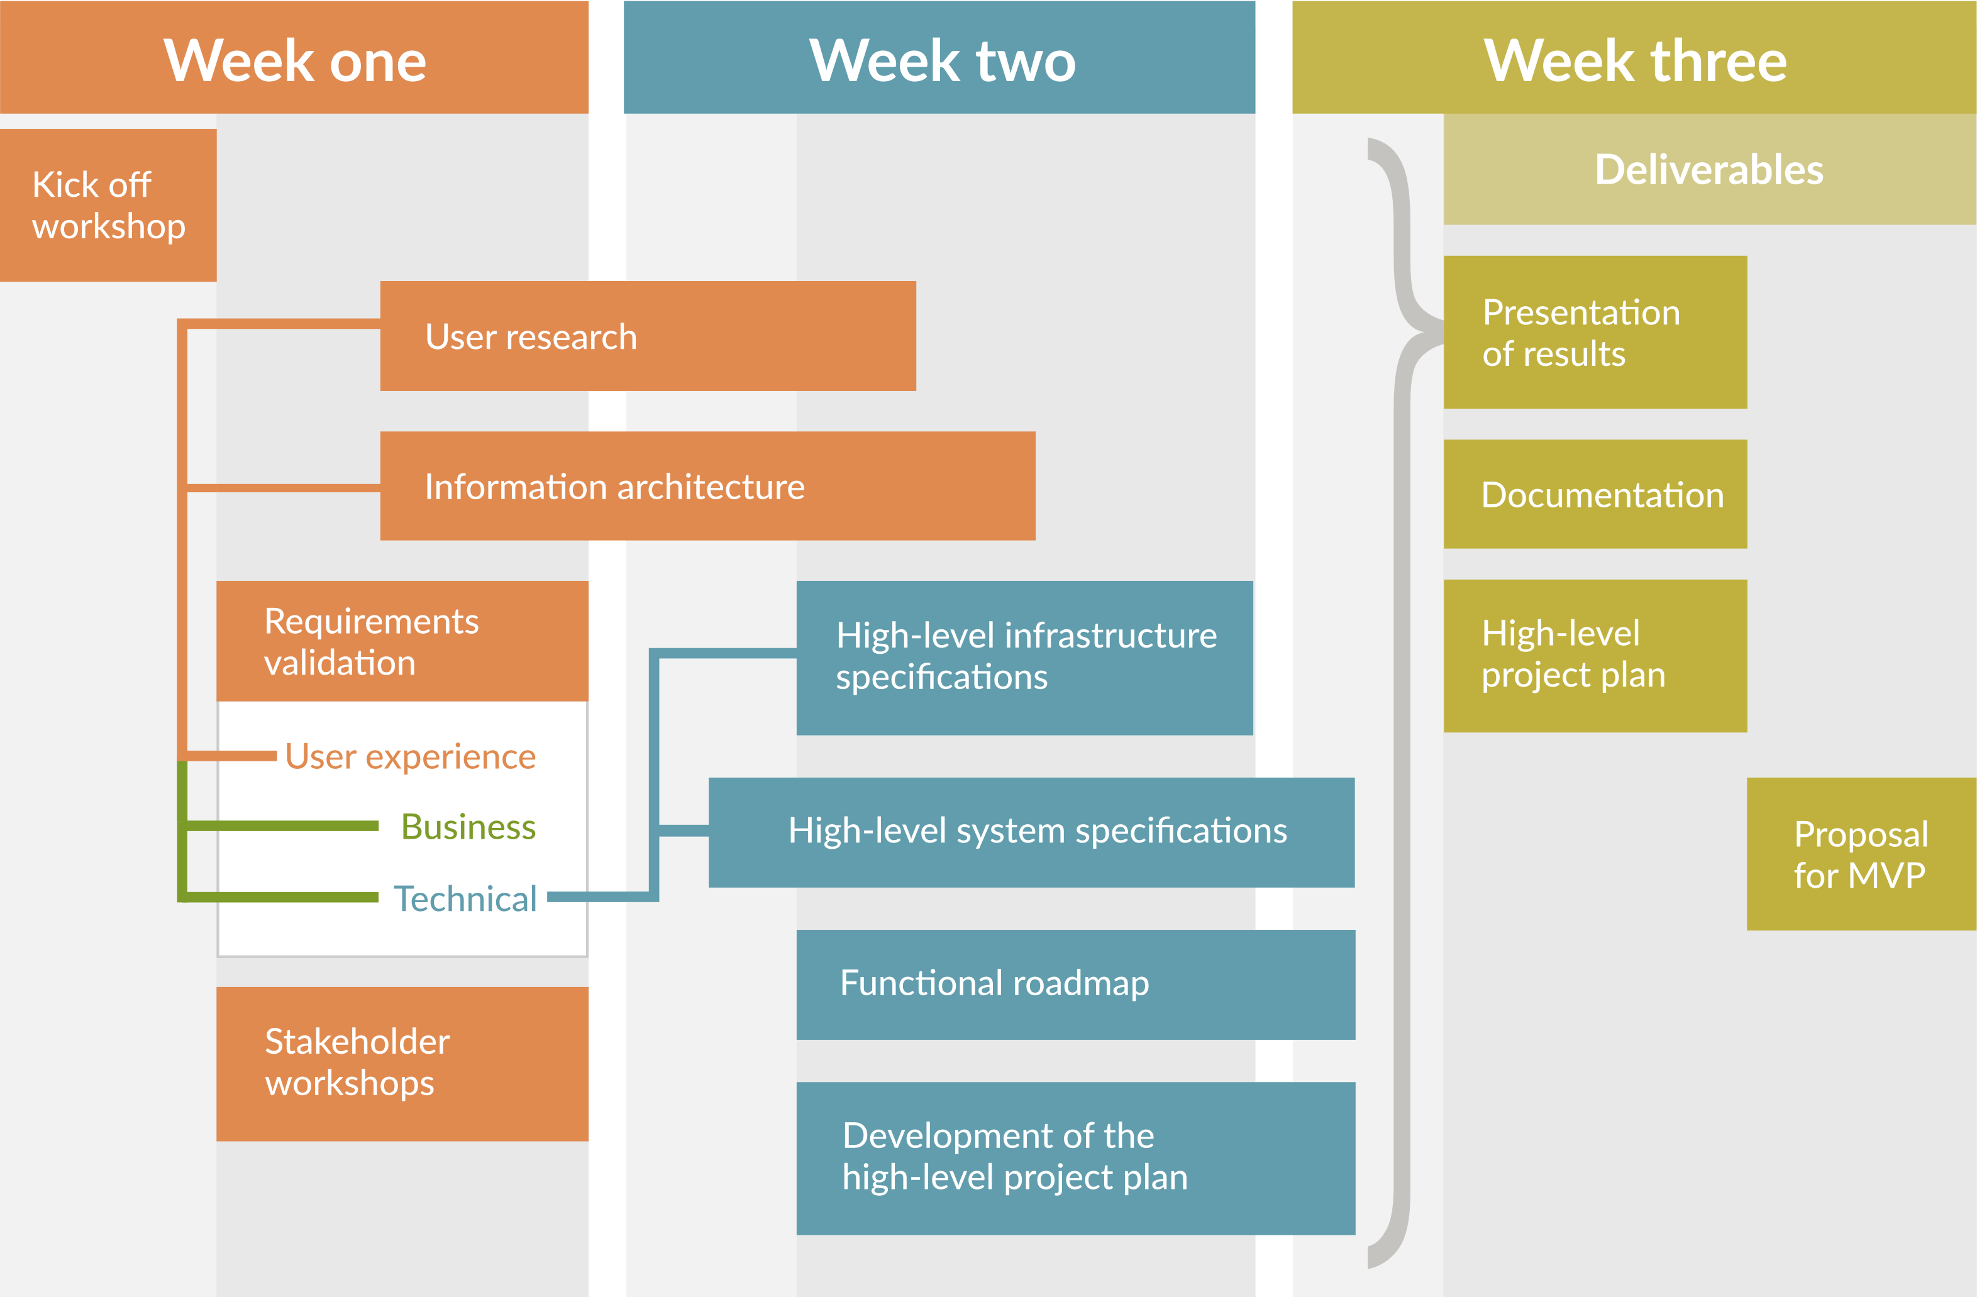
Discovery phase

Slide 14
Agile methodology
Appropriate to MCNZ
Iterative process
Responsive development
Collaborative work environment
Reducing risks

Slide 15
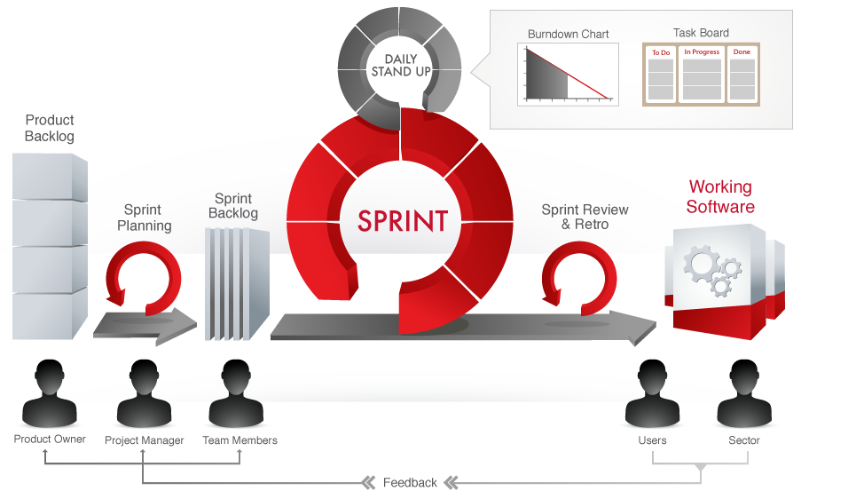
Agile methodology

Slide 16

Questions

