Slide 1
Koha and the cloud
Presented by Chris Cormack // 24 February 2017

Slide 2

Who am I?
Kāi Tahu, Kāti Mamoe, Waitaha
BSc Compsci, BA Maths and Māori Studies
One of the original Koha developers
Working at Catalyst IT
@ranginui on Twitter
chrisc@catalyst.net.nz

Slide 3
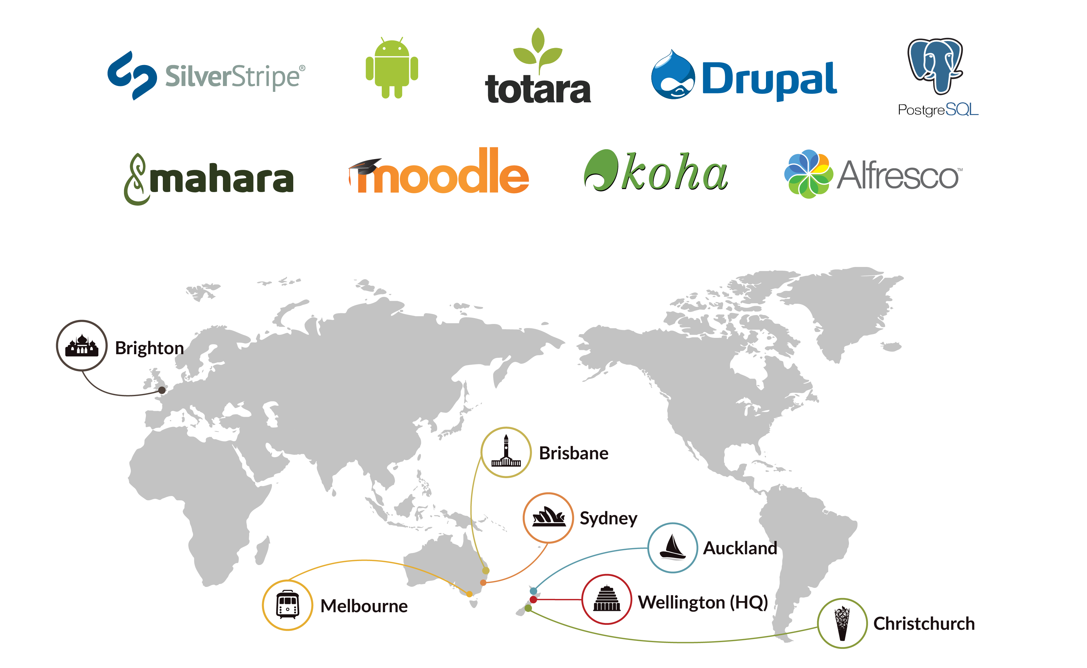
About Catalyst

Slide 4

Catalyst Clients

Slide 5
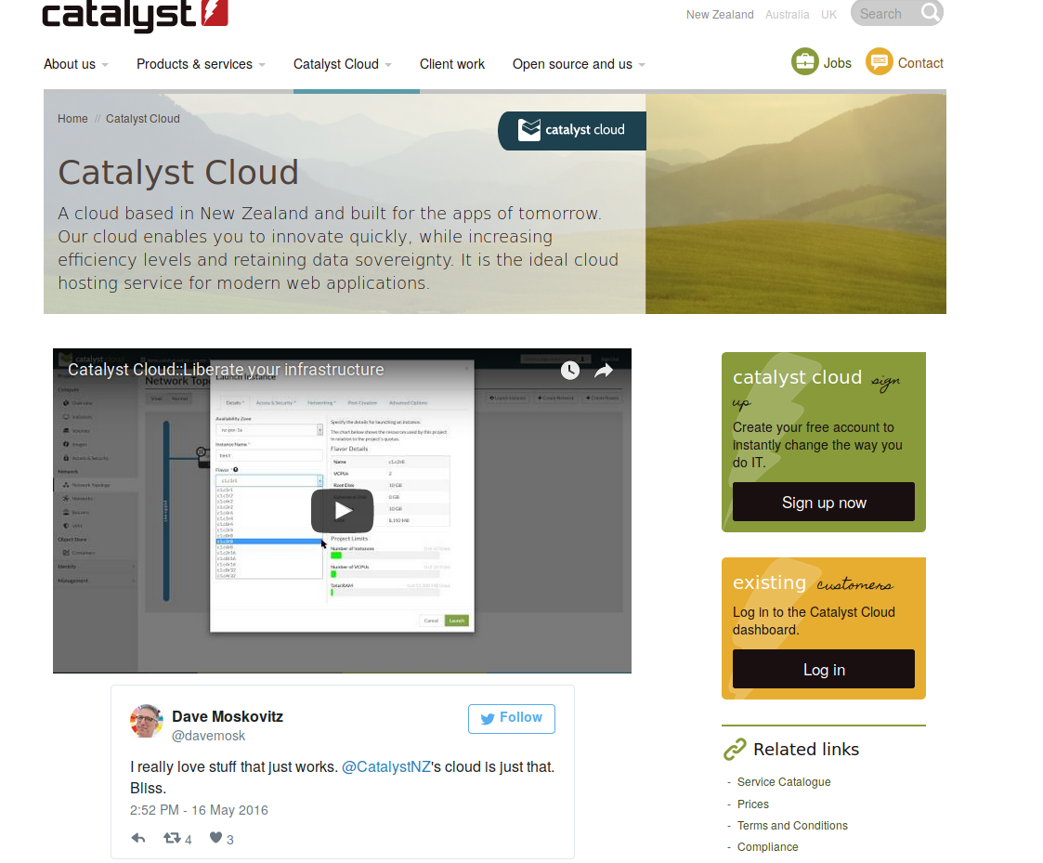
How does Catalyst use the cloud?

Slide 6
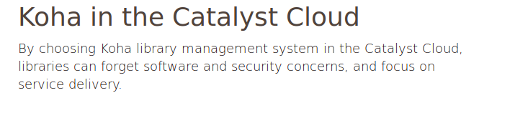
Koha and the Cloud

Slide 7
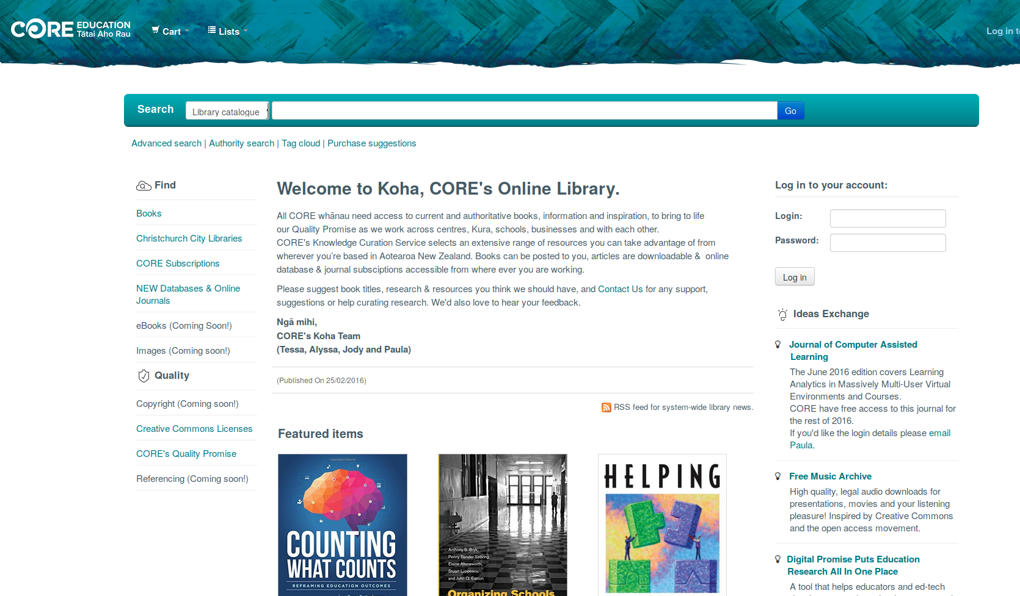
Some users

Slide 8
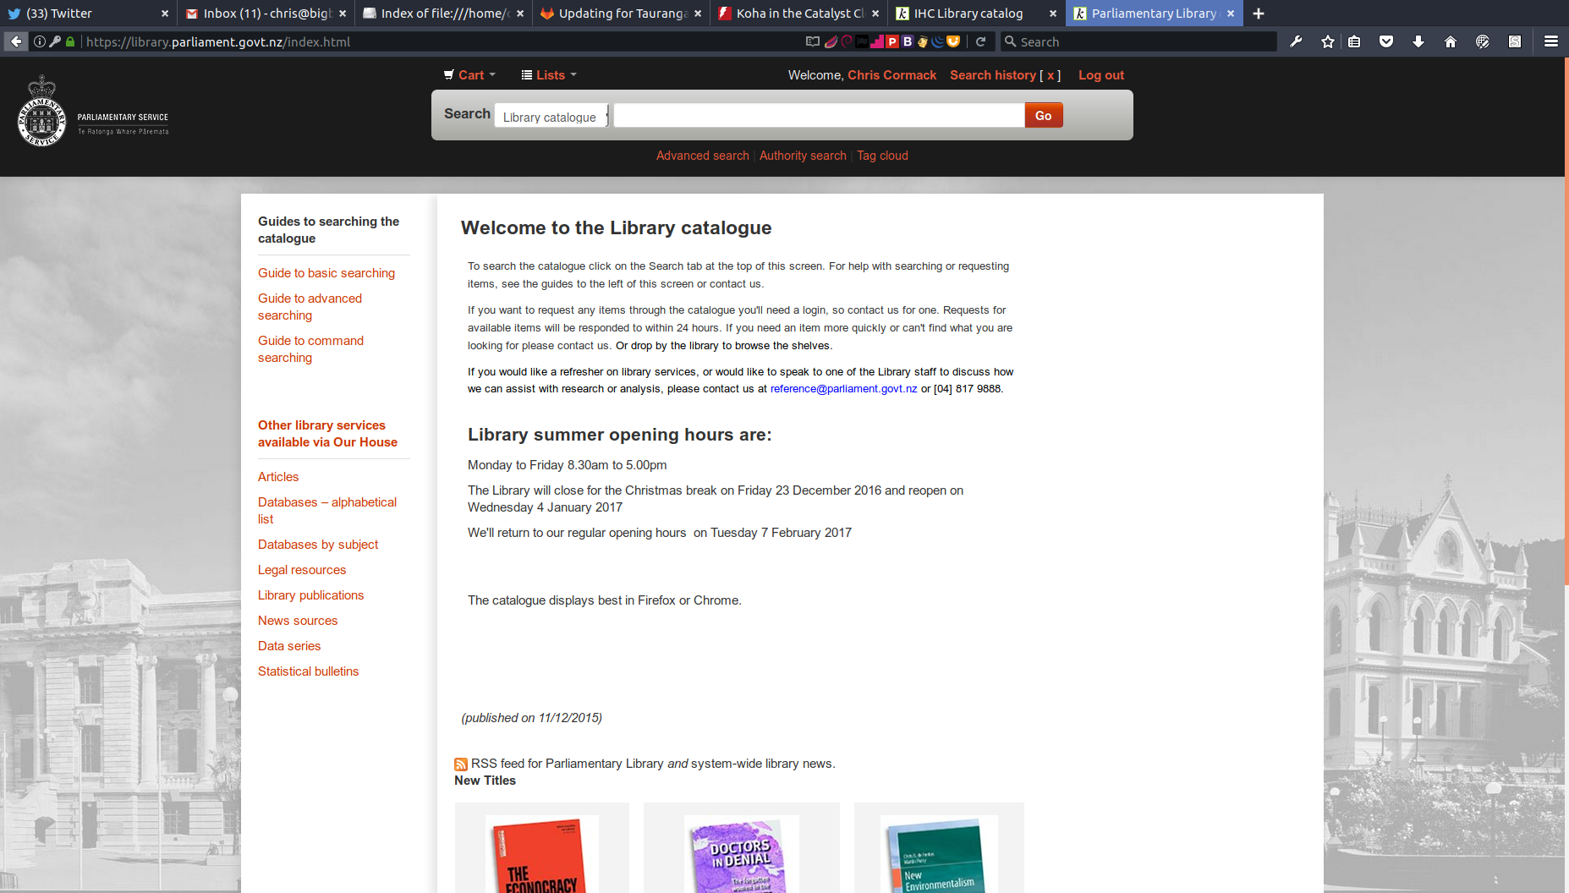

Slide 9
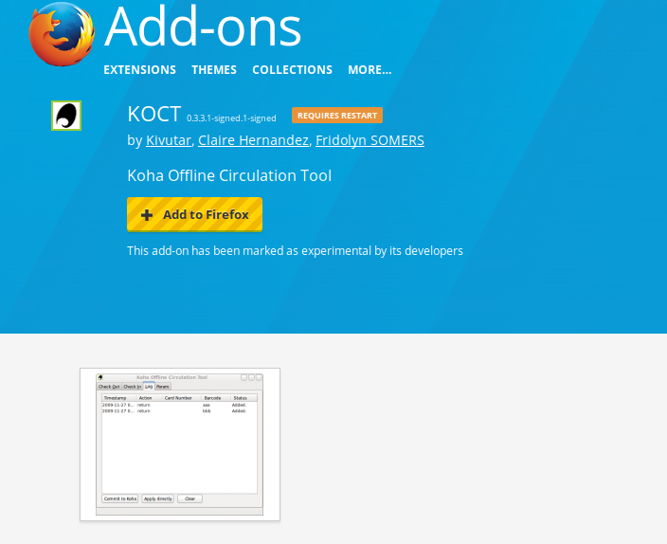
Offline Circulation

Slide 10
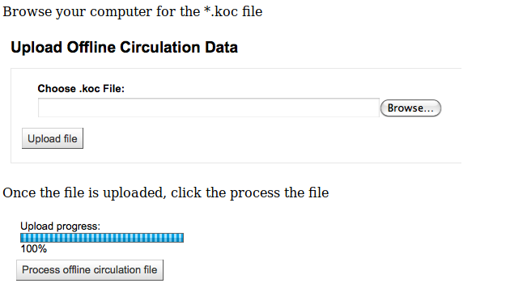
Offline Circulation

Slide 11
AJAX
Transfer small amounts of data
Only fetch what is needed
‘Lazy’ Loading

Slide 12
Questions

