Slide 1
Te Haerenga ō Koha
Presented by Catalyst // 25/09/2017
Notes:
Ka tangi te tītī, ka tangi te kākā, ka tangi hoki ko au
Tihei mauri ora
Ki ngā kaiwhakahaere o tēnei hui, tēnā koutou
Ki ōku whanaunga no tēnei rohe, tēnā koutou
Ko Aoraki te mauka
Ko waiau te awa
Ko Uenuku te whare
Ko Moeraki te marae
Anei tētahi uri o Tahu Potiki e tu ana.
Nō Te Awa kairangi toku whānau
Ko Te Awa kairangi te awa
Ko Te Awa kairangi toku whakakainga...
Aka I am well and truly from Lower Hutt!
Ko Pākeha ahau
Ko au te potiki o te whanau.

Slide 2
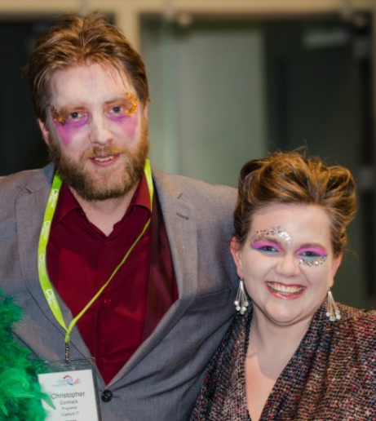
Ko wai maua?
Notes:
Ko Chris Cormack ahau
Anei tōku hoa mahi. Ko Kathryn Tyree tōnā Ingoa. E mahi ana maua ki Catalyst IT
Ka nui te koa ki roto i to maua ngakau, kua huihui mai koutou ki te whakarongo ki a maua.
Aroha mai mō tōku reo. Kaore au e kōrero ki roto i te reo i te nuinga ō te wa.
Hei aha, me timata tātou
This is Chris Cormack, and I’m his colleague Kathryn Tyree.
We work at Catalyst IT
Great is the joy in our hearts that you have gathered here to listen to us
Well then, lets start.

Slide 3
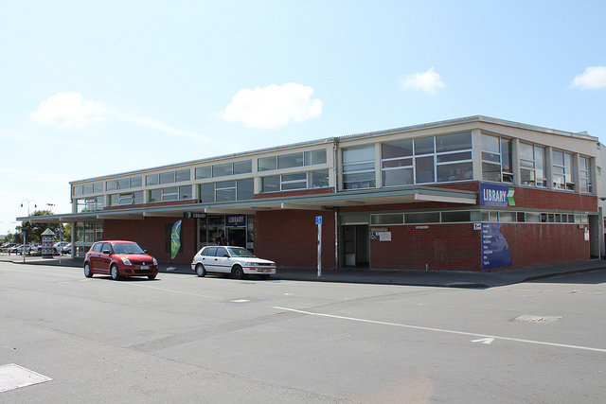
Te timatanga
CC-BY-SA Kristina D.C. Hoeppner
Notes:
Anei te kōrero paki mo tētahi pūmanawa rorohiko āra Ko Koha, me te hapori Koha hoki.
I te tau kotahi mano, iwi rau, iwi tekau ma iwi, hei te marama o Here-turi-kōkā ka timata tēnei kōrero paki.
I ngā rā o mua, I tu ētahi whare pukapuka kei roto i te rohe o Horowhenua.
Here is the story of the software called Koha, and the Koha Community also
In the year 1999, in the month of August this story starts
In those days there stood some libraries in Horowhenua

Slide 4
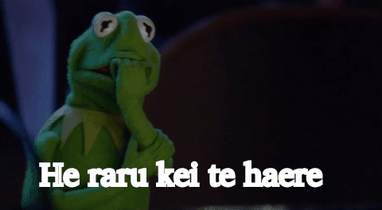
He raru kei te haere
Notes:
Engari he raru kei te haere, nā te mea I whakatata te tau rua mano. He tau whakamakutu tērā mo ngā tangata kaimahi rorohiko.
But, something bad was lurking, because the year 2000 was getting close.
A year to strike fear into the hearts of
software programmers

Slide 5
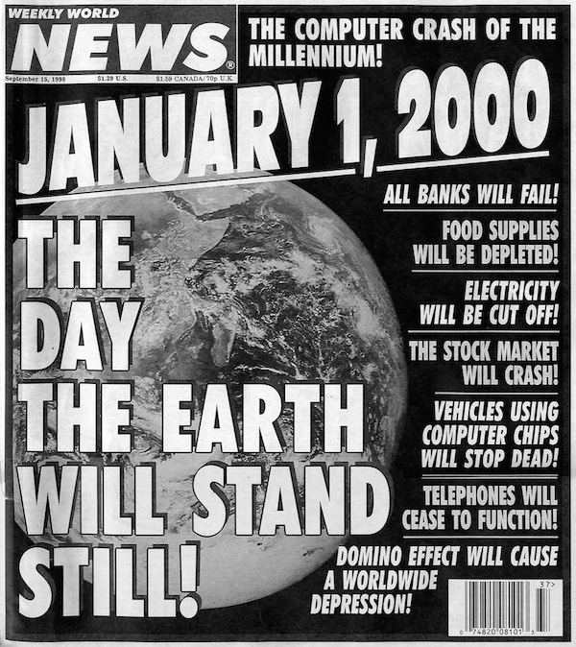
Y2K
Notes:
E ki ana te kōrero, ka pakaru ngā mea katoa I tae ana i tērā tau.
According to talk, everything was going to break that year

Slide 6
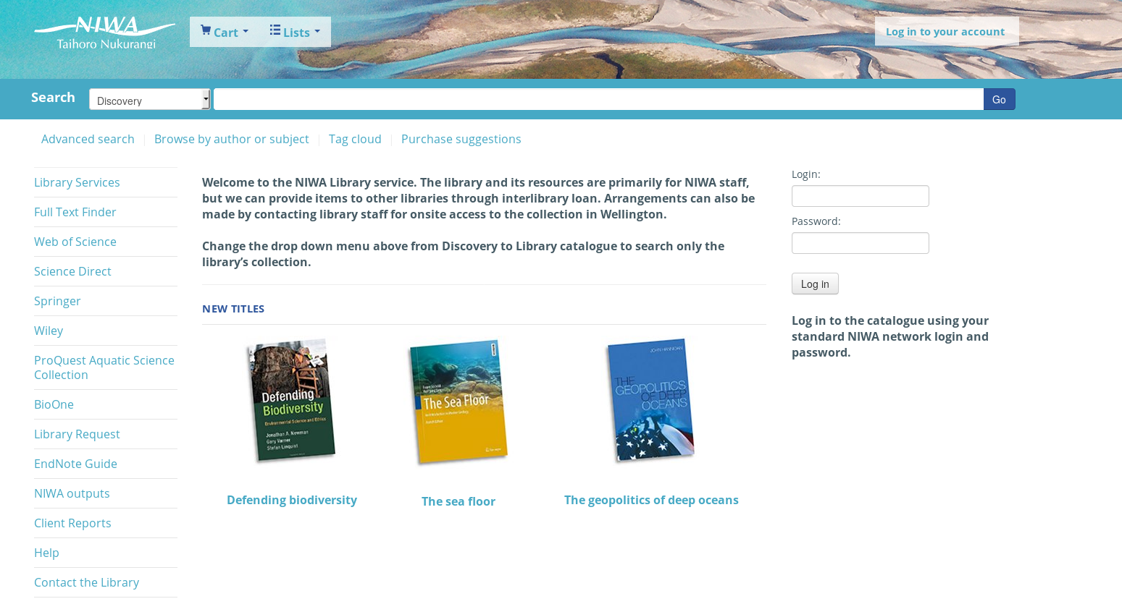
Ka puta
Notes:
Ka pakaru te pūmanawa o ērā whare pukapuka, a ka puta he pūmanawa hou, ko Koha te ingoa.
The software for these libraries was going to break, so a new piece of software was born, called Koha

Slide 7
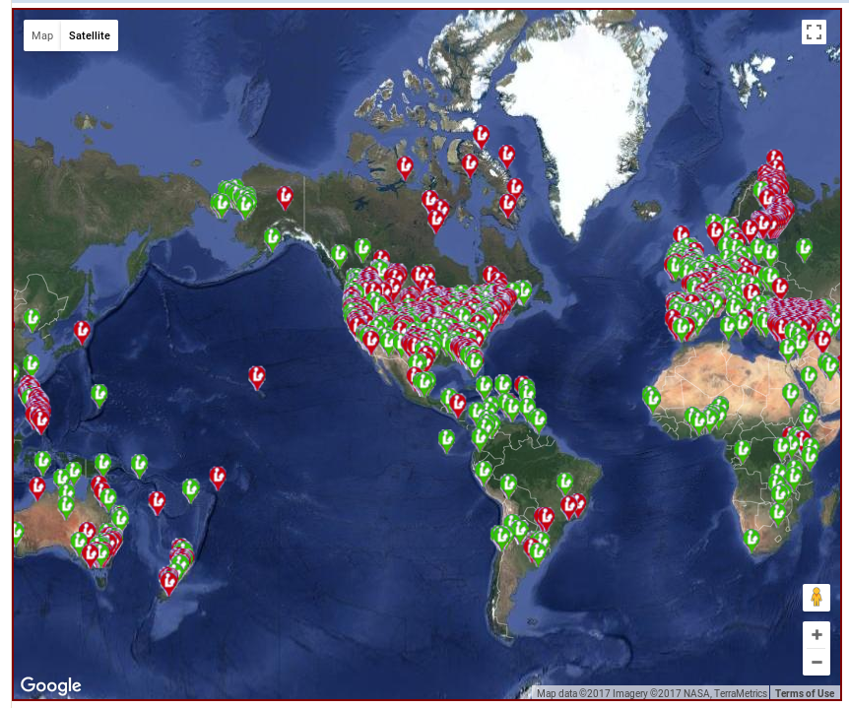
Stats
“I generally agree with Catalyst that the number of implementations around the world is something in the 15,000 range. I often mention in my talks that it is likely that Koha is the most implemented ILS globally.” - Marshall Breeding
Notes:
I tipu mai tēnei pūmanawa ā ka puta tētahi hapori kei te tautoko tēnei
Inaianei,
Tekau ma rima mano whare pukapuka e whakamahi ana
Toru rau ngā kaituhi waehere e tuhi ana
The software grew and a community was born. Koha gone and got big.
Now we are a community of:
15,000 libraries around the world
Over 300 developers
Over 50 vendors
Over 3 Million lines of code
Translated into over 50 languages...Koha would be tiny, if it wasn’t created to be blingual from the very start.

Slide 8
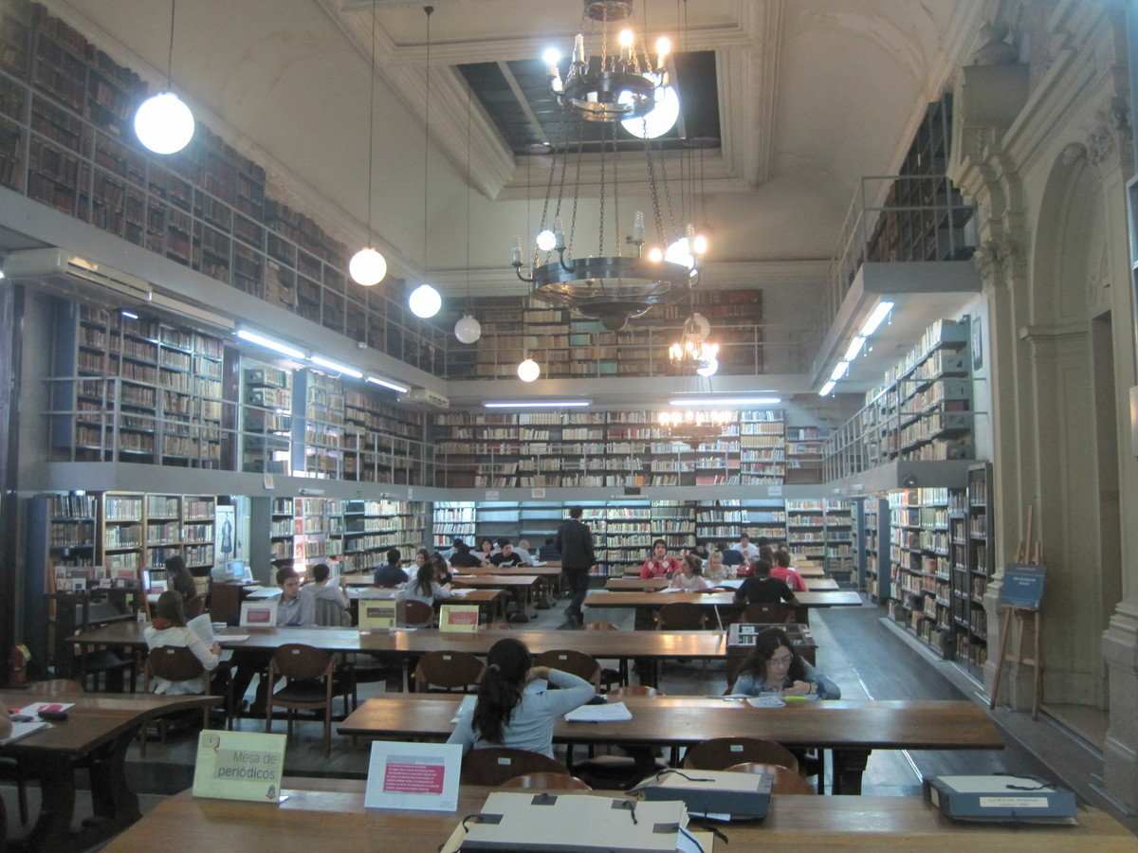
Kohacon
Paul Poulain - By Permission
Notes:
Ko te mea nui o te hinonga nei, me hui mātou ki te kōrerorero matou, kanohi ki te kanohi. Nā reira, he Kohacon ngā mea whakahirahira.
Ko Wīwī te wahi tuatahi
The main thing for this project is we meet to discuss, face to face. Therefore Kohacons are important.
France was the first place where Kohacon was held.
Koha grew very fast in France, not least because English could easily be translated away.

Slide 9
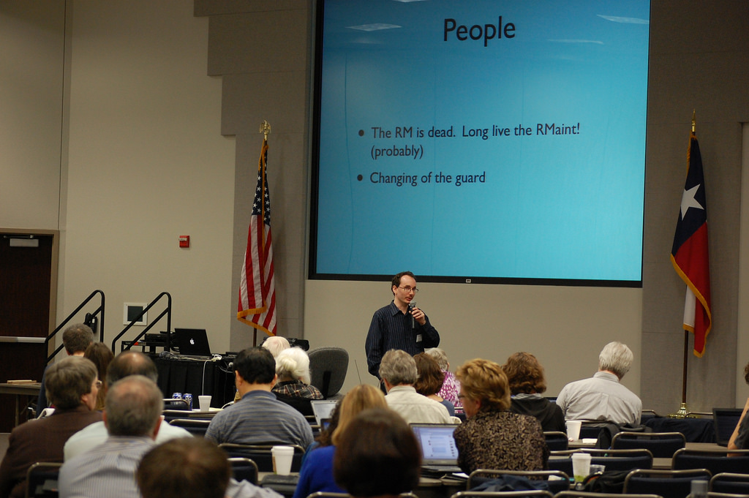
Kohacon
Notes:
Ngā Whenua Tōpū o Amerika
Then the USA

Slide 10
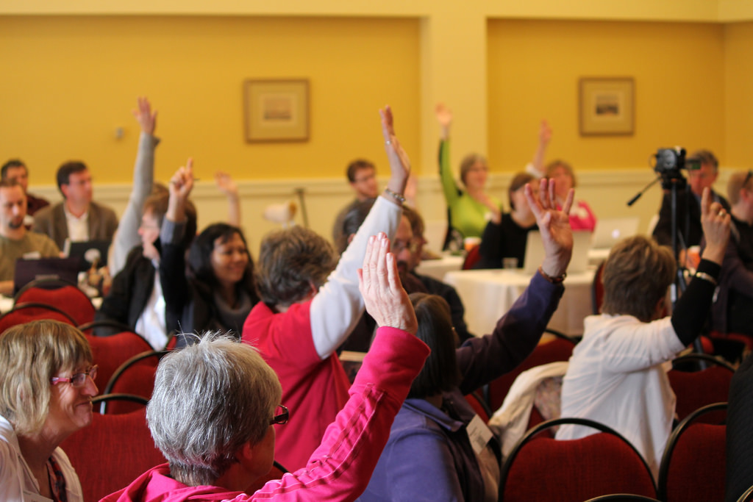
Kohacon
Notes:
Aotearoa
New Zealand

Slide 11
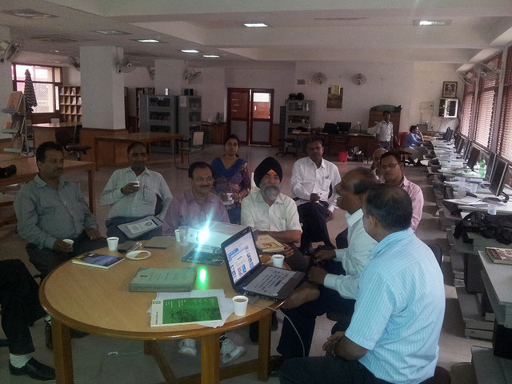
Kohacon
Notes:
Īnia
India

Slide 12
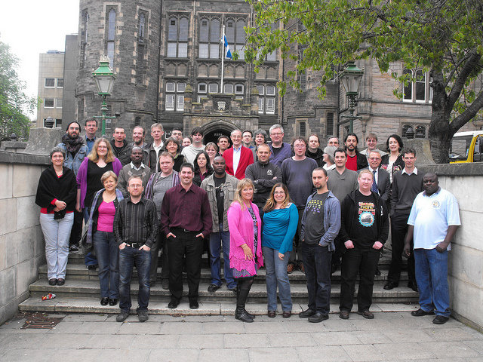
Kohacon
Notes:
Kōtirana
Scotland

Slide 13
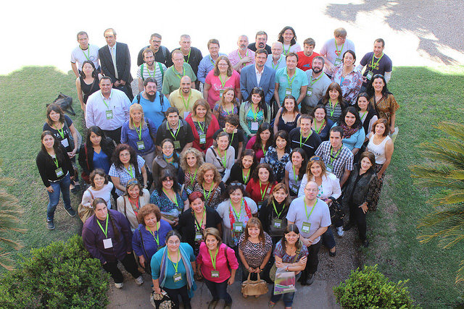
Kohacon
Notes:
Āketina
Argentina

Slide 14
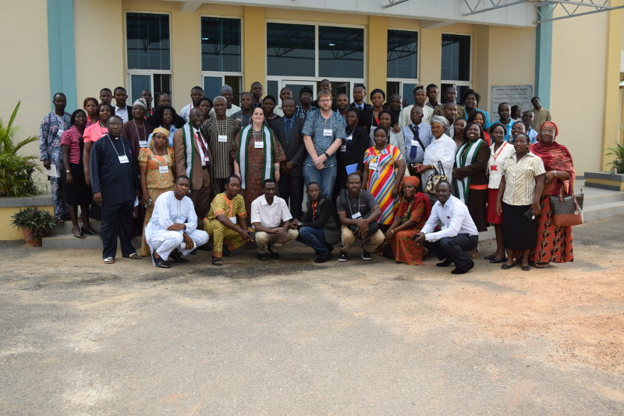
Kohacon
Notes:
Ngāitiria
Nigeria

Slide 15
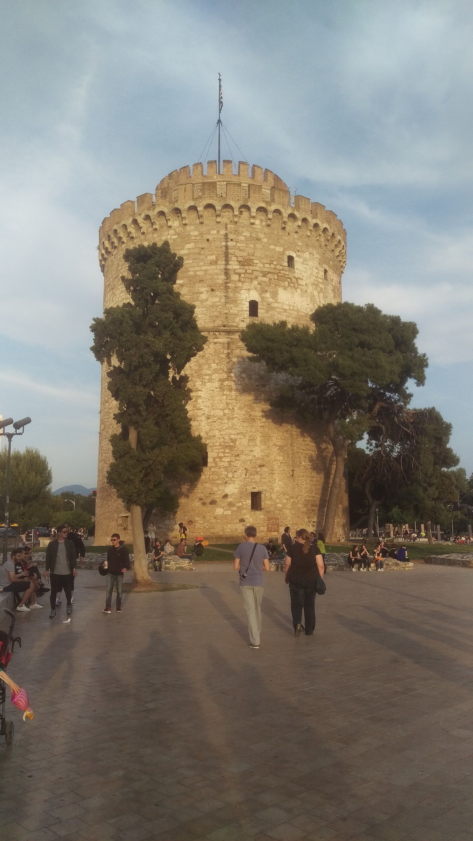
Kohacon
Notes:
Kirihi
Greece

Slide 16

Kohacon
Notes:
Piripīni
Phillipines

Slide 17
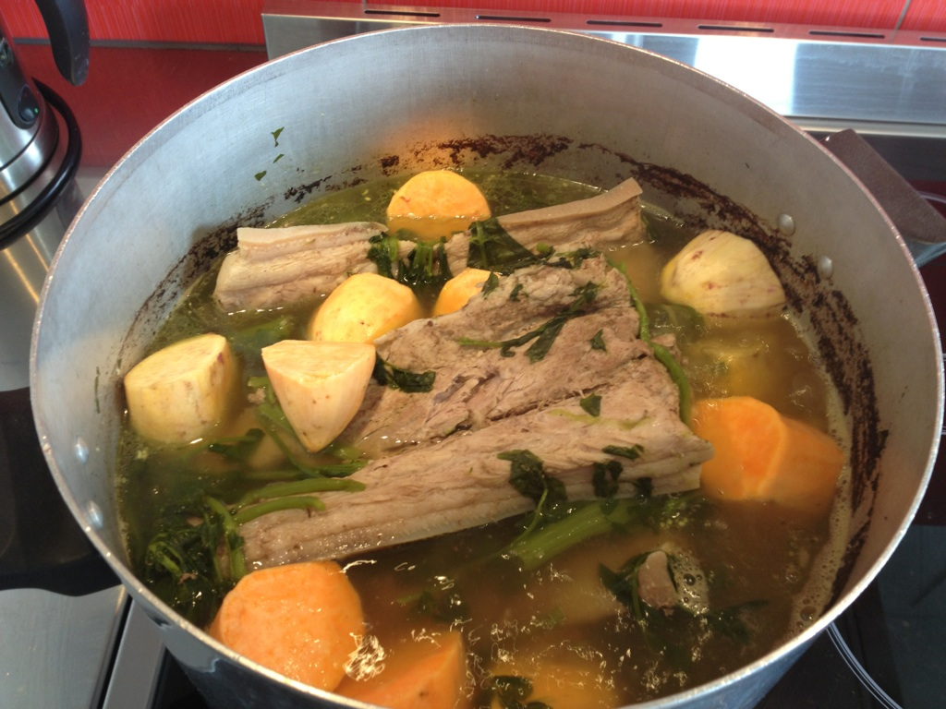
Koha is for everyone / He rau ringa e oti ai
Notes:
Koha is a community where everyone is welcome, and everyone contributes
Libraries big and small start in the same place, with the same tools. Big libraries may contribute more, and take smaller, less funded libraries on the journey. Everyone spends their budgets on software improvements and support. No one spends a cent on license fees.
Contributions can be code, documentation, a report for the community respository, or simply sharing sometihng you learned.
Ko te hapori Koha, te whanau Koha pea, he whanau whānui. E ki ana te kōrero, he waka eke noa, na te waka o Koha tēnei.
He tikanga o Koha tēnei. He tikanga o wharepukapuka tēnei. He tikanga Māori tenei.

Slide 18

Open
Notes:
Based on our shared value of openess, the community is strong.
Libraries exist to be open and to share. Koha would not still exist if it were not open.
Sharing and openess makes software strong, and helps protect the data of your communities – our modern-day taonga.
This is why we get out of bed in the morning.
(I can say more, you can say āe)

Slide 19

Tātou Tātou
Notes:
Naku te rourou, nau te rourou ka ora ai te iwi.
Ko te kaupapa o ngā whare pukapuka he tohatoha matauranga.
Ko tēnei te kaupapa o te hinonga nei hoki.

Slide 20

He Taniwha kei roto i tēnei korero
Notes:
Kei hea to koutou raraunga? Ara nga raraunga o to koutou hapori.
Nō te kī taurangi a ngā whare pukapuka kia mau rātou ki ngā uara o te Urunga Tuwhera ki ngā Mōhiohio, kāore mātou e kōrero ana mō ō mātou mōhiohio whaiaro e rokirokia ana i raro i ngā ture o ētahi atu whenua, ko te tikanga ko Te Hononga o Amerika.
Where is your data?
And when I say yours, I mean, the data of the the community you serve?
See, when libraires promised to uphold the value of Open Access to Information, communities didn’t mean our personal information should be used by, or stored in a country subject to legislation of other jurisdictions, most commonly the US.
Kei hea tō koutou mana raraunga?

Slide 21
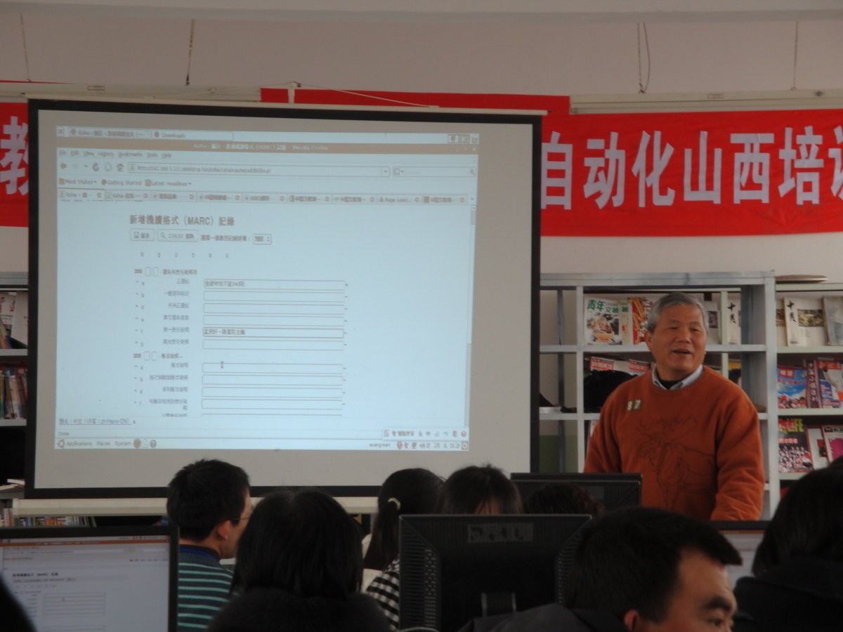
Happy Stories
Notes:
Anei tētahi tangata no Taiwana. Ko Anthony Mao Lins tōna ingoa.
Mai te tau rua mano ma iwa I mahi ia ki te hotaka tēnei. Ia tau, ia tau ka haera ia rātou ko tōna tauira ki Haina, ka tāuta rātou tēnei hotaka ki roto i ngā whare pukapuka i tērā wahi.
Ka ako ngā tauira, ā ka awhina rātou ki ngā tāngata o tērā wahi
This is a person from Taiwan. Anthony Mao Lins is his name. Since 2009 he has worked on this programme/software. Every year he and his students go to China. They install Koha for libraries.
His students learn, and they help people who may not have otherwise had library software with using a world-class system.

Slide 22
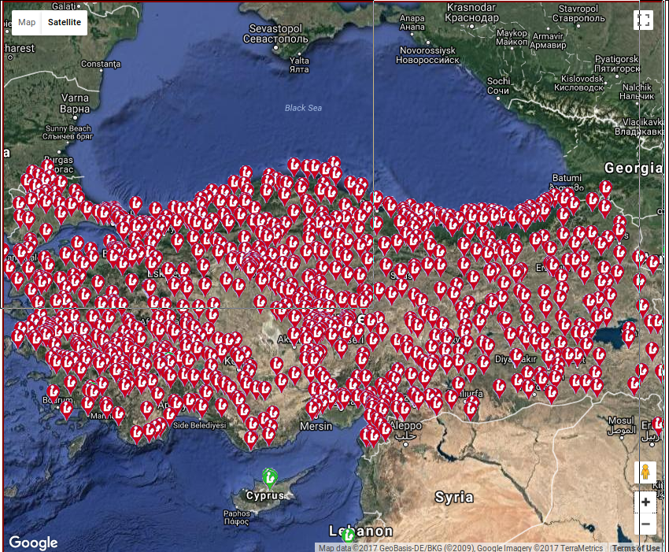
Happy Stories
Notes:
Koha was chosen by the Ministry of Culture and Heiritage of Turkey to provide a shared library system for it’s 1132 public libraries.
They used a combination of a hired vendor and inhouse staff to migrate all libraries to Koha in a two year period.
The whole system is run on a cluster of 15 servers.
I kōwhiringia te Manatū Taonga o Tākei ki te pumanawa nei. Inaianei, ko Koha te pumanawa o nga wharepukapuka katoa o tera wahi. Kotahi mano, kotahi rau, toru tekau ma rua te nama o nga wharepukapuka.

Slide 23
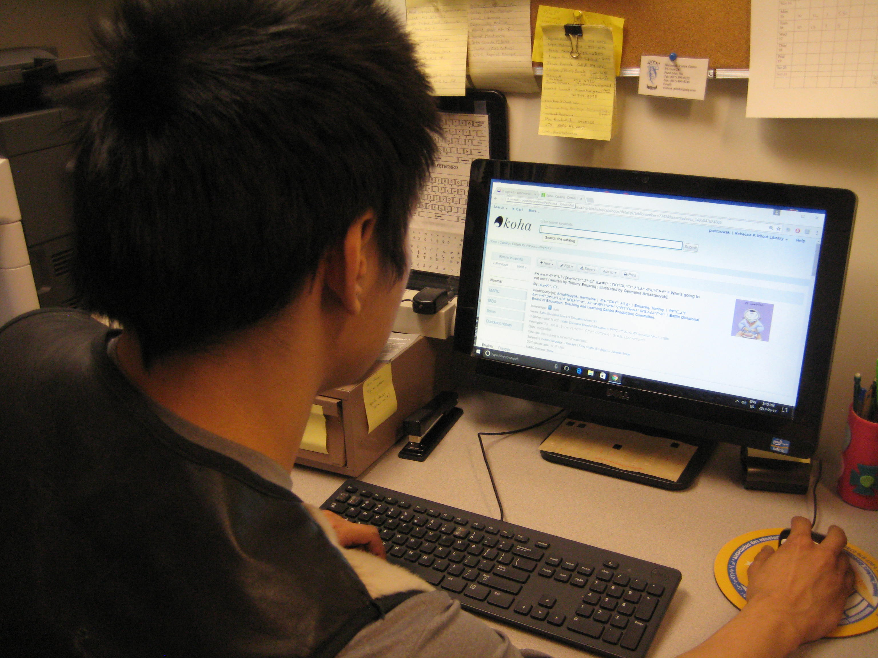
Happy Stories
Notes:
Anei tētahi tangata whenua ō Nunavut. He kaimahi ki roto i tētahi wharepukapuka o tera wahi. Ko Koha te pumanawa o nga wharepukapuka katoa o tera wahi.
Ki a au, Tau ke tēnei. Ka awhina nga tangata whenua o Aotearoa ki nga tangata whenua o tawahi
Here is an indigenous person of Nunavut, a north-west territory of Canada in the artic circle.
All public libraries in Nunavut use Koha.
To me this is amazing,
Worked on by Māori in NZ, used by Inuit in Nunavut, indigenous people helping indigenous people.

Slide 24
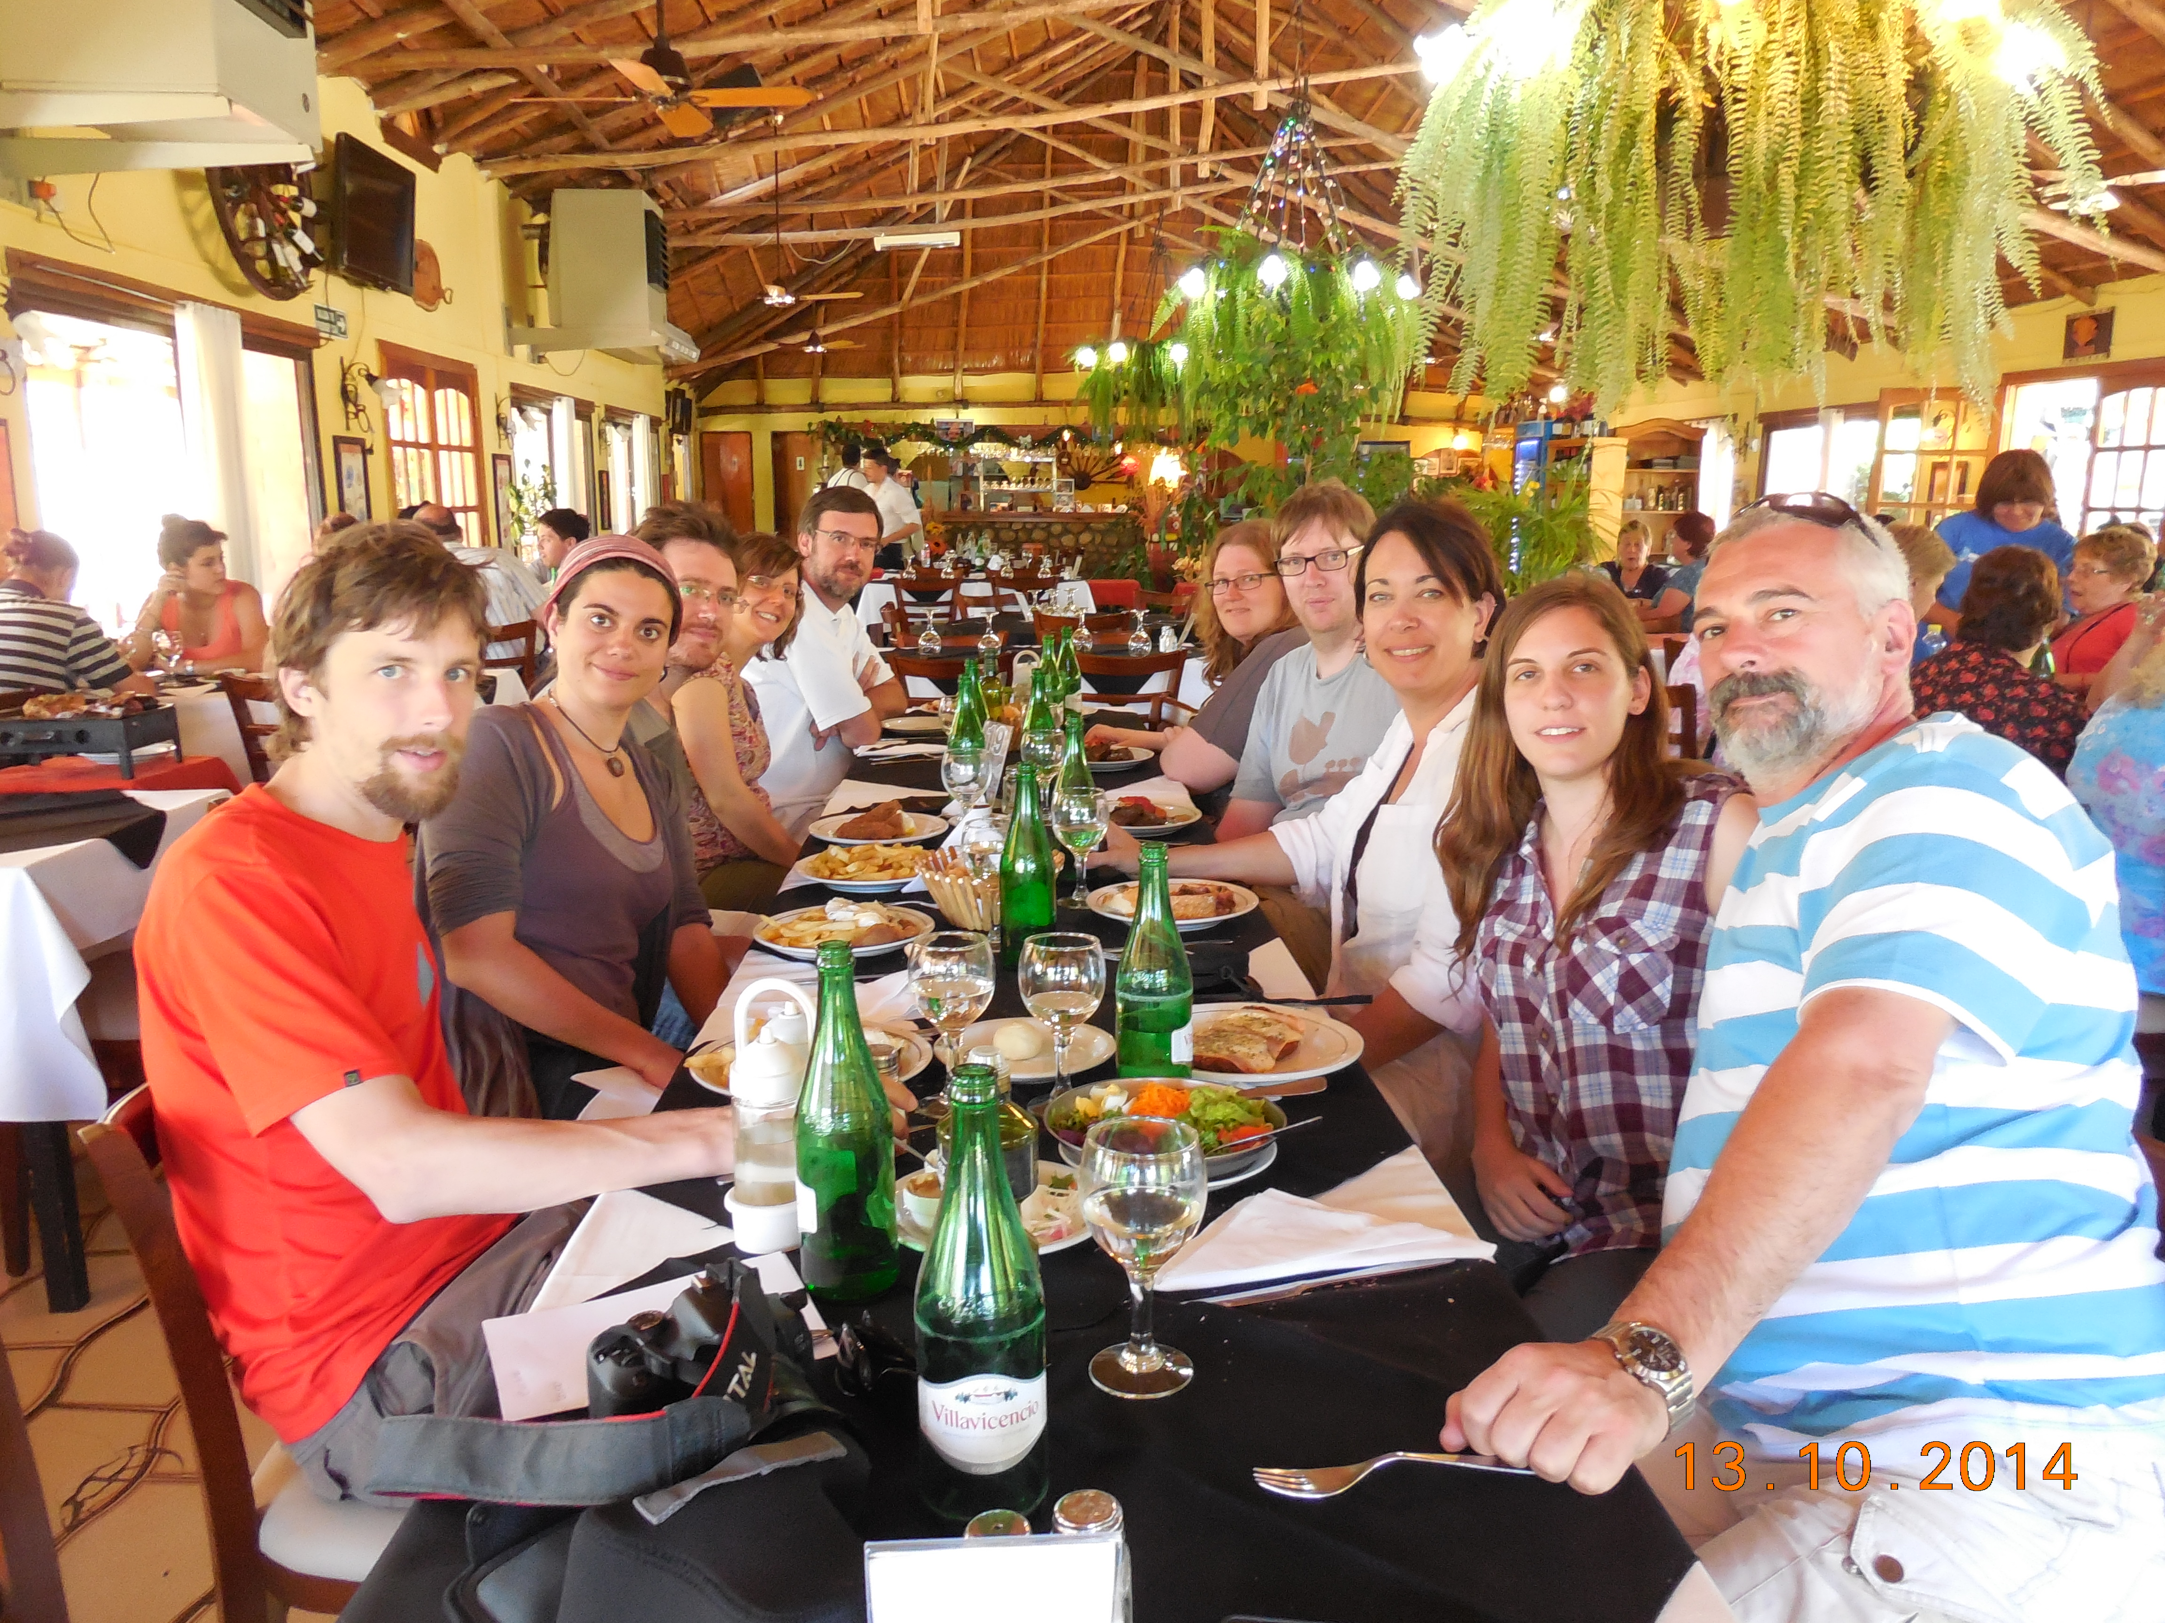
Finish need an image
Notes:
Te Haerenga o Koha is the story of the libraries who chose to be open, and succeeded
As Olungbenga Adara, a Koha librarian from Nigeria, once said “Alone we go faster, together we go further.”
Ehara taku toa i te toa takitahi. Engari, he toa takitini.
No reira tēnā koutou,
Tēnā koutou,
Tēnā tātou katoa.

