Slide 1
He aha te mea nui?
Presented by Chris Cormack // 4/6/2016
Notes:
Whano whano haramai te toki
Haumi e hui e taiki e
Tuatahi nga miihi ki nga tangata whenua tenei rohe ara nga tangata wathaurong
Na ratou te mana me te kaitiakitanga o tenei wahi.

Slide 2

Who am I?
Kāi Tahu, Kāti Mamoe, Waitaha
BSc Compsci, BA Maths and Māori Studies
One of the original Koha developers
Working at Catalyst IT
@ranginui on Twitter
That fulla who lost his bag

Slide 3
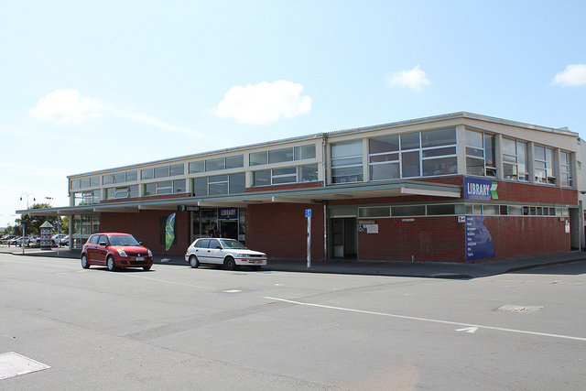
Brief history of Koha

Slide 4
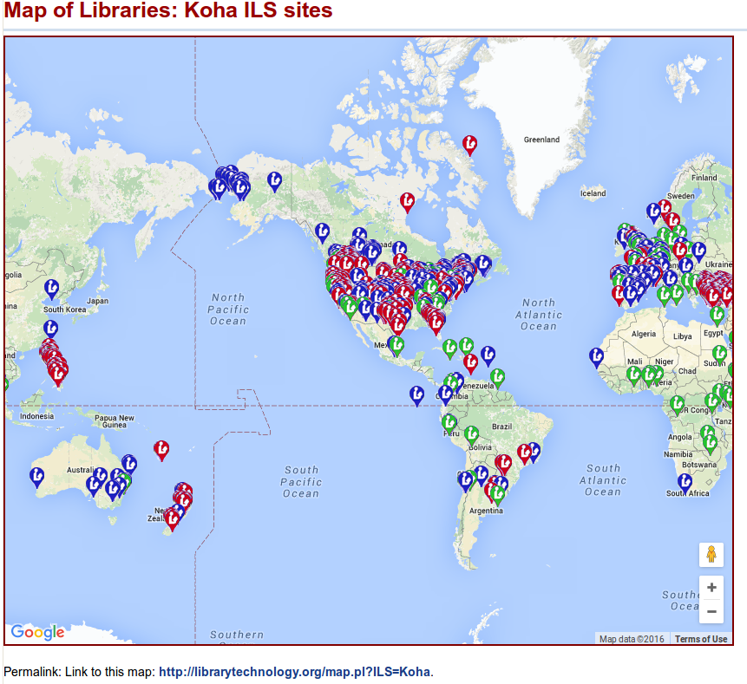

Slide 5
Some statistics
27,234 Commits
295 people have had patches accepted
Kohacons in Texas USA, Wellington NZ, Thane India, Edinburgh Scotland, Reno USA, Cordoba Argentina, Ibadan Nigeria. (Thessaloniki Greece this year in May … you should come)
50+ support companies around the world
Translated into 30(ish) languages

Slide 6
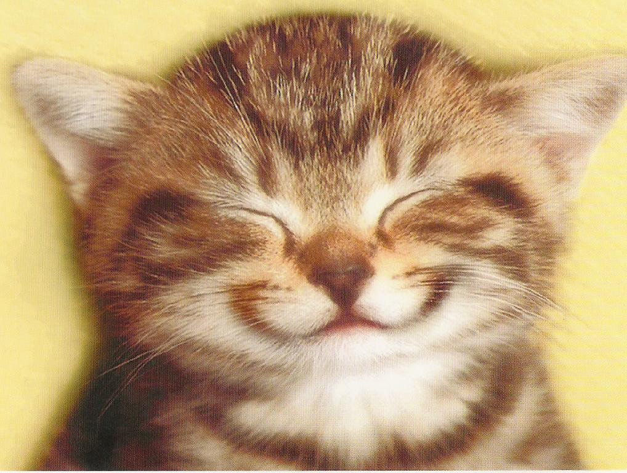
Stuff that makes me feel good

Slide 7
Issues

Slide 8
Mai ra ano
Nā tō rourou, nā taku rourou ka ora ai te iwi.
Ehara taku toa i te toa takitahi, engari he toa takitini.
He waka eke noa.
Ma tini ma mano ka rapa te whai.
Notes:
With your basket and my basket, we'll feed the people
My success should not be bestowed onto me alone, as it was not individual success but success of a collective
A canoe which we are all in with no exception.
With the many, the thousands the task will be done

Slide 9
Mana tangata
“To be a person is not to stand alone, but to be one with one's people, and the deeper the oneness the more we are truly persons and have that mana tangata.”
- Michael P Shirres : 2000

Slide 10
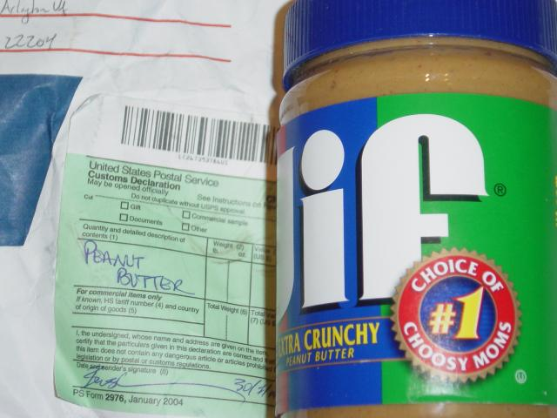
Whakanuia

Slide 11
Kaiakopono
“
“Not everyone needs to be the Welcome Wagon -- but someone ought to be.”
- Esther Schindler : 2009

Slide 12
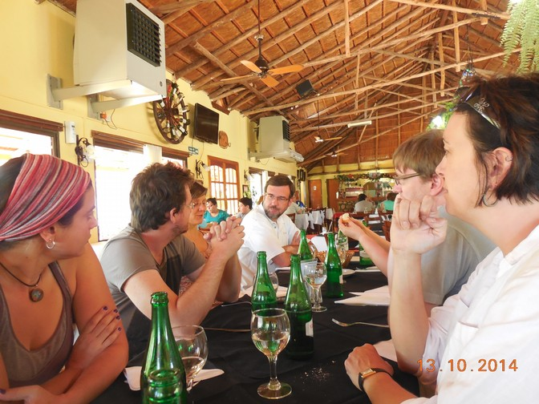
Korerorero

Slide 13
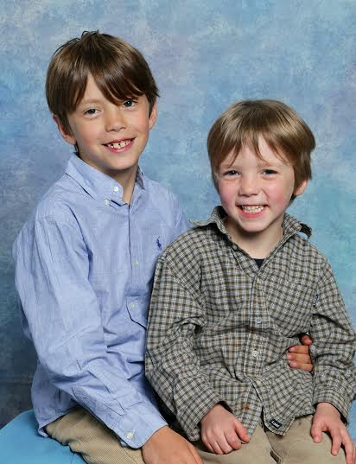
Whakaaro whānui

Slide 14
He aha te mea nui?
Hutia te rito, Hutia te rito o te harakeke. Kei hea te kōmako e kō?
Kī mai ki ahau, He aha te mea nui? He aha te mea nui o te ao? Māku e kī atu
He tangata! He tangata! He tangata, hī!
Pull out the shoot, Pull out the shoot of the flax bush Where will the bellbird sing?
Ask me What is the greatest thing? What is the greatest thing in this world? I will say
The people! The people! The people
Notes:
The flax plant grows from the centre. The first shoot divides into the father and the mother, and between them a child shoots up. As this continues to happen, the original parents become grandparents and so on, and you can have many generations in the same plant. The new shoot always grows in the middle.
When you cut a leaf from the flax, always cut it from the outside, because if you take the centre it destroys the whole plant

Slide 15
