Slide 1
The ICT Industry and its potential
Presented by Chris Cormack // 25/5/2015

Slide 2

Who am I?
Kai Tahu, Kati Mamoe, Waitaha
BSc Compsci, BA Maths and Māori Studies
Born in Kawakawa, High school in Whanganui
University in Palmerston North
Work at Catalyst IT

Slide 3

What do I do?

Slide 4
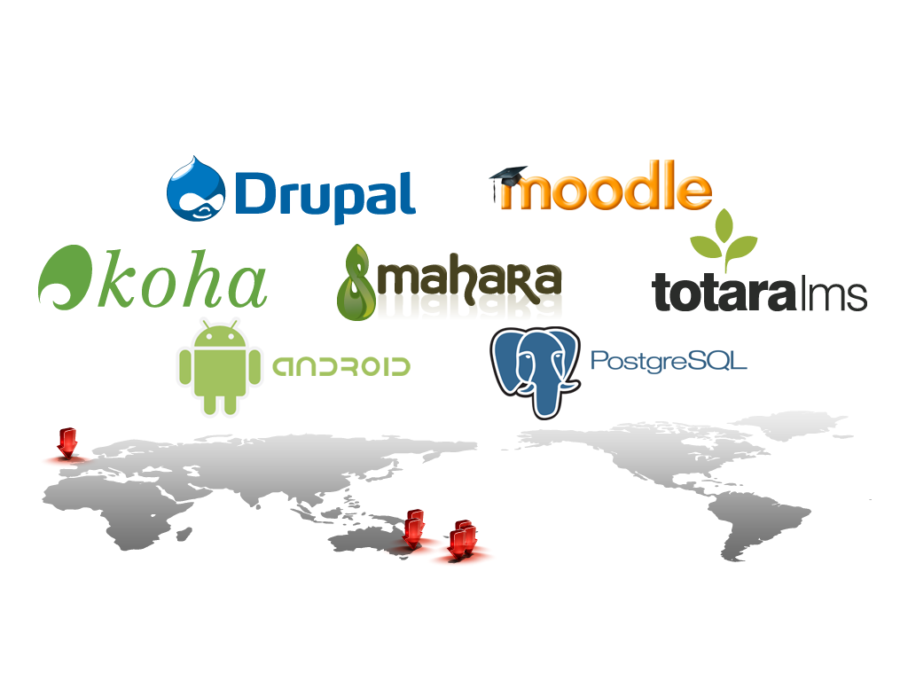
About Catalyst

Slide 5
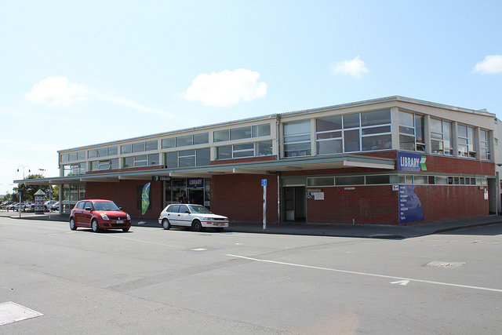
Koha

Slide 6
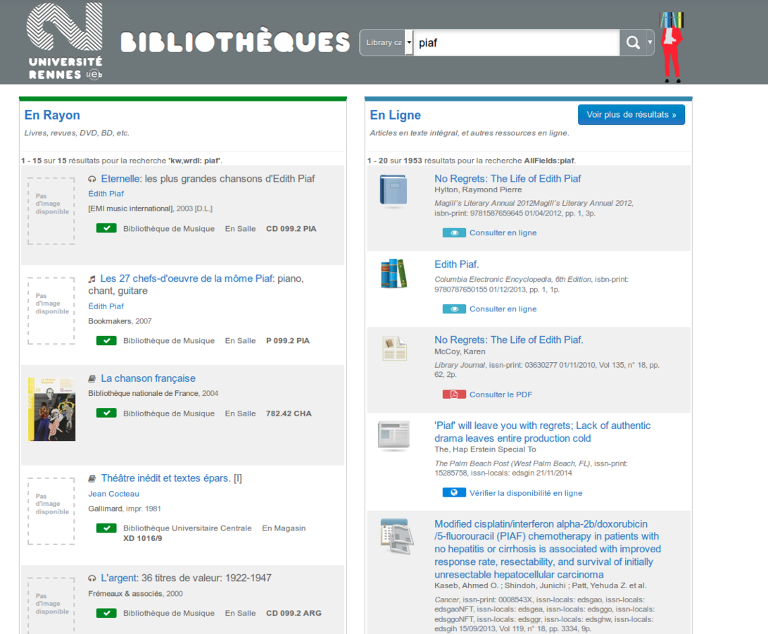
Koha

Slide 7
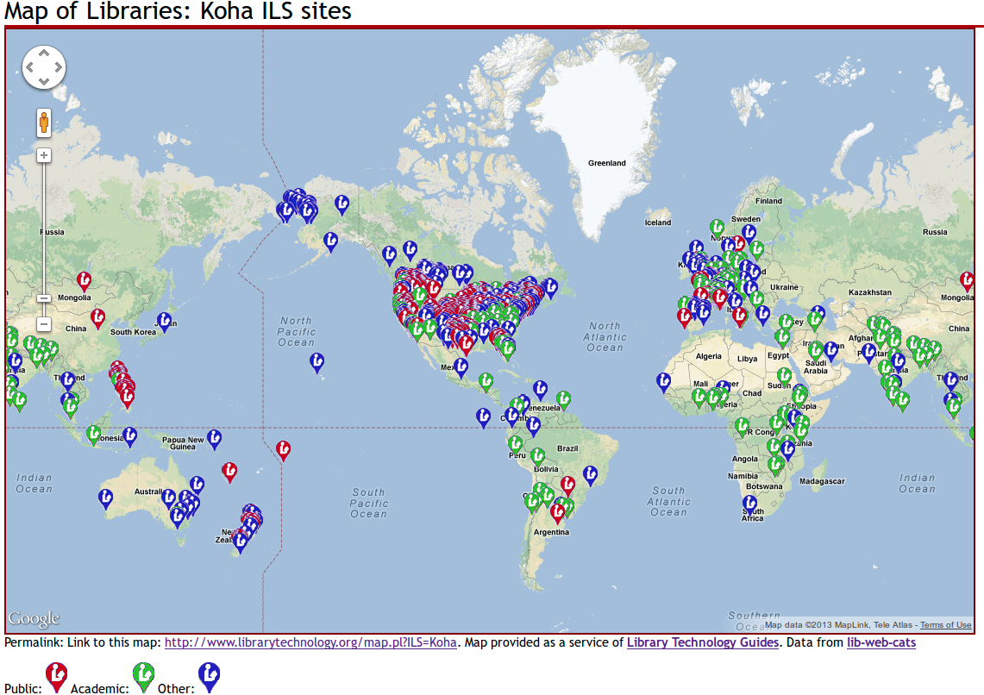
Koha

Slide 8
Koha
From 4 libraries in the Horowhenua to 10,000+ around the world
Automating libraries never before automated
Facilitating access to information
Providing employment

Slide 9

Software freedom?

Slide 10
Mai ra ano
Nā tō rourou, nā taku rourou ka ora ai te iwi.
Ehara taku toa i te toa takitahi, engari he toa takitini.
He waka eke noa.
Ma tini ma mano ka rapa te whai.

Slide 11
Mana tangata
“To be a person is not to stand alone, but to be one with one's people, and the deeper the oneness the more we are truly persons and have that mana tangata.”
- Michael P Shirres : 2000

Slide 12
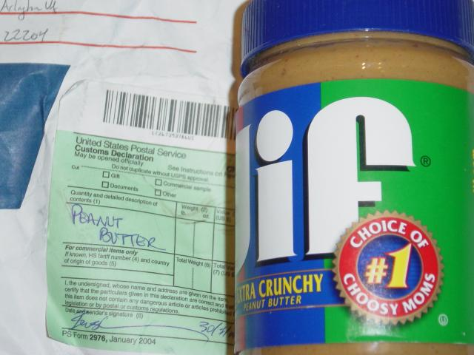
Whakanuia

Slide 13
Kaiakopono
“
“Not everyone needs to be the Welcome Wagon -- but someone ought to be.”
- Esther Schindler : 2009

Slide 14
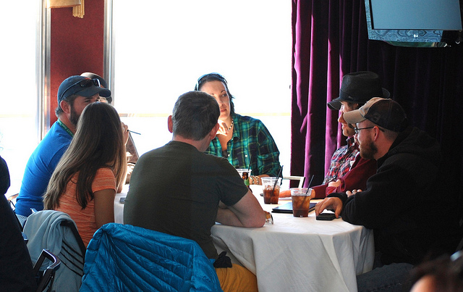
Korerorero

Slide 15
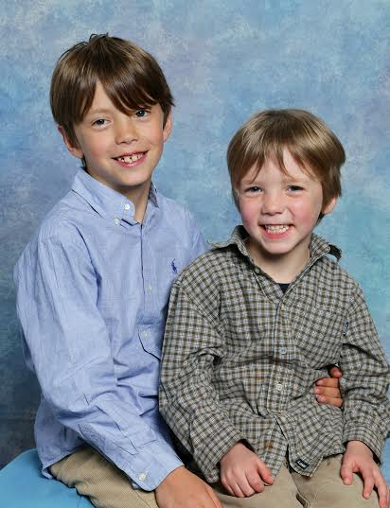
Whakaaro whānui

Slide 16
Ngā patai

