Slide 2

Who am I?
Kāi Tahu, Kāti Mamoe, Waitaha
BSc Compsci, BA Maths and Māori Studies
One of the original Koha developers
Works at Catalyst IT

Slide 3
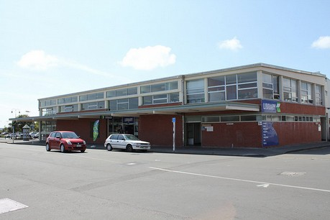
1999-00: the origin
Some kiwis and a y2k bug
  HLT Horowhenua Library Trust, in New Zealand
    has a system with a y2k bug
    Needs low prices
    Needs to work on a dialup line
    Easy to use for volunteers
    (reference : http://journal.code4lib.org/articles/1638)

Slide 4
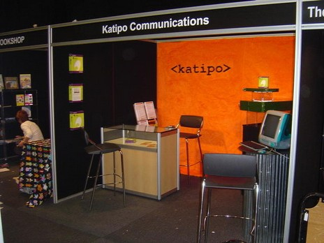
1999-00: the origin
Katipo started working on a full web ILS
  Work started in September, 1999
  Limited functional requirements (no serials, no acq, …)
  Not full web in fact : circ was a vt100 app
  Agile development before Agile methods exist !
  Team leader : Rachel Hamilton-Williams

Slide 5

2000-01: the origin
1st version delivered on time
  HLT goes live with Koha 1.0.0 on 2000, January 2nd
  1st full web ILS
Katipo was not a product vendor company
  Releasing Koha as FreeSoftware
CC-BY-SA Osama Khalid

Slide 6
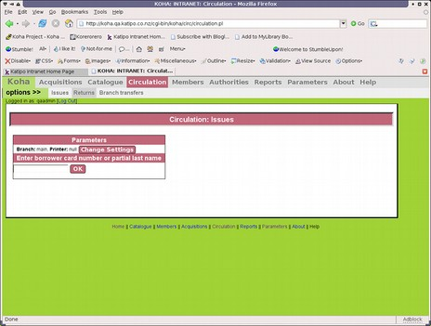
2000-09: First version released
1st public release after :
  Some sleep for the developers
  Some bugfixes for the software
  Some work on the web for the rest of the world website, Project created on SourceForge
New developers :
  Glen Stewart (1st patch not from Katipo)
  Steve Tonnesen (web based circulation)

Slide 7
2001-05 : non English speaking newcomers
1st non English developer (& maybe library) : Pawel Skuza
1st French developer & user: Paul Poulain (in 2002-01) & Dombes Abbey

Slide 8
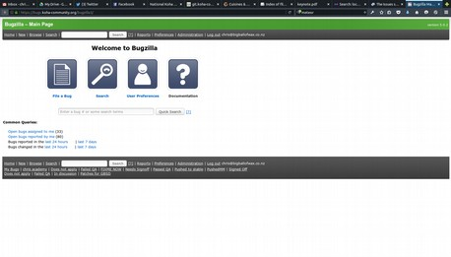
2002 : the expansion
  Koha 1.2 released
  Wiki launched
  Bugzilla launched
  2 major problems to fix
    Translating Koha : Move to HTML::Template decided
    MARC standards : Adding MARC support decided (1st sponsoring outside from HLT -Nelsonville Public Library-)
  17th committer at the end of the year

Slide 9
2002 : the need for a structure
International software, hacked « 24/7 », by ppl all around the world. It's time to add some organization !
First elected team
  Kaitiaki : our Guardian : Pat Eyler
  Release Manager : for the next version 1.4/2.0 : Paul Poulain
  Release Maintainer : for the current version 1.2 : Chris Cormack
  QA Manager : Ingrid, then no-one
  Doc Manager : Nicolas Rosasco

Slide 10
2003-2005 : strengthening the software
New functionalities like
  MARC support (incl authorities)
  Serials
  Stats
  Advanced OPAC
  Bulkimport

Slide 11
2003-2005 : New team
Team elected in 2003 :
  Kaitiaki : Rachel Hamilton
  Release Manager 2.4/3.0 : Joshua Ferraro
  Release Maintainer 2.2 : Paul Poulain
  QA manager : Pierrick Le Gall, then no-one
  Doc manager : Stephen Hedges

Slide 12
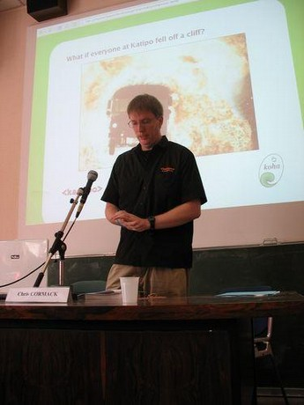
2006-2007 : road to 3.0
The SQL MARC structure is limited, and can't deal efficiently with large size catalogues (+300k items)
  Deciding to move to zebra
First KohaCon in France (KohaCon06)
  3 days user conference (more than 120 attendees, in Paris)
  5 days hackfest (15 developers from 4 countries, in Marseille)

Slide 13
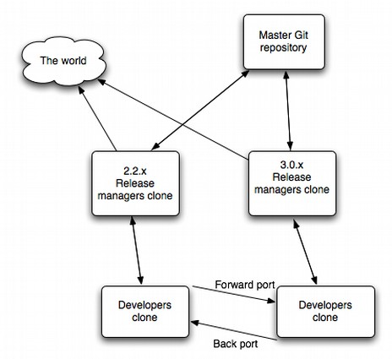
2006-2007 : road to 3.0
Changing tools :
  Moving from sourceforge/CVS to savannah/CVS then git
  Mailing lists on lists.koha.org
  French website (www.koha-fr.org)

Slide 14
2008-2009 : Why Open Source is stronger
In 2008-2009, Koha faced an issue. In a few words :
  In 2007, Liblime bought Katipo Koha activity & domain name
  A company called PTFS does some business in the US around Koha. Liblime says they are dangerous
  Something happens at Liblime and they stop contributing
  A lot of Liblime developers resign
  Liblime announces « Liblime Enterprise Koha », hosted only, source-code is not shared, the community no longer has access to koha.org domain & tools
  PTFS buy Liblime. It's now PTFS/Liblime (early 2010)

Slide 15
2008-2009 : Why OpenSource is stronger
Open Source is better (for users) because :
  No-one can « steal » the software. It's a « common good » That's a huge guarantee for libraries/users !
  The software evolution doesn't depend on a single company's success or decision !
Consequences of this crisis :
  For users (libraries) : nothing (Maybe a delay in releases)
  For developers : well, frankly, we spent a lot of time dealing with those problems that would have been better used for developing. But we have learnt a lot of things.

Slide 16
2010 : back to hacking
End of the crisis
  Decision to move to koha-community.org, with all our tools (Jan 2010)
  KohaCon09 in USA (Texas),10 in New Zealand (Wellington), 11 in India, 12 in UK, 13 in USA, 14 in Argentina, 15 in Nigeria
  PTFS/Liblime and community relationship still not normalised : we had some contacts with one of the developer at PTFS/Liblime, but They walked their way, and the rest of the community walked their way
  At least 90 libraries have switched from Koha, support by PTFS to Koha, supported by someone else in 2009 (see http://www.librarytechnology.org/libwebcats/)

Slide 17
2010: back to hacking
2010 and 2011 workflow changes
  Monthly IRC meeting
  Well defined patch workflow
  QA manager position filled !
  Many new contributors
It's time for a new start : the team is highly motivated, there are exciting things to do, there are more and more users that use Koha

Slide 18
2011: versions 3.4 and 3.6
Koha 3.4 was the 1st “time based release” (April 2011)
  Normarc support (welcome Magnus !)
  Fast add (add catalogue record from the circulation interface)
  Switch from H::T::P to T::T for template (presentation)
  Items removed from bibliographic MARC record
Koha 3.6 (Oct 2011)
  Easier analytics record
  365 bugfixes & improvements from 3.4

Slide 19
2012: version 3.8 and 3.10
Koha 3.8 (April 2012)
  Hourly loans
  Firefox offline circulation module (KOCT)
  Staff interface redesign
  130 enhancements ( + fixes)
  71 different developers

Slide 20
2012: version 3.8 and 3.10
Koha 3.10 (Nov 2012)
  Plack experimental on OPAC & staff interface
  Responsive design on OPAC
  160 enhancements & new features, 433 fixes (since 3.8.0)
  Detailed release notes are 43 pages long

Slide 21
2013: version 3.12 and 3.14
Koha 3.12 (May 2013, Jared Release Manager)
  Patron self-registration
  Link between subscription & acquisition
  Branch-limited authorised values
Koha 3.14 (Nov 2013, Galen Release Manager)
  Course Reserves
  New responsive Bootstrap theme for OPAC
  Alternative offline circulation module

Slide 22
2013 Trademark decision
IPONZ decision
  Liblime/PTFS trademark application rejected
  Costs awarded to Te Horowhenua Trust and Catalyst
  Trademark awarded to Te Horowhenua Trust

Slide 23
Some numbers

Slide 24
2014: version 3.16 and 3.18
Koha 3.16 (May 2014, Galen Release Manager)
  Different templates for notice types, eg 1 for email, different for sms
  Reworked experimental Plack support for OPAC
Koha 3.18 (Nov 2014, Tomás Release Manager)
  End of fiscal year rollover of open funds and orders
  On site checkouts
  Automatic renewals
  SRU download

Slide 25
2015: Koha 3.20 and 3.22
Koha 3.20 (May 2015, Tomás Release Manager)
  Batch editing of records
  Discharge notice generation and management
  Several holds related preferences moved to circulation matrix
Koha 3.22 (Nov 2015, Tomás Release Manager)
  Full plack support
  Audio Alerts
  Multi lingual itemtype descriptions
  RESTful API

Slide 26
2016 and beyond
Lots more libraries, documenters, testers, developers in India?

Slide 27
Fireworks
10 years in 10 minutes.
A video, made for KohaCon10 in New Zealand
http://www.youtube.com/watch?v=Tl1a2VN_pec

