Slide 2
www.koha-comunity.org
Koha is the first free and open-source Integrated Library System (ILS)
Koha has a vibrant, pro-active (and friendly) online community
Knowledge and support are shared on the IRC channel (online chat) or mailing lists (by email)
Free training materials are available online

Slide 3
Who am I?
Kai Tahu, Kati Mamoe, Waitaha
BSc Compsci, BA Maths and Māori Studies
One of the original Koha developers
Working at Catalyst IT
One of the QA team for 3.14 release

Slide 4
Brief history of Koha
Started in 1999 as a y2k fix
Went live January 3 2000
Released June 2000
Thousands of libraries, on every continent except Antartica
200+ developers

Slide 5
What is Koha?
A full feature ILS
8,028,986 lines of code (including translations)
1000s of features
0ver 4000 installs
30+ support companies

Slide 6
All the features you need
Acquisitions
Cataloguing
Serials
Circulation
Borrowers management
Search
So much more

Slide 7
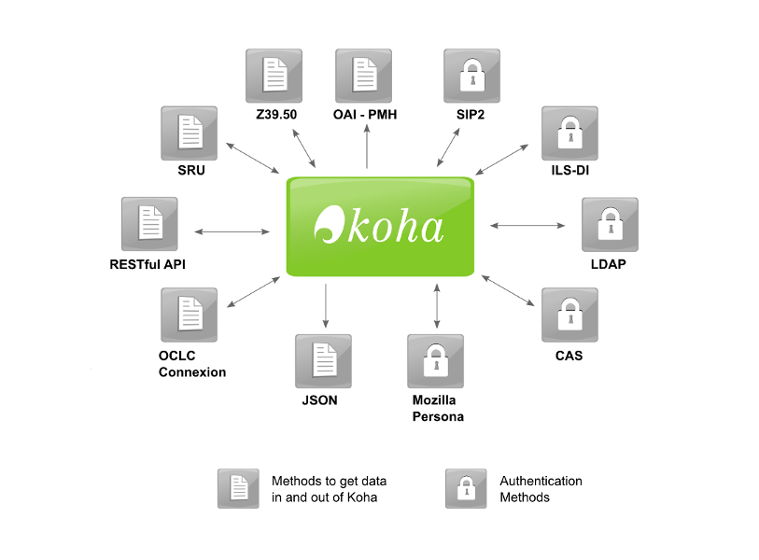
Taking the I out of ILS

Slide 8

But more importantly

Slide 9
Logistics
IRC
Mailing lists
Kohacon
Wiki
Bugzilla
Dashboard

Slide 10
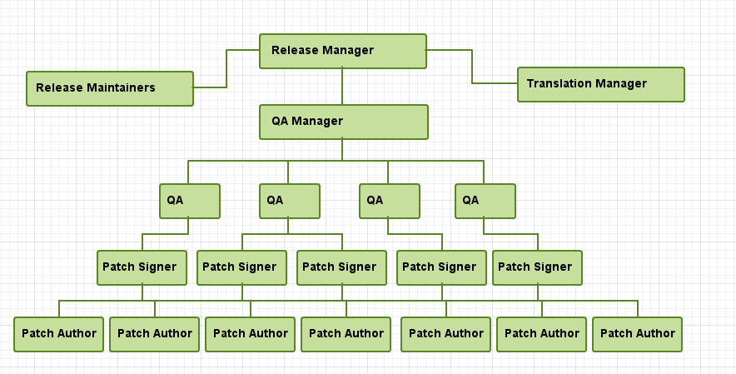
How does a release work?

Slide 11
What's coming up
Kohacon13 in Reno,NV USA in October
3.14 release in November
Voting for Kohacon14 – Will it be Argentina or Nigeria
3.16 release in May
Many many new features and code clean up

