Slide 1
Open Source ERMS

Slide 2
Introductions
Chris Cormack, Technical Lead
Catalyst
@ranginui at twitter
chrisc@catalyst.net.nz

Slide 3
Agenda
What is ERMS
Why Open Source/Free Software
What Open Source systems exist
Where to from here?
Q & A

Slide 4
What is ERMs?
Electronic Resource Management
Not Electronic Record Management or Election Result Management
“is the practices and software systems used by libraries to keep track of important information about electronic information resources, especially internet-based resources such as electronic journals, databases, and electronic books”

Slide 5
Why choose Software Freedom?
Code quality, more features, lower TCO
Freedom
Companies come and go, Open Source software remains

Slide 6
Open Source ERMS
E-Matrix
CUFTS
ERMes
Coral

Slide 7
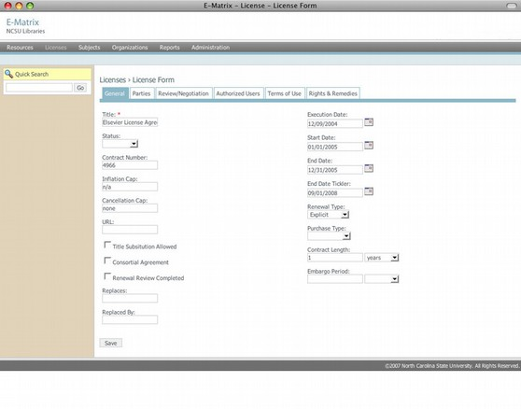
E-Matrix
http://www.lib.ncsu.edu/e-matrix/
Not released yet

Slide 8
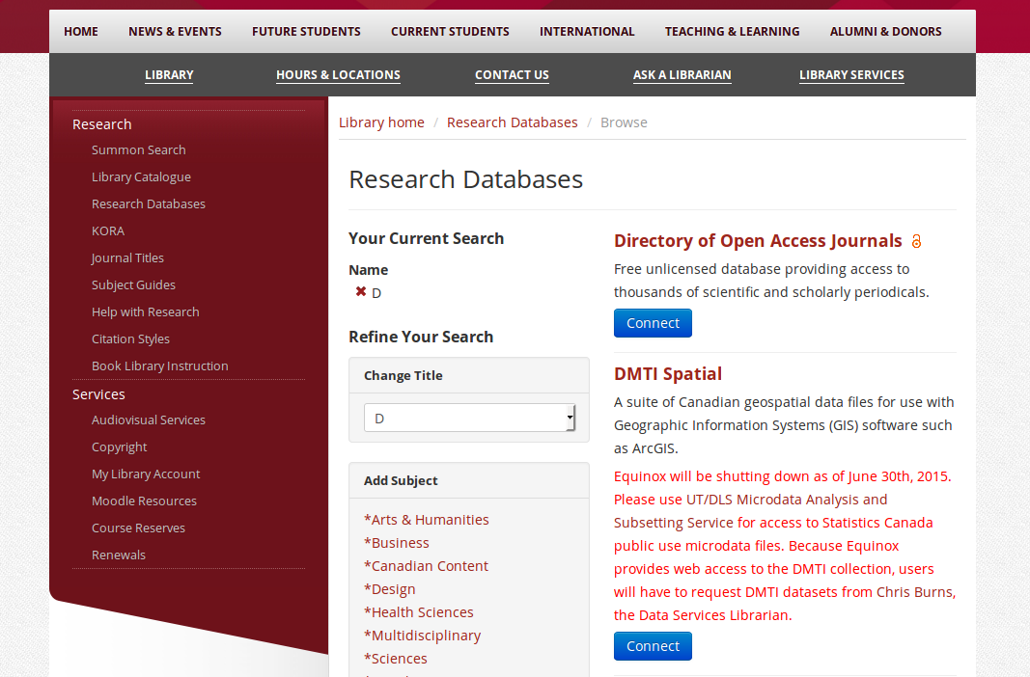
CUFTS
GPLv2
http://www.lib.sfu.ca/about/initiatives/researcher/cufts

Slide 9
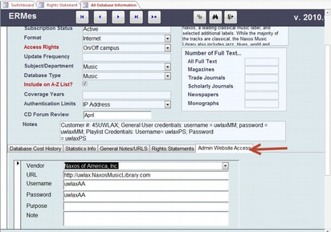
ERMes
No longer developed
ATTRIBUTION ASSURANCE LICENSE
http://murphylibrary.uwlax.edu/erm/

Slide 10
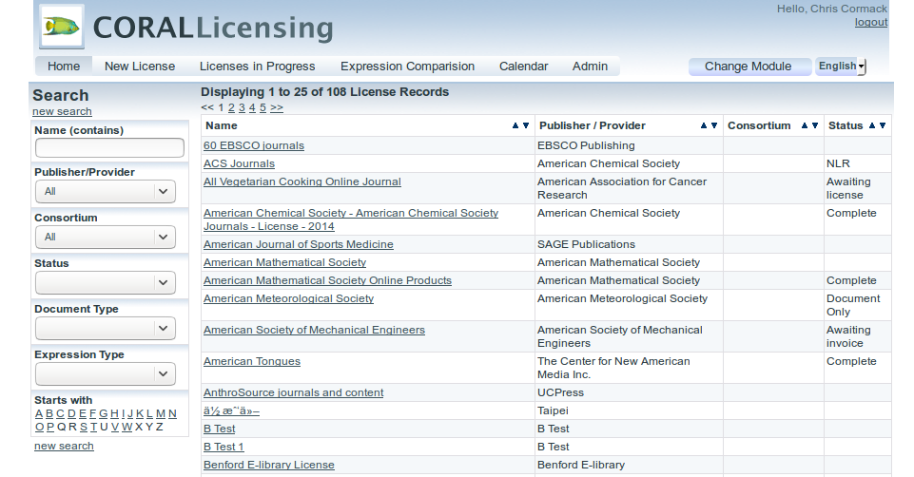
Coral
GPL3 or later
http://coral-erm.org/

Slide 11
Coral
4 Modules – Licensing, Resources, Organisations, Reporting
Released first 2010
PHP5 & MySQL
Under active development

Slide 12
Coral - Licensing
Store copies of current and expired licenses
Parent-child relationships available
Link resources to licenses
Additional attachments can be added

Slide 13
Coral - Resources
Designed to assist in the management of the entire electronic resource workflow
Highly customisable
Follows a definable acquisitions workflow
Email alerts, powerful search, export results

Slide 14
Coral - Organisations
Simplest of the modules
Tracks organisations and members of those organisations
Designed to be used with Licensing, Resources, and Reporting modules

Slide 15
Coral - Reporting
Supports JR1 and JR1a COUNTER reports
Can track outliers/suspicious activity
Six predefined reports for viewing roll-ups, specific title usage and top journal uses.

Slide 16

Where to from here?
Pat Pilon CC-BY

Slide 17
Integration with Koha
Biblibre host coral-erm.org
Tighter integration with Koha Serials and Acquisitions
Using ElasticSearch to search both databases

Slide 18

Questions
Horia Varlan - CC-BY

