Slide 1
Privacy and Koha
Presented by Chris Cormack // 19 Oct 2015

Slide 2

About Me
Kai Tahu, Kati Mamoe, Waitaha
BSc Compsci, BA Maths and Māori Studies
One of the original Koha developers
Been working in software development since 1995
Working at Catalyst IT

Slide 3
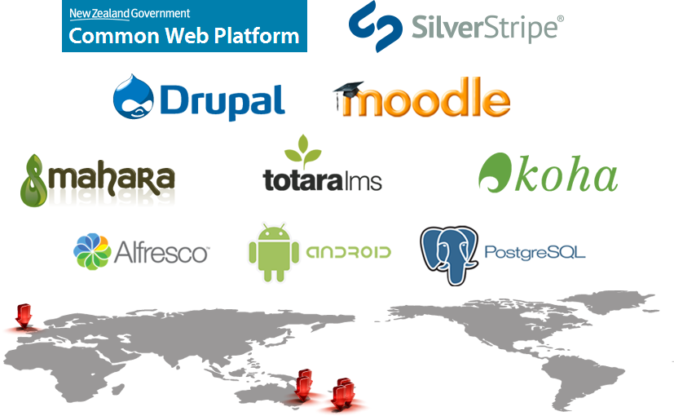
About Catalyst

Slide 4

Catalyst Clients

Slide 5
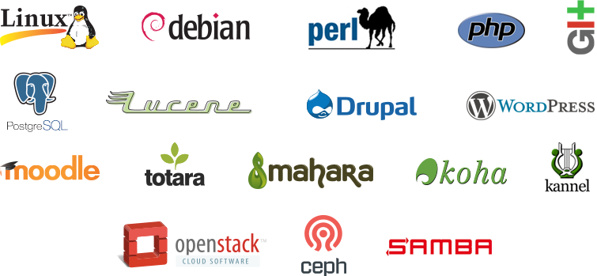
Open Source Technologies

Slide 6

Always watching

Slide 7
Danger points
User data (passwords, address information)
Borrowing/Searching information
SIP/RFID other selfcheck machines
Logs
3rd party analytics (Google etc)
3rd party content (Amazon, Overdrive)

Slide 8
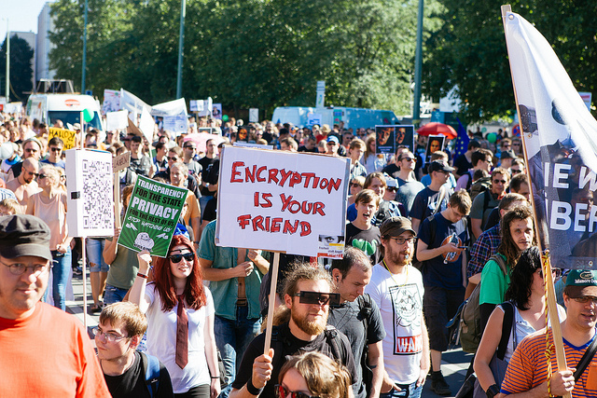
User Data
Don't collect what you don't need
Don't keep it, when your need is over
Encrypt

Slide 9
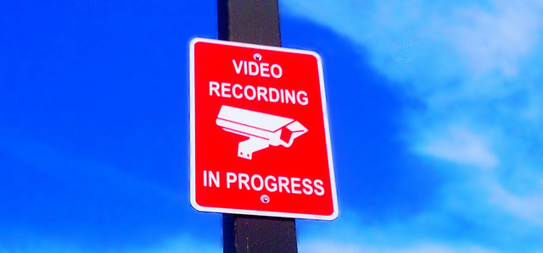
Circulation data

Slide 10

SIP2/NCIP

Slide 11
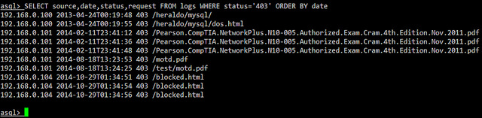
Logs

Slide 12
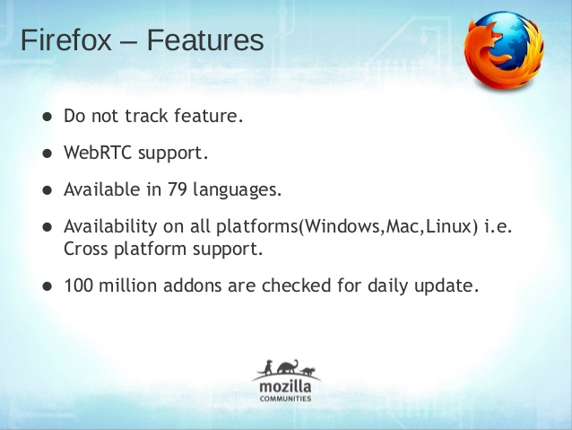
3rd party analytics

Slide 13
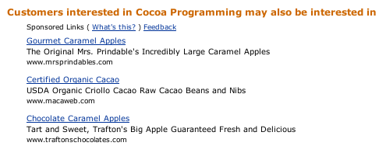
3rd party content

