Slide 1
Koha Roadmap
Presented by Chris Cormack // 25 February 2017

Slide 2
Koha development
Bug/Enhancement report filed
Patch submitted
Tested and Signed off
Tested by QA
Pushed by Release Manager
If bugfix pushed by Release Maintainer
Released

Slide 3
Koha versions
16.11 released November 2016
  16.11.04
16.05 released May 2016
  16.05.10
3.22 released November 2016
  3.22.17

Slide 4
Next version
17.05 release May 2017
  Feature Freeze April 22
  String Freeze May 8

Slide 5
Some users

Slide 6


Slide 7
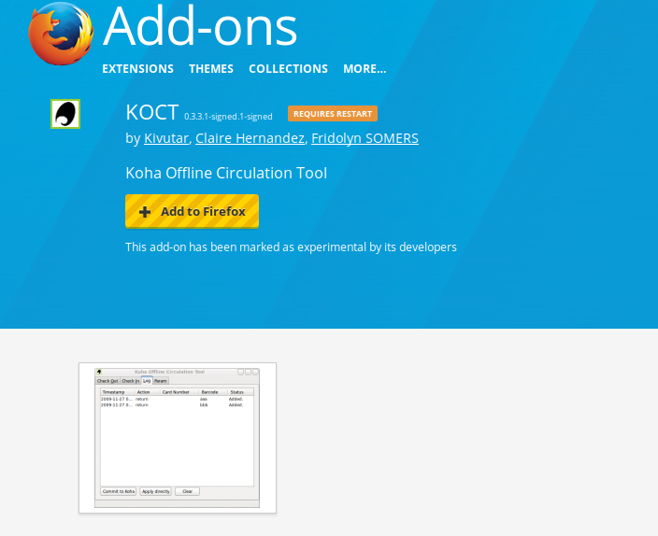
Offline Circulation

Slide 8
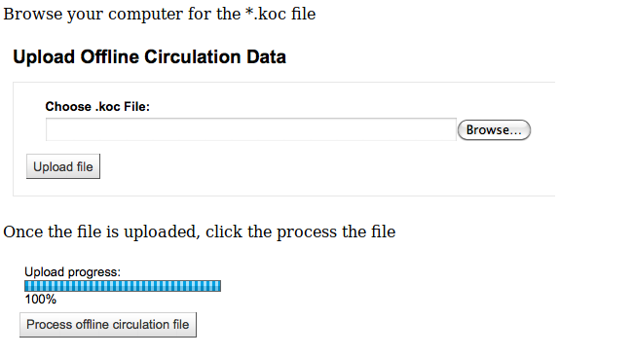
Offline Circulation

Slide 9
AJAX
Transfer small amounts of data
Only fetch what is needed
‘Lazy’ Loading

Slide 10
Questions

