Slide 1
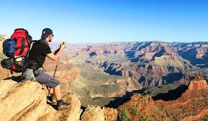
A-Z Travel Planning
CS-minor’s
By:
Rohan(181EC138)
Roshan(181EC139)
Saikumar(181EC140)
Chandravaran(181EC156)

Slide 2
Work Done by Each Person
Saikumar-Front end and database
Roshan-Backend and database
Rohan- ER diagram, Relations and database
Chandravaran-Backend and database

Slide 3
Abstract
So our aim is to make a DBMS system where you can plan a trip to a particular city and you can get the local train, taxi, hotel and other necessities, also you can plan the whole trip by connecting to various cities and see other necessities there.
We will make a database for cities and the relevant information such as hotels, attractions, restaurants, and make a database for transportation. Users will be able to pick the cities they would like to go to and all the places they want to visit.
This project aims to give all the information required to a user, to pick and plan to some extent where he or she would like to plan their next trip, it is to make sure the person has a single place to view and access data

Slide 4

Motivation
Have you ever planned a trip? Then there were probably 2 things you would have done, first being you went to a travel agency and picked up a travel plan for that place or you would have started searching online in many places.
But both of these do not give us a exiting feel about traveling. Traveling is all about the uncertainty in going to a place and you being in control of the places you can travel, to help people to easily navigate after getting to a place our website helps the person to get all the required elements to plan a stay at a particular place.
With our website we the fact of multiple searches is lost and this becomes easy for our user to plan his trip accordingly.

Slide 5
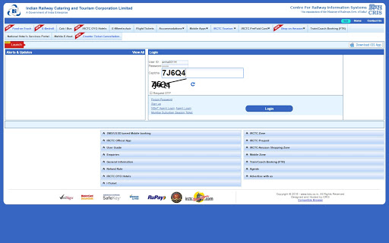
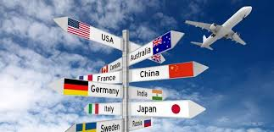
Existing Approaches
A huge surge in desire for tourism.
Hence, an increase in travel planning websites.
Current websites have some limitations :
Only focusing on one aspect of a tourist’s requirement.
A bulky and unstable interface.
A huge focus on international travel.
Don’t allow users to add their own suggestions.
Some websites like Tripadvisor and MakeMyTrip have done an excellent job.
Current climate has changed the way we look at travel.

Slide 6
Proposed Innovation
There has been an increase in trip planners, but there are still some limitations which can be fixed and improved on. Our website promotes domestic travel instead of international. Due to the current climate we have discluded flights from our database.
Allows users to plan their trip on the fly, instead of having it preplanned.
The model was created in oracle, where the ER diagram for our schema was created, then entries for our tables were made in excel and was connected to the front end, Javascript.
As it is not possible for every single city, location or tourist attraction to be added immediately, we have implemented a feature where anybody who has information about a new place, or attractions in an already existing city.

Slide 7
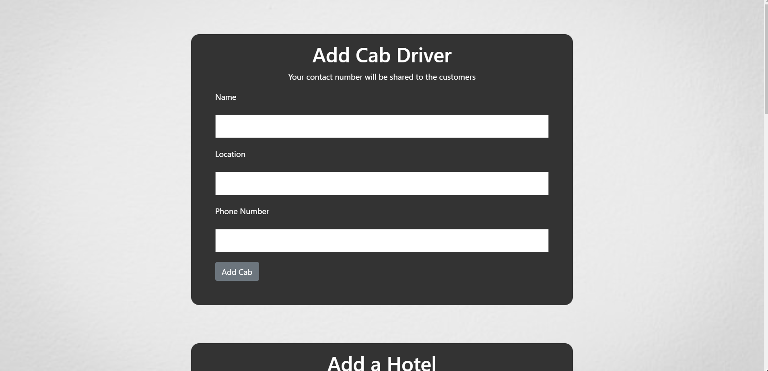
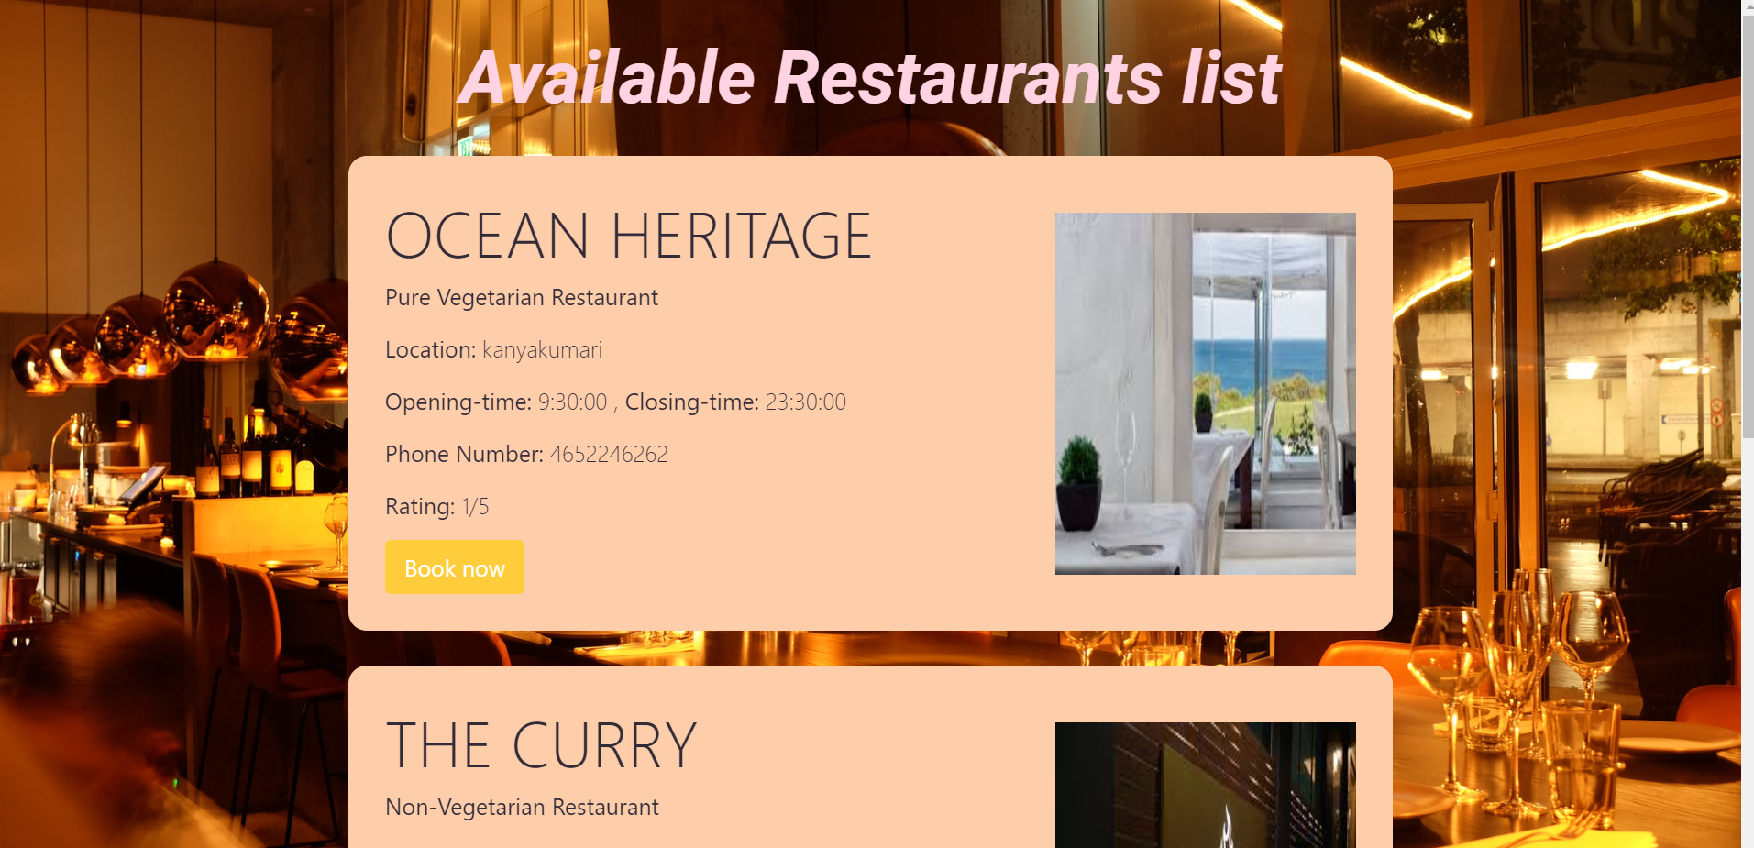
Outcomes
This website allows the user to add information information into the database.
User can search for hotels, restaurants, cabs, trains or tourist places by entering the required details for that, and available list of items will be displayed on the website.
The images of the items where also shown so that the user can make a better choice while choosing them.

Slide 8
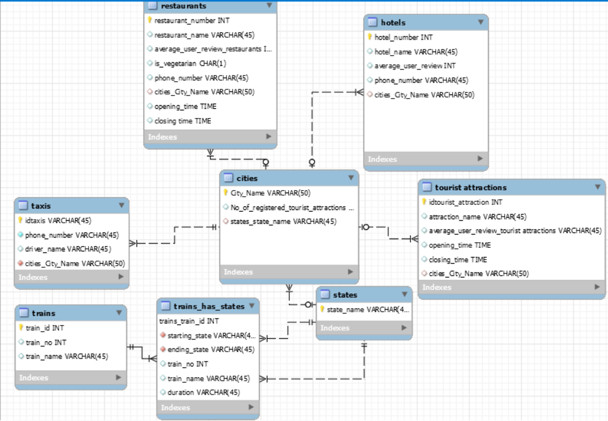

Slide 9
Conclusion
The project was completed as expected, with a fully functional front end which allows users to access and update the database, and to plan their trip on the fly.
This model can be expanded to work worldwide by adding new tables, and is scalable. Taking feedback from the user to give personalised suggestions can also be added. Accounting for real world conditions like current time to automatically figure out whether a restaurant is closed or not for example may be added too.
With some more entries, more computational power, a more rigorous relational model and more efficient method for accessing required transportation, this can be of significant help to a traveller.

