Slide 1
2、单周期 CPU - Datapath and Control
中央处理器：数据通路和控制器
第一讲 单周期数据通路的设计
第二讲 单周期控制器的设计
Notes:
Start X:40

Slide 2
第一讲 单周期数据通路的设计
主 要 内 容
数据通路的位置
单周期数据通路的设计
数据通路的功能和实现
操作元件（组合逻辑部件）
状态 / 存储元件（时序逻辑部件）
数据通路的定时
选择MIPS指令集的一个子集作为CPU的实现目标的数据通路

Slide 3
数据通路在计算机组成结构中的位置
计算机的五大组成部分：
什么是数据通路（DataPath）?
指令执行过程中，数据所经过的路径，以及路径中的部件。它是指令的执行部件。
控制器（Control）的功能是什么？
对指令进行译码，生成指令对应的控制信号，控制数据通路的动作。能对执行部件发出控制信号，是指令的控制部件。
CPU
Input
Control
Memory
Datapath
Datapath
Output
Notes:
Before we go any further, let’s step back for a second and take a look at the big picture.
All computer consist of five components: (1) Input and (2) output devices. (3) The Memory System. And the (4) Control and (5) Datapath of the Processor.
Today’s lecture covers the datapath design.
In the next lecture, I will show you how to design the processor’s control unit.
+1 = 5 min. (X:45)

Slide 4
状态元件：时序逻辑电路
状态元件（存储元件）的特点：
具有存储功能，在时钟控制下输入被写到电路中，直到下个时钟到达
输入端状态由时钟决定何时被写入，输出端状态随时可以读出
定时方式：规定信号何时写入状态元件或何时从状态元件读出
边沿触发（edge-triggered）方式：
状态单元中的值只在时钟边沿改变。每个时钟周期改变一次。
上升沿（rising edge） 触发：在时钟正跳变时进行读/写。
下降沿（falling edge）触发：在时钟负跳变时进行读/写。
最简单的状态单元（回顾：数字逻辑电路课程内容）：
D触发器：一个时钟输入、一个状态输入、一个状态输出
falling edge
cycle time
rising edge
Back

Slide 5
存储元件: 寄存器和寄存器组
寄存器（Register）
有一个写使能（Write Enable-WE）信号
WE=0: 时钟边沿到来时，输出不变
WE=1: 时钟边沿到来时，输出变为输入
若每个时钟边沿都写入，则不需WE信号
寄存器组（Register File）：32个寄存器
两个读口（组合逻辑操作）：busA和busB分别由RA和RB给出地址。地址RA或RB有效后，经一个“取数时间(AccessTime)”，busA和busB有效。
一个写口（时序逻辑操作）：写使能为1的情况下，时钟边沿到来时，busW上的值开始被写入RW指定的寄存器中。
Write Enable
Data In
Data Out
N
N
Clk
Write Enable
RW
RA
RB
5
5
5
busA
busW
32
32 32-bit
Registers
32
busB
Clk
32
Notes:
As far as storage elements are concerned, we will need a N-bit register that is similar to the D flip-flop I showed you in class.
The significant difference here is that the register will have a Write Enable input.
That is the content of the register will NOT be updated if Write Enable is zero.
The content is updated at the clock tick ONLY if the Write Enable signal is set to 1.
+1 = 31 min. (Y:11)
Complement:
To know more detailed diagram for a register, see page B22-B25.

Slide 6
寄存器组的内部结构
Write Enable
RA
RB
5
5
Register 0
0
C
RW
32-to-1
Decoder
D
Register 1
5
C
M
D
busA
31
U
32
C
Register 30
X
D
C
Register 31
busW
D
32
Clk
M
每个寄存器由32个触发器组成;
输入数据来自busW，读出数据分别送busA和busB;
WriteEnable信号控制是否写入新值。
busB
U
32
X
Back to add

Slide 7
存储元件: 理想存储器
Address
Write Enable
理想存储器（ idealized memory ）
Data Out：32位读出数据
Data In： 32位写入数据
Address：读写共用一个32位地址
读操作（组合逻辑操作）：
地址Address有效后，经一个“取数时间AccessTime”，Data Out上数据有效。
写操作（时序逻辑操作） ：
写使能为1的情况下，时钟Clk边沿到来时，Data In传来的值开始被写入Address指定的存储单元中。
Data In
DataOut
32
32
Clk
为简化数据通路操作说明，把存储器简化为带时钟信号Clk的理想模型。
Notes:
The last storage element you will need for the datapath is the idealized memory to store your data and instructions.
This idealized memory block has just one input bus (DataIn) and one output bus (DataOut).
When Write Enable is 0, the address selects the memory word to put on the Data Out bus.
When Write Enable is 1, the address selects the memory word to be written via the DataIn bus at the next clock tick.
Once again, the clock input is a factor ONLY during the write operation.
During read operation, it behaves as a combinational logic block.
That is if you put a valid value on the address lines, the output bus DataOut will become valid after the access time of the memory.
+2 = 35 min. (Y:15)

Slide 8
单周期MIPS处理器的设计
复习：MIPS的三种指令类型
大家记得是哪三种类型？
R-Type、I-Type、J-Type
31
26
21
16
11
6
0
加法与减法
add rd, rs, rt
sub rd, rs, rt
OR Immediate:
ori rt, rs, imm16
LOAD and STORE
lw rt, rs, imm16
sw rt, rs, imm16
BRANCH:
beq rs, rt, imm16
JUMP:
j target
op
rs
rt
rd
shamt
func
6 bits
5 bits
5 bits
5 bits
5 bits
6 bits
31
26
21
16
0
op
rs
rt
immediate
6 bits
5 bits
5 bits
16 bits
这些指令具有代表性！
有算术运算、逻辑运算；有RR型、RI型；有访存指令；有条件转移、无条件转移。
本讲目标：实现以上7条指令对应的数据通路！
教材中实现了11条指令，可将7条指令和11条指令的数据通路进行对比，以深入理解设计原理。
31
26
0
op
target address
6 bits
26 bits
Notes:
In today’s lecture, I will show you how to implement the following subset of MIPS instructions: add, subtract, or immediate, load, store, branch, and the jump instruction.
The Add and Subtract instructions use the R format. The Op together with the Func fields together specified all the different kinds of add and subtract instructions.
Rs and Rt specifies the source registers. And the Rd field specifies the destination register.
The Or immediate instruction uses the I format. It only uses one source register, Rs. The other operand comes from the immediate field. The Rt field is used to specified the destination register.
Both the load and store instructions use the I format and both add the Rs and the immediate filed together to form the memory address.
The difference is that the load instruction will load the data from memory into Rt while the store instruction will store the data in Rt into the memory.
The branch on equal instruction also uses the I format. Here Rs and Rt are used to specify the registers we need to compare.
If these two registers are equal, we will branch to a location specified by the immediate field.
Finally, the jump instruction uses the J format and always causes the program to jump to a memory location specified in the address field.
I know I went over this rather quickly and you may have missed something. But don’t worry, this is just an overview. You will keep seeing these (point to the format) all day today.
+3 = 13 min. (X:53)

Slide 9
Instruction Fetch Unit: 取指令部件
30
Addr<31:2>
30
Addr<1:0>
4
“00”
Target
1
Instruction
Memory
Instruc<25:0>
30
26
Mux
PC
30
0
32
PC的改变在下个Clk到达后发生！
0
Adder
30
Instruction<31:0>
imm16、Target、…
“1”
Mux
1
Jump
Adder
Clk
30
imm16
30
这是“取指部件”的完整设计
3 个输入: jump, Branch, Zero
1个输出: 指令字
16
SignExt
Instruction<15:0>
Branch
Zero
RegDst, RegWr, ALUctr, ExtOp, ALUSrc, MemWr, MemtoReg, Branch, Jump 各取何值？
Notes:
Well this (points to the equation) is easy to implement.
All we have to do is grab the four most significant bits of the PC and put them right next to the 26 bits target, and we will have the next PC for the jump (point to the feedback path).
If we are running Powerview, what we will do now is to create a symbol called Instruction Fetch Unit.
The output of this symbol is the 32-bit instruction word.
The input to the Instruction Fetch Unit are two control signals, Branch and Jump, and one conditional input Zero from the datapath.
Using this new symbol, we can complete our single cycle datapath.
+2 = 78 min. (Y:58)

Slide 10
实现7条MIPS指令的单周期处理器的数据通路
Branch
Instruction<31:0>
Instruction
Fetch Unit
Rd
Rt
Jump
<21:25>
<16:20>
<0:15>
Clk
<11:15>
RegDst
1
Mux
0
Rs
Rt
Rs
Rt
Rd
Imm16
RegWr
5
5
5
ALUctr
busA
Zero
MemtoReg
Rw
Ra
Rb
MemWr
busW
32
32 32 bit
Registers
0
32
busB
ALU
32
Clk
0
32
Mux
Mux
Data In
32
WrEn
Adr
1
1
32
imm16
Ext
32
Data
Memory
16
Clk
ALUSrc
ExtOp
指令执行结果总是在下个时钟到来时开始保存在 寄存器 或 存储器 或 PC 中！
下一讲考虑：如何产生控制信号！（控制器的设计内容）
Notes:
So here is the single cycle datapath we just built.
If you push into the Instruction Fetch Unit, you will see the last slide showing the PC, the next address logic, and the Instruction Memory.
Here I have shown how we can get the Rt, Rs, Rd, and Imm16 fields out of the 32-bit instruction word.
The Rt, Rs, and Rd fields will go to the register file as register specifiers while the Imm16 field will go to the Extender where it is either Zero and Sign extended to 32 bits.
The signals ExtOp, ALUSrc, ALUctr, MemWr, MemtoReg, RegDst, RegWr, Branch, and Jump are control signals.
And I will show you how to generate them in the next class..
+2 = 80 min. (Z:00)

Slide 11
数据通路中的关键路径(Load操作)花费的时间
Load操作：
R[Rt] ← M[R[Rs]+Imm16]
记住：寄存器组和理想存储器的定时方式
写操作时，作为时序逻辑电路。即：
时钟到达前，输入需setup；到达后经“Clk-to-Q”，写入数据到达输出端
读操作时，作为组合逻辑电路。即：
地址有效后经过“access time”，输出开始有效
Clk
PC
关键路径时长 = PC的 Clk-to-Q时间 +
指令存储器的取数时间 +
寄存器组的取数时间+
ALU 加法延时+
数据存储器的取数时间+
写寄存器的建立时间+
时钟偏移
Instruction Address
Ideal
Instruction
Memory
Instruction bus
Rd
Rs
Rt
Imm
5
5
5
16
Data
Address
Rw
Ra
Rb
32
Ideal
Data
Memory
32
32
DataOut
32 32-bit
Registers
ALU
DataIn
Clk
32
Clk
Notes:
Now with the clocking methodology back in your mind, we can think about how the critical path of our “abstract” datapath may look like.
One thing to keep in mind about the Register File and Ideal Memory (points to both Instruction and Data) is that the Clock input is a factor ONLY during the write operation.
For read operation, the CLK input is not a factor. The register file and the ideal memory behave as if they are combinational logic.
That is you apply an address to the input, then after certain delay, which we called access time, the output is valid.
We will come back to these points (point to the “behave” bullets) later in this lecture.
But for now, let’s look at this “abstract” datapath’s critical path which occurs when the datapath tries to execute the Load instruction.
The time it takes to execute the load instruction are the sum of:
(a) The PC’s clock-to-Q time.
(b) The instruction memory access time.
(c) The time it takes to read the register file.
(d) The ALU delay in calculating the Data Memory Address.
(e) The time it takes to read the Data Memory.
(f) And finally, the setup time for the register file and clock skew.
+3 = 21 (Y:01)
Complement:
Clock skew(B-40):

Slide 12
第二讲 单周期控制器的设计
主 要 内 容
考察每条指令在数据通路中的执行过程和涉及到的控制信号的取值
公共操作：取指令和计算下址PC
R-Type指令（add / sub）
立即数指令 （ori）
访存指令（lw / sw）
分支指令 （beq）
跳转指令 （j）
汇总各指令的控制信号取值
分两类控制信号：直接送往数据通路 / 送往局部控制单元
分析ALU操作对应的控制信号与func字段之间的关系
设计ALU局部控制单元
设计主控制单元

Slide 13
控制器在计算机组成结构中的位置
控制器在计算机的五大部件中的位置
Processor
Input
Control
Memory
Datapath
Output
下一个目标：设计单周期数据通路的控制器。
设计方法：
根据每条指令的功能，分析控制信号的取值，并在表中列出。
根据列出的指令和控制信号的关系，写出每个控制信号的逻辑表达式。
Notes:
So where are in in the overall scheme of things.
Well, we just finished designing the processor’s datapath.
Now I am going to show you how to design the control for the datapath.
+1 = 7 min. (X:47)

Slide 14
Add / Sub操作开始时取指部件中的动作
新指令还没有取出译码，所以控制信号的值还是原来指令的旧值。
新指令还没有执行，所以标志也为旧值。
取指令: Instruction ← M[PC]
所有指令都相同
30
Addr<31:2>
PC<31:28>
30
Addr<1:0>
Target
4
“00”
1
Instruction
Memory
Instr<25:0>
30
26
Mux
PC
0
30
0
32
Adder
30
“1”
Mux
Instruction<31:0>
Jump = 旧值
Adder
1
Clk
30
取出指令的第31-26位作为操作码首先被译码。op=000000, 则为R-type指令
16
SignExt
imm16
30
Instruction<15:0>
取指部件由旧控制信号控制，会不会有问题？
Branch = 旧值
Zero = 旧值
因为在下个Clk到来之前PC输入端的值不会写入，只要保证下个Clk来之前能产生正确的PC即可！
没有问题！Why?
Notes:
First let’s look at the Instruction Fetch Unit where everything begins.
Every instruction begins at the clock tick. The clock tick in this case is the high to low transition of the Clk (points to the “bubble” of PC).
What happens right after the clock tick?
After Clk-to-Q delay, the PC gets the value that points to the Add instruction and fetch the add instruction from the memory but sending the address to the Ideal Instruction memory.
Notice that since this is the beginning of the instruction, Control signals Branch and Jump will still have the old values from the previous instruction.
At the beginning of ALL instructions execution, the instruction unit behaves the same way as shown here and we won’t repeat this picture for every instruction.
+2 = 12 min. (X:52)

Slide 15
指令译码后R型指令（Add / Sub）操作过程
31
26
21
16
11
6
0
op
rs
rt
rd
shamt
func
R[rd] ← R[rs] + / - R[rt]
Branch = 0
Instruction<31:0>
Instruction
Fetch Unit
Rd
Rt
Jump = 0
<21:25>
<16:20>
<0:15>
RegDst = 1
Clk
<11:15>
1
Mux
0
Rs
Rt
ALUctr = Add or Sub
Rs
Rt
Rd
Imm16
RegWr = 1
5
5
5
busA
MemtoReg = 0
Rw
Ra
Rb
Zero
MemWr = 0
busW
32
32 32-bit
Registers
0
32
busB
ALU
32
Clk
0
32
Mux
Mux
32
WrEn
Adr
1
1
Data In
32
imm16
Ext
32
Data
Memory
16
Clk
ALUSrc = 0
ExtOp = x
Notes:
This picture shows the activities at the main datapath during the execution of the Add or Subtract instructions.
The active parts of the datapath are shown in different color as well as thicker lines.
First of all, the Rs and Rt of the instructions are fed to the Ra and Rb address ports of the register file and cause the contents of registers specified by the Rs and Rt fields to be placed on busA and busB, respectively.
With the ALUctr signals set to either Add or Subtract, the ALU will perform the proper operation and with MemtoReg set to 0, the ALU output will be placed onto busW.
The control we are going to design will also set RegWr to 1 so that the result will be written to the register file at the end of the cycle.
Notice that ExtOp is don’t care because the Extender in this case can either do a SignExt or ZeroExt. We DON’T care because ALUSrc will be equal to 0--we are using busB.
The other control signals we need to worry about are:
(a) MemWr has to be set to zero because we do not want to write the memory.
(b) And Branch and Jump, we have to set to zero. Let me show you why.
+3 = 15 min. (X:55)

Slide 16
R型指令（Add /Sub）最后阶段取指部件中的动作
PC ← PC + 4
除 beq 和 J指令以外的指令都相同
30
Addr<31:2>
PC<31:28>
30
Addr<1:0>
Target
4
“00”
1
Instruction
Memory
Instruction<25:0>
30
26
Mux
PC
0
30
0
32
Adder
30
“1”
Mux
1
Jump = 0
Instruction<31:0>
Adder
Clk
30
16
imm16
30
SignExt
Instruction<15:0>
Branch = 0
Zero = x
因为新的控制信号保证了正确的PC值的产生，在足够长的时间后，下个时钟Clk下降沿到来时将其值打入PC！
Notes:
This picture shows the control signals setting for the Instruction Fetch Unit at the end of the Add or Subtract instruction.
Both the Branch and Jump signals are set to 0.
Consequently, the output of the first adder, which implements PC plus 1, is selected through the two 2-to-1 mux and got placed into the input of the Program Counter register.
The Program Counter is updated to this new value at the next clock tick.
Notice that the Program Counter is updated at every cycle. Therefore it does not have a Write Enable signal to control the write.
Also, this picture is the same for or all instructions other than Branch and Jump.
Therefore I will only show this picture again for the Branch and Jump instructions and will not repeat this for all other instructions.
+2 = 17 min. (X:57)

Slide 17
Register-Register（R型指令） 时序
Clk
下条指令的PC值
下条指令的PC值
PCin
PC+4 PC
Clk-to-Q
PC
Old Value
New Value
PC建立时间
PC+4
指令存储器取数时间
Rs, Rt, Rd,
Op, Func
Old Value
New Value
控制单元延迟
ALUctr
Old Value
New Value
RegWr
Old Value
New Value
寄存器组取数时间
busA, B
Old Value
New Value
ALU 延迟
busW
Old Value
New Value
Rd
Rs
Rt
ALUctr
RegWr
写入寄存器
5
5
5
Rw
Ra
Rb
busA
busW
32
Result
32
32 32-bit
Registers
ALU
Clk
busB
32
32
Notes:
Let’s take a more quantitative picture of what is happening.
At each clock tick, the Program Counter will present its latest value to the Instruction memory after Clk-to-Q time(虽然早就产生，但PC值的改变一定在时钟边沿的控制下进行的).
After a delay of the Instruction Memory Access time, the Opcode, Rd, Rs, Rt, and Function fields will become valid on the instruction bus.
Once we have the new instruction, that is the Add or Subtract instruction, on the instruction bus, two things happen in parallel.
First of all, the control unit will decode the Opcode and Func field and set the control signals ALUctr and RegWr accordingly. We will cover this in the next lecture.
While this is happening (points to Control Delay), we will also be reading the register file (Register File Access Time).
Once the data is valid on busA and busB, the ALU will perform the Add or Subtract operation based on the ALUctr signal.
Hopefully, the ALU is fast enough that it will finish the operation (ALU Delay) before the next clock tick.
At the next clock tick, the output of the ALU will be written into the register file because the RegWr signal will be equal to 1.
+3 = 45 min. (Y:25)
Complement:
Instruction bus: see slide 12 on An Abstract View of the Critical Path

Slide 18
ori 指令译码后的执行过程
31
26
21
16
0
op
rs
rt
immediate
R[rt] ← R[rs] or ZeroExt[Imm16]
Branch = 0
Instruction<31:0>
Instruction
Fetch Unit
Rd
Rt
Jump = 0
<21:25>
<16:20>
<0:15>
RegDst = 0
Clk
<11:15>
1
Mux
0
Rs
Rt
ALUctr = or
Rs
Rt
Rd
Imm16
RegWr = 1
5
5
5
MemtoReg = 0
busA
Zero
MemWr = 0
Rw
Ra
Rb
busW
32
32 32-bit
Registers
0
32
busB
ALU
32
Clk
0
32
Mux
Mux
32
WrEn
Adr
1
Ext
1
Data In
imm16
32
Data
Memory
16
32
Clk
ALUSrc = 1
ExtOp = 0
Notes:
Now let’s look at the control signals setting for the Or immediate instruction.
The OR immediate instruction OR the content of the register specified by the Rs field to the Zero Extended Immediate field and write the result to the register specified in Rt.
This is how it works in the datapath. The Rs field is fed to the Ra address port to cause the contents of register Rs to be placed on busA.
The other operand for the ALU will come from the immediate field. In order to do this, the controller need to set ExtOp to 0 to instruct the extender to perform a Zero Extend operation.
Furthermore, ALUSrc must set to 1 such that the MUX will block off bus B from the register file and send the zero extended version of the immediate field to the ALU.
Of course, the ALUctr has to be set to OR so the ALU can perform an OR operation.
The rest of the control signals (MemWr, MemtoReg, Branch, and Jump) are the same as theAdd and Subtract instructions.
One big difference is the RegDst signal. In this case, the destination register is specified by the instruction’s Rt field, NOT the Rd field because we do not have a Rd field here.
Consequently, RegDst must be set to 0 to place Rt onto the Register File’s Rw address port.
Finally, in order to accomplish the register write, RegWr must be set to 1.
+3 = 20 min. (X:60)

Slide 19
Load指令译码后的执行过程
31
26
21
16
0
op
rs
rt
immediate
R[rt] ← Data Memory {R[rs] + SignExt[imm16]}
Branch = 0
Instruction<31:0>
Instruction
Fetch Unit
Rd
Rt
Jump = 0
<21:25>
<16:20>
<0:15>
RegDst = 0
Clk
<11:15>
1
Mux
0
Rs
Rt
ALUctr = addu
Rs
Rt
Rd
Imm16
RegWr = 1
5
5
5
Zero
MemtoReg = 1
busA
Rw
Ra
Rb
Overflow
busW
32
32 32-bit
Registers
0
32
busB
ALU
32
0
32
MemWr = 0
Mux
Clk
Mux
WrEn
Adr
1
Ext
1
Data In
32
imm16
32
Data
Memory
32
16
Clk
ALUSrc = 1
ExtOp = 1
ALUtcr应为add还是addu？差别在于溢出标志！
Notes:
Let’s continue our lecture with the load instruction. What does the load instruction do?
It first adds the contents of the register specified by the Rs field to the Sign Extended version of the Immediate field to form the memory address.
Then it uses this memory address to access the memory and write the data back to the register specified by the Rt field of the instruction.
Here is how the datapath works: first the Rs field is fed to the Register File’s Ra address port to place the register onto bus A.
Then the ExtOp signal is set to 1 so that the immediate field is Sign Extended and we place this value (output of Extender) onto the ALU input by setting ALUsrc to 1.
The ALU then add (ALUctr = add) the two together to form the memory address which is then placed onto the Data Memory’s address port.
In order to place the Data Memory’s output bus onto the Register File’s input bus (busW), the control needs to set MemtoReg to 1.
Similar to the OR immediate instruction I showed you earlier, the destination register here is specified by the Rt field. Therefore RegDst must be set to 0.
Finally, RegWr must be set to 1 to complete the register write operation.
Well, it should be obvious to you guys by now that we need to set Branch and Jump to 0 to make sure the Instruction Fetch Unit update the Program Counter correctly.
+3 = 28 min. (Y:08)

Slide 20
sw指令译码后的执行过程
31
26
21
16
0
op
rs
rt
immediate
M{R[rs] + SignExt[imm16]} ← R[rt]
Branch = 0
Instruction<31:0>
Instruction
Fetch Unit
Rd
Rt
Jump = 0
<21:25>
<16:20>
<0:15>
RegDst = x
Clk
<11:15>
1
Mux
0
Rs
Rt
ALUctr = addu
Rs
Rt
Rd
Imm16
RegWr = 0
5
5
5
MemtoReg = x
busA
Zero
MemWr = 1
Rw
Ra
Rb
busW
32
32 32-bit
Registers
0
32
busB
ALU
32
0
32
Mux
Clk
Mux
32
WrEn
Adr
1
1
Data In
32
imm16
Ext
32
Data
Memory
16
Clk
ALUSrc = 1
ExtOp = 1
Notes:
The store instruction performs the inverse function of the load. Instead of loading data from memory, the store instruction sends the contents of register specified by Rt to data memory.
Similar to the load instruction, the store instruction needs to read the contents of register Rs (points to Ra port) and add it to the sign extended verion of the immediate filed (Imm16, ExtOp = 1, ALUSrc = 1) to form the data memory address (ALUctr = add).
However unlike the Load instructoion where busB is not used, the store instruction will use busB to send the data to the Data memory.
Consequently, the Rt field of the instruction has to be fed to the Rb port of the register file.
In order to write the Data Memory properly, the MemWr signal has to be set to 1.
Notice that the store instruction does not update the register file. Therefore, RegWr must be set to zero and consequently control signals RegDst and MemtoReg are don’t cares.
And once again we need to set the control signals Branch and Jump to zero to ensure proper Program Counter updataing.
Well, by now, you are probably tied of these boring stuff where Branch and Jump are zero so let’s look at something different--the bracnh instruction.
+3 = 31 min. (Y:11)

Slide 21
beq指令译码后的执行过程
31
26
21
16
0
op
rs
rt
immediate
if (R[rs] - R[rt] == 0) then Zero ← 1 ; else Zero ← 0
Branch = 1
Instruction<31:0>
Instruction
Fetch Unit
Rd
Rt
Jump = 0
<21:25>
<16:20>
<0:15>
RegDst = x
Clk
<11:15>
1
Mux
0
Rs
Rt
ALUctr = subu
Rs
Rt
Rd
Imm16
RegWr = 0
5
5
5
MemtoReg = x
busA
Zero
MemWr = 0
Rw
Ra
Rb
busW
32
32 32-bit
Registers
0
32
busB
ALU
32
Clk
0
32
Mux
Mux
32
WrEn
Adr
1
Ext
1
Data In
32
Data
Memory
imm16
32
16
Clk
ALUSrc = 0
ExtOp = x
Notes:
So how does the branch instruction work?
As far as the main datapath is concerned, it needs to calculate the branch condition. That is, it subtracts the register specified in the Rt field from the register specified in the Rs field and set the condition Zero accordingly.
In order to place the register values on busA and busB, we need to feed the Rs and Rt fields of the instruction to the Ra and Rb ports of the register file and set ALUSrc to 0.
Then we have to instruction the ALU to perform the subtract (ALUctr = sub) operation and set the Zero bit accordingly.
The Zero bit is sent to the Instruction Fetch Unit. I will show you the internal of the Instruction Fetch Unit in a second.
But before we leave this slide, I want you to notice that ExtOp, MemtoReg, and RegDst are don’t cares but RegWr and MemWr have to be ZERO to prevent any write to occur.
And finally, the controller needs to set the Branch signal to 1 so the Instruction Fetch Unit knows what to do. So now let’s take a look at the Instruction Fetch Unit.
+2 = 33 min. (Y:13)

Slide 22
beq指令最后阶段取指部件中的动作
31
26
21
16
0
op
rs
rt
immediate
if (Zero == 1) then PC = PC + 4 + SignExt[imm16]*4 ; else PC = PC + 4
30
Addr<31:2>
PC<31:28>
30
Addr<1:0>
Target
4
“00”
1
Instruction
Memory
Instruction<25:0>
30
26
Mux
PC
0
30
0
32
Adder
30
“1”
Mux
1
Jump = 0
Instruction<31:0>
Adder
Clk
30
16
SignExt
imm16
30
Instruction<15:0>
Branch = 1
Zero = 1
Notes:
Let’s look at the interesting case where the branch condition Zero is true (Zero = 1).
Well, if Zero is not asserted, we will have our boring case where PC + 1 is selected.
Anyway, with Branch = 1 and Zero = 1, the output of the second adder will be selected.
That is, we will add the sequential address, that is output of the first adder, to the sign extended version of the immediate field, to form the branch target address (output of 2nd adder).
With the control signal Jump set to zero, this branch target address will be written into the Program Counter register (PC) at the end of the clock cycle.
+2 = 35 min. (Y:15)

Slide 23
Jump指令译码后的执行过程
31
26
0
op
target address
IFU中目标地址送PC，其他什么都不做（只要保证存储部件不发生写的动作）
如何保证存储部件不发生写？
使相应的写使能信号为0！
Branch = 0
Instruction<31:0>
Instruction
Fetch Unit
Rd
Rt
Jump = 1
<21:25>
<16:20>
<0:15>
RegDst = x
Clk
<11:15>
1
Mux
0
RegWr = 0
Rs
Rt
ALUctr = x
Rs
Rt
Rd
Imm16
5
5
5
MemtoReg = x
busA
Zero
MemWr = 0
Rw
Ra
Rb
busW
32
32 32-bit
Registers
0
32
busB
ALU
32
0
Clk
32
Mux
Mux
32
WrEn
Adr
1
1
Data In
Ext
32
Data
Memory
imm16
32
16
Clk
ALUSrc = x
ExtOp = x
Notes:
The control signals setting in the main datapath for the Jump instruction is pretty boring because in most cases, we DON’T CARE.
More specifically, control signals ExtOp, ALUSrc, ALUctr are all don’t cares because the ALU is not used at all for the Jump instruction.
Control signals MemtoReg and RegDst are don’t are because Jump does not write the register file. That is the reason why we still need to set RegWr to zero.
Furthermore, we also need to set MemWr to zero to avoid Data Memroy write.
Finally, the control signal Branch is set to zero but Jump is set to 1.
+2 = 37 min. (X:17)
Complement: So far as we have already seen, almost all instructions use ALU. But this jump instruction is exceptional.
which instruction doesn't use ALU?

Slide 24
Jump指令结束前IFU中的动作
31
26
0
op
target address
PC ← PC<31:28> concat target<25:0> concat “00”
30
Addr<31:2>
PC<31:28>
30
Addr<1:0>
Target
4
“00”
1
Instruction
Memory
Instruction<25:0>
30
26
Mux
PC
0
30
0
32
Adder
30
“1”
Mux
1
Jump = 1
Instruction<31:0>
Adder
Clk
30
imm16
30
16
SignExt
Instruction<15:0>
Branch = 0
Zero = x
Notes:
Inside the Instruction Fetch Unit, with Branch set to zero and Jump set to 1, we will not use the output of neither Adder.
What we will use is the concatenation of the four most significant bits of the current program counter and the twenty six bits of the target address.
With the control signal Jump set to 1, this value will be send to the Program Counter and get written into PC at the next clock tick (points to the Clk bubble).
+2 = 39 min. (Y:19)
There should be an improvement: When Jump=1, we don’t have to set Branch=0. We can set Branch=x to simply logical design of the control part. But we have to set Jump=0 when Branch=1.

Slide 25
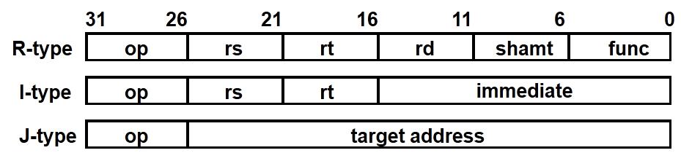
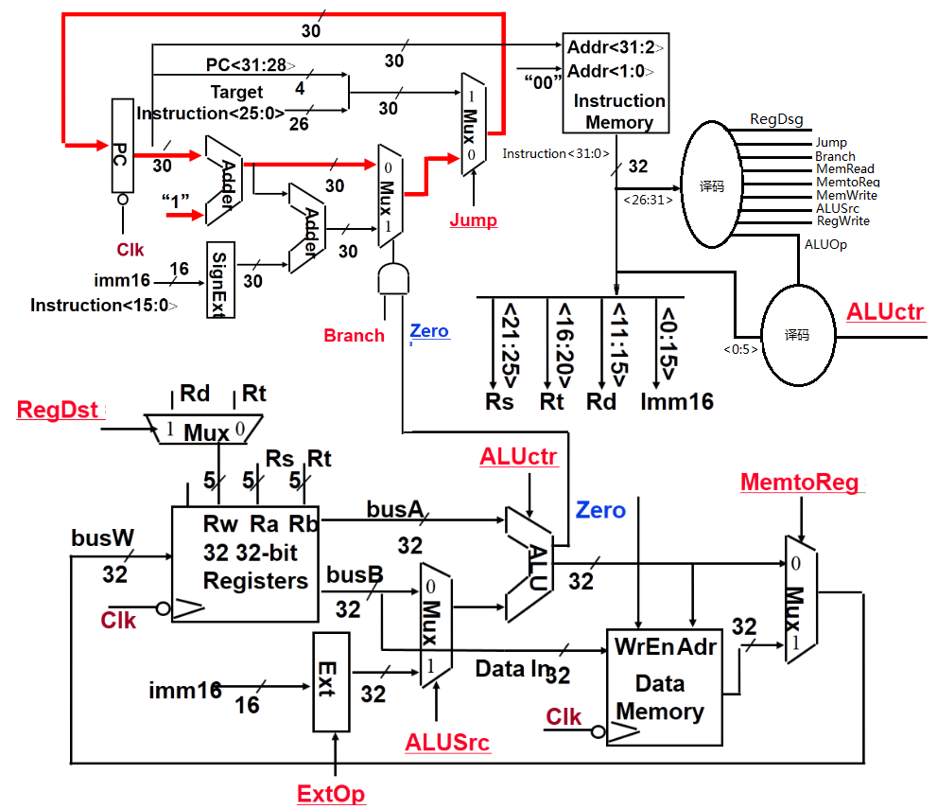

Slide 26
ALU的设计-实现11条MIPS指令的ALU
教材中给出的ALU实现了11条指令的运算功能，如下表所示：
指令
add
sub
subu
ori
lw
sw
beq
jump
addiu
slt
sltu
运算
add
sub
subu
or
addu
addu
subu
x
addu
slt
sltu
ALU共有7种不同的运算功能，故需要3位选择信号ALUctr[2:0]。
add：有溢出判断的加法
sub：有溢出判断的减法
addu：无溢出判断的加法，即加法器的溢出标志位不输出。
subu：无溢出判断的减法，即加法器的溢出标志位不输出。
or：按位逻辑或运算
slt：带符号数的大小比较，用两数相减的符合和溢出标志来判断。
sltu：无符号数的大小比较，用两数相减的借位标志来判断。
ALU中最核心的是加法器，加上各种逻辑电路可实现减法、无溢出判断的加减法、逻辑运算or以及“小于则置1” 等运算操作。
ALU各种运算功能是通过输入不同的ALUctr产生相应的逻辑电路控制信号，让加法器和外围逻辑电路实现指定的运算功能。因此ALU中需要一个控制信号产生逻辑。

Slide 27
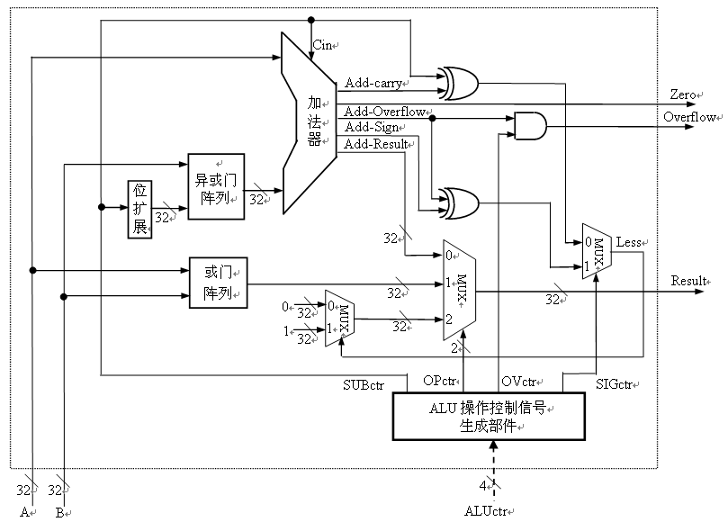
ALU的设计-实现11条MIPS指令的ALU（教材P. 155 图5.13）
ALUctr=add/sub时, OVctr=1
ALUctr=其余运算时, OVctr=0
溢出控制
ALUctr=sltu, SIGctr=0
ALUctr=slt, SIGctr=1
其余情况，任意
比较控制
ALUctr=sub/subu/slt/sltu时, SUBctr=1，其余 SUBctr=0
减法控制
控制信号SUBctr、Opctr、Ovctr和SIGctr由ALUctr产生
做减法以比较大小，规则：
Unsigned: CF=0时，大于
Signed：OF=SF时，大于
3
定点整数ALU！
Notes:
该ALU是定点整数运算器！
算术运算：无符号加、无符号减、带符号数加、带符号数减（原码加/减和移码加减运算电路在浮点运算器中）
按位运算：或
比较运算：小于置1
标志：ZF和OF
定点乘除运算是否也能实现？

Slide 28
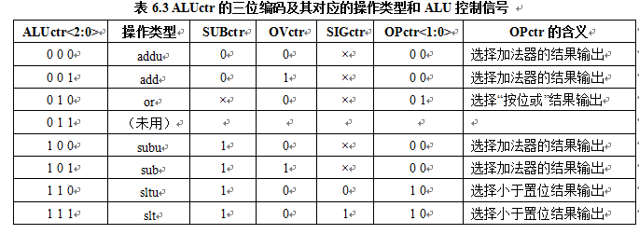
ALUctr与ALU内部控制信号的关系
5
7条指令系统中未用
根据上表可写出ALU操作控制信号的逻辑：
SUBctr = ALUctr<2>
OVctr = !ALUctr<1>&ALUctr<0>
SIGctr = ALUctr<0> 7条指令系统中不用
OPctr<1> = ALUctr<2> & ALUctr<1>
OPctr<0> = !ALUctr<2> & ALUctr<1> & !ALUctr<0>
参考

Slide 29
综合分析结果，得到指令与控制信号的关系表
func
10 0000
10 0010
与func字段无关！
op
00 0000
00 0000
00 1101
10 0011
10 1011
00 0100
00 0010
控制信号
指令
add
sub
ori
lw
sw
beq
jump
RegDst
1
1
0
0
x
x
x
ALUSrc
0
0
1
1
1
0
x
MemtoReg
0
0
0
1
x
x
x
RegWrite
1
1
1
1
0
0
0
MemWrite
0
0
0
0
1
0
0
Branch
0
0
0
0
0
1
0
Jump
0
0
0
0
0
0
1
ExtOp
x
x
0
1
1
x
x
ALUctr<2:0>
add
sub
or
addu
addu
subu
xxx
31
26
21
16
11
6
0
R-type
op
rs
rt
rd
shamt
func
add, sub
I-type
op
rs
rt
immediate
ori, lw, sw, beq
J-type
op
target address
jump
Notes:
Here is a table summarizing the control signals setting for the seven (add, sub, ...) instructions we have looked at.
Instead of showing you the exact bit values for the ALU control (ALUctr), I have used the symbolic values here.
The first two columns are unique in the sense that they are R-type instrucions and in order to uniquely identify them, we need to look at BOTH the op field as well as the func fiels.
Ori, lw, sw, and branch on equal are I-type instructions and Jump is J-type. They all can be uniquely idetified by looking at the opcode field alone.
Now let’s take a more careful look at the first two columns. Notice that they are identical except the last row.
So we can combine these two rows here if we can “delay” the generation of ALUctr signals.
This lead us to something called “local decoding.”
+3 = 42 min. (Y:22)

Slide 30
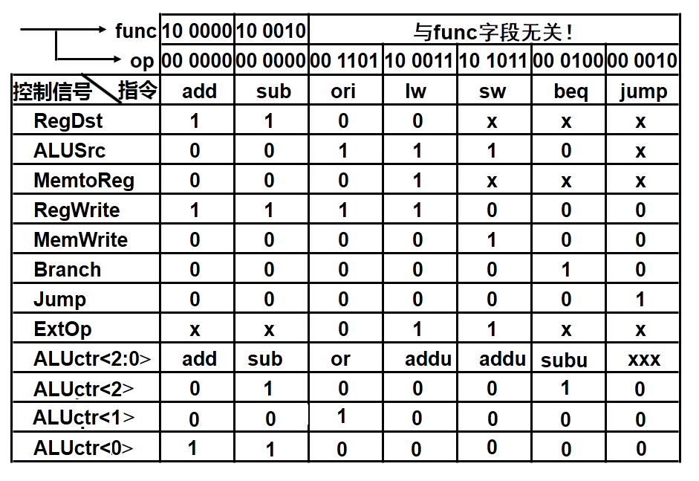
Main Control 的译码逻辑, ALU局部控制器的译码逻辑
assign ALUctr<2>=
(op==6’b000000)
&& (function=6’b100010)
|| (function==6’b000100)
assign ALUctr<1>=
(op==6’b000000)
&& (function=6’b001101)
assign ALUctr<0>=
(op==6’b000000)
&& (function==6’b100000)
|| (function==6’b100010)
Verilog设计控制器的逻辑
布尔式RegDst = !op5 & !op4 & !op3 & !op2 & !op1 & !op0
assign RegDst=(op==6’b000000)
assign ALUSrc=(op==6’b00 1101) || (op==6’b10 0011) || (op==6’b10 1011)
assign MemtoReg=(op==6’b10 0011)
assign RegWrite=(op==6’b000000) || (op==6’b00 1101) || (op==6’b10 0011)
assign MemWrite=(op==6’b10 1011)
assign Branch=(op==6’b00 0100)
assign Jump=(op==6’b00 0010)
assign ExtOp=(op==6’b10 0011) || (op==6’b10 1011)
Notes:
Here is a table summarizing the control signals setting for the seven (add, sub, ...) instructions we have looked at.
Instead of showing you the exact bit values for the ALU control (ALUctr), I have used the symbolic values here.
The first two columns are unique in the sense that they are R-type instrucions and in order to uniquely identify them, we need to look at BOTH the op field as well as the func fiels.
Ori, lw, sw, and branch on equal are I-type instructions and Jump is J-type. They all can be uniquely idetified by looking at the opcode field alone.
Now let’s take a more careful look at the first two columns. Notice that they are identical except the last row.
So we can combine these two rows here if we can “delay” the generation of ALUctr signals.
This lead us to something called “local decoding.”
+3 = 42 min. (Y:22)

Slide 32
第二讲 小结
考察每条指令在单周期数据通路中的执行过程
每条指令在一个时钟周期内完成
每个时钟到来时，都开始进入取指令操作
经过clk-to-Q，PC得到新值，经过access time后得到当前指令
按三种方式分别计算下条指令地址，在branch / zero / jump的控制下，选择其中之一送到PC输入端，但不会马上写到PC中，一直到下个时钟到达时，才会更新PC。三种下址方式为：
branch=jump=0：PC+4
branch=zero=1： PC+4+signExt[imm16]*4
jump=1： PC<31:28> concat target<25:0> concat “00”
指令取出后被译码，产生指令对应的控制信号
R-type指令：rd为目的寄存器，无访存操作，……
ori指令：rt为目的寄存器，0扩展，无访存操作，……
lw指令： rt为目的寄存器，计算地址、符号扩展，读内存，……
sw指令： rt为源寄存器，计算地址、符号扩展，写内存，……
汇总每条指令控制信号的取值，生成真值表，写出逻辑表达式，设计主控制逻辑和ALU局部控制逻辑

