Slide 1
实验二、5级流水线CPU
指令流水线
目的：
通过该实验，掌握流水线CPU的设计方法
要求：
对提供的五级流水线CPU仿真和代码分析，完成下面功能
1、画出流水线的数据通路，各个阶段用到的控制信号
2、分析数据冒险的实现方法,完善load use 代码
3、分析转移冒险的实现方法，完善beq 代码
4、在此代码中，增加中断部分。
Notes:
Start X:40流水线处理器中，指令重叠执行
流水线中，每条指令的执行被划分成相同多个阶段
每个流水段的执行时间相等，都在一个周期内完成
流水线中，多个指令可能同时需要用同一个部件
流水线中，转移指令或异常事件会破坏流水线的执行
流水线中，指令数据相关时也可能破坏流水线的执行

Slide 2
3: Instruction Pipeline
指令流水线
第一讲 流水线数据通路和控制逻辑
第二讲 流水线冒险处理
第三讲 高级流水线技术
Notes:
Start X:40流水线处理器中，指令重叠执行
流水线中，每条指令的执行被划分成相同多个阶段
每个流水段的执行时间相等，都在一个周期内完成
流水线中，多个指令可能同时需要用同一个部件
流水线中，转移指令或异常事件会破坏流水线的执行
流水线中，指令数据相关时也可能破坏流水线的执行

Slide 3
第一讲 流水线数据通路和控制
主 要 内 容
如何设计流水线数据通路
  以MIPS指令子集来说明
如何设计流水线控制逻辑
  分析每条指令执行过程中的控制信号
  给出控制器设计过程
流水线冒险的概念

Slide 4
复习：A Single Cycle Processor
Branch
<31:26>
RegDst
Jump
Instruction<31:0>
op
Main
Control
ALUSrc
Instruction
Fetch Unit
:
Zero
<0:15>
<21:25>
<11:15>
Clk
<16:20>
ALUop
3
Rd
Rt
Rd
<5:0>
ALU
Control
RegDst
Imm16
1
Mux
0
func
Rs
Rt
3
RegWr
5
5
5
ALUctr
busA
MemWr
MemtoReg
Rw
Ra
Rb
Zero
busW
32
32 32-bit
Registers
ALU
0
32
busB
0
32
Clk
32
Mux
Mux
32
WrEn
Adr
1
1
Data In
32
imm16
Extender
Data
Memory
16
32
Instr<15:0>
Clk
ALUSrc
ExtOp
Notes:
I like to start today’s lecture with a look back at the single cycle processor.
The reason is that this single cycle processor has a lot of common with the pipeline processor we are going to talk about today.
Everything in this single cycle processor starts at the Instruction Fetch Unit which sends the Rs, Rt, Rd, and Immediate fields of the instruction to the datapath.
At the same time, the Opcode and Func fields of the instruction are sent to the Control Unit.
Based on the OP field of the instruction, the Main Control will set the control signals RegDst, ALUSrc, .... etc. properly.
The ALU Control then uses the ALUop from the Main control and the Func field of the instruction to generate the ALUctr signals to ask the ALU to do the right thing.
As far as the datapath is concerned, the data pretty much flow from left to right.
+1 = 1 min. (X:41)
Question: Why do we say that single cycle processor has more commonplaces with pipeline processor?

Slide 5
复习：Timing Diagram of a Load Instruction
Instruction Fetch
Instr Decode /
Address
Data Memory
Reg Wr
Reg. Fetch
Clk
Clk-to-Q
PC
Old Value
New Value
Instruction Memory Access Time
Rs, Rt, Rd,
Op, Func
Old Value
New Value
1
Delay through Control Logic
ALUctr
Old Value
New Value
ExtOp
Old Value
New Value
ALUSrc
Old Value
New Value
RegWr
Old Value
New Value
2
Register File Access Time
busA
Old Value
New Value
Register File Write Time
Delay through Extender & Mux
3
busB
Old Value
New Value
ALU Delay
Address
Old Value
New Value
Data Memory Access Time
busW
Old Value
New
Notes:
Well let’s take a look at the Load instruction’s timing diagram and see how we can break it up into smaller steps. The biggest contributors to the cycle time appears to be:
(1) Instruction Memory Access Time.
(2) Delay through the Control Logic, which happens in parallel with Register File Access.
(3) ALU Delay.
(4) Data Memory Access Time.
(5) And Register File Write Time.
Therefore, it makes sense to break up the Load instructions into these five steps:
(1) Instruction Fetch.
(2) Instruction Decode “slash” Register Fetch.
(3) Memory Address Calculation.
(4) Data Memory Access.
(5) And finally, Register File Write.
Notice that here I have used the term Register File Write time instead of Register File Write Setup time. The reason is that in a “real” register file, there is no such thing as set up time.
+2 = 13 min. (X:53)

Slide 6
Sequential Laundry（串行方式）
6 PM
7
8
9
10
11
Midnight
Time
30
40
20
30
40
20
30
40
20
30
40
20
T
a
s
k
O
r
d
e
r
A
B
C
D
串行方式下， 4 批衣服需要花费 6 小时（4x(30+40+20)=360分钟）
N批衣服，需花费的时间为Nx(30+40+20) = 90N
如果用流水线方式洗衣服，则花多少时间呢?

Slide 7
Pipelined Laundry: (Start work ASAP)
6 PM
7
8
9
10
11
Midnight
Time
30
40
40
40
40
20
T
a
s
k
O
r
d
e
r
串行为90分钟x4=6小时
N批则为90xN分钟
A
B
流水线方式下，需30+4x40+20
=210分 (3.5小时)
如果有N批衣服呢？
30+Nx40+20分钟
假定每一步时间均衡，则比串行方式提高约3倍！
C
D
流水方式下，所用时间主要与最长阶段的时间有关！

Slide 8
复习：Load指令的5个阶段
阶段1
阶段2
阶段 3
阶段 4
阶段5
Ifetch
Reg/Dec
Exec
Mem
Wr
Ifetch (取指) : 取指令并计算PC+4 (用到哪些部件？)
Reg/Dec (取数和译码) : 取数同时译码 (用到哪些部件？)
Exec (执行) : 计算内存单元地址 (用到哪些部件？)
Mem (读存储器) : 从数据存储器中读 (用到哪些部件？)
Wr(写寄存器): 将数据写到寄存器中 (用到哪些部件？)
  指令存储器、Adder
寄存器堆读口、指令译码器
这里寄存器堆的读口和写口可看成两个不同的部件。
扩展器、ALU
数据存储器
寄存器堆写口
指令的执行过程是否和“洗衣”过程类似？是否可以采用类似方式来执行指令呢？
Notes:
As shown here, each of these five steps will take one clock cycle to complete.
And in pipeline terminology, each step is referred to as one stage of the pipeline.
+1 = 8 min. (X:48)

Slide 9
单周期指令模型与流水模型的性能比较
假定以下每步操作所花时间为：
    取指：2ns
    寄存器读：1ns
    ALU操作：2ns
    存储器读：2ns
    寄存器写：1ns
单周期模型
  每条指令在一个时钟周期内完成
  时钟周期等于最长的lw指令的执行时间，即：8ns
  串行执行时，N条指令的执行时间为：8Nns
流水线性能
  时钟周期等于最长阶段所花时间为：2ns
  每条指令的执行时间为： 2nsx5=10ns
  N条指令的执行时间为：(4+N)x2ns
  在N很大时，比串行方式提高约 4 倍
  若各阶段操作均衡(例如，各阶段都是2ns)，则提高倍数为5倍。
Load指令执行时间总计为：8ns
(假定控制单元、PC访问、信号传递等没有延迟)
流水线方式下，单条指令执行时间不能缩短，但能大大提高指令吞吐率！

Slide 10
流水线指令集的设计
具有什么特征的指令集有利于流水线执行呢？
  长度尽量一致，有利于简化取指令和指令译码操作
    MIPS指令32位，下址计算方便: PC+4
    X86指令从1字节到17字节不等，使取指部件极其复杂
  格式少，且源寄存器位置相同，有利于在指令未知时就可取操作数
    MIPS指令的rs和rt位置一定，在指令译码时就可读rs和rt的值
    若位置随指令不同而不同，则需先确定指令类型才能取寄存器编号
  load / Store指令才能访问存储器，有利于减少操作步骤，规整流水线
    lw/sw指令的地址计算和运算指令的执行步骤规整在同一个周期
    X86运算类指令操作数可为内存数据，需计算地址、访存、执行
  内存中”对齐”存放，有利于减少访存次数和流水线的规整
  总之，规整、简单和一致等特性有利于指令的流水线执行
31
26
21
16
11
6
0
op
rs
rt
rd
shamt
func
6 bits
5 bits
5 bits
5 bits
5 bits
6 bits

Slide 11
Load指令的流水线
Cycle 1
Cycle 2
Cycle 3
Cycle 4
Cycle 5
Cycle 6
Cycle 7
Clock
1st lw
Ifetch
Reg/Dec
Exec
Mem
Wr
2nd lw
Ifetch
Reg/Dec
Exec
Mem
Wr
3rd lw
Ifetch
Reg/Dec
Exec
Mem
Wr
每个周期有五个功能部件同时在工作
后面指令在前面完成取指后马上开始
每个load指令仍然需要五个周期完成
但是，吞吐率(throughput)提高许多，理想情况下，有：
  每个周期有一条指令进入流水线
  每个周期都有一条指令完成
  每条指令的有效周期(CPI)为1
Notes:
For the load instructions, the five independent functional units in the pipeline datapath are:
(a) Instruction Memory for the Ifetch stage.
(b) Register File’s Read ports for the Reg/Decode stage.
(c) ALU for the Exec stage. (d) Data memory for the Mem stage.
(e) And finally Register File’s write port for the Write Back stage.
Notice that I have treated Register File’s read and write ports as separate functional units because the register file we have allows us to read and write at the same time.
Notice that as soon as the 1st load finishes its Ifetch stage, it no longer needs the Instruction Memory. Consequently, the 2nd load can start using the Instruction Memory (2nd Ifetch).
Furthermore, since each functional unit is only used ONCE per instruction, we will not have any conflict down the pipeline (Exec-Ifet, Mem-Exec, Wr-Mem) either.
I will show you the interaction between instructions in the pipelined datapath later. But for now, I want to point out the performance advantages of pipelining.
If these 3 load instructions are to be executed by the multiple cycle processor, it will take 15 cycles. But with pipelining, it only takes 7 cycles. This (7 cycles), however, is not the best way to look at the performance advantages of pipelining.
A better way to look at this is that we have one instruction enters the pipeline every cycle so we will have one instruction coming out of the pipeline (Wr stages) every cycle.
Consequently, the “effective” (or average) number of cycles per instruction is now ONE even though it takes a total of 5 cycles to complete each instruction.
+3 = 14 min. (X:54)

Slide 12
R-type指令的4个阶段
Cycle 1
Cycle 2
Cycle 3
Cycle 4
R-type
Ifetch
Reg/Dec
Exec
Wr
Ifetch: 取指令并计算PC+4
Reg/Dec: 从寄存器取数，同时指令在译码器进行译码
Exec: 在ALU中对操作数进行计算
Wr: ALU计算的结果写到寄存器
Notes:
Well, so far so good. Let’s take a look at the R-type instructions.
The R-type instruction does NOT access data memory so it only takes four clock cycles, or in our new pipeline terminology, four stages to complete.
The Ifetch and Reg/Dec stages are identical to the Load instructions. Well they have to be because at this point, we do not know we have a R-type instruction yet.
Instead of calculating the effective address during the Exec stage, the R-type instruction will use the ALU to operate on the register operands.
The result of this ALU operation is written back to the register file during the Wr back stage.
+1 = 15 min. (55)

Slide 13
含R-type和 Load 指令的流水线
Cycle 1
Cycle 2
Cycle 3
Cycle 4
Cycle 5
Cycle 6
Cycle 7
Cycle 8
Cycle 9
Clock
R-type
Ifetch
Reg/Dec
Exec
Wr
Ops! We have a problem!
R-type
Ifetch
Reg/Dec
Exec
Wr
Load
Ifetch
Reg/Dec
Exec
Mem
Wr
R-type
Ifetch
Reg/Dec
Exec
Wr
R-type
Ifetch
Reg/Dec
Exec
Wr
上述流水线有个问题: 两条指令试图同时写寄存器，因为
  Load在第5阶段用寄存器写口
  R-type在第4 阶段用寄存器写口
把一个功能部件同时被多条指令使用的现象称为结构冒险(Struture Hazard)
为了流水线能顺利工作，规定：
  每个功能部件每条指令只能用一次（如：写口不能用两次或以上）
  每个功能部件必须在相同的阶段被使用（如：写口总是在第五阶段被使用）
或称为资源冲突！
Notes:
What happened if we try to pipeline the R-type instructions with the Load instructions?
Well, we have a problem here!!!
We end up having two instructions trying to write to the register file at the same time!
Why do we have this problem (the write “bubble”)?
Well, the reason for this problem is that there is something I forget to tell you.
+1 = 16 min. (X:56)

Slide 14
R-type的Wr操作延后一个周期执行
NOOP!
1
2
3
4
5
R-type
Ifetch
Reg/Dec
Exec
Mem
Wr
加一个NOP阶段以延迟“写”操作:
  把“写”操作安排在第5阶段, 这样使R-Type的Mem阶段为空NOP
Clock
Cycle 1
Cycle 2
Cycle 3
Cycle 4
Cycle 5
Cycle 6
Cycle 7
Cycle 8
Cycle 9
R-type
Ifetch
Reg/Dec
Exec
Mem
Wr
R-type
Ifetch
Reg/Dec
Exec
Mem
Wr
Load
Ifetch
Reg/Dec
Exec
Mem
Wr
R-type
Ifetch
Reg/Dec
Exec
Mem
Wr
R-type
Ifetch
Reg/Dec
Exec
Mem
Wr
这样使流水线中的每条指令都有相同多个阶段!
Notes:
Well one thing we can do is to add a “Nop” stage to the R-type instruction pipeline to delay its register file write by one cycle.
Now the R-type instruction ALSO uses the register file’s witer port at its 5th stage so we eliminate the write conflict with the load instruction.
This is a much simpler solution as far as the control logic is concerned. As far as performance is concerned, we also gets back to having one instruction completes per cycle.
This is kind of like promoting socialism: by making each individual R-type instruction takes 5 cycles instead of 4 cycles to finish, our overall performance is actually better off.
The reason for this higher performance is that we end up having a more efficient pipeline.
+1 = 20 min. (Y:00)

Slide 15
Store指令的四个阶段
Cycle 1
Cycle 2
Cycle 3
Cycle 4
NOOP!
Store
Ifetch
Reg/Dec
Exec
Mem
Wr
Ifetch：取指令并计算PC+4
Reg/Dec： 从寄存器取数，同时指令在译码器进行译码
Exec：16位立即数符号扩展后与寄存器值相加，计算主存地址
Mem：将寄存器读出的数据写到主存
Wr: 加一个空的写阶段，使流水线更规整！
Notes:
Let’s continue our lecture by looking at the store instruction.
Once again, the Ifetch and Reg/Decode stages are the same as all other instructions.
The Exec stage of the store instruction calculates the memory address.
Once the address is calculated, the store instruction will write the data it read from the register file back at the Reg/Decode stage into the data memory during the Mem stage.
Notice that unlike the load instruction which takes five cycles to accomplish its task, the Store instruction only takes four cycles or four pipe stages.
In order to keep our pipeline diagram looks more uniform, however, we will keep the Wr stage for the store instruction in the pipeline diagram.
But keep in mind that as far as the pipelined control and pipelined datapath are concerned, the store instruction requires NOTHING to be done once it finishes its Mem stage.
+2 = 27 min. (Y:07)

Slide 16
Beq的四个阶段
Cycle 1
Cycle 2
Cycle 3
Cycle 4
NOOP!
Beq
Ifetch
Reg/Dec
Exec
Mem
Wr
与多周期通路有什么不同？
Ifetch: 取指令并计算PC+4
Reg/Dec:从寄存器取数，同时指令在译码器进行译码
Exec: 执行阶段
  ALU中比较两个寄存器的大小（做减法）
  Adder中计算转移地址
Mem: 如果比较相等, 则：
  转移目标地址写到PC
多周期通路中，在Reg/Dec阶段投机进行了转移地址的计算！可以减少Branch指令的时钟数
为什么流水线中不进行“投机”计算？
Wr: 加一个空写阶段，使流水线更规整！
因为流水线中所有指令的执行阶段一样多，Branch指令无需节省时钟，因为有比它更复杂的指令。
按照上述方式，把所有指令都按照最复杂的“load”指令所需的五个阶段来划分，不需要的阶段加一个“NOP”操作
Notes:
Well similar to the store instruction, the branch instruction only consists of four pipe stages.
Ifetch and Reg/decode are the same as all other instructions because we do not know what instruction we have at this point. We have not finish decoding the instruction yet.
During the Execute stage of the pipeline, the BEQ instruction will use the ALU to compare the two register operands it fetched during the Reg/Dec stage.
At the same time, a separate adder is used to calculate the branch target address.
This is difference from M-cycle processor where target address is calculated by ALU but at the 2nd cycle.
If the registers we compared during the Execute stage (point to the last bullet) have the same value, the branch is taken.
That is, the branch target address we calculated earlier (last bullet) will be written into the Program Counter.
Once again, similar to the Store instruction, the BEQ instruction will require NEITHER the pipelined control nor the pipelined datapath to do ANY thing once it finishes its Mem stage.
With all these talk about pipelined datapath and pipelined control, let’s take a look at how the pipelined datapath looks like.
+2 = 29 min. (Y:09)

Slide 17
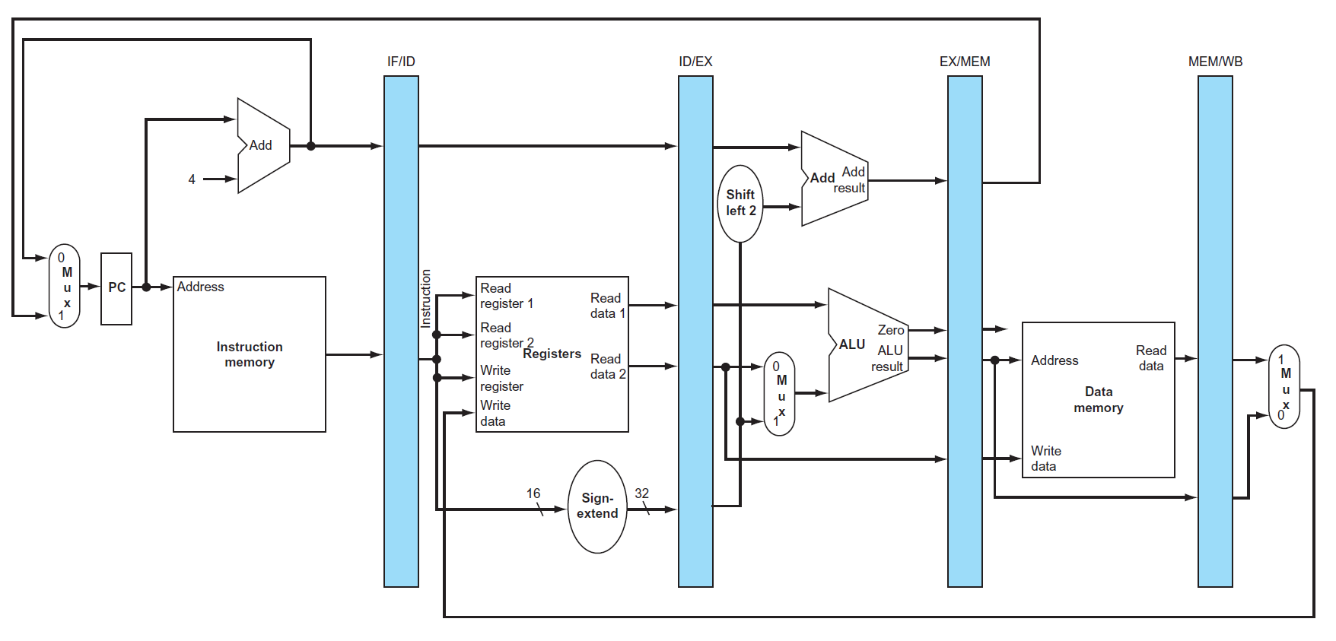
A Pipelined Datapath（五阶段流水线数据通路）
Clock-to-Q delay
不包含控制逻辑
Clk
Ifetch (IF)
Reg/Dec (ID)
Exec (Ex)
Mem
Wr
为什么需要这些Reg？
保存每个周期执行的结果!
属于内部寄存器，对程序员透明，不需作为现场保存
下面看每条指令在流水线通路中的执行过程
Notes:
The pipelined datapath consists of combination logic blocks separated by pipeline registers. If you get rid of all these registers (not the PC), this pipelined datapath is reduced to the single-cycle datapath.
This should give you extra incentive to do a good job on your single cycle processor design homework because you can build your pipeline design based on your single cycle design.
Anyway, the registers mark the beginning and the end of a pipe stage.
In the multiple clock cycle lecture, I recommended that the best way to think about a logic clock cycle is that it begins slightly after the clock tick and ends right at the next clock tick.
For example here, the Reg/Decode stage begins slightly after this clock tick when the output of the IF/ID register has stabilized to its new value AND ends RIGHT at the next clock tick when the output of the register file is clocked into the ID/Exec register.
At the end of the Reg/Decode stage, the register output that just clocked into the ID/Exec register has NOT yet propagate to the register output yet. It takes a Clk-to-Q delay.
When the new value we just clocked in (points to the clock tick) has propagate to the register output, then we have reach the beginning of the Exec stage.
Notice that the Wr stage of the pipeline starts here (last cycle) but there is no corresponding datapath underneath it because the Wr stage of the pipeline is handled by the same part of the pipeline that handles the Register Read stage.
This part of the datapath (Reg File) is the only part that is used by more than one stage of the pipeline. This is OK because the register file has independent Read and Write ports.
More specifically, the Reg/Decode stage of the pipeline uses the register file’s read port while the Write Back stage of the pipeline uses the register file’s write port.
+3 = 32 min. (Y:12)

Slide 18
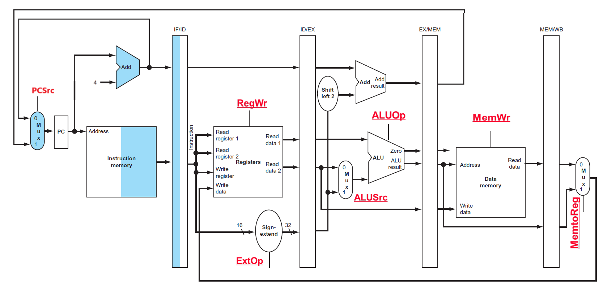
取指令（Ifetch) 阶段
第10H单元指令: lw $1, 0x100($2) 功能：$1 <- Mem [($2) + 0x100]
You are here!
Clk
Ifetch
Reg/Dec
Exec
Mem
Reg[Rs],Reg[Rt],Rt,Rd,Imm16,PC+4等被保存在ID/EXE中
该阶段有哪些控制信号？
没有！因是所有指令的公共操作，故无控制信号！
Notes:
Let’s follow a Load instruction down the pipeline and see how everything works.
Every instruction starts at the Instruction Fetch stage which:
(a) Begins slightly after the first clock tick when PC output has stabilized to its new value.
(b) And ends when the output of the I-Unit is clocked into the IF/ID register.
This picture shows the state of the pipeline at the end of the Ifetch stage (you are here).
Let’s expand this part of the datapath and take a better look.
+1 = 33 min. (Y:13)

Slide 19
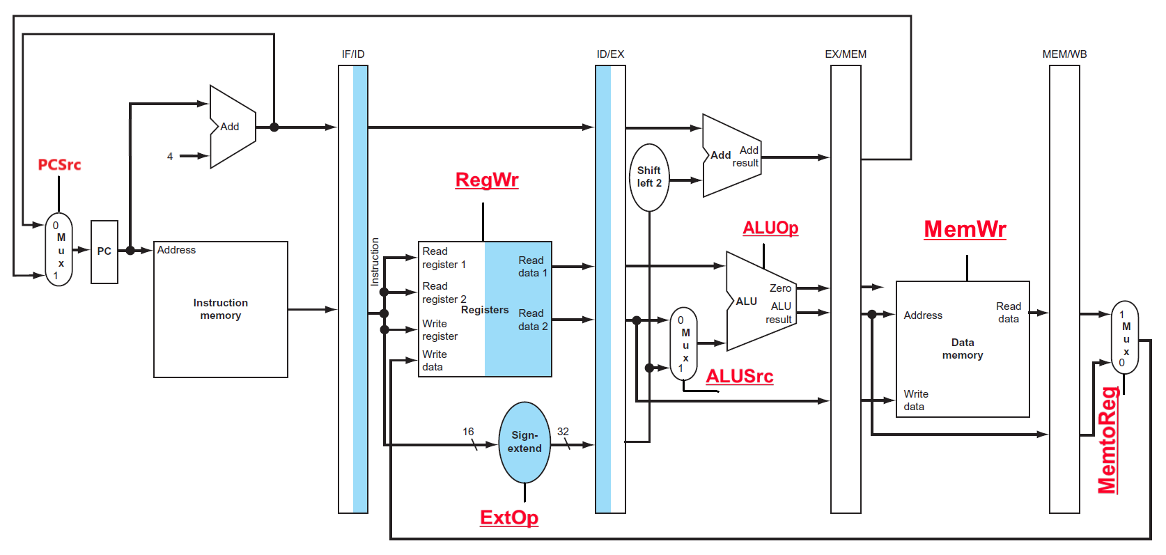
译码/取数（Reg/Dec）阶段
Location 10H: lw $1, 0x100($2) 功能：$1 <- Mem[($2) + 0x100]
You are here!
Clk
Ifetch
Reg/Dec
Exec
Mem
Reg[Rs],Reg[Rt],Rt,Rd,Imm16,PC+4等被保存在ID/EXE中
该阶段有哪些控制信号？
没有！因是所有指令的公共操作，故无控制信号！
Notes:
This picture shows the state of the pipeline at the end of Load’s Reg/Decode stage.
All the datapath has to do is read register (Ra and busA) R2 from the register file.
As the same time, we need to pass the Immediate field of the instruction onto the next stage (ID/Exec) register because the immediate field is needed for address calculation.
Let’s concentrate on the load instruction (point to the 1st bullet) going down the pipe and ignore what is in the PC and IF/ID registers for now.
Since we are here (Your are Here), Register R2 and Imm16 have already clocked into ID/Exec register but they have not yet appeared at the register’s output.
+1 = 36 min. (Y:16)

Slide 20
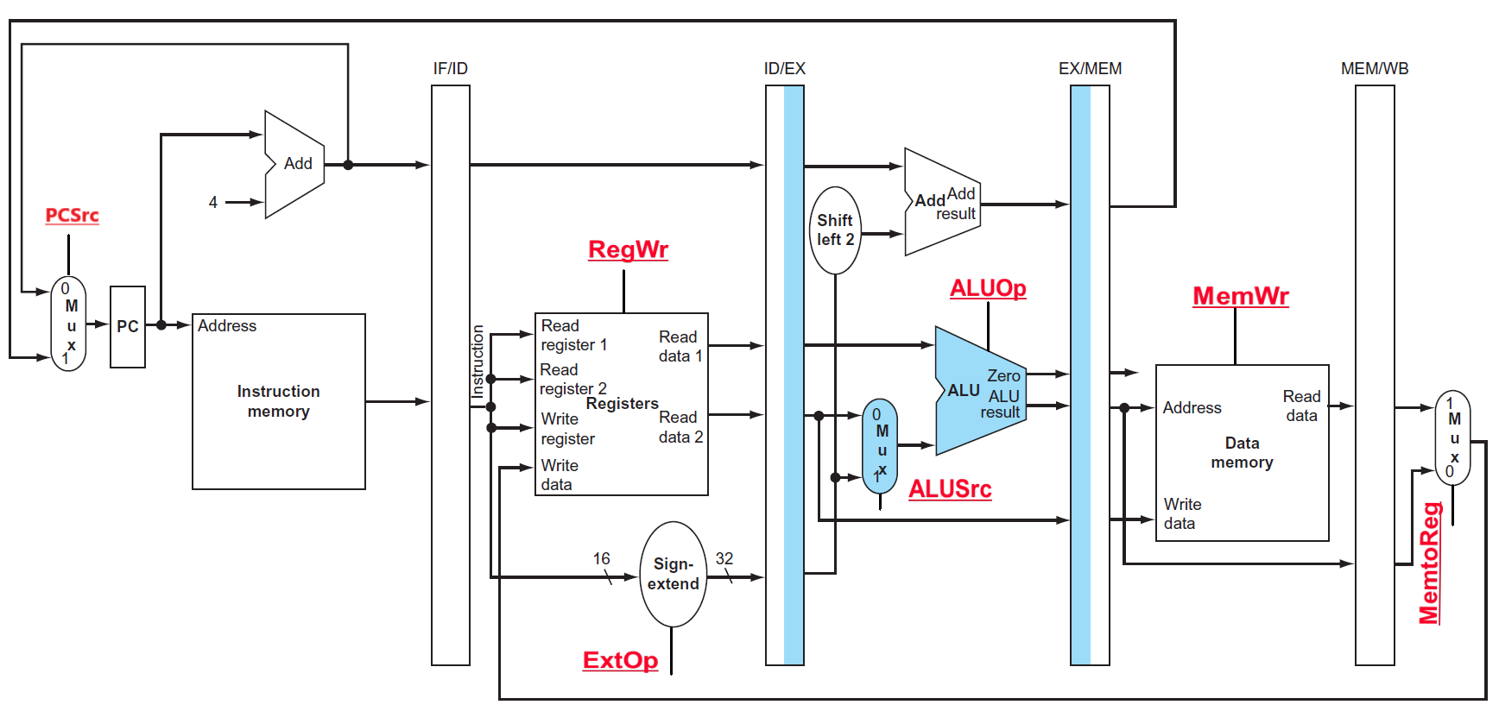
Load指令的地址计算阶段
Location 10H: lw $1, 0x100($2) 功能：$1 <- Mem[($2) + 0x100]
指令已被译码，可确定执行部件的控制信号！
You are here!
Clk
Ifetch
Reg/Dec
Exec
Mem
目的寄存器Rt不传递下去会怎样？
连接到错误的目的地址，指令执行错误！
Notes:
If we wait a little bit longer (beginning of Exe), Register R2 and Imm16 will appear at the ID/Exec register output and we are now in the Exec stage where we will calculate the Memory Address for the load instruction.
Notice that besides calculating the Load’s Memory Address, we also need to pass the Rt field (RegDst = 0) of the instruction down the pipeline.
The reason is that we will need to use Rt field later on to specify which register to write to when we reach the end of the Load pipeline.
Also notice that this is the first stage of the pipeline that requires any control signals.
We will talk more about this (Rt field and other control signals) later but for now, let’s expand this part of the datapath and take a closer look at what is going on.
+2 = 38 min. (Y:18)

Slide 21
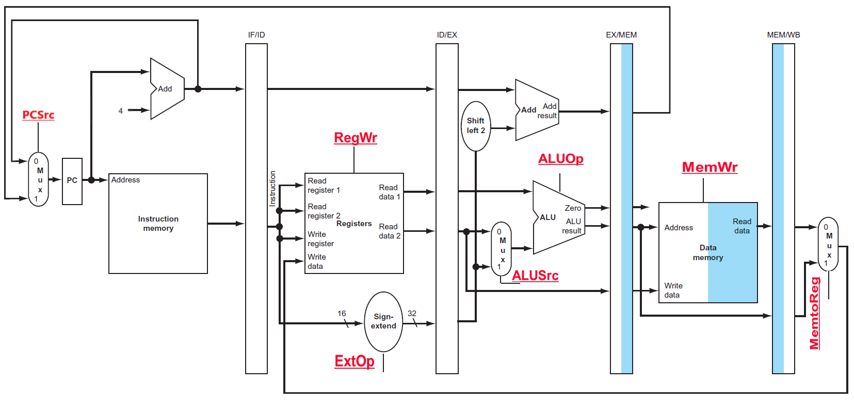
Load指令的存储器读(Mem)周期
Location 10H: lw $1, 0x100($2) 功能： $1 <- Mem[($2) + 0x100]
You are here!
Clk
Ifetch
Reg/Dec
Exec
Mem
Notes:
And it will be used to read the Data Memory (RA).
By setting the clock cycle time longer than the data memory read access time, we can guarantee the memory output (Do) will be stable by the end of the Mem cycle (you are here).
And this clock tick will trigger the Mem/Wr register to latch in Load’s data.
We have to pass the Load instruction’s Rt field down the pipeline one more time because we still have not use it yet.
+1 = 40 min. (Y:20)

Slide 22
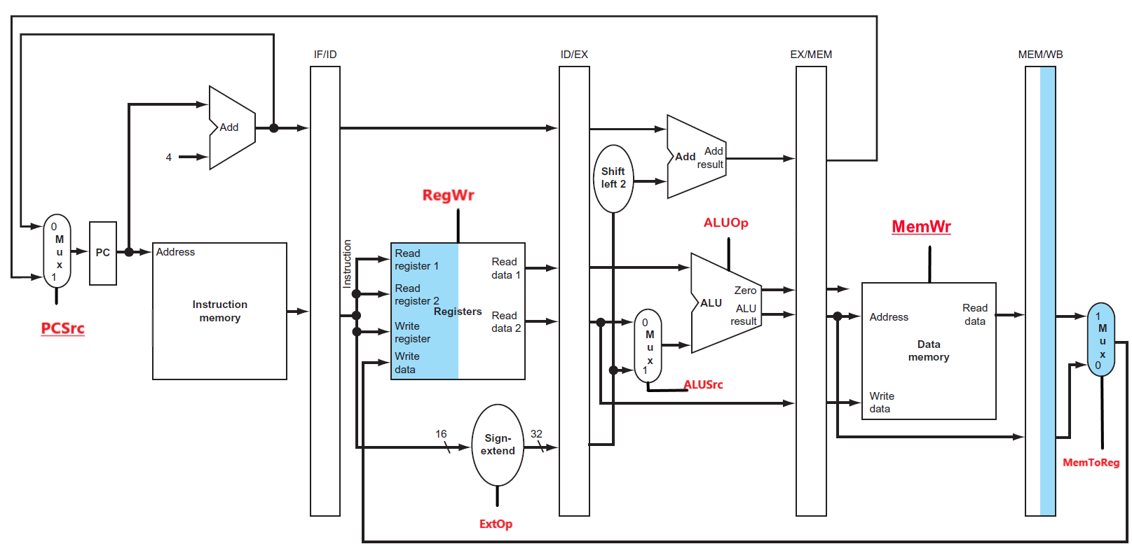
Load指令的回写（Write Back）阶段
Location 10H: lw $1, 0x100($2) 功能：$1 <- Mem[($2) + 0x100]
Clk
Ifetch
Reg/Dec
Exec
Mem
Wr
该阶段有反向数据流，可能会引起冒险！以后介绍。
各阶段所经DataPath已有，控制信号如何得到？
Notes:
The Rt filed of the load instruction will be used in the Register Write back stage of the pipeline (Wr) to specified the register (Rw) where the load data is written.
Since we are writing the load’s data into the register file, the control signal MemtoReg and RegWr must be set to 1.
So this finishes the grand tour of how a load instruction flows through the datapath.
But how about control signals?
+1 = 41 min. (Y:21)

Slide 23
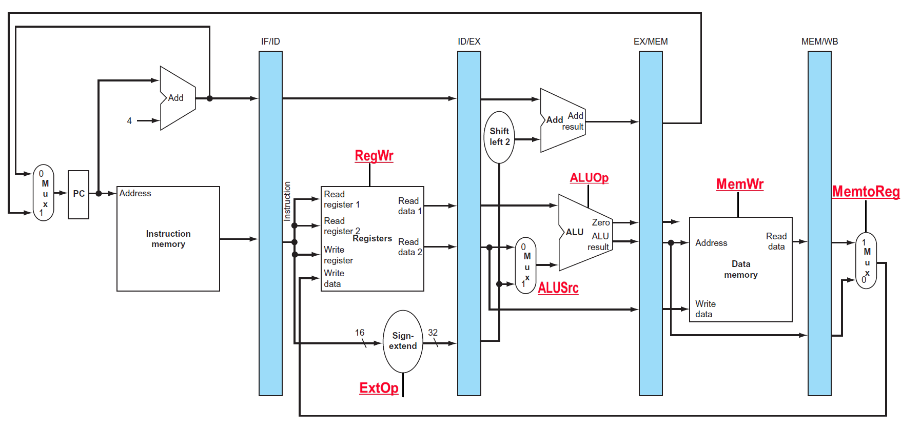
流水线中的Control Signals如何获得?
主要考察: 第N阶段的控制信号，它取决于是某条指令的某个阶段。
  N = Exec, Mem, Wr (只有这三个阶段有控制信号）
  例: Load的Exec段的控制信号 = Func (Load’s Exec)
Ifetch Reg/Dec Exec Mem Wb
为什么 1st 和 2nd 阶段没有控制信号?
IF和ID阶段的功能对每条指令来说都一样
Notes:
The key observation about the control signals is that the control signals at Stage N depends ONLY on the instruction that is currently in Stage N, where N is either Exec, Mem, or Wr (points to the control signals at each stage, especially RegWr at Wr stage).
Notice that I did not mention anything about the Ifet and Dec stage because there cannot be any instruction dependent control signals at these two stages. Why?
Because at these two stages (Ifetch and Dec) we do not know what instructions we have yet: we have just fetch the instruction (Ifetch) and is still in the process of decoding it (Dec).
Here is an example of this rule (1st bullet). During the Load instruction’s Exec stage, the control signals (ExtOp, ALUSrc, ALUOp) in the Exec stage are set this way because this is the setting required to do the right things for Load instruction's Exec stage.
Since the control signals depend ONLY on the instruction that is currently in that stage of the pipeline (1st Bullet), the control is very similar to the Controller for the single cycle processor.
The difference is that after we generate the control signals, we need to pipeline them so they are applied to the correct stage of the pipeline (Exec, Mem, an Wr) when the instruction reaches that stage.
Let me show you what I mean by this.
+2 = 43 min. (Y:23)

Slide 24
Load指令:流水线中的控制信号
在取数/译码（Reg/Dec）阶段产生本指令每个阶段的所有控制信号
  Exec信号 (ExtOp, ALUSrc, ...) 在1个周期后使用
  Mem信号 (MemWr, Branch) 在2个周期后使用
  Wr信号 (MemtoReg, RegWr) 在3个周期后使用
所以，控制信号也要保存在流水段寄存器中！
Reg/Dec
Exec
Mem
Wr
ExtOp
ExtOp
ALUSrc
ALUSrc
ALUOp
ALUOp
Main
Control
RegDst
RegDst
Ex/Mem Register
IF/ID Register
MemWr
ID/Ex Register
MemWr
MemWr
Mem/Wr Register
Branch
Branch
Branch
MemtoReg
MemtoReg
MemtoReg
MemtoReg
RegWr
RegWr
RegWr
RegWr
各流水段部件在一个时钟内完成某条指令的某个阶段的工作！
在下个时钟到达时，把执行结果以及前面传递来的后面各阶段要用到的所有数据（如：指令、立即数、目的寄存器等）和控制信号保存到流水线寄存器中！
Notes:
The main control here is identical to the one in the single cycle processor. It generate all the control
signals necessary for a given instruction during that instruction’s Reg/Decode stage.
All these control signals will be saved in the ID/Exec pipeline register at the end of the Reg/Decode cycle.
The control signals for the Exec stage (ALUSrc, ... etc.) come from the output of the ID/Exec register. That is they are delayed ONE cycle from the cycle they are generated.
The rest of the control signals that are not used during the Exec stage is passed down the pipeline and saved in the Exec/Mem register.
The control signals for the Mem stage (MemWr, Branch) come from the output of the Exec/Mem register. That is they are delayed two cycles from the cycle they are generated.
Finally, the control signals for the Wr stage (MemtoReg & RegWr) come from the output of the Exec/Wr register: they are delayed three cycles from the cycle they are generated.
+2 = 45 min. (Y:45)

Slide 25
流水线中的Control Signals
通过对前面流水线数据通路的分析，得知：
  PC需要写使能吗？
  流水段寄存器需要写使能吗？
  Ifecth阶段和Dec/Reg阶段都没有控制信号
  Exec阶段的控制信号有四个
    ExtOp (扩展器操作)：1- 符号扩展；0- 零扩展
    ALUSrc (ALU的B口来源)：1- 来源于扩展器；0- 来源于BusB
    ALUOp (主控制器输出，用于辅助局部ALU控制逻辑来决定ALUCtrl)
    RegDst (指定目的寄存器)：1- Rd；0- Rt
  Mem阶段的控制信号有两个
    MemWr (DM的写信号)：Store指令时为1，其他指令为0
    Branch (是否为分支指令)：分支指令时为1，其他指令为0
  Wr阶段的控制信号有两个
    MemtoReg (寄存器的写入源)：1- DM输出；0- ALU输出
    RegWr (寄存器堆写信号)：结果写寄存器的指令都为1，其他指令为0
  每个时钟都会改变PC，故不需要!
  每个时钟都会改变流水段寄存器，故不需要!
Notes:
The key observation about the control signals is that the control signals at Stage N depends ONLY on the instruction that is currently in Stage N, where N is either Exec, Mem, or Wr (points to the control signals at each stage, especially RegWr at Wr stage).
Notice that I did not mention anything about the Ifet and Dec stage because there cannot be any instruction dependent control signals at these two stages. Why?
Because at these two stages (Ifetch and Dec) we do not know what instructions we have yet: we have just fetch the instruction (Ifetch) and is still in the process of decoding it (Dec).
Here is an example of this rule (1st bullet). During the Load instruction’s Exec stage, the control signals (ExtOp, ALUSrc, ALUOp) in the Exec stage are set this way because this is the setting required to do the right things for Load instruction's Exec stage.
Since the control signals depend ONLY on the instruction that is currently in that stage of the pipeline (1st Bullet), the control is very similar to the Controller for the single cycle processor.
The difference is that after we generate the control signals, we need to pipeline them so they are applied to the correct stage of the pipeline (Exec, Mem, an Wr) when the instruction reaches that stage.
Let me show you what I mean by this.
+2 = 43 min. (Y:23)

Slide 26
控制逻辑 Control)的设计
流水线控制逻辑的设计
  每条指令的控制信号在该指令执行期间变不变？
  与单周期的控制逻辑设计类似
  设计过程
    控制逻辑分成两部分
      主控制逻辑：生成ALUop和其他控制信号
      局部ALU控制逻辑：根据ALUop和func字段生成ALUCtrl
    用真值表建立指令和控制信号之间的关系
    写出每个控制信号的逻辑表达式
  控制逻辑的输出（控制信号）在ID阶段生成，并存放在ID/EX流水段寄存器中，然后每来一个时钟跟着指令传送到下一级流水段寄存器
  某时刻在不同阶段同时执行不同指令，不同的指令得到不同控制信号
不变！

Slide 27
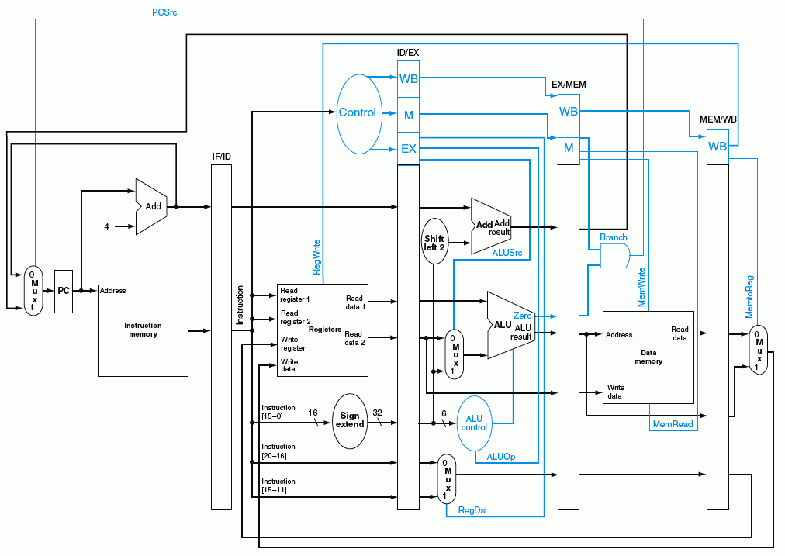
蓝色部分是控制信号

Slide 28
Load指令:流水线中的控制信号
在取数/译码（Reg/Dec）阶段产生本指令每个阶段的所有控制信号
  Exec信号 (ExtOp, ALUSrc, ...) 在1个周期后使用
  Mem信号 (MemWr, Branch) 在2个周期后使用
  Wr信号 (MemtoReg, RegWr) 在3个周期后使用
(这里是否会有问题？)
所以，控制信号也要保存在流水段寄存器中！
Rt和Data在RegWr后到达咋办？
Reg/Dec
Exec
Mem
Wr
ExtOp
ExtOp
同样，这里也有问题！
ALUSrc
ALUSrc
ALUOp
ALUOp
Rt
Main
Control
RegDst
RegDst
IF/ID Register
ID/Ex Register
Ex/Mem Register
Mem/Wr Register
MemWr
MemWr
MemWr
Data
Branch
Branch
Branch
MemtoReg
MemtoReg
MemtoReg
MemtoReg
RegWr
RegWr
RegWr
RegWr
保存在流水段寄存器中的信息（包括前面阶段传递来或执行的结果及控制信号）一起被传递到下一个流水段！
Notes:
The main control here is identical to the one in the single cycle processor. It generate all the control
signals necessary for a given instruction during that instruction’s Reg/Decode stage.
All these control signals will be saved in the ID/Exec pipeline register at the end of the Reg/Decode cycle.
The control signals for the Exec stage (ALUSrc, ... etc.) come from the output of the ID/Exec register. That is they are delayed ONE cycle from the cycle they are generated.
The rest of the control signals that are not used during the Exec stage is passed down the pipeline and saved in the Exec/Mem register.
The control signals for the Mem stage (MemWr, Branch) come from the output of the Exec/Mem register. That is they are delayed two cycles from the cycle they are generated.
Finally, the control signals for the Wr stage (MemtoReg & RegWr) come from the output of the Exec/Wr register: they are delayed three cycles from the cycle they are generated.
+2 = 45 min. (Y:45)

Slide 29
第一讲内容小结
指令的执行可以像洗衣服一样，用流水线方式进行
  均衡时指令吞吐率提高N倍，但不能缩短一条指令的执行时间
  流水段数以最复杂指令所需步骤数为准（有些指令的某些阶段为空操作），每个阶段的宽度以最复杂阶段所需时间为准（尽量调整使各阶段均衡）
以Load指令为准，分为五个阶段
  取指令段(IF)
    取指令、计算PC+4（IUnit：Instruction Memory、Adder）
  译码/读寄存器(ID/RF)段
    指令译码、读Rs和Rt（寄存器读口）
  执行(EXE)段
    计算转移目标地址、ALU运算（Extender、ALU、Adder）
  存储器(MEM)段
    读或写存储单元（Data Memory）
  写寄存器(Wr)段
    ALU结果或从DM读出数据写到寄存器（寄存器写口）
流水线控制器的实现
  IF和ID/RF段不需控制信号控制，只有EXE、MEM和Wr需要
  ID段生成所有控制信号，并随指令的数据同步向后续阶段流动

Slide 30
第二讲 流水线冒险的处理
主 要 内 容
流水线冒险的几种类型
数据冒险的现象和对策
  数据冒险的种类
    相关的数据是ALU结果：可以通过转发解决
    相关的数据是DM读出的内容：随后的指令需被阻塞一个时钟
  数据冒险和转发
    转发检测 / 转发控制
  数据冒险和阻塞
    阻塞检测 / 阻塞控制
控制冒险的现象和对策
  静态分支预测技术
  动态分支预测技术
  缩短分支延迟技术
流水线中对异常和中断的处理

Slide 31
总结：流水线的三种冲突/冒险（Hazard）情况
Hazards：指流水线遇到无法正确执行后续指令或执行了不该执行的指令
  Structural hazards (hardware resource conflicts):
  现象：同一个部件同时被不同指令所使用
    一个部件每条指令只能使用1次，且只能在特定周期使用
    设置多个部件，以避免冲突。如指令存储器IM 和数据存储器DM分开
  Data hazards (data dependencies):
  现象：后面指令用到前面指令结果数据时，前面指令的结果还没产生
    采用转发(Forwarding/Bypassing)技术
    Load-use冒险需要一次阻塞(stall)
    编译程序优化指令顺序
  Control (Branch) hazards (changes in program flow):
  现象：转移或异常改变执行流程，后继指令在目标地址产生前已被取出
    采用静态或动态分支预测
    编译程序优化指令顺序(分支延迟)
SKIP

Slide 32
Structural Hazard（结构冒险）现象
Time (clock cycles)
Load
Mem
Reg
ALU
Mem
Reg
Instr 1
Mem
Reg
ALU
Mem
Reg
Instr 2
Mem
Reg
ALU
Mem
Reg
Instr 3
Mem
Reg
ALU
Mem
Reg
Instr 4
Mem
Reg
ALU
Mem
Reg
只有一个存储器时，在Load指令取数据同时又取指令的话，则发生冲突！
如果不对寄存器堆的写口和读口独立设置的话，则发生冲突！
结构冒险也称硬件资源冲突：同一个执行部件被多条指令使用。

Slide 33
Structural Hazard的解决方法
为了避免结构冒险，规定流水线数据通路中功能部件的设置原则为：
每个部件在特定的阶段被用！（如：ALU总在第三阶段被用！）
将Instruction Memory (Im) 和 Data Memory (Dm)分开
将寄存器读口和写口独立开来
Time (clock cycles)
I
n
s
t
r.
O
r
d
e
r
Load
Im
Reg
ALU
Dm
Reg
Instr 1
Im
Reg
ALU
Dm
Reg
BACK
Instr 2
Im
Reg
ALU
Dm
Reg
Instr 3
Im
Reg
ALU
Dm
Reg
Instr 4
Im
Reg
ALU
Dm
Reg

Slide 34
Data Hazard现象
举例说明：以下指令序列中，寄存器r1会发生数据冒险
想一下，哪条指令的r1是老的值？
哪条是新的值？
add r1 ,r2,r3
sub r4, r1 ,r3
读r1时，add指令正在执行加法(EXE)，老值!
and r6, r1 ,r7
读r1时，add指令正在传递加法结果(MEM), 老值!
or r8, r1 ,r9
读r1时，add指令正在写加法结果到r1(WB), 老值!
xor r10, r1 ,r11
读r1时，add指令已经把加法结果写到r1, 新值
画出流水线图能很清楚理解！
补充：三类数据冒险现象
RAW: 写后读（基本流水线中经常发生，如上例）
WAR：读后写（基本流水线中不会发生，乱序执行时会发生）
WAW：写后写（基本流水线中不会发生，乱序执行时会发生）
本讲介绍基本流水线，所以仅考虑RAW冒险

Slide 35
Data Hazard on r1
Time (clock cycles)
IF
ID/RF
EX
MEM
WB
add r1,r2,r3
Im
Reg
ALU
Dm
Reg
I
n
s
t
r.
O
r
d
e
r
sub r4,r1,r3
Im
Reg
ALU
Dm
Reg
and r6,r1,r7
Im
Reg
ALU
Dm
Reg
or r8,r1,r9
Im
Reg
ALU
Dm
Reg
xor r10,r1,r11
Im
Reg
ALU
Dm
Reg
最后一条指令的r1才是新的值！
如何解决这个问题？

Slide 36
数据冒险的解决方法
方法1：硬件阻塞（stall）
方法2：软件插入“NOP”指令
方法3：合理实现寄存器堆的读/写操作（不能解决所有数据冒险）
  前半时钟周期写，后半时钟周期读，若同一个时钟内前面指令写入的数据正好是后面指令所读数据，则不会发生数据冒险
方法4：转发（Forwarding或Bypassing 旁路）技术
    若相关数据是ALU结果，则如何？
    可通过转发解决
    若相关数据是上条指令DM读出内容，则如何？
    不能通过转发解决，随后指令需被阻塞一个时钟 或 加NOP指令
方法5：编译优化：调整指令顺序（不能解决所有数据冒险）
称为Load-use数据冒险！
实现“转发”和“阻塞” 要修改数据通路：
（1）检测何时需要“转发” ，并控制实现“转发”
（2）检测何时需要“阻塞”，并控制实现“阻塞”

Slide 37
方案4: 利用DataPath中的中间数据：转发+阻塞
仔细观察后发现：流水段寄存器中已有需要的值r1！
在哪个流水段R中？
Time (clock cycles)
IF
ID/RF
EX
MEM
WB
add r1,r2,r3
Im
Reg
ALU
Dm
Reg
I
n
s
t
r.
O
r
d
e
r
sub r4,r1,r3
Im
Reg
ALU
Dm
Reg
and r6,r1,r7
Im
Reg
ALU
Dm
Reg
or r8,r1,r9
Im
Reg
ALU
Dm
Reg
xor r10,r1,r11
Im
Reg
ALU
Dm
Reg
把数据从流水段寄存器中直接取到ALU的输入端
称为转发（Forwading）或旁路（Bypassing）

Slide 38
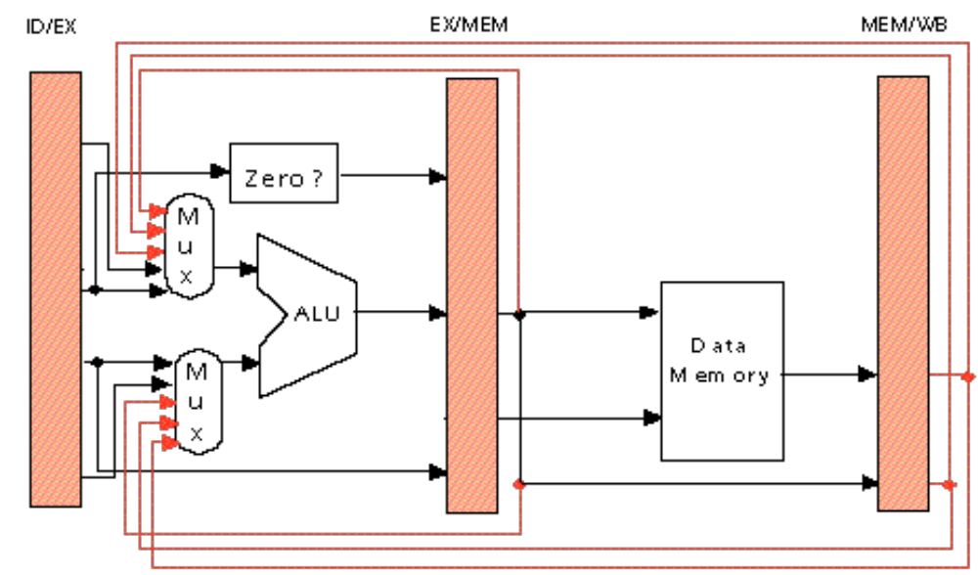
硬件上的改动以支持“转发”技术
加MUX，使流水段寄存器值返送ALU输入端
Ex
Mem
add r3, r2, r1
sub r5, r3, r4
lw r3, 100(r1)
or r6, r2, r1
sub r5, r3, r4
ALU
DM
add r3, r2, r1
or r6, r2, r1
sub r5, r3, r4
如果指令序列为
lw r3, 100(r1)
or r6, r3, r1
sub r5, r3, r4
能用“转发”技术解决第1、2两条指令间的数据冒险吗？
请看后面的幻灯片！
Notes:
Why do we need the orange-color forwarding? See the following examples. The result of present instruction(1st one) is needed by next next instruction(3rd one).
Add R3, R2, R1 Add R3, R2, R1
Add R5, R4, R3 Lw R5, 100(R3)
Add R6, R5, R3 Add R6, R5, R3
Add R7, R6, R3
What is the meaning of the 2nd bullet? It means that register read of R3 gets the new result of register write R3 in the 1st instruction. That is, the 4th instruction can get the result of the 1st instruction without forwarding.

Slide 39
复习: Load指令引起的延迟现象
Cycle 1
Cycle 2
Cycle 3
Cycle 4
Cycle 5
Cycle 6
Cycle 7
Cycle 8
Clock
I0: Load
Ifetch
Reg/Dec
Exec
Mem
Wr
Plus 1
Ifetch
Reg/Dec
Exec
Mem
Wr
Plus 2
Ifetch
Reg/Dec
Exec
Mem
Wr
Plus 3
Ifetch
Reg/Dec
Exec
Mem
Wr
若不采用转发，在何时才能使用Load指令的结果？
Plus 4
Ifetch
Reg/Dec
Exec
Mem
Wr
Load指令最早在哪个流水线寄存器中开始有后续指令需要的值？
实际上，在第四周期结束时，数据在流水段寄存器中已经有值。
采用数据转发技术可以使load指令后面第二条指令得到所需的值
但不能解决load指令和随后第一条指令间的数据冒险，要延迟执行一条指令！
这种load指令和随后指令间的数据冒险，称为“装入- 使用数据冒险(load- use Data Hazard)”
Notes:
Similarly, although the load instruction is fetched during cycle 1, the data is not written into the register file until the end of Cycle 5.
Consequently, the earliest time we can read this value from the register file is in Cycle 6.
In other words, there is a 3-instruction delay between the load instruction and the instruction that can use the result of the load.
This is referred to as Data Hazard in the text book.
We will show in the next lecture that by clever design techniques, we can reduce this delay to ONE instruction.
That is if the load instruction is issued in Cycle 1, the instruction comes right next to it (Plus 1) cannot use the result of this load but the next-next instruction (Plus 2) can.
+2 = 73 min. (Y:53)

Slide 40
“Forwarding”技术使Load-use冒险只需延迟一个周期
Time (clock cycles)
IF
ID/RF
EX
MEM
WB
lw r1, 0(r2)
Im
Reg
ALU
Dm
Reg
I
n
s
t
r.
O
r
d
e
r
sub r7,r1,r3
Im
Reg
ALU
Dm
Reg
and r6,r1,r7
Im
Reg
ALU
Dm
Reg
or r8,r1,r9
Im
Reg
ALU
Dm
Reg
采用“转发”后仅第二条指令 SUB r7,r1,r3 不能按时执行！
发生“装入- 使用数据冒险”时，需要对load后的指令阻塞一个时钟周期！
数据冒险处理最佳方案：“转发” + “Load-use阻塞”

Slide 41
RAW（写后读）数据冒险的“转发”条件
Ex
Mem
C3
C1
ori r3, r2, 100
sub r5, r3, r4
lw r3, 100(r1)
or r6, r2, r1
sub r5, r3, r4
C2
add r3, r2, r1
or r6, r2, r1
sub r5, r3, r4
后面指令需用ALU输出结果
C1: 目寄是后一条指令的源寄
C2: 目寄是后第二条指令的源寄
(例如：R-Type后跟R- / lw / sw / beq等)
后面指令需用从DM读出的结果
C3: 目寄是后第二指令的源寄
(例如：load指令后跟R-Type / beq等)
用流水段寄存器来表示转发条件（C3以后考虑）
C1(a): EX/MEM. RegisterRd=ID/EX. RegisterRs
C1(b): EX/MEM. RegisterRd=ID/EX. RegisterRt
C2(a): MEM/WB. RegisterRd=ID/EX. RegisterRs
C2(b): MEM/WB. RegisterRd=ID/EX. RegisterRt
这里的RegisterRd是指目的寄存器
实际上是R-type的Rd 或 I-Type的Rt
Notes:
Why do we need the orange-color forwarding? See the following examples. The result of present instruction(1st one) is needed by next next instruction(3rd one).
Add R3, R2, R1 Add R3, R2, R1
Add R5, R4, R3 Lw R5, 100(R3)
Add R6, R5, R3 Add R6, R5, R3
Add R7, R6, R3
What is the meaning of the 2nd bullet? It means that register read of R3 gets the new result of register write R3 in the 1st instruction. That is, the 4th instruction can get the result of the 1st instruction without forwarding.

Slide 42
指令的回写（Write Back）阶段
Clk
Ifetch
Reg/Dec
Exec
Mem
Wr
RegWr=1
ExtOp
ALUOp
Branch
1
0
PC+4
PC+4
PC
PC+4
IF/ID:
Imm
Imm
Rs
busA
Zero
Data
Mem
A
Ra
busB
IUnit
Rb
Exec
Unit
RA
Do
ID/Ex Register
Ex/Mem Register
Mem/Wr Register
Rt
1
RFile
WA
Mux
Rw
Di
Di
Rt
0
0
I
Rd
1
Rd还是Rt取决于是R-型指令，还是I-型指令！
RegDst
ALUSrc
MemWr
MemtoReg=1/0
beq r3, r2, 100
add r4, r3, r2
sub r5, r3, r2
若是beq指令会怎样？
因为beq指令无需写结果，故不能进行转发！
Notes:
The Rt filed of the load instruction will be used in the Register Write back stage of the pipeline (Wr) to specified the register (Rw) where the load data is written.
Since we are writing the load’s data into the register file, the control signal MemtoReg and RegWr must be set to 1.
So this finishes the grand tour of how a load instruction flows through the datapath.
But how about control signals?
+1 = 41 min. (Y:21)

Slide 43
转发条件的进一步完善
beq r3, r2, 100
add r4, r3, r2
sub r5, r3, r2
以下两种情况下，转发会发生错误
  指令的结果不写入目的寄存器Rd时
    例如，Beq指令只对rs和rt相减，不写结果到目的寄存器Rt
    即：EX / MEM 或 MEM / WB 流水段寄存器的RegWr信号为0
  Rd等于$0时
    例如，指令 sll $0, $1, 2 的转发结果为(R[$1]<<2) ，但实际上应该是0
因此，修改转发条件为：
  C1(a): EX/MEM.RegWr
  and EX/MEM. RegisterRd ≠ 0
  and EX/MEM. RegisterRd=ID/EX. RegisterRs
  C1(b): EX/MEM.RegWr
  and EX/MEM. RegisterRd ≠ 0
  and EX/MEM. RegisterRd=ID/EX. RegisterRt
  C2(a): MEM/WB.RegWr
  and MEM/WB. RegisterRd ≠ 0
  and MEM/WB. RegisterRd=ID/EX. RegisterRs
  C2(b): MEM/WB.RegWr
  and MEM/WB. RegisterRd ≠ 0
  and MEM/WB. RegisterRd=ID/EX. RegisterRt

Slide 44
转发路径和转发条件
加MUX，使流水段寄存器值返送ALU输入端
Ex
Mem
C1反映本条指令和随后指令间的相关关系
C2反映本条指令和随后第二条指令间的相关关系
C1(a)
C3
C2(a)
C2(b)
C1(b)
红线和兰线可以合并，在原数据通路中确实是合并在一起的。记得吗？
由一个二路选择器（控制端为MemtoReg）合并输出到寄存器堆！
所以, 无需另有一个检测条件C3! C3就是C2！
C1和C2分别反映哪两条指令的关系呢？
Notes:
Why do we need the orange-color forwarding? See the following examples. The result of present instruction(1st one) is needed by next next instruction(3rd one).
Add R3, R2, R1 Add R3, R2, R1
Add R5, R4, R3 Lw R5, 100(R3)
Add R6, R5, R3 Add R6, R5, R3
Add R7, R6, R3
What is the meaning of the 2nd bullet? It means that register read of R3 gets the new result of register write R3 in the 1st instruction. That is, the 4th instruction can get the result of the 1st instruction without forwarding.

Slide 45
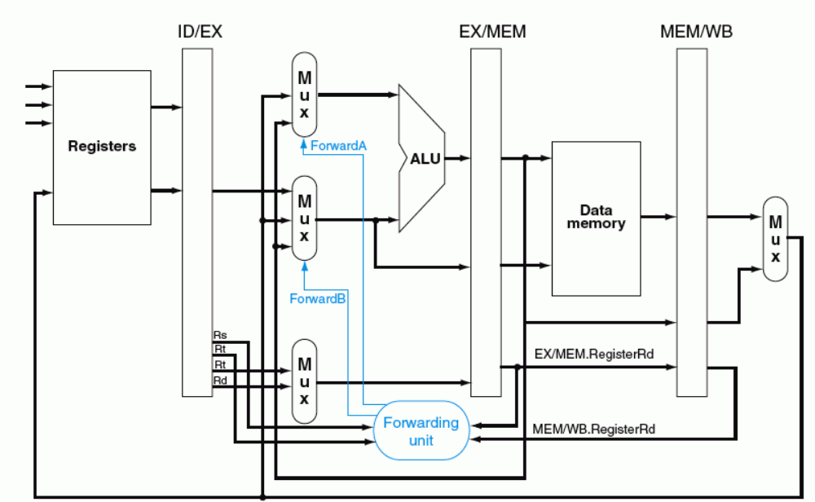
转发路径和转发条件
ForwardA (ForwardB) =
01 当c2(a)=1 或C2(b)=1 时
10 当c1(a)=1或C1(b)=1 时
C1
C2
“转发检测”部件中缺何条件？
MEM/WB.RegWr=1、EX/MEM.RegWr=1

Slide 46
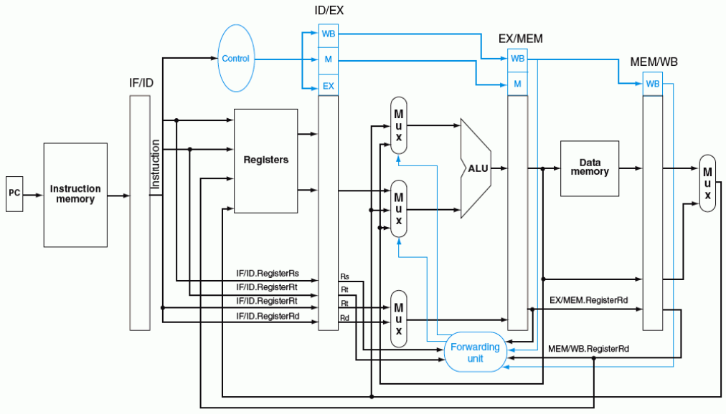
带转发的流水线数据通路
ForwardA
ForwardB

Slide 47
更加复杂的数据冒险问题
考察以下指令序列，采用前述转发条件会发生什么情况？
  add $1, $1, $2
  add $1, $1, $3
  add $1, $1, $4
  ……
  可能会使转发到第3条指令的操作数是第1条指令结果，而不是第2条指令的结果！
怎样改写“转发”检测条件：改C1还是改C2?
需要改写“转发”条件C2(a)和C2(b)为：
ForwardA (ForwardB) =
01 当c2(a)=1 or c2(b)=1 时
10 当c1(a)=1 or c1(b)=1 时
本条指令
对于左边的指令序列，C1和C2的值各是什么？
C1=C2=1, 使得Forward信号取值不确定！
应该让C1=1,C2=0!
C2(a)=MEM/WB.RegWrite and (MEM/WB.RegisterRd ≠ 0) and (EX/MEM.RegisterRd ≠ ID/EX.RegisterRs) and (MEM/WB.RegisterRd=ID/EX.RegisterRs)
C2(b)=MEM/WB.RegWrite and (MEM/WB.RegisterRd ≠ 0) and (EX/MEM.RegisterRd ≠ ID/EX.RegisterRt) and (MEM/WB.RegisterRd=ID/EX.RegisterRt)
上述公式相当于加了一个条件限制：
如果本条指令源操作数和上条指令的目的寄存器一样，则不转发上上条指令的结果，
而转发上条指令的结果（即：此时的C1=1而C2=0）
所有RAW数据冒险都能通过转发来解决吗？
至此，解决了RAW数据冒险的“转发”处理

Slide 48
Load-use Data Hazard（硬件阻塞方式）
Time (clock cycles)
IF
ID/RF
EX
MEM
WB
lw r1, 0(r2)
Reg
ALU
Reg
I
n
s
t
r.
O
r
d
e
r
Im
Dm
sub r4,r1,r3
检测点
Im
Reg
bubble
bubble
bubble
sub r4,r1,r3
阻塞点
Im
Reg
Dm
Reg
ALU
and r6,r1,r7
Im
Reg
ALU
Dm
Reg
or r8,r1,r9
Im
Reg
ALU
Dm
Reg
需解决以下问题：
(1) 判断什么条件下需要阻塞
  ID/EX.MemRead
  and (ID/EX.RegisterRt=IF/ID.RegisterRs
  or ID/EX.RegisterRt=IF/ID.RegisterRt)
前面指令为Load 并且
前面指令的目的寄存器等于当前刚取出指令的源寄存器
(2) 如何修改数据通路来实现阻塞

Slide 49
Load-use Data Hazard（硬件阻塞方式）
阻塞前的情况：
Time (clock cycles)
I
n
s
t
r.
O
r
d
e
r
IF
ID
EX
MEM
WB
lw r1, 0(r2)
Im
Reg
ALU
Dm
Reg
sub r4,r1,r3
检测点
Im
Reg
ALU
Dm
Reg
and r6,r1,r7
阻塞点
Im
Reg
Dm
Reg
ALU
or r8,r1,r9
Im
Reg
ALU
Dm
Reg
检测“阻塞”过程中：
1) sub指令在IF/ID寄存器中，并正被译码，控制信号和Rs/Rt的值将被写到ID/EX段寄存器
2) and指令地址在PC中，正被取出，取出的指令将被写到IF/ID段寄存器中
在阻塞点，必须将上述两条指令的执行结果清除，并延迟一个周期执行这两条指令
延迟一个周期执行后面指令，相当于把阻塞点前面一个周期的状态再保持一个周期
lw指令还是继续正常执行下去
想想看，lw后面的指令如何做到继续保持状态？

Slide 50
Load-use Data Hazard（硬件阻塞方式）
Time (clock cycles)
阻塞后的情况：
IF
ID/RF
EX
MEM
WB
I
n
s
t
r.
O
r
d
e
r
lw r1, 0(r2)
Reg
Reg
Im
ALU
Dm
sub r4,r1,r3
检测点
Im
Reg
bubble
bubble
bubble
sub r4,r1,r3
阻塞点
Im
Reg
Dm
Reg
ALU
and r6,r1,r7
Im
Reg
ALU
Dm
Reg
or r8,r1,r9
Im
Reg
ALU
Dm
Reg
在阻塞点，将上述两条指令的执行结果清除，并延迟一个周期执行这两条指令
① 将ID/EX段寄存器中所有控制信号清0 ，插入一个“气泡”
② IF/ID寄存器中的信息不变（还是sub指令），sub指令重新译码执行
③ PC中的值不变（还是and指令地址），and指令重新被取出执行

Slide 51
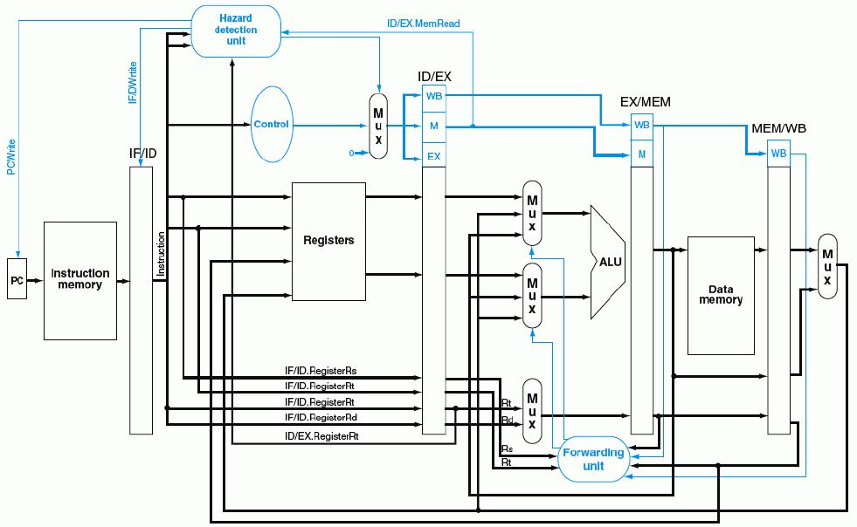
带“转发”和“阻塞”检测的流水线数据通路
  ID/EX.MemRead and (ID/EX.RegisterRt=IF/ID.RegisterRs or ID/EX.RegisterRt=IF/ID.RegisterRt)
使控制信号清0，阻塞指令执行！
①
“写使能”信号为0，使PC和IF/ID不变
②
0
③
至此，硬件处理数据冒险（转发+阻塞）全部完成！

Slide 52
Control Hazard的解决方法
方法1：硬件上阻塞（stall）分支指令后三条指令的执行
  使后面三条指令清0或 其操作信号清0，以插入三条NOP指令
方法2：软件上插入三条“NOP”指令
（以上两种方法的效率太低，需结合分支预测进行）
方法3：分支预测（Predict）
  简单（静态）预测：
    总是预测条件不满足(not taken)，即：继续执行分支指令的后续指令
    可加启发式规则：在特定情况下总是预测满足(taken)，其他情况总是预测不满足。如：循环顶部（底部）分支总是预测为不满足（满足）。能达65%-85%的预测准确率
  动态预测：
    根据程序执行的历史情况进行动态预测调整，能达90%的预测准确率
注：流水线控制必须确保被错误预测指令的执行结果不能生效，而且要能从正
确的分支地址处重新启动流水线工作
方法4：延迟分支（Delayed branch）（通过编译程序优化指令顺序！）
  把分支指令前面与分支指令无关的指令调到分支指令后执行，也称延迟转移
另一种控制冒险：异常或中断控制冒险的处理

Slide 53
简单（静态）分支预测方法
基本做法
  总预测条件不满足(not taken)，即：继续执行分支指令的后续指令
    可加启发式规则：
    在特定情况下总是预测满足(taken)，其他情况总是预测不满足
  预测失败时，需把流水线中三条错误预测指令丢弃掉
    将被丢弃指令的控制信号值或指令设置为0
    （注：涉及到当时在IF、ID和EX三个阶段的指令）
性能
  如果转移概率是50%，则预测正确率仅有50%
预测错误的代价
  预测错误的代价与何时能确定是否转移有关。越早确定代价越少
  是否可以把“是否转移”的确定工作提前，而不等到MEM阶段才确定？
可以！
那最早可以提前到哪个阶段呢？
SKIP

Slide 54
复习: Control Hazard现象
Cycle 4
Cycle 5
Cycle 6
Cycle 7
Cycle 8
Cycle 9
Cycle 10
Cycle 11
Clk
12: Beq
(target is 1000)
Ifetch
Reg/Dec
Exec
Mem
Wr
16: R-type
Ifetch
Reg/Dec
Exec
Mem
Wr
20: R-type
Ifetch
Reg/Dec
Exec
Mem
Wr
24: R-type
Ifetch
Reg/Dec
Exec
Mem
Wr
1000: Target of Br
Ifetch
Reg/Dec
Exec
Mem
Wr
虽然Beq指令在第四周期取出，但:
  “是否转移”在Mem阶段确定，目标地址在第七周期才被送到PC输入端
  第八周期才取出目标地址处的指令执行
  结果：在取目标指令之前，已有三条指令被取出，取错了三条指令！
发生转移时，要在流水线中清除Beq后面的三条指令，分别在EXE 、ID、 IF段中
延迟损失时间片C：发生转移时，给流水线带来的延迟损失
BACK
这里 C=3
Notes:
Notice that although the branch instruction is fetched during Cycle 4, its target address is NOT written into the Program Counter until the end of clock Cycle 7.
Consequently, the branch target instruction is not fetched until clock Cycle 8.
In other words, there is a 3-instruction delay between the branch instruction is issued and the branch effect is felt in the program.
This is referred to as Branch Hazard in the text book.
And as we will show in the next lecture, by clever design techniques, we can reduce the delay to ONE instruction.
That is if the branch instruction in Location 12 is issued in Cycle 4, we will only execute one more sequential instruction (Location 16) before the branch target is executed.
+2 = 71 min. (Y:51)

Slide 55
简单（静态）分支预测方法
缩短分支延迟，减少错误预测代价
  可以将 “转移地址计算”和“分支条件判断”操作调整到ID阶段来缩短延迟
    将转移地址生成从MEM阶段移到ID阶段，可以吗？为什么？
    （是可能的：IF/ID流水段寄存器中已经有PC的值和立即数）
    将“判0”操作从EX阶段移到ID阶段，可以吗？为什么？
    （用逻辑运算(如，先按位异或，再结果各位相或)来直接比较Rs和Rt的值）
    （简单判断用逻辑运算，复杂判断可以用专门指令生成条件码）
    （许多条件判断都很简单）
预测错误的检测和处理（称为“冲刷、冲洗” -- Flush）
  当Branch=1并且Zero=1时，发生转移（taken）
  增加控制信号：IF.Flush=Branch and Zero，取值为1时，说明预测失败
  预测失败 (条件满足) 时，完成以下两件事（延迟损失时间片C=1时）：
    将转移目标地址->PC
    清除IF段中取出的指令，即：将IF/ID中的指令字清0，转变为nop指令
原来要清除三条指令，调整后只需要清除一条指令，因而只延迟一个时钟周期，每次预测错误减少了两个周期的代价！
即：这里 C=1

Slide 56
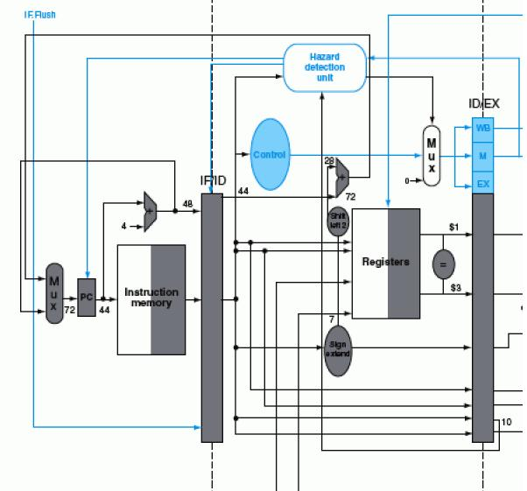
带静态分支预测处理的数据通路
sub $3, $5, $1 add $1, $5, $2
beq $1, $3, 7
IF.Flush=Branch and Zero
40#指令“beq $1,$3,7” ID段
转移目址
(72)->PC
控制转移
目址->PC
IF/ID中指令字清0，变为nop指令
若$1或$3和前面指令数据相关，会怎么样？
上上条指令的EXE段结果可转发回来进行判断
上条指令的EXE段结果来不及转发回来，引起1次阻塞!
需重新改“转发”条件和转发线路！
作业中有相应的练习
BACK

Slide 57
动态分支预测方法
简单的静态分支预测方法的预测成功率不高，应考虑动态预测
动态预测基本思想：
  利用最近转移发生的情况，来预测下一次可能转移还是不转移
  根据实际情况来调整预测
  转移发生的历史情况记录在BHT中（有多个不同的名称）
    分支历史记录表BHT（Branch History Table）
    分支预测缓冲BPB（Branch Prediction Buffer）
    分支目标缓冲BTB（Branch Target Buffer）
  每个表项由分支指令地址低位作索引，故在IF阶段就可以取到预测位
    低位地址相同的分支指令共享一个表项，所以，可能取的是其他分支指令的预测位。会不会有问题？
    由于仅用于预测，所以不影响执行结果
现在几乎所有的处理器都采用动态预测（dynamic predictor）

Slide 58
分支历史记录表BHT（或BTB、BPB）
分支历史记录表BHT
最初BHT为空
分支指令地址
=？
分支指令地址
预测位
转移目标地址
①
查找
转移取
顺序取
查找时发现都不相等，则“未命中”
未命中说明什么？
指令预取器
④ 修正
②
预测
说明以前没有执行过该分支指令
加入新项
③
选择
控制逻辑
命中与否
指令执行
实际执行情况
  命中时：
  根据预测位，选择“转移取”还是“顺序取”
  未命中时：
  加入新项，并填入指令地址和转移目标地址、初始化预测位
BACK

Slide 59
动态预测基本方法
采用一位预测位：总是按上次实际发生的情况来预测下次
  1表示最近一次发生过转移（taken），0表示未发生（not taken）
  预测时，若为1，则预测下次taken，若为0，则预测下次not taken
  实际执行时，若预测错，则该位取反，否则，该位不变
  可用一个简单的预测状态图表示
  缺点：当连续两次的分支情况发生改变时，预测错误
    例如，循环迭代分支时，第一次和最后一次会发生预测错误，因为循环的第一次和最后一次都会改变分支情况，而在循环中间的各次总是会发生分支，按上次的实际情况预测时，都不会错。
采用二位预测位
  用2位组合四种情况来表示预测和实际转移情况
  按照预测状态图进行预测和调整
  在连续两次分支发生不同时，只会有一次预测错误
采用较多的是二位或二位以上预测位。如：Pentium 4 的BTB2采用4位预测位
BACK

Slide 60
一位预测状态图
发生
正确
不发生
正确
Loop: g = g +A[i];
i = i+ j;
if (i != h) go to Loop:
Assuming variables g, h, i, j ~ $1, $2, $3, $4 and base address
of array is in $5
不发生
错误
预测发生
预测不发生
1
0
发生
错误
指令预取时，按照预测位读取相应分支的指令
  预测发生时，选择“转移取”
  预测不发生时，选择“顺序取”
指令执行时，按实际执行结果修改预测位
  对照状态转换图来进行修改
  例如：对于一个循环分支
  若初始状态为0(再次循环时为0)，则第一次和最后一次都错
  若初始状态为1，则只有最后一次会错。（再次循环时又改为0，还是有两次错）
Loop: add $7, $3, $3 ; i*2
add $7, $7, $7 ; i*4
add $7, $7, $5
lw $6, 0($7) ; $6=A[i]
add $1, $1, $6 ; g= g+A[i]
add $3, $3, $4
bne $3, $2, Loop
… …
即：只要本次和上次的发生情况不同，就会出现一次预测错误。

Slide 61
举例：双重循环的一位动态预测
… …
Loop-i: beq $t1,$a0, exit-i # 若( i=N)则跳出外循环
add $t2, $zero, $zero #j=0
Loop-j: beq $t2, $a0, exit-j # 若(j=N)则跳出内循环
addi $t2, $t2, 1 # j=j+1
addi $t0, $t0, 1 #sum=sum+1
j Loop-j
exit-j: addi $t1, $t1, 1 # i=i +1
j Loop-i
exit-i: … …
into sum (int N)
{
int i, j, sum=0;
for (i=0; i < N; i++)
for (j=0; j <N; j++)
sum=sum+1;
return sum;
}
外循环中的分支指令共执行N+1次，
内循环中的分支指令共执行N×(N+1)次。
N=10, 分别90.9%和82.7%
N=100, 分别99%和98%
若预测位初始为0，则外循环只有最后一次预测错误；跳出内循环时预测位变为1，再进入内循环时，第一次总是预测错误，并且任何一次循环的最后一次总是预测错误，因此，总共有1+2×(N–1)次预测错误（第一次循环有1次预测错，后面(N-1)次循环每次有2次预测错）。
N越大预测准确率越高！

Slide 62
动态预测基本方法
采用一位预测位：总是按上次实际发生的情况来预测下次
  1表示最近一次发生过转移（taken），0表示未发生（not taken）
  预测时，若为1，则预测下次taken，若为0，则预测下次not taken
  实际执行时，若预测错，则该位取反，否则，该位不变
  可用一个简单的预测状态图表示
  缺点：当连续两次的分支情况发生改变时，预测错误
    例如，循环迭代分支时，第一次和最后一次会发生预测错误，因为循环的第一次和最后一次都会改变分支情况，而在循环中间的各次总是会发生分支，按上次的实际情况预测时，都不会错。
采用二位预测位
  用2位组合四种情况来表示预测和实际转移情况
  按照预测状态图进行预测和调整
  在连续两次分支发生不同时，只会有一次预测错误
采用较多的是二位或二位以上预测位。如：Pentium 4 的BTB2采用4位预测位
BACK

Slide 63
两位预测状态图
发生
正确
不发生
错误
Loop: add $7, $3, $3 ; i*2
add $7, $7, $7 ; i*4
add $7, $7, $5
lw $6, 0($7) ; $6=A[i]
add $1, $1, $6 ; g= g+A[i]
add $3, $3, $4
bne $3, $2, Loop
… …
预测发生
预测发生
11
10
发生
正确
发生
不发生
错误
错误
不发生
正确
预测不发生
预测不发生
01
发生
00
错误
不发生
正确
预测发生时，选择“转移取”
预测不发生时，选择“顺序取”
基本思想：只有两次预测错误才改变预测方向
  11状态时预测发生（强转移），实际不发生时，转到状态10（弱转移），下次仍预测为发生，如果再次预测错误（实际不发生），才使下次预测调整为不发生00
好处：连续两次发生不同的分支情况时，会预测正确
  例如，对于循环分支的预测（假定预测初始位为11）
  第一次：初始态为11（再次进入循环时为10），预测发生，实际也发生，正确
  中间：状态为“11”，预测发生，实际也发生，正确
  最后一次：状态为“11”，预测发生，但实际不发生，错

