Slide 1
Automobile Selector
Team Torque:
Priyanka Annapureddy
Justin Wang
Rani Sebastian

Slide 2

Introduction
The attributes of the cars such as horsepower, weight, acceleration, and fuel economy varies depending on the vehicle models and its manufacturers.
It is important for the buyers to know what are the attributes they are looking for in a car to make the tough but right decision when getting a car.
Goal: a model that can highlight the relationships between fuel consumption and other attributes.

Slide 3
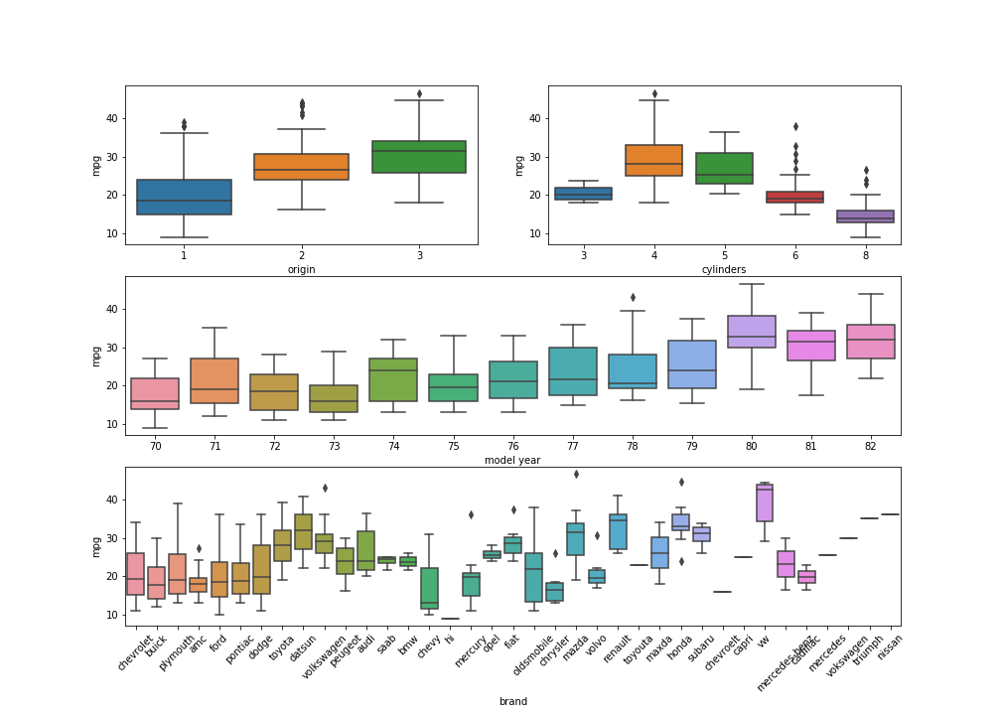
Dataset
Auto-mpg dataset
Contains data between 1970-1982

Slide 4
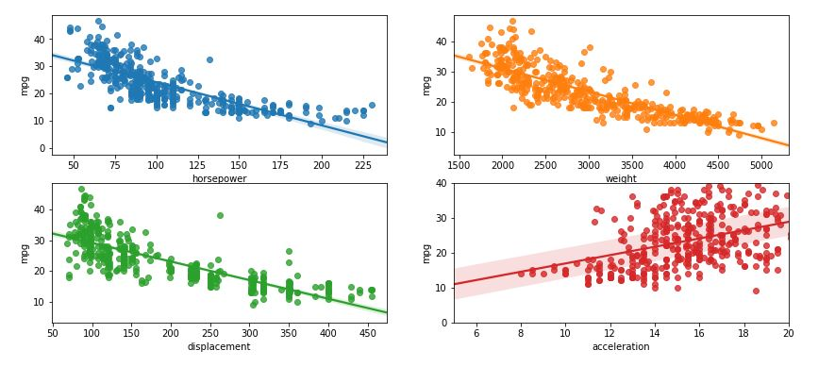
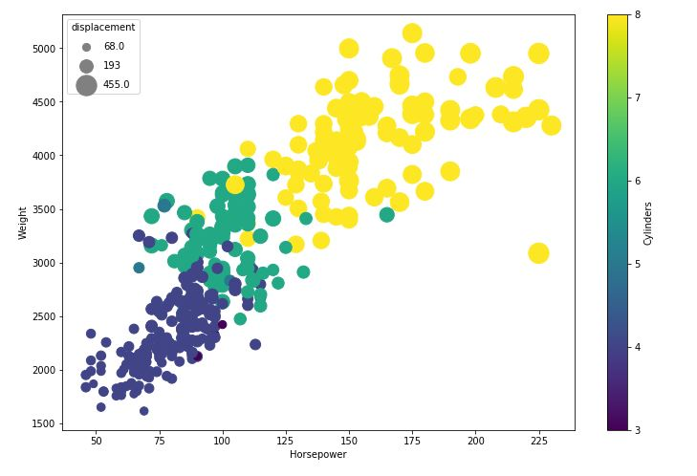
Exploratory Analysis for mpg
Mpg versus the various attributes of the vehicle.

Slide 5
Linear Regression +
Forward Feature Selection
Model No | Model | RMSE | RSquare
1 | Weight, Model Year, Origin, Acceleration, Displacement, cylinders | 2.916940532 | 0.856083
2 | Weight, Model Year, Origin, Acceleration, Displacement | 2.918961993 | 0.855883
3 | Weight, model year, acceleration, origin, cylinders | 2.921087261 | 0.855673
4 | Weight, Model Year, Origin | 2.925966139 | 0.855191
5 | Weight, Model Year, Origin, acceleration, displacement, cylinders, horsepower | 2.927363823 | 0.855052
6 | Weight, Model Year, Origin, Acceleration | 2.915579927 | 0.8547119

Slide 6
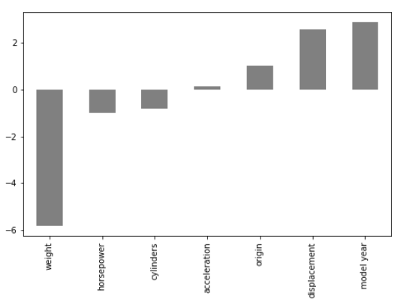
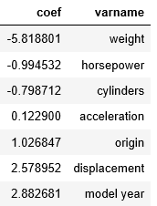
Linear Regression
Linear Regression coefficients:

Slide 7
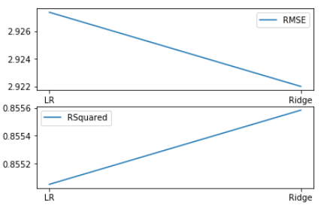
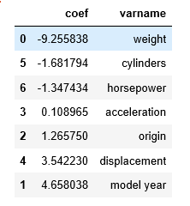
Ridge Regression

Slide 8
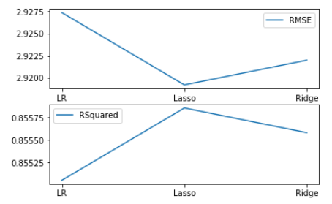
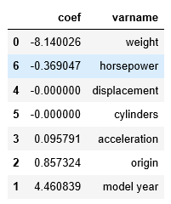
Lasso Regression

Slide 9
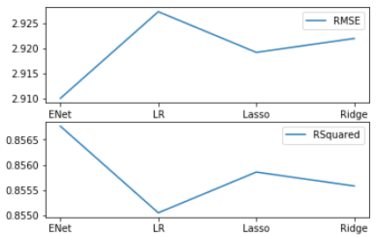
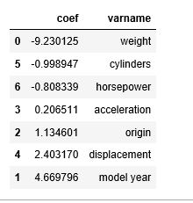
ElasticNet Regression

Slide 10
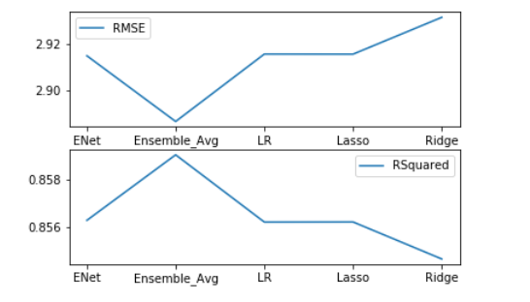
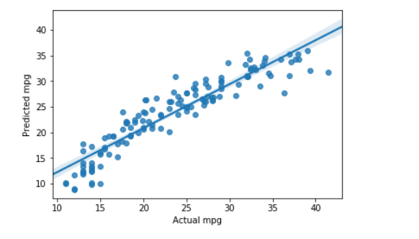
Ensemble Methods
We used the average Mpg from all of results generated from the different methodologies we applied to the dataset.
There are different ensemble methods that were attempted, however only the average worked out for us.

Slide 11
Conclusion
Mpg has strong linear relationships with other variables, the variables themselves exhibit linear properties among themselves.
Model Comparisons:
Linear Regression (best with 6 features): 85.60%
All 7 features
Linear Regression: 85.50%
Ridge Regression : 85.55%
Lasso Regression : 85.58%
E-Net Regression : 85.67%
Ensemble by Average : 85.68%

