Slide 1
Solar Panal Regression
A Data Science Approach to Predict Solar Energy Output
GROUP -5

Slide 2
GROUP - 5
CHARISHMA REDDY.C
AFTAB ALI AKHTAR ALI SHAIKH
RANI
JANANI SRI S K
MUSKAN FIRDOSE
BATNA .JANARDHANA
MUDUNURI SATYA SIVA ANURAG VARMA

Slide 3
Objective
Predict solar power generation based on environmental features
Use regression models to find the best predictive model
Clean, analyze, and model real-world solar data for insights

Slide 4
DATA COLLECTION
EDA
MODEL BUILDING
DEPLOYMENT

Slide 5
Dataset Overview
Source: solarpowergeneration.csv
Target variable: Power generated (kW)
The file solarpowergeneration.csv contains the data for this example. Here, the number of variables (columns) is 10, and the number of instances (rows) is 2920. We have the following variables for this analysis:
distance_to_solar_noon, in radians.
temperature, daily average temperature, in degrees Celsius.
wind_direction, daily average wind direction, in degrees (0-360).
wind_speed, daily average wind speed, in meters per second.
sky_cover, on a five-step scale from 0 to 4, with 0 completely clear and 4 wholly covered.
visibility, in kilometres.
humidity, in percentage.
average_wind_speed, average wind speed during the 3 hours de measure was taken in meters per second.
average_pressure, average barometric pressure during the 3 hours the measure was taken in, in mercury inches.
power_generated(Target), in Jules for each 3 hours

Slide 6
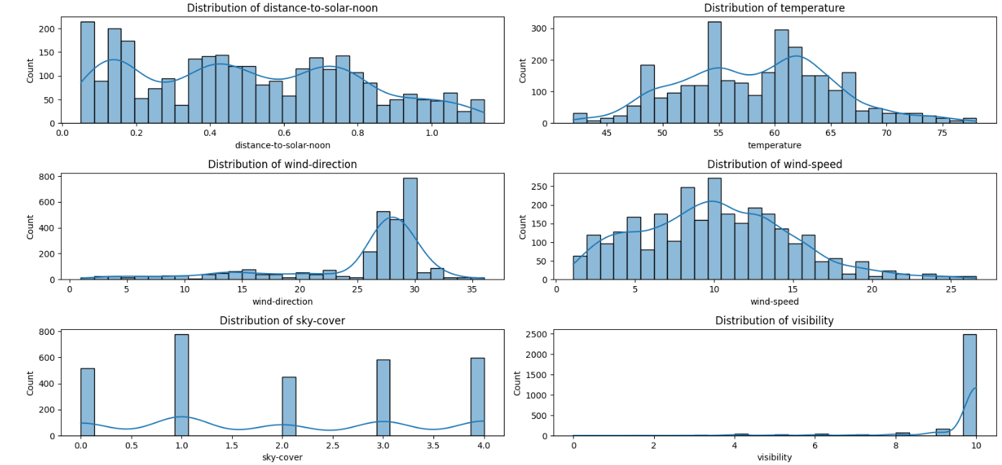
Exploratory Data Analysis (EDA)
Histograms plotted for all numerical features

Slide 7
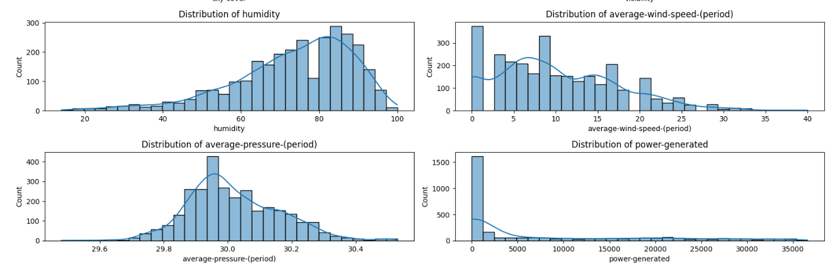
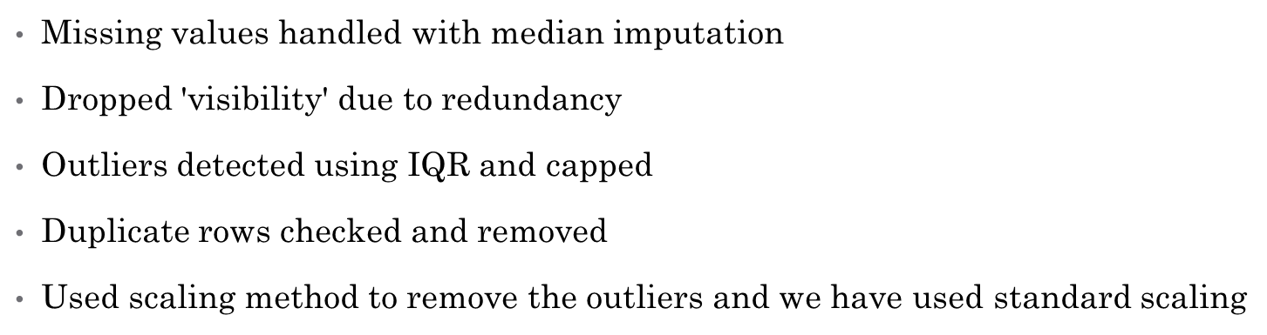

Slide 8
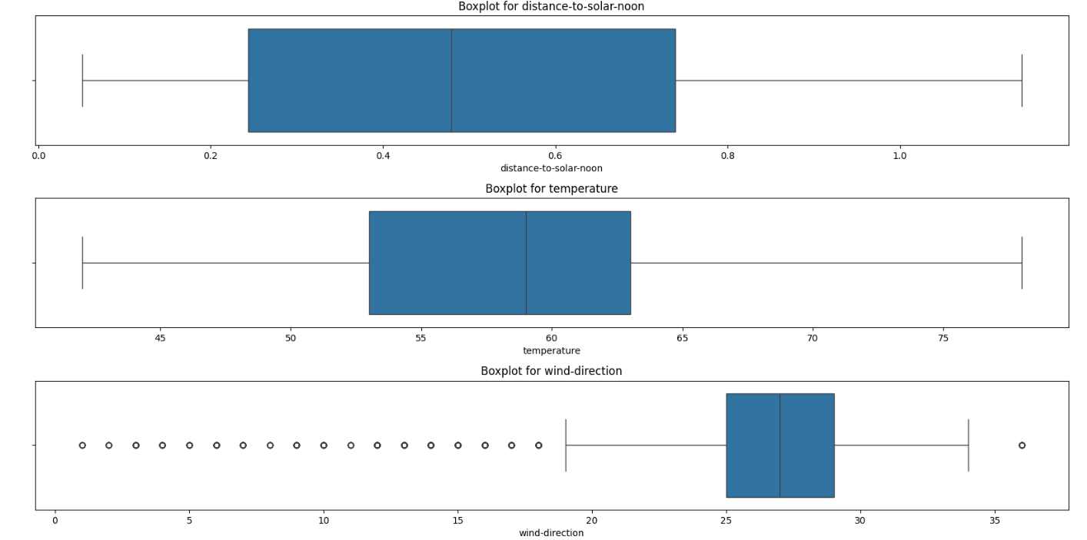
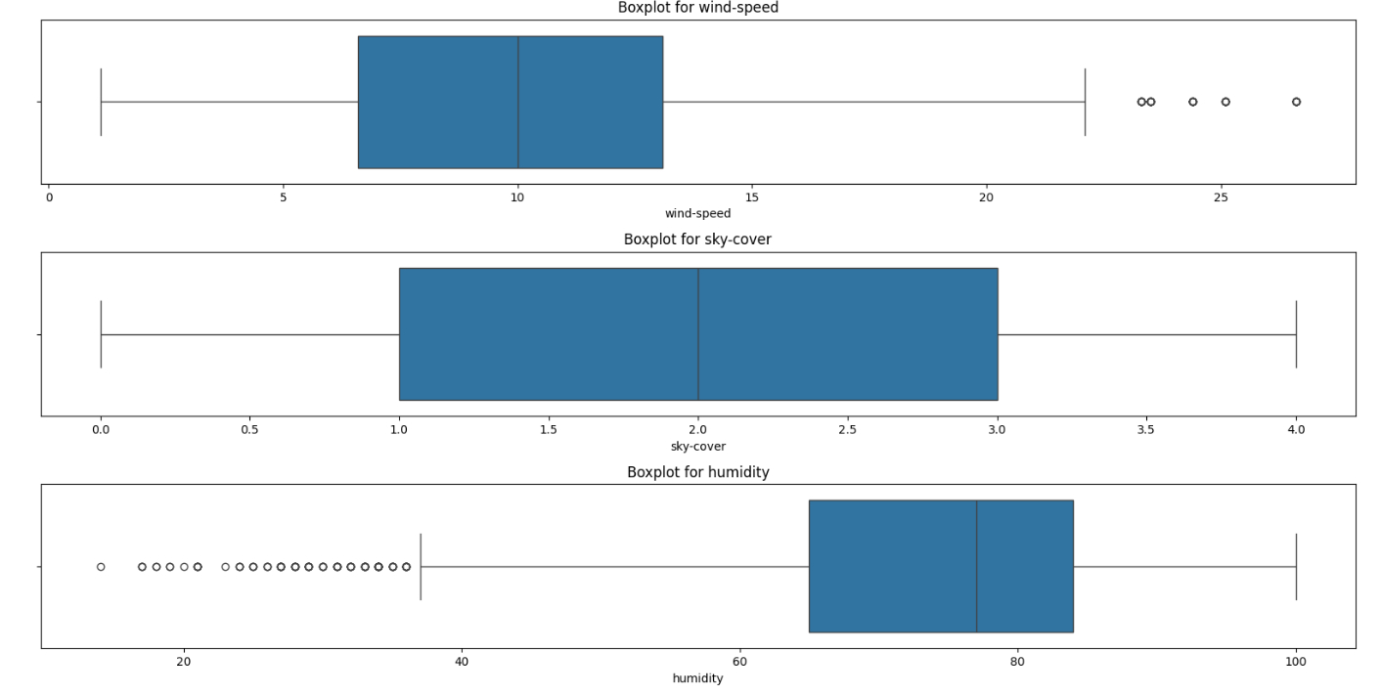

Slide 9
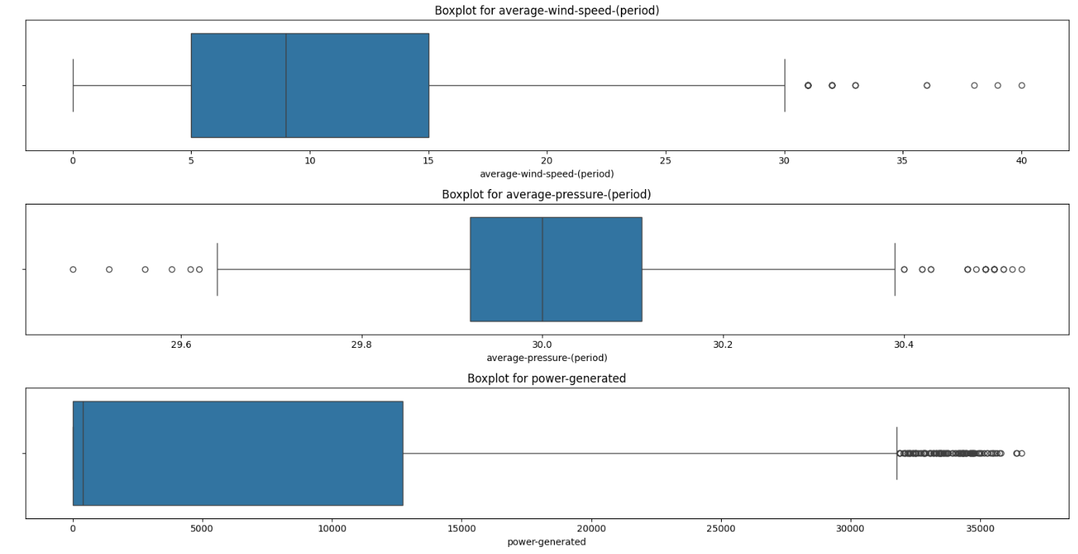

Slide 10
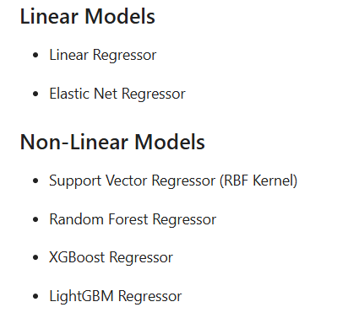
Model Building
Regression models tested:
Evaluation metrics: R², MAE, RMSE

Slide 11
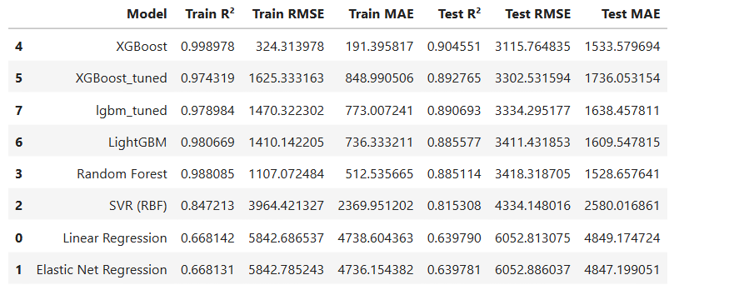

Slide 12
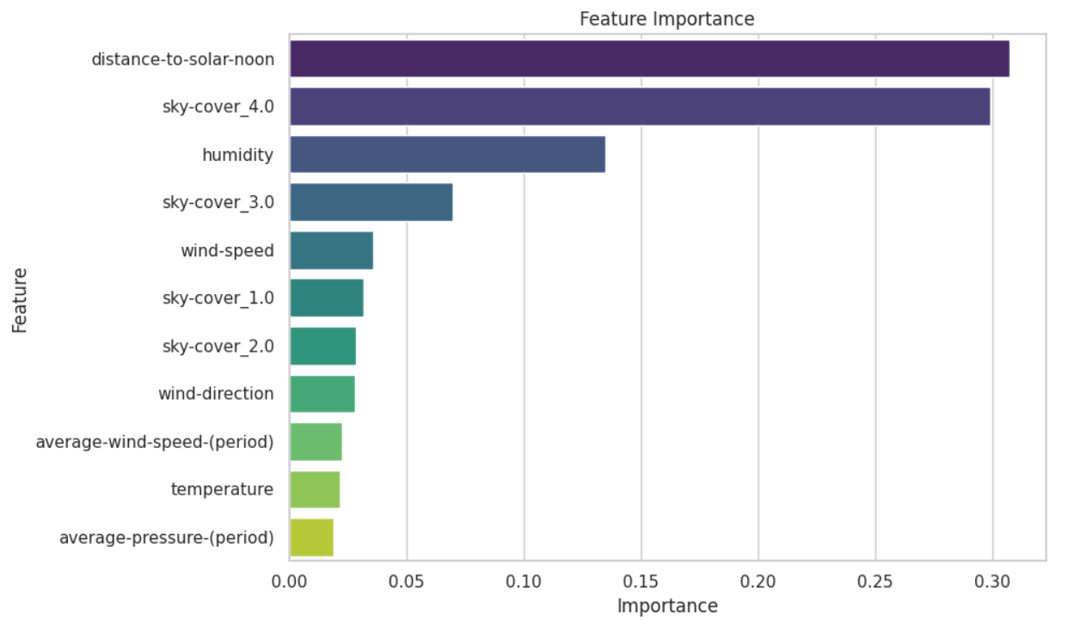
Best Model: XGBoost
High accuracy and robustness
Tuned using GridSearchCV
Selected based on best RMSE and R² on test set

Slide 13
Model Deployment using XGBoost and Streamlit
The best-performing model, XGBoost Regressor was deployed using streamlit, a lightweight web app framework for python. The deployment was done on localhost for demonstration purposes.
Steps followed:
The trained XGBoost model was saved using joblib.
A simple Streamlit app was created with user input fields to collect environmental parameters like temperature, humidity, wind speed, etc.…
The model was loaded within the Streamlit app and used to predict solar power output based on the inputs.
The application was launched locally using the command :
streamlit run app.py
Outcome: A user-friendly interface was created for real-time solar power prediction using environmental inputs.

Slide 14
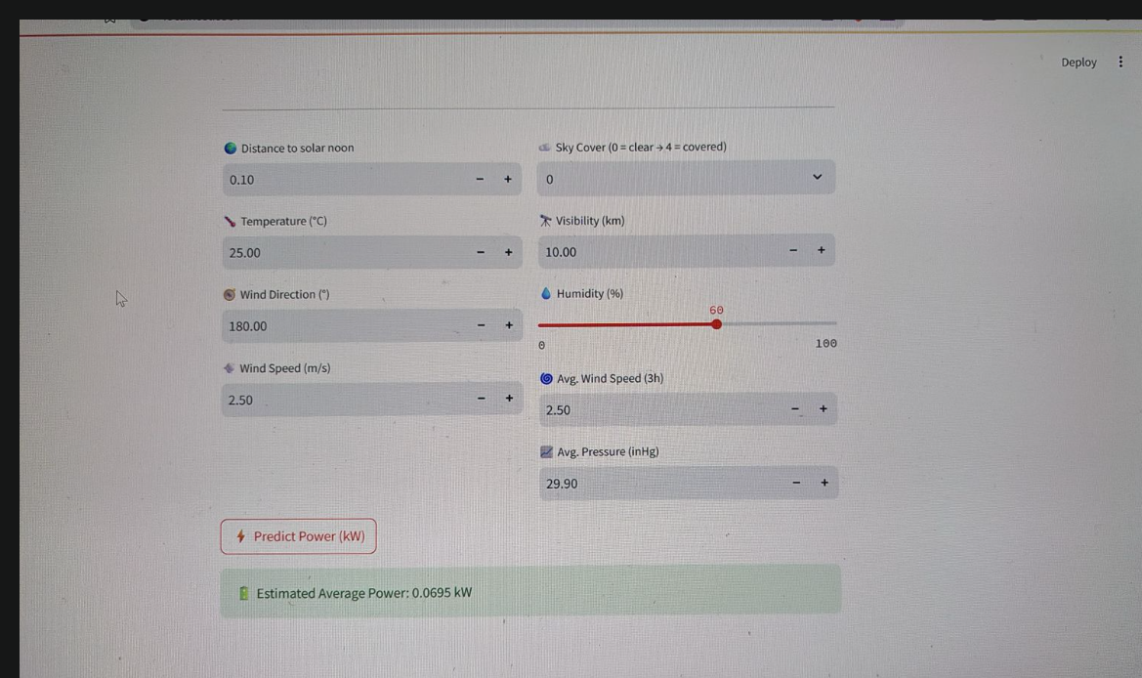

Slide 15
CHALLENGES FACED
Linear models underperformed due to the presence of non-linear relationships between features and target (power-generated), as observed through residual plots and actual vs predicted visualizations.
While XGBoost performed well, it initially overfitted the training data, requiring hyperparameter tuning (e.g., max_depth, gamma, subsample) via RandomizedSearchCV to improve generalization on the test set.
Target variable was highly skewed with many zero values, making it necessary to apply log transformation to stabilize variance and improve model predictions.

Slide 16
Importance of the Project
Optimizes solar energy harvesting
Supports sustainable energy initiatives
Applies ML on real-world environmental data
Demonstrates end-to-end data science pipeline

Slide 17
Conclusion
Cleaned and preprocessed real-world data
Built and evaluated multiple regression models
Deployed best model locally using Streamlit

