Slide 1
HUMAN THERMOREGULATION
Here is where your presentation begins

Slide 2
CONTENTS OF THIS TEMPLATE
You can delete this slide when you’re done editing the presentation
Fonts | To view this template correctly in PowerPoint, download and install the fonts we used
Used and alternative resources | An assortment of graphic resources that are suitable for use in this presentation
Thanks slide | You must keep it so that proper credits for our design are given
Colors | All the colors used in this presentation
Icons and infographic resources | These can be used in the template, and their size and color can be edited
Editable presentation theme | You can edit the master slides easily. For more info, click here
More information:
SLIDESGO · BLOG · FAQS
Visit our projects:
FREEPIK · FLATICON · STORYSET · WEPIK · VIDEVO

Slide 3
TABLE OF CONTENTS
01
02
03
04
SECTION
SECTION
You can describe the topic of the section here
You can describe the topic of the section here
SECTION
SECTION
You can describe the topic of the section here
You can describe the topic of the section here

Slide 4
WHOA!
This can be the part of the presentation where you introduce yourself, write your email…

Slide 5
01
NAME OF THE SECTION
You can enter a subtitle here if you need it

Slide 6
DO YOU NEED LONGER TEXT?
Mercury is the closest planet to the Sun and the smallest one in the entire Solar System. This planet's name has nothing to do with the liquid metal, since Mercury was named after the Roman messenger god. Despite being closer to the Sun than Venus, its temperatures aren't as terribly hot as that planet's. Its surface is quite similar to that of Earth's Moon, which means there are a lot of craters and plains
Speaking of craters, many of them were named after artists or authors who made significant contributions to their respective fields. Mercury takes a little more than 58 days to complete its rotation, so try to imagine how long days must be there! Since the temperatures are so extreme, albeit not as extreme as in Venus, and the solar radiation is so high, Mercury has been deemed to be non-habitable for humans

Slide 7
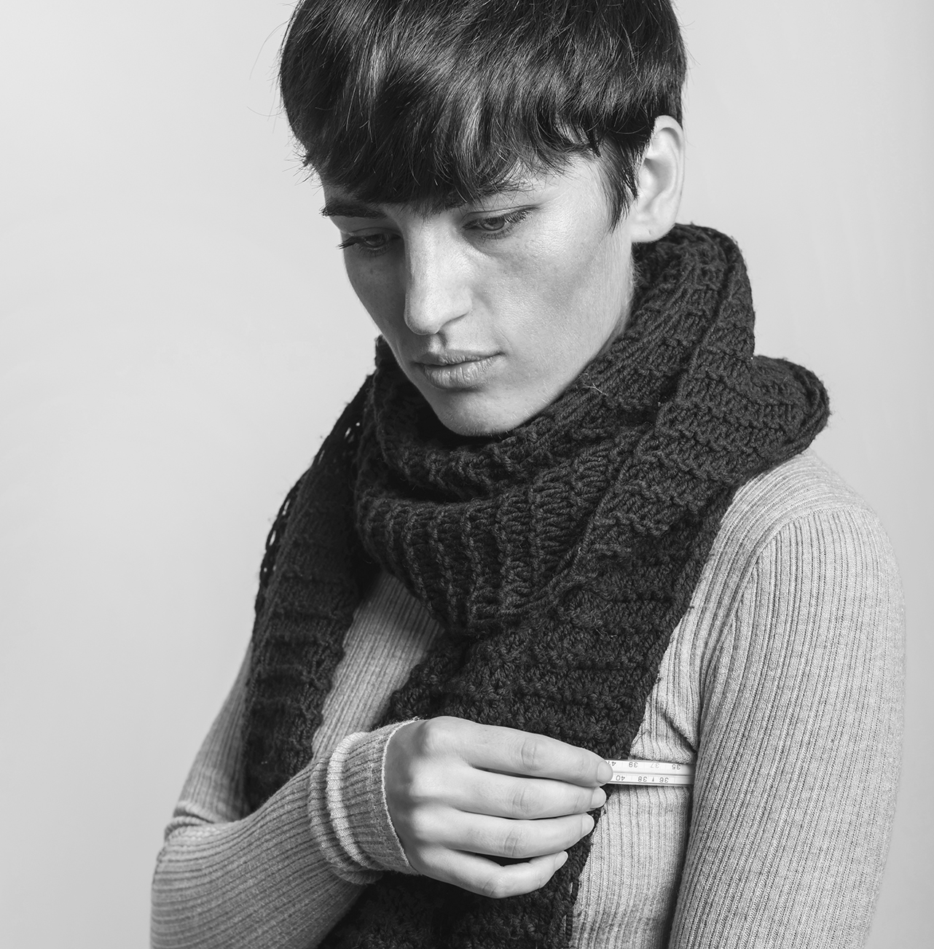
THE SLIDE TITLE GOES HERE!
Do you know what helps you make your point crystal clear? Lists like this one:
They’re simple
You can organize your ideas clearly
You’ll never forget to buy milk!
And the most important thing: the audience won’t miss the point of your presentation

Slide 8
DIVIDE THE CONTENT
MERCURY
VENUS
Mercury is the closest planet to the Sun and the smallest one in the Solar System—it’s only a bit larger than the Moon
Venus has a beautiful name and is the second planet from the Sun. It’s hot and has a poisonous atmosphere

Slide 9
HERE ARE THREE IDEAS
MERCURY
VENUS
MARS
Mercury is the closest planet to the Sun and the smallest of them all
Venus has a beautiful name and is the second planet from the Sun
Despite being red, Mars is actually a cold place. It’s full of iron oxide dust

Slide 10
DIVIDE THE CONTENT
MARS
VENUS
Mars is actually a very cold place
Venus has extremely high temperatures
JUPITER
SATURN
Jupiter is the biggest planet of them all
Saturn is a gas giant and has several rings

Slide 11
MORE CONCEPTS
MARS
VENUS
NEPTUNE
Mars is actually a very cold place
Venus is the second planet from the Sun
Neptune is the farthest planet from the Sun
MERCURY
SATURN
JUPITER
Mercury is the closest planet to the Sun
Saturn is a gas giant with several rings
Jupiter is the biggest planet of them all

Slide 12
AWESOME WORDS

Slide 13
—SOMEONE FAMOUS
“This is a quote, words full of wisdom that someone important said and can make the reader get inspired.”

Slide 14
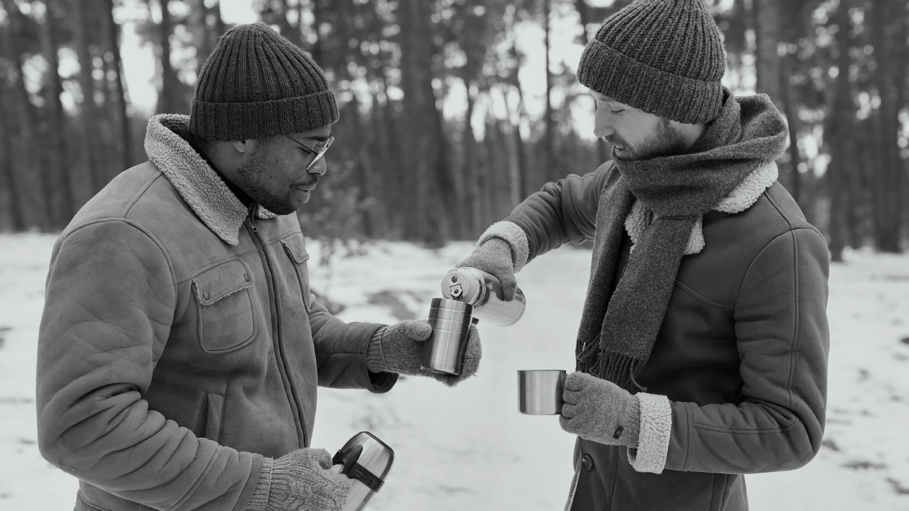
A PICTURE IS WORTH A THOUSAND WORDS

Slide 15

A PICTURE ALWAYS REINFORCES
THE CONCEPT
Images reveal large amounts of data, so remember: use an image instead of a long text. Your audience will appreciate it

Slide 16
150,000
Big numbers catch your audience’s attention

Slide 17
9h 55m 23s
333,000
386,000 km
Jupiter's rotation period
The Sun’s mass compared to Earth’s
Distance between Earth and the Moon

Slide 18
LET’S USE PERCENTAGES
25%
50%
75%
MERCURY
VENUS
MARS
Mercury is the closest planet to the Sun and the smallest of them all
Venus has a beautiful name and is the second planet from the Sun
Despite being red, Mars is actually a cold place. It’s full of iron oxide dust

Slide 19
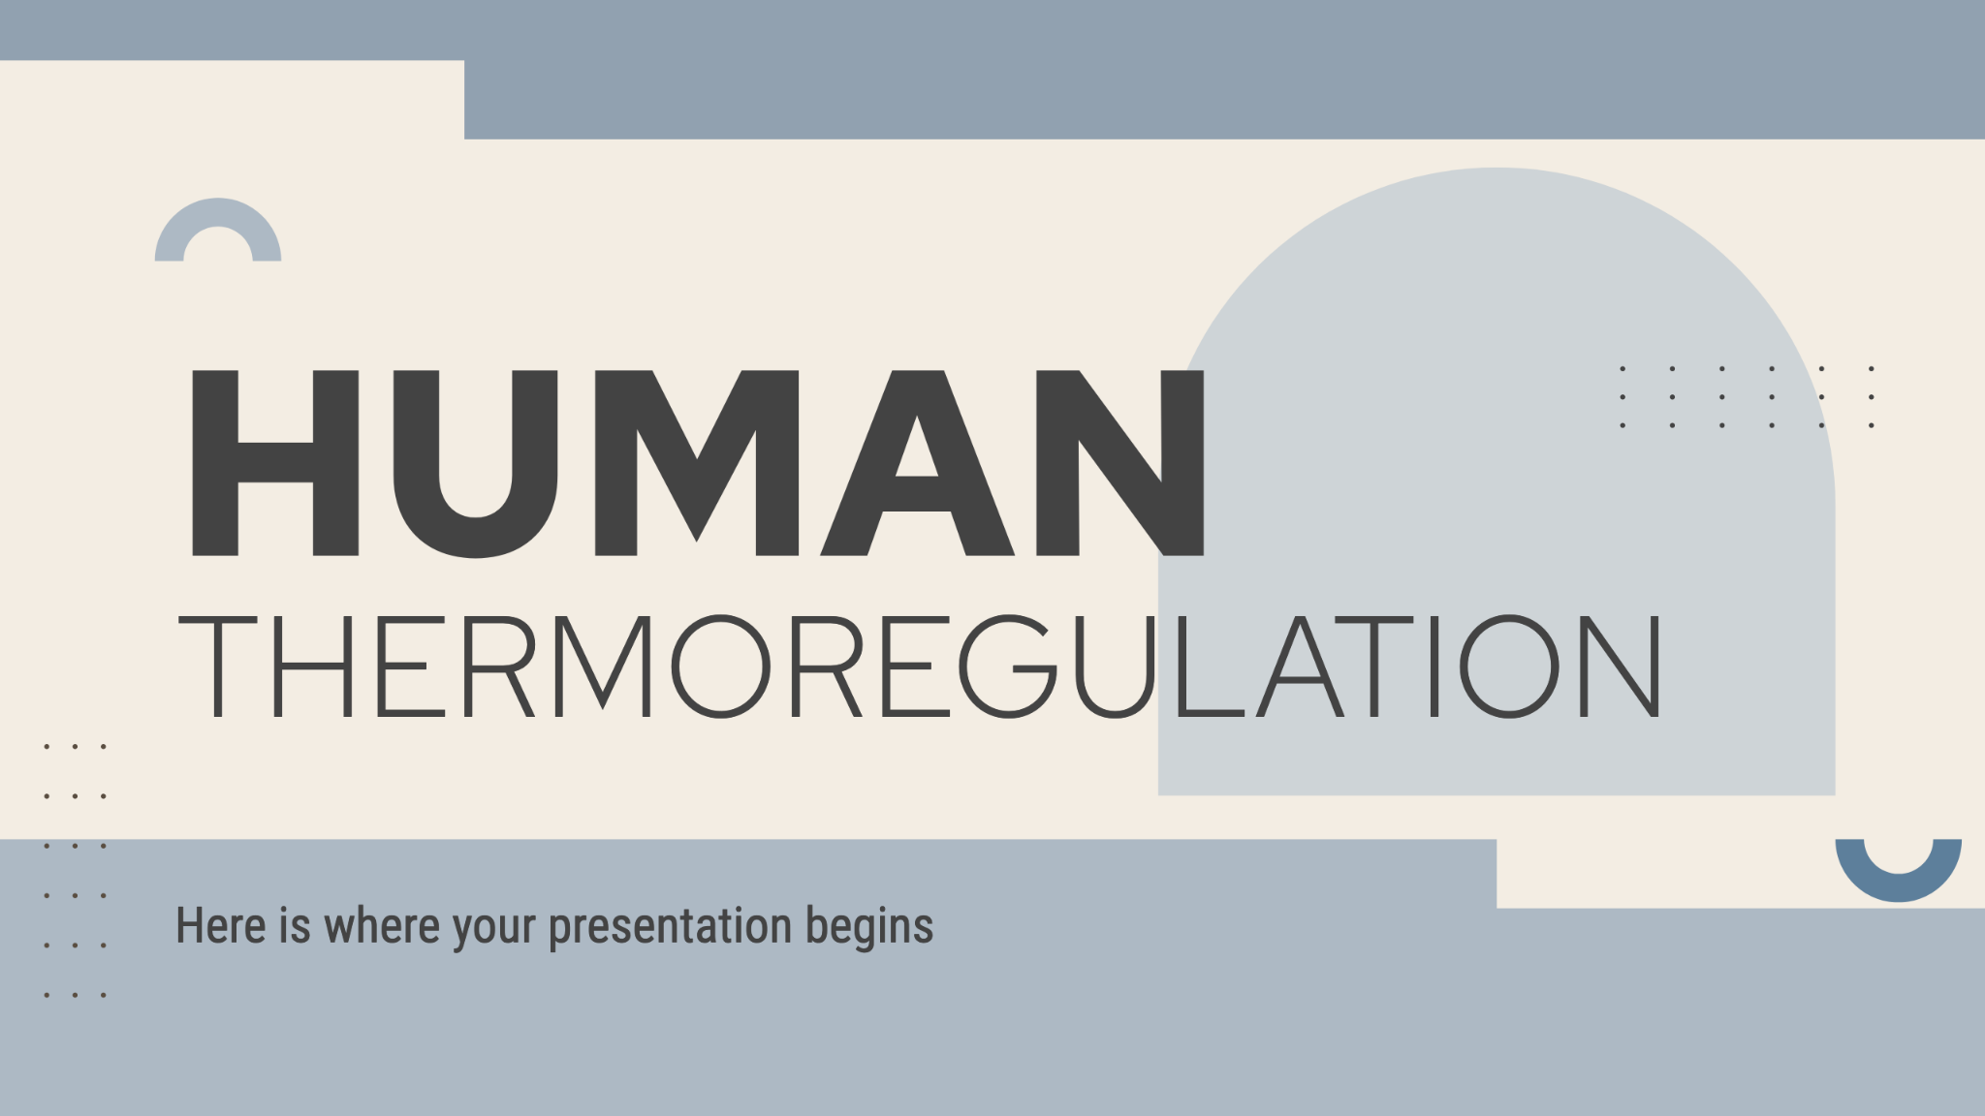
COMPUTER MOCKUP
You can replace the image on the screen with your own work. Just right-click on it and select “Replace image”

Slide 20
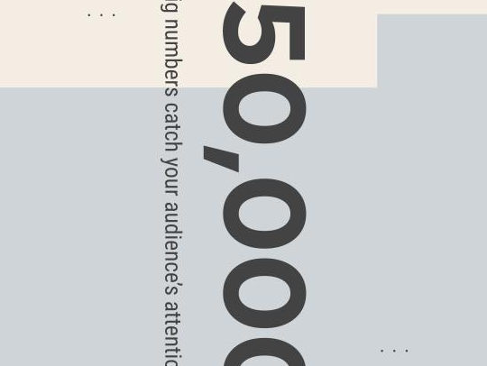
TABLET MOCKUP
You can replace the image on the screen with your own work. Just right-click on it and select “Replace image”

Slide 21
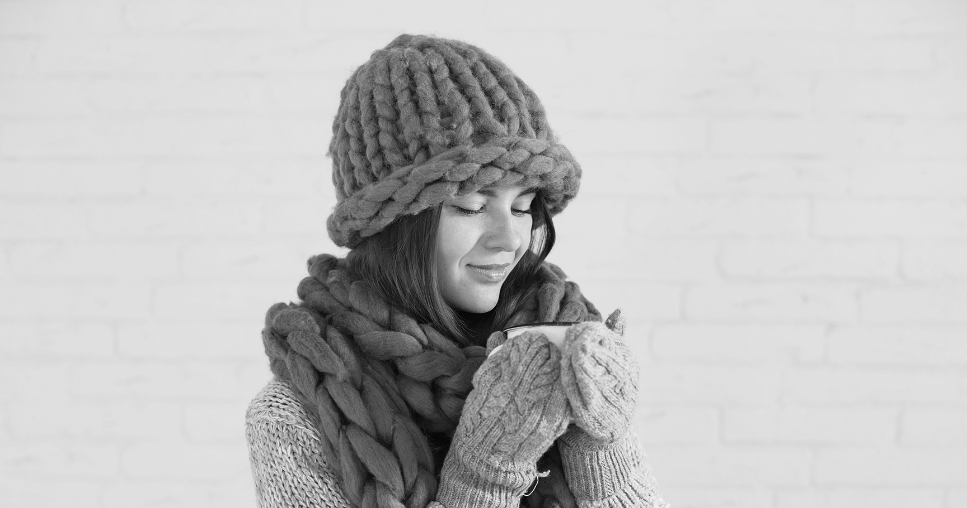
PHONE MOCKUP
You can replace the image on the screen with your own work. Just right-click on it and select “Replace image”

Slide 22
THIS IS A MAP
JUPITER
VENUS
Jupiter was named after a Roman god
Neptune is far away from Earth
MARS
MERCURY
Mars is full of iron oxide dust
Mercury is quite a small planet

Slide 23
A TIMELINE
MERCURY
JUPITER
Mercury is the closest planet to the Sun
Jupiter is the biggest planet of them all
VENUS
MARS
Venus is the second planet from the Sun
Despite being red, Mars is a very cold place

Slide 24
AN INFOGRAPHIC
JUPITER
VENUS
Jupiter was named after a Roman god
Neptune is far away from Earth
MARS
MERCURY
Mars is full of iron oxide dust
Mercury is quite a small planet

Slide 25
TABLES REPRESENT YOUR DATA
 | MASS (EARTHS) | DIAMETER (EARTHS) | SURFACE GRAVITY (EARTHS)
MERCURY | 0.25 | 0.99 | 0.45
MARS | 0.15 | 0.23 | 0.82
SATURN | 24.5 | 10,6 | 3.79

Slide 26
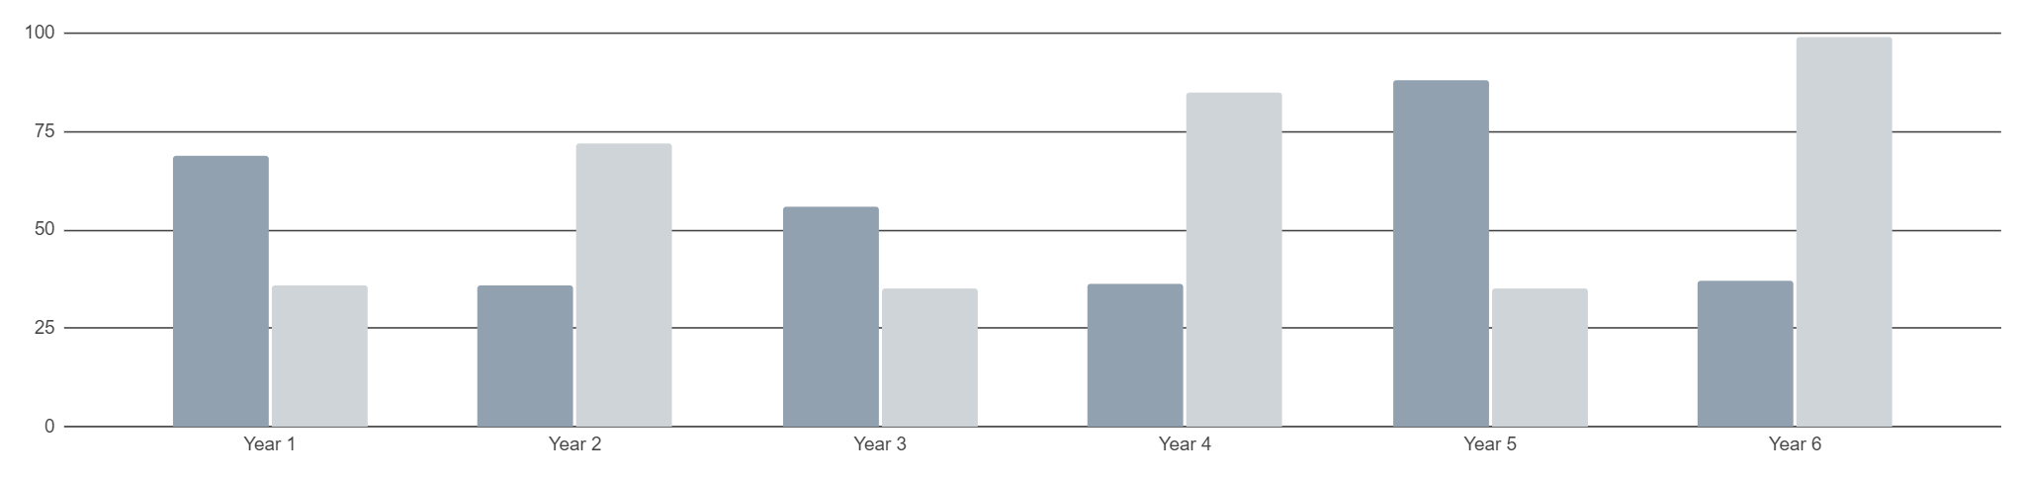
YOU CAN USE THIS GRAPH
AVERAGE TEMPERATURE 36.5 GRADES
MARS
VENUS
Follow the link in the graph to modify its data and then paste the new one here. For more info, click here
Mars is actually a very cold place
Venus has extremely high temperatures

Slide 27
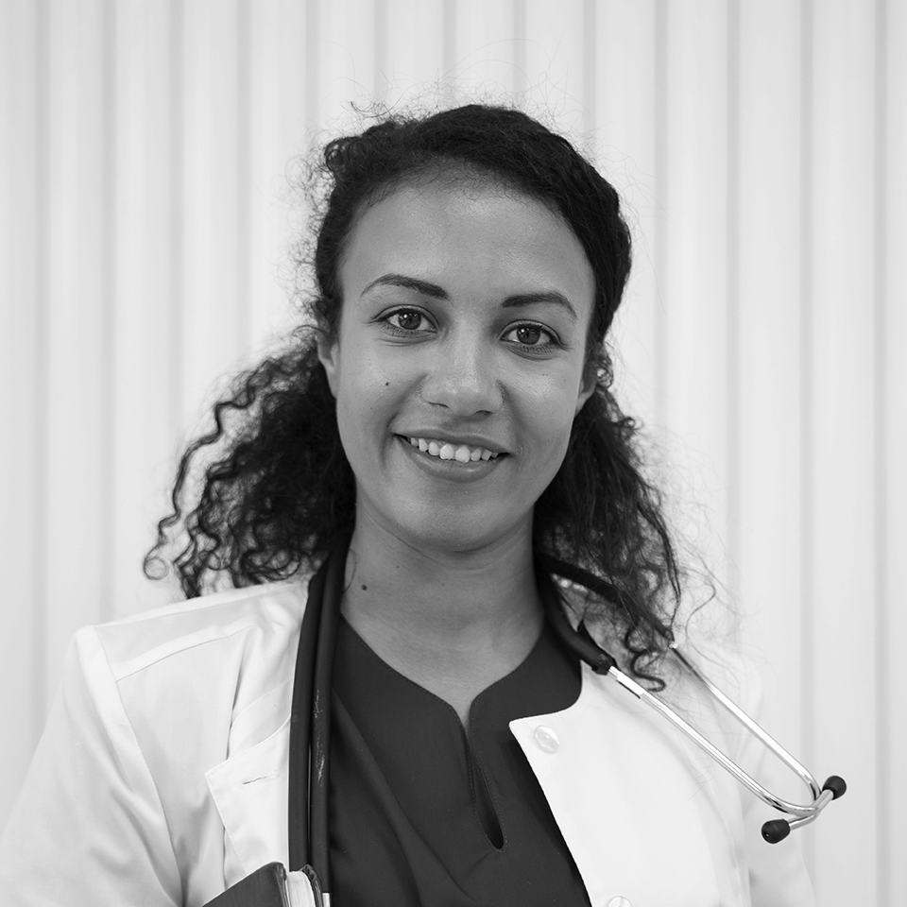

OUR TEAM
SOFIA HILL
ANNA HARRIS
You can speak a bit about this person here
You can speak a bit about this person here

Slide 28
SOME PUBLICATIONS
“Neptune is the farthest planet from the Sun and the fourth-largest object in the Solar System!”
“Mercury is the closest planet to the Sun and also the smallest one in the entire Solar System”
“Despite being red, Mars is a cold place. It’s full of iron oxide dust, which gives the planet its reddish cast”
By Julia Smith
By Sarah Miles
By John James

Slide 29
PHYSICAL EXAMINATION
MERCURY
Mercury is the closest planet to the Sun and the smallest of them all
VENUS
Venus has a beautiful name and is the second planet from the Sun
JUPITER
Jupiter is a gas giant and the biggest planet in the Solar System

Slide 30
CASE TIMELINE
VENUS
MARS
JUPITER
Venus is the second planet from the Sun
Despite being red, Mars is a cold place
Jupiter is the biggest planet of them all
01
02
03
04
05
MERCURY
SATURN
Mercury is the closest planet to the Sun
Saturn is a gas giant and has several rings

Slide 31
REASONS TO STOP OR START
CONTRAINDICATIONS
INDICATIONS
Describe the reasons to stop the treatment here
Describe the reasons to stop the treatment here
Describe the reasons to stop the treatment here
Describe the reasons to stop the treatment here
Describe the reasons to stop the treatment here
Describe the reasons to stop the treatment here
Describe the reasons to stop the treatment here
Describe the reasons to start the treatment here
Describe the reasons to start the treatment here
Describe the reasons to start the treatment here
Describe the reasons to start the treatment here
Describe the reasons to start the treatment here
Describe the reasons to start the treatment here
Describe the reasons to start the treatment here

Slide 32
CLEAR SCHEME
Cerebral cortex
Hypothalamus
Central thermoreceptors
Cutaneous thermoreceptors
Skeleton muscle
Skeleton muscle
-
-
Decreased skin temperature
Drop in blood temperature
Cutaneous arterioles
Skin muscles
Adrenal medulla

Slide 33
THERMOREGULATION
MARS
NEPTUNE
Mars is actually a very cold place
Neptune is the farthest planet from the Sun
VENUS
SATURN
Venus is the second planet from the Sun
Saturn is a gas giant with several rings
MERCURY
JUPITER
Mercury is the closest planet to the Sun
Jupiter is the biggest planet of them all

Slide 34
CONCLUSIONS
Mercury is the closest planet to the Sun and the smallest one in the Solar System
Venus has a beautiful name and is the second planet from the Sun
Jupiter is a gas giant and the biggest planet in the Solar System
Saturn is the second-largest planet in the Solar System. It’s a gas giant

Slide 35
THANKS!
DO YOU HAVE ANY QUESTIONS?
youremail@freepik.com
+34 654 321 432
yourwebsite.com
Please keep this slide for attribution

Slide 36
ALTERNATIVE RESOURCES
Here’s an assortment of alternative resources whose style fits the one of this template:
VECTORES
Flat design fashion collection twitch banner
Geometric background concept

Slide 37
SOME RESOURCES
Did you like the resources on this template? Get them for free at our other websites:
VECTORES
PHOTOS
Flat design fashion collection youtube channel art
Flat design fashion collection twitch background
Flat design fashion collection landing page
Sick young woman checking temperature of body with thermometer
Medium shot men with drinks
Full shot woman drinking coffee
Charming lady in mittens, hat and scarf with cup in hands
Front view smiley doctor at clinic
Doctor preparing for consult

Slide 38
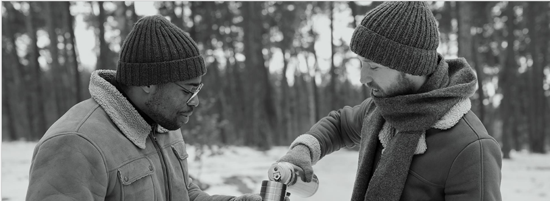

Slide 39
Instructions for use
If you have a free account, in order to use this template, you must credit Slidesgo by keeping the Thanks slide. Please refer to the next slide to read the instructions for premium users.
As a Free user, you are allowed to:
- Modify this template.
- Use it for both personal and commercial projects.
You are not allowed to:
- Sublicense, sell or rent any of Slidesgo Content (or a modified version of Slidesgo Content).
- Distribute Slidesgo Content unless it has been expressly authorized by Slidesgo.
- Include Slidesgo Content in an online or offline database or file.
- Offer Slidesgo templates (or modified versions of Slidesgo templates) for download.
- Acquire the copyright of Slidesgo Content.
For more information about editing slides, please read our FAQs or visit our blog:
https://slidesgo.com/faqs and https://slidesgo.com/slidesgo-school

Slide 40
Instructions for use (premium users)
As a Premium user, you can use this template without attributing Slidesgo or keeping the "Thanks" slide.
You are allowed to:
Modify this template.
Use it for both personal and commercial purposes.
Hide or delete the “Thanks” slide and the mention to Slidesgo in the credits.
Share this template in an editable format with people who are not part of your team.
You are not allowed to:
Sublicense, sell or rent this Slidesgo Template (or a modified version of this Slidesgo Template).
Distribute this Slidesgo Template (or a modified version of this Slidesgo Template) or include it in a database or in any other product or service that offers downloadable images, icons or presentations that may be subject to distribution or resale.
Use any of the elements that are part of this Slidesgo Template in an isolated and separated way from this Template.
Register any of the elements that are part of this template as a trademark or logo, or register it as a work in an intellectual property registry or similar.
For more information about editing slides, please read our FAQs or visit our blog:
https://slidesgo.com/faqs and https://slidesgo.com/slidesgo-school

Slide 41
Fonts & colors used
This presentation has been made using the following fonts:
Red Hat Text
(https://fonts.google.com/specimen/Red+Hat+Text)
Roboto Condensed
(https://fonts.google.com/specimen/Roboto+Condensed)
#434343
#f3ede3
#91a1b0
#ced4d7
#adb9c4
#5d7f9b
#ffffff

Slide 42



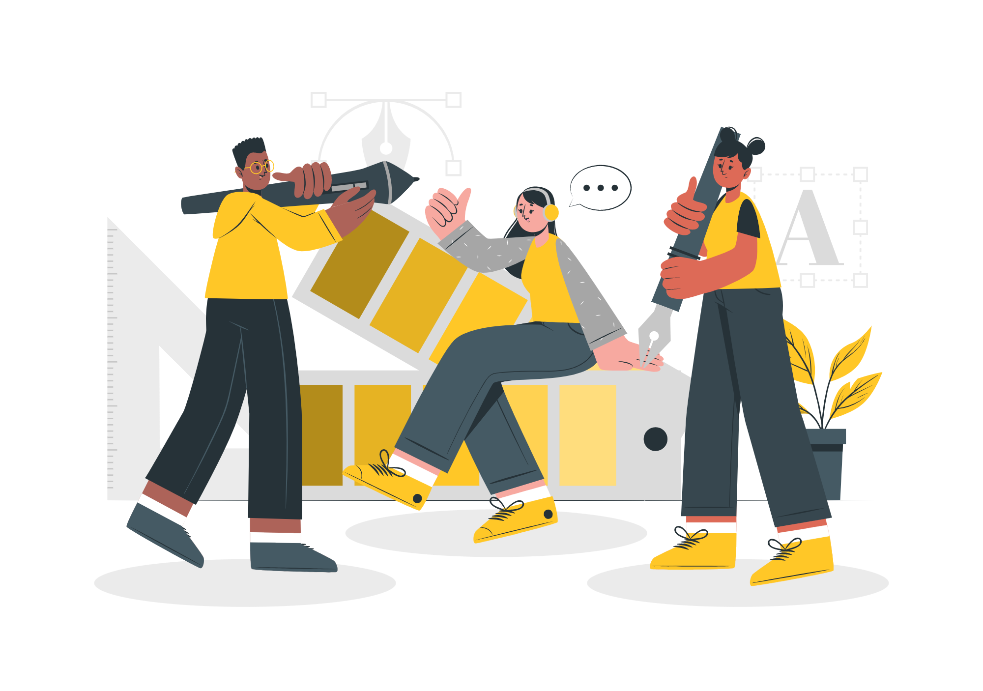

Storyset
Create your Story with our illustrated concepts. Choose the style you like the most, edit its colors, pick the background and layers you want to show and bring them to life with the animator panel! It will boost your presentation. Check out how it works.
Pana
Amico
Bro
Rafiki
Cuate

Slide 43
Use our editable graphic resources...
You can easily resize these resources without losing quality. To change the color, just ungroup the resource and click on the object you want to change. Then, click on the paint bucket and select the color you want. Group the resource again when you’re done. You can also look for more infographics on Slidesgo.

Slide 46
JANUARY
FEBRUARY
MARCH
APRIL
MAY
JUNE
PHASE 1
Task 1
Task 2
PHASE 2
Task 1
Task 2
JANUARY
FEBRUARY
MARCH
APRIL
PHASE 1
Task 1
Task 2

Slide 49
...and our sets of editable icons
You can resize these icons without losing quality.
You can change the stroke and fill color; just select the icon and click on the paint bucket/pen.
In Google Slides, you can also use Flaticon’s extension, allowing you to customize and add even more icons.

Slide 50
Educational Icons
Medical Icons

Slide 51
Business Icons
Teamwork Icons

Slide 52
Help & Support Icons
Avatar Icons

Slide 53
Creative Process Icons
Performing Arts Icons

Slide 54
Nature Icons

Slide 55
SEO & Marketing Icons

Slide 56


