Slide 1

RECORDING my BUDGET

Slide 2
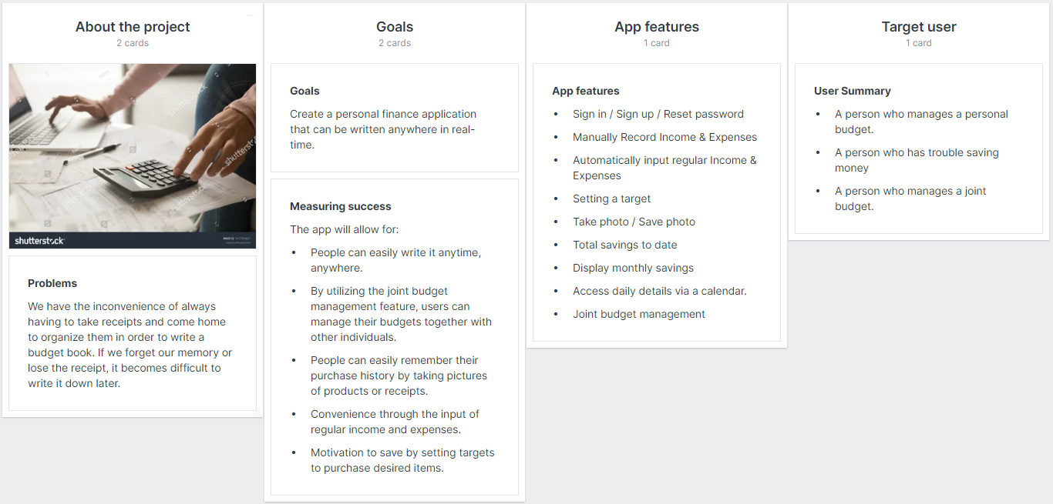
brief

Slide 3
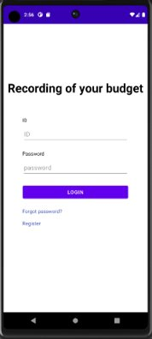
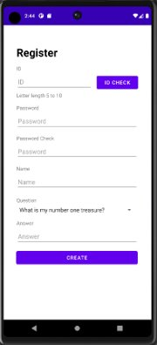
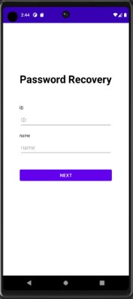
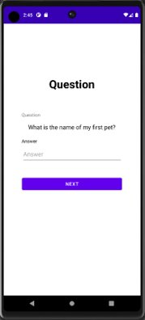
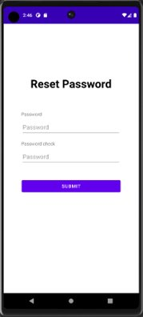
User management
These are user management features that allow users to perform actions such as login, registration, and password changes.

Slide 4
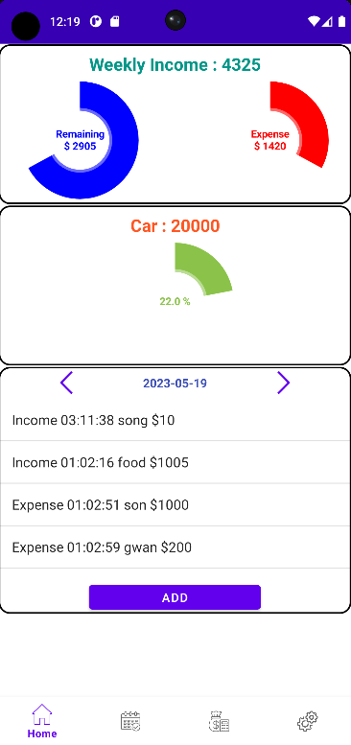
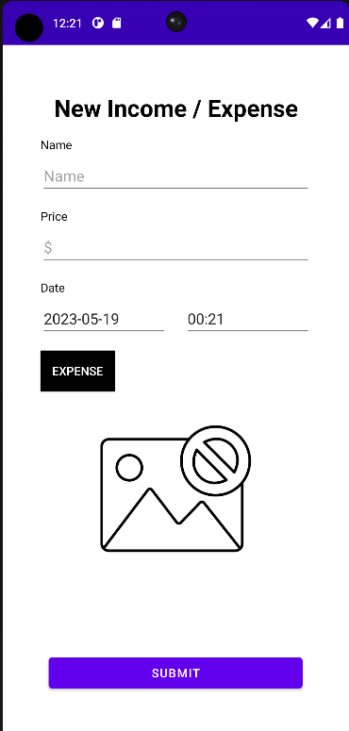
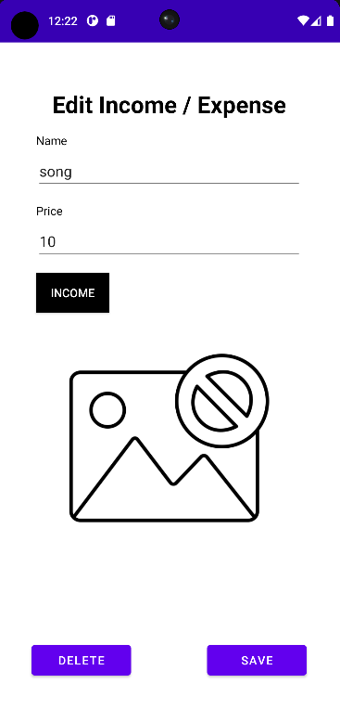
Personal Budget management
These are personal budget management features that display the user's this week income, expenses, remaining balance, as well as the user's goals and achievements. It also allows users to track their daily income and expenses and provides the functionality to add or modify personal budgets.

Slide 5
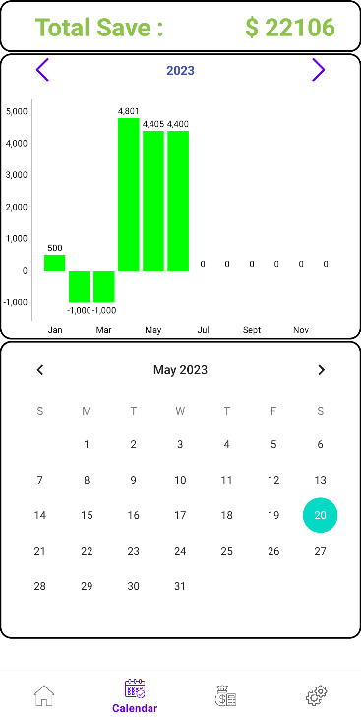
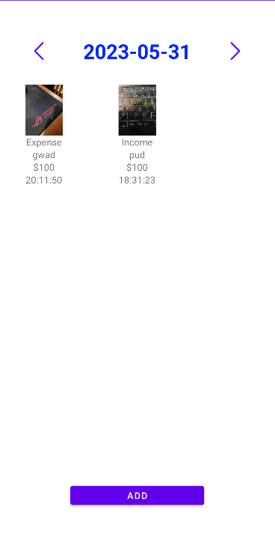
Budget information display
This displays all of the user's budget information. It includes the total savings of the user, monthly budget information for the current year. And user can access detail daily budget information through a calendar.

Slide 6
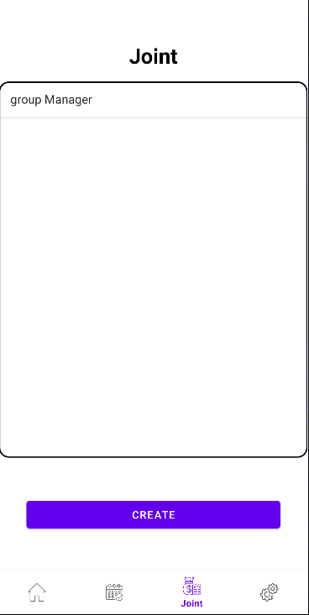
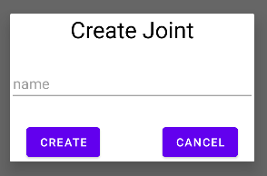
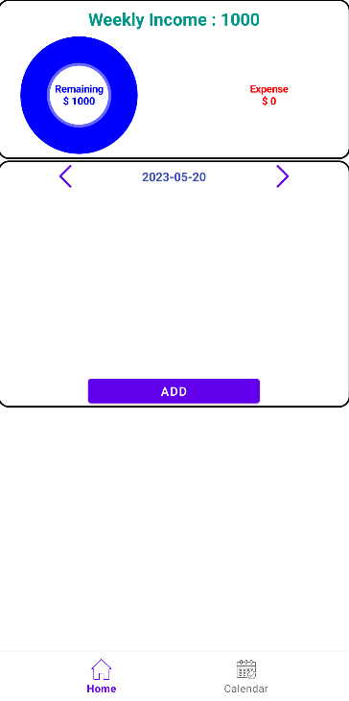
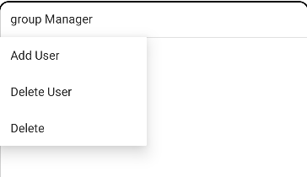
Joint Budget management
This is joint budget management, where groups can manage budgets collectively. It displays and allows users to create shared budget ledgers that can be accessed by multiple users. Additionally, by long-pressing on a shared budget ledger, users can manage access for other users. With a single click, they can also easily access the respective shared budget ledger.

Slide 7
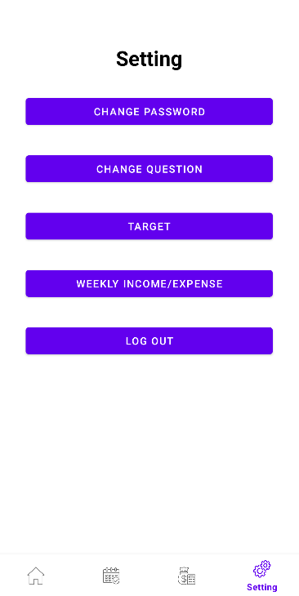
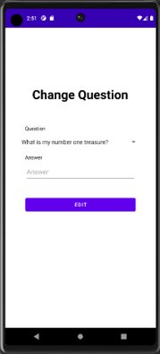
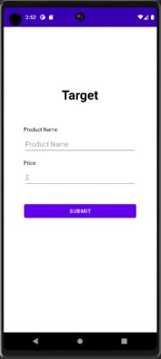
Setting management
This is settings management. Here, users can manage such as their password, change security questions, set target for desired items, and regular weekly income and expenses.

Slide 8
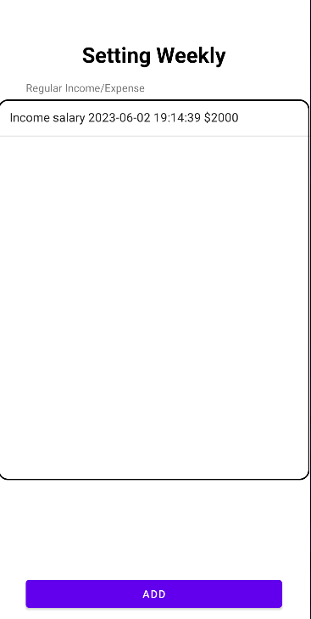
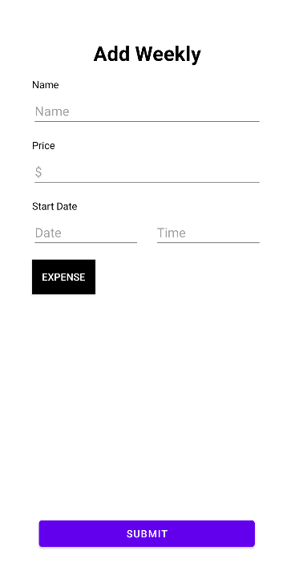
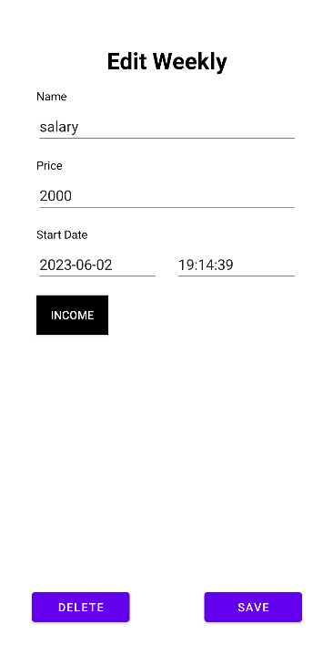
Regular weekly management
This is regular weekly income and expense management. Here, users can input, modify, and delete their regular weekly income and expenses. The configured items will automatically input the set values on a weekly basis starting from the specified start date.

