Slide 1


Arabic Social Media Sentiment Analysis Using RCNN
Workshop
Rania Abd EL Monam Mohamed
Department of Computer Sciences
Faculty of Graduate Studies for Statistical Research
Cairo University, Egypt
11/12/2019

Slide 2
Agenda
Introduction.
Proposed Corpus.
Embedding Layer.
Architecture of RCNN Model.
Publications.
RCNN Code.

Slide 3
Agenda
Introduction.
Proposed Corpus.
Embedding Layer.
Architecture of RCNN Model.
Publications.
RCNN Code.

Slide 4
Social Media
Social Media is generating a large volume of sentiment rich data in the form of tweets, status updates, blog posts, comments, reviews, etc.
Social Media are considered an excellent source of information and can provide opinions, thoughts, and insights toward various important topics.
It is expected that the estimated amount of data on the web will be about 40 trillion gigabytes, in 2020 [1].
ــــــــــــــــــــــــــــــــــــ
1- Gantz, J. and D. Reinsel, Digital Universe Study. Extracting Value from Chaos, IDC Go-to-Market Services, 2011.

Slide 5
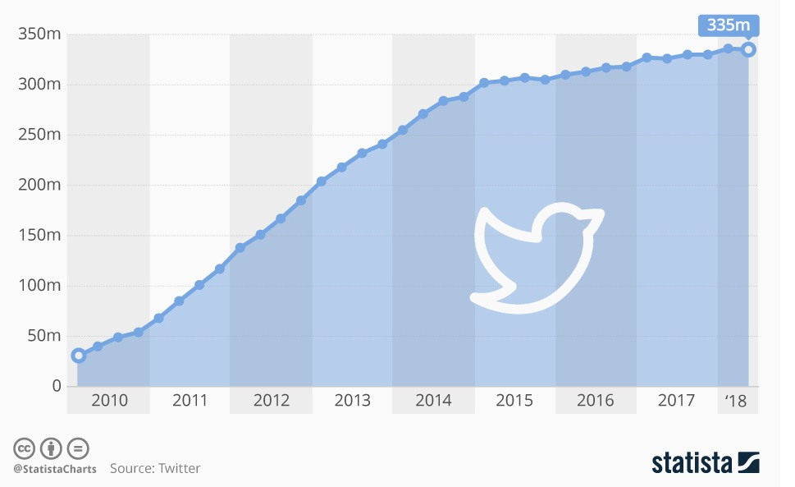
Twitter is one of the most popular, widely used social media.
Official Twitter statistics show that 335 million monthly users actively used Twitter in 2018.
ـــــــــــــــــــــــــــــــــــــ
2- Twitter, https://www.businessofapps.com/data/twitter-statistics/. 2018.
Number of monthly active twitter users around the world from 2010 to 2018 [2]

Slide 6
Sentiment Analysis
Sentiment Analysis (SA) also known as review mining.
SA can be defined as a process that automates mining of attitudes, opinions and emotions from text.
SA is the process of determining whether a piece of writing is positive ☺ or negative ☹.
SA refers to the process of deriving high-quality information from text.

Slide 7
SA plays a significant role in our daily decision making process.
SA helps in achieving various goals like observing public mood regarding political topics, market intelligence, new product sales prediction, the measurement of customer satisfaction and many more.
SA can be divided into three levels, namely
Document Level
Sentence Level.
Aspect Level (also known as word- or feature- level).

Slide 8
Arabic Contents
Arabic language is one of six official languages of the United Nations.
Arabic is the official language of 21 countries, and it’s the major language in several areas of the world.
Arabic language is classified into three types;
Classical Arabic ( “AL-Qur’an”)
Modern Standard Arabic (formal communications, television, radio, news, education)
Colloquial Arabic (shopping, chatting or in their homes.)

Slide 9
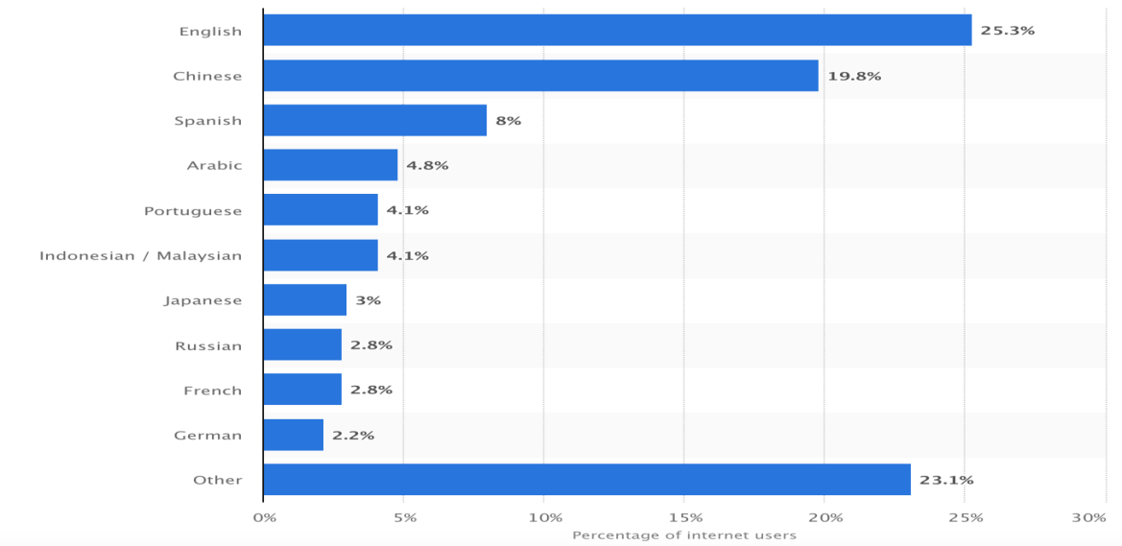
Arabic Contents
Arabic is currently ranked as the forth language used in the web, and there are about 168 million of Arabic Internet user [5].
Top 10 Languages used on the internet today
ــــــــــــــــــــــــــــــــــــ
5- Languages, https://www.internetworldstats.com/stats7.htm , 2018.

Slide 10

Colloquial Arabic language
Analyzing Arabic contents is a challenging task due to:
Unstructured language (informal language).
Spelling inconsistencies.
Slang words. Such as ( كدا,ولو , كويس, يلا )
Idiomatic expressions.
Such as ( الطيور على اشكالها تقع, التكرار يعلم الحمار, بعد ما شاب ودوه الكتّاب,
هاك الشبل من ذاك الأسد, شحات ونزهي, طباخ السم بيدوقه)
Colloquial expressions.
Such as (ناس مابتجيش الا بالعين الحمرا, مفيش فايدة, في المشمش, يا خبر أبيض,
يا سلام, زي السمن على العسل, يسرق الكحل من العين, زي القطط تاكل وتنكر)
Emoticons. Such as
The tendency to repeat letters in writing to convey feelings.
Such as( كتيرررررررررررر)

Slide 11
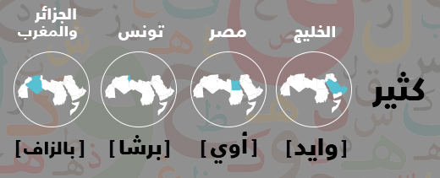
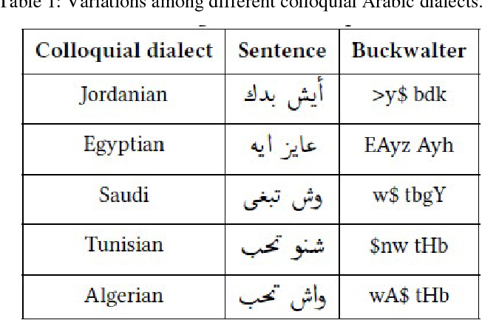
Colloquial Arabic language
“Colloquial Arabic” (CA) is most widely spoken and written in daily live conversations with different dialects.
( colloquial Arabic varies from region to another region, from country to other countries, even from even state to another.)

Slide 12
Agenda
Introduction.
Proposed Corpus.
Embedding Layer.
Architecture of RCNN Model.
Publications.
RCNN Code.

Slide 13
Proposed Corpus (Egyptian Corpus)
Proposed Corpus
Data Collection
Data Annotation
Pre-processing

Slide 14
Proposed Corpus (Egyptian Corpus)
Proposed Corpus
Data Collection
Data Annotation
Pre-processing

Slide 15

Proposed Corpus (Egyptian Corpus)
Tweets was collected using twitter APIs.
The collected tweets span the period from April 11, 2015 to December 12, 2015. In this initial stage, a collection of 2,408,128 noisy raw tweets were gathered.

Slide 16
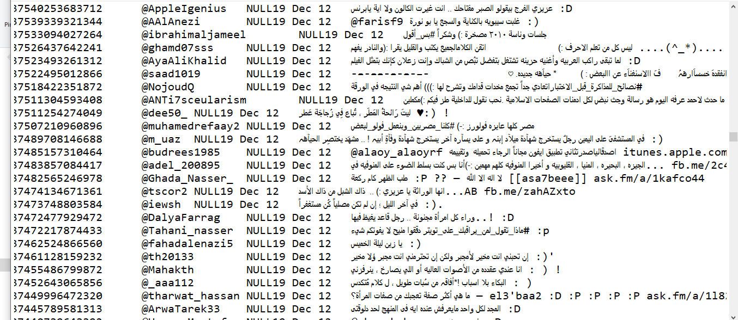
Original tweets

Slide 17
Proposed Corpus (Egyptian Corpus)
Proposed Corpus
Data Collection
Annotation Data
Pre-processing

Slide 18
Preprocessing (Egyptian Corpus)
Phase 1: Filtering Data
Phase 2: Cleaning Data
Phase 3: Normalization Data

Slide 19
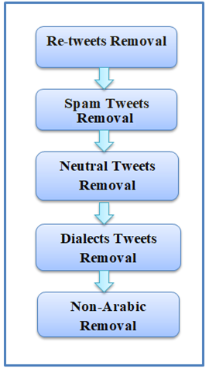
Phase 1: Filtering Data
After collecting the data from Twitter, we found that the collected tweets have many problems that will affect the annotation process accuracy.
This phase consisted of five steps manually:
Tweet filtering phase

Slide 20
Phase 2: Cleaning Data
This phase is important since it deals with the noisy nature of tweets.
data cleaning deals manually:
Such as (hashtag (#), username (@username),emoticons (=D, XD), time stamps and URL)
Some tweets may contain:
(missing spelling words, missing letters and written incorrectly)
This problem is handled by correcting these words and wrong characters.
Some words are combined together due to space limitation of Twitter. This problem is handled by adding spaces between words.

Slide 21
Phase 3: Normalization Data
Normalization Rules
Normalization is the process of transforming the Arabic text in order to be consistent.
For example:
All these forms cause the word to be considered as three different words.
Rule | Example
Tashkeel | ﺗُﻘﺮّﺏ -< تقرب
Repeate | كتيررررر -< كتير
Tatweel | اللــــــــــــه -> الله
Hamza | ؤ) , ىء , (ء -> ء
Alef | آ), أ , إ) -> ا
Lamalef | لا) , لآ , (لأ -> لا
Yeh | ي) , ى) -> ي
Heh | ه). ة) -> ه
أنت | انــــــــت | إنت | انت

Slide 22
Proposed Corpus (Egyptian Corpus)
Proposed Corpus
Data Collection
Data Annotation
Pre-processing

Slide 23
Data Annotation
At this phase, the annotation process is done manually, which manually classify each tweet as “positive” or “negative”.

Slide 24
Egyptian Corpus

Slide 25
Proposed Corpus (Egyptian Corpus)
New Arabic corpus for mixed tweets written in Egyptian dialect and MSA.
Cover several topics including:
Political, Sportive, Health, Social topics.
Sarcastic jokes.
Proverbs.
Poetry.
Users' opinions concerning different products.

Slide 26
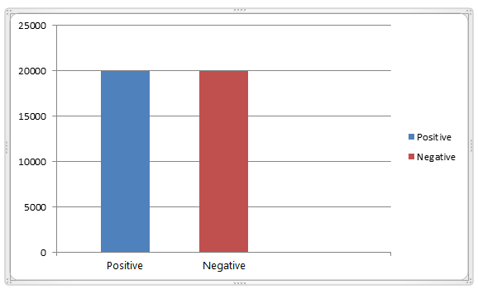
Proposed Corpus (Egyptian Corpus)
This corpus consists of 40000 tweets ( classified as 20000 positive and 20000 negative).
Total distribution of Corpus (balanced data)

Slide 27
Proposed Corpus (Egyptian Corpus)
It divided into two columns:
The first column is called review.
The second column is called label.

Slide 28
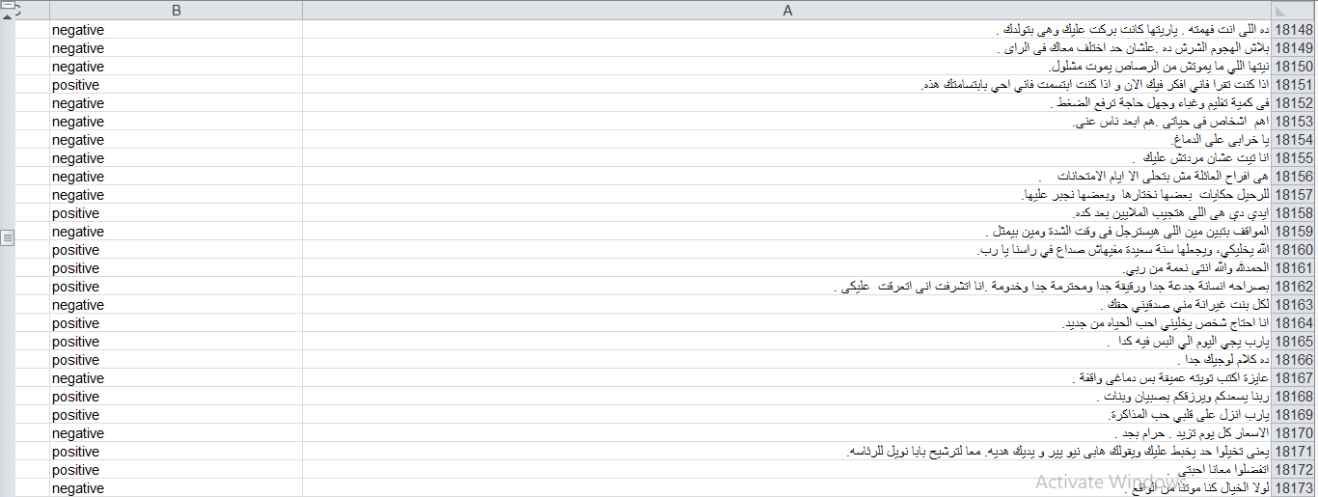
Sample of our corpus

Slide 29
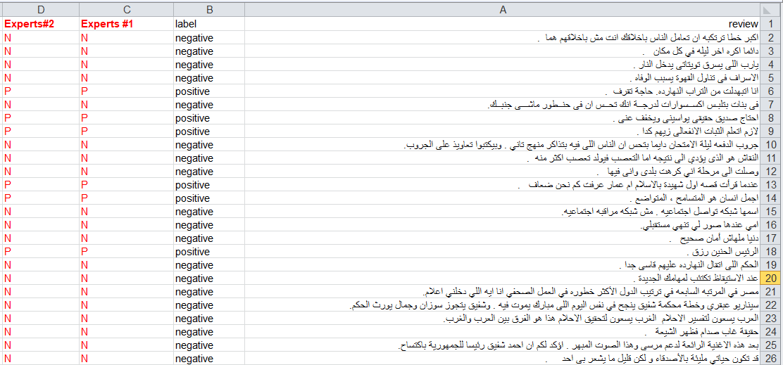
Notes:
we construct the corpus from those tweets having clearly positive or negative sentiment.
Also, to validate the annotation of corpus, two different experts were asked to check the annotation. The results of both experts were consistent with the corpus annotations with 100 % accuracy.

Slide 30
Egyptian Corpus Statistics
Total number of tweets | 40000
Number of positive tweets | 20000
Number of negative tweets | 20000
Number of words | 359,818
Max tweet token | 39
Number of tokens | 1,953,869
Average tokens per tweet | 17

Slide 31
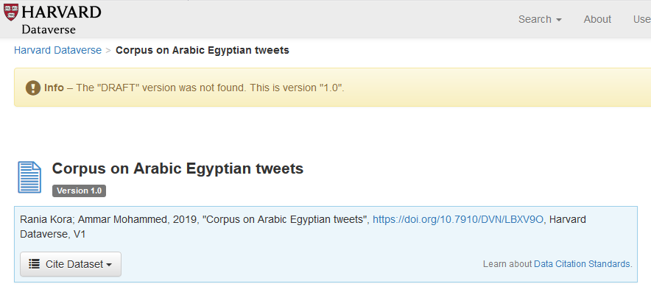
This corpus is available in [6].
ــــــــــــــــــــــــــــــــــــ
6- Kora, R. and A. Mohammed, “Arabic tweets Egyptian dialect”, . Mendeley Data, V1, 2019.
https://dataverse.harvard.edu/dataset.xhtml?persistentId=doi:10.7910/DVN/LBXV9O&version=DRAFT&faces-redirect=true

Slide 32
Agenda
Introduction.
Proposed Corpus.
Embedding Layer.
Architecture of RCNN Model.
Results and Discussion.
Publications.
RCNN Code.

Slide 33
Embedding Layer of RCNN Model

Slide 34
Agenda
Introduction.
Proposed Corpus.
Embedding Layer.
Architecture of RCNN Model.
RCNN Code.
Publications.

Slide 35
RCNN Model
Recurrent Convolutional Neural Network (RCNN) is a network the combining the advantages of both CNN and LSTM neural networks.
The RCNN architecture consists of: Embedding Layer, Convolutional Layer, Max-pooling Layer, Flatten Layer, LSTM layer, and Dense an activation layer.

Slide 36
Architecture of RCNN Model

Slide 37
Agenda
Introduction.
Objectives.
Proposed Corpus.
Proposed Approaches.
Publications.
RCNN Code.

Slide 38
Agenda
Introduction.
Proposed Corpus.
Embedding Layer.
Architecture of RCNN Model.
Publications.
RCNN Code.

Slide 39
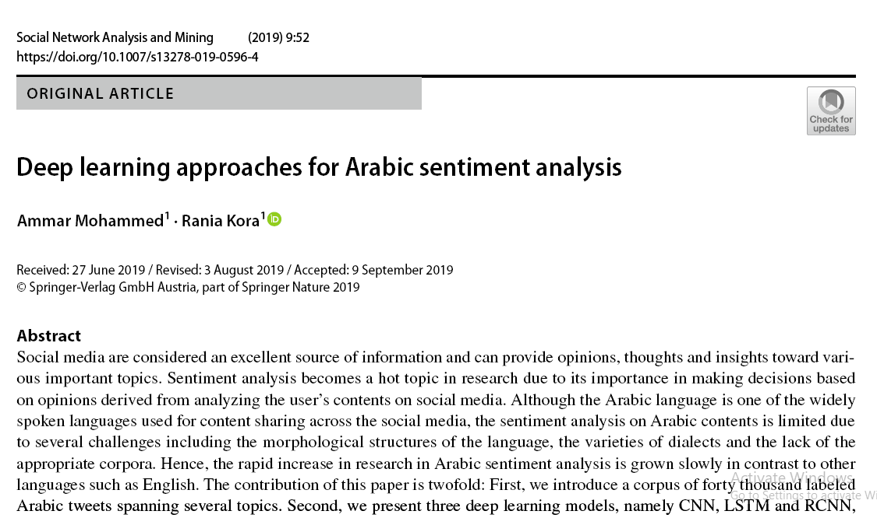
Publications
Mohammed, A., Kora, R.: Deep learning approaches for arabic sentiment analysis. Social Network Analysis and Mining 9 (1), 52 (2019) Springer. DOI 10.1007/s13278-019-0596-4. URL https://link.springer.com/article/10.1007%2Fs13278-019-0596-4

Slide 40
2. Kora, R., Mohammed, A.: Corpus on Arabic Egyptian tweets (2019). DOI 10.7910/DVN/LBXV9O. URL https://dataverse.harvard.edu/dataset.xhtml?persistentId=doi:10.7910/DVN/LBXV9O&version=DRAFT&faces-redirect=true

Slide 41
Agenda
Introduction.
Proposed Corpus.
Embedding Layer.
Architecture of RCNN Model.
Publications.
RCNN Code.

Slide 42


