Slide 1
Presentation:
How does the web work?
What do i need to be a web developer?
Why did i choose to learn web development?
Notes:
1

Slide 2
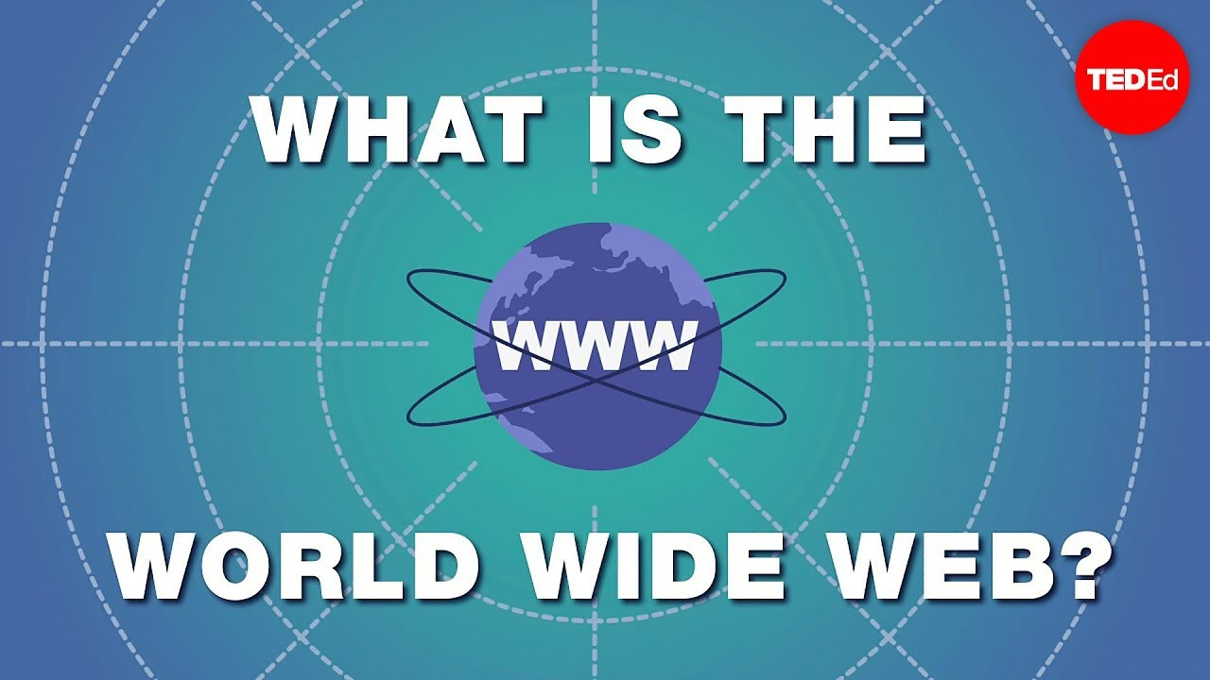
How does the web work?
How the web works provides a simplified view of what happens when you view a webpage in a web browser on your computer or phone.
When you type a web address into your browser (for our analogy that's like walking to the shop):
The browser goes to the DNS server, and finds the real address of the server that the website lives on (you find the address of the shop).
The browser sends an HTTP request message to the server, asking it to send a copy of the website to the client (you go to the shop and order your goods). This message, and all other data sent between the client and the server, is sent across your internet connection using TCP/IP.
If the server approves the client's request, the server sends the client a "200 OK" message, which means "Of course you can look at that website! Here it is", and then starts sending the website's files to the browser as a series of small chunks called data packets (the shop gives you your goods, and you bring them back to your house).
The browser assembles the small chunks into a complete web page and displays it to you (the goods arrive at your door — new shiny stuff, awesome!).
Notes:
2

Slide 3

What do i need to be a web developer?
To become a Web Developer, you should have an understanding of HTML, CSS, and JavaScript. It’s also recommended to learn about CSS and CSS frameworks. Developing these fundamental web development skills will give you the foundation and logic for communicating with programming languages.
How to become a Web Developer:
Learn web development fundamentals
Choose a development specialization
Learn key programming languages for web development
Work on projects to develop your Web Developer skills
Build a web development portfolio
Notes:
3

Slide 4
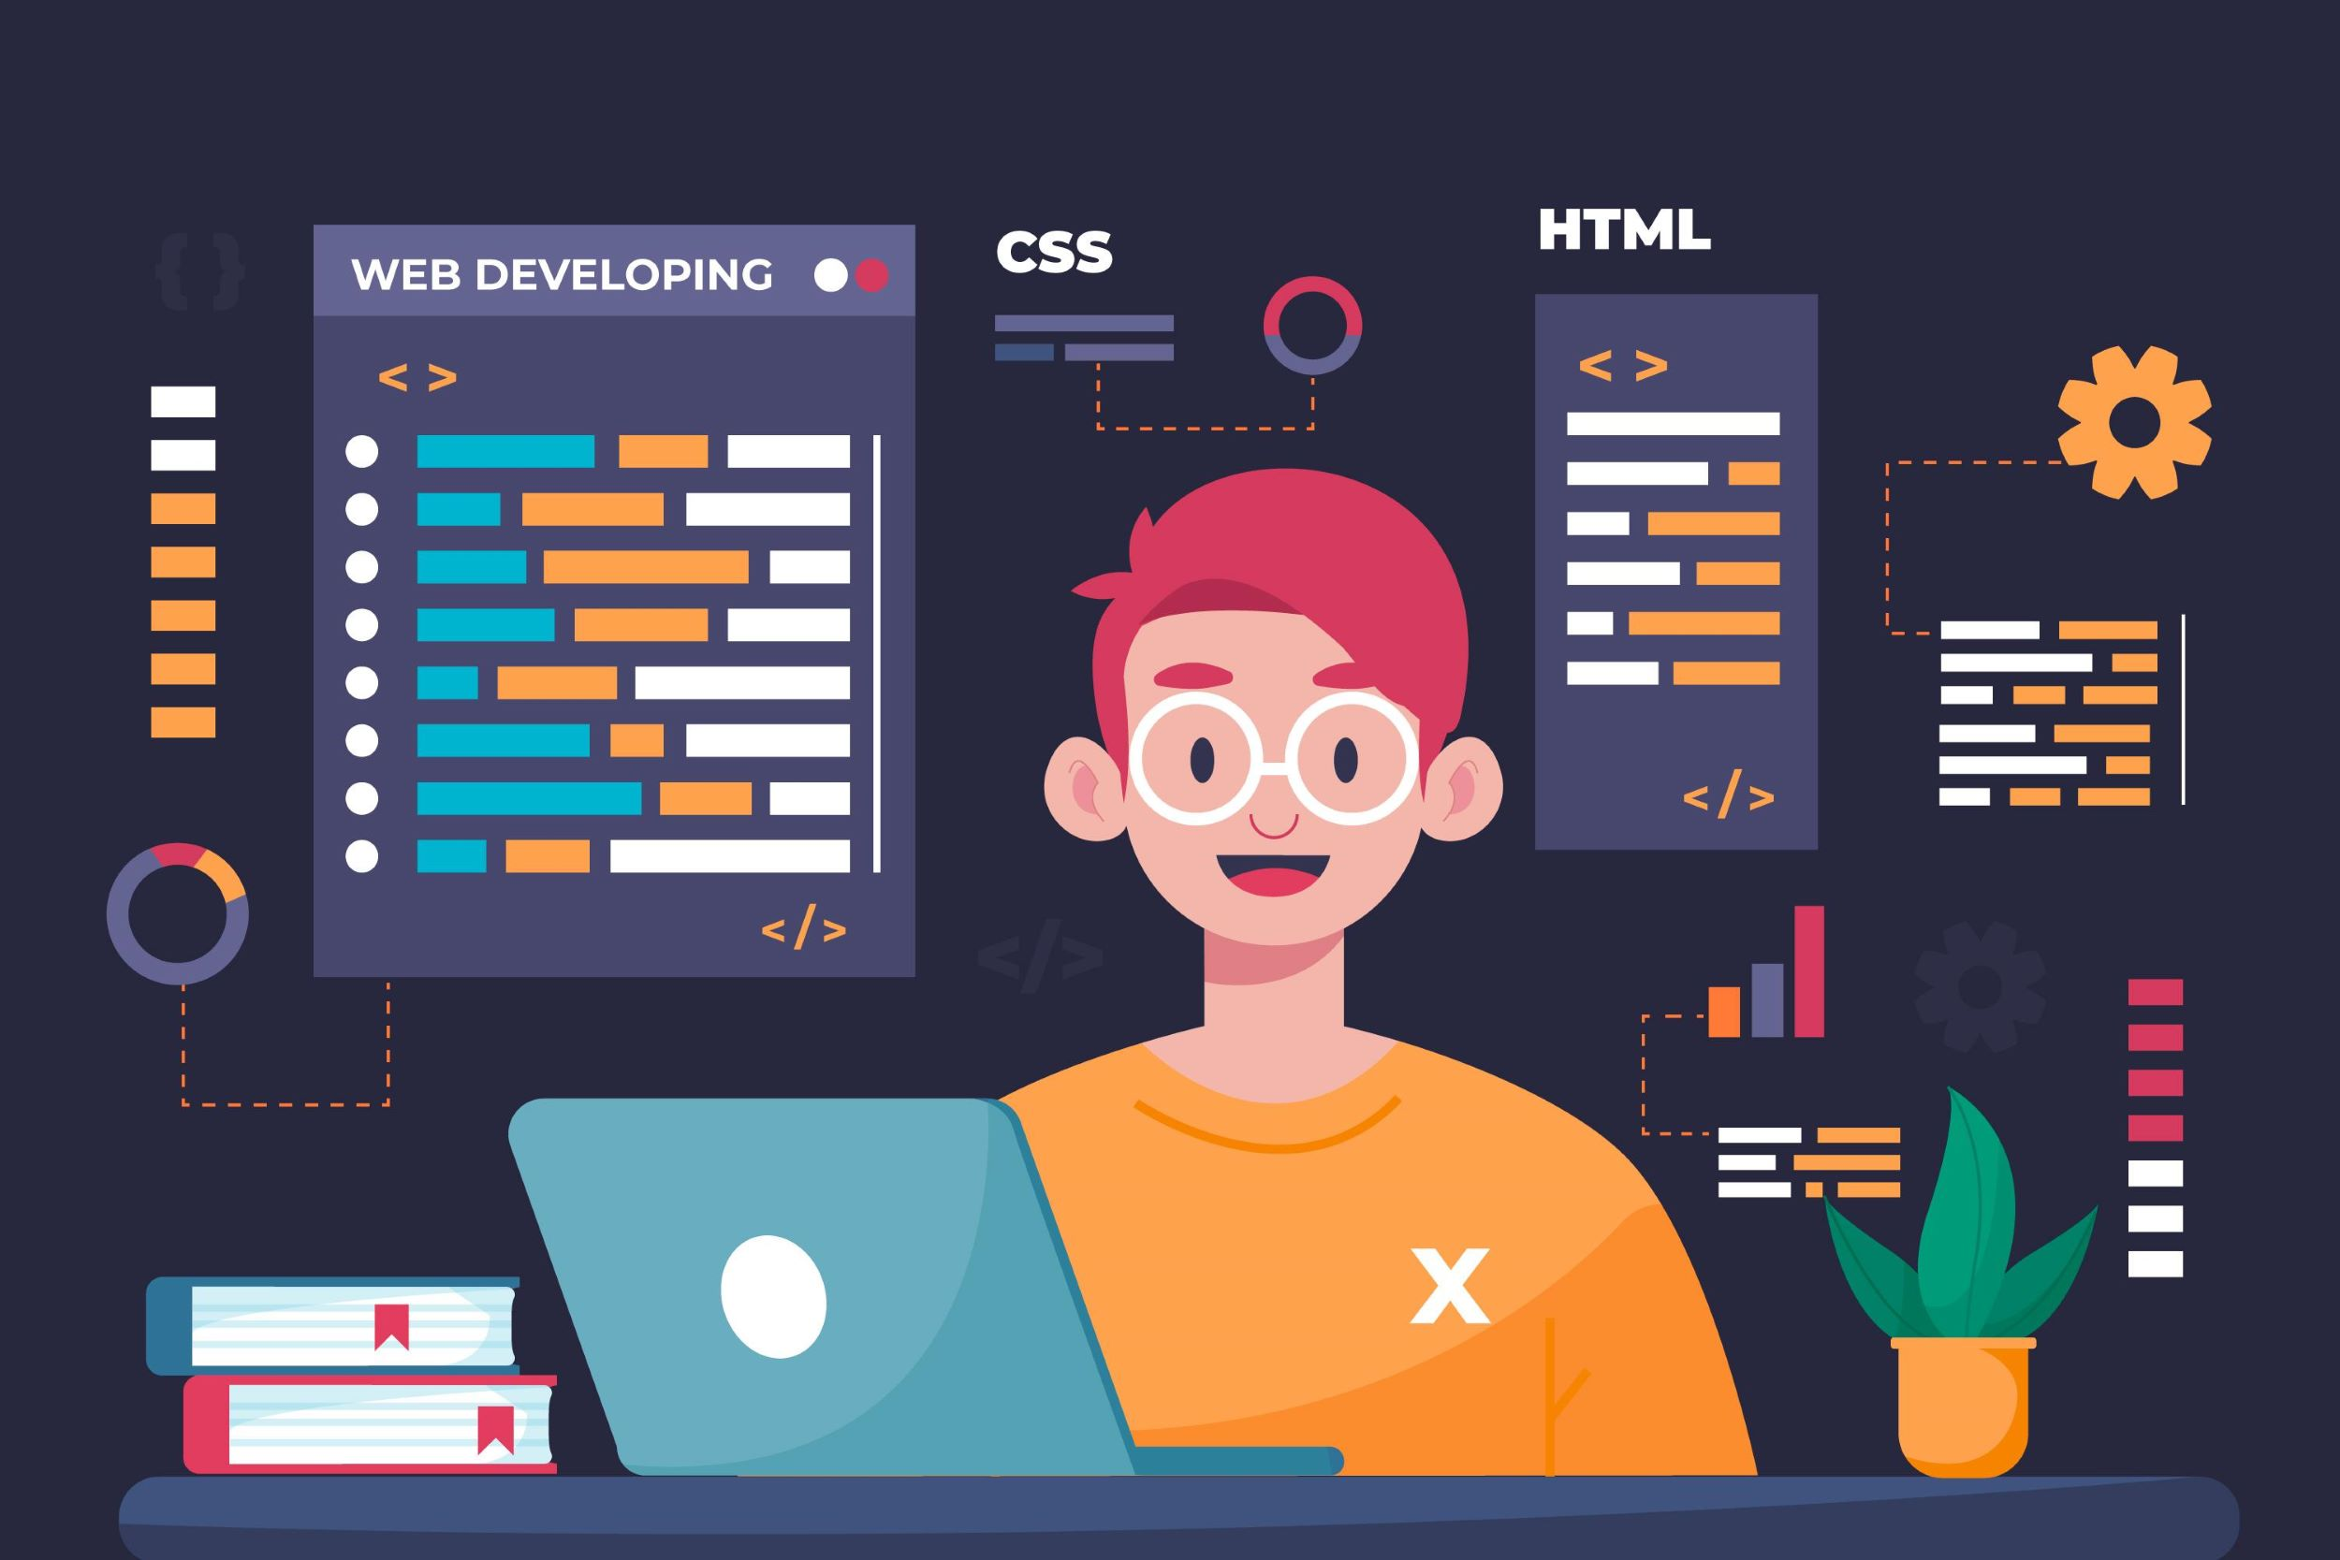
Why did i choose web development?
Web development is a fast-paced, challenging career centered on creative problem-solving and continuous innovation.
While many web developers come from a more analytical or technical background, they have found that anyone can become a web developer if they apply themselves.
The technology industry moves quickly, and web developers are constantly learning and advancing in their careers.
There is practically no limit to how much you can improve your skills and progress in your career as a web developer.
As a web developer, you have the opportunity to work for startups, agencies, large corporates, or even freelance. You may even be able to work remotely from anywhere in the world.
Notes:
4

