Slide 1
State of the INFORE optimizer

Slide 2
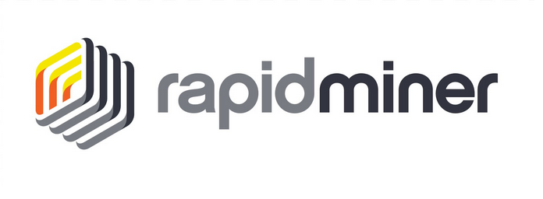
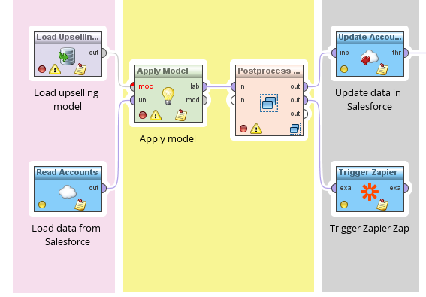
Problem statement
The RapidMiner framework offers:
Workflow creation via a simple and intuitive GUI.
Variety of operators that can be deployed and executed seamlessly.
Automatic deployment and execution of workflows with almost no user input.
Friendly plugin developer tools.
However, there are some drawbacks.
Operator execution is mostly local.
The distributed nature of some operators can’t be leveraged.
Various distributed operator parameters (e.g. Parallelism) can’t be fine tuned.
RapidMiner example workflow

Slide 3



Proposed solution
Ideas
Submit (some) operators to Big-Data platforms that can automatically and transparently handle the scale-up.
Handle the operator deployment automatically.
Provide guarantees about operator placement under limited resources.
Goals
Develop an intermediate optimizer module that transforms the RM workflow to a platform-specific plan.
Pick an optimal combination of platforms and resources for each operator.
Track platform statistics to provide better plans and handle anomalies.

Slide 4



Architecture
Update platform statistics periodically
Offline configuration files
Statistics
BigData platforms
Optimizer
Parser
Dispatcher
Load, validate and process configuration files
Submit jobs
Plan submission/retrieval
RM COM
RM Framework
Plans

Slide 5
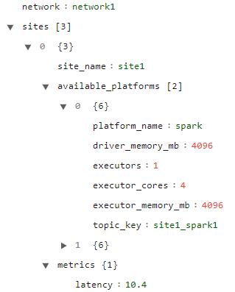
Parser
Network topology contains
Network sites
BigData platforms
Platform and site statistics
Parser
Topology
Dictionary
RM Plan
Resources

Slide 6
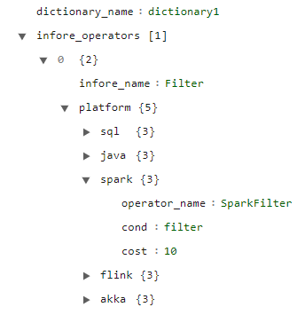
Parser
Operator Dictionary
Supported operators
Available platform implementations
Default cost estimation per platform
Parser
Topology
Dictionary
RM Plan
Resources
Operator implementation

Slide 7
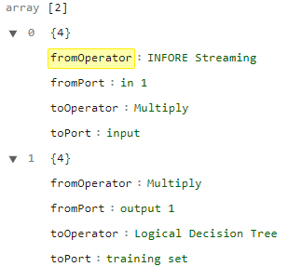
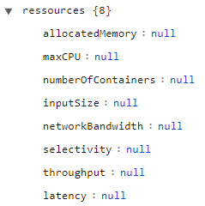
Parser
Submitted plan of operators provided by the RapidMiner FW
List of operators and operator connections
Operator details
Available resources
Parser
Topology
Dictionary
RM Plan
Resources
Operators
Resources

Slide 8
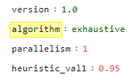
Parser
Available resources
Optimizer details and configurations
Selected algorithms
Concurrency level
Additional details
Parser
Topology
Dictionary
RM Plan
Resources
Optimizer configuration

Slide 9
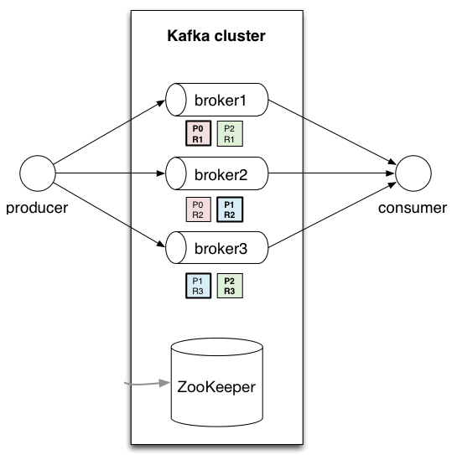
Communication with the RM FW
RapidMiner-Kafka communication
Workflows (Plans) are sent as a serialized JSON Kafka record produced by the RM FW to a specified topic.
A Consumer inside the Optimizer module is subscribed to the specified topic and ready to receive incoming messages with new Workflows.
After a Workflow has been processed and optimized a return message can be sent to the RM FW containing the new Workflow.
Apache Kafka is ideal for reliable message passing and scales easily.
RM Workflow
Optimizer
ZK used for shared state

Slide 10



Dispatcher
Submit workflows based on
Platform resources
Operator implementations
Connectivity status
Operator JARs are submitted via REST API calls to the necessary Resource Managers (RM).
Can be done programmatically or via a shell script.
JARs like these can be huge!
Optimizer
Op 1
Op 2
Dispatcher
Op 3
Available Frameworks

Slide 11
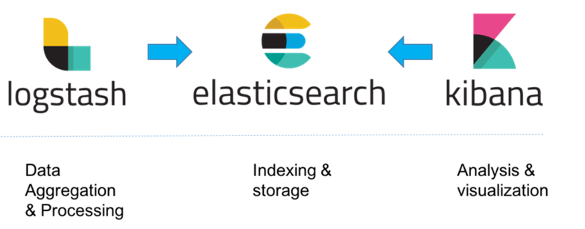


Statistics
Metrics collection
All FWs provide some form of metrics.
Metrics collection is done via JMX (Java Metrics eXtension).
JMX is supported by most BigData frameworks.
ELK stack is used to handle incoming metrics.
ELK stack components
Logstash, used for ingestion and data filtering.
Elasticsearch, used for indexing and external aggregation and CRUD queries.
Kibana, used for data visualization.
ELK stack provides both a direct REST API and Java connectors.
The stack can be used for other modules that need to access metrics.
Statistics
Optimizer
Available Frameworks

Slide 12
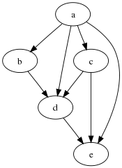
Optimizer Graph
The 1st step of the optimizer is to transform the input RM graph to an in-memory one.
The RM Workflow is validated and checked for errors and cycles.
The graph contains one node per..
Network
Platform
Cluster
A global source and sink are also added in order to simplify some algorithmic problems.
RM Workflow
Operator Graph

Slide 13
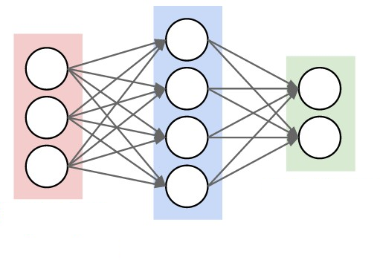
Graph Traversal
The optimization process requires for each operator to be placed in a single available BigData platform per network and cluster.
The optimizer to decides the placement of each operator by performing the following actions.
The graph is topologically sorted.
Each operator is assigned a cost value based on a cost model.
The graph is traversed from source to sink based on a graph traversal strategy (eg. Breadth-first, Depth-first, A*).
Each unique operator implementation with the min cost is selected as part of the optimal plan.
The optimal plan, essentially a path between the source and sink, is returned to forwarded to the RM FW and the dispatcher.
Since the operator placement is done based on cost, selecting and fine tuning a cost model is an essential part of the optimizer.
3 Operators
4 Platforms
1 Cluster
1 Network
Op1
Op2
Op3

Slide 14
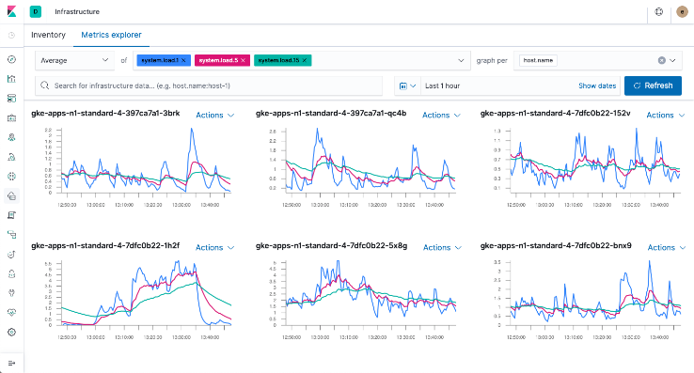
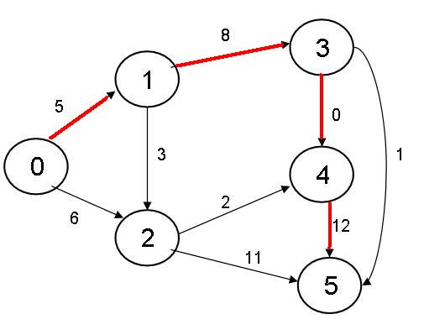
Cost Model (CM)
Although we currently use a dummy CM, a future one will take into account platform metrics and optimizer constraints.
In order to keep the CM up to date the optimizer periodically collects and updates operator statistics.
Assigning cost to operators is necessary in order to discover the optimal path in the optimizer’s graph.
Operator benchmarks can also be used as a way to cold-start the optimizer.
More sophisticated models that include NNs and Time-Series forecasting can also be used.
Statistics
Cost assignment
Operator costs and optimal path

Slide 15
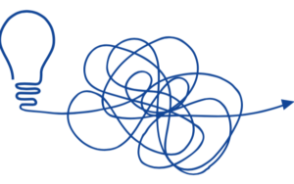
Issues
Current problems
Operator and Platform statistics are not dynamic.
Support more operators.
Ask RM for a better input plan (for testing purposes).
Although metrics and statistics are gathered correctly, the current CM needs a lot of work.
Akka support is non-existent.
Akka JMX statistics are required.
Need to integrate the optimizer project to the RM plugin.

Slide 16

Thank you for your patience
George Stamatakis
e-mail: giorgoshstam@gmail.com

