Slide 1

Bayesian Network for interaction between smoking social class and risk of asthma.
Rani Basna, Krefting Research Center,
University of Gothenburg.

Slide 2
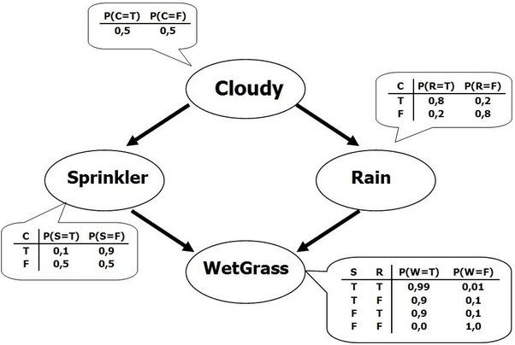
Introduction to Bayesian Network

Slide 3
Correlation and Dependence
Two random quantities can be uncorrelated but still be dependent but if they are independent they are necessarily uncorrelated.
Set of correlated random variables is a subset of set of dependent random variables.

Slide 4
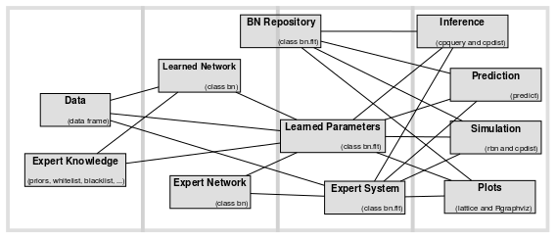
Introduction to Bayesian Network

Slide 5
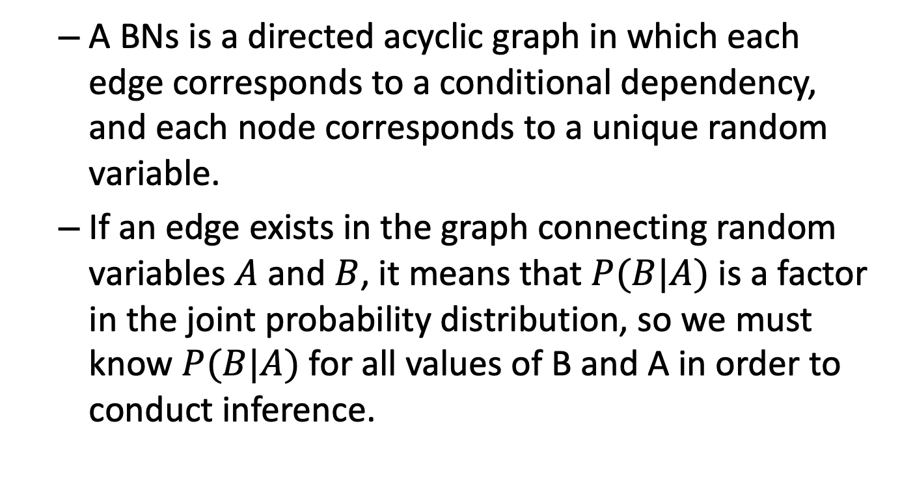
Introduction to Bayesian Network
A BNs is a directed acyclic graph in which each edge corresponds to a conditional dependency, and each node corresponds to a unique random variable.
If an edge exists in the graph connecting random variables $A$ and $B$, it means that $P(B|A)$ is a factor in the joint probability distribution, so we must know $P(B|A)$ for all values of B and A in order to conduct inference.

Slide 6
Reasons to use Bayesian Networks
Encode the association between all variables (interactive view).
Encode the association as Conditional Independence structure of variables.
Generative as opposed to regression as discriminative.
Casual effect, intervention, Counterfactual and what-if scenario.
Expert system, Hybrid learning, or learn completly from data.
BN can be extended into decision models by incorporating decision and utility nodes to automate decisions.
Multiple outcomes and exposures in one BN model.
Avoiding the collider bias (feature selection.).
probability distribution with inference.

Slide 7
Steps of Building a Bayesian Network Analysis
Learning the Network structure:
Data_driven approach (Score-based approach, Constraint based approach)
Expert knowledge approach
Hybrid approach (using white and blacklist as constraint)
Learning the parameter
Maximum likelihood estimation
Bayesian Estimation
Approximate Inference

Slide 8
Example of Socioeconomic Airway data
Learning the Network Structure
Data Preprocessing
Missing value imputation
Variable transformation

Slide 9
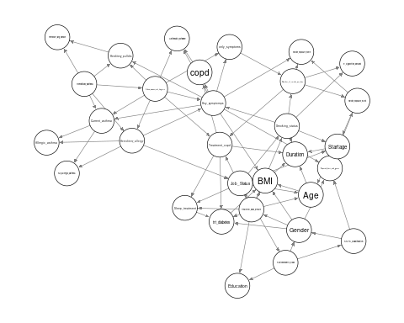
Structure learned from data (Hill-Climbing)

Slide 10
Challenges
Overfitting, Bayesian information Criteria
Stability
we can improve the quality of the structure learned from the data by averaging multiple DAGs
One possible approach to that end is to apply bootstrap resampling.

Slide 11
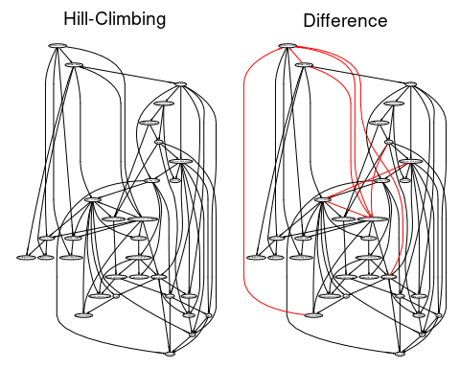
Comparing tow different structure learning

Slide 12
Bootstrap resampling
Repeat many times
sample a new data set from the original data using either parametric or nonparametric bootstrap;
learn the structure of the graphical model for each sample data.
Estimate the probability that each possible edge is present in the true network structure.
This result in arc strength and arc direction.
Arcs are considered significant if they appear in at least 85% of the networks, and in the direction that appears most frequently.

Slide 13
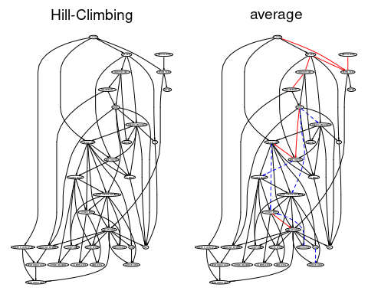
Averaging

Slide 14
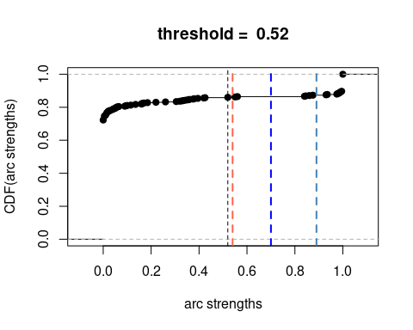
Cumulative Distribution of the arcs strength
Cumulative distribution function of the arc strength values computed with bootstrap resampling

Slide 15
Learning the parameters and Validations
Cross-validation
- number of folds: 10 - loss function: Classification Error (Posterior, cond. Gauss.)
- training node: Current_asthma - number of runs: 5 - average loss over the runs: 0.001961034 - standard deviation of the loss: 3.258955e-07

Slide 16
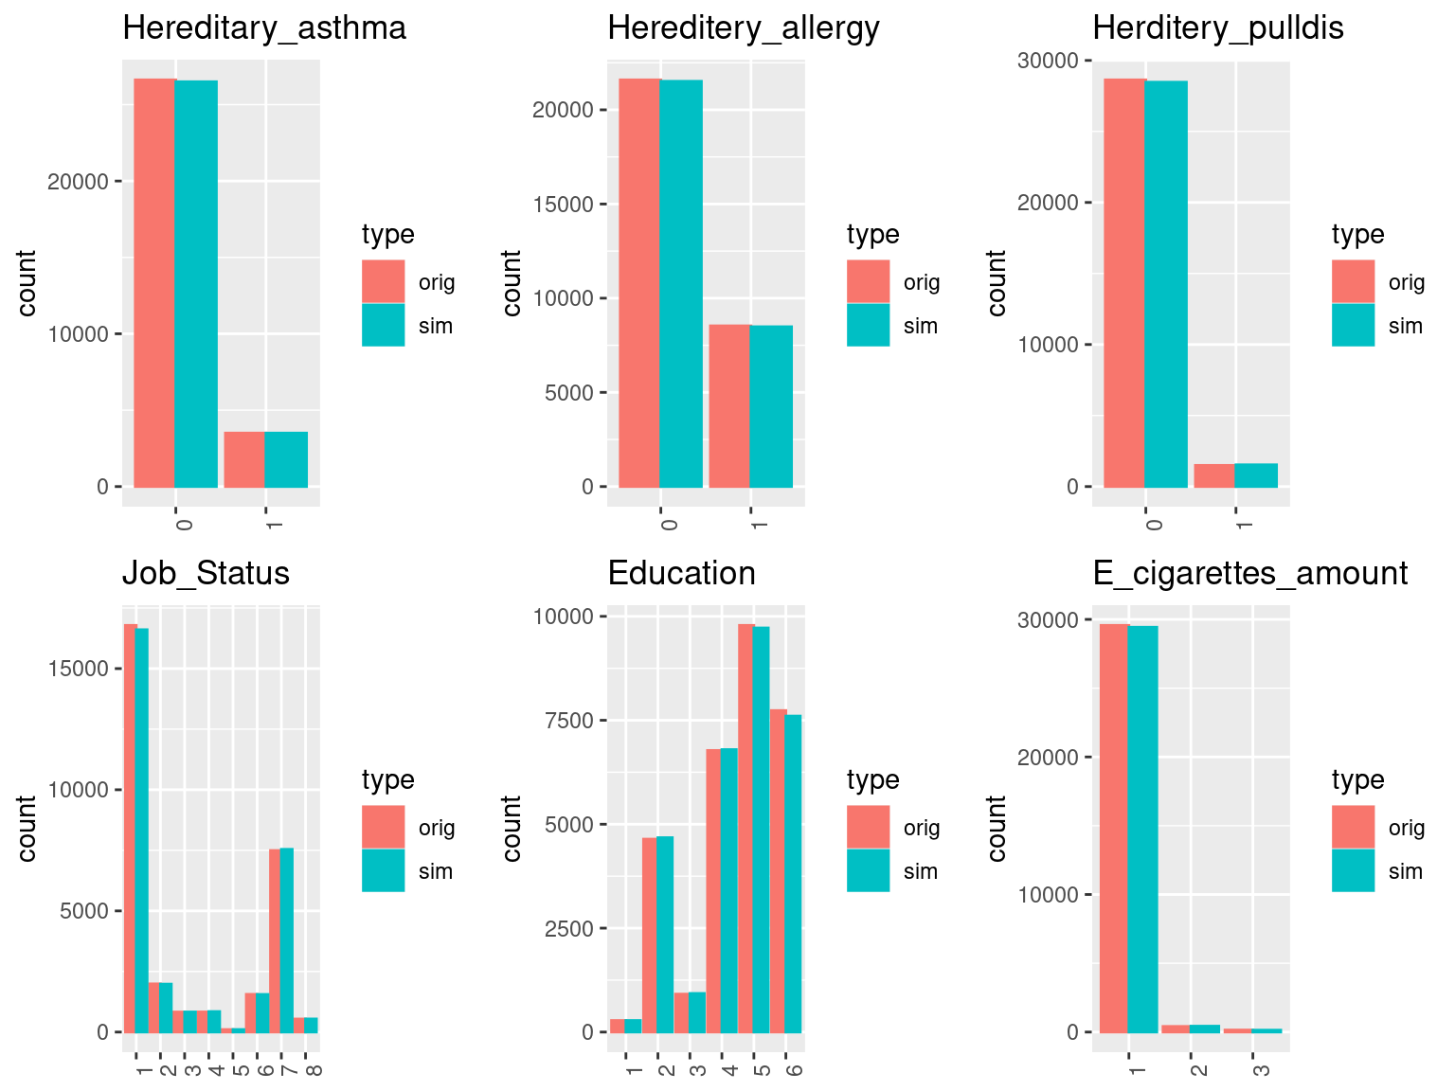
Checking generated data
Original vs Simulated 1

Slide 17
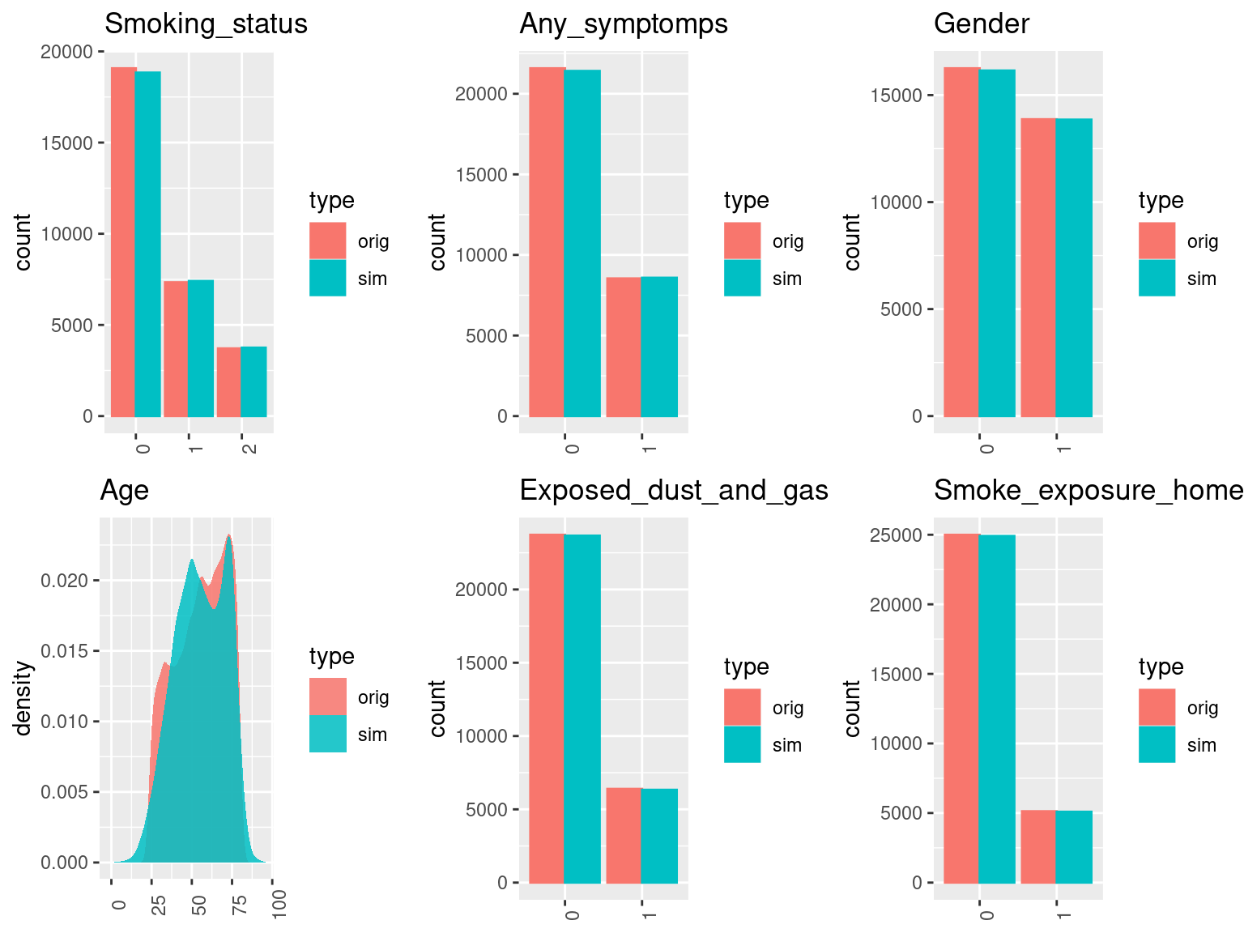
Original vs Simulated 2

Slide 18
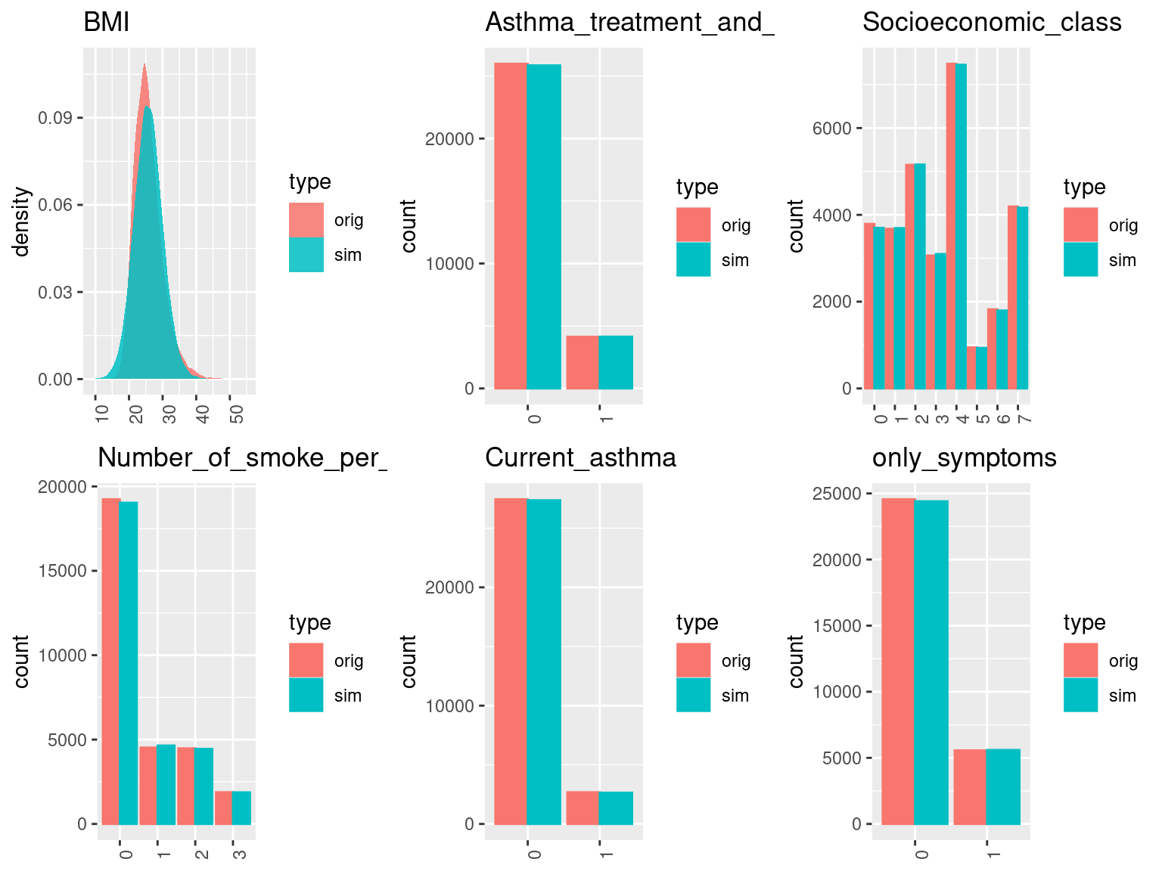
Original vs Simulated 3

Slide 19
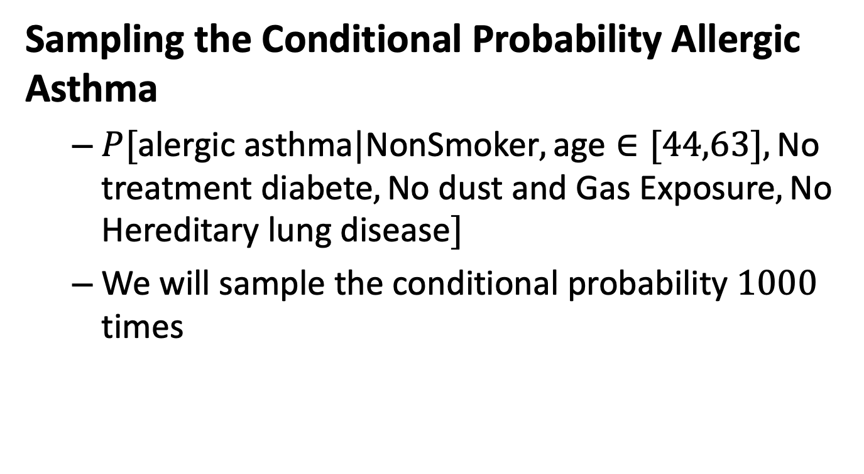
Inference
Sampling the Conditional Probability Allergic Asthma
$P[\text{alergic} \text{asthma}|\text{NonSmoker},\text{age}∈[44,63],\text{No} \text{treatment} \text{diabete},\text{No} \text{dust} \text{and} \text{Gas} \text{Exposure},\text{No} \text{Hereditary} \text{lung} \text{disease}]$
We will sample the conditional probability $1000$ times

Slide 20
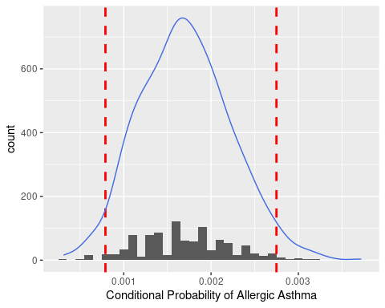
Plotting the results

Slide 21

Sampling the Conditional Probability Asthma
$P[\text{Asthma}|\text{NonSmoker},\text{age}∈[44,63],\text{No} \text{treatment} \text{diabete},\text{No} \text{dust} \text{and} \text{Gas} \text{Exposure},\text{No} \text{Hereditary} \text{lung} \text{disease},\text{2 }\text{years} \text{high} \text{school}]$
We will sample the conditional probability $1000$ times

Slide 22
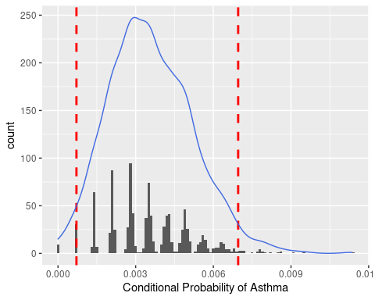
Plotting the result

Slide 23
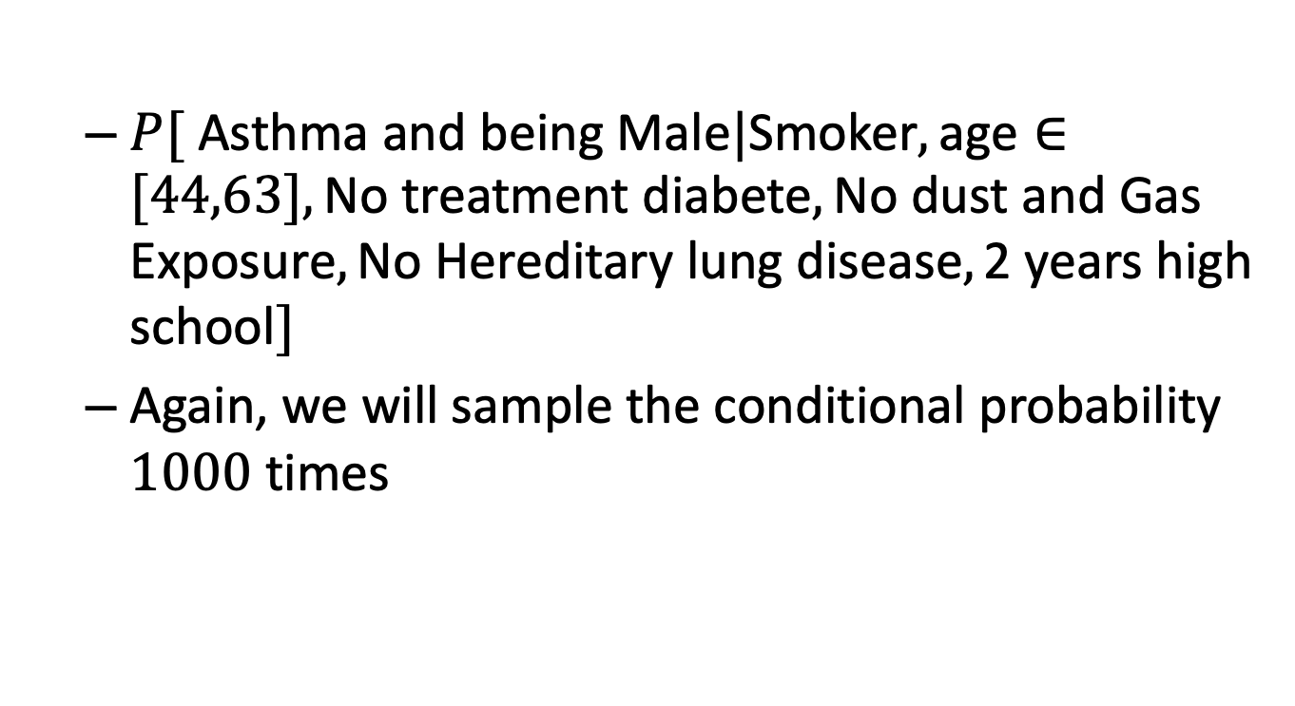
Sampling the Conditional Probability
Asthma and gender
$P[ \text{Asthma} \text{and} \text{being} \text{Male}|\text{Smoker},\text{age}∈[44,63],\text{No} \text{treatment} \text{diabete},\text{No} \text{dust} \text{and} \text{Gas} \text{Exposure},\text{No} \text{Hereditary} \text{lung} \text{disease},\text{2 }\text{years} \text{high} \text{school}]$
Again, we will sample the conditional probability $1000$ times

Slide 24
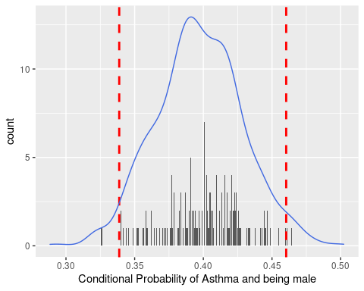
Plotting the results

Slide 25
Thank you for your attention

