Slide 1
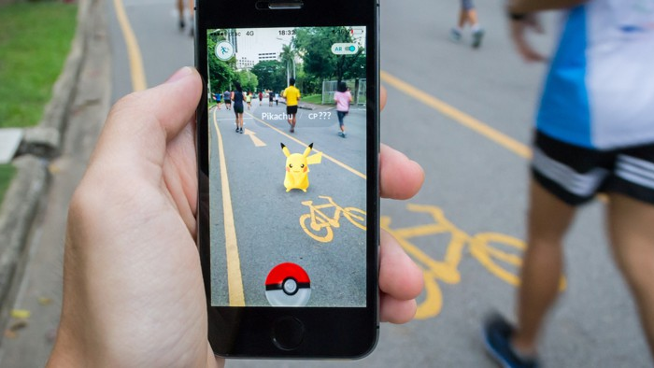
exploiting spawning algorithm <
a statistical approach

Slide 2




population density
type of terrain
temperature
wind speed
hour
season
problem <
Notes:
Intro to the problem coff*mixture*coff

Slide 3

goal <
Notes:
objective

Slide 4
Pokèmon ID [1:151]
fixed attribute (attack, defense, speed, ...)
variable attribute (weight, height, level, ...)
(Date, Time)
hour : (morning | afternoon | evening | night)
month : (spring | summer | fall | winter)
(Latitude, Longitude)
distance from fixed-position game spot (gym, villain, ...)
lakes, rivers, ...
population density : (urban | suburban | rural)
(Date, Time) + (Latitude, Longitude)
wind speed
pressure
clouds, fog
rain
sunset, sunrise
dataset <
Notes:
output algorithm => id pokemon + variable attribute ignored
input

Slide 5
151 pokémon
26 observable features (18 binary + 8 numeric)
principal component analysis
2 or 3 dimensions
clustering
5 or 6 group of pokémon
dimens-reduct <
Notes:
Dimensionality reduction idea

Slide 6
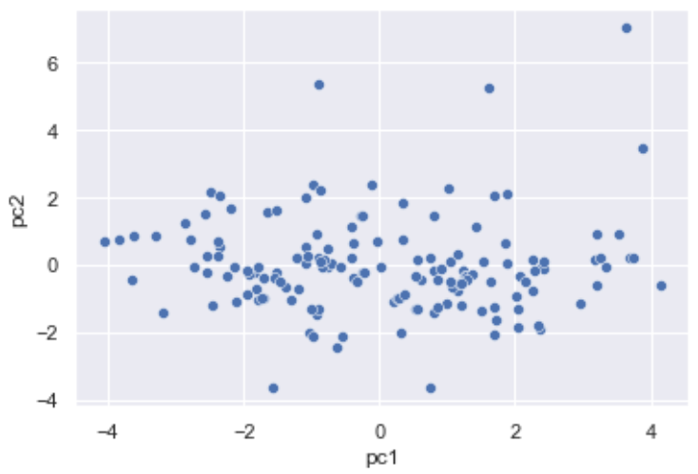
princ-comp <
Notes:
Dimensioanlity reduction results

Slide 7
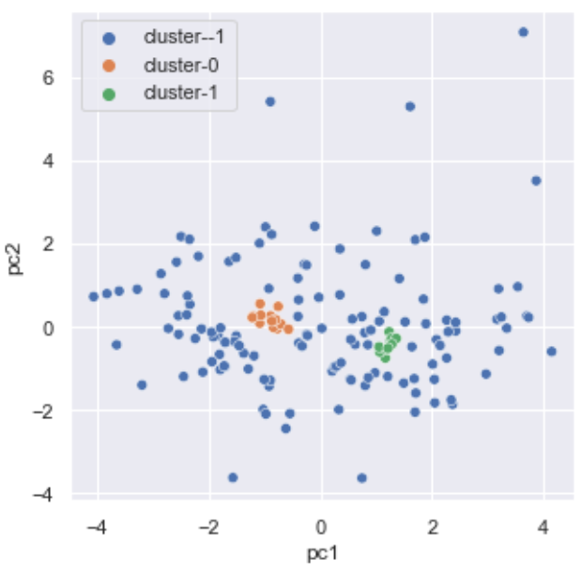
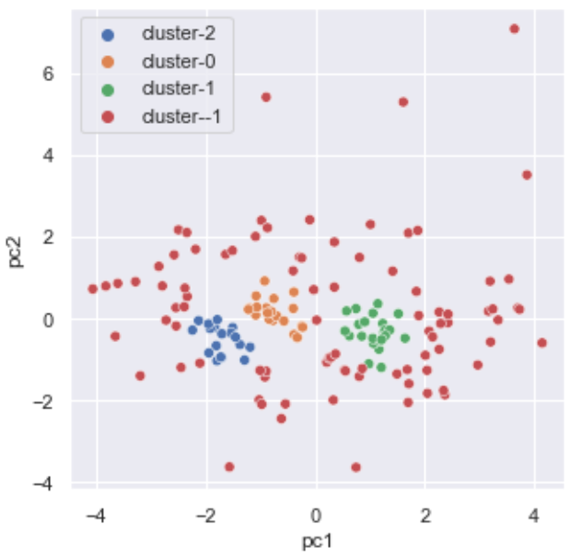
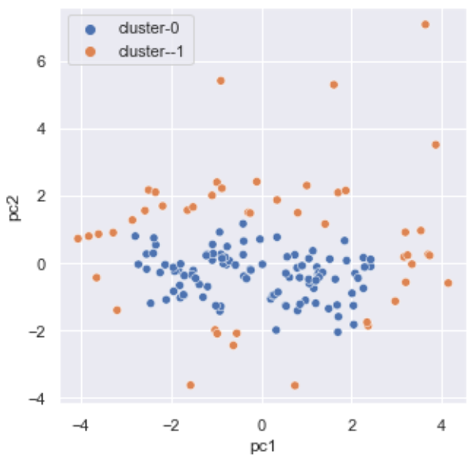

db-scan <

Slide 8
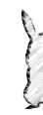
correspondence <
Notes:
Correspondence analysis idea

Slide 9
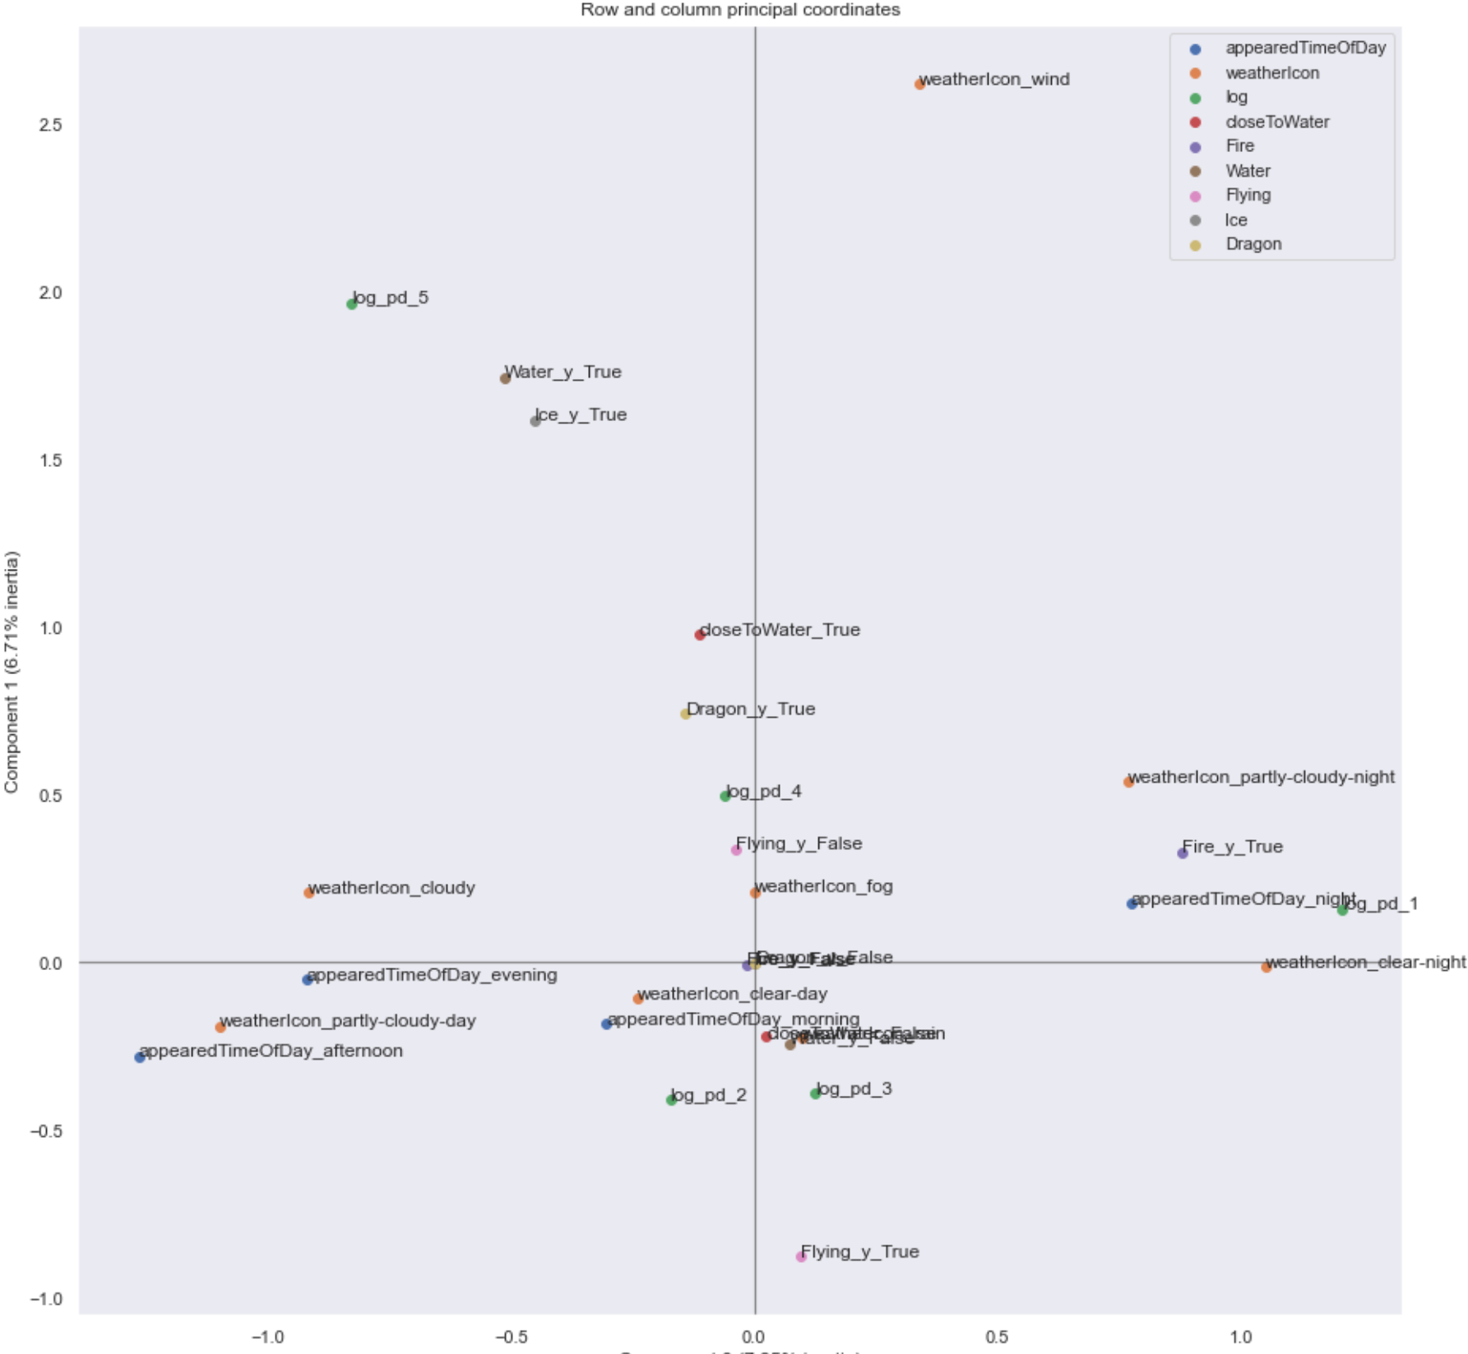
correspondence <
Notes:
categorical values
Mostly related to weather, density population was discetized

Slide 10
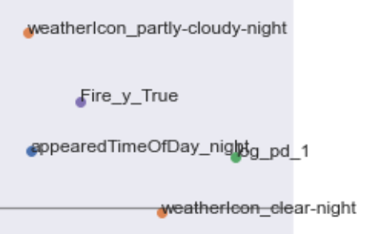
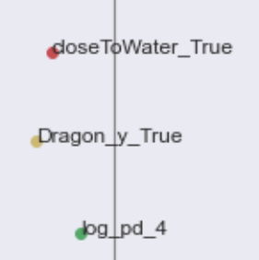


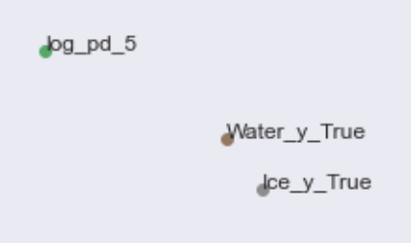

correspondence <
Notes:
Correspondence analysis results

Slide 11
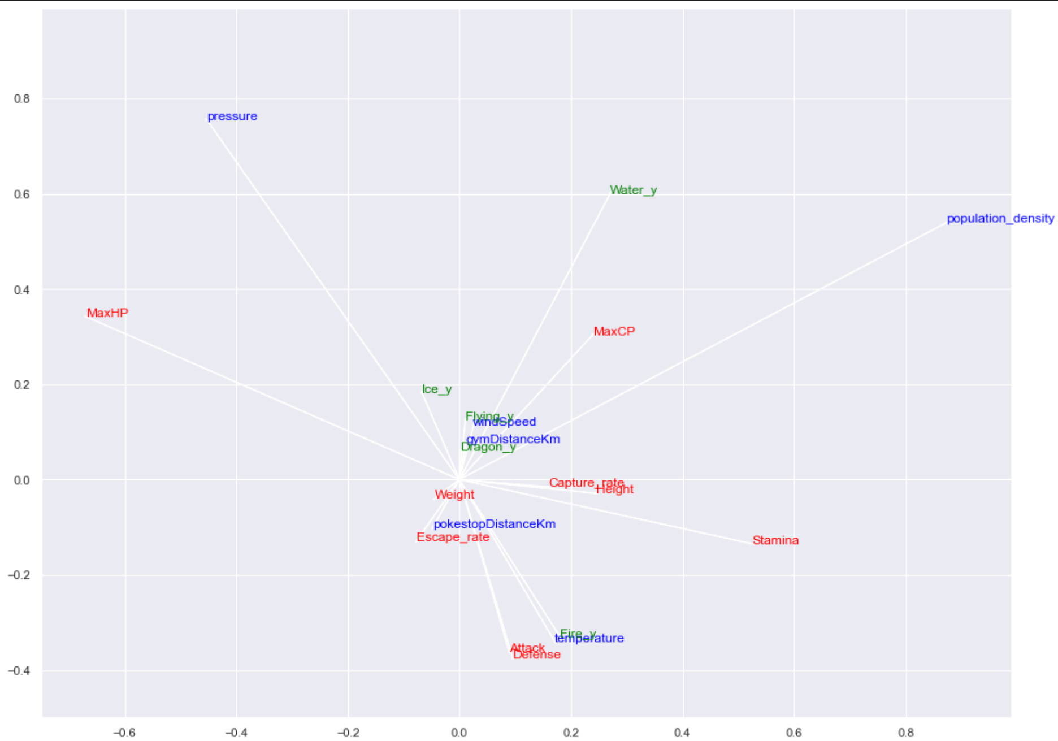
canonical-corr <
Notes:
Canonical correlation analisys

Slide 12
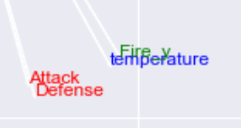
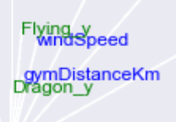

canonical-corr <
Notes:
Canonical correlation results

Slide 13
conting-table <
Notes:
conclusion

Slide 14
notebook github.com/ranieri-unimi/spawn-em-all-manzi-2022
dataset kaggle.com/semioniy/predictemall
end <

